Slide 1
2o Γυμνάσιο Περιστερίου/Erasmus project
HISTORICAL TREASURES OF EUROPE
2nd meeting in Aggius, Sardinia, Italy
18-23/3/2019

Slide 2
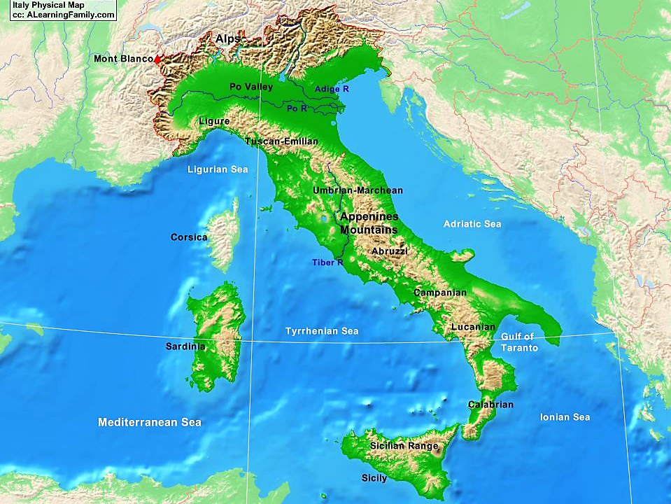
In the north of Italy

Slide 3
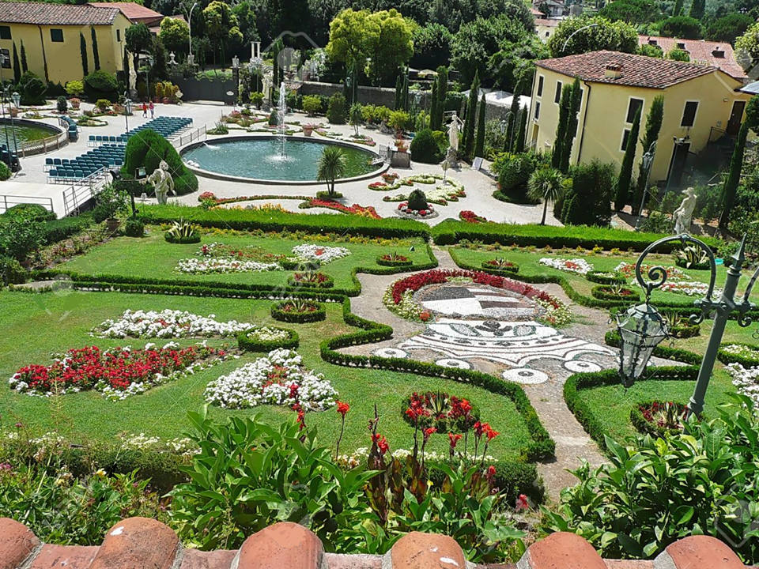
In an older era

Slide 4
In search of
power
and splendour…

Slide 5
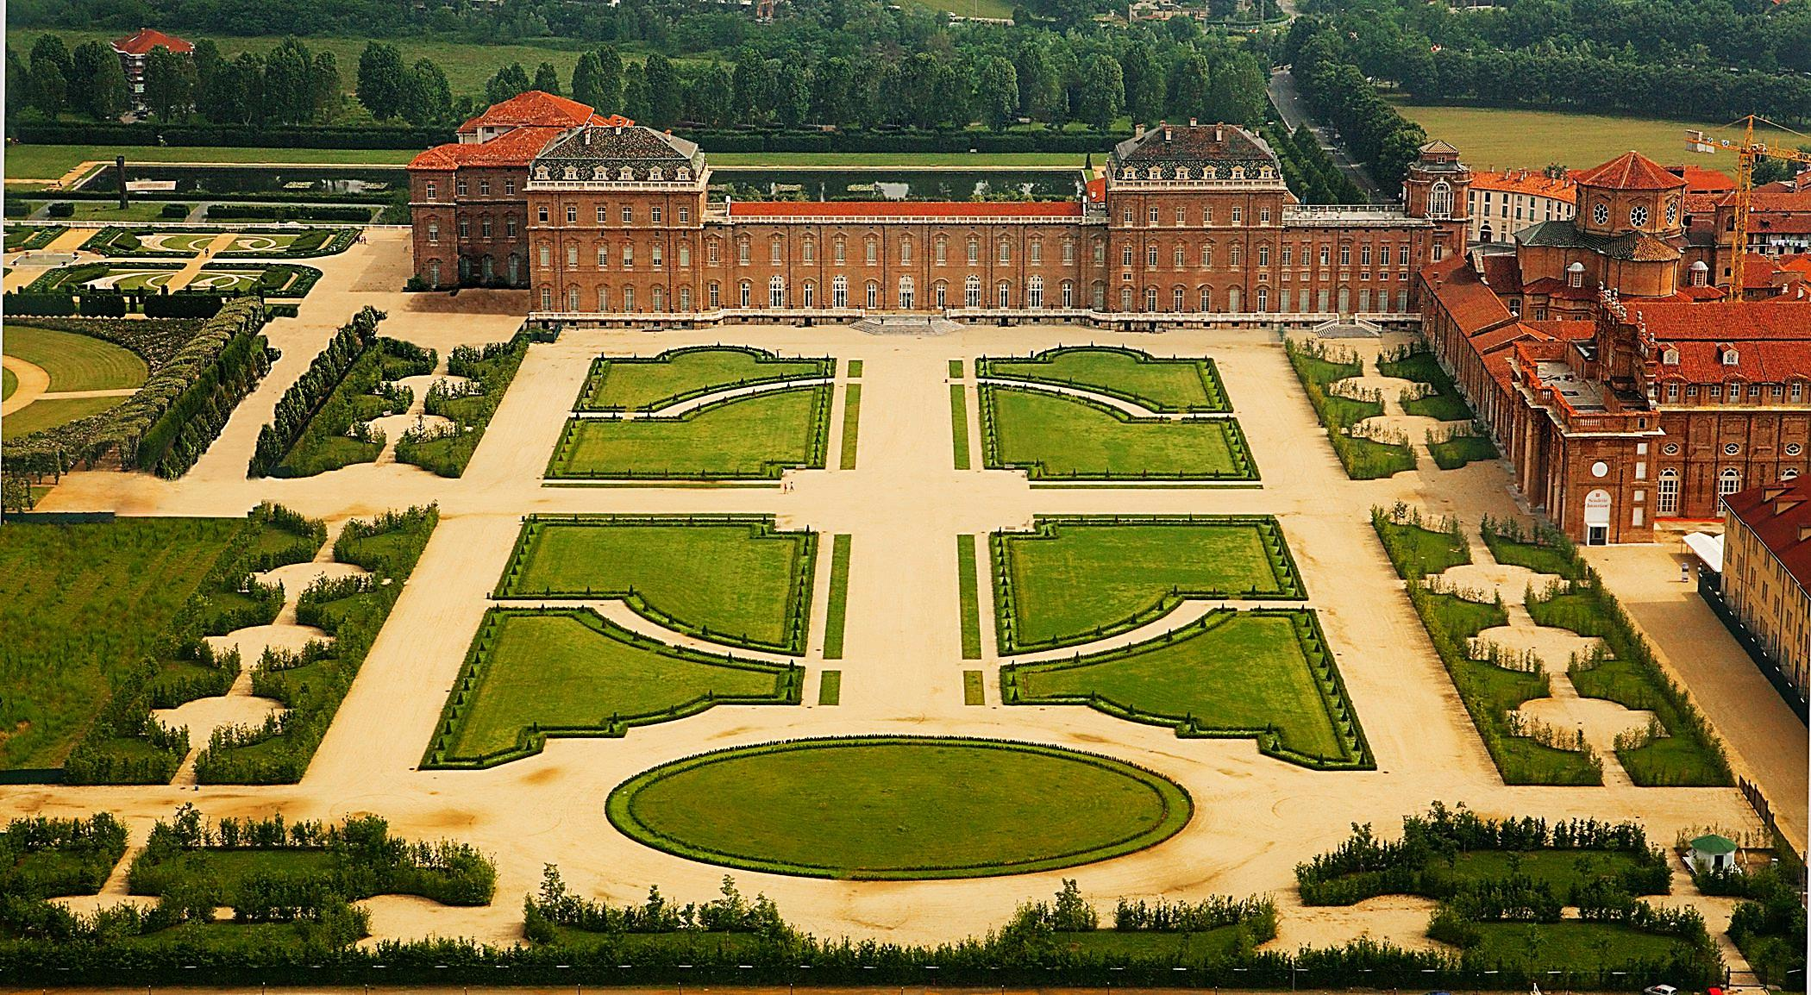
Reggia di Venaria Reale

Slide 6
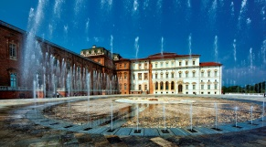
The Palace of Venaria
is a former royal residence and gardens located near the city of Turin in northern Italy.
Turin

Slide 7
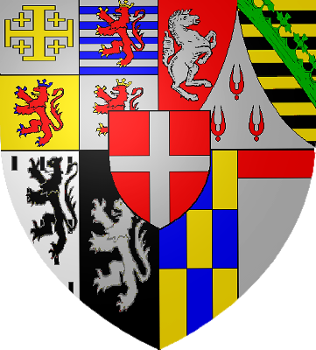
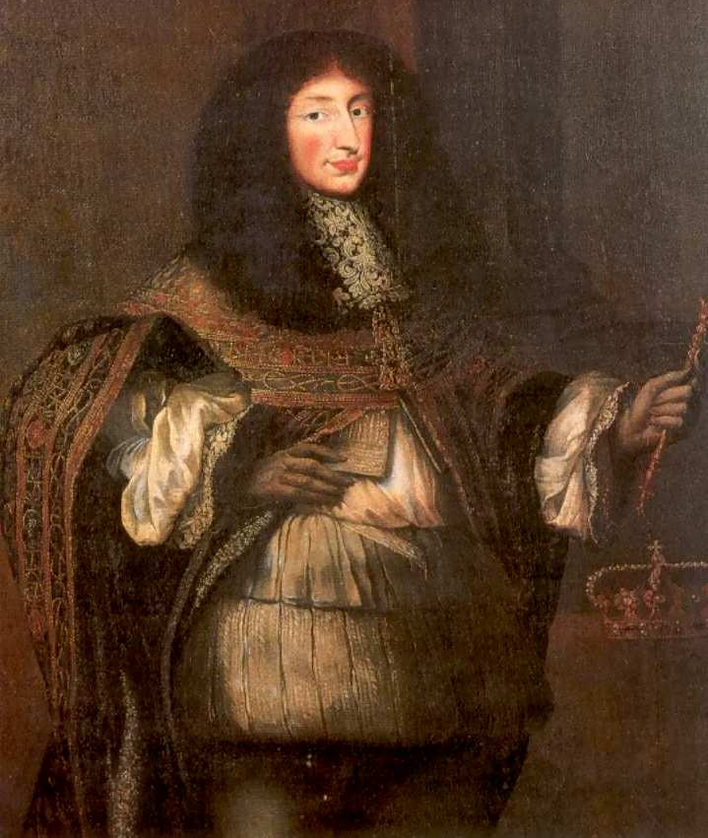
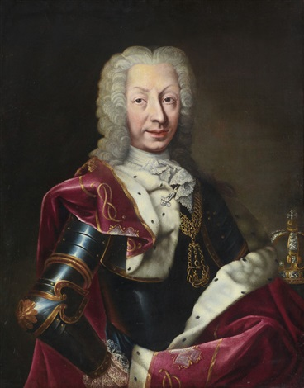
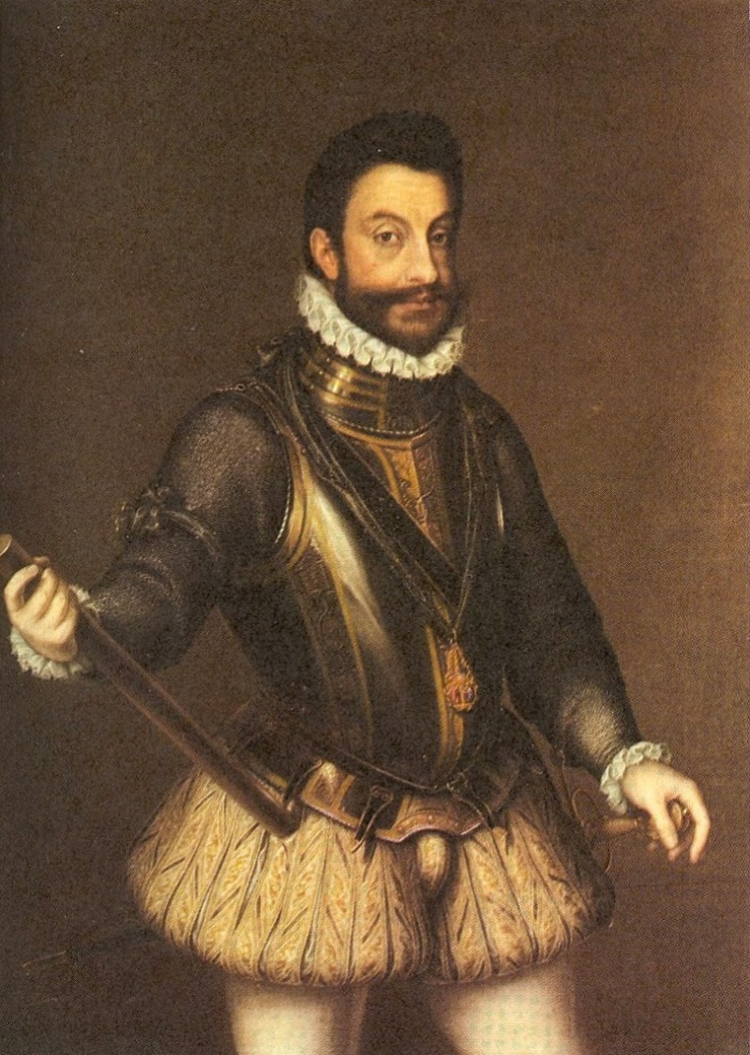
The construction of the palace started in 1675 by the sovereigns of the Royal House of Savoy.

Slide 8
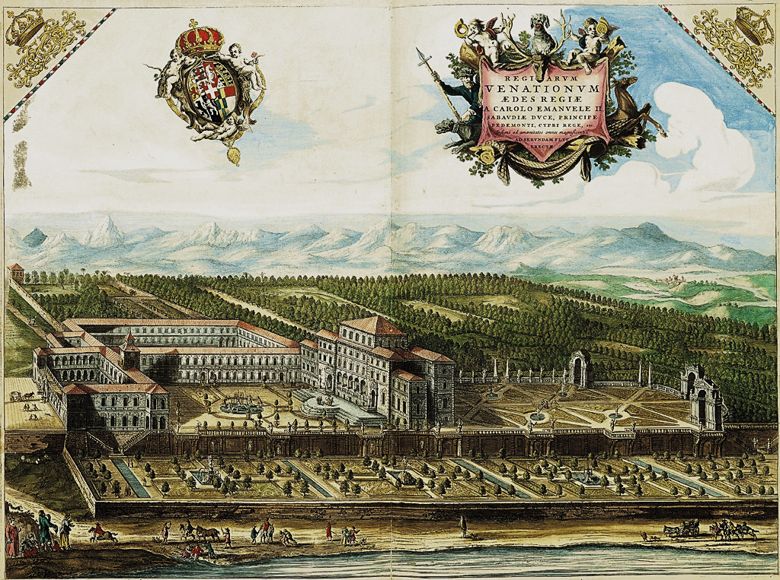
In the first place, the palace was used as a base for hunting expedition. The name derives from Latin: Venatio Regia meaning "Royal Hunt".

Slide 9
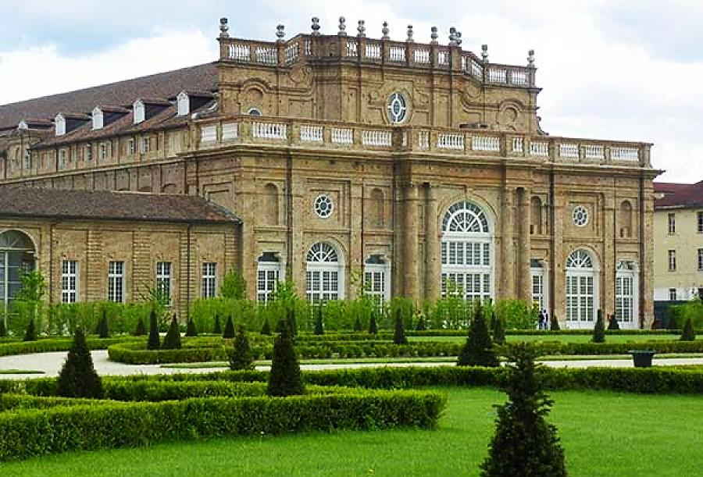
The palace provides outstanding testimony to the genius of Baroque art and architecture.

Slide 10
It is a masterpiece of architecture, which was declared World Heritage Site by UNESCO in 1997.

Slide 11
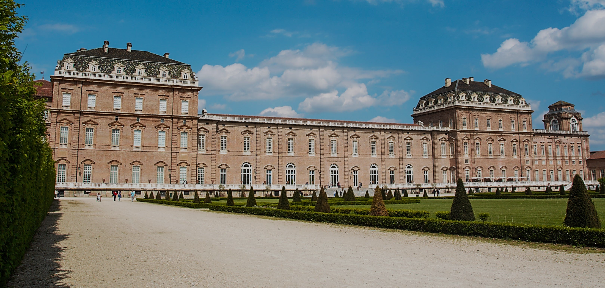
The Reggia is an outstanding example of European monumental architecture that illustrates the power of absolute monarchy of that era.

Slide 12
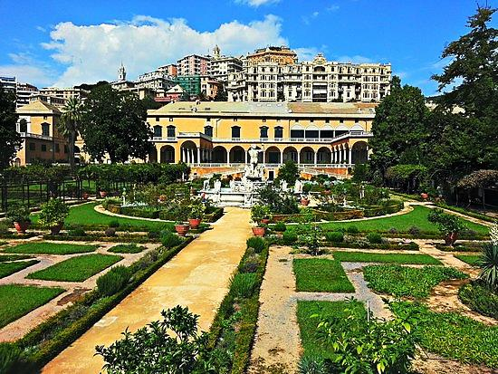
The complex was turned into a military barracks in the 19th century, When the military left, the complex fell prey to vandals who stripped it bare.

Slide 13
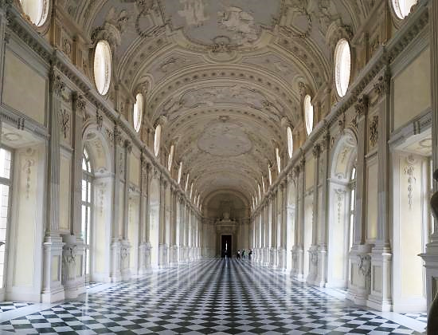
The restoration of the Reggia began in 1999. Frescoes, decorations and archaeological findings were brought back to light using cutting-edge techniques. It was the largest project for the restoration of a cultural asset ever undertaken in Europe.

Slide 14
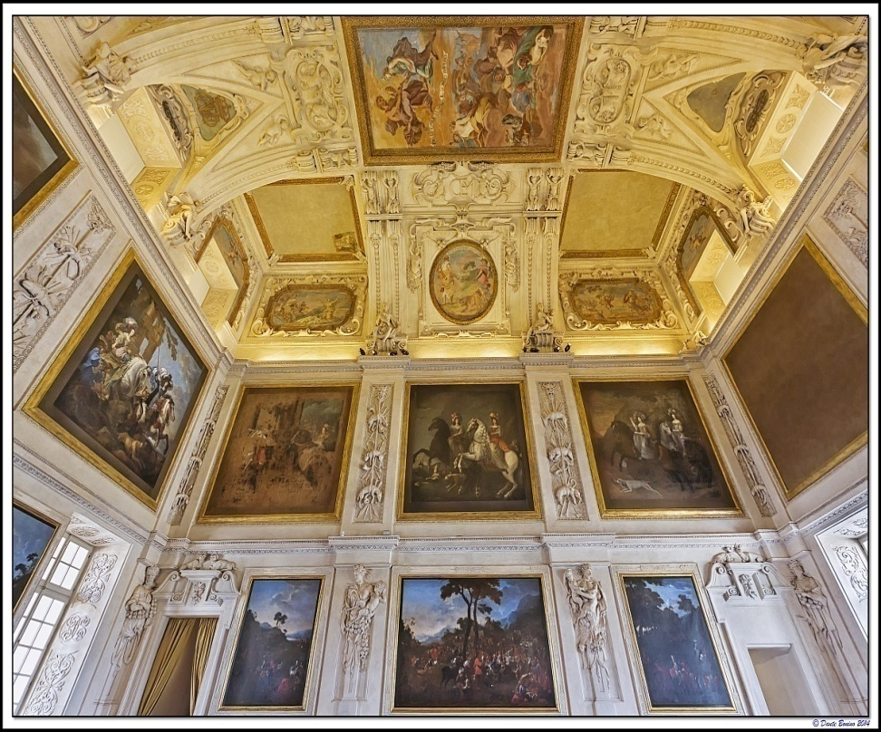
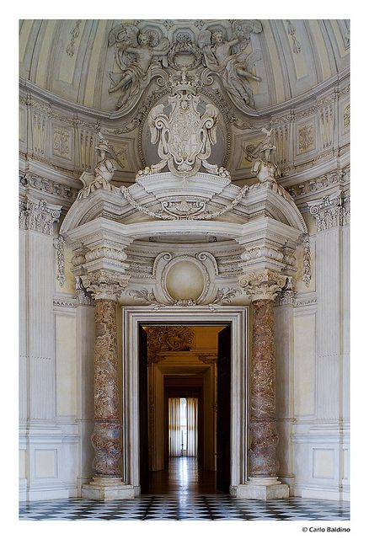
The inauguration on 12 October 2007 marked the rebirth of the Reggia and its Gardens. It’s a modern court that is home to a permanent display, major exhibitions, art performances, concerts, conferences, entertainment programs and events.

Slide 15
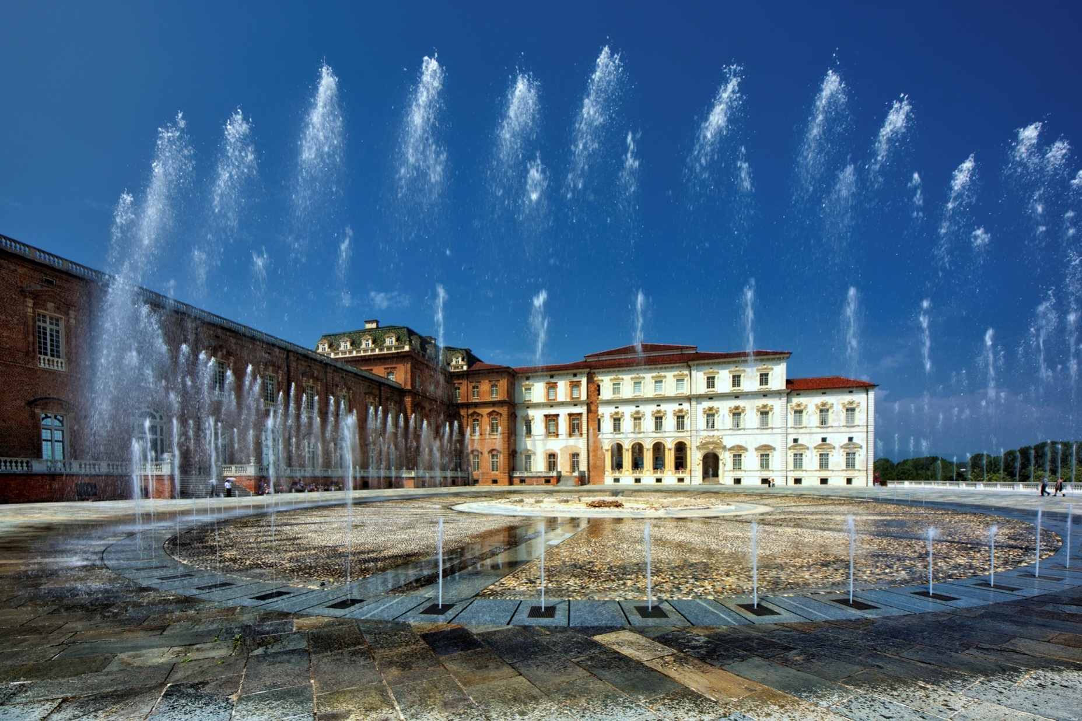
The Reggia in 3D
Click on the image to see the video

