Slide 1
Project
Of
3rd High School
Polichni
Thessaloniki
GREECE

Slide 2
Subject
Promotion of the cultural heritage of Thessaloniki’s historical center

Slide 3
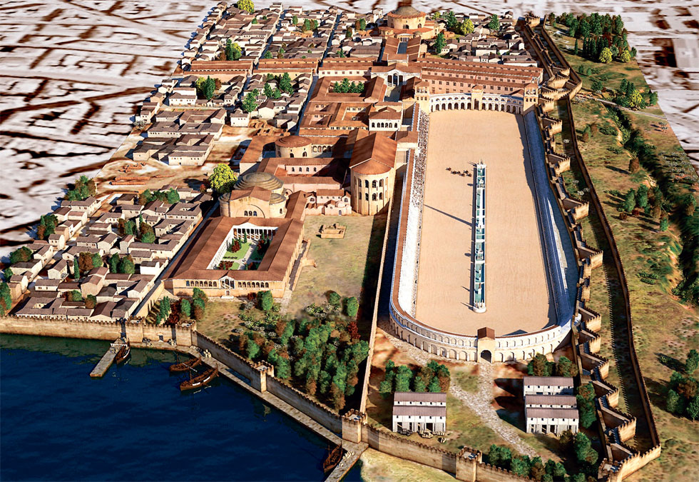
Brief history of Thessaloniki
Foundation by King Cassander Of Macedonia in 315 BC
The Roman Period
Notes:
Thessaloniki was founded in 315 BC by King Cassander of Macedonia. After the fall of the Kingdom of Macedon in 168 BC it became part of the Roman republic and was further developed into an important trade center actually connecting Europe with Asia. Many of the most imposing and well decorated structures were built during the Roman period of its history. During the first century AD and afterwards, the city became one of the first early Christian centers after Paul the Apostle preached here and laid the foundations for a new religion.

Slide 4
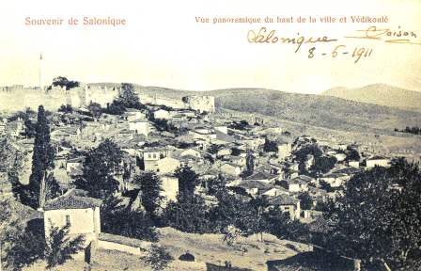
The Byzantine period (313-1430)
Ottoman occupation period (1430)
Notes:
During the Byzantine period the city was further developed and became even bigger, being the second most important city of the empire after Constantinople itself. Wonderful churches and other buildings were built in several areas while extended defensive constructions took place. In 1204 AD during the fourth crusade the city fell into the hands of the Crusaders and thus the “Kingdom Of Thessalonica” was created. In 1246 though, the Byzantines managed to recover the entire area. After 1430 the ottomans conquered Thessaloniki, under the commands of Mourad II. During the Ottoman occupation period the city once again became the most important commercial and trade center of the area and was considered of great strategic importance due to the trade routes established

Slide 5
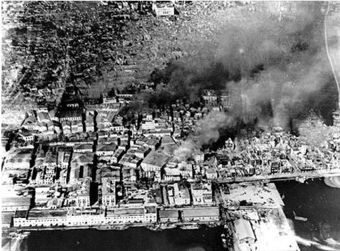
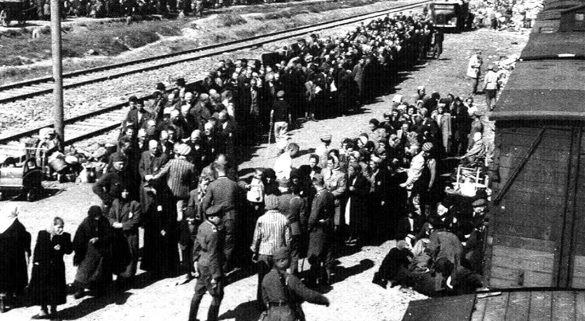
In 1492 Jews from the Iberian Peninsula and
Central Europe settled in Thessaloniki and
were dislodged by the Germans(1943)
1917: the city faced a huge fire
Notes:
In 1492 AD thousands of persecuted Jews from the Iberian Peninsula and Central Europe settled in Thessaloniki. In 1941 the Germans invade Thessaloniki and in 1943 all Jews of the city were dislodged (1940 numbered 49000 people) from the Nazi Germans and transported to concentration camps. An estimated 45000 of them perished there.

Slide 6
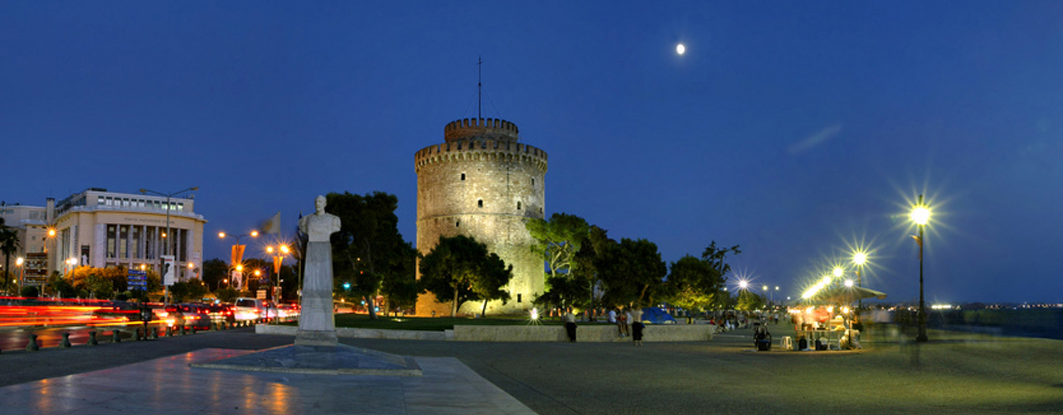
MODERN HISTORY OF THE CITY 2016: Today Thessaloniki is a modern European city
Notes:
In October 27, 1912 during the first Balkan War the Greek army liberated the city, while in 1917 the city faced what was perhaps its greatest disaster ever, as a huge fire destroyed almost three quarters of the center.
Serious efforts and proposals were made by famous architects in order for the city center to be rebuilt like a modern European capital. Today Thessaloniki is a modern European city, as always an important trade and transportation center connected to all the Balkan Countries, while it was nominated as the Cultural Capital of Europe in 1997. It is one of the largest student centers in South-Eastern Europe while many of its monuments are included on the UNESCO World Heritage List. In 2004 during the Athens Olympics, the city hosted a number of athletic events while being one of the Greek Olympic Cities. Finally the city was selected in 2011 as the European Youth Capital of 2014

Slide 7
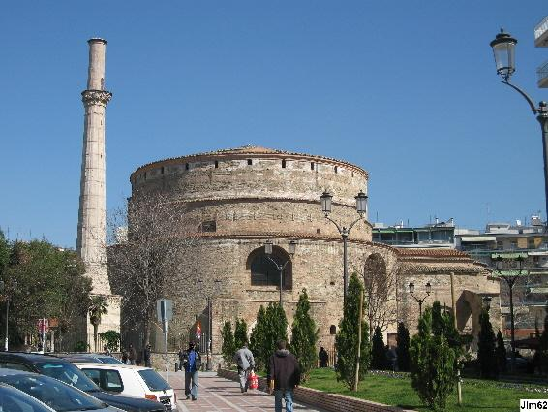
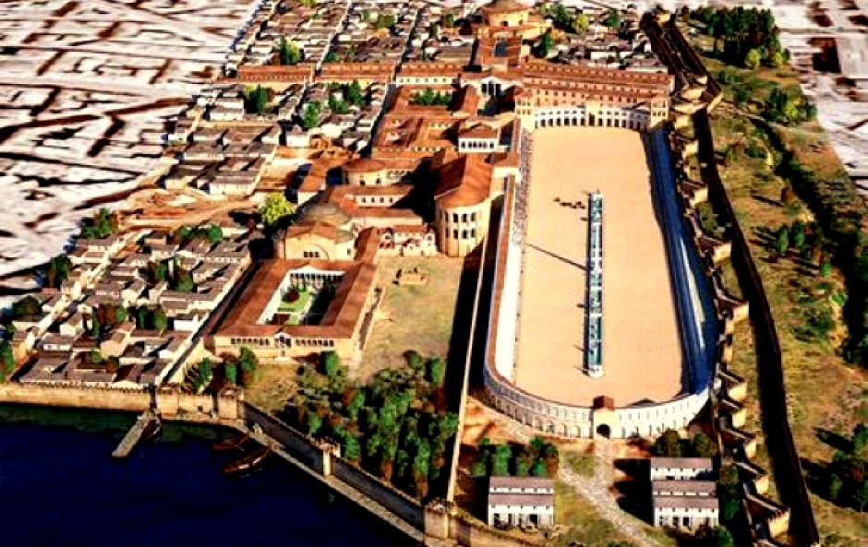
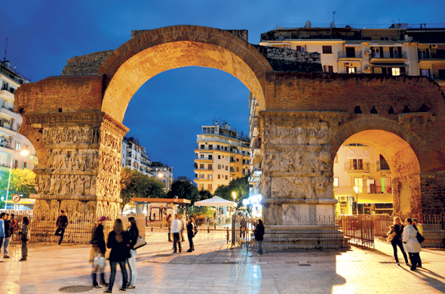
Roman Period
The Roman emperor Galerius (250-311 AD) played a very important role in the city of Thessaloniki by leaving a lot of monuments behind after his death. Such monuments are:
The Rotunda
The Arch of Galerius
The hippodrome

Slide 8
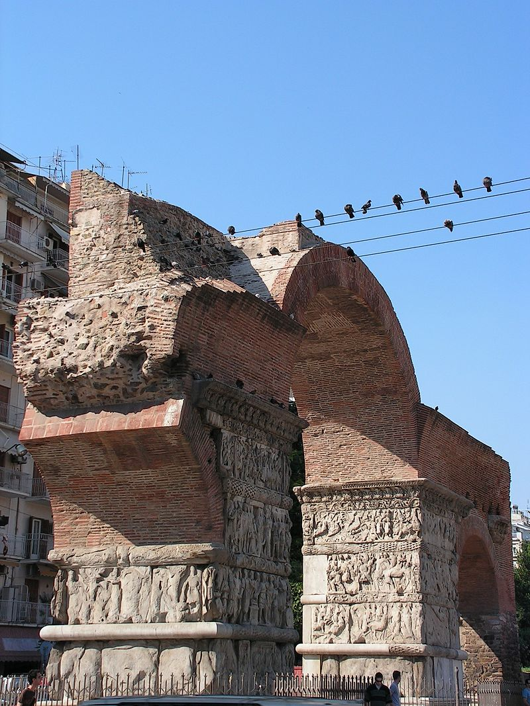
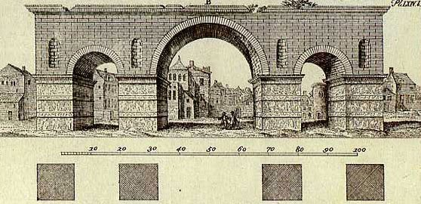
the Arch of Galerius
Built by Galerius in the early 4th century
A symbol of Victory
Impressive sculptures
Notes:
The Arch of Galerius or Kamara is a monument from the Roman era in the beginning of the 4th century and it is a part of an arcade, that was constructed from arches. It was built to honor the Roman emperor, when he came back winner from the Persian wars. The victorious arch was placed vertically to ancient Egnatia street. The art of Kamara's sculptures is mostly story-telling as well as decorations. The most eye-attracting thing it is the great variety of individual sculptures and full scenes of action, which still have a beautiful Greek comeliness.

Slide 9
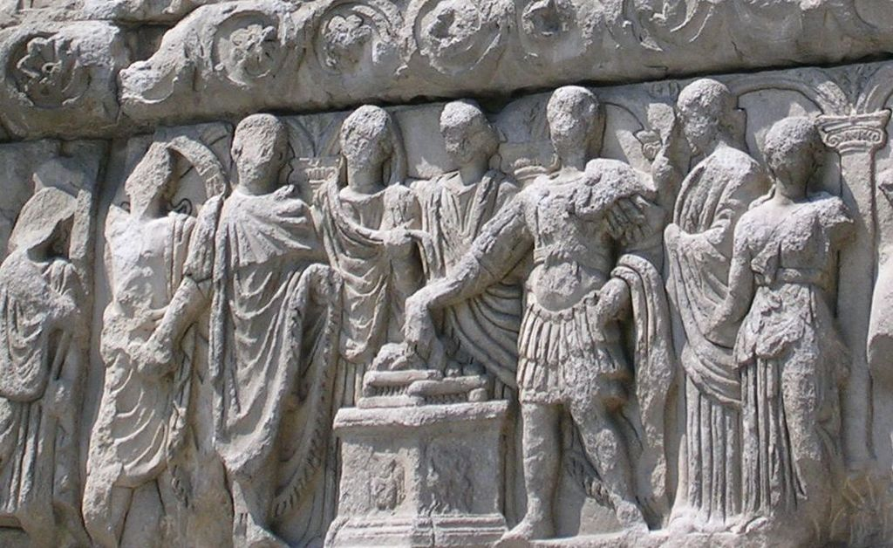
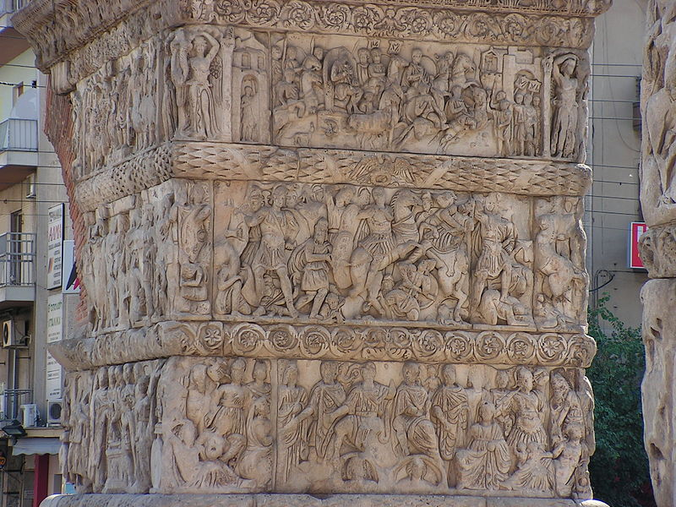
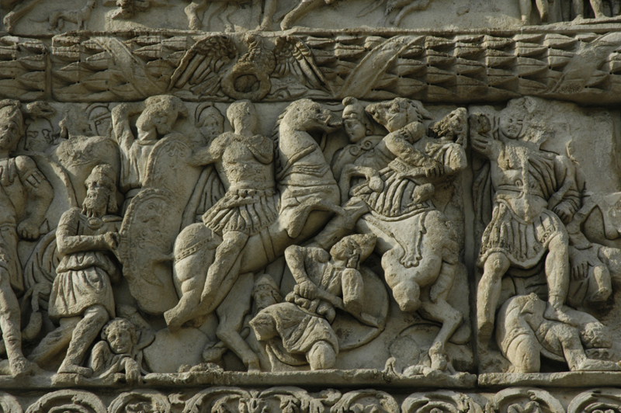

Slide 10
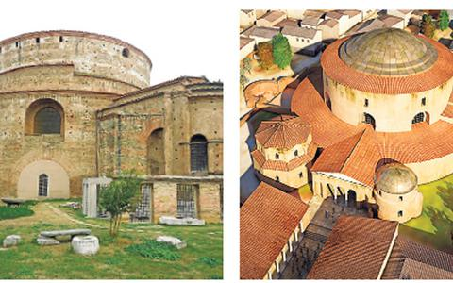
The Rotunda
Built in 306 AD
Many functions through the years
Currently used as a museum
Notes:
The Rotunda was also built in the years of the emperor Galerius around 306 AD as a temple of Zeus. It was also connected to the Kamara. The cylindrical structure was build from the emperor, who was thought to have intended it to be his mausoleum. The monument was used in the early Christian years as a church. The church was embellished with very high quality, breathtaking mosaics. Only fragments have survived of the original decoration, for example, a band depicting saints with hands raised in prayer. The Rotunda has a diameter of 24.5 m. Its walls are more than 6 m thick. The walls are interrupted by eight rectangular bays, with the south bay forming the entrance. A flat brick dome, 30 m high at the peak, crowns the cylindrical structure. It was used as a mosque until 1912, when the Greeks captured the city during the Balkan War. Greek Orthodox officials reconsecrated the structure as a church, and they left the minaret.

Slide 11
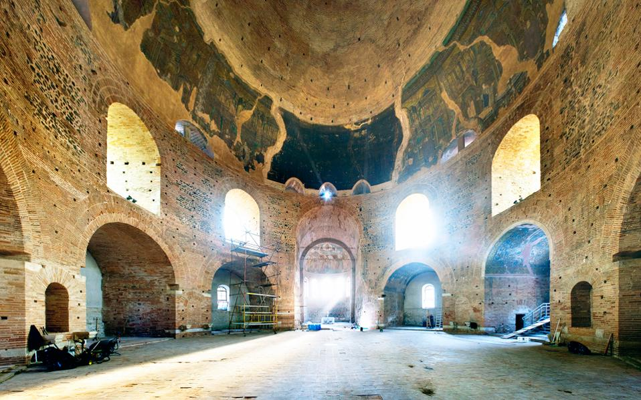
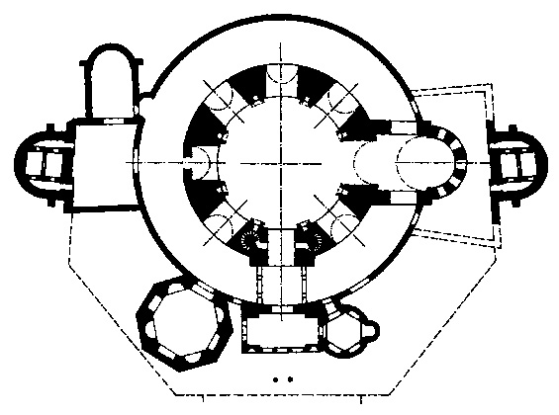
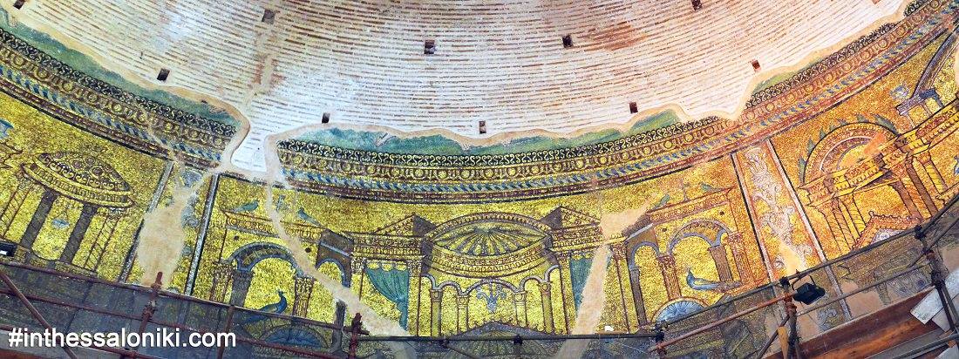

Slide 12
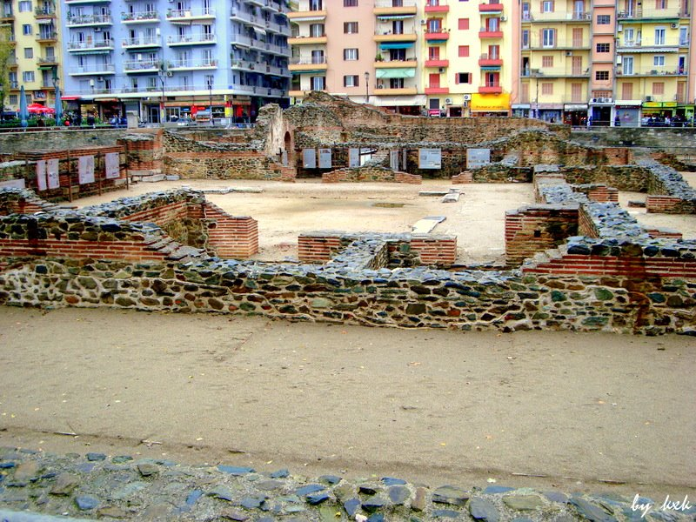
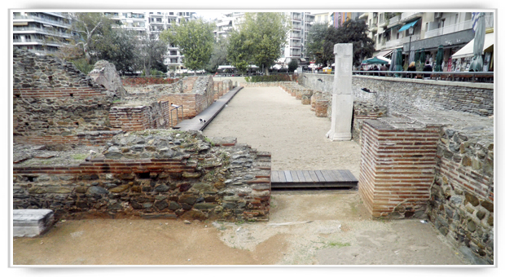
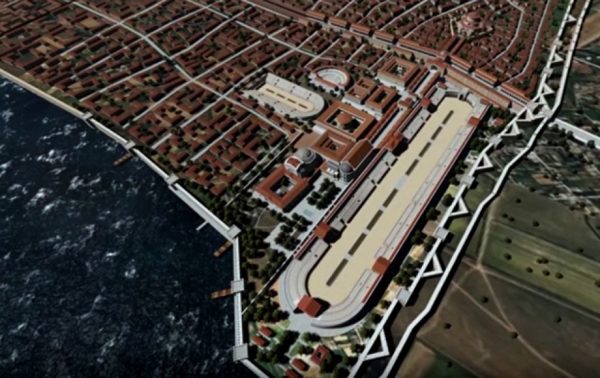
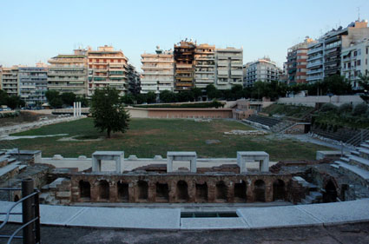

Slide 13
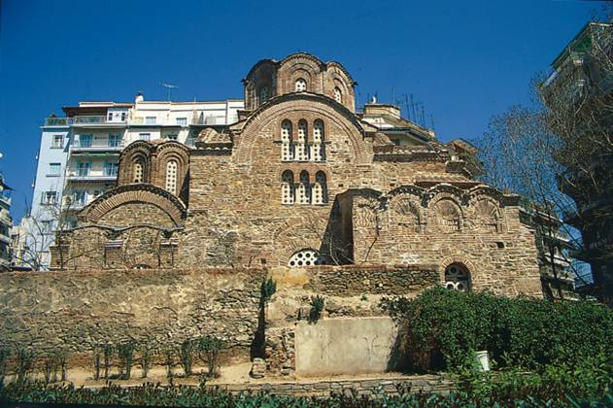
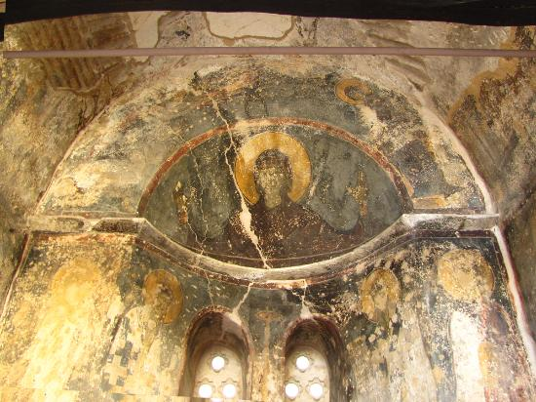
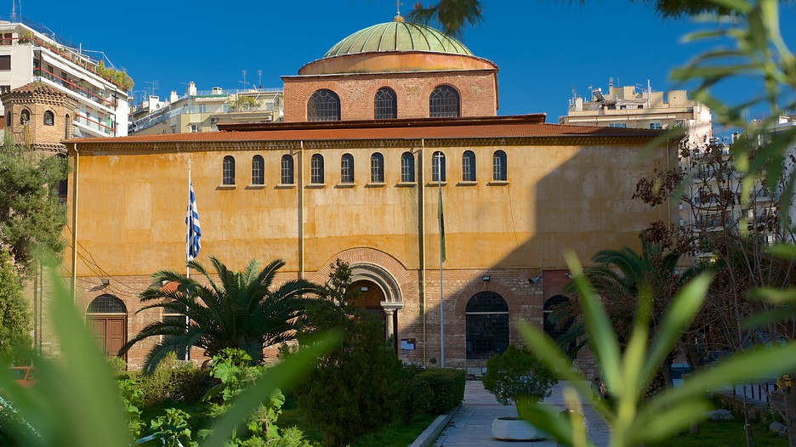
Byzantine Period
Throughout this period Thessaloniki was treated as a great city and a religious center. As a result lot of churches were built over the years.
Saint Panteleimon
Saint Sophia

Slide 14
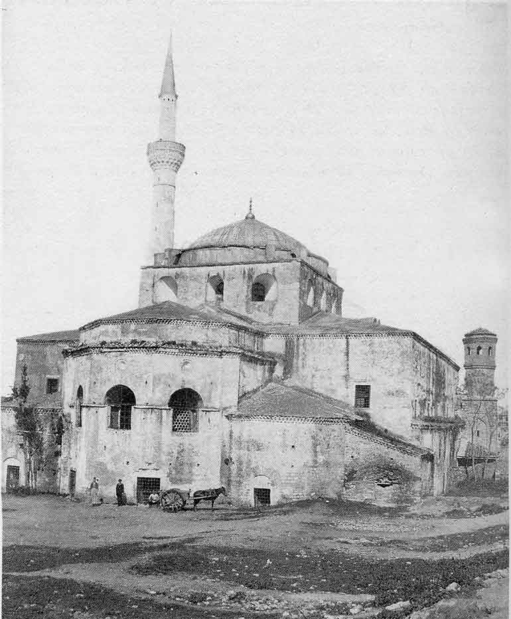
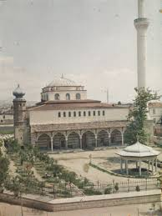
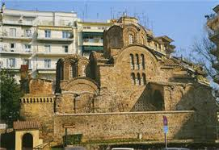
Ottoman Period
During the Ottoman period a lot of the monuments changed. Most notably a lot of Byzantine churches were converted to mosques
Agia Sophia Saint Panteleimon Rotunda Rotunda

Slide 15
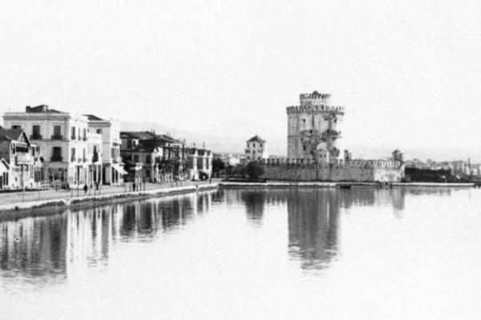
The White Tower
Symbol of Thessaloniki
Built in the end of the 15th century
Originally used as a fortress
Now used as a museum
Notes:
The exact date the White Tower was built is not known but it’s almost sure it was built in the end of the 15th century, after Thessaloniki was captured by the Turk Sultan Murad II in 1430.The Tower has gone through many names over the years. Originally it was named Πύργος του Λέοντος (Lion’s Tower), as stated in an inscription from 1535 or 1536.From the 17th century onwards it is unofficially called the Fortress of Kalamaria and the Tower of the Janissaries. In 1826, at the order of the Sultan Mahmud II, there was a massacre of some rebellious Janissaries imprisoned there. That along with the countless victims whose blood was spilled at the hand of the Ottoman tortures and executioners caused the Tower’s name to change to Kanli-Kule, the Tower of Blood. A name it kept until the end of the 19th century.Τhe tower seems to have gotten its current name after a Jewish prisoner, Nathan Guidili, offered to coat it with lime in exchange for his freedom in 1892. It currently functions as a museum and gallery

Slide 16
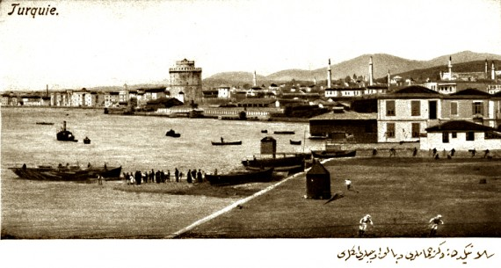
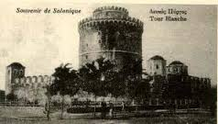
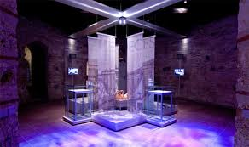
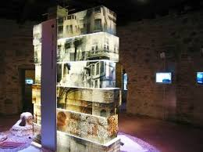
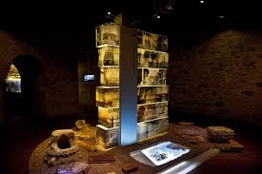

Slide 17
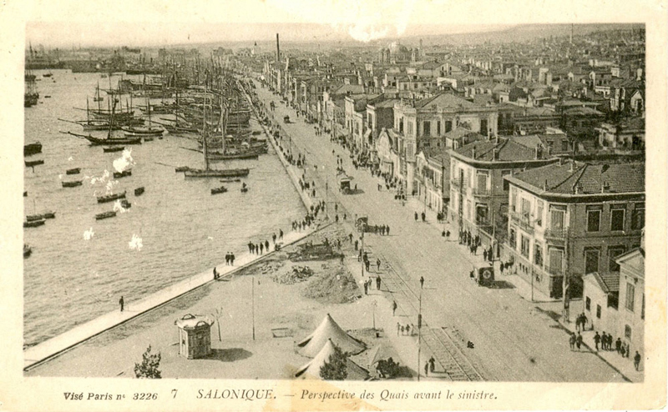
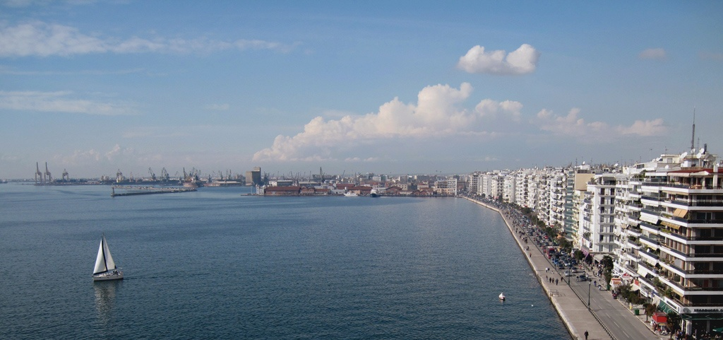
After the Great Fire of 1917 the city transformed from a city of
mostly eastern style ,to a city with a mostly western style

Slide 18
Promotion through a travel agency
The travel agency provides packages that include a tour of the monuments plus :
Religious Tourism: The package includes a trip to Mount Athos
Recreational Tourism :The package includes visits to the beaches of Khalkidhiki
Mountain Tourism : This package includes a visit to Mount Olympus
Notes:
We tried to find the best ways to accomplish our goal of promoting the monuments of historical and cultural significance located in the center of Thessaloniki. We came up with two that suit our needs.
We have come to contact with a travel agency that provides package tours that combine the monuments we have mentioned with visits to recreation areas of historical and cultural importance around Thessaloniki. Those include :

Slide 19
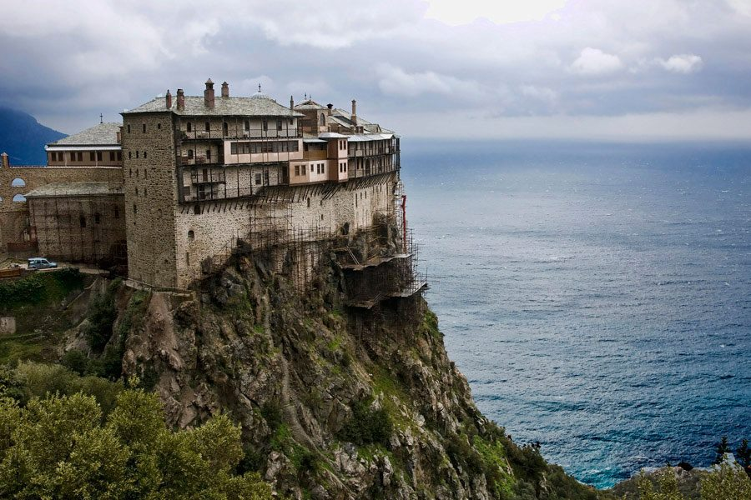
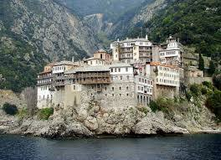
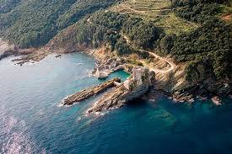
Religious Tourism
Visits to mount Athos
It has over monasteries
Caters to Orthodox Christians with similar monasteries
Notes:
Religious tourism
That includes visits to the aforementioned monument plus a visit to Mount Athos «Αγιον Ορος»
Mount Athos is located in the peninsula of Khalkidhiki. It is an autonomous state within the Hellenic Republic and it is considered one of the holiest places in the Orthodox Church. Over 2000 monks from Greece and other orthodox countries inhabit Mount Athos and it has over 20 monasteries. Since 1988, it is considered a World Heritage Site.
The package aims mostly to orthodox Christians of Slavic descent since they have similar monasteries

Slide 20
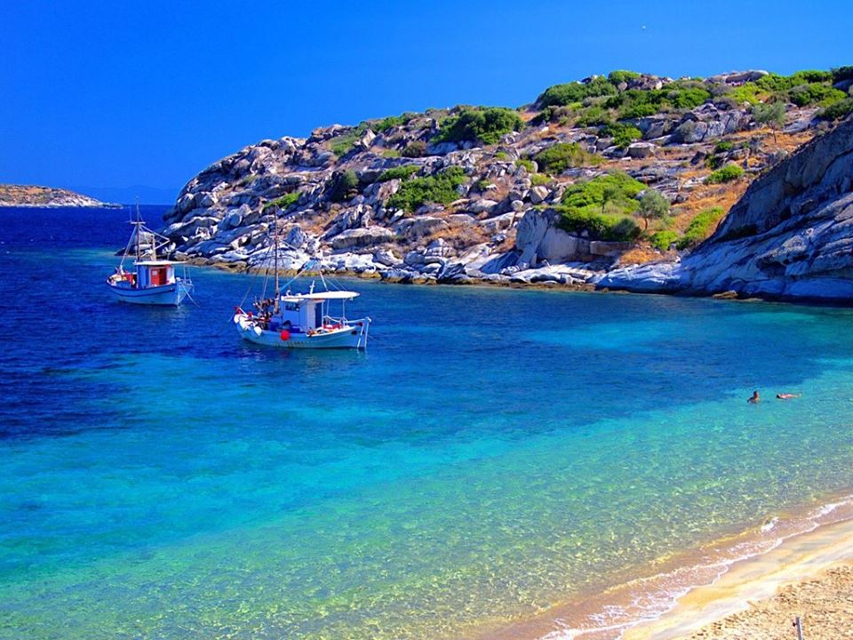
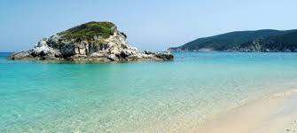
Recreational Tourism
Visits to the beautiful beaches of Khalkidhiki
Getting to know the Greek hospitality
Caters to the lovers of the sun and sea
Notes:
Recreational Tourism
That also includes the monument, however this packages includes visits to the beautiful beaches of Khalkidhiki
This mostly caters to people who like the sun and the sea

Slide 21
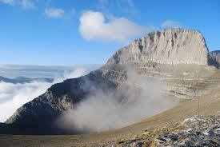
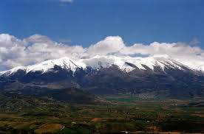
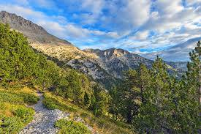
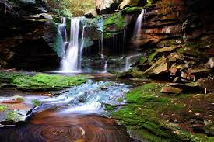
Alternative Tourism
Visits to Mount Olympus
The highest mountain in Greece (20918 m)
Believed to be the home of the 12 Olympians
Caters to people who like hiking and wildlife
Notes:
Alternative Tourism
This package includes visits to the monuments as well however it also includes a visit to Mount Olympus
Mount Olympus is the highest mountain in Greece. Mount Olympus has 52 peaks, deep gorges, and exceptional biodiversity. The highest peak «Mytikas», meaning "nose", rises to 2,918 meters. In Ancient Greek mythology Olympus was the home of the Twelve Olympians with the Palace of Zeus on top.
The package caters to people who like hiking, mountains and wildlife in general

Slide 22
Potential for the city
Increase of tourists from the formerly soviet countries
One of the most politically stable countries in the Balkan region

Slide 23
Problems we might face
Unsatisfactory facilities (few and small hotels, unsatisfactory city transport)
Problems of protection and lack of supervision over the monuments
Potential problems in travelling due to increased measures against illegal immigration

Slide 24
Potential solutions
Upgrade of already existing facilities
Elimination of these ways of thinking through education
Raise awareness to younger generations of politicall matters

