Slide 1
Flying words : mythology in literature and music
The Trojan War

Slide 2
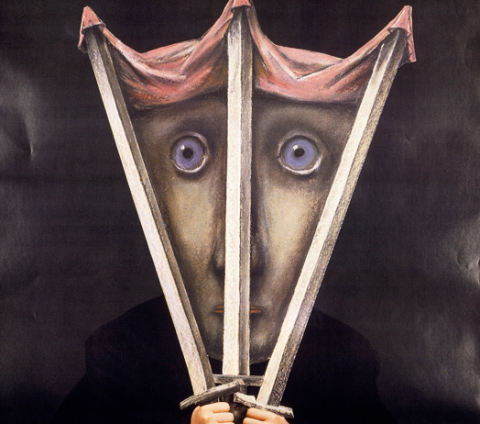
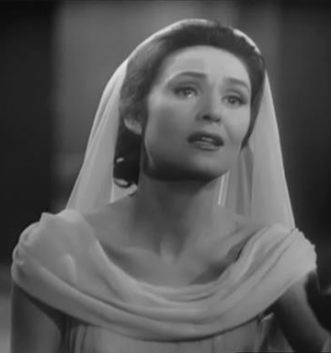
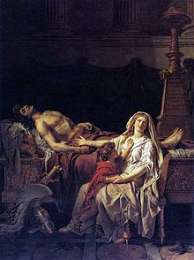
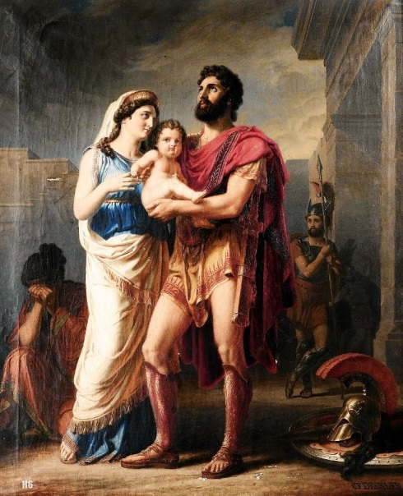
Andromaque
THROUGHOUT THE time
Jacques Louis David, La Douleur et les Regrets d'Andromaque sur le corps d'Hector (1783)

Slide 3
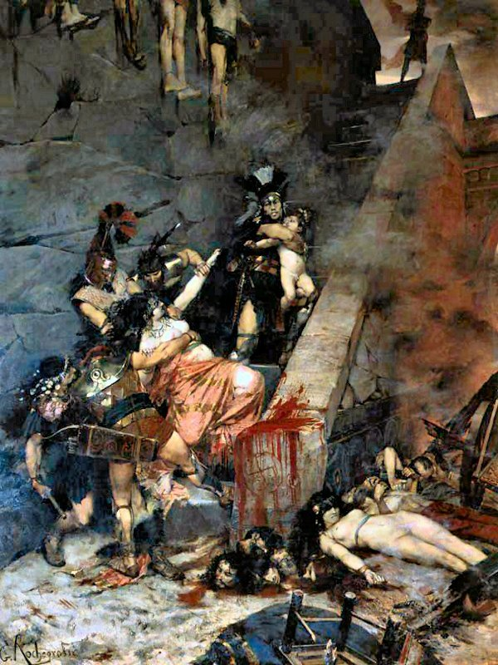
Andromaque by Georges Antoine ROCHEGROSSE

Slide 4
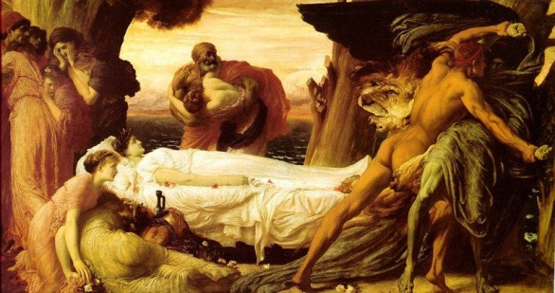
Andromaque during the antiquity
Andromaque, daughter of Eetion, king of Thebes, became the wife of Hector.
She sensed the imminent death of her husband who was killed by Achilles.
His son, Astyanax, was killed by the Greeks. Andromaque became the captive of Pyrrhus, son of Achilles.
She lost everything, her father, her brother, her husband and her son.

Slide 5
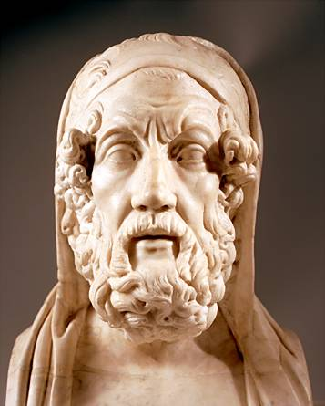
Andromaque by Homère
« Hector ! Tu es pour moi un père, une mère vénérable, un frère et un époux plein de jeunesse ! Aie pitié ! Reste sur cette tour ; ne fais point ton fils orphelin et ta femme veuve. »
"Hector ! You are a father for me, a venerable mother, a brother and a youthful husband ! Have mercy ! Stay on this tower; not doing your orphan son and your wife a widow."
« Mais retourne dans tes demeures, prends soin de tes travaux, de la toile et de la quenouille, et mets tes servantes à leur tâche. »
"But go back to your homes, take care of your works, the fabric and the distaff, and put your servants to the task. "

Slide 6
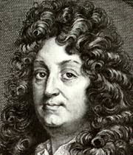
Andromaque by Racine
The scene is set during the Trojan War.
« Ma flamme par Hector fut jadis allumée;
Avec lui dans la tombe elle s’est refermée »
”My flame was lit by Hector; With him in the grave she has closed”

Slide 7
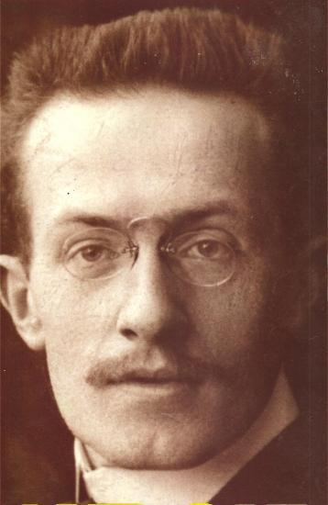
Andromaque by Giraudoux
The scene is set before the Trojan War.
« Tout à l’heure, en te quittant, je vais solennellement, sur la place, fermer les portes de la guerre. Elles ne s’ouvriront plus. »
”Later, leaving you, I will solemny, on the place, close the doors of the war. They will not open anymore .”

Slide 8
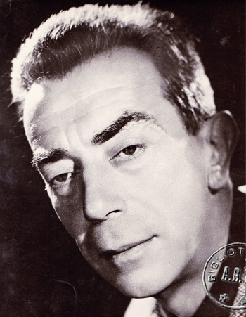
Andromaque by M. Aymé
« Passez-moi Astyanax, on va filer en douce. »
"Give me Astyanax, we will go away gently."

Slide 9
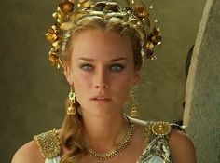
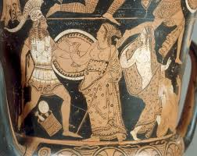
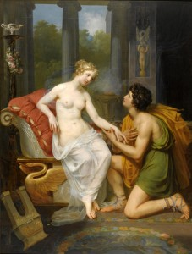
Helene throughout the time

Slide 10
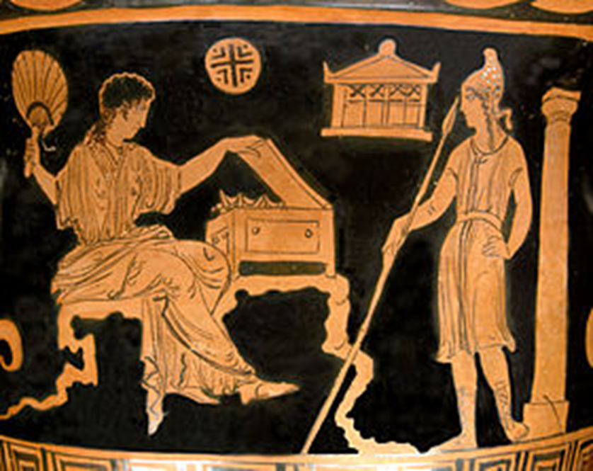
Helene during the antiquity
Helene, wife of King Menelas of Sparta and daughter of Zeus and Leda, is kidnapped by Paris, son of Priam (King of Troy) and is taken at Troy by the man. This kidnapping is the reason of the war between Greeks and Trojans.
Hélène and Pâris, bell-krater with Apulian red-figure, 380-370 before J-C., museum of Louvre

Slide 11
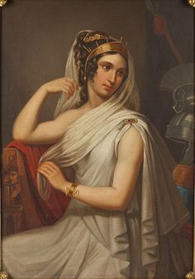
Homere and his Helene
« Que n'ai-je subi la noire mort quand j'ai suivi ton fils, abandonnant ma chambre nuptiale et ma fille née en mon pays lointain, et mes frères, et les chères compagnes de ma jeunesse ! Mais telle n'a point été ma destinée, et c'est pour cela que je me consume en pleurant. »
« What have I suffered the black death when I followed your son, leaving my wedding room and my daughter born in my far-off country, and my brothers and dear companions of my youth ! But this has not been my destiny, and that is why I am consumed with tears.»
Helene regrets her husband. She is not guilty of her escape with Paris. It’s the Gods who have decided that.

Slide 12
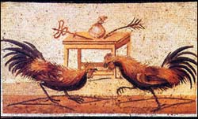
Helene in a fable of La Fontaine
« Où du sang des Dieux même on vit le Xanthe teint.
Longtemps entre nos coqs le combat se maintint.
Le bruit s'en répandit par tout le voisinage,
La gent qui porte crête au spectacle accourut.
Plus d'une Hélène au beau plumage
Fut le prix du vainqueur. »
…
« Where strife arose, and god opposed to god, Till Xanthus flowed with their celestial blood. Long time the cocks maintained the fight, The noise of which spread everywhere around ; The crested tribes came flocking to the sight. Many a Helen plumed the victor crowned ;
The vanquished hero blushing fled »
Extract of The Two Cocks , La Fontaine
In this fable, Helene is the representation of the woman. Here, the woman is the cause of the quarrel of the two cocks which are in the reality, two men. Moreover, there is traditional misogyny in this text.

Slide 13
Helene in the theater
Giraudoux wrote a play in 1935 entitled The Trojan War Will Not Take Place (La guerre de Troie n’aura pas lieu). In his work, he tries to warnthe WWII which will happen few years later. He wants the peace, like it was said previously.
« ANDROMAQUE : Vous ne l’aimez pas !
HÉLÈNE : Si tous croient que nous nous aimons, cela revient au même. »
« Andromaque : You don’t love him!
Helene: If all the people believe that we love each other, it’s the same. »
Helene doesn’t love Paris, it is just an illusion. Consequently, the war hasn’t got a noble reason to be anymore.

Slide 14
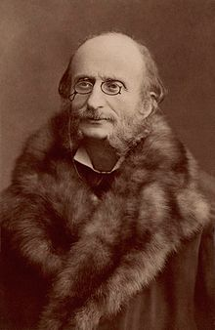
Helene in an opera
Offenbach realizes an opera « bouffe » titled La Belle Hélène at Paris on the 17th December, 1864. It’s composed of three acts.
Here is an extract of the opera.
It’s a comic opera which lets appear a dizzy, precious and particularly beautiful Helene, what confirms her designation as « the most beautiful woman of the world » according to the legend.
In the extract in the bedroom with Paris, she appears in a pink dress, very short and modern, especially for the age when she belongs. So this apparition reinforces the image of a pretty and dizzy woman.
In the following scene, Helene is only wearing a sheet of her bed, that she keeps in order to does not fall. We all can see that she’s not prudish and she's not afraid to show herself.

Slide 15
The Helene of Laurent Gaudé
Laurent Gaudé wrote a novel in 2002 entitled The death of King Tsongor.
In his story, the author goes back over the Troyan war : two men fight to have a woman. The two men represent Trojans and Greeks and the woman represents Helene of Sparta. She is also considered as responsable of the war of the two men.
Because of that, she decides to flee for escaping at the death and to show at her two pretendants that she is not the cause of their battles.
We have here a modernization of the character of Helene who was before a sexual toy and who is now an actress of the war.

Slide 16
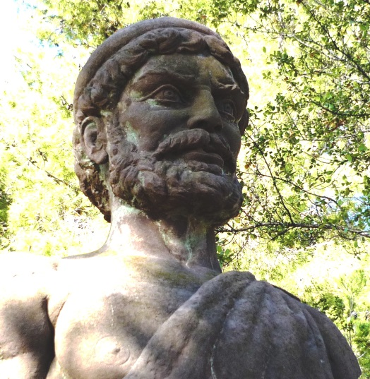
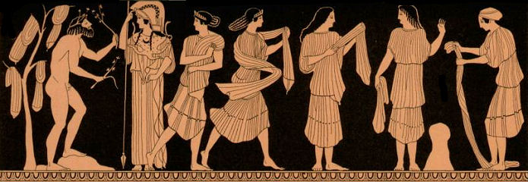
ODYSSEUS throughout the time Ulysse

Slide 17
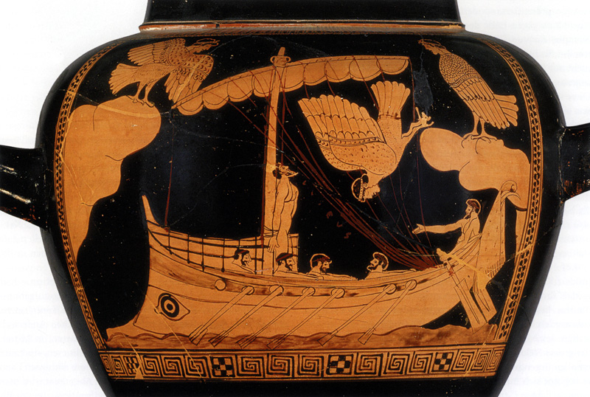
Odysseus of Homère

Slide 18
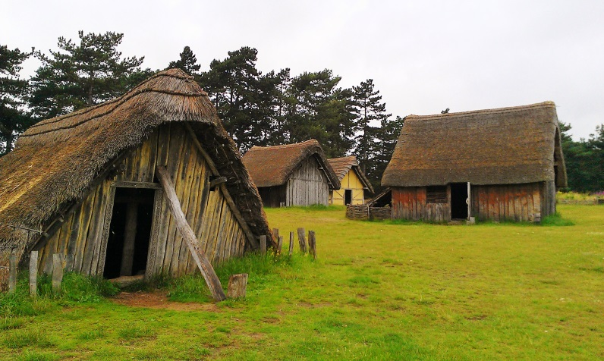
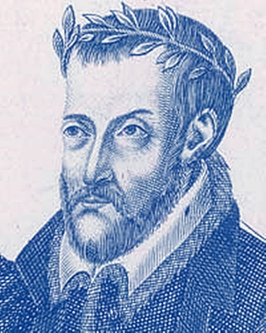
Odysseus of Joachim du Bellay
Heureux qui, comme Ulysse, a fait un beau voyage,
Ou comme cestuy là qui conquit la toison,
Et puis est retourné, plein d’usage et raison,
Vivre entre ses parents le reste de son aage !
Quand reverray-je, hélas, de mon petit village
Fumer la cheminée, et en quelle saison
Reverray-je le clos de ma pauvre maison,
Qui m’est une province, et beaucoup d’avantage ?
Plus me plaist le séjour qu’ont basty mes ayeux,
Que des palais Romains le front audacieux ;
Plus que le marbre dur me plaist l’ardoise fine,
Plus mon Loyre Gaulois, que le Tibre Latin,
Plus mon petit Lyré, que le mont Palatin,
Et plus que l’air marin la douceur Angevine.
Happy he who like Ulysse has returned successful from his travels,
Or like he who sought the Golden Fleece,
Then returned, wise to the world
Live amongst his family to the end of his age !
When shall I see again, alas, of my dear village,
Its smoking chimney, and in which season,
Will I see again my little modest plot of earth
That is a province to me, and far more than I draw here ?
I’m drawn far more to my forefathers home,
Than to a Roman palace fine and proud ;
More than hard marble I prefer fine slate,
My gaul Loir I prefer to latin Tiber,
My little Liré I prefer to Palatine,
And to sea air, soft climate Angevine ?

Slide 19
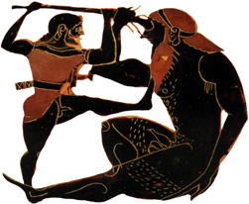
Odysseus of Giono

Slide 20
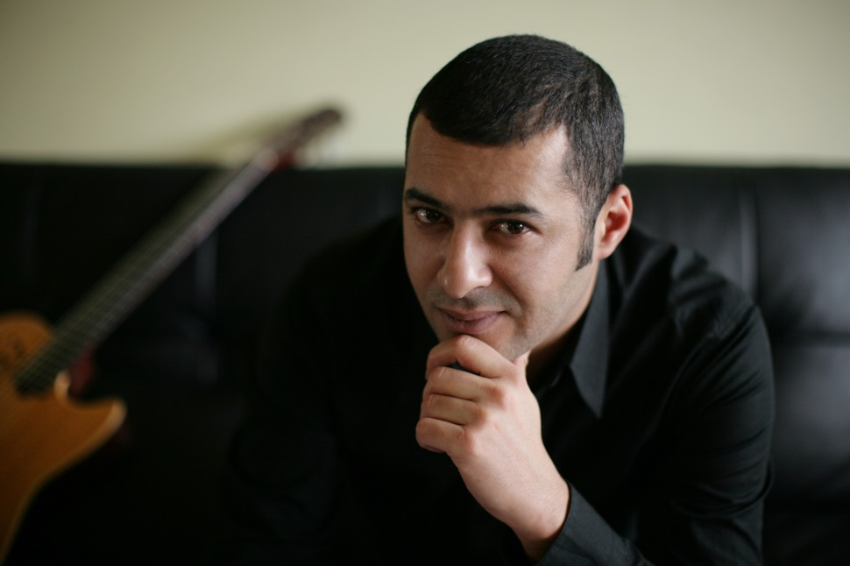
Odysseus of Ridan

Slide 21
Odysseus of Eric-Emmanuel Schmitt

