Slide 1
Mediterranean maritime trade routes

Slide 2
Antiquity: second colonization
Hellenistic period
Roman era
Latin empire - Venetian
Discoveries of new countries

Slide 3
Second colonization
During the Second colonization (8th to 6th century BC.) were founded Greek cities in a broad geographic area from the Black Sea to today's Spain and the north coast of the Aegean to the North African coast. Specifically:
To the north and northeast founded colonies in Chalkidiki, on the coast of Thrace, the Hellespont, the Propontis, the Bosporus and the Black Sea coast. The first to found colonies in Chalkidiki were Chalcedeans that gave the name to the region. Chalkidean important colony in the region was Olynthos. Remarkable was also Potidea, colony of Corinth. The area gave timber and minerals while Paggeo region, further east, gave gold.
In the region of the Straits (Hellespont, Marmara, Bosphorus), cities that lead the way in the colonial movement was Miletus and Megara. Important colony of Megara on the European shore of the Bosporus was Byzantium. The Milesians founded many colonies in the Black Sea ensuring control of trade in the region. They bought from indigenous cereals, wood, leather and slaves and selling oil, wine and various craft products such as vases, weapons and jewelry.

Slide 4
In central and western Mediterranean, was also developed important colonial movement. The Greek colonies founded in southern Italy (South Italy) and Sicily were so many and such acne knew that the area was named Great Greece. Among them stood out Taras, a colony of Sparta, the Crotone and Sybaris Achaean colonies of the Peloponnese, Kimi, colony of Evia and Syracuse, a Corinthian colony in Sicily.
Even further west, the Phocaeans from Phocaea in Asia Minor founded on the southern coast of France in Marseille today. Then the inhabitants of Marseille founded colonies even further west, on the coast of today's Spain.
In Egypt, at the delta of the Nile River, Greek traders created Naucratis as a commercial station, which quickly developed into an important city. In the west, the region of Cyrenaica (modern Libya), settlers from Thera (Santorini) founded Cyrene that became an important commercial center.

Slide 5
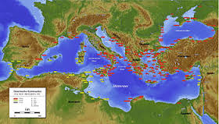

Slide 6
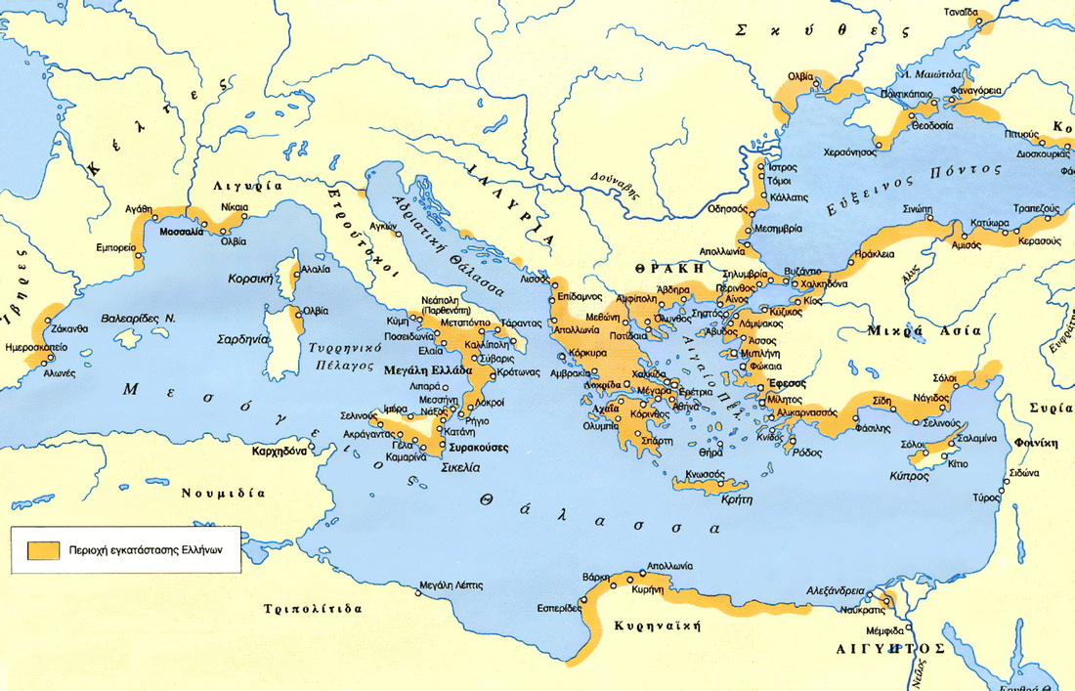

Slide 7
Hellenistic period
Economic globalization
In economic life there is a real revolution. There are no longer national currencies, but only the golden Greek, which facilitates trade. In fertile countries of the East are implemented new crops and thriving agriculture.
The new knowledge acquired in geography, navigation, construction of ports, lighthouses and various other projects, promote commercial shipping. From several new countries, that Alexander the Great arrived, unknown materials are now known and reach everywhere thanks to trade, affecting the nature of the industry.
The rich class of merchants and bankers are created while big groups of people move to the big cities. Because of urbanization, the countryside is ravaged and small farmers are unhappy that they are obliged to give to the king the bulk of their harvest.
About 160 new cities are created, among them, Antioch, Pergamum, Laodicea, Seleucia on the Tigris and Alexandria, which become enormous cultural and trade centers. With wonderfully organized urban system, with wide roads, market arcades around, temples, theaters, music schools, gymnasiums, palaestrae baths and stadiums with rich libraries and museums,they gather large crowds of artists and scientists from all parts of the known world.

Slide 8
According to researchers, the trade of this period can be divided into internal and international. The first was between the kingdoms and countries belonging to the Hellenistic "system", irrespective whether it is local or to trade between parts of the same kingdom or between different states. The second was conducted between the Hellenistic world and countries outside it, for example with India, Parthia, the southern Arab states, Italy, the countries of the Illyrians, the Thracians, the Celts, the Sarmatians and Scythians.
Also, trade, depending on the nature, organization and manner of conduct can be characterized terrestrial, marine and river trade.
The most important was the maritime trade conducted in the Mediterranean, the Black Sea, the Persian Gulf and the Red Sea, which is however difficult the lack of progress in navigation. While playing a crucial role in the economies of the Hellenistic states, the only useful achievement observed during this period in this respect seems to be the use of the triangular sail. Based on a long axis forming an angle of 45 degrees with the main sail, which allow better navigation in adverse weather conditions.
But the profession of merchant seamen concealed great dangers and anxieties, as they had to face off against pirates and the various wars between kingdoms, the elements of nature and ignorance. Possibly even the most ships have been lost to powerful storms, or because of the difficulties in shipping and the lack of maps than from pirate attacks.
The terrestrial trade was not very developed and the most interesting shopping street was the caravans from Syria, Mesopotamia, Arabia and the land of Persia.
The trade through rivers was limited and only local. The most important river was Nile, as it was the main route of internal trade of Egypt, and used for the transport of goods from India, Arabia and East Africa to the Mediterranean.

Slide 9
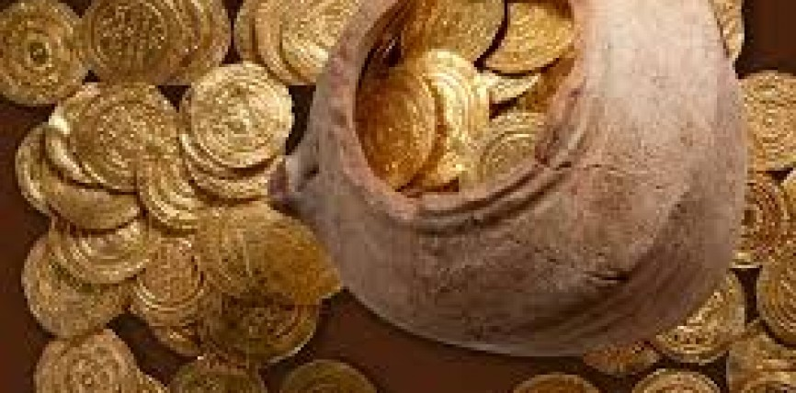
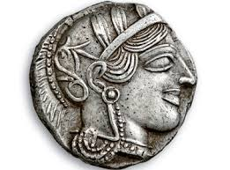
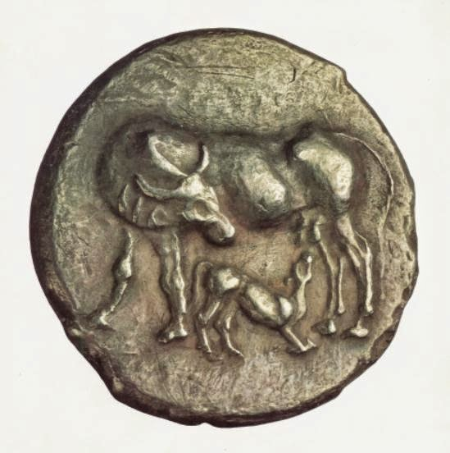
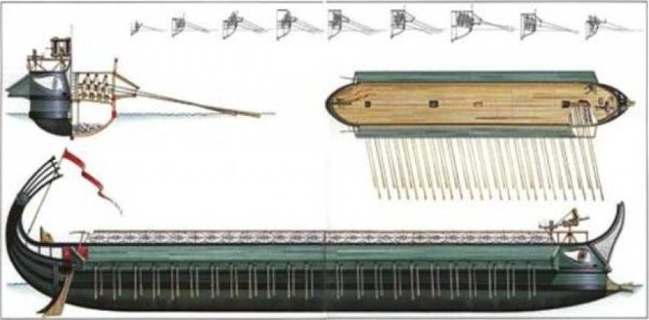

Slide 10
Roman era
In the Roman Empire, one of the two most important trade routes leading to the capital Rome was via Egnatia, an oversea extension of via trail through the port of Gnafias that crossed the Greece to the Evros river. Egnatia passed through Durres, Lychnidos, Heraclea, Pella, Thessaloniki, Amphipolis, Philippi, Topeiro, Maximianoupolis and Traianoupolis.
Egnatia was built between 146-120 BC, on the traces of an ancient, pre-Roman road that stretched from the Adriatic and the Aegean. Later, it was extended from Evros river to Byzantium and finally the name Egnatia was all the way from Rome to Constantinople, in honor of the Roman proconsul Gnaeus Egnatius who built it.
The first explicit mention of the via Egnatia is located in the geographer Strabo work.
In 1270 AD the via Egnatia referred to as connecting highways between Durres and Istanbul and by the 16th century used basically as a commercial road trafficked races, religions, social classes, ideologies, customs, economies, cultures, beliefs.

Slide 11
16th Century
The routes that European travelers followed to go to Constantinople or Jerusalem was preferably through Venice, which had possessions throughout the eastern Mediterranean, secured necessary provisions and it was Venice that handled and organized the pilgrimage. The Venice dominates the seas to the entire eastern Mediterranean and continues the next centuries to be the economic, commercial, diplomatic and driving factor for the balance of forces in the Mediterranean, remaining the privileged shipping commerce power.
Corfu, Zakynthos, Kythira and Kefallonia were necessary station for vessels before reaching Crete and the Middle East. From Venice and through Pagousa, the Ionian Islands, Crete and Cyprus, as necessary stations, they arrived in the Holy Land in 1566 and headed to the capital of the Empire. From Constantinople again, with stops in Chios and Rhodes, travelers were bound for Alexandria and of course Palestine. The terrestrial roads crossing the Balkan peninsula and from Belgrade, through Sofia and Adrianople ended again in the Ottoman capital with stations in Novi-Pazar and Sofia, follow the rest of the way to Istanbul. Few voyages were made as the 17th century in Asia Minor.

Slide 12
18th Century
With the entry of the 18th century some trips toppled not only the hitherto knowledge of readers on the islands predominantly Archipelago, but also opened new and attractive travel routes. These services are broken down in all directions, they cut off the beaten track, although most ended or started to and from the capital of the Ottoman Empire. Athens is simultaneously a visiting goal and is reached either by roads of mainland or Peloponnese or by the sea.
The first quarter of the 19th century, the travelers reflect the many faces of the traveling. From Epirus of Ali Pasha to the Aegean Archipelago, the Ithaca of Odysseus to Kydonies and Chios, from bustling Istanbul to Crete and commercial Smyrna to western Peloponnese, by the oracle of Delphi to the port of Thessaloniki and from the salt marshes of Cyprus to Zakynthos, roads, paths, seas and mountains was crossed by travelers, lovers of the past and surprised "readers" of the modern Greek reality.

Slide 13
The most important and frequently used roads connecting the major port cities of the Black Sea to Istanbul. Such a sea route linking the Byzantine capital with Heraclea Pontica and with Sinope and Amisos and end by Trebizond on the southern coast of the Black Sea. Another coastal sea route hugs the west coast of the Black Sea and connecting Constantinople to Nessebar, Anchialos and ports in the Danube delta. From there, the road followed the northwestern coastline and along the estuary of the Dniester River and Dnieper went to the northern coast of the Black Sea, reaching up to Cherson, where along the Crimean coast, the road went to the Cimmerian Bosporus Azov.

Slide 14
The period of the Latin Empire, the Venetians annexed territories such as three-eighths of Constantinople, Methoni and Koroni, Evia, Aegean islands, in order to control the sea routes. Later, Genoa managed to acquire Byzantine territories and granted, after treaty, Galatas, a district outside of Istanbul to reside.
The development of Venice and Genoa as trading powers had the effect of creating "world market" in the eastern Mediterranean, ie Greece, the islands of the Aegean and Ionian Sea, Crete, Constantinople and the Black Sea. The ports were transit countries for products of Central Asia and the Far and Middle East. At the same time these areas sent to Western Europe raw materials and foodstuffs. The main export products were: wheat, flax, olive oil, wine, sugar, cheese, skins, wool, cotton and wax. However, glassware imported from Western Europe were textiles and craft products, such as metallurgical objects and weapons.

Slide 15
Sources:
http://travellers.ekt.gr/index.php?item=headerpage
http://www.slideshare.net/dbatsi/ss-41229287
http://www.egnatia.eu/page/default.asp?la=1&id=23
http://blacksea.ehw.gr/forms/fLemmaBodyExtended.aspx?lemmaID=12232

