Slide 1
Trojan War
The Trojan War,in greek mythology ,was a ten-year warfare between the Greeks(Achaeans or Danaans)and the Trojans under the walls of Troy.The main motive of this war was the rape of Helen,wife of the Spartan king Menelaus,by the prince of Troy Paris.
The cause of the war originates from the divine strife between Athena,Hera and Aphrodite, caused by Eris after giving the godesses a golden apple with the marking "to the most beautiful".Zeus, to solve the conflict about who deserved to take the apple ,sent the godesses to Paris who, finally chose Aphrodite.As a reward for choosing her ,Aphrodite made the most beautiful mortal woman,Helen,fall in love with him and follow him to Troy.After the rape of Helen,Agamemnon ,king of Mycenae ,and brother of Helen's husband,Menelaus,led an organised Greek expidition and besieged Troy for ten years.After the fall of many heroes, such as Achilles and Ajax of Telamon ,as well as Trojans ,Hector and Paris,Troy was captured thanks to the trick of the Trojan Horse.The conquest of the city by the Achaeans was accompanied by slaughter,complete destruction and as well as sacrilege of temples.This action caused the gods' rage,who avenged a lot of surviving Achaean kings.Few of them managed to continue their lives peacefully back home.
Ancient Greeks believed that the Trojan War (like many events from mythology) was a historic event that took place during either the 13th or the 12th century B.C and that Troy was located on the asian side of Hellespont.Just in 1870 did German archaeologist Heinrich Schliemann,after excavations ,discover the,until then mythical,Troy.Today the majority of the archaelogical community agrees that this location is indeed Troy and that there is definately some historic core regarding the war. The Greeks besieged Troy for ten years.Most of the surviving information talks about the last year of the war so we do not know much about the rest of the nine years.After the initial debarkation and consolidation of the Greeks in the coastal zone of Troy,they begun to plunder the countryside and master cities adjacent to Troy,even plunder the opposite Thracian coast.Troy had not had any mass siege up to the ninth year of operations and communication with the interior of Asia Minor continued undisturbed.On the other hand,the Greeks,accepted significant millitary aid even before the war ended.However,they were still not able to penetrate the hinderland and encircle the Trojans,who kept contact even with their allies on the European shore.
The Rape of Helen of Troy
The traditional and the <<new >>Helen of Euripides
According to the tradition,Helen,wife of Menelaus Sparta's king,was famous for her beauty.Paris,son of Troy's king Priam,with Aphrodite's help,kidnapped her and led her to Troy.The Greeks,with Agamemnon and Menelaus in charge marched against Troy and after ten years of war,captured the city.Helen was associated with the distructive war and is often presented as responsible for the death of many people
There was,howerver,another,less known,tradition Stisihorus,for example,a poet presented another version in his poem,named "Παλινωδία",Helen never went to Troy with Paris.The gods took her to Egypt and created a reflexion that Paris kidnapped,belieaving it was Helen.So the Greeks and the Trojans fought for ten years,not for Helen but for her reflexion.

Slide 2
This is the myth that Euripidis uses in his tragedy <<Helen>>
Homer names her daughter of Zeus.Greek mythology says that she was born by the beautiful Lyda, after she was seduced by Zeus,who had transformed into a swan.The legend of Helen's beauty had spread all across Greece.At a very young age,she was stolen by Theseus with the help of Pelithius,while she was dancing at the temple of Artemis.He transported her to Attica and hid her at Aphidnes to be taken care of by his mother Aethra.She was rescued by her brothers Dioskouri(Castor and Pollux)
Helen returned to her homeland,Argos, and was the most sought after bride of the whole Greece.Finally, her father,Tyndareus,wed her to king Menelaus.Because of Helens numerous suitors, her father made them swear an oath:
"Regardles of who wins we will all help,in case an enemy takes her away from her home and husband,and we will march against him,destoying his city (Euripidis,Agamemnon,Iphigenia in Aulis lyric 57)
It is said that Tyndareus,worried that Agamemnon might divorce Clytemnestra for Helen,made him swear the oath too,after being advised so by Odysseus.But Aphrodite had promised Paris (Alexander)that she would give him the most beautiful woman in the world.So,Paris travelled to Sparta , took Helen,on her own will,and brought her to Troy.This rape,according to the myth,was the cause of the bloody and cruel ten year Trojan War between Greeks and Trojans and the destruction of Troy. After the rape of Helen by Paris,the oath of Tyndareos was activated by Menelaus and so his brother Agamemnon organised the expedition against Troy..According to Homer, many famous Greek kings took part in this war.After Paris' death ,Helen married Deiphobus(Paris' brother).After the fall of Troy, Helen followed her husband,Menelaus, to Sparta.They arrived after numerous adventoures that lasted eight years .Since then they lived the rest of their lives peacefully.However, another myth says that Menelaus sailed to Egypt.There,in the land of the Nile,he met the real Helen.Helen that men fought for in Troy was actually a vision,a fake.
This is the myth that the ancient poet Stisihorus is refering to in his poem "Παλινωδία“which exists in Plato’s <<Φαίδρος>> In Iliad Homer presents Helen as a human creature of divine origin.Even though she loves Paris, she leaves him because he is not brave.
The gathering of the Greeks
Menelaus damanded the oath of Helen's ex-suitors be kept and talked to Agamemnon.For that purpose,he sent embassies to all Achaean leaders to make sure they did it.
First gathering at Aulis
The Greek forces originally gathered at Aulis.All former suitors were present except foe the king of Cyprus,Cinyras, who promised to send fifty ships.Eventually he only sent one ship,led by Mygdalionas,and another fourty-nine ship models sculpted out of mud.The last one to go to Aulis was the fifteen year old Achilles.
When the Greek forces begun their journey to Troy, they landed in Mysia,by disorientation.King Telephus,son of Hercules,had previously allowed a group of Arcadians to settle in the area.In the ensuing battle,Achilles injured Telephus,who had previously killed Thersandros.Because Telephus' wound would not heal, an oracle predicted that it would only be healed by the one who caused it.After Mysia the Achaeans sailed to Troy but bad weather condition and contrary winds scattered the fleet and businesses were temporarily postponed.A new gathering was organised in Aulis.
Telephus went to Aulis either disguised as a beggar or asking Agamemnon to help him with the healing of his wound,directly kidnapped Oristis,,Agamemnon's son,and asked for his treatment as ransom.Achilles refused to provide any

Slide 3
assistance saying that he did not have the proper knowledge.Odysseus interpreting the relevant oracle,believed that the spear that caused the wound ,if in contact with the wound would heal it and so it happened.Telephus in exchange showed the Achaeans the right way to Troy.
Some researchers believe that the conflict with Telephus and the solution of the problem that followed is an integral part of the Trojan cycle and was originally part of the seige of Troy itself, which over the centuries was detached from the events of the major military operations followed in time.
Second gathering at Aulis
Eigth years after the failed attempt to sail to Troy, the Greeks ,whose fleet consisted of more than a thousand ships gathered at Aulis.But the wind had died completely and sailing was impossible.Seer Calchas stated that godess Artemis had caused it as punisment for the death of her sacred deer by Agamemnon,in his attempt to prove that he was a better hunter than her.The only way to appease Artemis was,according to Calchas,for Agamemnon to sacrifice his and Clytemnistra’s daughter Iphigenia.
Agamemnon initialy refused but the rest of the Achaean leaders threatened that they would nominate Palamides as the leader of the expedition,so he eventually accepted.Shortly before the sacrifice,Artemis intervened and transported Iphigenia to a distant place,where she served as a priestess of the godess.Agamemnon seeing that his daughter supernaturally disapeared, following the advice of Calchas, sacrificed a lamp.
The Achaean forces are discribed in detail in the list of ships in the second rhapsody of Iliad.It consisted of 28 regions: Central Greece,Thessaly,Peloponnese,Crete,Dodekanisa and some island in the Ionian sea,gathering a fleet of 1.178 pentikontoros and 50 rowers.Thucydides says that the fleet consisted of 1.200 vessels an more specifically the fleet of Beotians had 80 people crew in each boat, while the ships of Philoctetes had only 50 rowers each. Obviously these numbers were the maximum and the minimum crew that a ship could have.Including all of the above,the overall armed force of the Greeks rises up to 70.000 to 130.000 men. Another list of ships by Apollodorus slightly differs from Homer’s list, but agrees on the final numbers of the expeditionary force.
In the sacond rhapsody of the Iliad the list of the Trojans and their allies is also presented.Beside Troy itself led by Hector ,the allies included:Dardanus(under Aeneas) , Andrasteneis , Perkotianoi, Pelagesians, Thracians, Kikones spearmen ,Paeonian archers,Mysias,Phrysigians,Milesians,Lyciansand Carians.It is not specified what language these people spoke,only Carians are reported as "βαρβαρόφωνοι".The rest of Trojan allies,spoke different languages,as it is reported ,and the various command on the battlefield had to be translated by the ones in charge.Particularry importand is the fact that,Trojans and Achaeans,according to the epics,were corelinguists and receivers of the same culture ,and heroes among them spoke the same language.This,of course, may be for the sake of simplification and dramatization of the epics
The return of the heroes
The gods were outraged by the destruction of the temples and generally the insusts that the Achaeans had commited.As the fleet was retuning near Tinos an intense storm broke out.According to one version, Nauplius to avenge them,misled their fleet by sending false signals with a mirror from the cape of Cafireas in Euboea(Cavo Doro),resulting in the sinking of many ships.

Slide 4
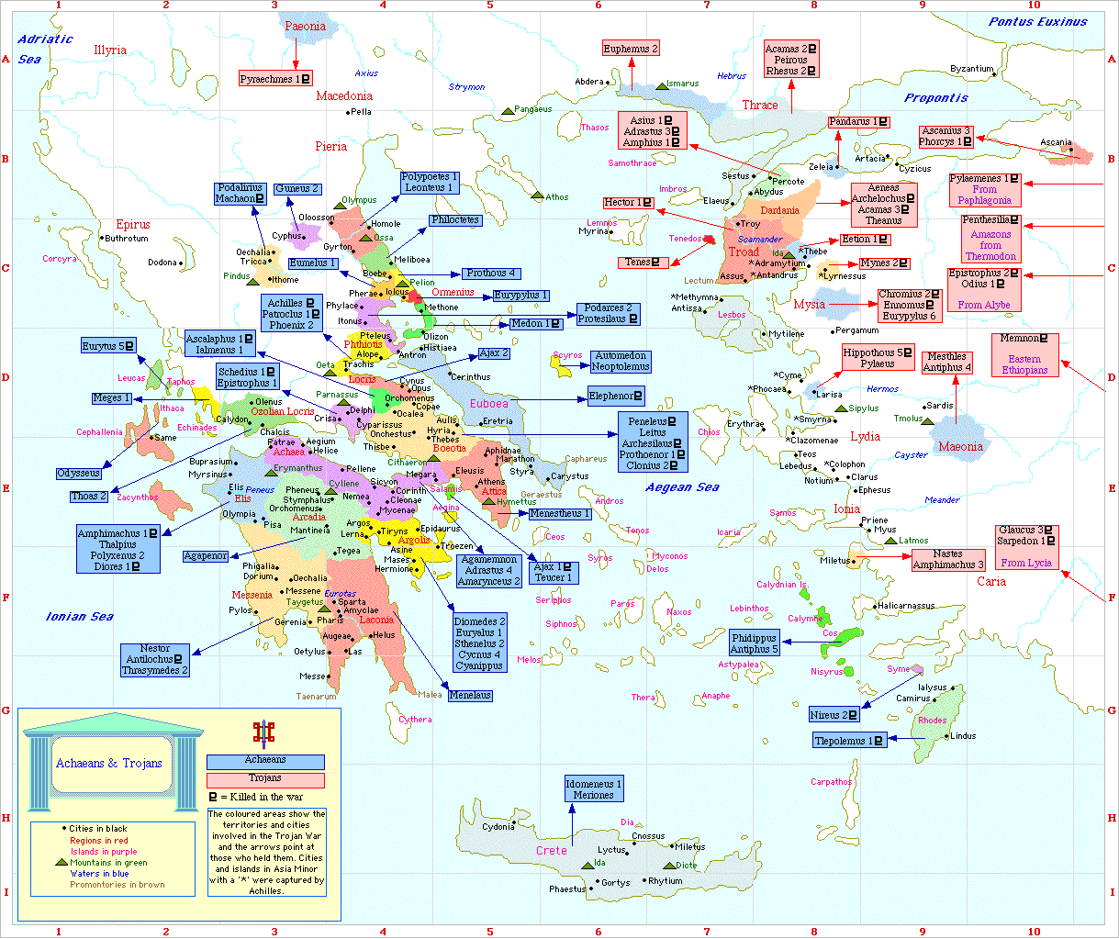
Below you will see a map showing the route of Achaeans during the Trojans’ expedition

Slide 5
The influence of Helen of Troy’s myth in literature
Helen of Troy has inspired many poets from ancient times until nowdays. The following poems of Greek literature talk about Helen of Troy and present her function as a symbol.
CHORUS If everything goes well from now on your older calamities will be extinguished
MESSENGER Allow me , Menelaus , to be part of your joy ,I don’t know it but I ‘m able to see it
MENELAUS Come on , elder ,discuss with us .
MES.Isn’t Helen the reason why we fought for in Troy ?
ΜEN.It’s not her , gods tricked us, We kept a pernicious cloud.
MES.What are you talking about ? So much toil and struggle just for a shade?
ΜEN .Works of Hera and three gods .
MES.So,is she your real wife?
ΜEN .Yes she is ,and believe what I say .
MES.God is hard to understand ,my friend he changes all the time . Here and there he drags you sometimes higher ,sometimes deeper ,some may be sad and some others not. But even those who are not, find tragic death. Fate is not always definite .Both of you have dealt with afflictions, you (Helen) from people’s judgmental words and

Slide 6
him (Menelaus) from wars. While he was fighting he was sad and now, effortless , he feels happy. You (Helen) didn’t disgrace your father and your siblings, you are not responsible for any of those you are accused of .I remember of your wedding , I remember when I was running along side your chariot, holding the candles while you ,the bride and him ,were both waving at your family’s house . A servant who does not respect his masters and does not commiserate to happiness and sadness is a bad servant .Even though I am a slave, I want to be considered as a good one .
Euripides Helen, lyr. 777-837

Slide 7
Helen
By george seferis
Teucer: . . . in sea-girt Cyprus, where it was decreed
by Apollow that I should live, giving the city
the name of Salamis in memory of my island home.
. . . . . . . . . .
Helen: I never went to Troy; it was a phantom.
. . . . . . . . . .
Servant: What? You mean it was only for a cloud
that we struggled so much?
— Euripides, Helen
‘The nightingales won’t let you sleep in Platres.’
Shy nightingale, in the breathing of the leaves,
you who bestow the forest’s musical coolness
on the sundered bodies, on the souls
of those who know they will not return.
Blind voice, you who grope in the darkness of memory
for footsteps and gestures — I wouldn’t dare say kisses —
and the bitter raving of the frenzied slave-woman.
‘The nightingales won’t let you sleep in Platres.’
Platres: where is Platres? And this island: who knows it?
I’ve lived my life hearing names I’ve never heard before:
new countries, new idiocies of men
or of the gods;
my fate, which wavers
between the last sword of some Ajax
and another Salamis,
brought me here, to this shore.

Slide 8
The moon
rose from the sea like Aphrodite,
covered the Archer’s stars, now moves to find
the heart of Scorpio, and alters everything.
Truth, where’s the truth?
I too was an archer in the war;
my fate: that of a man who missed his target.
Lyric nightingale,
on a night like this, by the shore of Proteus,
the Spartan slave-girls heard you and began their lament,
and among them — who would have believed it? — Helen!
She whom we hunted so many years by the banks of the Scamander.
She was there, at the desert’s lip; I touched her; she spoke to me:
‘It isn’t true, it isn’t true,’ she cried.
‘I didn’t board the blue bowed ship.
I never went to valiant Troy.’
Breasts girded high, the sun in her hair, and that stature
shadows and smiles everywhere,
on shoulders, thighs and knees;
the skin alive, and her eyes
with the large eyelids,
she was there, on the banks of a Delta.
And at Troy?
At Troy, nothing: just a phantom image.
That’s how the gods wanted it.
And Paris, Paris lay with a shadow as though it were a solid being;
and for ten whole years we slaughtered ourselves for Helen.
Great suffering had desolated Greece.
So many bodies thrown

Slide 9
into the jaws of the sea, the jaws of the earth
so many souls
fed to the millstones like grain.
And the rivers swelling, blood in their silt,
all for a linen undulation, a filmy cloud,
a butterfly’s flicker, a wisp of swan’s down,
an empty tunic — all for a Helen.
And my brother?
Nightingale nightingale nightingale,
what is a god? What is not a god? And what is there in between them?
‘The nightingales won’t let you sleep in Platres.’
Tearful bird, on sea-kissed Cyprus
consecrated to remind me of my country,
I moored alone with this fable,
if it’s true that it is a fable,
if it’s true that mortals will not again take up
the old deceit of the gods;
if it’s true that in future years some other Teucer,
or some Ajax or Priam or Hecuba,
or someone unknown and nameless who nevertheless saw
a Scamander overflow with corpses,
isn’t fated to hear
messengers coming to tell him
that so much suffering, so much life,
went into the abyss
all for an empty tunic, all for a Helen.

Slide 10
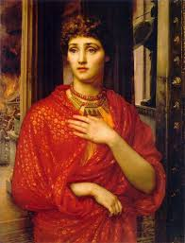
Continuing, we present paintings and vessels that show scenes of the battles in Troy and Helen

Slide 11
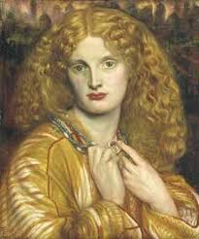

Slide 12
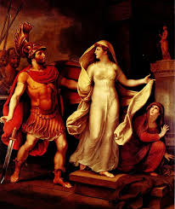

Slide 13
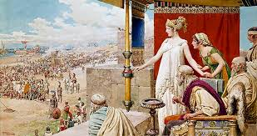

Slide 14
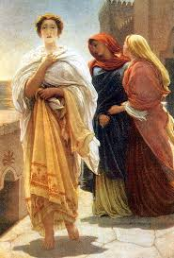

Slide 15
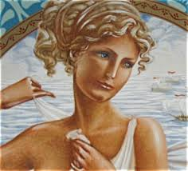

Slide 16
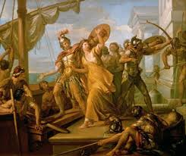

Slide 17
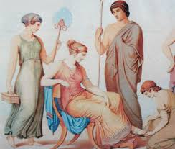

Slide 18
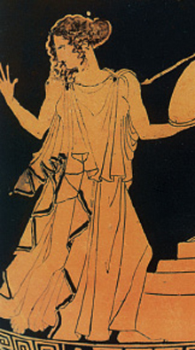

Slide 19
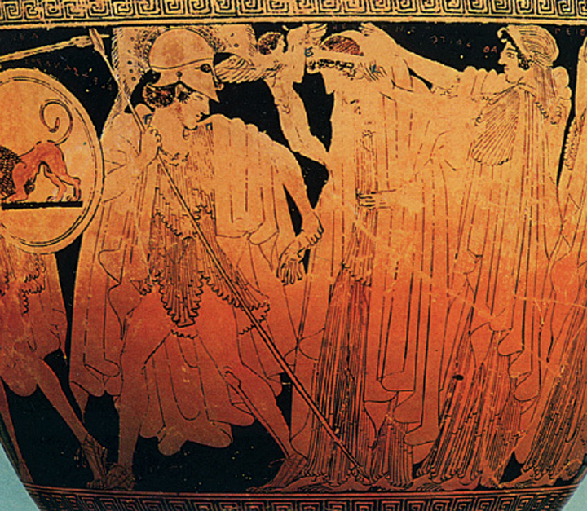

Slide 20
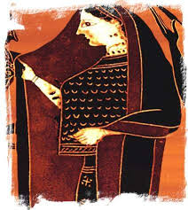

Slide 21


Slide 22
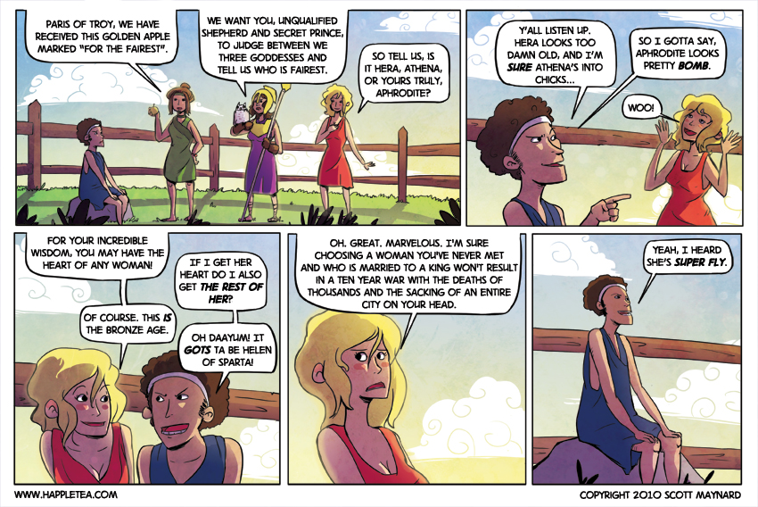
Unusual comics about Helen of Troy

Slide 23
