Slide 2
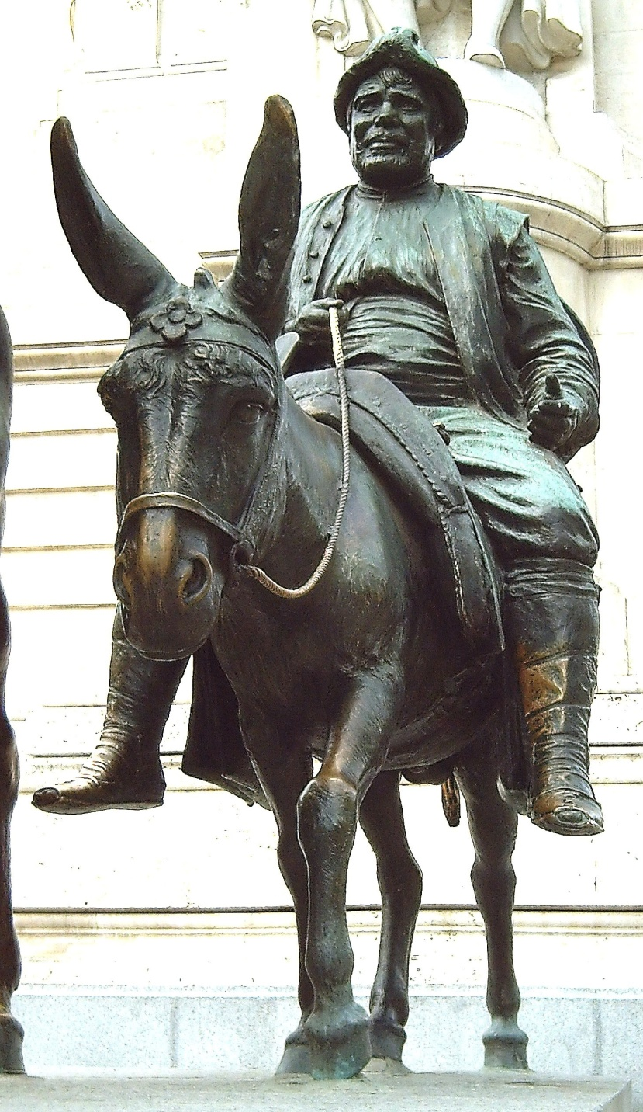
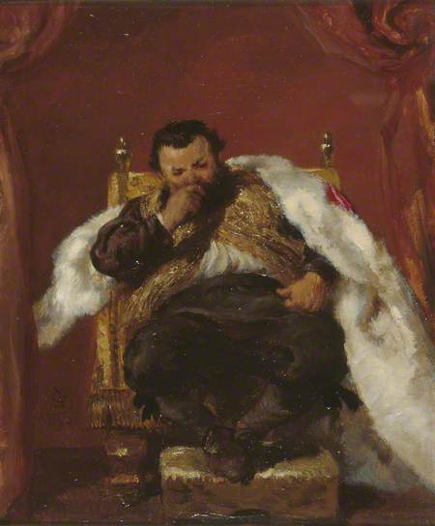
THE FIGURE
OF
SANCHO PANZA
Plaza de España, Madrid 1928
Sancho Panza, Governor of Barataria
by John Gilbert

Slide 3
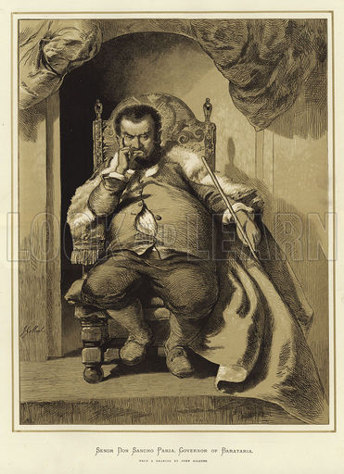
The character of Don Quixote is comic in all, he is the last Knight of the Ideal without fear and sacrifices everything in order to establish on earth the kingdom of Truth and Justice. The ridiculous ends with his rusty armor, under which the heart beats more pure, more generous and loyal. Let's start smiling of him, then our smile is converted into pity and finally in sympathy. We love the poor and great hero, the crazy magnanimous in which we find all something about ourselves.
Sancho is the opposite, and the complementary of Don Quixote. He is a poor farmer, that follows Don Quixote faithfully on his donkey, dazzled by the hope of a governorate. It represents the prose next to poetry, the practical spirit beside the dreamer, the interest next to duty.

Slide 4
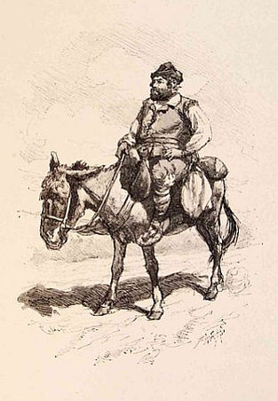
Uncouth, plump, bobbing on the donkey, is the master’s squire, he participated in his good and bad luck. Crude, ignorant, fearful, but not without an instinctive common sense, which he testes during the "government" of Barataria.
Sancho Panza tries to curb the flights too audacious of Don Quixote instilling his lessons of judgments, of nonsense and realism. He is a philosopher in his simple. His dominant thought is eating well, drinking better, sleeping well.
Looking beyond Sancho Panza himself, we find a popular subculture that is part and parcel of the novel. Cervantes appropriates and makes ample use of a repertory of existent popular refrains in Don Quixote.

Slide 5
Part 2 ,Chapter 45

Slide 6
HOW THE GREAT SANCHO PANZA TOOK POSSESSION OF HIS ISLAND, AND HOW HE BEGUN HIS GOVERNMENT
Sancho arrives in Barataria a flourishing town, which the Duke Don Quixote gave him as a gift. The citizens come out to salute him . But the costume, the beard, and the fat squat figure of the new governor astonished all. Finally Sancho was carried to the judgment seat and after seated him on it, the majordomo let him know that there was an ancient custom in the island. In fact the governor, who came and took possession of that island, is bound to answer a question which shall be put to him; and by his answer the people take the measure of their new governor’s wit, and hail with joy or deplore his arrival accordingly.
A series of villagers beseech the new Lord Governor to listen to their arguments and complaints. Sancho proves to be very wise and clever in the role of judge and people were astonished. In fact he managed with successful strangers question.

Slide 7
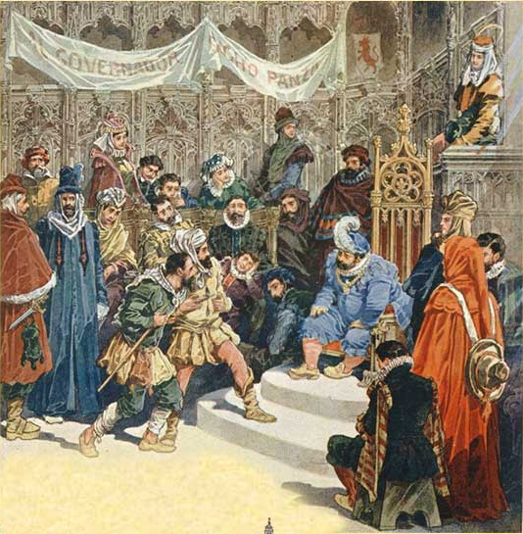
The first question is about a dispute between a tailor and a farmer. The farmer asked for five caps, and tailor says he made five caps out of cloth like the farmer asked, even though they are only big enough to fit on the ends of fingers. Sancho decides that neither man will be recompensed for being so silly, and he sends the caps to the prisoners.
The next conflict is between two old men. One with a cane and the second without. The second man claims that he lent to the first man ten escudos, but when he asked the other to give him back he affirmed that he has already returned the debt, so he suggests to swear an oath in the presence of the governor. Just before the oath he gave him his cane. Sancho is satisfied by the oath, but he suddenly understood that in the cane there were the ten escudos so he returned them to the lender.

Slide 8
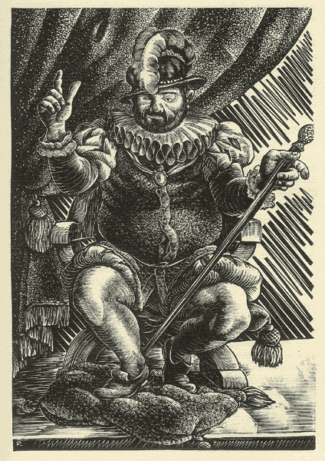
The third test of Sancho's sagacity involves a strong woman who says she has been raped by the hog driver who accompanies her. Sancho first orders the man to give her his entire purse and, when the girl has left, instructs the man to wrest the money from her. They both return and the mistress has still her purse in her hands because the man could not steal to her. So Sancho decided to return the money to the hog driver because she is much stronger than the man so he could not have raped her . Finally The governor sends the wench out of the Court in disgrace.

Slide 9
Analysis & Themes
The novel emphasizes various kinds of social prejudices and inequalities during Sancho’s brief reign as governor in Barataria. The author denounces the positions of the members of the ruling class, since they were assumed if only wealthy and refined people considered capable leaders. Here, Cervantes makes as a governor an illiterate peasant: Sancho governs excellently and fairly.
In the course of his travels, Sancho has learned to use deceit as a tool and uses it to serve justice. Deceit can have so many purposes so it is a vox media. Despite the extravagances of these novels, this form of writing has different of literaly forms:
dialogue form to reveal the entire configuration of human personality.
narrative form to create a strong unity of episode and dynamic image of the characters.
In the two forms of writing Sancho uses two different ways: with the butler he speaks like a noble; while, with his citizens he talks like a paesant to emphasize his humble origins. The overall success lies in the vivid and organic descriptions of the characters themselves.

Slide 10
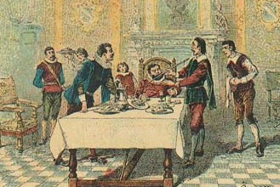
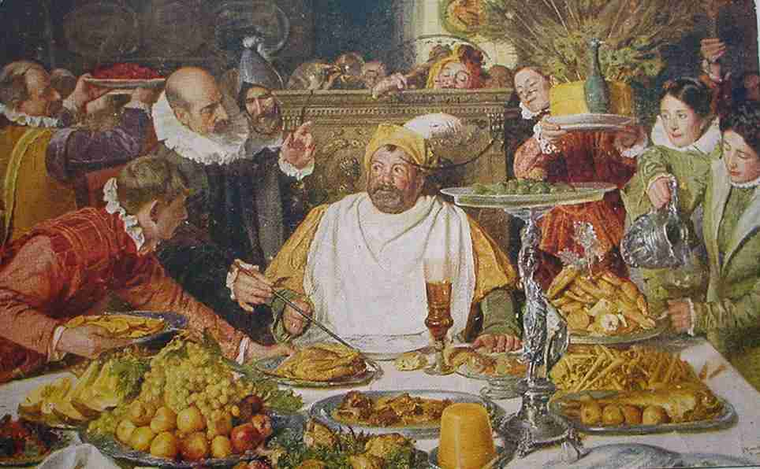
Part 2
Chapter 47

Slide 11
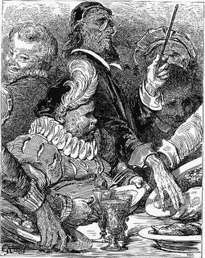
Chapter XLVII of Don Quixote talks about a humble walks of life. In the story the reality of the places contrast with the imagination of the characters. One of the emerging characters is the doctor (Pedro Recio of Auguero). The scene takes place in the sumptuous palace of Sancho, governor of Barataria. During the banquet, Sancho starts eating but he suddenly was stopped by the doctor who scolds him
Where in is continued the account of how Sancho Panza conducted himself in his government.
because that food is not suitable for a governor and must be avoided to have a good health, such as the olla podrida. The governor should eat some thin slices of quince that can help the digestion. Sancho did not accept his suggestions and sent away the doctor.

Slide 12
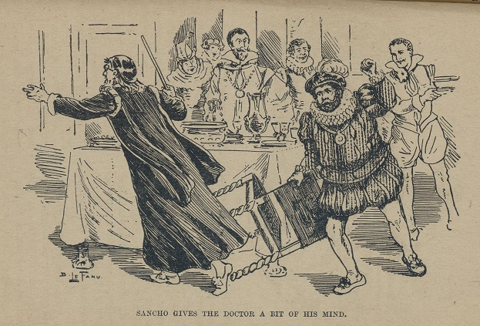
At the same time enters another character, the courier of the Duke, which heralds a sudden assault in the court, causing fear and terror in the governor. Meanwhile, in the room enters a farmer, he asks Sancho to write a letter to a merchant of pearls to recommend his son for the marriage between the merchant’s daughter. Cervantes describes in detail the inner beauty of the two guys which does not match with their external appearance. In addition, the farmer asks Sancho an excessive amount of money
to face the charges of marriage, but the governor hunting abruptly calling him rude, boastful and impertinent. The farmer leaves the palace, leaving Sancho alone in his anger.

Slide 13
The language of this chapter is medium-high and there are parts of dialogues and narrative. The author includes elements of rural life, such as olla podrida. Cervantes in this chapter criticizes the class structure in Spain, he also includes characters from higher to lower class as the doctor – the courier of the Duke – the farmer. He expresses a part of the real world where ideas and ideals have to make their impressions on the human consciousness. The different social strata becomes central to the narration and Sancho’s language is less dramatic and pompous, it is comic, grammatically and lexically faulty. It is also serious and gives the true reflections of folk wisdom. Everything is told with sarcasm and parody, to bring attention and smiling in the reader.
Analysis & Themes

Slide 14
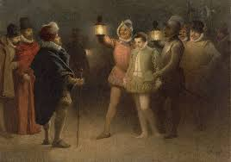
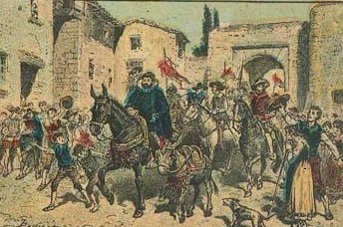
Part 2
Chapter 49

Slide 15
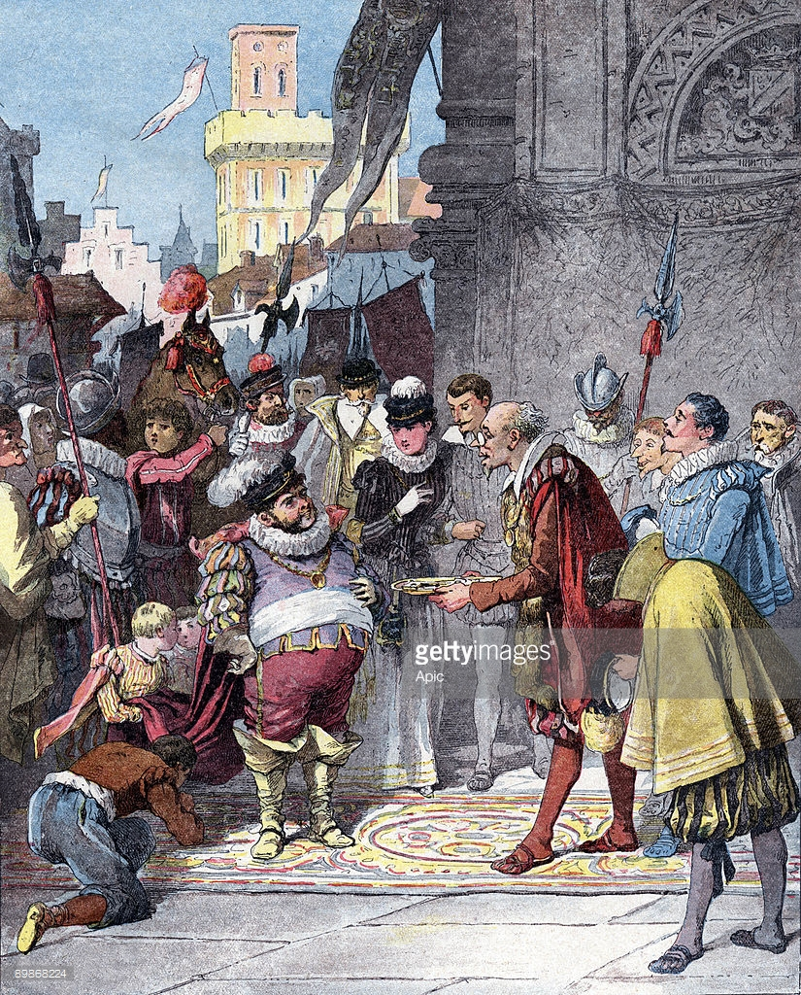
After Sancho finished his dinner , which was characterized by very humble meals, he goes out to make the rounds of his governorship. He was walking through the street when he heard a loud noise and saw two men fighting: One accuses the Other who won a lot of money and gave him only a little bit of tip to help him. Then Sancho decided that the winner must share the sum between the payer and the prisoners and also banished him from the island for ten years.
Of what happened Sancho in making the round of his island

Slide 16
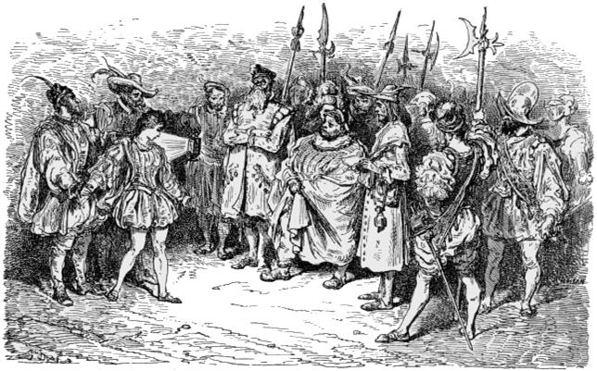
Keeping on his walk, he saw a police officer with a suspicious lad in custody, who had tried to escape. Sancho after talking to him understood that he was not a criminal, so he released him After that, A few more officers bring to Sancho a young woman who is dressed up like a man. She is actually a very beautiful young lady who is nearly sixteen years old. The young lady claims that she is the daughter of a rich farmer who never lets her out of the house to see the world. Her dad knows how
beautiful she is and wants to keep her away from the eyes of lusty men. But she doesn't want to spend her life cooped up in a house, so with the help of her brother, she broke out to explore the town. Sancho lets her go out to do more exploring.

Slide 17
Analysis & Themes
In this chapter, Sancho is clearly going above and behind his basic duties as governor, since there is no question of legality in this situation. He assumes the role of a kind public sage and advice-giver. He also seems to be able to tell bad people from good instinctively. In fact he immediately puts his thinking into action by taking money from the rich and giving it to the poor because he wants to use his power to lessen suffering and drive out corruption. Moreover the young and good girl, humble but actually of noble family, can be considered one of the most important symbols in this chapter. She is opposed to the woman in Chapter 45 instead considered a false and cheater person. The young girl represents the theme of justice and especially the freedom.

Slide 18
The chapter is full of proverbs and common sayings and the language used by Cervantes is direct and lively whose helps the reader feel closer to the characters. Since it has not a single unitary language system, but the multivoices or the linguistic polyphony become more complex as each character acquires a different speech register. The speech is mainly oral and at the same time the author gives an oratorical form high in sound as well as in selection of words according to the situations. However Cervante’s descriptions are a result of his own life’s experience. Cervantes traveled widely and spent some time in Italy (between 1569 and 1575) where he knew the works of his Italian contemporaries such as Petrarch, Boccaccio, Tasso and Ariosto. During his journey he searches for an appropriate place to solve his problem or maybe he searches for the places he has read or visited.

Slide 19
