Slide 1
El viaje como elemento de cohesión europea
The journey as an element of European cohesion

Slide 2
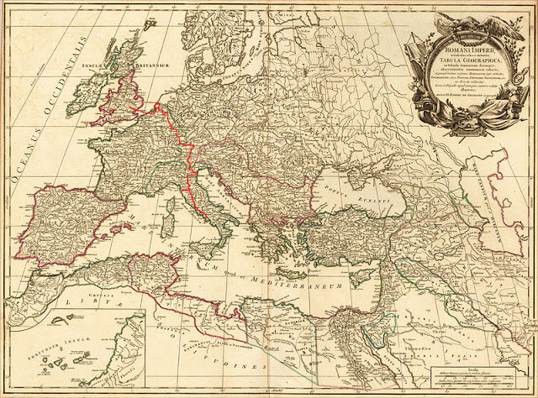

Slide 3
A 19: EL “GRAND TOUR COMO ANTECESOR DEL TURISMO MODERNO. SCRAPBOOK “
A19 THE GRAND TOUR AS A FORERUNNER OF MODERN TOURISM. SCRAPBOOK

Slide 4
GRAND TOUR
Lo primero que haremos será trabajar con el concepto de “GRAND TOUR”
First of all we have to work wiht the meaning of “GRAND TOUR” the student have to look for information about it

Slide 5
  El llamado Grand Tour era un itinerario de viaje por Europa, antecesor del turismo moderno, que tuvo su auge entre mediados del siglo XVII y la década de 1820.
  fue especialmente popular entre los jóvenes británicos de clase media-alta, considerándose que servía como una etapa educativa y de esparcimiento, previa a la edad adulta y al matrimonio

Slide 6
"GRAND TOUR"
  The so-called Grand Tour itinerary was a trip to Europe, the forerunner of modern tourism, which flourished between the mid-seventeenth century and the decade of 1820
  It was especially popular among young British upper middle class, considering that served as a stage of education and recreation, pre-adulthood and marriage
  Travel was arduous and costly throughout the period, possible only for a privileged class

Slide 7
Itinerary
London was a frequent starting point for Grand Tourists, and Paris a compulsory destination; many traveled to the Netherlands, some to Switzerland and Germany, and a very few adventurers to Spain, Greece, or Turkey. The essential place to visit, however, was Italy.

Slide 8
PRODUCT
Ours student have to choose one of these standars itineraries, an then, they have to hand made a travel book, whith fotographs, and other things, that they think, that the Grand Tourists may found on their travel.

Slide 9
For example, if one of them choose a tourist that start him travel in England, maybe, it first scrapbook page could be some think like this .

Slide 10
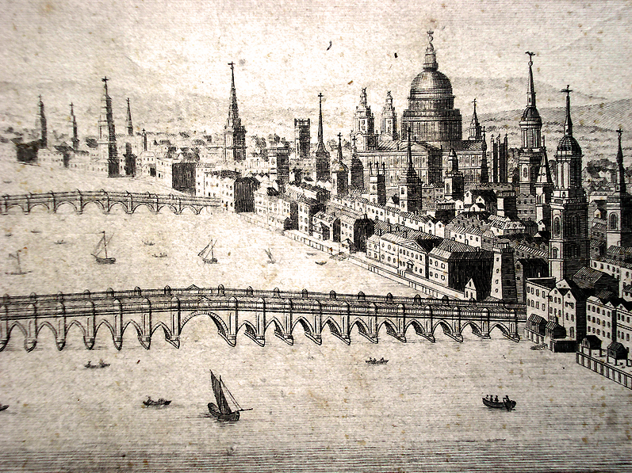
Plan des Villes de Londres et de Westminster et de leurs Faubourgs avec le Bourg de Southwark. Par de Fer Avec Priv du Roy 1700

Slide 11
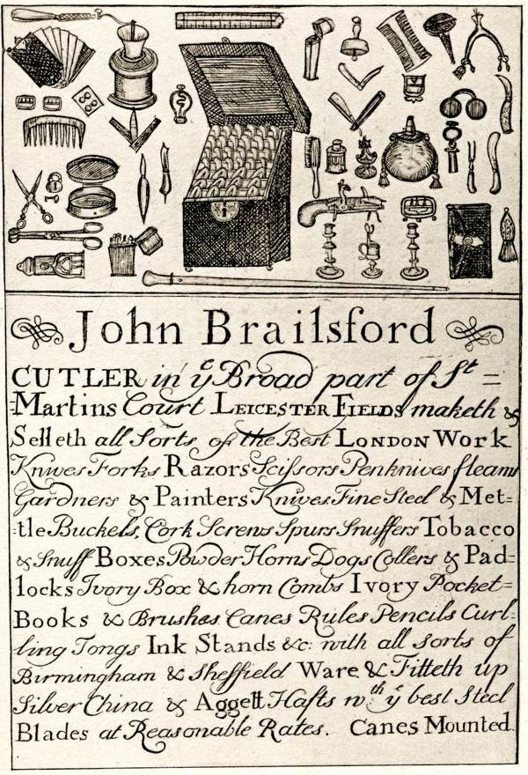
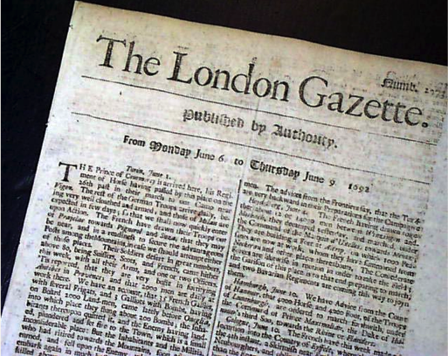
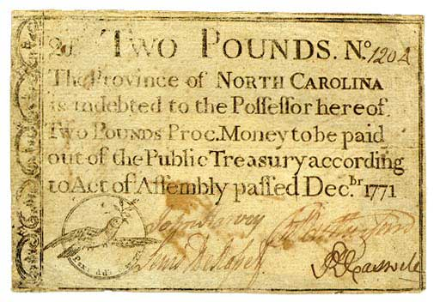
As well as coining offences, the rapid development of bills of exchange, small denomination bank notes issued by both the Bank of England and a large number of independent provincial banks.

Slide 12
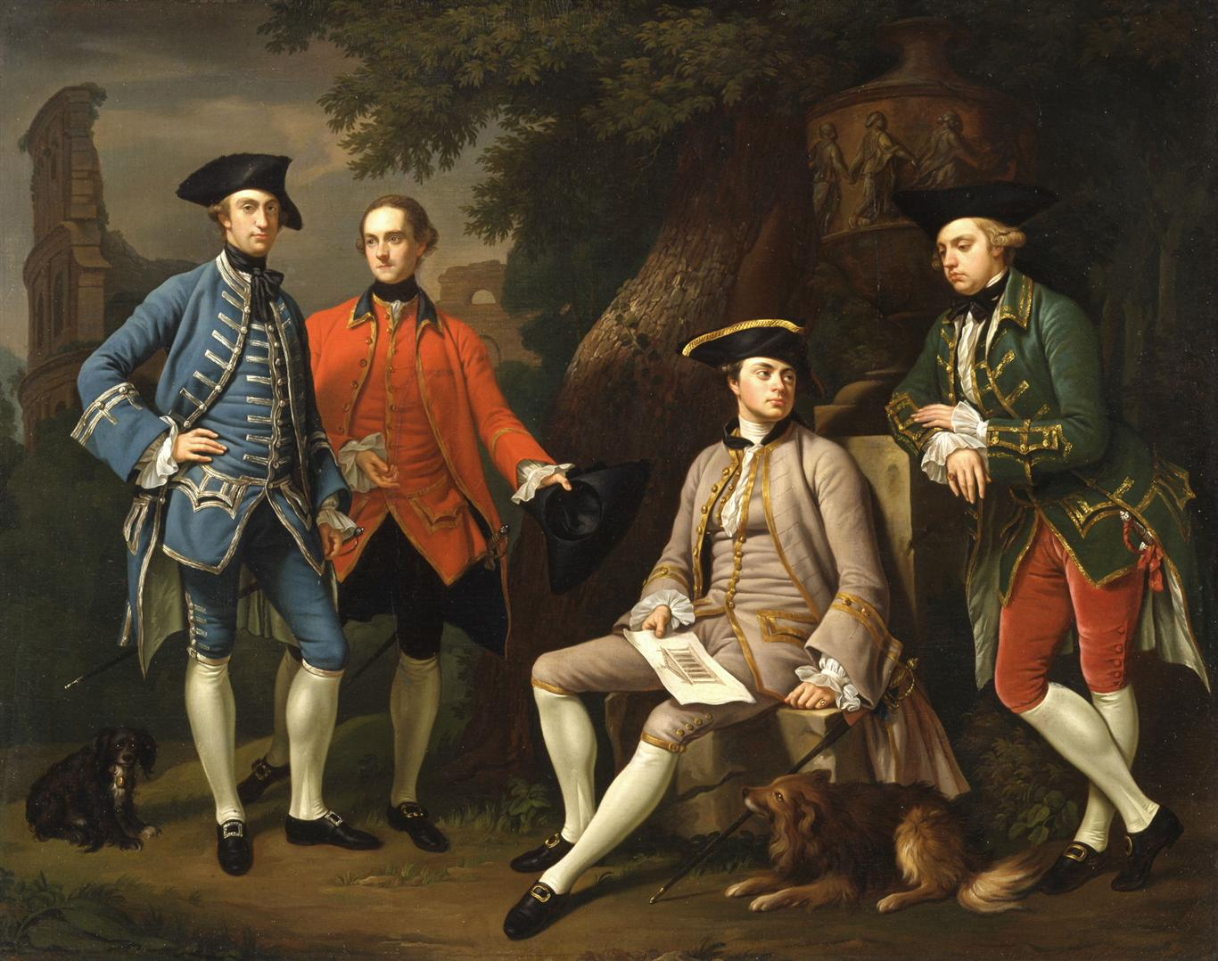

Slide 13
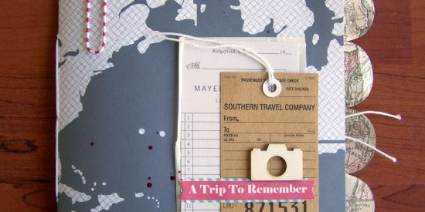
Scrapbook examples

Slide 14


Slide 15
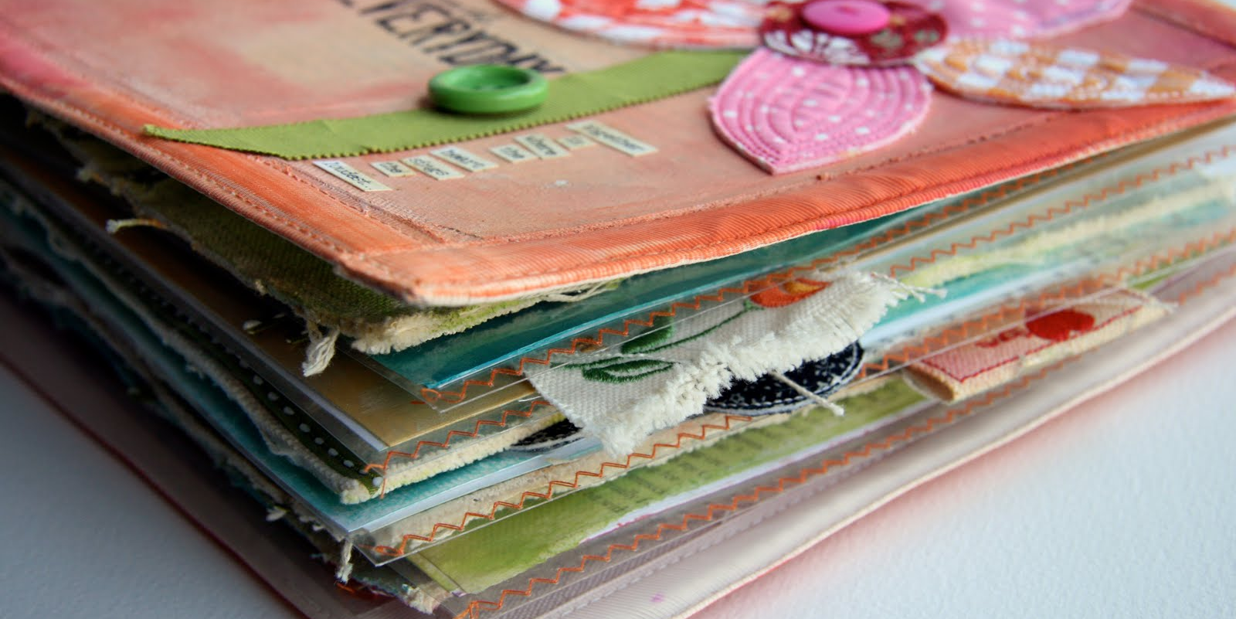

Slide 16
