Slide 1
PLATO’S TRAVELS

Slide 2
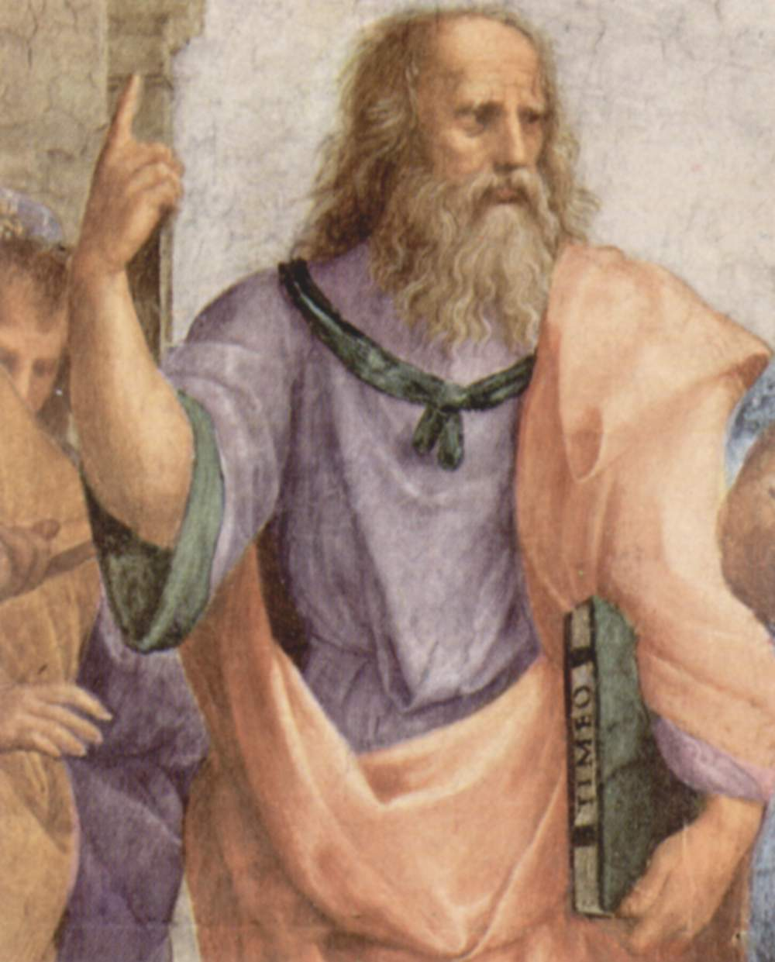
Plato’s travels
After the death of Socrates, Plato left Athens to make a series of travels. When he was forty, took the first of his three travels to Sicily, moved by a simple touristic interest, although he wanted to establish a contact with the Pythagoreans. Arrived to Syracuse he was invited to the court by Dyonisius, where he met Dion. The relations between Plato and the tyrant, however, were quite tense. Because of the philosopher was disgusted by the excesses of the court. The Syracusan tyrant, Dionysius, became angry by the arrogance shown by Plato, so he ordered that Plato was captured and sold as a slave in the island of Aegina. At the time of his execution, in Aegina Plato was recognized and rescued and returned to Athens.

Slide 3
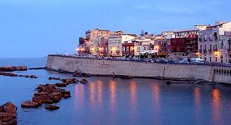
In 361 B.C. Plato went back to Syracuse, invited by Dionysius the Younger, who promised to change his behavior. But this did not happen. In fact as soon as Plato arrived to Syracuse, Dionysius forgot all his promises, so the philosopher left the island and returned to Athens.
A few years later Dionysius I died and Dion invited Plato to Syracuse to entrust the education of the new tyrant, Dionysius the Younger. Although his good intentions, the experience ended badly again. When Dion was dismissed by the court Plato was arrested, but later released.

Slide 4
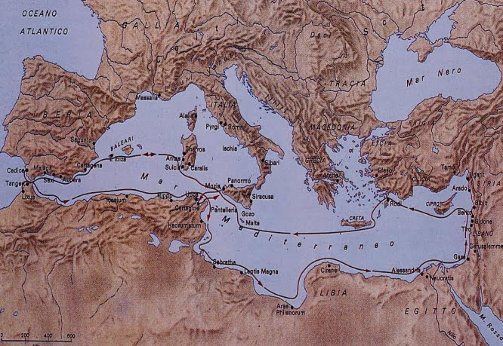
The first travel to Syracuse

Slide 5
“Quando io arrivai la prima volta a Siracusa avevo all’incirca quarant’anni -, Dione aveva l’età che oggi ha Ipparino, e proprio allora maturò quell’idea che in seguito non mutò più: era convinto, cioè, che i Siracusani meritassero la libertà, sotto la guida delle migliori leggi.” Lettera VII Platone

Slide 6
When Plato went to Syracuse he believed that the Syracusans needed laws to respect their freedom.

Slide 7
In 388 BC,Plato, after meeting the Pythagorean Archita (governor of Taranto),went to Syracuse, governed by Dyonisous I, where he became friend to tyrant’s brother in law, Dion.
He admired Plato’s political programmes. But his thoughts and his moral exhortations weren’t approved by the tyrant, who sent him away.The virtous Athenian philosopher was sold as a slave. In Egina he was rescued by Anniceride of Cirene and he came back to Athens.

Slide 8
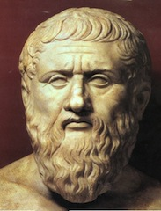
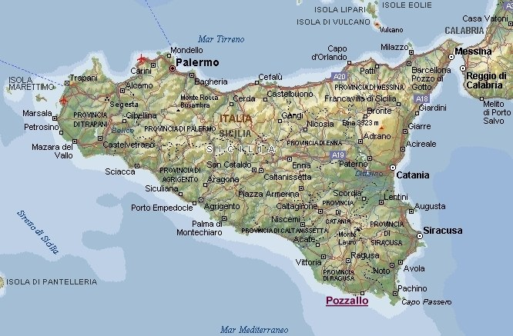
Plato’s second travel

Slide 9
The hope to convert Dionysius to philosophy
“Certo che se il suo progetto si fosse realizzato non solo la vita di Dione, ma anche quella degli altri Siracusani fatalmente sarebbe diventata felice oltre ogni dire. In conseguenza di ciò, ritenni necessario che con ogni mezzo io mi recassi al più presto a Siracusa per prendere parte all’iniziativa, ben ricordando che il nostro ritrovarci insieme aveva avuto su di lui il felice effetto di acuire il desiderio di una vita eccellente e perfetta.”
Lettera VII Platone

Slide 10
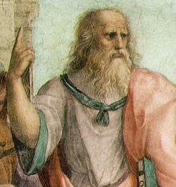
What this speech means?
In his speech, Plato says that he wants to go to Syracuse to realize his reforms. If his project could be realized, the life of Dion and of all Syracuse’s people would change in better.

Slide 11
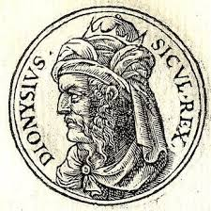
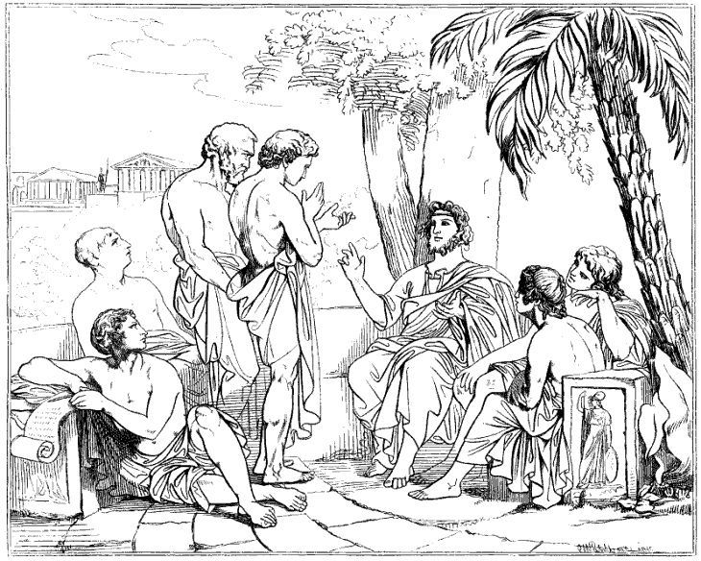
In 367 BC, after Dyonisius’ death and the succession to power of his son Dyonisius II Plato comes to Syracuse, invited by Dion. Plato hopes to realize his reforms and his plans about institutional transformation of Syracuse’s State.
In 365 BC Syracuse is at war and Plato cames back to Athens. He promises to come again to Syracuse at the end of the war and reach his friend Dion.

Slide 12
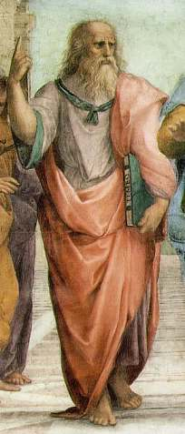
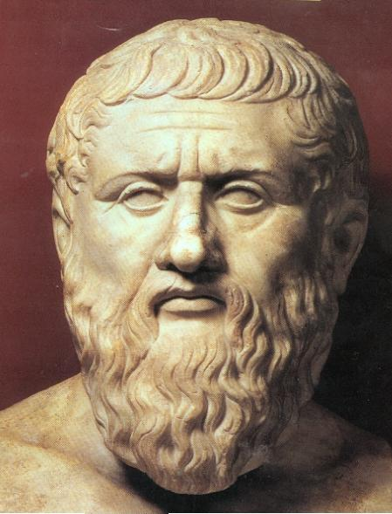
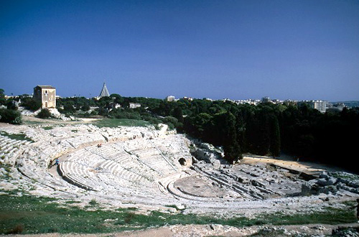
Plato’s third travel

Slide 13
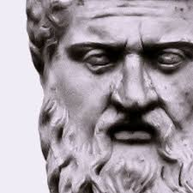
“... Mi metto dunque in viaggio... con molto timore e con previsioni nient'affatto liete...”
Lettera VII Platone

Slide 14
This is an extract from the VII Plato’s letter in which he describes the beginning of his travel with a pessimistic view.

Slide 15
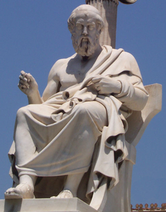
Exactly in 361 BC, Plato makes his third - and last - travel to Syracuse and there he doesn’t find Dion, (his supporter) he meets Dionysius whom shows openly his hostility. Plato’s attempts to defend his friend lead to the breakdown of the relation with the Syracusan tyrant and he imprisons the philosopher.
Released thanks to Archita’s intervention (the tyrant of Taranto) the next year Plato leaves for Athens. During the journey he arrives to Olympia, here he meets for the last time Dion who was planning a war against Dionysius, and Plato tried in vain to dissuade him.
(Plato’s portrait
in modern Athens Academy)

