Slide 1
Travel as an element of european cohesion, April, 18-23 / 2016, La Seine-sur-mer, France, Lycee Beaussier

Slide 2
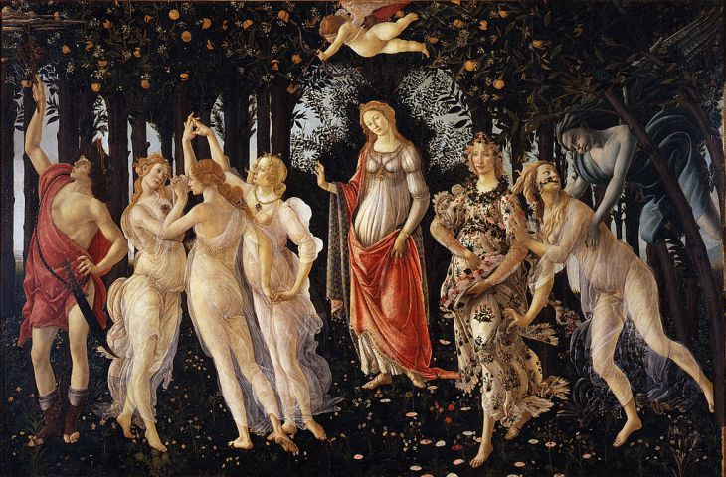
La Primavera, Sandro Botticelli, 1478, Uffizi Firenze

Slide 3
Zephyrus transforming Chloris in Flora

Slide 4
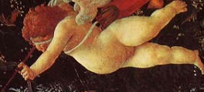
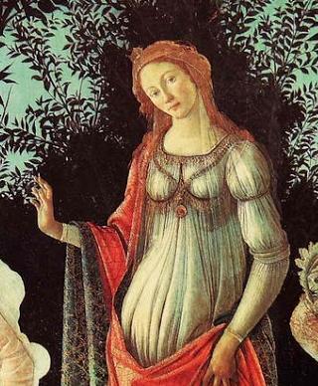
Venus, in front of a myrtle, makes a gesture denoting greeting and inhibition.
Her child, Cupid, is preparing to strike the Three Graces with his fiery arrow

Slide 5
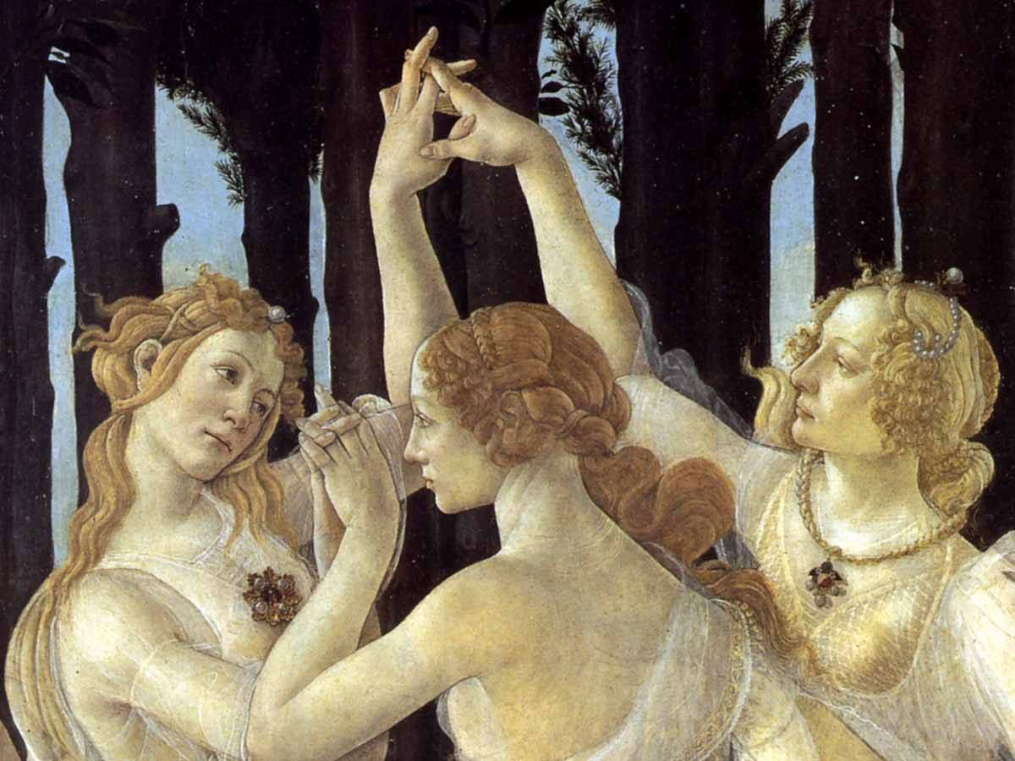

Slide 6
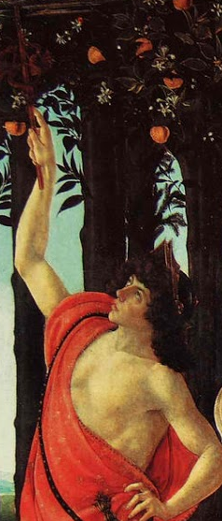
the god Hermes with his caduceus turns away the clouds

Slide 7
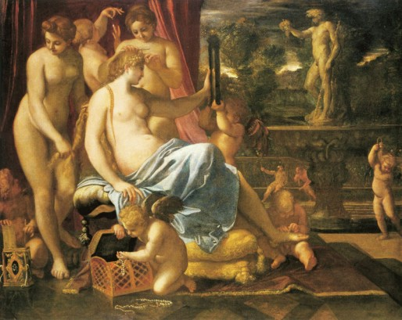
“Venus adorned by the Graces” Annibale Carracci, 1590-95, National Gallery of Art, Washington, USA.

Slide 8
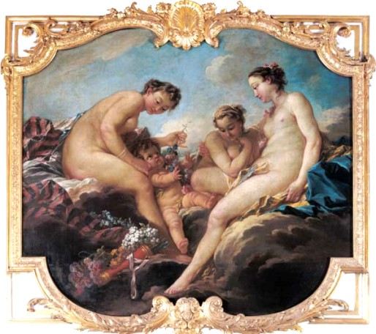
“The three Graces” decoration in princess’ Rohan bedroom, Francois Boucher, 1735-40.

Slide 9
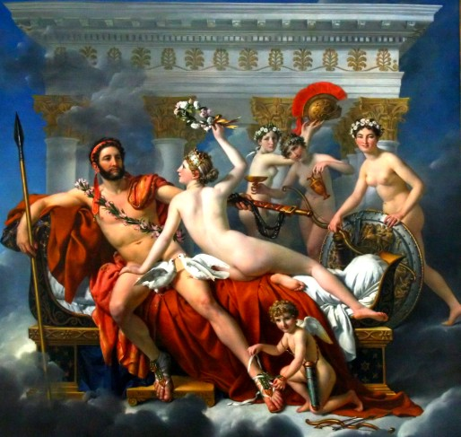
“Venus and the Graces disarming Mars” by Jacques-Louis David, 1824, Royal Museum of Fine Arts, Belgium

Slide 10
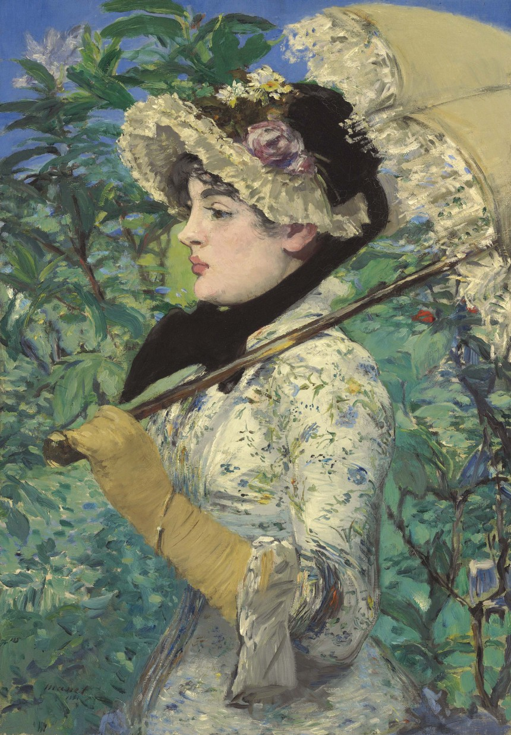
Edouard Manet, “Spring” 1881, J.P. Getty museum

Slide 11
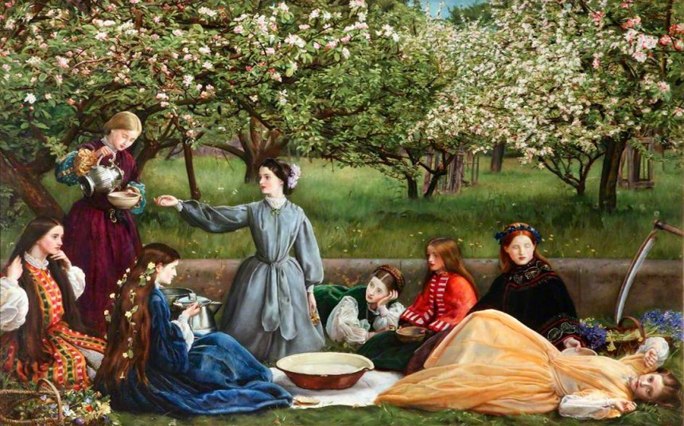
John Everett Millais “Apple blossoms” (1856-59)

Slide 12
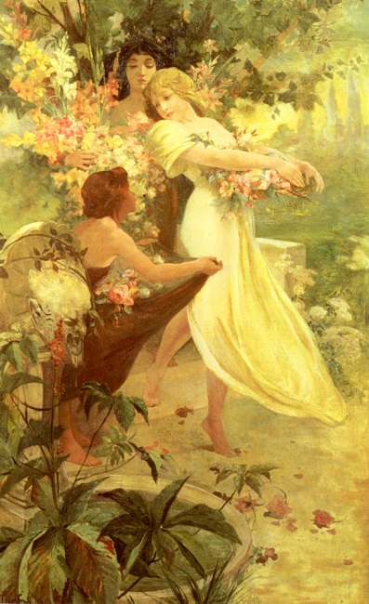
Alphonse Mucha “The Spirit of the Spring”

Slide 13
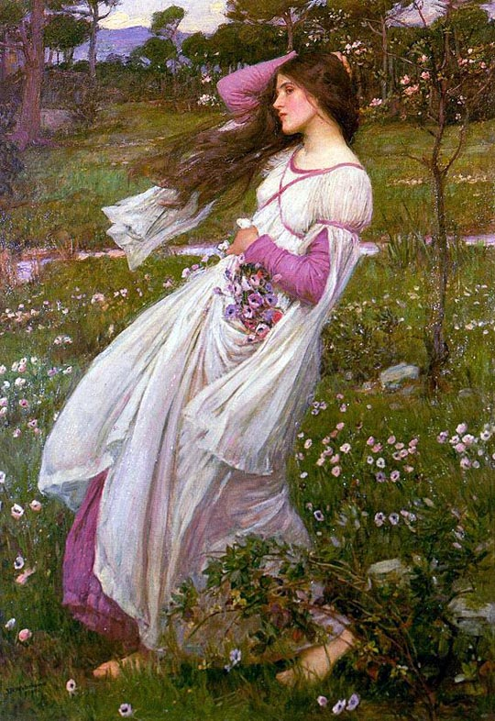
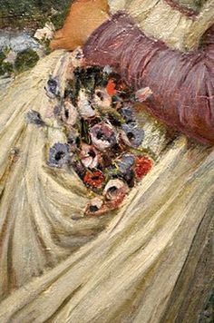
J. W. Waterhouse, Windflowers, 1903, Private collection

Slide 14
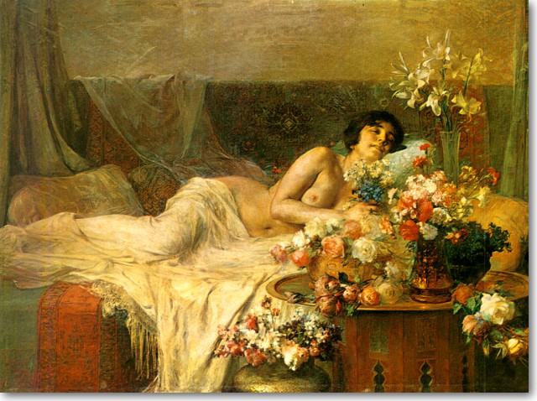
George Iakovidis, “Spring”, 1927

Slide 15
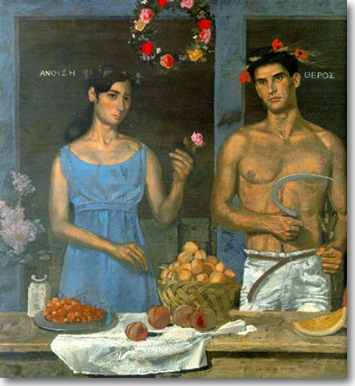
Yiannis Tsarouchis, “The four seasons, detail: Spring-summer”, 1968-1969

Slide 16
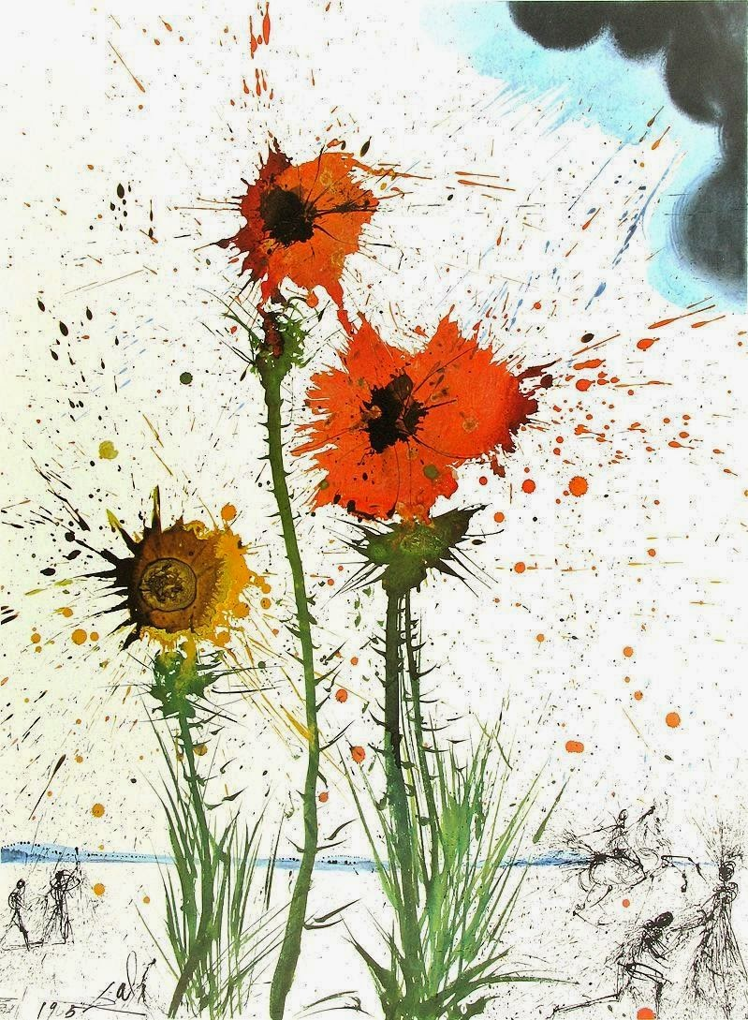
Salvador Dali, Spring Explosive

Slide 17
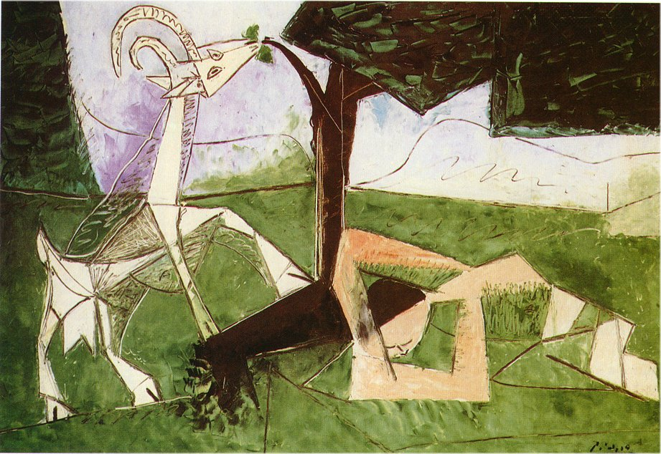
Picasso, Spring, 1956

Slide 18
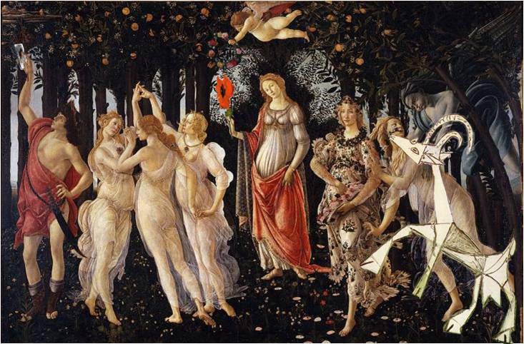
Our personal look on Sandro’s Botticelli’s “La Primavera”

Slide 19
3rd High School of Polichni, Thessaloniki, Greece
Our team:
Anastasia Demertzi
Fotis Fotiou
Chrysa Aslanidou
Elli Tsiakalidou
Ioanna Katemidou
Vasilis Chatzigeorgiou
Nick Papagiannoulis
Ms Assimina Vlachou, sociologist
Ms Maria Avgeri
Special thanks to our colleagues for their help :
Ms Zacharoula Tzamou , English teacher and
Mr Philippe Chatziandreas, informatics teacher
Our students
Teachers involved:

