Slide 1
Erasmus project
Meeting La Seyne sur Mer-Mazzarino 18-23 April 2016

Slide 2
Michelangelo Merisi of Caravaggio

Slide 3
Caravaggio’s life
Caravaggio as Michelangelo Merisi was born in Italy around 1571. He was
orphaned at age 11 and apprenticed with Simone Peterzano in Milan. He moved
to Rome. He was a frequent fighter and
his violence finally erupted with force in 1606, when he killed Ranuccio
Tomassoni. Immediately following the murder, Caravaggio fled Rome and
sought refuge as a host in other locations: Naples, Malta and Sicily.
In Malta, he was received into the Order of Malta as a Knight of Justice, an award that he was
soon stripped when the Order learned of the crime he had committed.
However, Caravaggio continued to work. In Malta, he created
"Beheading of St. John the Baptist" for the cathedral in Valletta. In Messina, his
work included "The Resurrection of Lazarus" and "The Adoration of the
Shepherds," while in Palermo he painted the "Adoration with St. Francis and St.
Lawrence" . The murder that Caravaggio committed in 1606 was not the end of
his violence. In July 1608, he attacked Fra Giovanni Rodomonte Roero.
Caravaggio was arrested but managed to escape just one month later.
Caravaggio's salvation could come from the pope, who had the power to
pardon him. In 1610 Caravaggio began to make his way back to Rome. Sailing
from Naples, he was arrested in Palo, where his boat had made a stop. Upon his release,
he resumed his journey and eventually arrived at Port'Ercole, where died just a few days
later, on July 18, 1610.

Slide 4
He was born in Milan in 1570
Milan
Rome
Naples
1609
Palermo
Messina
1609
1608-9
Syracuse
1608
Caravaggio’s trips
Malta
1607

Slide 5
Caravaggio in Malta
In Malta, Caravaggio arrived in 1607, from Naples, in rather dubious circumstances having fled Rome to avoid justice. He was wanted for murder. He found refuge on the island at the Knights of the Maltese Cross, and maybe he tried to obtain the grace of Alof De Vignacourt, Grand Master of the time. Caravaggio became a Knight of the Order, and for it he made several works of fundamental importance for its artistic and personal journey as The Beheading of St. John the Baptist and the Portrait of Alof de Vignacourt and his court. But it also knows that in 1608 he was arrested, imprisoned in Fort St. Angelo and later escaped to Sicily, only to die two years later at the age of 38.He left in Valletta many signs of his presence that now enrich the heritage artistic island.

Slide 6
The Beheading of Saint John the Baptist

Slide 7
The Beheading of Saint John the Baptist is an oil painting by the Italian artist Caravaggio. According to Andrea Pomella in Caravaggio: An Artist through Images (2005), the work is widely considered to be Caravaggio's masterpiece as well as "one of the most important works in Western painting
The image depicts the execution of John the Baptist while nearby Salome stands with a golden platter to receive his head. Another woman, who has been identified as Herodias or simply a bystander who realizes that the execution is wrong, stands by in shock while a jailer issues instructions and the executioner draws his dagger to finish the beheading. The scene, popular with Italian artists in general and with Caravaggio himself, is not directly inspired by the Bible, but rather by the tale as related in Golden Legend.
It is the only work by Caravaggio to bear the artist's signature, which he has placed in red blood spilling from the Baptist's cut throat. There is considerable empty space in the image, but because the canvas is quite large the figures are approximately life-sized. His style, with its powerful use of shadow and shafts of light (chiaroscuro), created an almost choreographed drama with the subject; a technique which broke with the tradition of religious painting.
According to John Varriano in Caravaggio: the Art of Realism (2006), Caravaggio drew the background for his picture from the depiction of a prison in the Knights of Malta's penal code. Characteristically of his later paintings, the number of props and the detail in the props used is minimal.

Slide 8
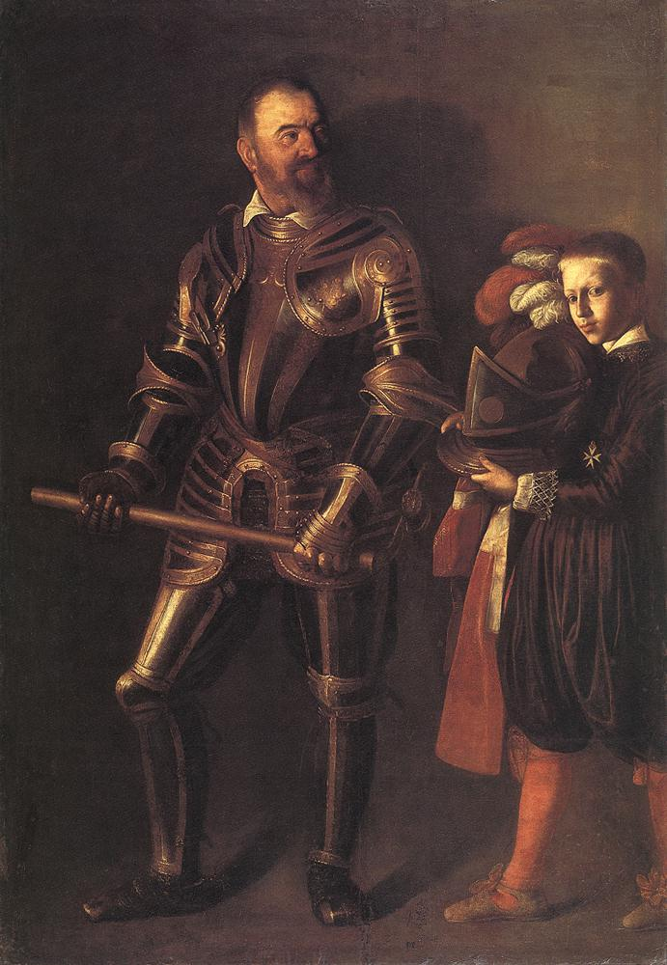
Portrait of Alof de Wignacourt
Portrait of Alof de Wignacourt is an oil painting on canvas (195x134 cm) realized in 1608.
It is conserved in the Musée du Louvre in Paris.
The artist has portrayed Alof de Wignacourt, Grand Master of the Knights of the order of the Hospital of St. John of Jerusalem, dressed in his armor. On the right a young man, also adorned with the star of the knights, hands him his helmet to complete the dressing. The picture in arms wants to show a praise of the active life of the Wignacourt. Probably thanks to this painting Caravaggio was named " Knight of Grace” .
The picture was soon sent to France, the canvas would have to go for an inheritance to 'Order itself; instead the owner wanted to get rid of it , which confirms the embarrassment of Wignacourt that caused the expulsion of Caravaggio, for still unknown reasons. One possibility , according to some, should be sought in this painting and in homosexual key: the portrait of a page in the work that looks mischievously at the viewer , would be a possible " object of desire " from both the painter and the Grand Master; from here it would have emerged the resentment for Caravaggio until to have him imprisoned.

Slide 9
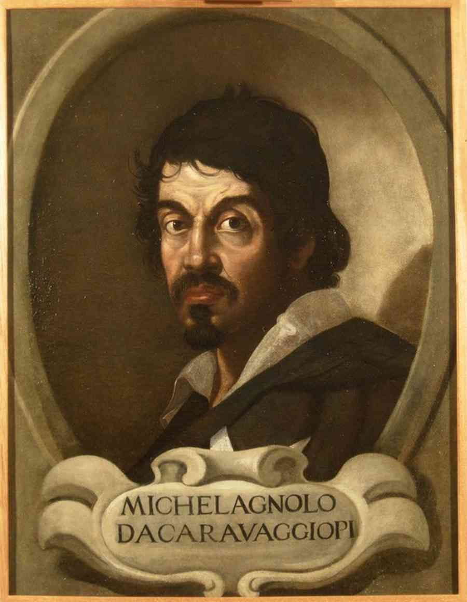
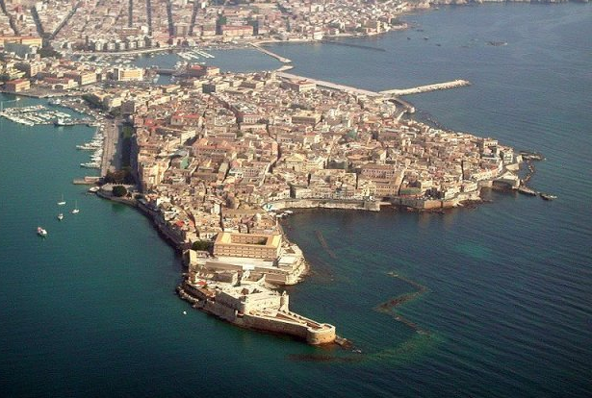
Caravaggio in Syracuse

Slide 10
Burial of St. Lucy

Slide 11
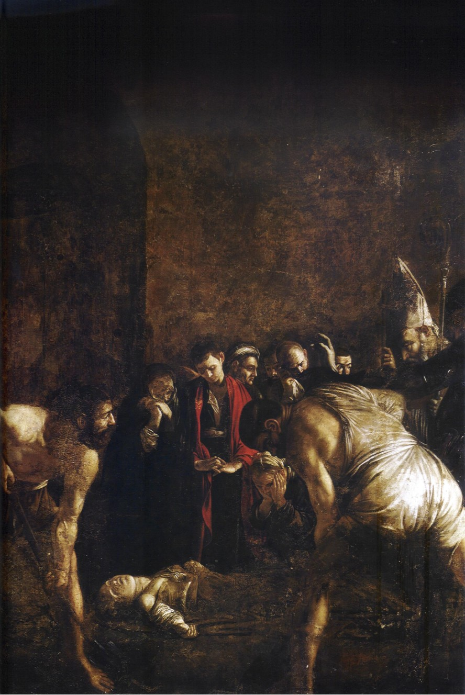
Caravaggio had escaped from prison on Malta in 1608, fleeing to Syracuse. There ,his Roman companion Mario Minniti helped him getting a commission for the present altarpiece. Caravaggio painted it in 1608, for the Franciscan church of Santa Lucia al Sepolcro. The choice of subject was driven by the fact that St. Lucy was the patron saint of Syracuse and had been interred below the church. Burial of Saint Lucy is located in the church of Santa Lucia alla Badia located on the Piazza Duomo in Syracuse, Sicily. The subject was unusual, but especially important to the local authorities, who were eager to reinforce the local cult of St. Lucy, which had sustained a setback with the theft of her remains during the Middle Ages.
According to The Golden Legend, Saint Lucy had bestowed her wealth on the poor, in gratitude for the miraculous healing of her mother. Denounced as a Christian, she refused to recant, offered her chastity to Christ, and was sentenced to be dragged to a brothel. Miraculously, nothing could move her from the spot where she stood. She was pierced by a knife in the throat and, where she fell.

Slide 12
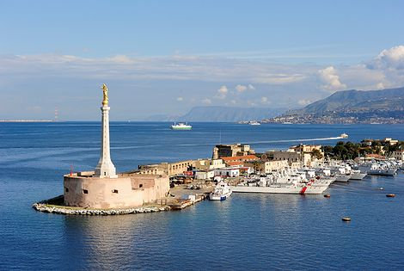
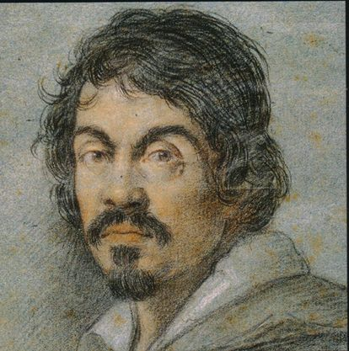
Caravaggio in Messina

Slide 13
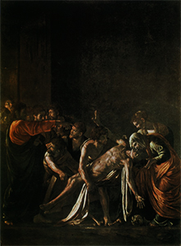
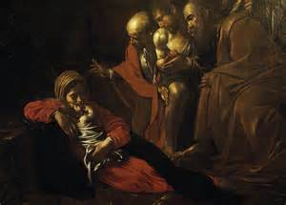
Caravaggio made his way to Sicily where he met his old friend Mario Minniti. Together they set off on a triumphal tour from Syracuse to Messina and, maybe also to Palermo. In Messina Caravaggio received the assignment to paint a canvas for the superior altar of Church Santa Maria la Concezione: The Raising of Lazarus, and Adoration of the Shepherds,commissioned by Lazzari family. This masterpiece was painted between 1608 and 1609 in the Ospedale Grande.

Slide 14
The Raising of Lazzaro
Lazarus, the brother of Martha and Mary, was the patron saint of Giovanni Battista de' Lazzari, to whom Caravaggio was contracted to paint an altarpiece in the church of the Padri Crociferi. The Gospel of John tells how he fell sick, died, was buried and then miraculously raised from the dead by Christ. As in several paintings from this period of Caravaggio's career, the scene is set against blank walls that overwhelm the frieze of human actors. The interaction of the relief of figures caught in corporate effort and emotion, with a large void above, is quite different from the closely focused individualised dramas of his early and middle periods. As is usual with Caravaggio, light becomes an important element in the drama, picking out crucial details such as Lazarus's hands—one lax and open to receive, the other reaching towards Christ—and the wonder-struck faces of the onlookers.

Slide 15
The adoration of Shepherds
Mary and her child rest on the floor of a simple barn. In the back are the ox and the ass; on the foreground Joseph's tools. Joseph is the man in brown, to be identified by the halo over his head
It is a very peaceful tableau. Apart from the two halos, only the clasped hands of one of the shepherds hint at the religious importance.

Slide 16
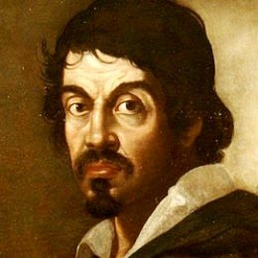
Caravaggio in Palermo
It all began in 1609, when Caravaggio - just escaped from a Maltese prison and chased by a death sentence - staying for some time in Sicily realizing the painting of the "Nativity" for the Oratory of San Lorenzo in Palermo. For 360 years the work remains in its place reaching intact until 1969, despite the guilty absence of any protective measure. Until, on the night between 16 and October 17, the painting was stolen by unknown persons entered the oratory without any effort unattended. Followed by 30 years of darkness, during which you lose track of the painting.

Slide 17
Nativity with St. Francis and St. Lawrence

Slide 18
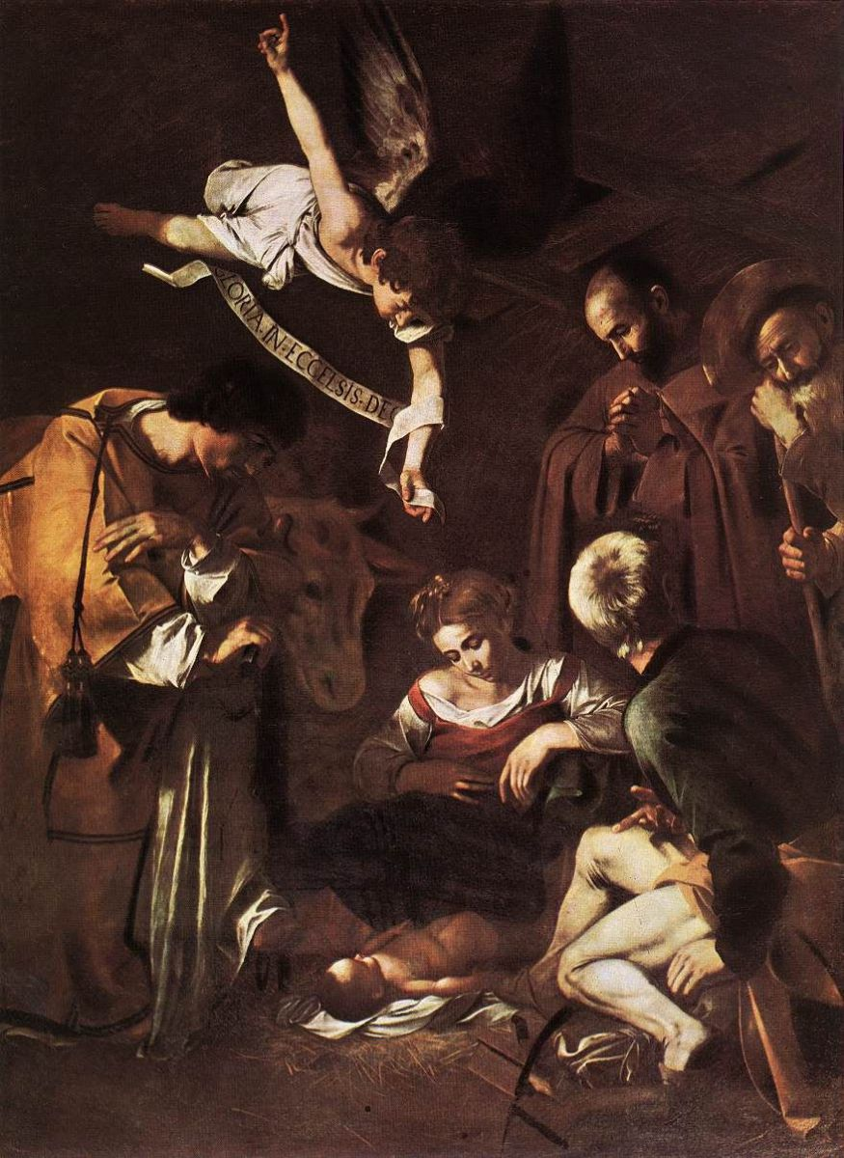
The painting, which hung above the altar, was large, measuring almost six square metres (actual size 268 cm x 197 cm). Probably because of its size, it was removed from its frame by the thief or thieves (two suspected) before being taken out of the church. After it was stolen, the Oratory was pillaged of other art, along with choir stalls of carved and gilded wood and benches inlaid with precious woods and mother of pearl.
The Nativity with St. Francis and St. Lawrence (also known as The Adoration) is a painting believed to have been created in 1609 by the Italian Baroque master Caravaggio. Recent acquisitions link the painting to that commissioned by Fabio Nuti in April 1600, and thus sent from Rome to Palermo.
It was stolen on October 18, 1969 from the Oratory of San Lorenzo in Palermo, Sicily.

Slide 19
The local Sicilian Mafia are generally considered to be the main culprits in the theft although nobody actually knows who committed the crime. Rumours of its destruction during the theft have circulated from time to time as also the notion that the masterpiece is now hidden abroad. In 1996, Francesco Marino Mannoia, an informant and former member of the Sicilian Mafia, claimed he had stolen the painting as a young man on the orders of a high-ranking mobster, but other sources say it was stolen by amateurs and then sold on to various Mafiosi. In 2009 Gaspare Spatuzza, an informer Mafia claimed that he was told in 1999 that the painting was stolen for a private collector but had been destroyed by rats and pigs while hidden in a farm outbuilding and the remains burned.
The Nativity is one of the most famous unrecovered stolen works of art; its theft is on the FBI’s top ten list of art crimes. The value is estimated to be $20 million.

Slide 20
