Slide 1
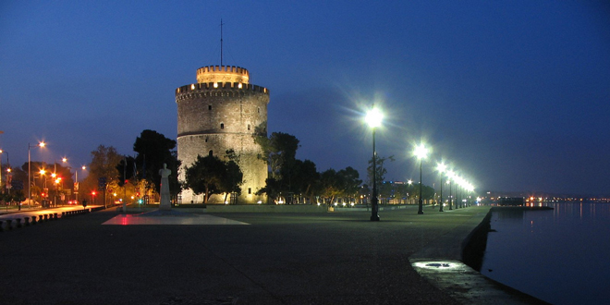
Thessaloniki, The Nymph of Thermaikos

Slide 2
Thessaloniki
Was founded in 315 BC by Cassander, king of the Kingdom of Macedon.
Was named after his wife, half sister of Alexander the Great.
In Greek it means the "victory of the Thessalians".

Slide 3
Roman Era
Became the capital of one of the four Roman districts of Macedonia.
Due to the city's key commercial importance, the famous Burrowed Harbour was built by the Romans.
Thessaloniki's acropolis was built in 55 BC.

Slide 4
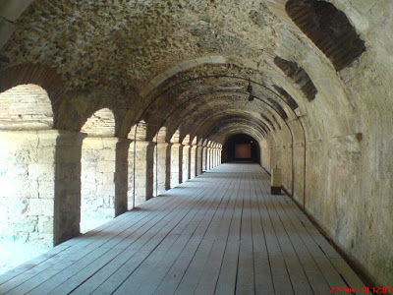
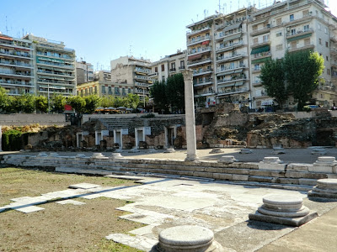
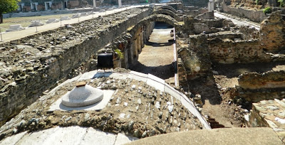
The Roman Forum

Slide 5
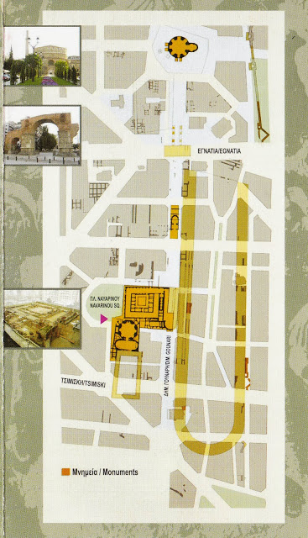
The Palace Complex of Galerius

Slide 6
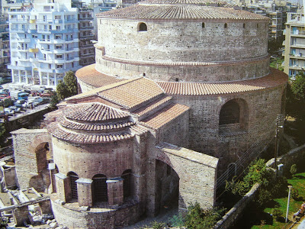
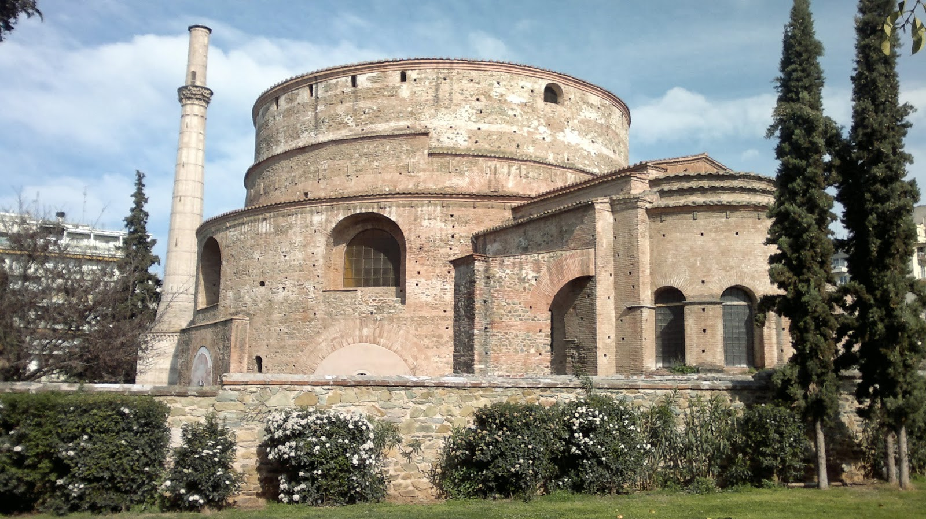
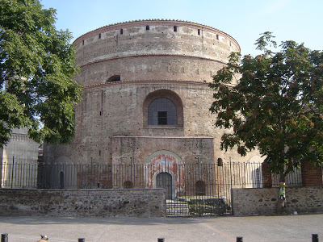
The Rotunda

Slide 7
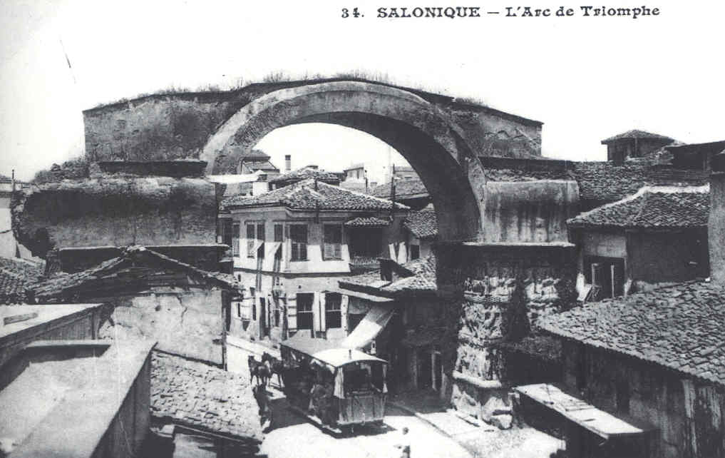
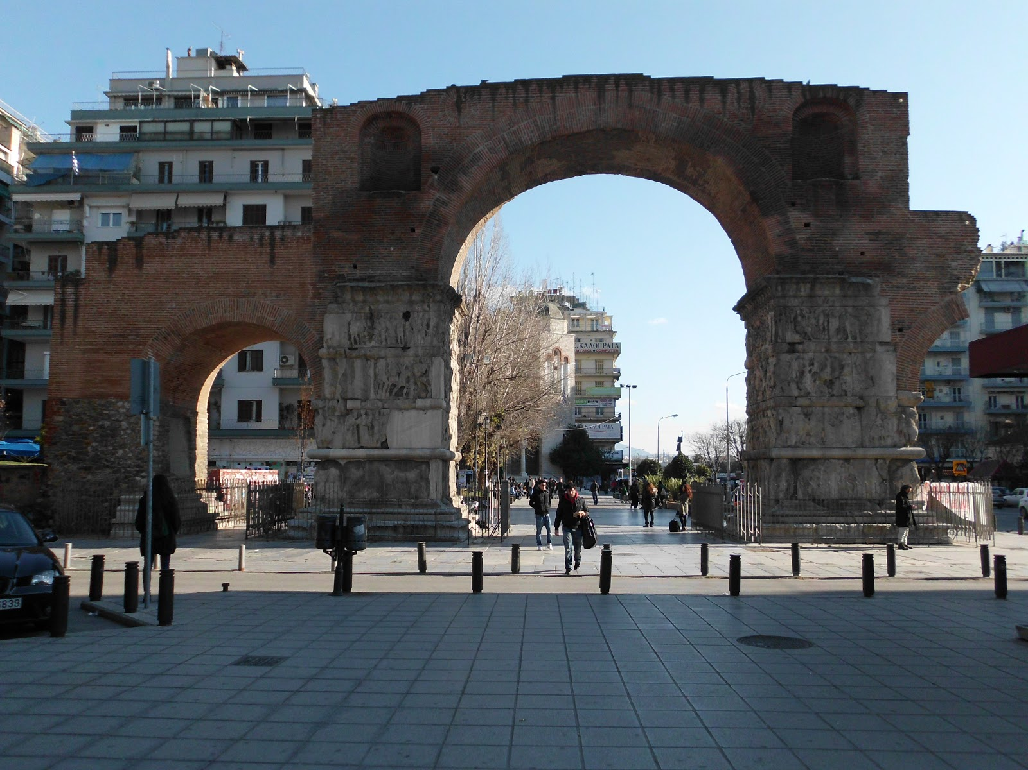
The Triumphant Arch

Slide 8
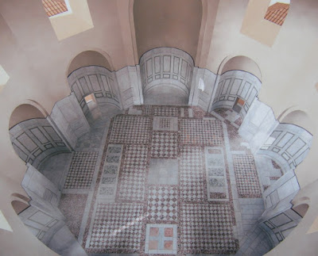
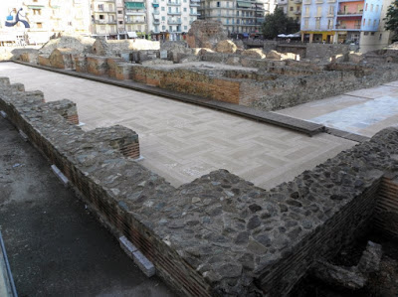
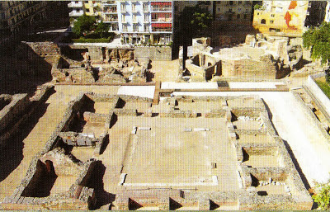
The Octagon and The Palace

Slide 9
Byzantine Era
Thessaloniki became the second city in the Empire after Constantinople, both in terms of wealth and size.
After the Fourth Crusade, Thessaloniki became the capital of the Kingdom of Thessalonica.
Thessaloniki passed out of Byzantine hands.

Slide 10
Ottoman Era
Byzantium ceded Thessaloniki to Venice to keep it from the Ottomans, but the Venetians were unable to prevent its fall to the Turks.
The city's Muslim and Jewish population grew substantially.
Thessaloniki and Smyrna, although smaller in size than Constantinople, were the Ottoman Empire's most important trading hubs.

Slide 11
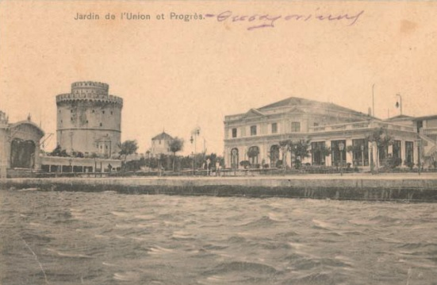
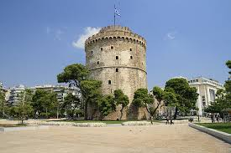
White Tower

Slide 12
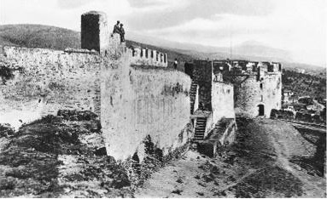
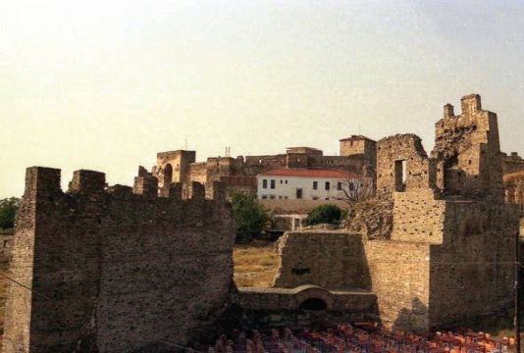
Heptapyrgion

Slide 13
Modern History of Thessaloniki

Slide 14
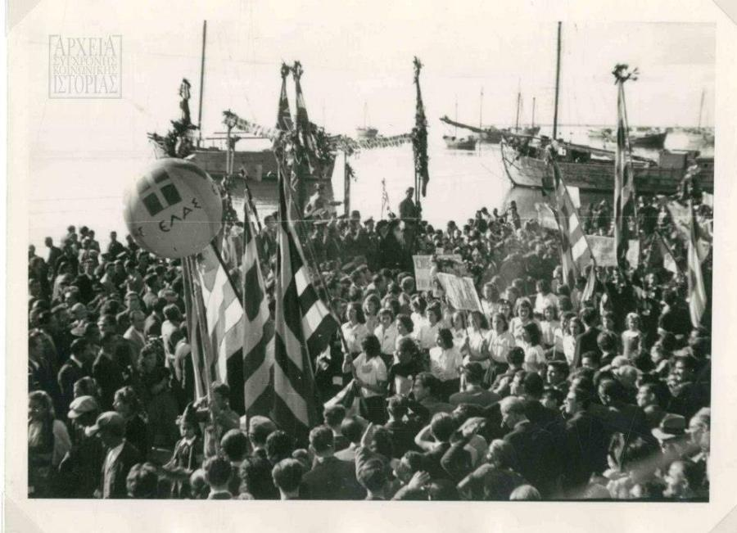
The Liberation
On 1912 Greece was at war with the Ottoman Empire.
On the 26th of October the protocol of the city’s surrender is signed.
The city’s population grew enhancing the Greek community.

Slide 15
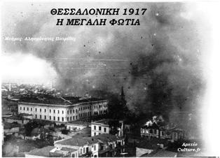
The Great Fire of 1917
It began by accident at a small house of refugees on 5 August.
On the evening of Sunday 6 19 August, the fire completely died out.

Slide 16
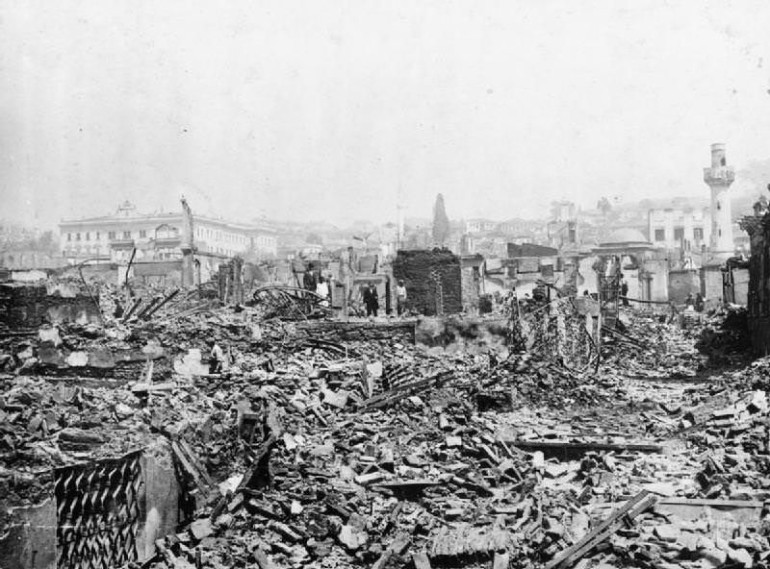
The Great Fire of 1917
It destroyed two thirds of the city, including are architecture buildings, mosques, synagogues, and approximately 4000 shops, leaving more than 70,000 homeless.
The extent of material damage within Thessaloniki was calculated to be worth 8,000,000 golden pounds.

Slide 17
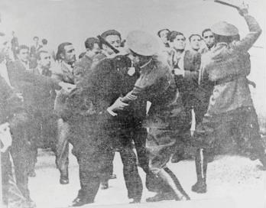
The Bloody May of ‘36
As a result of the Great Depression and the suspension of payments, 12000 tobacco workers went on strike asking for wage rise.
The police tried to impede the protestors whilst the government commanded the armed forces to be prepared.

Slide 18
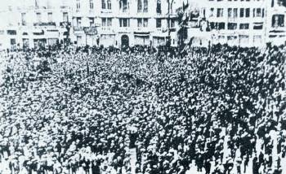
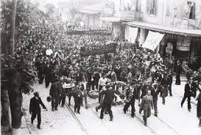
The Bloody May of ‘36
By Saturday 9 May, the strike had become a general strike.
The strike ended with a compromise.

Slide 19
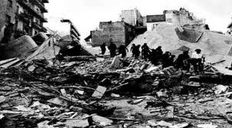
The Great Earthquake
It occurred on 20 June 1978 at 23.03.
The shock registered 6.2 on the moment magnitude scale.

Slide 20
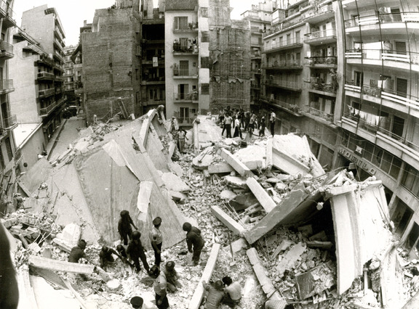
The Great Earthquake
49 people were killed and 220 were injured while thousands became homeless.
The material damage calculated to be worth around 1,2 billion Euros.

Slide 21
Thessaloniki
Is the second largest city in Greece.
Is one of the most important trade and business hubs.

Slide 22
Thessaloniki
Forms one of the largest student centres in Southeastern Europe.
Became the European Youth Capital in 2014.
Is regarded as the cultural and entertainment capital of Greece.

Slide 23
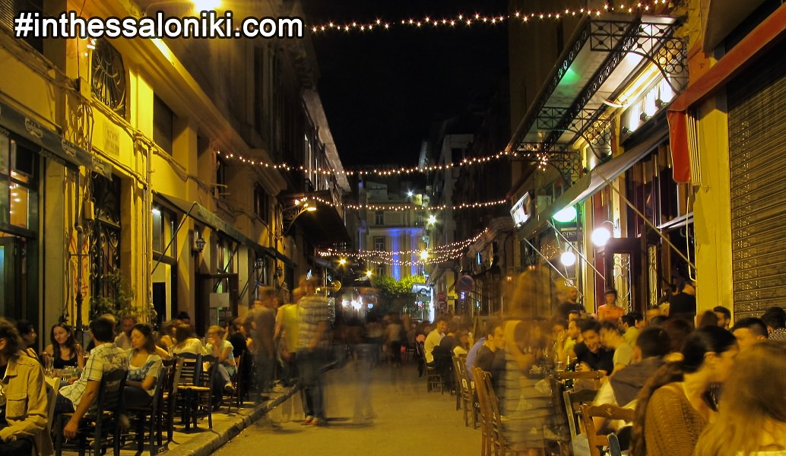
Thessaloniki
Has the most cafes and bars per capita of any other city in Europe.
Is listed among the world’s “nightlife cities” and “ultimate party cities”.

Slide 24
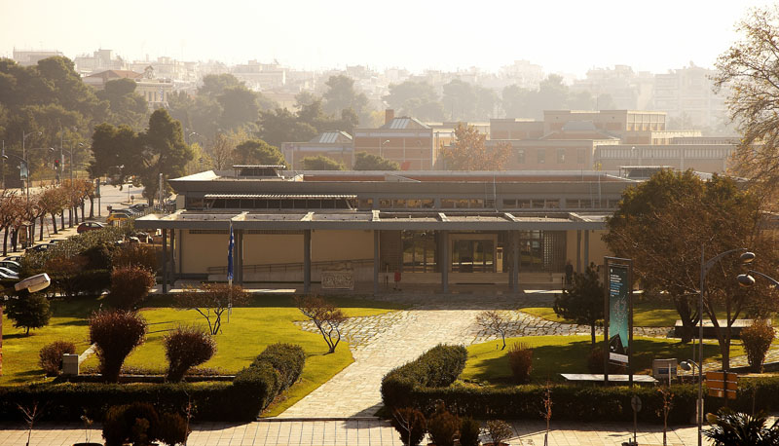
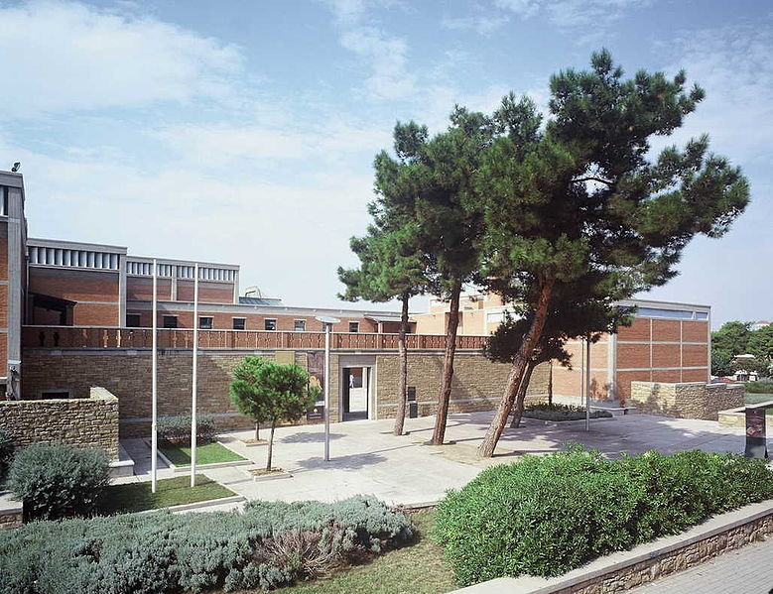
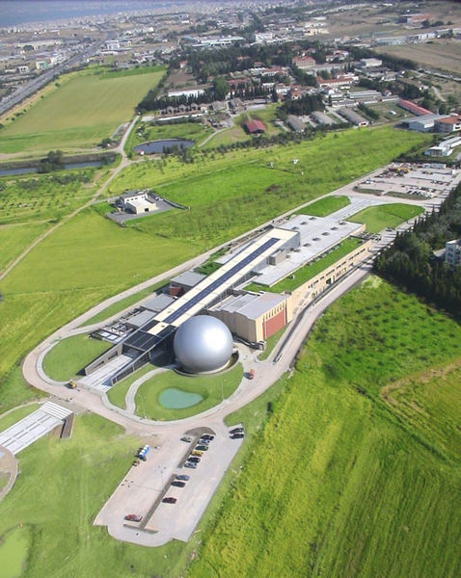
Museums

Slide 25
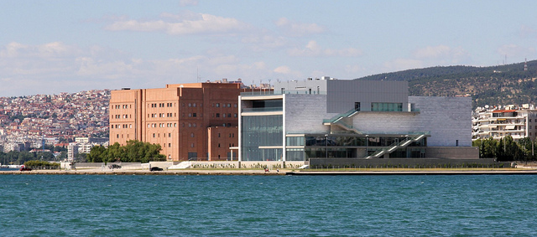
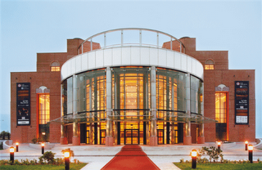
Thessaloniki Concert Hall

Slide 26
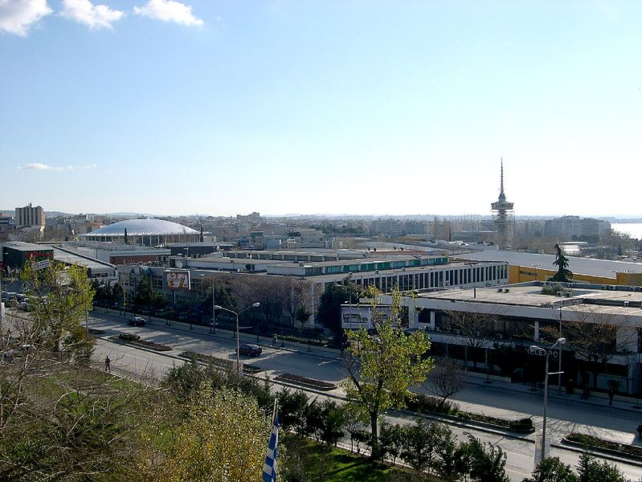
Festivals

Slide 27
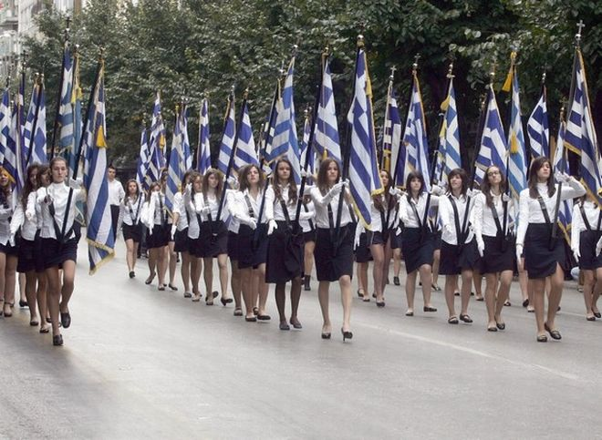
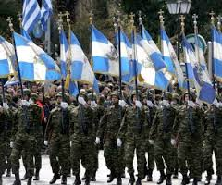
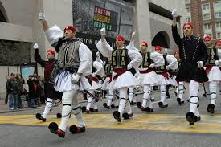
Parades

Slide 28
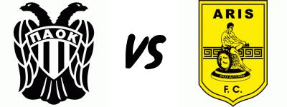
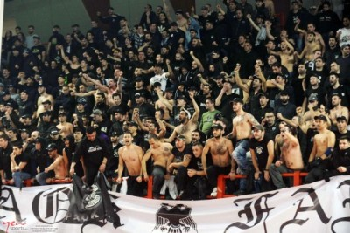
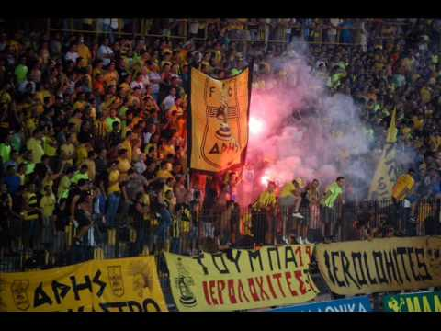

Slide 29
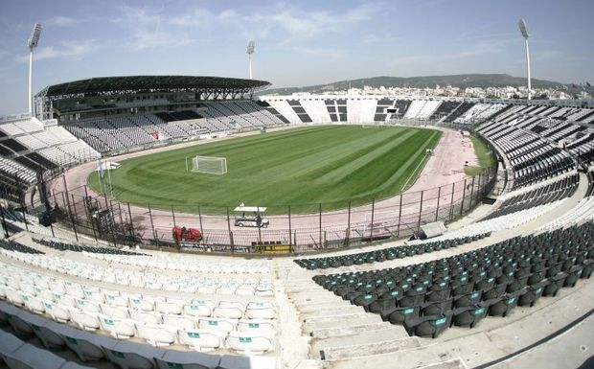
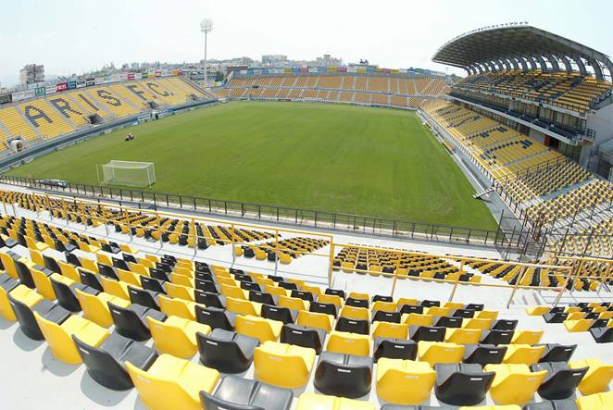
Stadiums

Slide 30
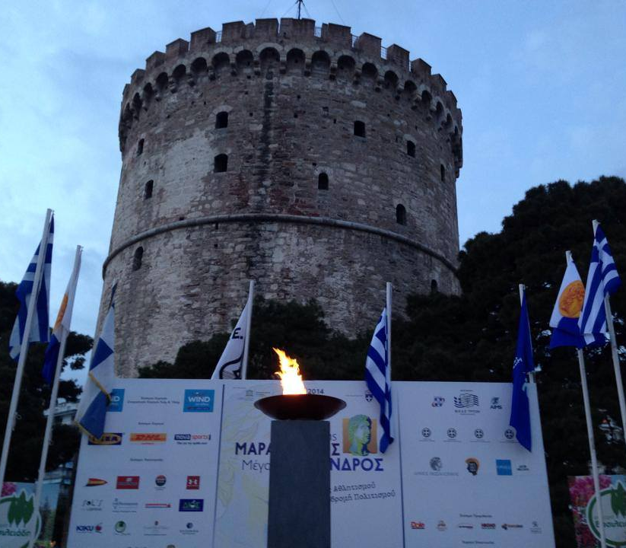
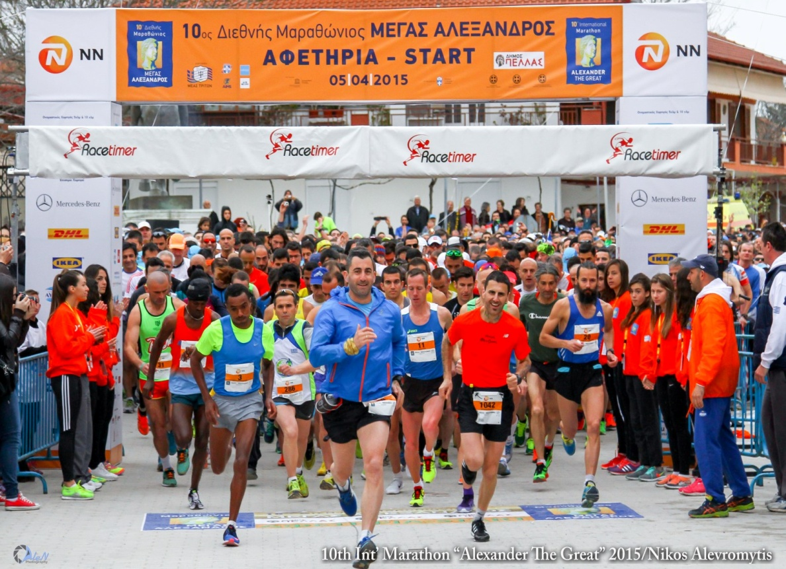
Alexander the Great International Marathon

Slide 31
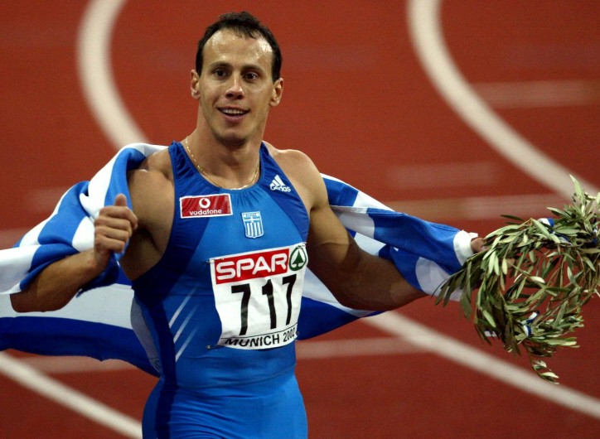
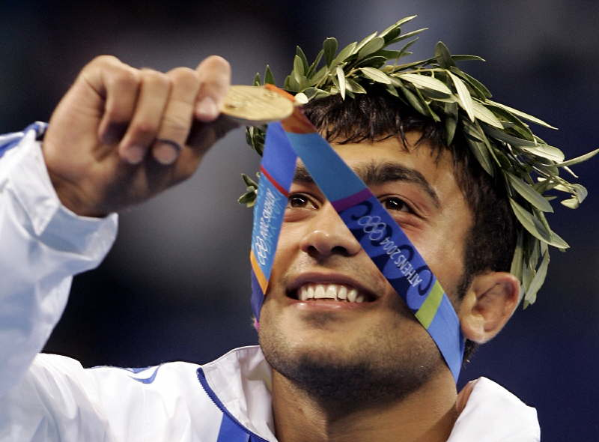
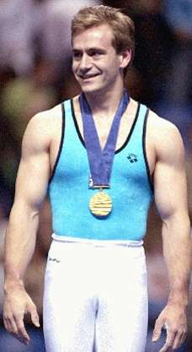
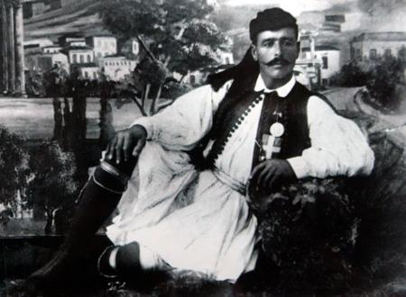
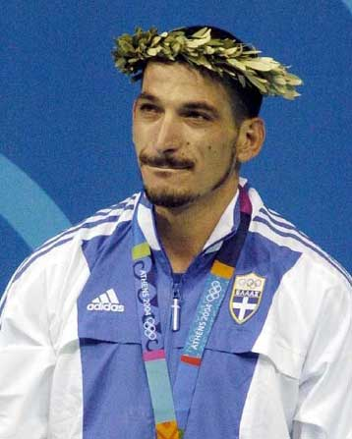
Olympic Gold Medalists

Slide 32
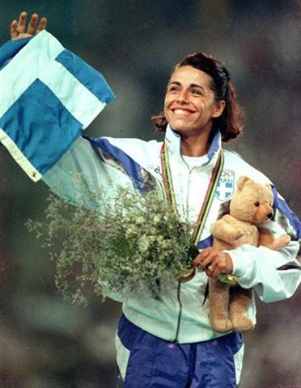
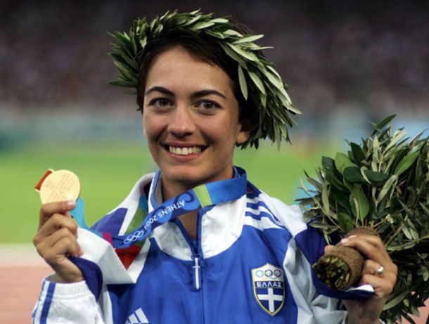
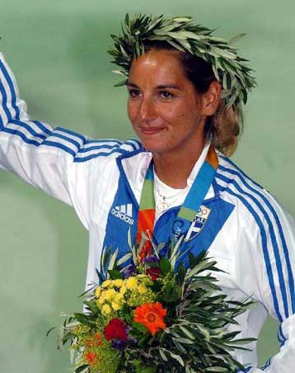
Olympic Gold Medalists

Slide 33
The New Promenade

Slide 34
Ladadika-Valaoritou

Slide 35
Aristotelous Square

Slide 36
Sources:
www.greeka.com
www.wikipedia.com
www.greeknewsagenda.gr
www.science.gu.se
www.inthessaloniki.com
www.enjoythessaloniki.com
www.world-guides.com
www.hotel-nikopolis.com
www.patrickcomerford.com
www.mouseiodimokratias.gr
www.sansimera.gr
travel.nationalgeographic.com
www.lonelyplanet.com

Slide 37
Created by:
Olga Kyparidou
Despoina Ntone
Sandy Sagiridou

