Slide 1
α και τον πολιτισμό.
Management of Cultural Heritage and New Technologies
The Cultural Heritage Management and New Technologies department aims to cultivate and promote knowledge about cultural heritage for proper management.
1)Public and private entities specializing in the promotion and management of products, activities and services of culture
.
2)Management and promotion of museums and monuments
3)Organizations and institutions of the European Union concerning the Ministries and agencies of government on the organization, policy formulation to technology and culture.
4)Museums, Galleries, Art Exhibitions and Cultural Organizations focusing on the design and development of digital applications.

Slide 2
5)Education and training providers to new technologies (educational technology).
6)Institutions and Companies that are directly or indirectly related to culture and new technologies
7)Multimedia production companies with a focus on promotion of cultural heritage and management companies (management) music, film, visual arts and other artistic events.
8) National and international Organizations and Institutions for the promotion and management of Cultural Heritage
9)National and international Organizations and Institutions for the promotion and management of Cultural Heritage
10)Libraries and archives and documentation centers.

Slide 3
Theatrical studies
Graduates can fill jobs in fields similar to their studies and their specialization. lIlustration, can be employed in the public and private sectors as: responsible for theatrical and artistic programs, ministries, agencies and local authorities, teachers in drama schools and tertiary education and in training, theatrologists, critics and theorists of Art, the daily and periodical press, on radio and on TV.

Slide 4
Musical Education
The purpose of the section is to highlight talented scientists to engage with Musicology, the Musicological research and promotion of music education in our country.
1) Research centers, cultural institutions
2) Institutes, organizations, theaters, cinema
3) Studio audio and video, musical instruments production workshops
4) Libraries, publishers and museums
5) In broadcasting, and information and communication stations
6) Musicians and conductors in symphony orchestras in Opera

Slide 5
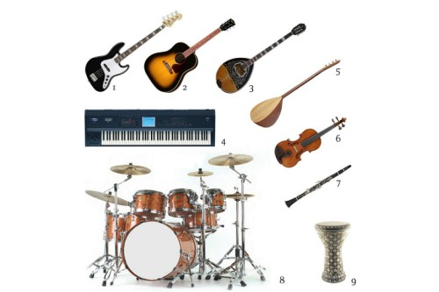
7) Choirs and churches
8) Private and public education
9) Musicologists and music critics to public bodies and the private sector and local government

