Slide 1
Intellectual and cultural aspects of thessaloniki
Painting- Literature- Cinematography

Slide 2
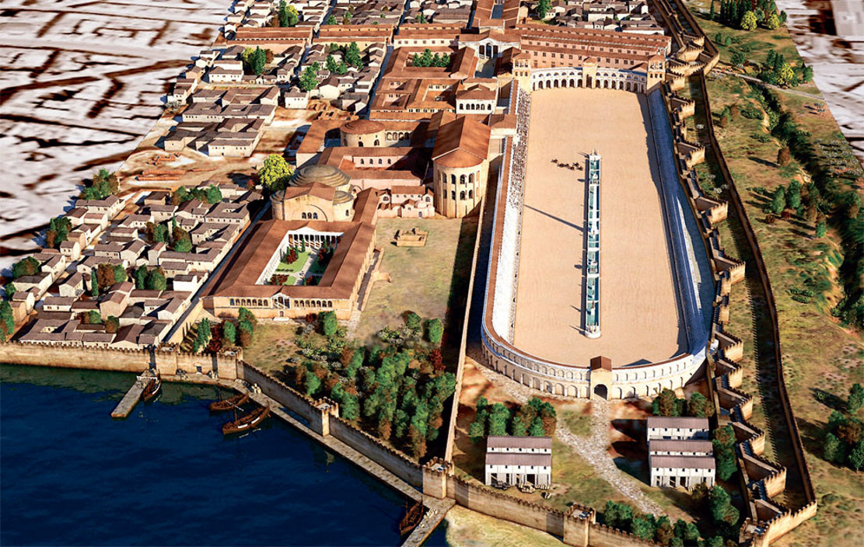
Thessaloniki through the artworks of five artists.

Slide 3
Nick Gabriel Pentzikis (1908- 1993)

Slide 4
Nick Gabriel Pentzikis (1908- 1993)
He was a writer and a self-taught painter from Thessaloniki.
He studied Medicine and later Botany and Pharmacy.
In the 1930s he took on his father's pharmacy and was involved in painting. He began writing and later, he published novels and short stories
He was also awarded with many prizes .

Slide 5
His paintings:

Slide 6
Uranupolis (1962)

Slide 7
Thessaloniki (1979)

Slide 8
Panos Papanakos (1930-1999)

Slide 9
Panos Papanakos (1930-1999)
He was a doctor and a self taught painter.
His artworks are simple and spontaneous expression of his talent.
His works were gradually enriched in colours as movements began appearing.

Slide 10
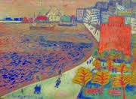
His paintings:

Slide 13
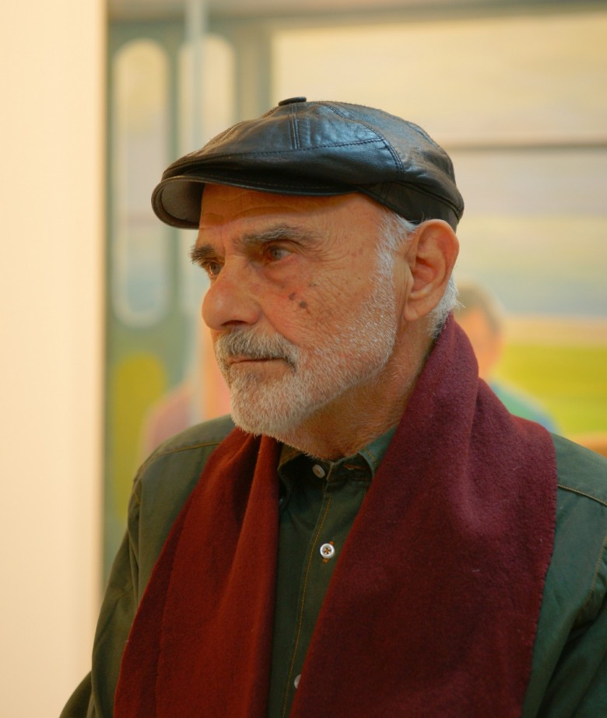
Fonis Zoglopitis

Slide 14
Fonis Zoglopitis
He was first appeared in 1974 with his personal exhibition.
He founded his own atelier, where he organised pictorial exhibitions for young artists.
He would mostly illustrate in his art landscapes and sceneries of the city of Thessaloniki.

Slide 15
His Paintings:

Slide 17
Scenery of Halkidiki (1996)

Slide 18
Lukas Venetulias (1930-1984)

Slide 19
Lukas Venetulias (1930-1984)
He graduated from the School of Fine Arts of Athens.
He was first taught painting by Nick Gabriel Pentzikis.
In his art, he mainly depicts aspects of Thessaloniki.

Slide 20
His paintings:

Slide 23
Macedonian Museum of Contemporary Art

Slide 24
Macedonian Museum of Contemporary Art
It is located at the centre of Thessaloniki.
Founded in 1979, initially as a club with the name 'Macedonian Centre of Contemporary Art'.
The museum now houses about 2000 works of art and after the latest building expansion, it now has large exhibition and storage areas, coffee shop, and a scientific library.

Slide 25
Dennis Oppenheim, Explosions
Opi Zouni, Red column

Slide 27
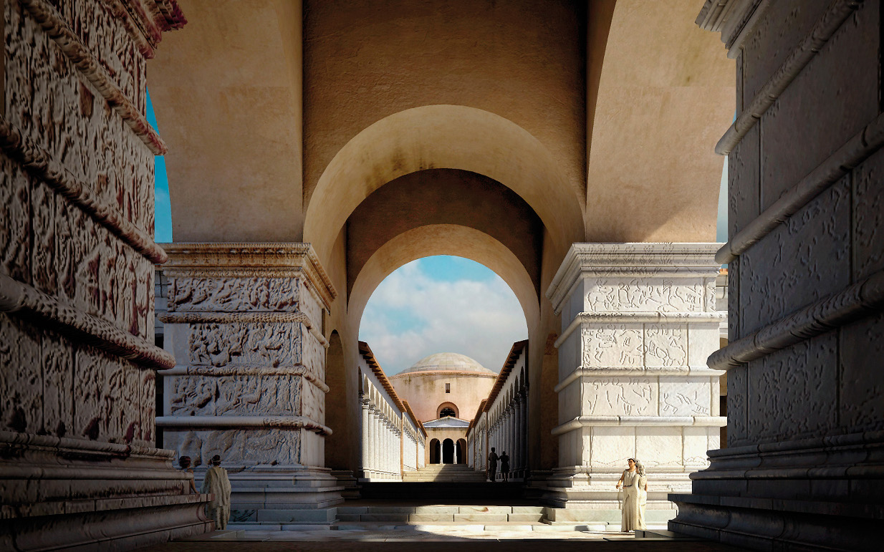
Literature of Thessaloniki

Slide 28
How did it all begin?
1850 is considered to be the starting point of the intellectual life of the modern Thessaloniki, due to the foundation of the first Greek printing shop in the city.
Before the 1920s there wasn’t any remarkable prose tradition that was to be overturned.
After 1920, some notable writers began appearing who unfortunately remained to the one and only prose.

Slide 29
Literature of Thessaloniki
The writers and poets of Thessaloniki have laid the foundation for a literary tradition. And this, exactly, is the stigma of the succeeding literature of Thessaloniki.
In 1960 the second postwar generation is revealed, but was already born in the silence of the cold war.

Slide 30
Yiorgos Ioannou
Born in Thessaloniki in 1927.
He studied Philology.
His main literary activity was prose writing, establishing his own personal style by which many post-date writers were influenced.

Slide 31
Dinos Christianopulos
Born in Thessaloniki in 1931.
He studied Philology.
He founded the literary magazine “Diagonios”.
His work was characterised by an erotic mood.
He was influenced by Kavafis.

Slide 32
Nikos Gabriel Pentzikis
Born in Thessaloniki in 1908
He studied Medicine. He was a writer and a painter.
He was mainly influenced by the symbolic Scandinavian literature. The major characteristic οf his works is the frequent usage of interior monologues.

Slide 33
Manolis Anagnostakis
Born in Thessaloniki in 1925
He studied Medicine
He is the most distinctive poet of the post war generation.
In his poetry are reflected social and political conflicts that followed the occupation.

Slide 34
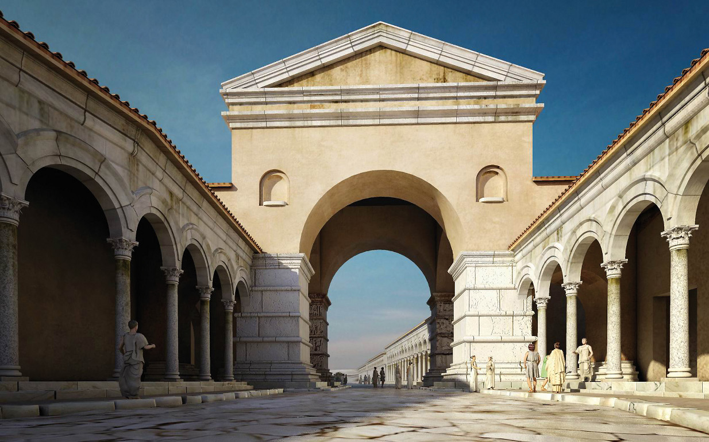
Cinematography of Thessaloniki

Slide 35
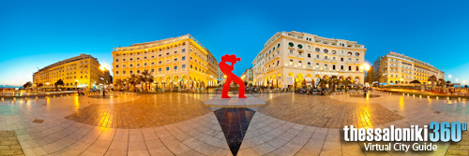
Thessaloniki International Film Festival

Slide 36
Thessaloniki International Film Festival
Thessaloniki International Film Festival is held every November in Thessaloniki since 1960. In 1992 the Festival became International.
The festival awards the Best Feature-Length Film with Golden, Silver and Bronze Alexander. There are also Special Committee awards for Originality and Innovation, as well as five other awards, Director, Screenplay, Actor, Actress and Artistic Achievement.

Slide 37
National Theatre of Northern Greece

Slide 38
National Theatre of Northern Greece
It operates since 1961. The first play was performed in the summer of 1961 and was “Oedipus Rex” by Sophocles directed by S. Karantinou.
It is a private entity and is sponsored by the Ministry of Culture.
Its activity extends to cultural sectors such as education, literature and the arts through the organization of exhibitions, conferences, festivals, theatre-educational programmes and so forth.

Slide 39
Thessaloniki Concert Hall

Slide 40
Thessaloniki Concert Hall
Its purpose is to provide a contemporary cultural and conference center of international standards.
It consists of two buildings. The first has a large hall, a public reception area, offices of various services and other ancillary facilities.

Slide 41
Sources
http://www.tovima.gr/books-ideas/article/?aid=459530
http://dp.iset.gr/artist/view.html?id=83
http://voria.gr/article/efige-echthes-apo-ti-zoi-o-zografos-fonis-zoglopitis
http://tiff.filmfestival.gr/
https://el.wikipedia.org/
http://www.filmfestival.gr/default.aspx?lang=el-GR&page=448
http://www.voria.gr/article/etsi-itan-to-kentro-tis-thessalonikis-ti-romaiki-epochi-foto
http://www.tch.gr/default.aspx?lang=en-GB&page=47
http://aetoshal.blogspot.gr/2014/09/blog-post_31.html
http://www.mmca.org.gr/mmst/el/collection.htm?m=1&l=16;443:bio
http://www.biblionet.gr/author/3725/%CE%9D%CE%AF%CE%BA%CE%BF%CF%82_%CE%93%CE%B1%CE%B2%CF%81%CE%B9%CE%AE%CE%BB_%CE%A0%CE%B5%CE%BD%CF%84%CE%B6%CE%AF%CE%BA%CE%B7%CF%82
http://artemnotes.blogspot.gr/2012/01/blog-post.html
https://en.wikipedia.org/wiki/National_Theatre_of_Northern_Greece

