Slide 1
Activity 1- The Rape of Helen
«IISS C.M. Carafa», Mazzarino-Italy.
2015

Slide 2
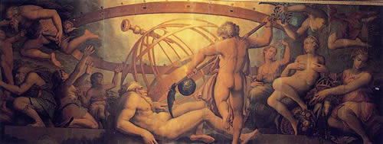
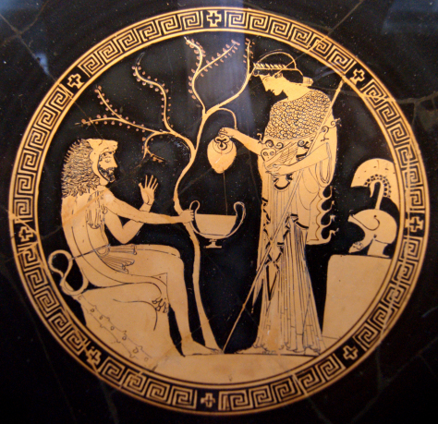
The myth in ancient Greece

Slide 3
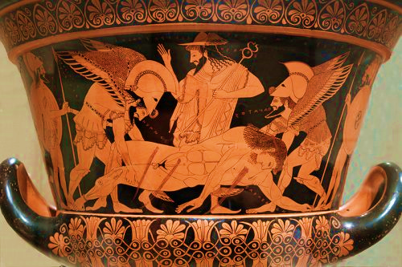
The myth is a fantastic story that explains historical events actually occurred through a simple language. The myth is the richest source of information in human history, it can be considered a sacred story that reveals the mysteries and that gives the answer to many questions of men, how the universe and man were born, where the stars and the earth came from and explains how civil societies were formed. Usually its characters are gods and heroes and often the events narrated take place in an era before the written history.
The myth has been extremely important to explain the archaic history and an explanation for natural phenomena or the cosmos. The narrative seeks to understand the tragedy of our own homeland, master of civilization and yet defeated. In this and in the related issues of responsibility, of guilt, of morality. In order to give rise to a historiographical impressive flowering, the history of greek philosophical thought should be mature from the naturalistic premises till the revolution of thought and of the moral sense.

Slide 4
Philosophy, that is "love for wisdom", is a field of knowledge that poses questions like: who we are, what kind of world we live in, what is our destiny. Before philosophy, these eternal questions were answered by myths, that is, tales about the world, created to overcome the fear of pain and death. The main task of philosophy from the beginning is to replace the myths as a product of fantasy and imagination, with a description of reality based on observation and on reason.
It is a particular material that determines the art of mythology: the mythologem that is is the set of elements of a universal character found in different myths, and just through these elements we find the meaning of the myth. There are several examples of mythologems, for example the Flood, the mutilation or the incest. What interests us most, however, is the mythologem of the rape. One of the most important rape of Greek history is the one of Elena, which will lead to the Trojan War.

Slide 5
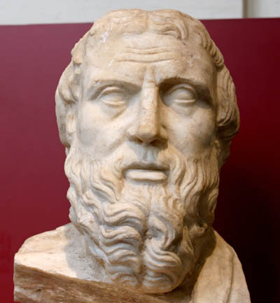
Helen of Herodotus

Slide 6
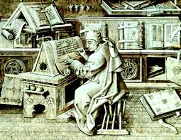
“Ἡροδότου Ἁλικαρνησσέος ἱστορίης ἀπόδεξις ἥδε, ὡς μήτε τὰ γενόμενα ἐξἀνθρώπων τῷ χρόνῳ ἐξίτηλα γένηται, μήτε ἔργα μεγάλα τε καὶ θωμαστά,τὰ μὲν Ἕλλησι τὰ δὲ βαρβάροισι ἀποδεχθέντα, ἀκλεᾶ γένηται, τά τε
ἄλλακαὶ δι᾽ ἣν αἰτίην ἐπολέμησαν ἀλλήλοισι.”
“Ἑκαταῖος Μιλήσιος ὧδε μυθεῖται· τάδε γράφω, ὥς μοι δοκεῖ ἀληθέα εἶναι· οἱ γὰρ Ἑλλήνων λόγοι πολλοί τε καὶ γελοῖοι, ὡς ἐμοὶ φαὶνονται, εἰσίν.”
Homer's work can be considered an encyclopedia of old ages: in it, the myth is the story of the greek people, its evolution, the slow and gradual acquisition of their own space in time and reality.
But the most exciting Asian environment soon will produce the work of Hecataeus of Miletus: while not breaking away completely from the mythical tale, however, he tries to explain it through reason, certainly influenced by the growing of the naturalistic philosophy of Thales. Therefore Ecateo defines mythological tales as "ridiculous”, he redifines the imaginative aspects and tries to interpret them according rationalistic assumptions.

Slide 7
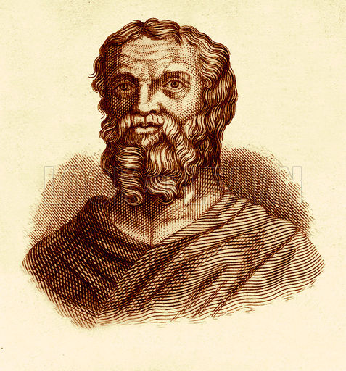
Herodotus will go beyond the speculation of Hecataeus, introducing for the first time the concept of "history" as autopsy, that is concrete, real and conscious perception of the historical process. In Herodotus the myth is symbolic: the rape of Helen for example is the “adikema”, the ancestral guilt that will bring the historical hate between the Greeks and Persians, the West and the East. The fairy-tale elements in Herodotus are not a certainty, but an element of reading the historical reality on the bases of universal symbolic values. In Herodotus as in the epic traditions the tale of men’s deeds serves to give immortality to heroes: however, if in Homer and Hecataeus the deeds are related to the celebration of the myth, in Herodotus the great deeds are the celebration of history.

Slide 8
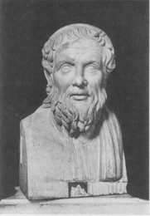
Apollonius Rhodius

Slide 9
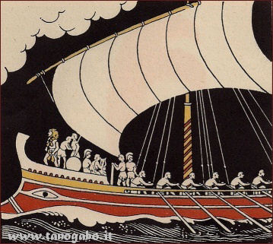
The subject of the poem by Apollonius Rhodius is made from the ancient myth of the Argonauts. It is mentioned in the Homeric poems and in Hesiod, and was the subject of two of the so-called cycle Homeric poems. He later will offer material to Pindar (Pythian IV) and Euripides (Medea).
The recovery of this myth already discussed at the beginning of the Hellenic civilization allows Apollonius to stand as a second Homer. In any case, the Homeric poems are the indispensable model with which Apollonius is measured with the intention to renew and revitalize a literary genre in decline for some time.
Furthermore, the theme of the trip offered the opportunity for erudite digressions of geographical, ethnological, religious, laudatory, etiological content, according to the taste of the typical Alexandrian age. Besides, the almost universal knowledge of the affair from the public allowed the author to play a game suggestive allusions in terms of emotional contents, anticipating eg. the future abandonment of Medea by Jason. Therefore, the relationship of Apollonius with Homer is not of imitation but of profound revision.

Slide 10
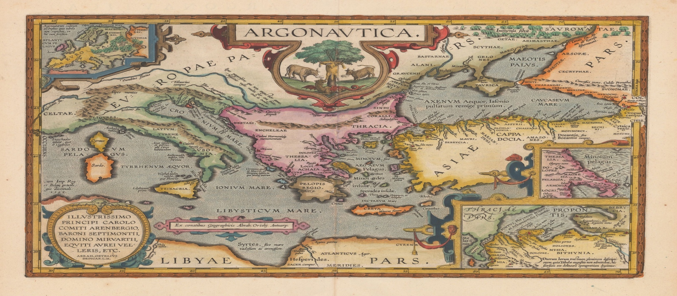
The “nostos” of the Argonauts follows a route that leads the heroes to travel a route similar to that of Odysseus, but while in the Odyssey the return has a positive meaning, in the Argonautica the journey is circular: the final goal coincides with the situation of departure; the Homeric itinerary, linear and progressive has become a circle, in which the value of the heroic journey is weakened.
the Argonautica merge into a single design the basic themes of the two Homeric poems: the heroic and adventurous wanderings. To the two mentioned "epic" issues there is another one that covered a great importance in the tragedy, as well as in the opera. It is the 'love,that with Argonautica acquires a centrality totally unknown to the traditional epic. The love between Medea and Jason dominates infact all the second part of the work, and constitutes the solution to the story.

Slide 11
You can measure another innovation in the epic: the important of the female figure, which assumes unprecedented importance in the epic genre (there is no doubt that Medea is the most complex and artistically successful character in the work, in the deeper, the more dynamic, which also fulfills a decisive role for the achievement of the heroic enterprise); the attention paid to the interiority of the characters, their emotional dimension and their psychological motions . For this, the distance from Homer is enormous, while the model is rather the Greek tragedy and particularly Euripides.
Jason is a less structured character than Medea. For Apollonius he represents the prototype of the antihero. For his passivity and weakness he is placed on the opposite side of the Homeric hero,safe in his certainties that derived from the strength of a system of war values ​​, now gone; in some ways Jason anticipates Enea from Virgil. Jason reflects the image of the new man, lost in a world of which he has no control, exposed to the action of forces above him. The gods of the Argonautica do not intervene to solve human affairs, instead they accompany the action when this has already been determined. Their presence is basically a tribute to tradition. Actually, their role is secondary.
Even the language expresses a clear desire for experimentation, from sophisticated reinterpretation of the expressive code used by Homer: though wanting to imitate the language and style of the Homeric poems, through lexical variations, Apollonius highlights the distance and the deviation from the Homeric model, as evidenced by the new value got by similarities.

Slide 12
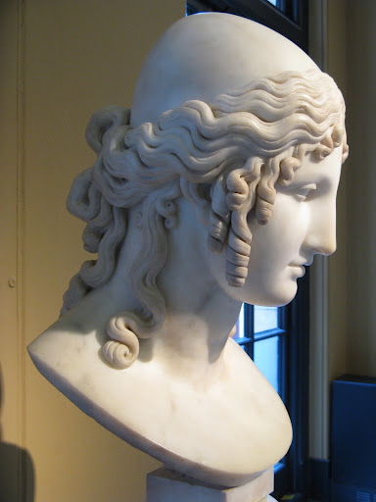
The ethical and moral value of beauty

Slide 13
Καλοκαγαθία
The expression καλοκαγαθία indicates the ideal of human perfection according to the ancient Greeks. The term represents the fusion of a couple of adjectives indicating the harmonious development of the person, that is "beautiful and good", considering the latter not only as a " powerful in war," but also as "possessing all the virtues ". It is the unity in the same person of beauty and moral value, a principle that involves therefore aesthetics and ethics.
In the myth, Achilles and Memnon - destined to clash - fully embody the greek concept ; the opposite, however, is represented by Thersites, a common soldier who appears in an episode of the Iliad, when he exhorts his fellow soldiers to abandon the Trojan War, but is interrupted by Ulysses who forced by Gods, convinces the soldiers to stay, in disagreement with Thersites, who will be brutally beaten by the hero of Ithaca for the attempted mutiny.

Slide 14
Achille ferito al tallone da Paride, di Charles-Alphonse-Achille Gumery, Princeton

Slide 15
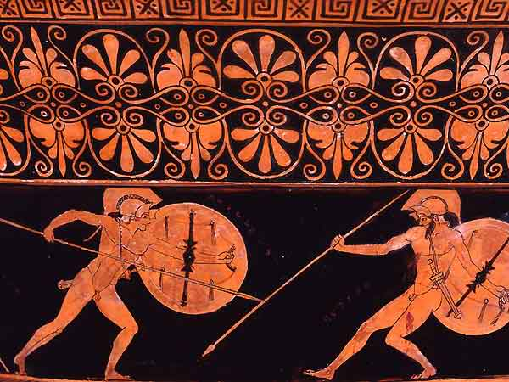
There are however two mythological characters for which one cannot speak of Καλοκαγαθία, despite their great beauty, because they do not prove to be brave. This is Paris, Hector’s brother, who besides missing the typical virtues of the heroes is also the one who causes the Trojan War, and Narciso, a boy indifferent to arms and love, except for himself.

Slide 16
Narciso, di Caravaggio, Galleria nazionale di Arte Antica, Roma

Slide 17
Κόσμος
The concept of "beautiful" had a complex and rich meaning, which the Greeks schematically connected to:
l 'ἁρμονία, found in the cosmic balance;
the συμμετρία, that is the appropriate size;
l 'εὐριθμία, ie the exact rhythm and the correct proportions.
All this is summarized in the concept of kósmos, which refers to the beauty of an object due to the perfection of its structure on the basis of the proportion of its parts. Since the archaic age a work of art is conceived as a combined set of items that represent the copy of an order external to the work itself that provokes pleasure and admiration. In the field of verbal arts, as reported by Homer himself, the concept of kósmos is connected to harmony and coherence: a singer can be said to perform a song according to the canons of beauty if he goes katá Kosmon , according to a fine order .

Slide 18
Le Grazie, di A.Canova, Museo dell’Ermitage, San Pietroburgo

Slide 19
The compositional process of kósmos is activated, in turn, by the impulse to reproduce that, according to Aristotle, characterizes man as a being devoted and oriented towards knowledge. This impulse is defined mimesis, the imitation process that can refer not only to the process of poetry, visual arts and music, but also of voice and acting, until you get to more philosophical meanings.
That's where the whole speech is to touch the fourth kind of delirium: one for which one when, at the sight of earthly beauty, remembering the true beauty, takes wing, and again feathery and yearning to fly, but powerless to do it, like a bird gazes the height [and] and neglects earthly things, provides reason to be considered out of his mind. That delirium, for me, is the noblest form of all divine deliriums and proceeds from what is nobler, so much for those who are taken as for those who participate; and who knows this divine rapture, love and beauty, is called amateur. Because, as it has been said, every human soul by its nature has contemplated the true being, otherwise it would not have got in this [250] creature which is called man.
Plato. Phaedrus 249d

Slide 20
῾Ελένη
It is not a coincidence, perhaps, that to physically embody the Dionysian need of beauty is just the charm of a woman, Helen, a word between war and seduction. It’s a kind of beauty, symbol of divine Eumorphia and, at the same time, bringing destruction, death and revenge, as the fragment of Canti Ciprii (fr.7 Bernabé) shows, considering Helen not Leda’s daughter, but Nemesi’s, the "righteous indignation", through which the gods’father offers humanity a frightening demonstration of his power.
`And after them she bare a third child, Helen, a marvel to men. Rich-tressed Nemesis once gave her birth when she had been joined in love with Zeus the king of the gods by harsh violence. For Nemesis tried to escape him and liked not to lie in love with her father Zeus the Son of Cronos; for shame and indignation vexed her heart: therefore she fled him over the land and fruitless dark water. But Zeus ever pursued and longed in his heart to catch her. Now she took the form of a fish and sped over the waves of the loud-roaring sea, and now over Ocean's stream and the furthest bounds of Earth, and now she sped over the furrowed land, always turning into such dread creatures as the dry land nurtures, that she might escape him.'
Cypria, fr. 8

Slide 21
Helen, superhuman beauty, embodies the 'ἀνάγκη divine: "Certainly you are not guilty before me, the gods are guilty, / they urged me against the sad war of Danai" (Il., III 164-165), tells Priam to mitigate if not to justify, with good-natured and hieratic smile , his daughter’s in law guilty. Helen, after all, is the embodiment of seduction, of 'love δολοπλόκος, Aphrodite’s son, who with his magic band wins the eternal and mortal men. Her prohibited charm can have disastrous and harmful results, yet her beauty is a magnet that attracts and can raise to ecstasy or drag into the abyss. In an interview with Priam she calls herself "shameless." Yet the elders people of the Trojans are motionless, like cicadas, sitting at the gates of the city: they are wise, good speakers, indifferent to the female charm. But when she appears, accompanied by her two daughters-and the tears in her eyes could not be distinguished, because she was wrapped in a bright white veil -seniors exclaim to one another: "It is not a nemesis, that for such a woman Trojans and Greeks have been suffering for so long and are still suffering. She is, in fact, as one of the immortal goddesses. "Simple ,natural words in that particular situation-and yet through them something unspeakably great happens: the redemption of beauty from sin.

Slide 22
Elena e Paride. Particolare di un cratere a campana apulo a figure rosse (IV secolo a.C.), museo del Louvres, Parigi

Slide 23
Helen in the classical world
Since ancient times, the figure of Helena has been the stereotype of the femme fatale, let’s just think about the etymological origin of the name. Ἑleῖn means in fact destroy. It represents the destructive woman, almost a demonic creature, because of which the Trojan War broke out. Although she is acknowledged as a temptress, evil deity, of extraordinary beauty but dangerous, which is worth dying for, there are many exceptions to the interpretation of her figure.

Slide 24
The first is the one of Homer himself, who presented her ,for the first time, in his Iliad making her already aware of the evil she brought, in fact Elena calls herself "evil bitch".
In the Odyssey, however, she is even defended as a victim of a perverse fate that forces her to submit to the will of the gods, that make her a paradigm of a destructive eros and perverse seduction of adultery.

Slide 25
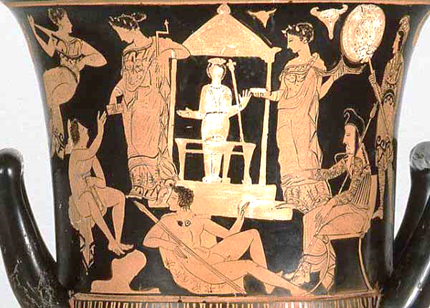
The first historical document that describes in detail the living conditions of the Greek woman is given just in the Homeric poems, which, regardless of the truth of the events narrated and their protagonists, offer to 'today's reader and offered to' old listener of bards and rhapsodists a look at the history, values ​​and rules of Greek society in the centuries between the end of the Mycenaean civilization and 'eighth century. The situations that the singers described were then, if not true, certainly plausible, and the characters, even fruit of their imagination, surely adherents to the rules and real social conventions . It is therefore possible, starting from the Homeric texts, to make some observations about the conditions of the Greek woman in that period. The virtue of women is to devote herself to the oikos and is particularly focused on activities such as spinning , praying and protecting the property of the landlord, including children generated with him. The main quality for a woman was beauty, and she used to attract the male attention and adorning herself with jewels, brooches, buckles and using combs for her hair. The body of women, opposed to that of the hero, is little exalted: beyond generic references to beautiful cheeks or shining eyes - or to the beautiful arms - there is no precise description of a female body in 'epos, so that we barely distinguish heroines from each other for their own individual characteristics. Women wear the veil as men the armour, to go outside. The colors of beauty are clear, bright, iridescent.
“Pudicizia, fedeltà, rispetto della divisione dei ruoli e obbedienza, virtù proprie di una figura subalterna, sono le virtù richieste alla donna, vittima in età omerica di un' ideologia misogina.”

Slide 26
Iliad
Odyssey
In the Iliad, Helen is a tragic character, forced to be Paris’s wife by the goddess Aphrodite. No blame can he be reproached, for her innocent beauty, although she is blamed for the war of Troy. She is not a happy woman, she despises Paris and is hated by many Trojans: only Hector is nice to her, and at the death of the hero, Helen feels in a great sorrow.
At Paris’s death, Elena is forced to marry his brother Deiphobus. During the night of the fall of Troy she hides her husband’s weapons and lets Menelaus and Ulysses in. Together in the bedroom they find Deiphobus asleep and drunk.
In the Odyssey Helen reaches a greater decision-making autonomy. In the ILIAD feeling seems to be absolutely referred to a woman and the passion it inspires is stronger than any rational objection. And one of the most valuable example is love between Elena, Menelaus' wife, Agamemnon’s brother, and Paris Priam’s son , king of Troy. Elena is absolutely the cause of the war: fate, represented for her by Aphrodite involved her in this event by driving her to a passion for Paris. In the Odyssey (IV 563) it is said that Menelaus and Helen were not destined to die and to be received in the Elysian Fields; in the Odyssey she will call her kynòpis (κυνῶπις), “face of a bitch” like Pandora and Clytemnestra, symbol of a lascivious woman.

Slide 27
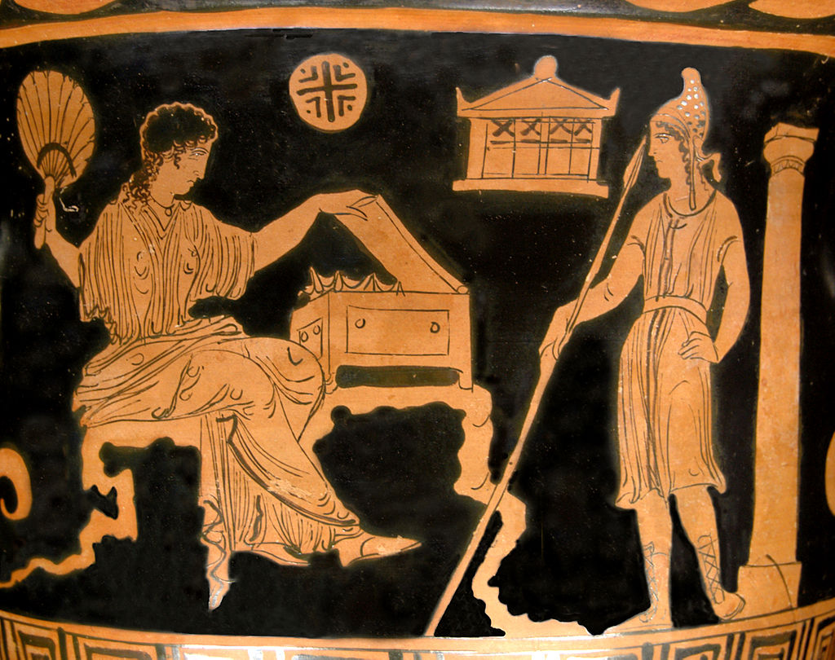
The transition from literature to theatre takes place with the Agamemnon by Aeschylus. Elena is indicated in the tragedy, along with Paris, as the cause of the Trojan War and therefore defined by the choir "destroyer of ships", "of men", "of the city". With Euripides the character becomes central, appears in six dramas, plays a decisive role in the Trojan 415. In the third picture she defends herself from the accuses trying to give the fault to the Trojans, especially on Paris that has seduced her and Priam for not having killed Paris himself, despite the grim premonitory dream. The angry response of Hecuba contributes to present a different personality and the acting of Helen: the deadly events do not come by divine intervention, but by human will. Therefore, is the heroine innocent as she herself says, or guilty as Hecuba wants?
Euripides sides with the former possibility. He presents a resigned and humble woman, without the old living force, at the tomb of King Proteus in Egypt, obsessed with the unrestrained courtship of Theoclymenus, waiting for Menelaus who, as in the best adventure novels, suddenly abruts. The couple meets and runs away. The happy ending contrasts with the tragic Trojan war fought for a cause strange to Helen and highlights the absurdity of life and the weaknesses of human action. "So, in a few years - Donadi says -, Helen tragically turns into the Helen, in a humble and persecuted Lucia Mondella"

Slide 28
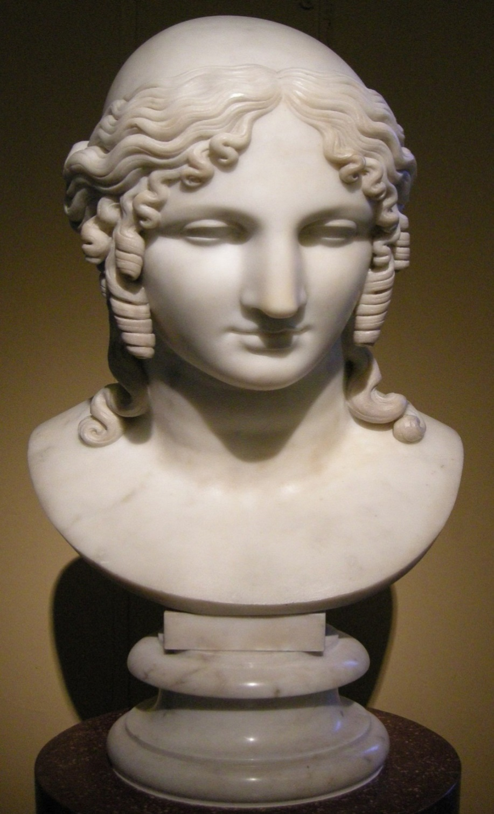
Helen of Troy

Slide 29
Tindaro’s daughters (93)
Tindaro, sacrificing all the Gods, forgot Aphrodite, who promised revenge for all his beautiful daughters.
«Le vide, le ammirò l’amica del riso Afrodite; ma poi su lor gittò trista fama. Timandra, lasciato Èchemo, andò con Filèo, prediletto dai Numi del cielo: il letto abbandonò d’Agamènnone pari ai Celesti, e scelse Egisto, sposo che meno valea, Clitemnestra: di Menelao chioma bionda cosí macchiò Elena il letto.»

Slide 30
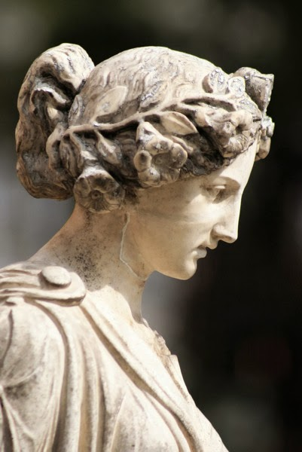
THE MARRIAGE OF HELEN(94-95)
The fragments that follow, found in pieces of papyrus constitute the longest and complex part we have from the catalogue of women. I translate the better preserved passages. At the beginning it is narrated how Tindaro Castor and Pollux, respectively Helen’s father and brothers, invited all the lords of Hellas to compete for the wedding of the beautiful maiden. There followed the numbering of the heroes (another catalogue) specifying the place of origin of each of them, and the gifts : another repetition ,within the epic production, of the famous Homeric catalogues. The name of the hero of the first fragment is lost. This passage comes out from the narrative that Agamemnon makes to his servant in the first scene of Iphigenia in Aulis. Heroes from all over Hellas appear asking to marry Helen. In the previous and lost lines are listed the gifts of some suitor.

Slide 31
“E d’Itaca venía la forza divina d’Ulisse, del figlio di Laerte, che scaltro era d’ogni malizia. Mandati ei non aveva presenti per l’agil fanciulla, perché sapeva che Menelao chioma bionda la gara avrebbe vinta: ch’era di tutti gli Achivi il piú ricco. A Lacedèmone, pure, mandare soleva messaggi a Càstore, a Polluce, maestro a domare corsieri l’uno, trionfatore di gare il secondo.
A Càstore, a Polluce, maestro a domare cavalli l’uno, trionfatore d’agoni il secondo:
sposare Elena chioma bella voleva: né pure veduta l’avea; ma solo udite parole ne aveva dagli altri.
Poi, dall’Eubea giungeva Elefènore, sire di genti, di Calcodonte figlio, signor dei magnanimi Abanti,
e molti doni a lei recò: ché nutriva gran brama d’avere Elena sposa.
D’Idomenèo la gran possa giungeva da Creta, a cui padre Deucalïone fu, flgliuolo del grande Minosse; né alcun dei pretenenti mandò che messaggi recasse, ma nella nave negra dai multipli banchi, egli stesso andò, pei foschi flutti del mare d’Ogílio alla casa di Tíndaro assennata, per Elena avere consorte.»

Slide 32
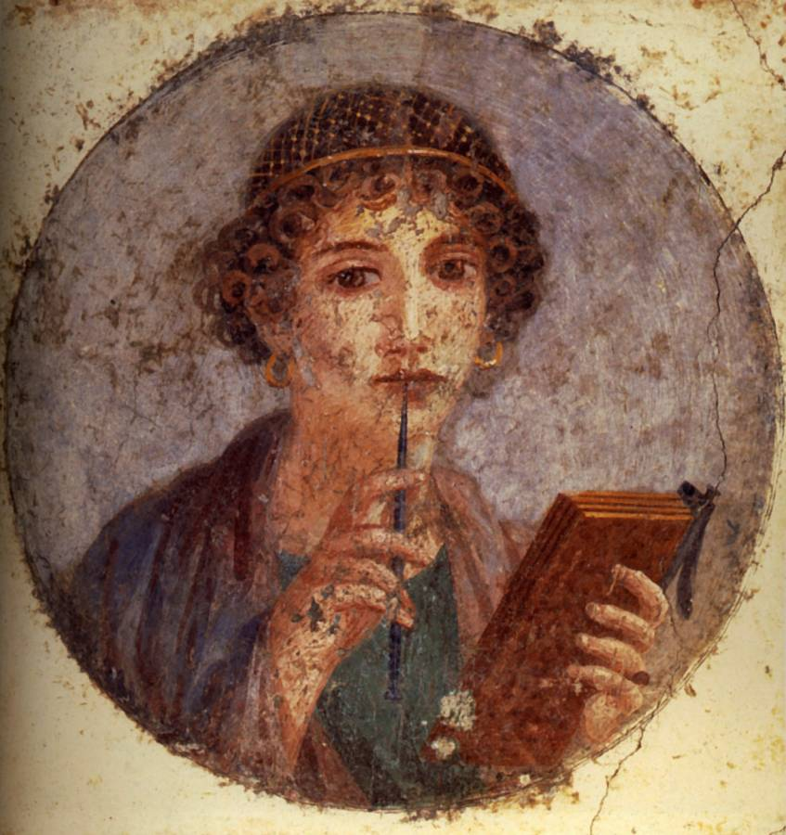
Helen in Sappho

Slide 33
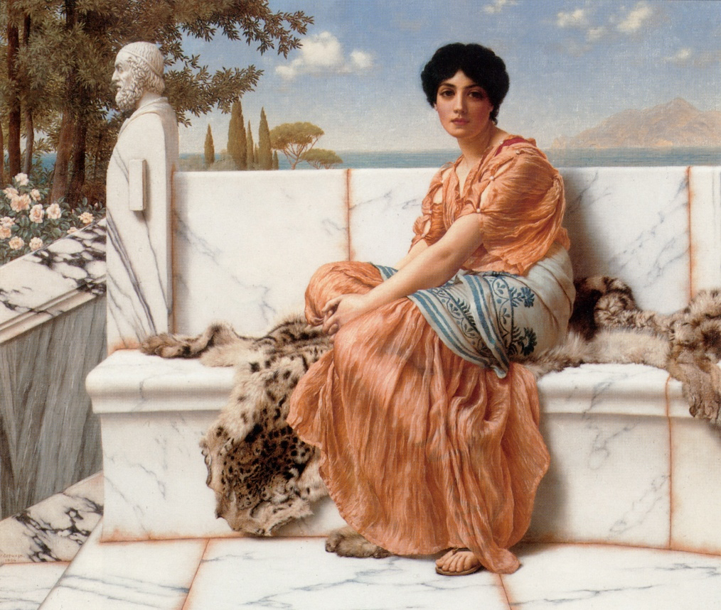
Born from the relationship of Leda, Tyndareus’s wife, with Zeus turned into a swan, Elena became famous for her extraordinary beauty. Kidnapped by Theseus and brought to Attica, was given freedom by her brothers Castor and Pollux, and brought back to Sparta, where many people wanted to marry her.
Woman of extraordinary beauty, asked by lots of men as their bride: it was Menelaus who won. During the absence of her husband, arrives in Sparta Paris.
Elena’s extraordinary charm burns the heart of the young Trojan prince, to whom Aphrodite had already promised the most beautiful woman in the world as a gift.
Elena accepts Paris’s courtship and runs away with him to Troy, abandoning Menelaus and her little daughter Hermione.
Menelaus asks the other Greek kings for help to have his wife back: so the Trojan War broke out.
The Rape of Helen develops in these ways:
She was taken from his home;
she followed Paride for love (satisfaction of the senses);
She took refuge in Egypt under the protection of King Proteus. Meanwhile, Paris is given a ευδολον. Menelaus goes to Egypt and recognizes his true wife.

Slide 34
Was Helena really guilty?
Abandoning her husband Elena, was accused of adultery and for this she was harshly condemned by poets and writers of all ages. However there were some exceptions.
The Greek poetess Sappho (7th-6th century BC) instead seems to justify her behavior: She was struck by Aphrodite and chose Paris as "the most beautiful thing: what you love." This appens in the fragment 16.
"The coolest thing” fragment 16
Male and female Ethics
The opposition male ethics of war and feminine values has its model in the mythical figure of Elena, who is seen by the tiaso as bearer of positive values: beauty, obedience towards Aphrodite, the courage to follow the voice of love.
Forgetfulness and memory
The theme of memory- with which the ode ends in the part that is preserved for us (on the papyrus we can read traces of other verses) – is also connected to an important value of Sappho’s group: you never forget love, even when the girl is forced to abandon her tiaso for the wedding. The ode plays on the antithesis: forgetfulness / memory. Elena "forgets" Menelaus and her daughter (ie the family values of an adult woman), while Sappho "remembers" Anattoria in her sensuality even when she is separated from her friend’s affection just from those values that Elena rejected: her family and her groom.

Slide 35
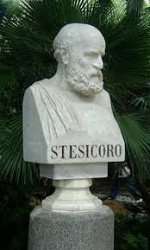
Helen in
Stesicoro

Slide 36
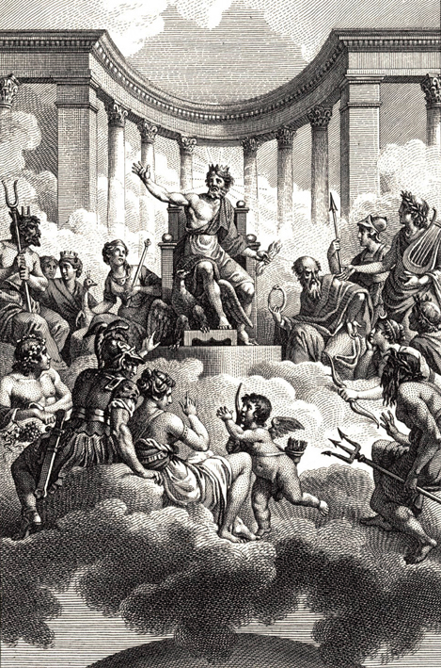
The myth is not an unchangeable "dogma" that is the "basis of a compulsory belief", but rather "a cloth" that is enriched and enhanced by many different narrative forms. But, despite this, the remaking of mythological content is not entirely arbitrary nor free from rules. The poet Stesicoro and the famous dramatist Euripides represent two examples, with their remaking of the theme of Elena, of how the myth can be totally opposed to the traditional one. These different remaking about the myth of Helena by Stesicoro, sometimes opposite to each other, however, are innovations "of content", which concern the substance and not the formal aspect of the myth itself. But what may have caused Stesicoro to reinterpret the content of the story of Helen and to make him write even a recantation?

Slide 37
Probably Stesicoro rewrites the myth of Helen to satisfy the religious needs of the Doric world, or because the Spartan people, that worshipped Helena as a deity, could not accept the adultery version transmitted by the Homeric epos. Apart from the content, also the interest towards individual mythological characters (especially smaller ones) changes.
If in Homer ,Greeks and Trojans disappear behind Achilles or Odysseus, in Stesicoro, Elena from the symbol of seduction, in the tragedy becomes a " simble of marital virtue." In fact, to rehabilitate the character of Elena, discredited in the first composition inspired by the Homeric version of the heroine, and this was the cause of his blindness, he remade the story by writing a Palinodia thanks to which he could see again. Isocrates says that "Elena proved her power even to the poet Stesicoro.

Slide 38
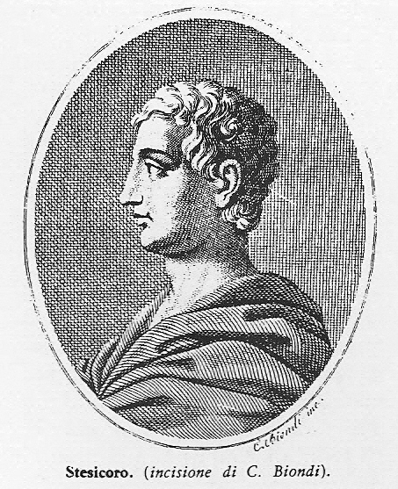
When at the beginning of his poem, he used negative words towards her, he became blind; but after realizing the reason of his disgrace and writing the Palinodia she brought him to his original state. "A second witness, contained in Plato’s Fedrus, shows three verses of the palinode itself:" for those who commit a sin against the myth, there is an ancient rite of purification, which Homer was not aware of, but Stesicoro was. In fact, deprived of the sight for having despised Elena, he did not ignore the cause like Homer, but as a lover of the Muses, he realized to write some lines.
After the discovery of a papyrus containing a commentary, Chameleon, author of a treatise on Stesicoro, shows to be aware of two different poems of Palinodia by Stesicoro: these palinodes are different and independent from each other. In the first Palinodia, Stesicoro would therefore have opposed to the Homeric version the Hesiod one, according to which Elena, after being kidnapped by Paris, would have been held in Egypt by King Proteus, during a stop of the couple travelling towards Ilium. However, if Stesicoro’s purpose , as mentioned before, was to protect the reputation of Elena’s innocence, even this version could not be satisfactory, since neither it did not deny Elena’will to escape with the Trojan prince, nor the adultery. In fact Hesiod himself, in his catalog of women, quotes the couple Elena-Clytemnestra as an example of women who had betrayed their own husband. Hence a second remaking by Stesicoro, in which the author strongly denies the same tradition of the kidnapping, stating clearly, in the second verse:
« Οὐκ ἔστ'ἔτυμος λόγος οὗτος οὐδ'ἔβας ἐν νηυσὶν εὐσέλμοις οὐδ'ἵκεο Πέργαμα Τροίας »
So, the 'εἴδωλον, the false image of the queen of Sparta ,who in the previous version, was the result of Proteus deception , here becomes a divine creature, through which the Olympic world preserves the "divine" Queen of Sparta from every sin, removing her miraculously from the lusts of Paris and bringing her in an Egyptian land, where she was waiting to join Menelaus at the end of the long and bloody war. Thus, Stesicoro definetly overturns the image of Elena, surrounding her with a mystique halo of innocence and royalty,and reaching, through this original creature, a great poetic fame.

Slide 39
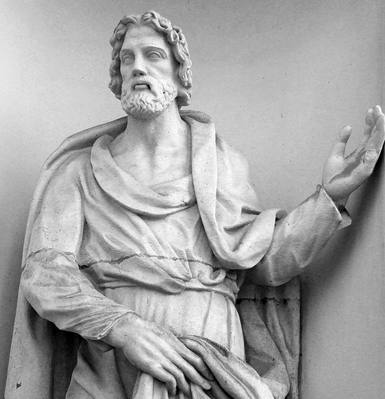
Helen in Euripides

Slide 40
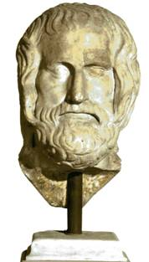
It Must be attributed to Euripides the most original version of the Myth: the dramatist imagines the woman never departing for Troy, but spending the war years in Egypt, remaining faithful to her husband Menelaus. The Helen by Paris is thus a ghost, not the real Elena. This image gives way to various interpretations: Elena is inside a sweet woman , female in all her aspects, but outside she appears as a ruthless woman, completely indifferent to the fate of men. That’s why Elena is an extraordinary character, she represents in fact many aspects of the human soul, and therefore the perfect woman, sweet and strong at the same time ; faithful and unfaithful at the same time; wife and lover.
“L’oggetto della difesa dei Troiani, il trofeo per cui combatterono i Greci, non ero io, era solo il mio nome.”
Euripide, Elena, vv 42-43, introd. e cura di M. Fusillo, Milano, Rizzoli, 1997, p.49

Slide 41
Helen in Gorgia

Slide 42
The famous philosopher Gorgias, following the "Palinodia" by Stesicoro, was the author of '' Praise to Helen ". The philosopher, in order not to give her any fault, presents a series of logical implications according to which Elena is not really guilty for the conflict between the Greeks and Trojans: he refers in fact to τύχη (tyche, "destiny"), eros, to the persuasive power of the word and to the physical strength .
Either Elena was acting on behalf of fate or gods, or because subdued by the physical violence or convinced by Paris’ words, or, even , because she is driven by the passion of love, anyway , according to Gorgia, she still deserves to be considered unguilty. This Helena is a tragic figure; in fact her ability to decide appears to be strongly limited from the beginning. The main theme of his praise is therefore the ethical irresponsibility of man before irrational forces, by which he is necessarily dominated.

Slide 43
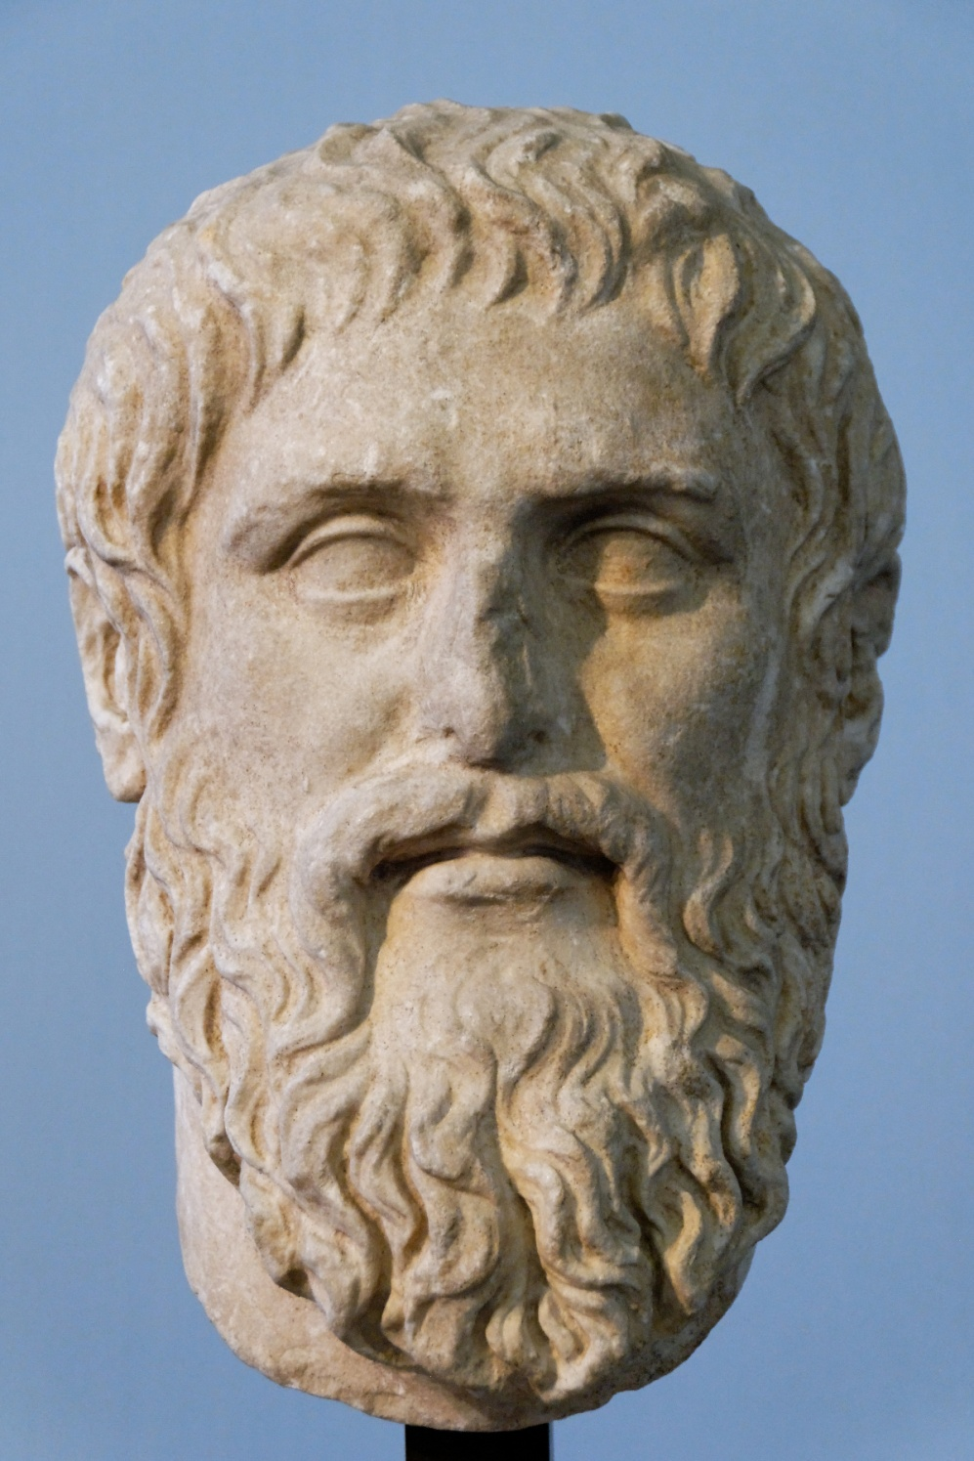
After condemning violence as the possible and further reason that prompted Helen to act, Gorgias passes to analyze another type of force (violence), different from the physical one , but also effective: the word is a powerful tool able to perform the most divine works: it can stop fear, take the pain away , produce joy and increase compassion. In the final paragraph of the 'Praise, whose function is to summarize the above, Gorgias tells again the possible reasons for Helen’s behavior in an order different from the initial one. If at the beginning the four causes are set out in a sequence that starts from the transcendental level to the immanent one , in conclusion the human and natural causes are probably the most convincing and appear first: "either by love or persuaded by the word or caught by violence, or forced by divine necessity ". The fourth cause, love, or, better, the sight , of which love is only a consequence, is, like "logos", an extraordinary element of charm that makes our soul uncertain and passive.

