Slide 1
The game of “Santiago De Compostela” a variation of the well-known “Goose game”.

Slide 2
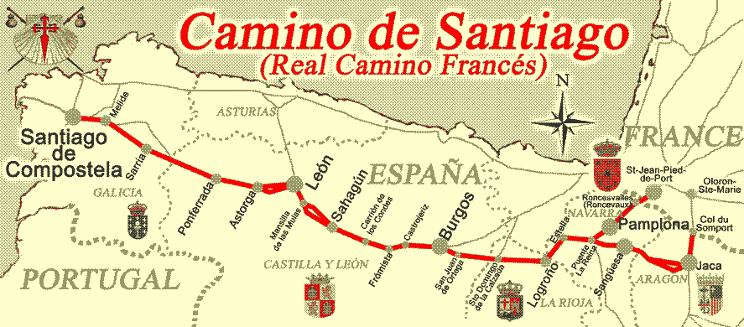
The object of the game is to be the first person to get to the end of the journey, which is the city of Santiago De Compostela, by following the route of the French prayers to the Camino De Compostela.

Slide 3
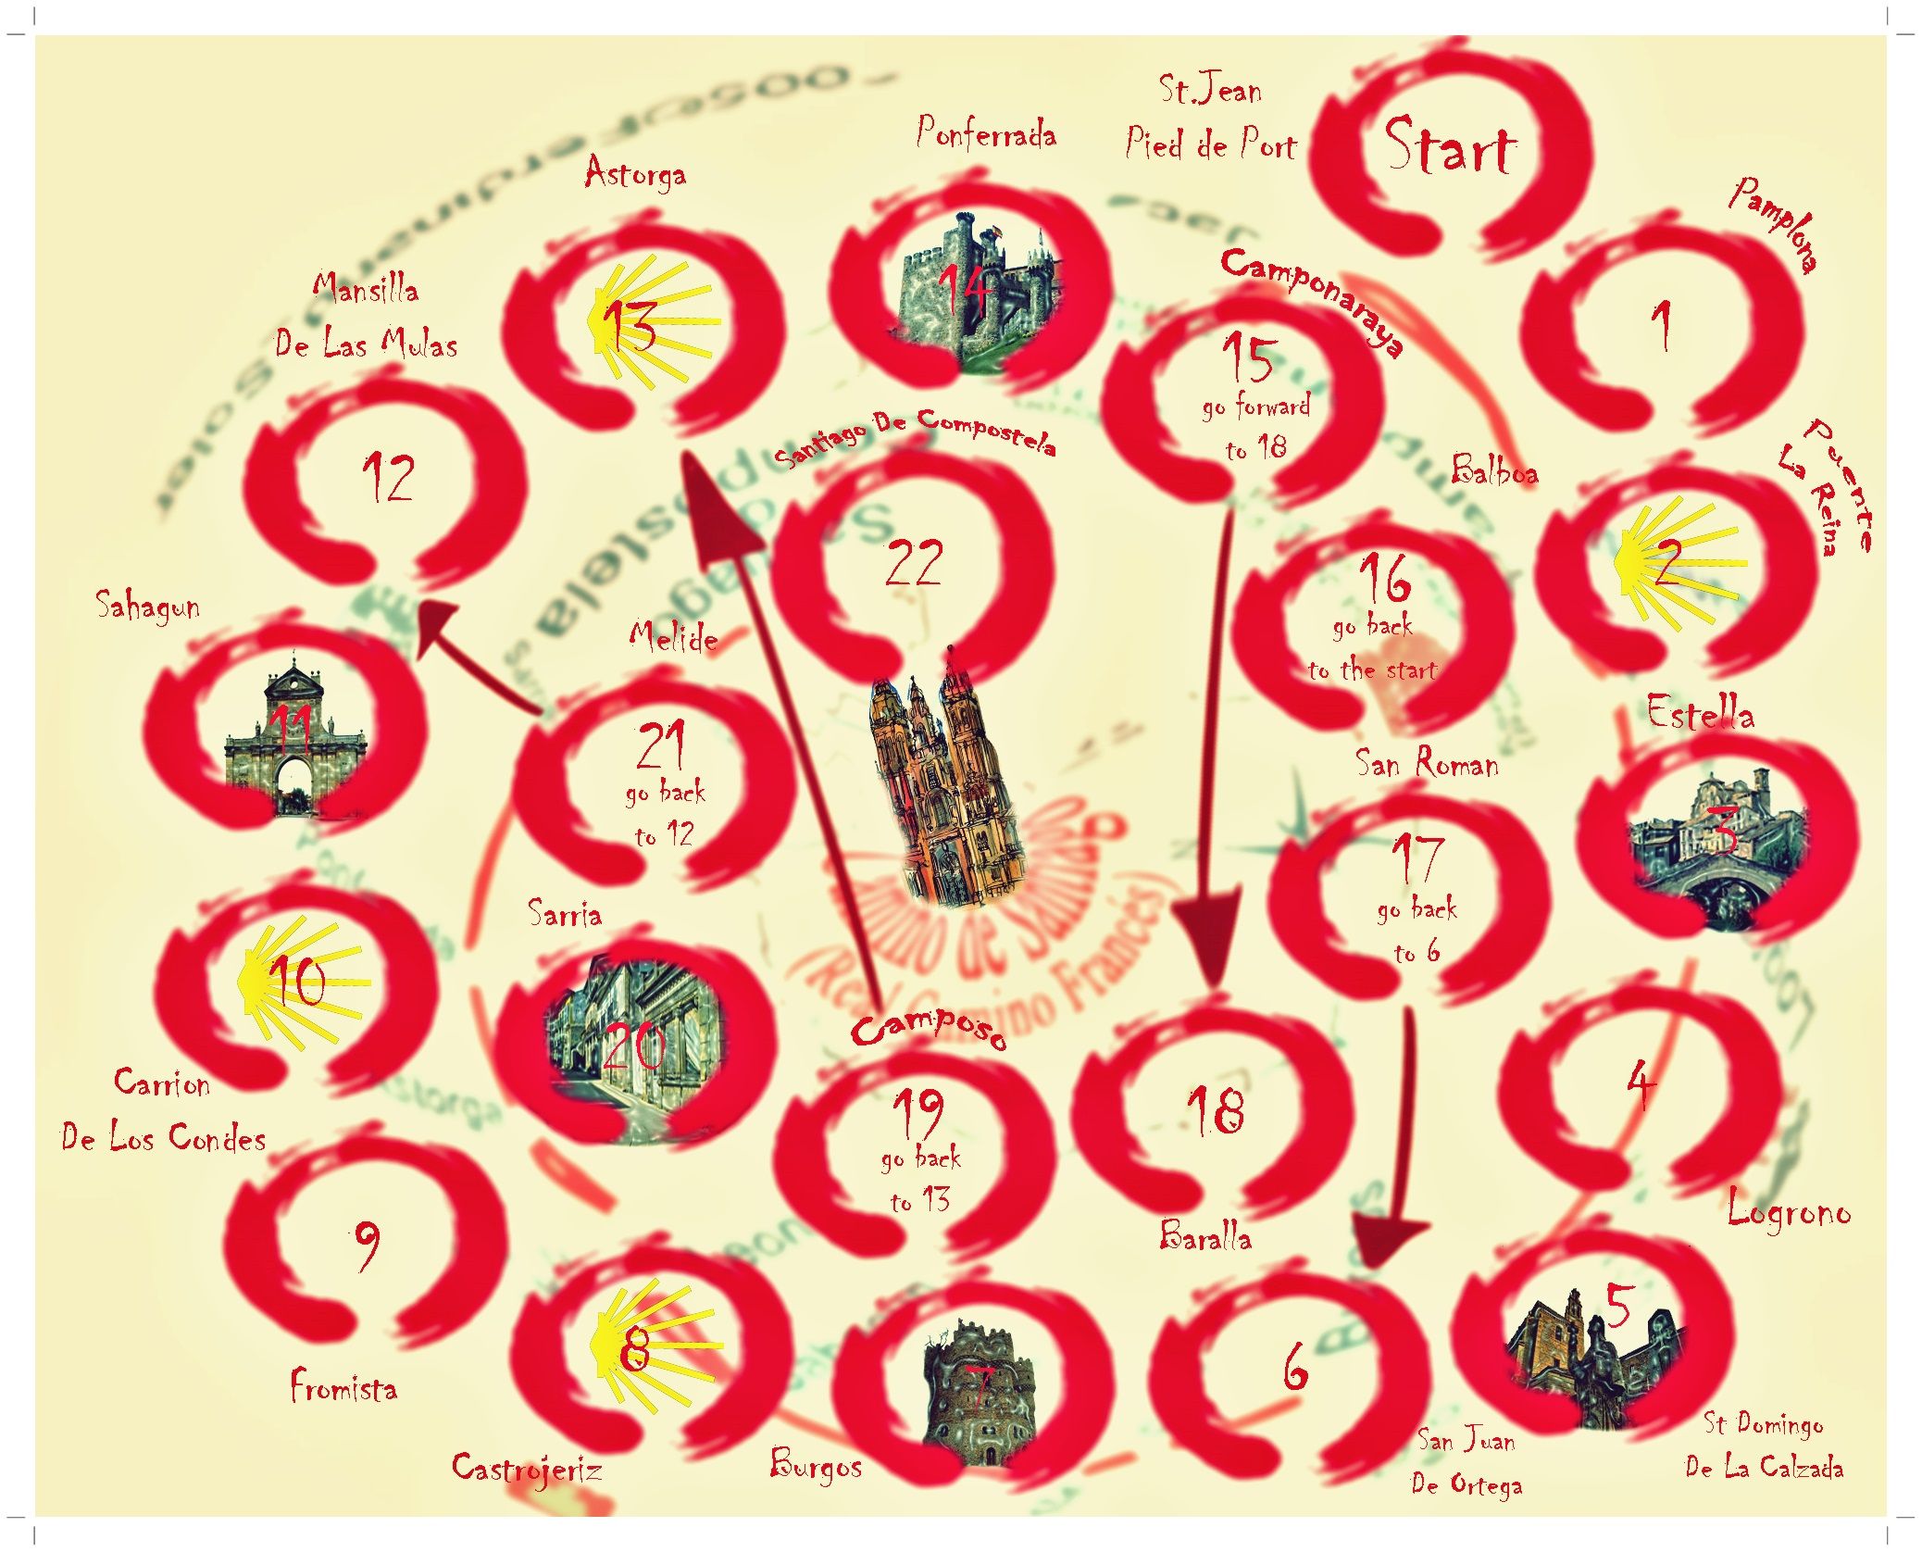
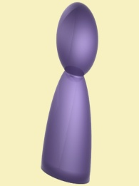
You will need a board, a dice and a counter (for each player).

Slide 4
How To Play The youngest player goes first. Roll the dice and move your counter one square for each spot on the dice. Then it is the next player's turn unless one of these things happens: If your counter lands on a square with the icon you can move again without throwing the dice. You move the number of spots of your original throw. For example throw a 3, land on an icon, move three squares forward again. If you land on a square with a monument icon, miss a turn while you stop for some dinner. If you land on the squares 17, 19, 21 you will have to move back to the mentioned square. If you land on the square 15, you will have to go forward to the square 18. If you land on square 16, you have to go back home and start all over again! Players may not share squares, so if your dice roll would land you on an occupied square you will have to stay where you are until it is your turn again. To win you must reach square 22 exactly. If your dice roll is more than you need then you move in to square 22 and then bounce back out again, each spot on the dice is still one square in this move. If you land on any of the special squares while you are doing this then you must follow the normal instructions. When you land on square 22 exactly you are the winner!

