Slide 1
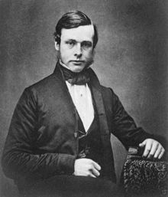
Joseph Lister
Joseph Lister ( April 5, 1827 – February 10, 1912) was a British surgeon pioneering antiseptic surgery. Hollister promoted the idea of sterile surgical instruments when working at the Royal Glasgow Hospital. Successfully introduced carbonic acid ( now known as phenol) as a sterilizer to these tools and to clean wounds.

Slide 2
Lister was born to a prosperous Quaker family in Upton,West Ham, Essex, then near but now in London[4], England. He was the second son of six siblings to gentleman scientist and wine merchant Joseph Jackson Lister and Isabella Harris.[5] His father was a pioneer in the design of achromatic object lenses for use in compound microscope.[4] His spent father spent 30 years of his life, perfecting the microscope, discovering the Law of Aplanatic foci[6], building a microscope where the image point of one lens coincided with the focal point of another.[4] Up until that point, the best higher magnification lenses produced an excessive secondary aberration known as a coma which interfered with normal use.[4] His work built a reputation sufficient[7], to enable his being elected to the Royal Society in 1832.[8]

Slide 3
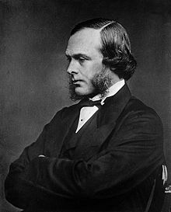
Although Lister was so roundly honoured in later life, his ideas about the transmission of infection and the use of antiseptics were widely criticised in his early career.[5] In 1869, at the meetings of the British Association at Leeds, Lister's ideas were mocked; and again, in 1873, the medical journal The Lancet warned the entire medical profession against his progressive ideas.[24] However, Lister did have some supporters including Marcus Beck, a consultant surgeon at University College Hospital, who not only practiced Lister's antiseptic technique, but included it in the next edition of one of the main surgical textbooks of the time.[25][26]
Lister's use of carbolic acid proved problematic, and he eventually repudiated it for superior methods. The spray irritated eyes and respiratory tracts, and the soaked bandages were suspected of damaging tissue, so his teachings and methods were not always adopted in their entirety.[27] Because his ideas were based on germ theory, which was in its infancy, their adoption was slow.[28] General criticism of his methods was exacerbated by the fact that he found it hard to express himself adequately in writing, so they seemed complicated, unorganised, and impractical.[29]

Slide 4
Before Lister's studies of surgery, many people believed that chemical damage from exposure to "bad air", or miasma, was responsible for infections in wounds. Hospital wards were occasionally aired out at midday as a precaution against the spread of infection via miasma, but facilities for washing hands or a patient's wounds were not available. A surgeon was not required to wash his hands before seeing a patient; in the absence of any theory of bacterial infection, such practices were not considered necessary. Despite the work of Ignaz Semmelweis and Oliver Wendell Holmes Sr., hospitals practised surgery under unsanitary conditions. Surgeons of the time referred to the "good old surgical stink" and took pride in the stains on their unwashed operating gowns as a display of their experience.[15]
While he was a professor of surgery at the University of Glasgow, Lister became aware of a paper published by the French chemist, Louis Pasteur, showing that food spoilage could occur under anaerobic conditions if micro-organisms were present. Pasteur suggested three methods to eliminate the micro-organisms responsible: filtration, exposure to heat, or exposure to solution/chemical solutions. Lister confirmed Pasteur's conclusions with his own experiments and decided to use his findings to develop antiseptic techniques for wounds.[16] As the first two methods suggested by Pasteur were unsuitable for the treatment of human tissue, Lister experimented with the third idea.

