Slide 1
CELEBRATIONS IN SLOVENIA
PRIMARY SCHOOL KOMEN

Slide 3
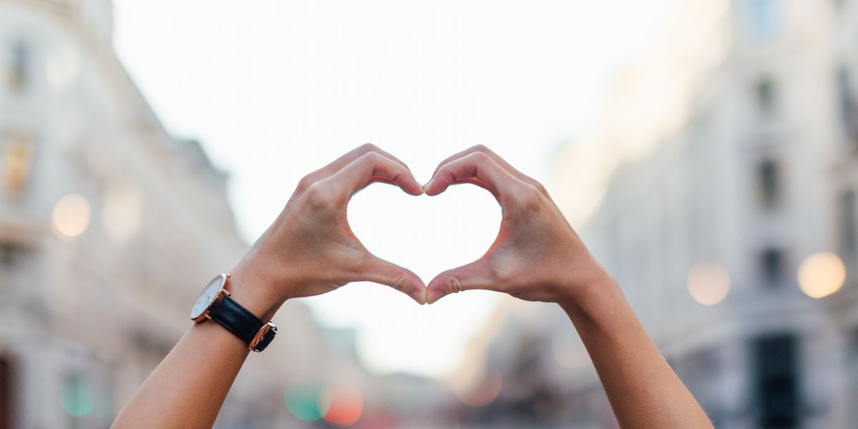
WHICH CELEBRATIONS?
We decided to present two celebrations that children like and are proud of.
Here are Saint Nicholas Day and Gregorjevo, our holiday of love.

Slide 4
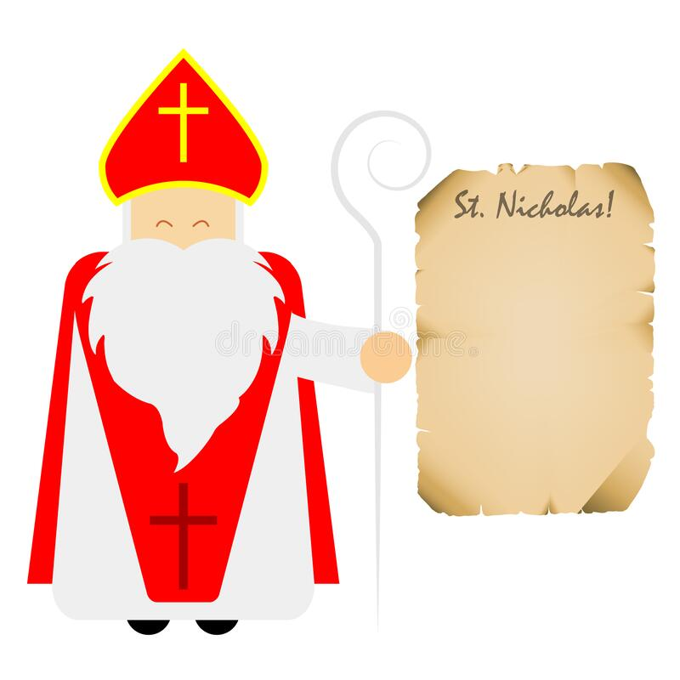
SAINT NICHOLAS

Slide 5
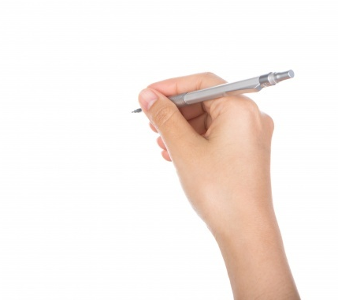
A LETTER
A few days before the 6th December, children in our country send a letter to Saint Nicholas.

Slide 6
PRESENTS, PLEASE.
All children – those who have been good and those who haven‘t behaved themselves really well. They all keep their fingers crossed.

Slide 7
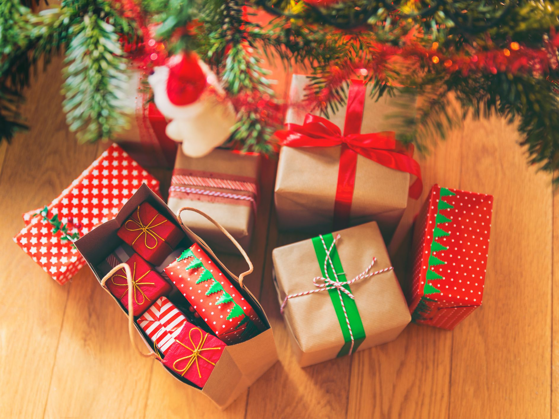
WHAT DO THEY GET?
They usually get toys and sweets. Lots of chocolate, of course.
Saint Nicholas comes at night on the 6th of December so all the presents are there in the morning already.

Slide 8
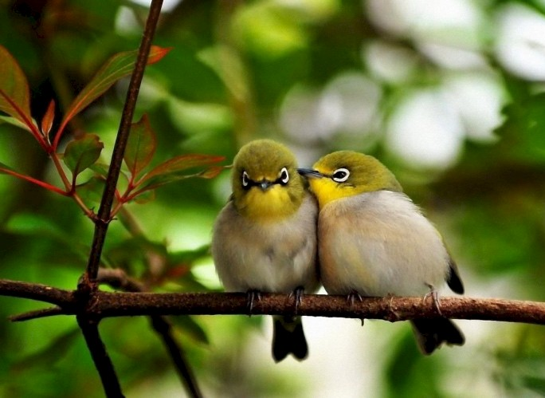
GREGORJEVO
This holiday is unique.
It‘s on the twelfth of March.
We call it the day when birds date.

Slide 9
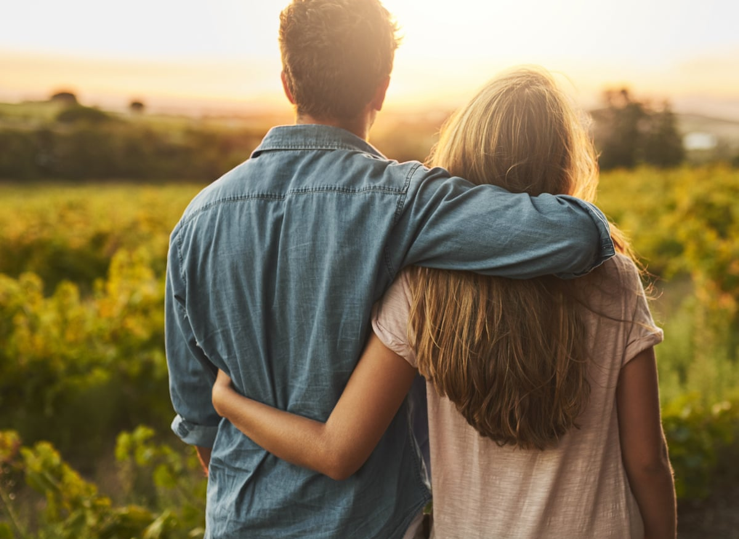
WHAT IS IT ALL ABOUT?
… and if birds can date … so can we. ☺
It‘s our own celebration of love.

Slide 10
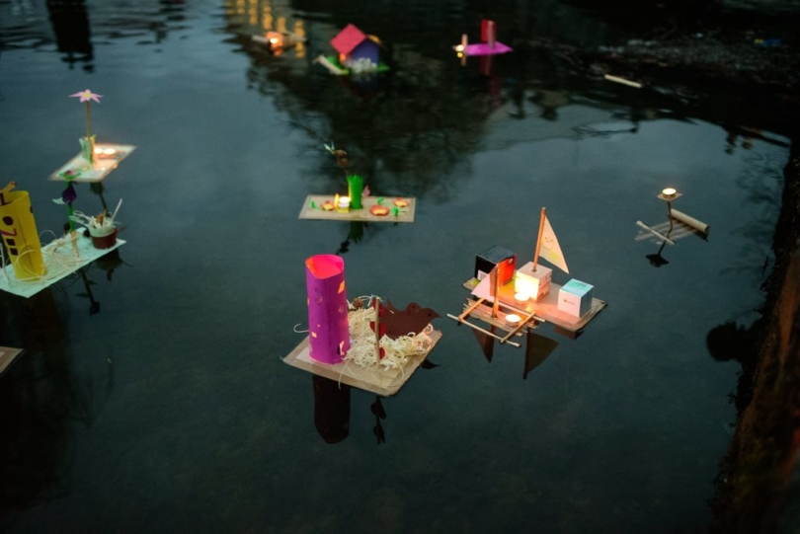
WHAT DO WE DO?
We make paper boats and put a candle on them. We put them on water and watch them float in the evening.

Slide 11
WHY CANDLES?
We put candles as symbols of light on boats to remember the time when
days become longer and those who worked in the past no longer needed
artificial light so they let it float away.

Slide 12
CAN WE MAKE THEM TOO?
Here is a video of how to make the boats!
https://www.youtube.com/watch?v=suFTX1oYLl8

