Slide 1
Presentation
Erasmus + Salt work in progress: Piccoli Ciceroni, 2019-1-IT02-KA229-063242_5
Schools
- Intituto Comprensivo Margherita di Savoia - Italy
Scuola Gimnaziala “George Valsan”- Romania
- 20th primary school of Heraklion Crete - Greece
Scuola elementare – Osnovna sola Dante Alighieri Isola Izola - Slovenia
- Agrupamento de Escolas de Pardilhó - Portugal

Slide 2
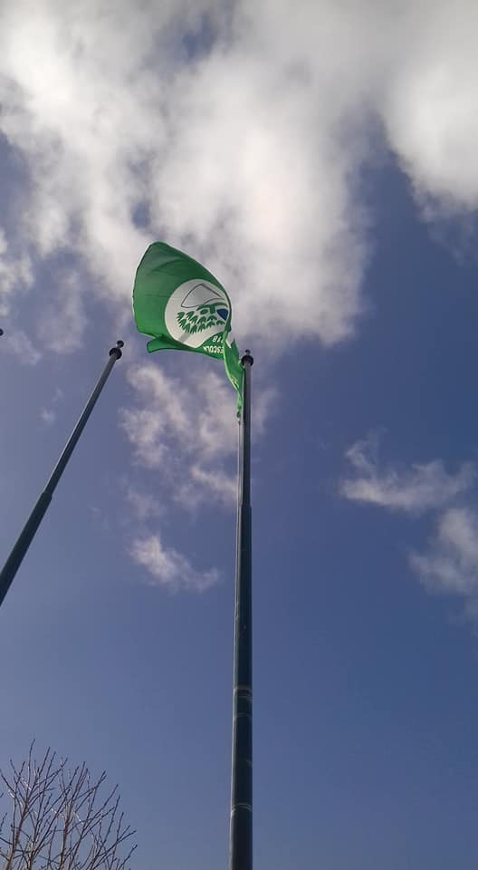
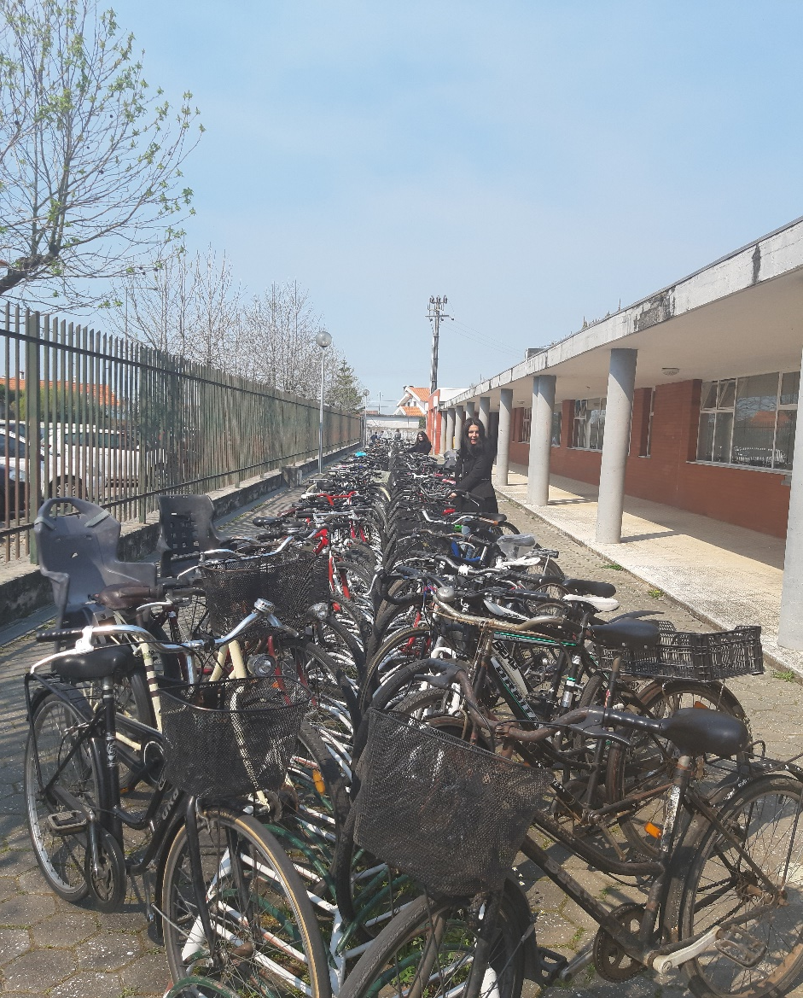
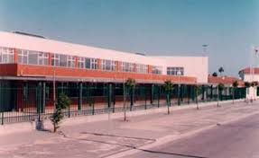
OUR SCHOOL

Slide 3
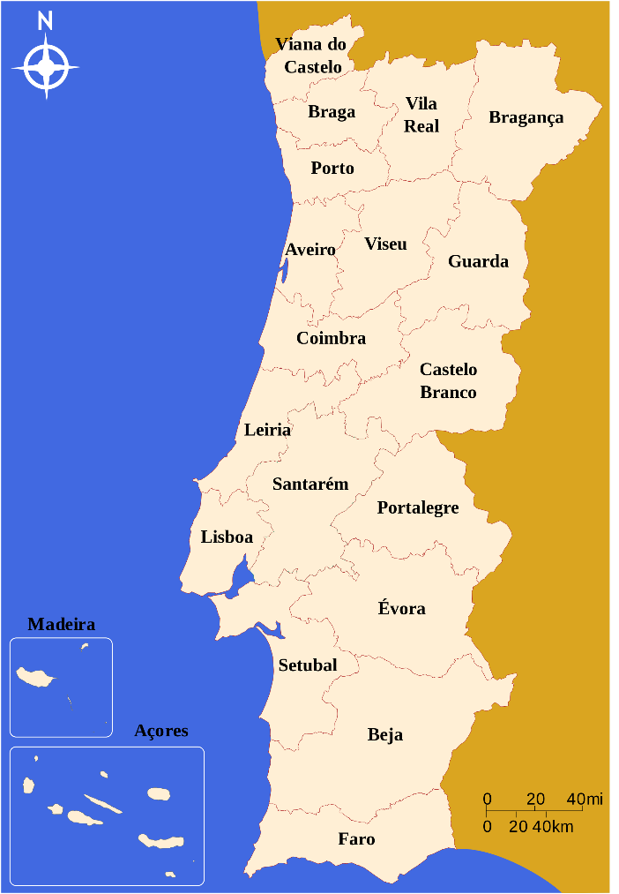
Portugal
The salt route in Portugal. Portuguese salt pans.

Slide 4
Algarve

Slide 5
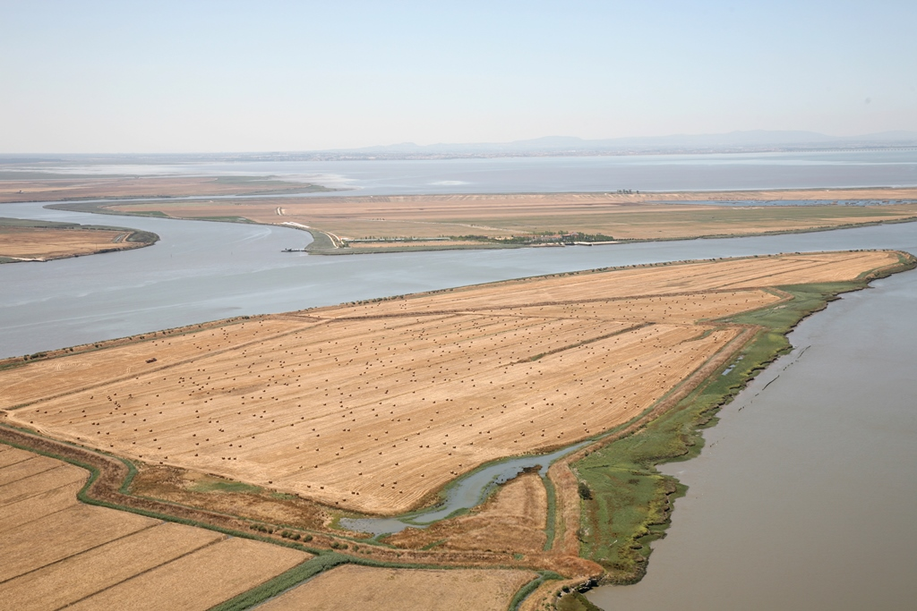
Tejo

Slide 6
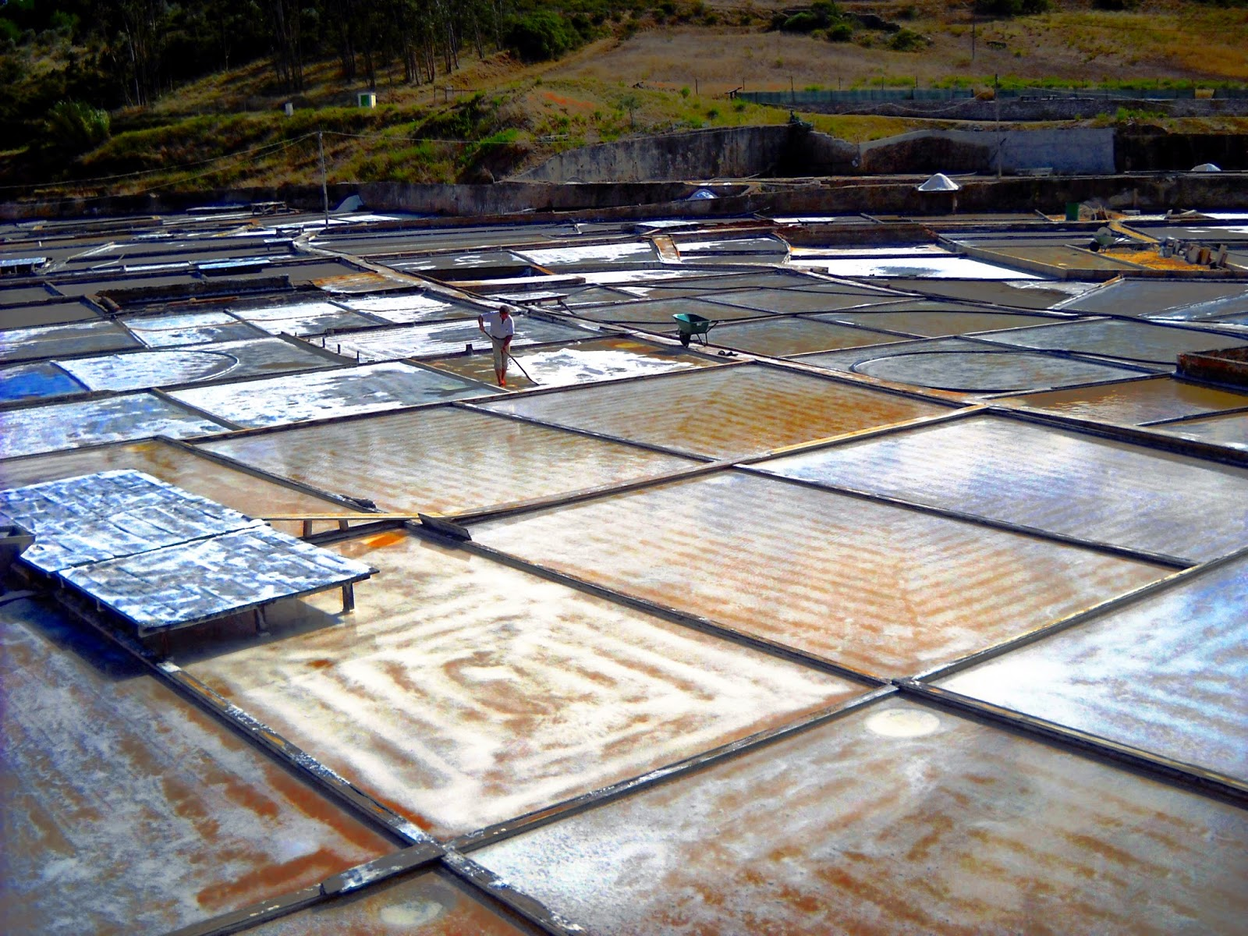
Rio Maior

Slide 7
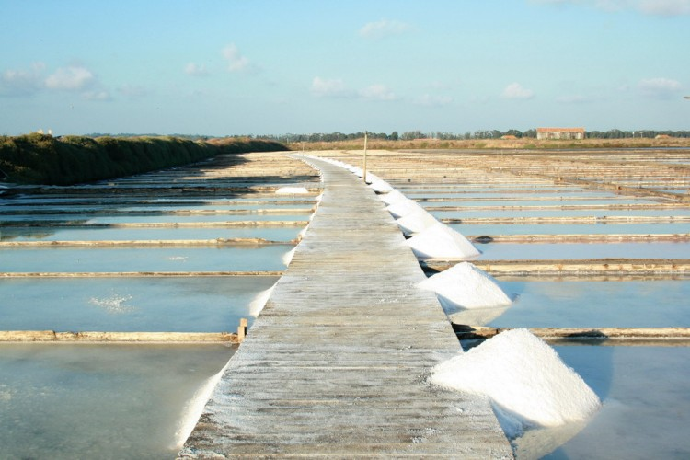
Figueira da Foz

Slide 8
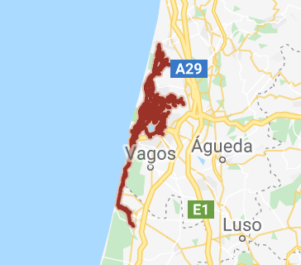
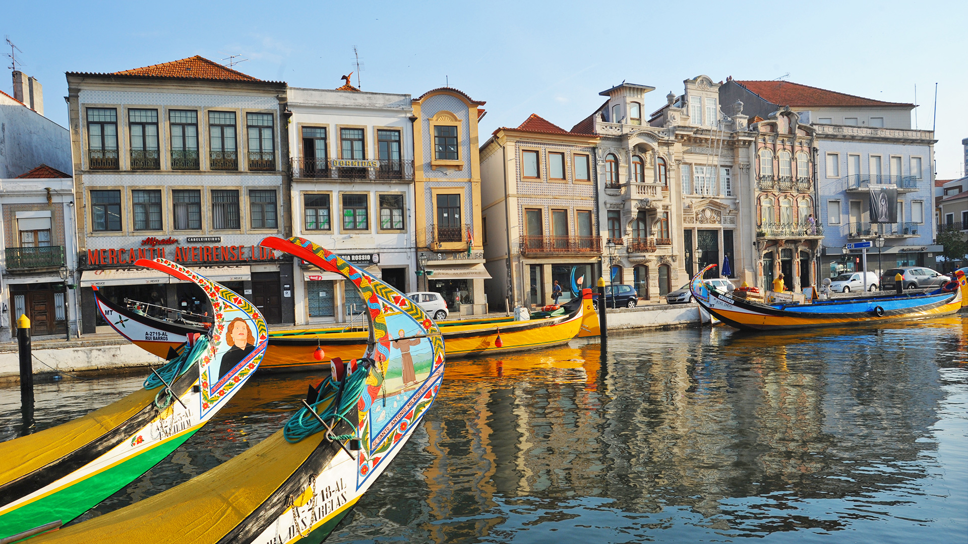
AVEIRO

Slide 9
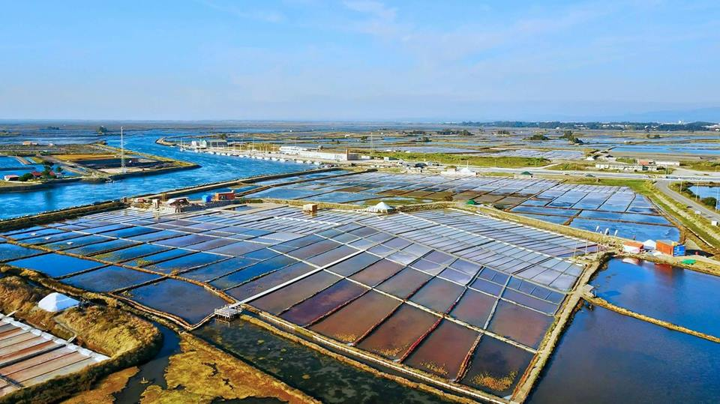
Aveiro
Aveiro salt pans
An essential part of the region’s identity culture

Slide 10
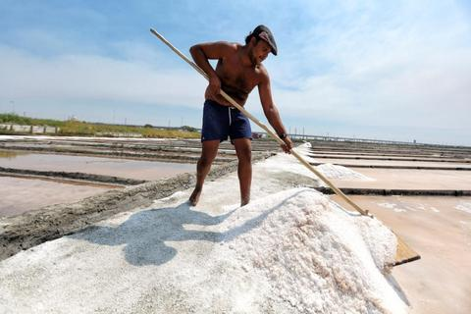
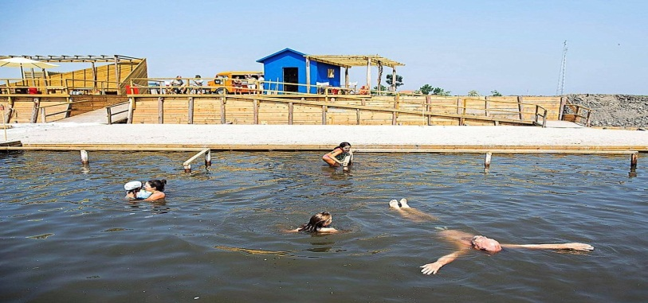
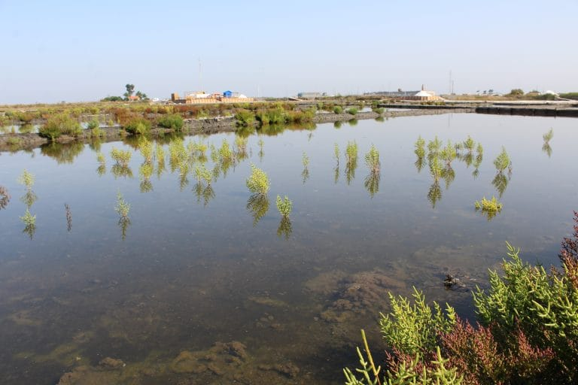
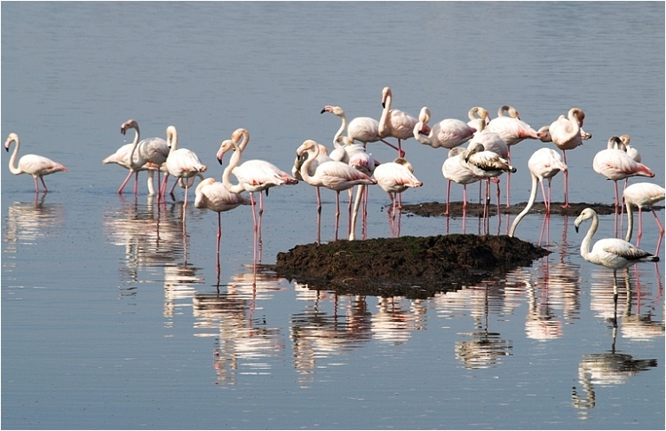
The Marnoto is responsible for harvesting salt manually with the help of wooden tools.
Salt baths have recently become popular at the salt pans .
Salicornia, sea beans or pickleweed, as it is also commonly called, is a small plant that grows on the banks of salt pans.
The rich landscape is a biodiversity sanctuary and haven for many species of birds.

Slide 11
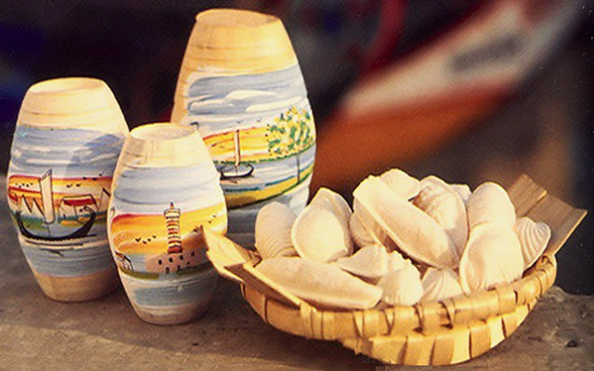
Traditional sweets called Ovos moles (sweet soft eggs) of Aveiro

Slide 12
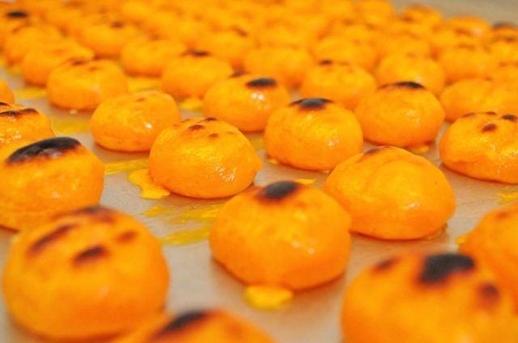
Aveiro
This is a typical pastry and comes from the ancient feminine convents in Aveiro. It’s obtained by mixing eggs and sugar and it is prepared according to traditional knowledge (XVII century). The recipe passed on from generation to generation and it has been kept alive until today.

Slide 13
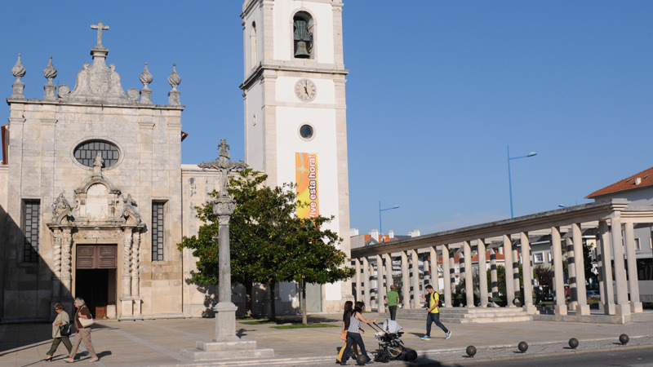
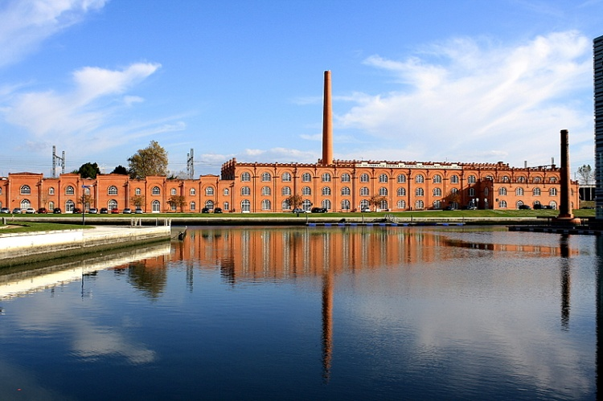
Aveiro

Slide 14
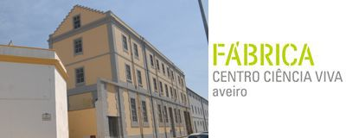
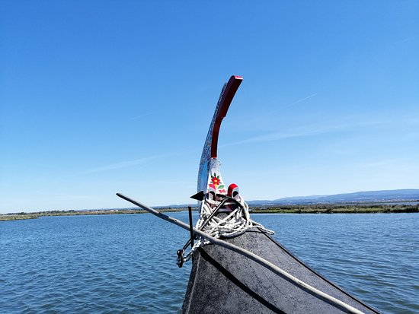
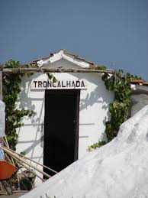
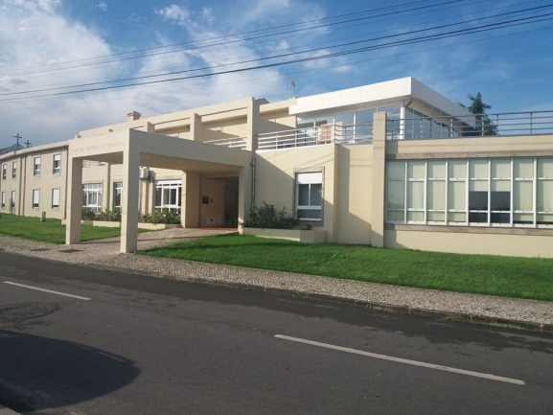

Slide 15
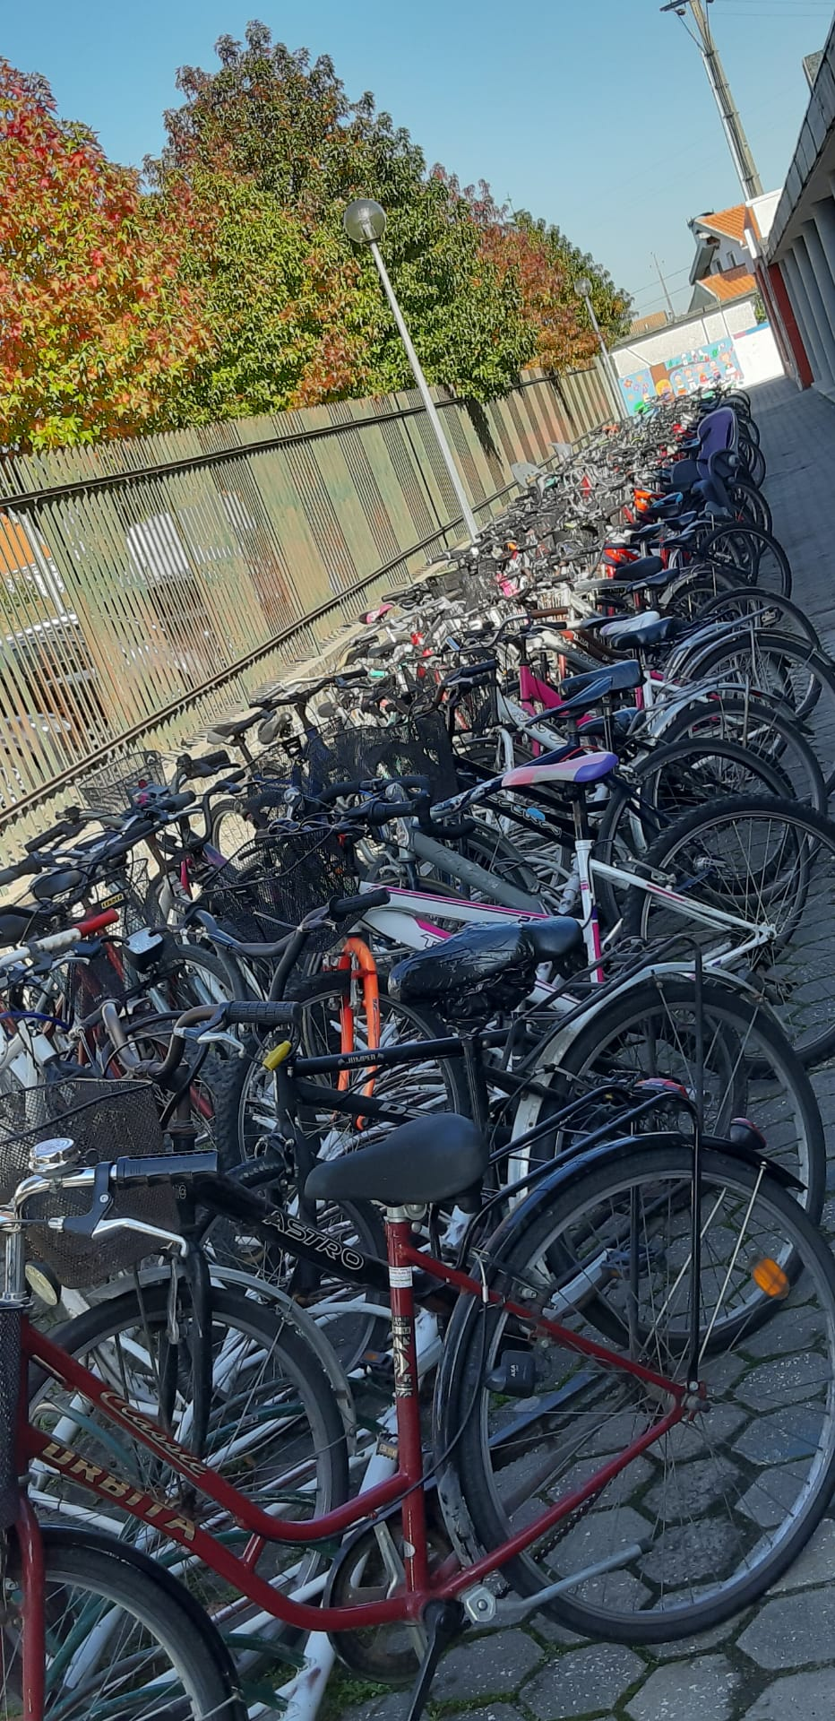
Most of our students cycle to school every day.

Slide 16
A project worth its salt

