Slide 1
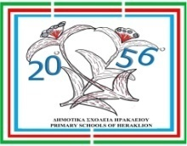
SALT-WORK-IN PROGRESS: PICCOLI CICERONI
20th & 56th
Primary Schools of Heraklion, Crete

Slide 2
Salt-work-in progress: Piccoli Ciceroni
Locations
Active Saltpans of Greece
Messolonghi and Tourlida Saltpans
Kalloni and Polichnitos Saltpans
Citrus Saltpans, Pieria
Angelochori Saltpans, Thessaloniki
Mesi Saltpans, Komotini
Nea Kessani Saltpans, Xanthi

Slide 3
Salt-work-in progress: Piccoli Ciceroni
Crete - Elounda
The salt marshes of Elounda
Elounda salt marshes were built by the Venetians in the 15th century.
They produced premium quality salt that was exported to Europe, generating great profits.
From 1669 until the end of the 19th century the Ottoman Turks exploited the salt marshes.
Elounda

Slide 4
Salt-work-in progress: Piccoli Ciceroni
Crete - Elounda
The salt marshes of Elounda
Then, the Cretan state (1898-1913) took over the salt management in an autonomous but subordinate tax to the Turks.
From 1920 onwards, the salt marshes of Elounda were subject to the Greek state monopoly, until 1972 when they were abolished.
In all these years salt was traditionally produced by the local population. There has never been any use of modern machinery and chemical additives.

Slide 5
Flora and Fauna of Saltpans (1/5)
In the salt marshes flora there are aquatic producers consisting of phytoplankton and photosynthetic algae as well as terrestrial ones which constitute the alophytic, mainly, flora of the salt marshes.
In the wetlands of Crete there are 250 species of hydrophilic plants of which only 60 represent its true aquatic flora.
The main types of vegetation that dominate in Crete are succulent, wetland, shrubby and arboreal.
In addition, many wetlands in Crete contain halophytic vegetation or are surrounded by vegetation of sandy shores and dunes.
There are few wetlands that have subdued vegetation with species living in the water.

Slide 6
Flora and Fauna of Saltpans (2/5)
There are certain microorganisms in the fauna of the salt marshes.
It is a fact that the ecological importance of the salt flats is inherent in its ornithological interest.
During the period of 1991, 79 species of birds were observed in the areas of the Messolonghi salt flat.
Of these, 25 have been identified as endangered species in Europe, 20 of which are protected by Greek and Community law.

Slide 7
Flora and Fauna of Saltpans (3/5)
In Crete only a small percentage of the fauna is characterized as aquatic.
Specifically, there are 3 species of amphibians:
The frog of Crete,
The Cretan Tree Frog and
The Green Toad.
Pelophylax cretensis
Hyla arborea cretensis
Bufotes viridis

Slide 8
Flora and Fauna of Saltpans (4/5)
In addition, more than 260 species of birds have been observed in the wetlands of Crete.
In short, they make up about 80% of the birds observed on the island.
Botaurus stellaris
Ardeola ralloides
Plegadis falcinellus

Slide 9
Flora and Fauna of Saltpans (5/5)
More than 80 species are frequented in the wetlands of Crete, with the most important being Botaurus stellaris, Ardeola ralloides, Plegadis falcinellus, Aythya ferina, Anas crecca and Aythia nyroca.
Aythya ferina
Anas crecca
Aythia nyroca

Slide 10
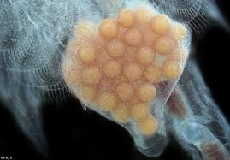
Αρτέμια - Artemia salina (1/4)
Artemia (artemia salina) is a species of shrimps that lives in the salt lagoons and salt marshes of southern Europe and North Africa.
It is a very old species, which does not seem to have changed much in the last 100 million years.
Adult Artemis has three eyes and eleven pairs of legs.

Slide 11
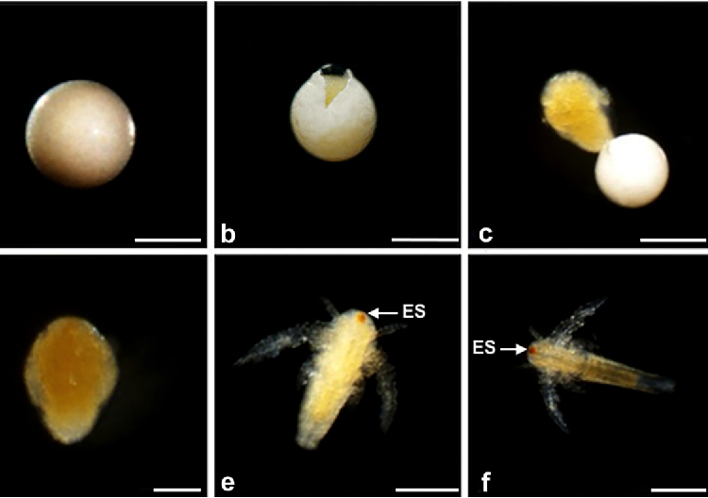
Αρτέμια - Artemia salina (2/4)
It can reach 15 mm in length because it can live in very high salinity waters (25%-50%),and therefore, it is not in danger of being eaten by fish.
Artemis can give birth to two types of eggs: Eggs with a thin shell that hatch immediately and...

Slide 12
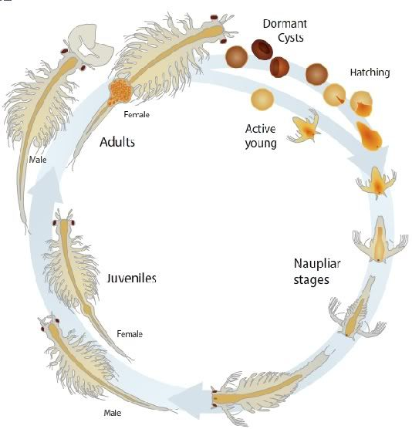
Αρτέμια - Artemia salina (3/4)
Hard-shelled eggs (cysts) that can be maintained for years and hatch when placed in seawater.
These eggs are born for birds living in saltwater. Flamingos eat large quantities of Artemisia and cause the pink-salmon color of their wings!

Slide 13
Our small Aquarium with Artemia Salina! (4/4)

Slide 14
Aργυροτσικνιάς - Αrdea alba (1/3)
The ardea alba is a bird of the heron family. It lives in wetlands of every continent and comes to Europe to breed or spend the winter.
Its color is snow-white and its beak is yellow. It’s green in the area of the eyes.

Slide 15
Aργυροτσικνιάς - Αrdea alba (2/3)
Its neck forms a characteristic S
It eats fish, amphibians, reptiles, ground insects and even small mammals.

Slide 16
Aργυροτσικνιάς - Αrdea alba (3/3)
Its nest is 1m. in diameter.
It lays 3-4 eggs, which are incubated for 26 days.
In Greece we find it in most active saltwater.

Slide 17
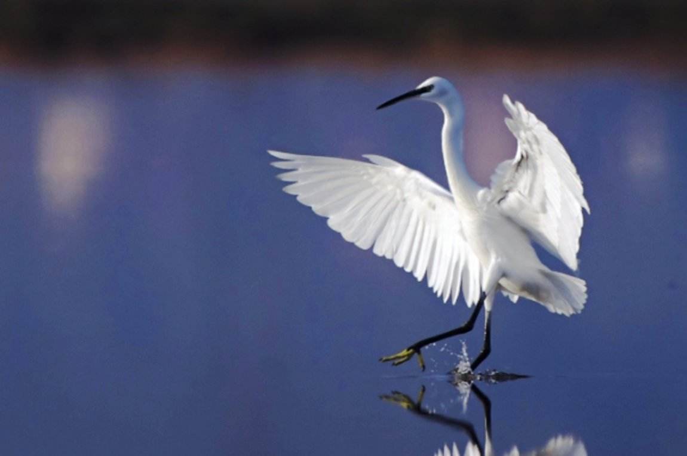
A White Egret (Egretta garzetta) in Elounda Saltpans

Slide 18
A White Egret (Egretta garzetta) in Elounda Saltpans

Slide 19
Αβοκέτα - Recurvirostra Avosetta (1/3)
The avocet (recurvirostra avosetta) is one of the most beautiful water birds.
It stands out for its long, slender, upwards curved beak, black and white plumage and long greenish-blue legs.
Its spectacular appearance and its elegant walking have given it the nickname “Swamp Lady”.

Slide 20
Αβοκέτα - Recurvirostra Avosetta (2/3)
Abacus nests in coastal wetlands, especially in salt lagoons or salt marshes.
It makes its nest, which is a shallow puddle, paved with plant material, in islets.
It looks for its food (insects, crustaceans, worms) in shallow mud.

Slide 21
Αβοκέτα - Recurvirostra Avosetta (3/3)
Today in Greece it is estimated that 500-700 pairs nest.
They are usually reproduced in the lagoon and salt marshes of Messolonghi.

Slide 22
Elounda 1966 – Salt harvesting

Slide 23
Our Leaflet (1/2)

Slide 24
Our Leaflet (2/2)

Slide 25
Thank you for your attention…!
To Be Continued...

