Slide 1
Istituto comprensivo "Dante Alighieri " Isola Osnovna šola Dante Alighieri Izola Comprehensive Institute Dante Alighieri Izola
Coordinator: jadranka mittendorfer

Slide 2
Our school is situated in a small town Isola.
It was founded by the Italian Community and the Town Council of Isola.
It is situated in a multicultural and bilingual context.
OUR MOTTO
Siamo una scuola italiana che fa crescere nel reciproco rispetto, amicizia, conoscenza e multiculturalità.
We are an Italian school that raises pupils in mutual respect, friendship, knowledge and multiculturalism.

Slide 3
The learning language is Italian.
Slovene is the language of the environment.
The old school was founded in 1899.
Our new building was opened on January 24, 1998.

Slide 4
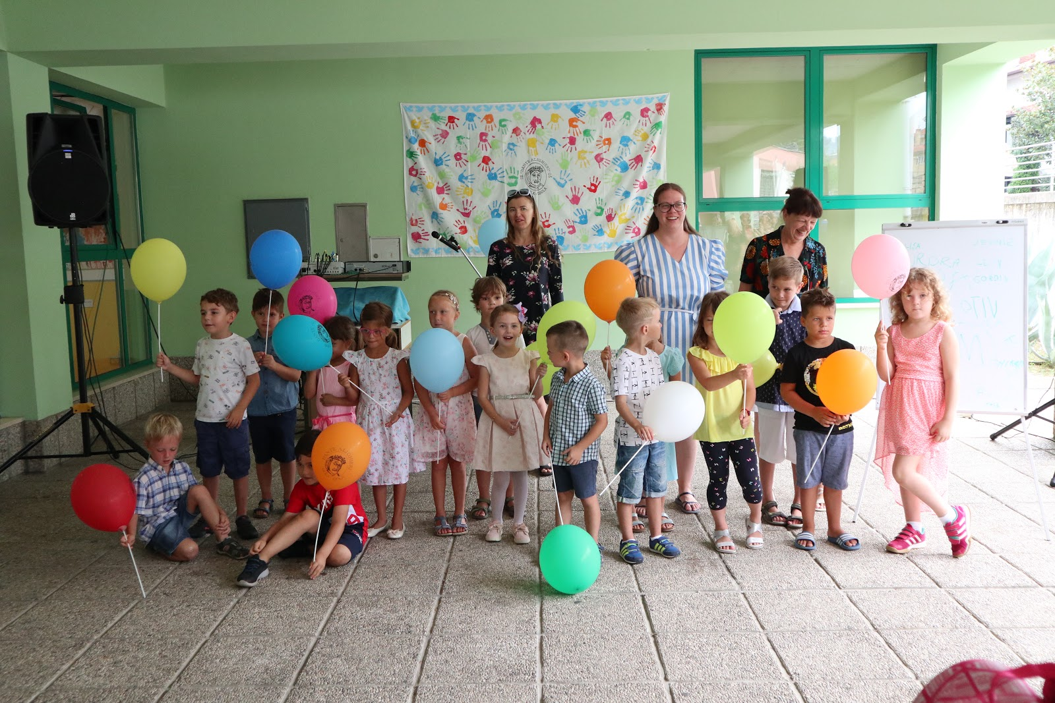
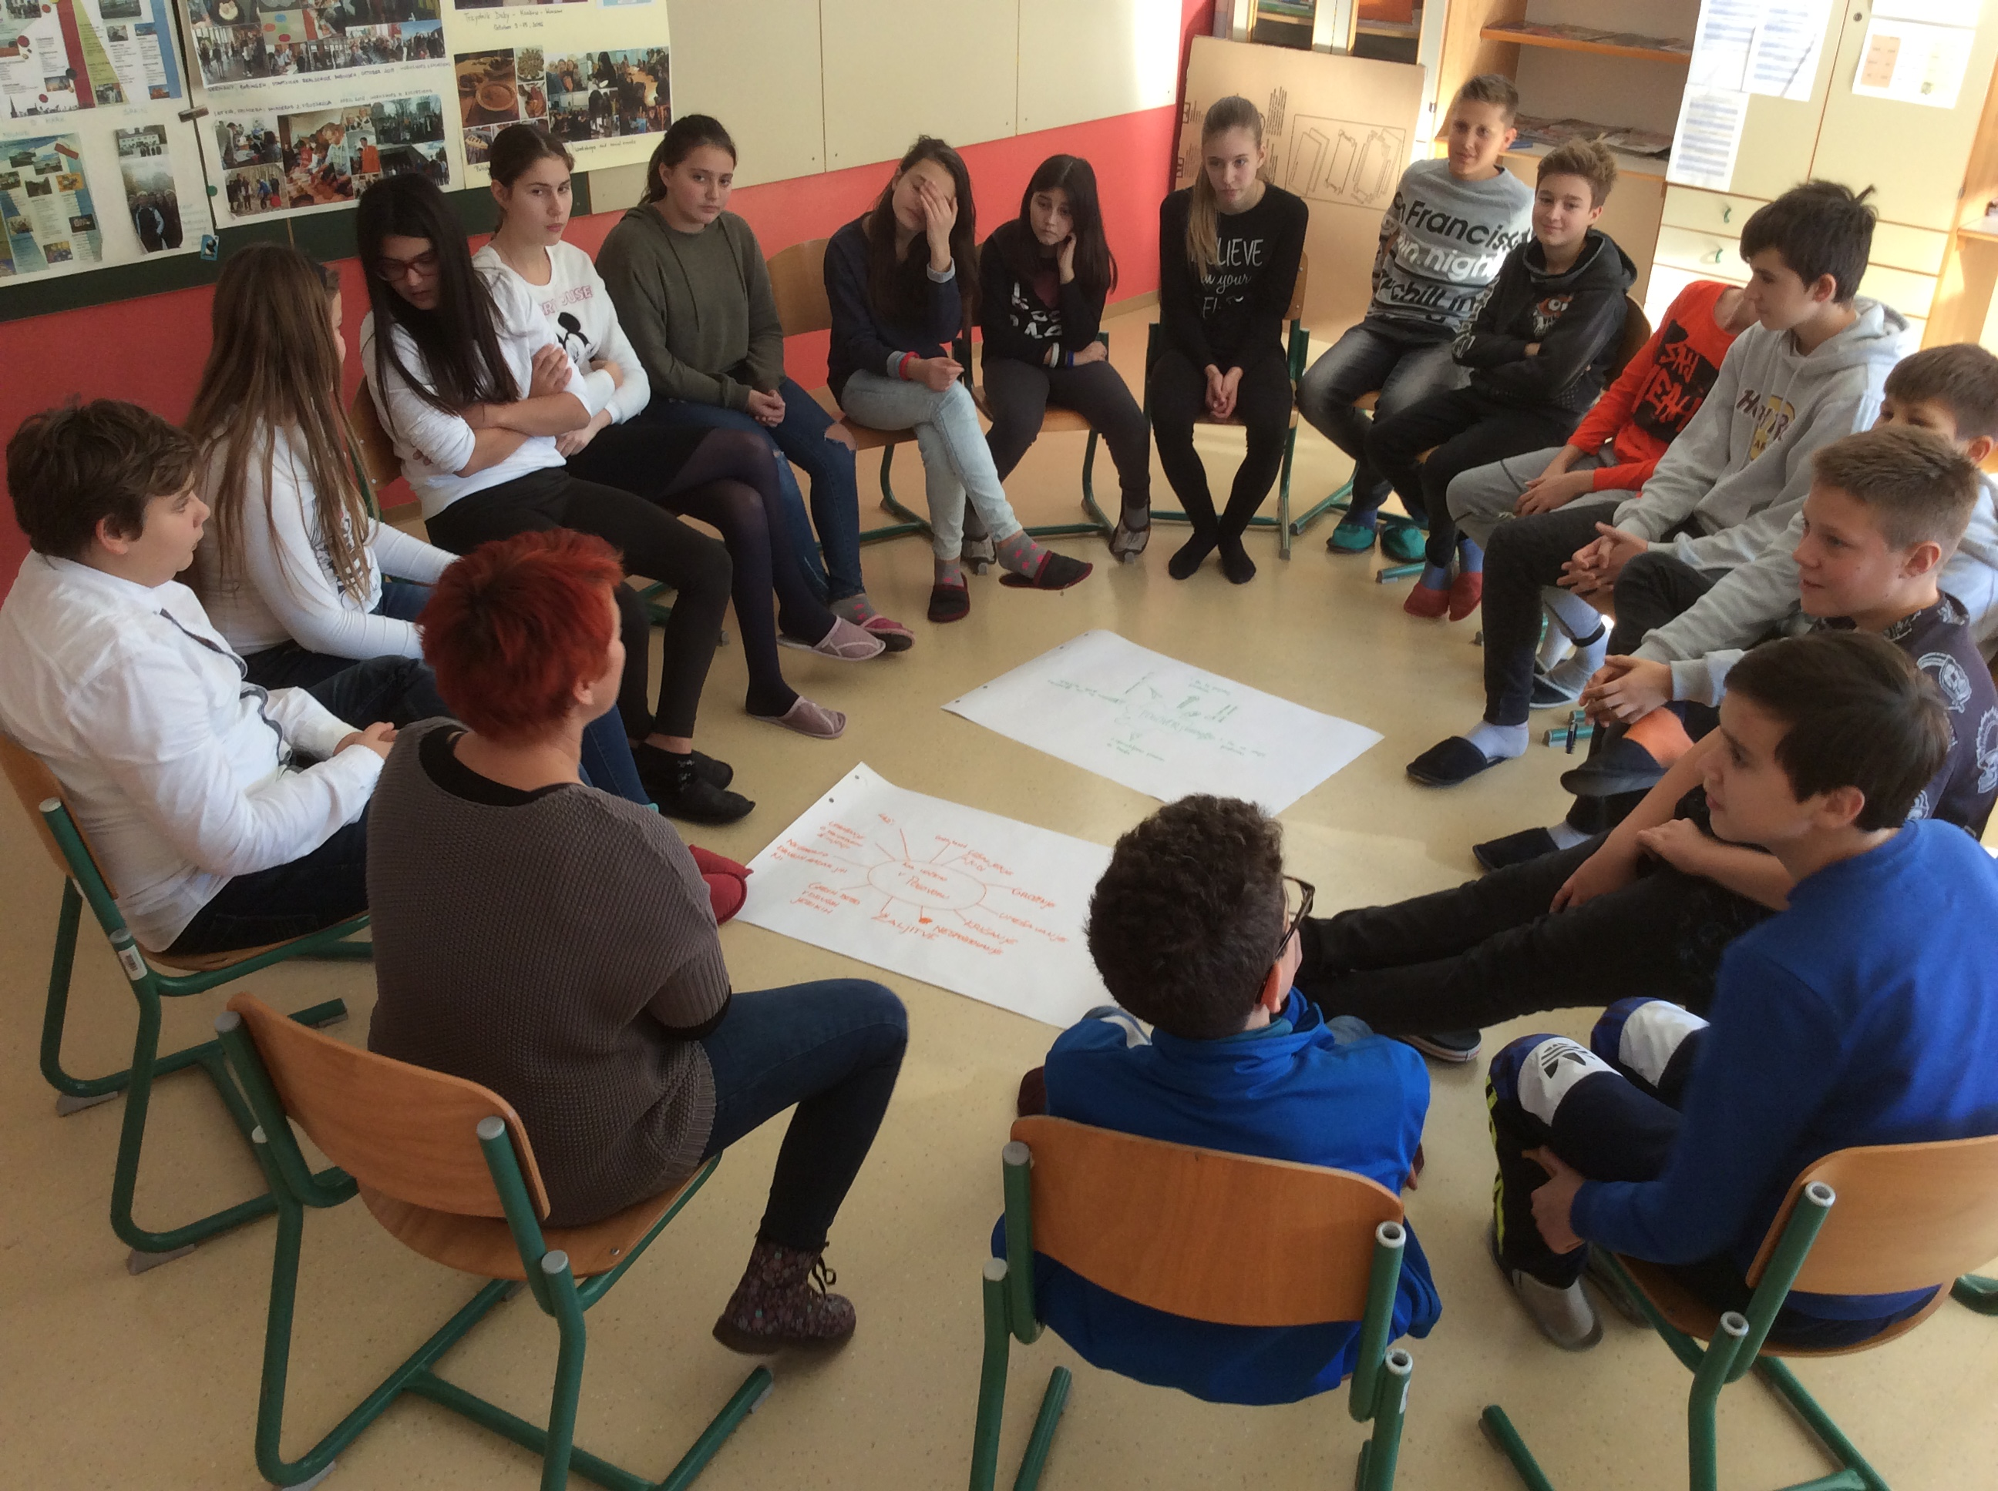
The comprehensive school Dante Alighieri comprises:
the Kindergarten L’Aquilone
(1-to-5-year-old children)
the Primary
(6-to-10-year-old pupils)
the lower Secondary School
(11-to-14-year old pupils)

Slide 5
There are 132 children in the KINDERGARTEN this year, divided into 7 sections. 20 educators take care of them.
The kindergarten opens at 6.15 am and closes at 16.30 pm.

Slide 6
In the SCHOOL there are 179 pupils. 27 teachers all together teach in the primary (1-5) and lower secondary classes (6-9).
The school door opens at 6.20 am, but the first lesson usually starts at 8.20 am. The school closes at 16.30 am.
The school year normally starts on 1 September and it ends on 24 June.

Slide 7
SUBJECTS
Italian | Geography | Technics & Technology
Slovene | History | Food Technology
English | Citizenship & Ethics
Art & Craft | Physics | Physical Education
Music | Chemistry
Society | Biology | Class Community
Natural environment | Natural Sciences

Slide 8
OPTIONAL SUBJECTS
Primary classes: | Secondary classes:
English | German
German | Chemical Experiments
ICT | Chess
Arts and Craft | Tourism
Sport 1 | Cinematography
Sport 2 | Sports in the Free time
Sport 3 | Sports for Health

Slide 9
Additional activities
NAME OF ACTIVITY | CLASS
The School Choir | 4 - 7
Theatre in the Classroom | 1 - 9
English Drama group | 3 - 5
You and me: We are Europe | 6 -7
The School Magazine | 7 - 9
Creative recycling | 2- 4
Manual work | 4 - 5
The Sports Group 1, 2, 3 | 1 - 9
Football | 1 - 4
Table tennis | 4 - 6
Mini-handball | 1 - 5

Slide 10
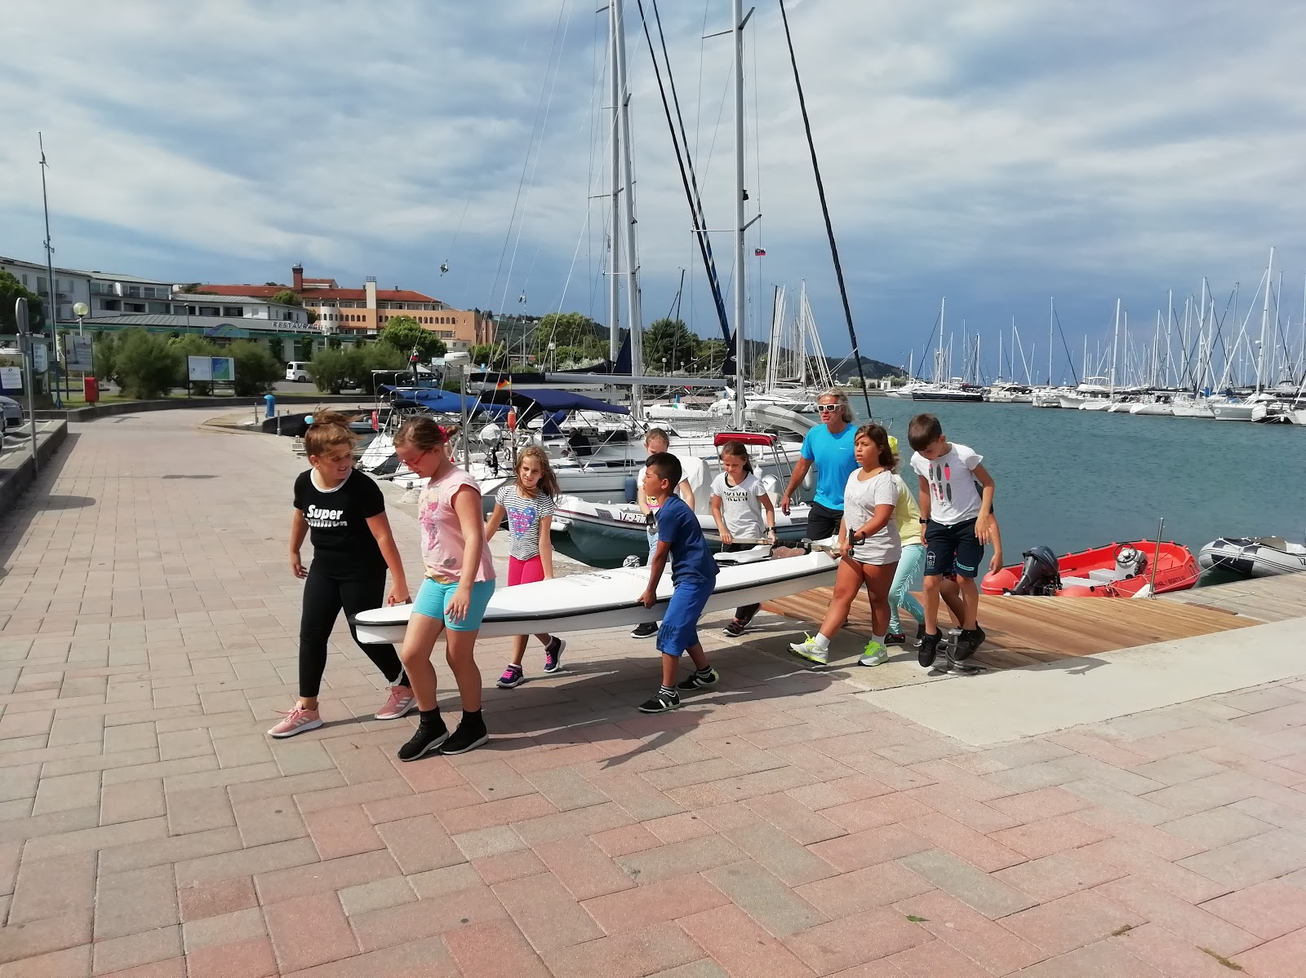
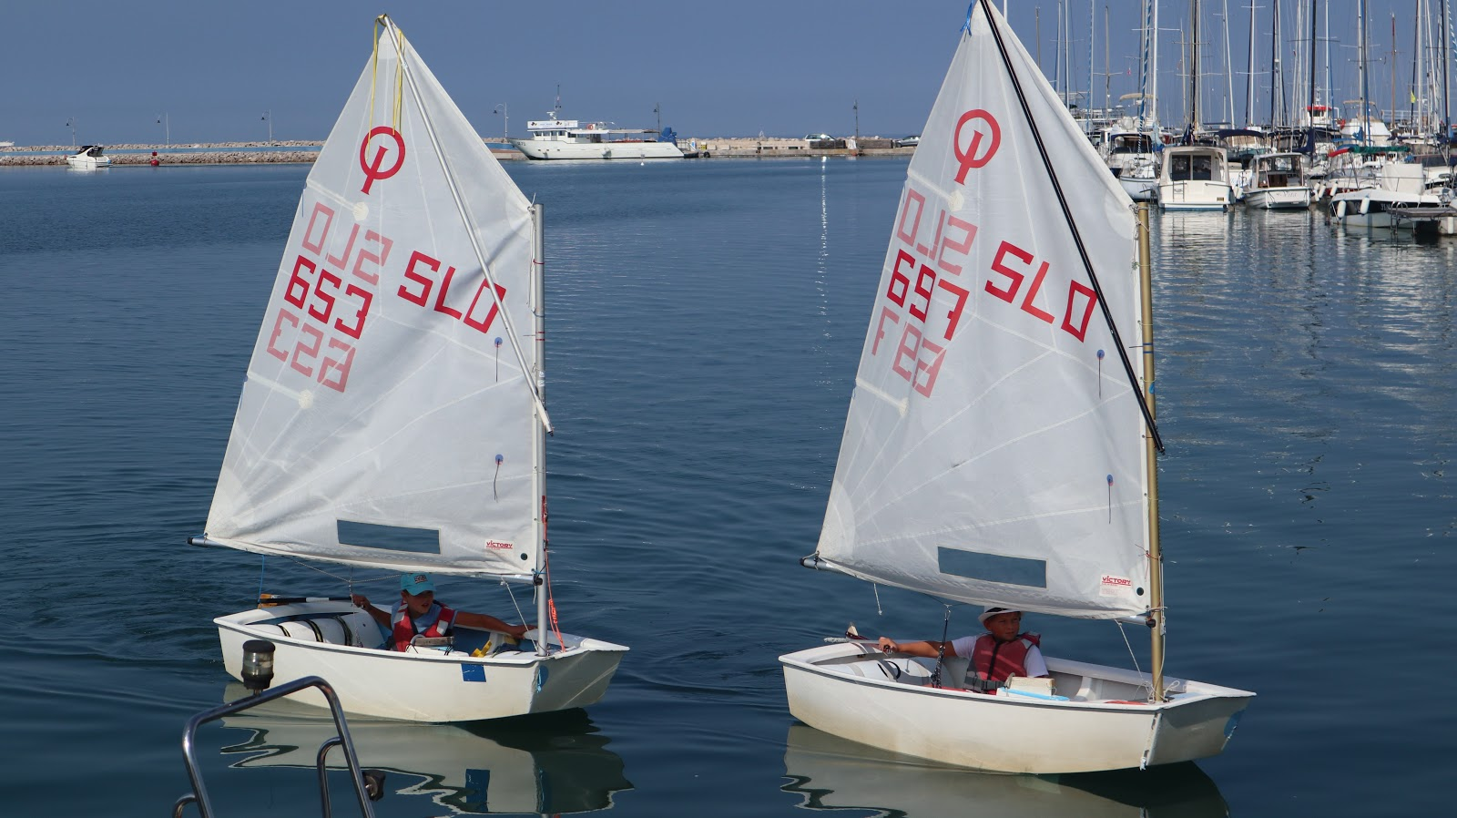
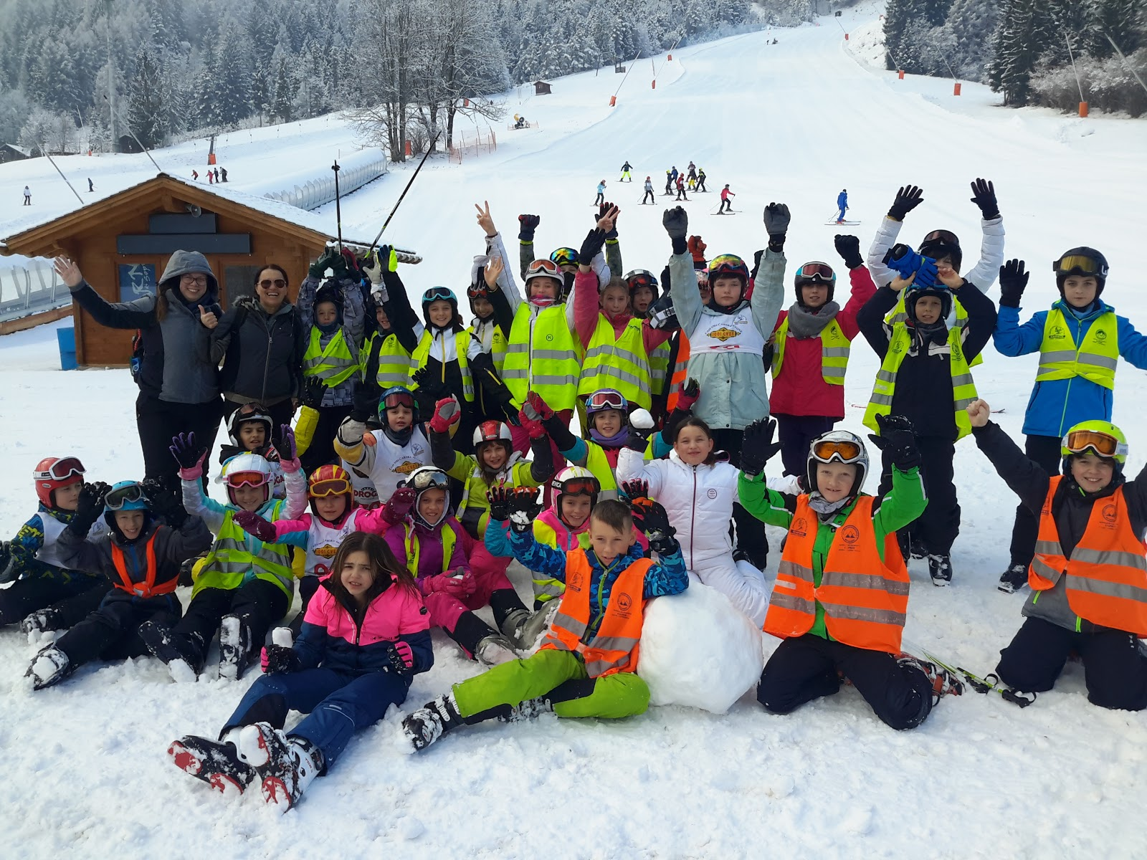
Courses
The Italian Language Course | Cycling
The Italian Book Club | Sports Badge
The Slovene Reading Badge | Peer Violence Prevention
The English Reading Badge | Coding
Skiing | Safe Use of the Internet
Sailing | Safety in Traffic
Rowing | Ecological Actions

Slide 11
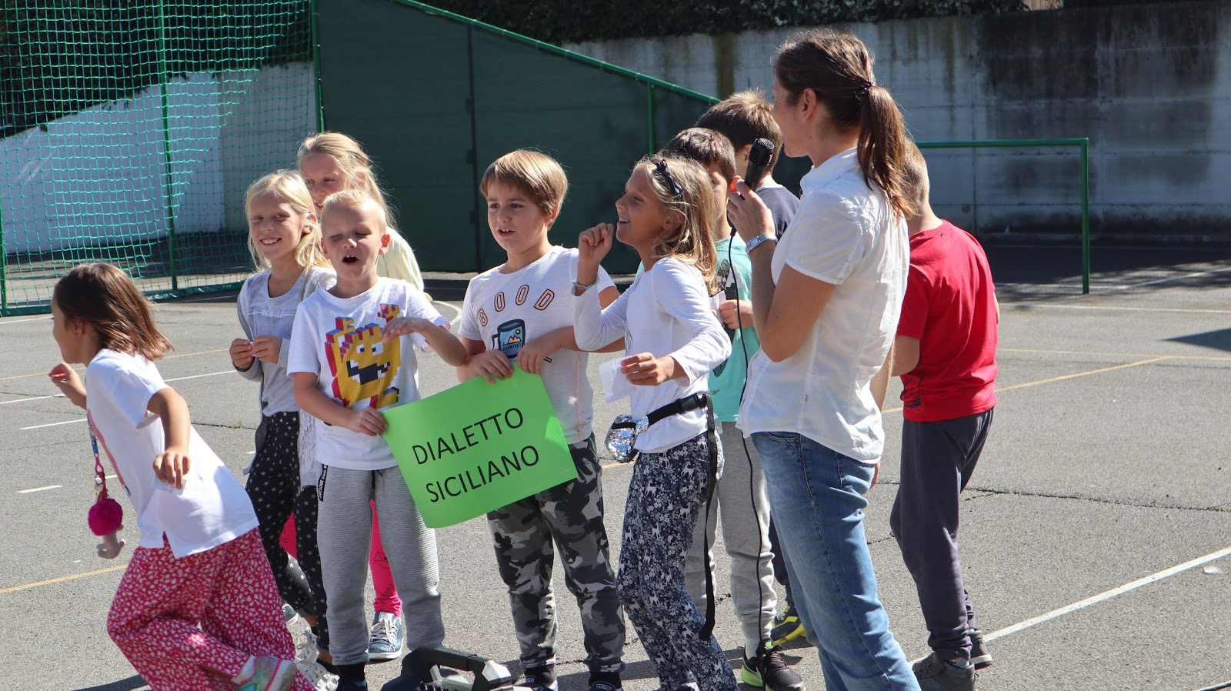
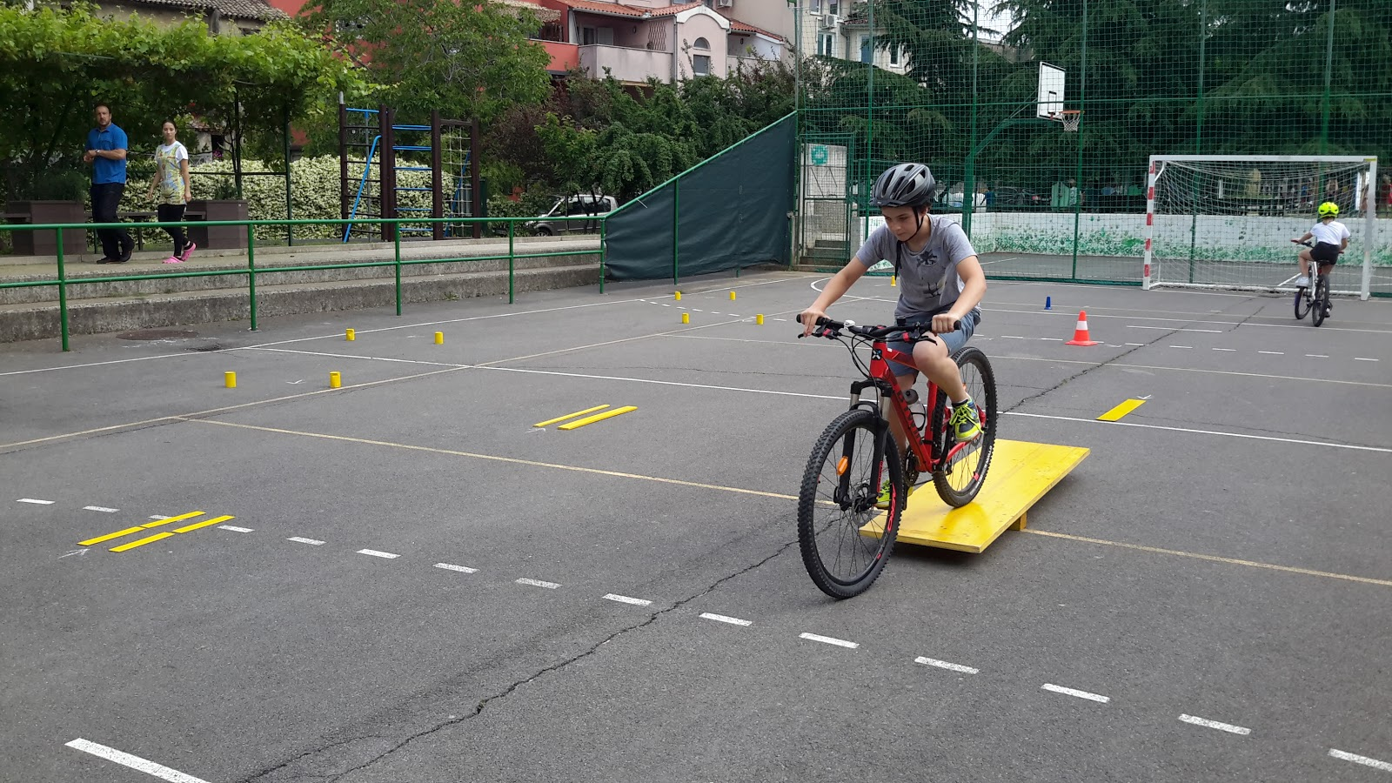
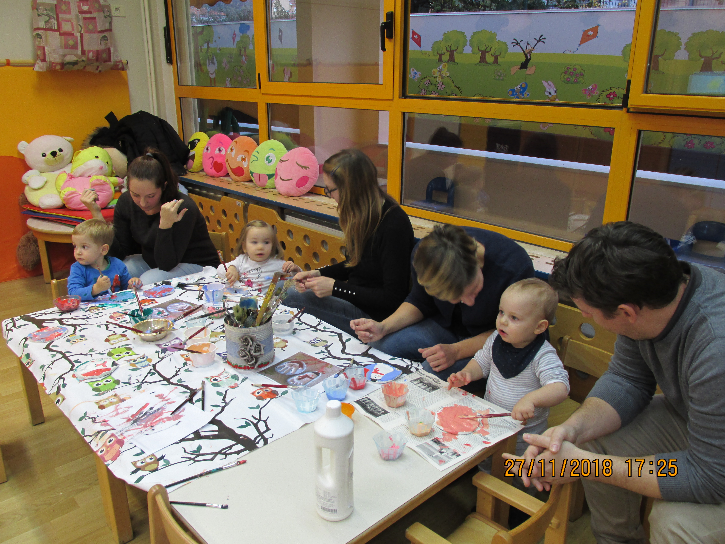
Projects
KINDERGARTEN | SCHOOL
Storytelling | Erasmus + “EDUCOM: Educate the community to reduce the risk of social exclusion of children
Meetings with parents | Erasmus + KA 229: SALT-WORK-IN-PROGRESS: Piccoli Ciceroni
Tourism in the kindergarten | Languages matter (JEŠT)
Alltogether passionately | The Film Badge
Health in the kindergarten | RaP: A broadened school curriculum
Say, do, and create | “Largo ai giovani” - Developing the youth entrepreneurship
Sustainable Mobility | Sustainable Mobility

Slide 12
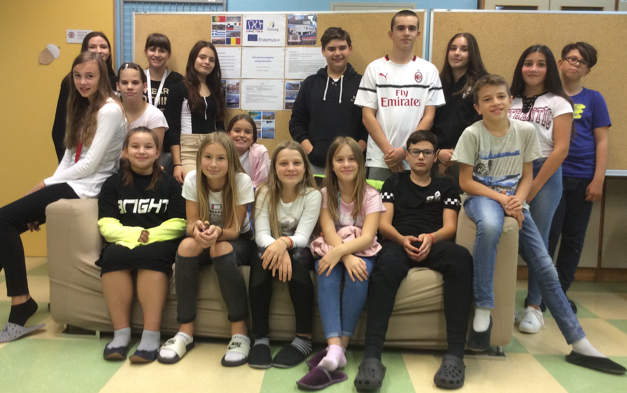
Our Erasmus Team 2019
PICCOLI CICERONI

Slide 13
Social and cultural background
No official data about students’ social background.
The Red Cross, the Ministry of Education, Science and Sport and the Social care centre Izola offer different types of financial aid for books, students’ meals and the "School in nature" program.
Many students come from former Yugoslavian and former Soviet union countries.
Individual learning plans for foreign students are created during the first two years of their schooling in our country.
Foreign students are not assessed the first year of their schooling in Slovenia.
They are entitled to a certain amount of hours of the Italian language course.
National project Languages matter (Jeziki štejejo) promotes multilingusim and encourages the use of foreign students' mother languages.

Slide 14
Students with special educational needs (SEM)
Depending on the level of the deficit, children with SEM are often included in regular primary schools where they are trained according to the regular school curriculum.
Currently trained at our institute:
pupils with autism spectrum, pupils with deficits in specific areas of learning, pupils with language and speech disorders, pupils with emotional and behavioural disturbances, pupils with chronical diseases and pupils with physical disabilities.
Individual learning plans are elaborated for pupils with SEM.
Individual teaching support is carried out by:
a psychologist, a speech and language therapist, a defectologist, a social pedagogue and an inclusive pedagogue

