Slide 1
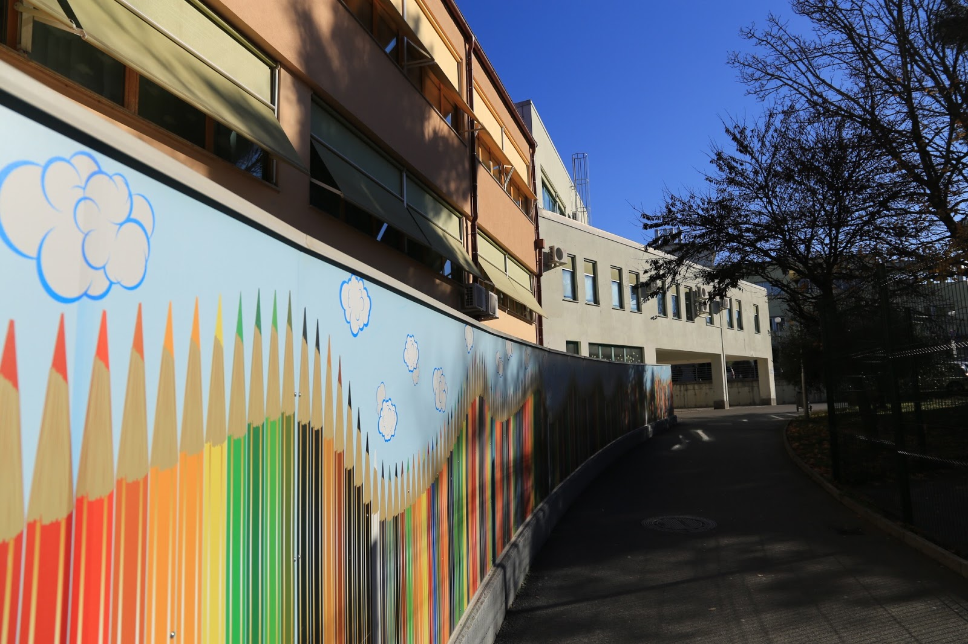
Our school building
Watch the video of the Dante Alighieri school,
done by our students, too.
Our school celebrated its 20th anniversary in January 2018.
Our school spaces are on the ground, first and second floor.
We also have a gym and an external playground.
We spend our break times outside.
We have lots of fun on the handball or basketball court, the younger pupils can also play in the playground.

Slide 2
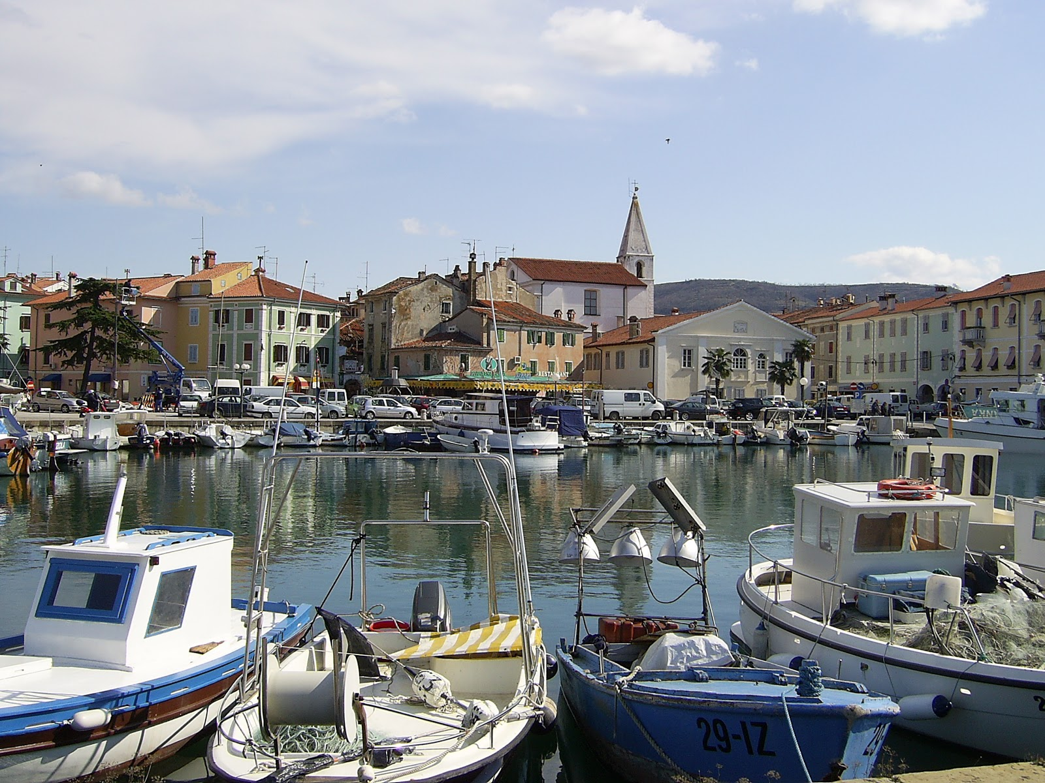
IZOLA OUR TOWN
Its name originates from the Italian Isola, which means “island”. It was an island in the past.
Izola is an old fishing town. This is evident due to the many ships and boats that one can see in the little harbor.
Today there is also a modern marina, since tourism has developed.

Slide 3
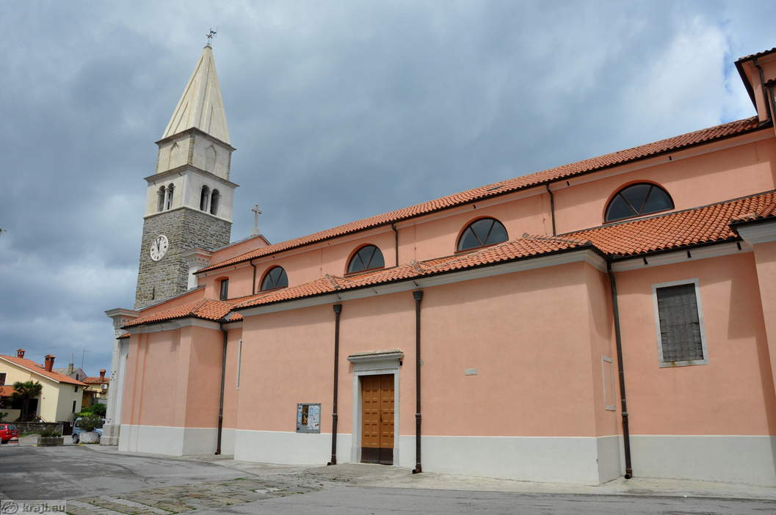
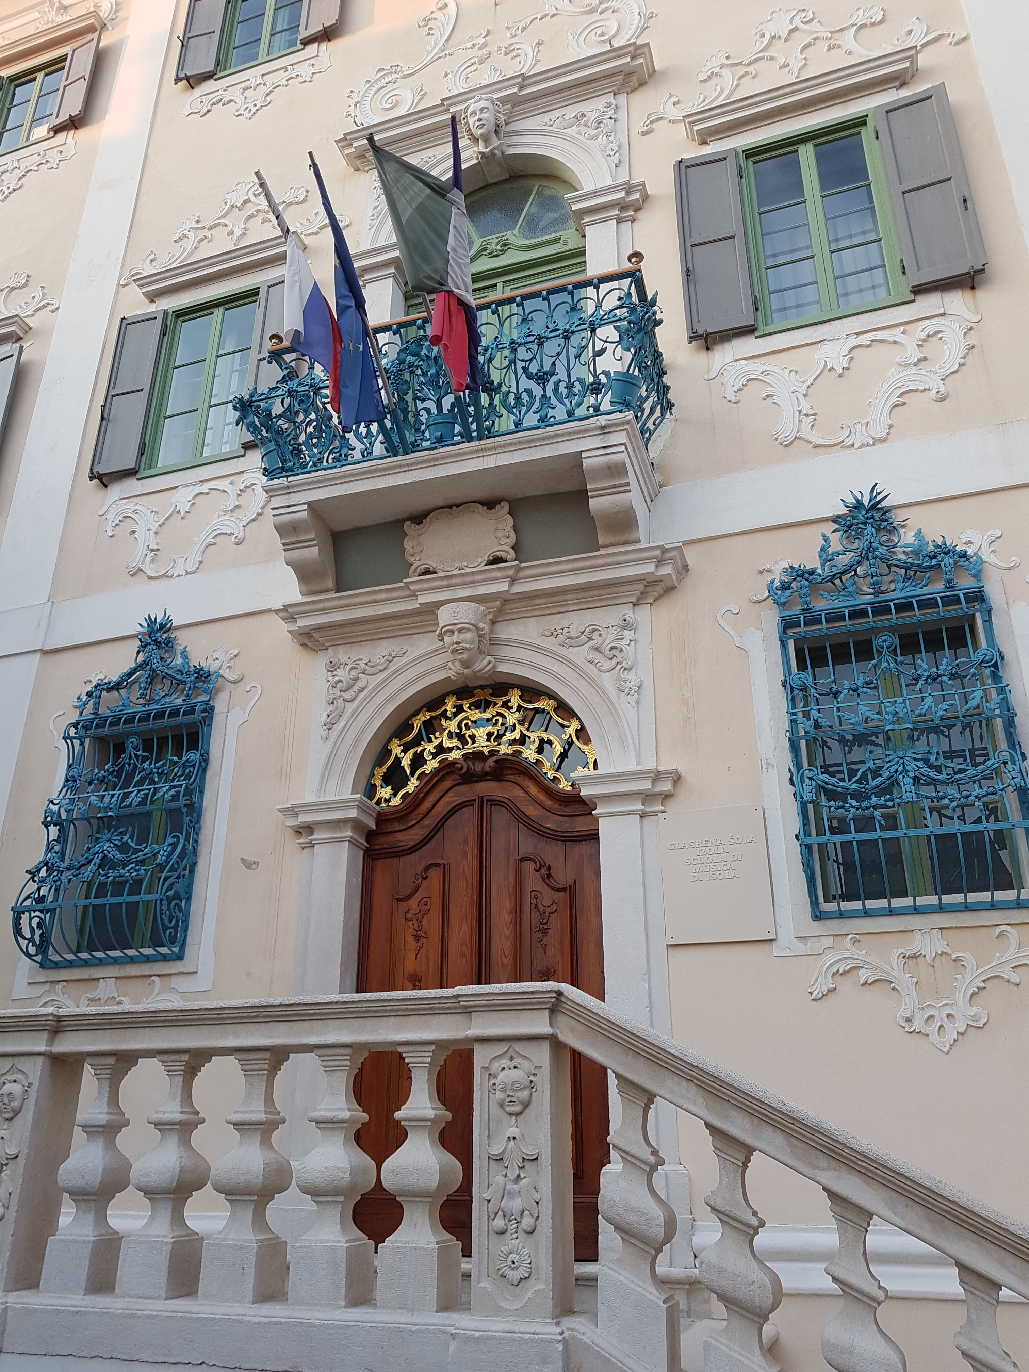
SIGHTSEEING IN IZOLA
There aren’t many palaces in Izola.
The Besenghi degli Ughi palace is the most beautiful Baroque monument on the coast. It houses our Music School and an old library.
Saint Maurus is Isola’s protector. The most visible church bears his name and it was built in 1356. It has preserved Baroque and Renaissance elements.

Slide 4
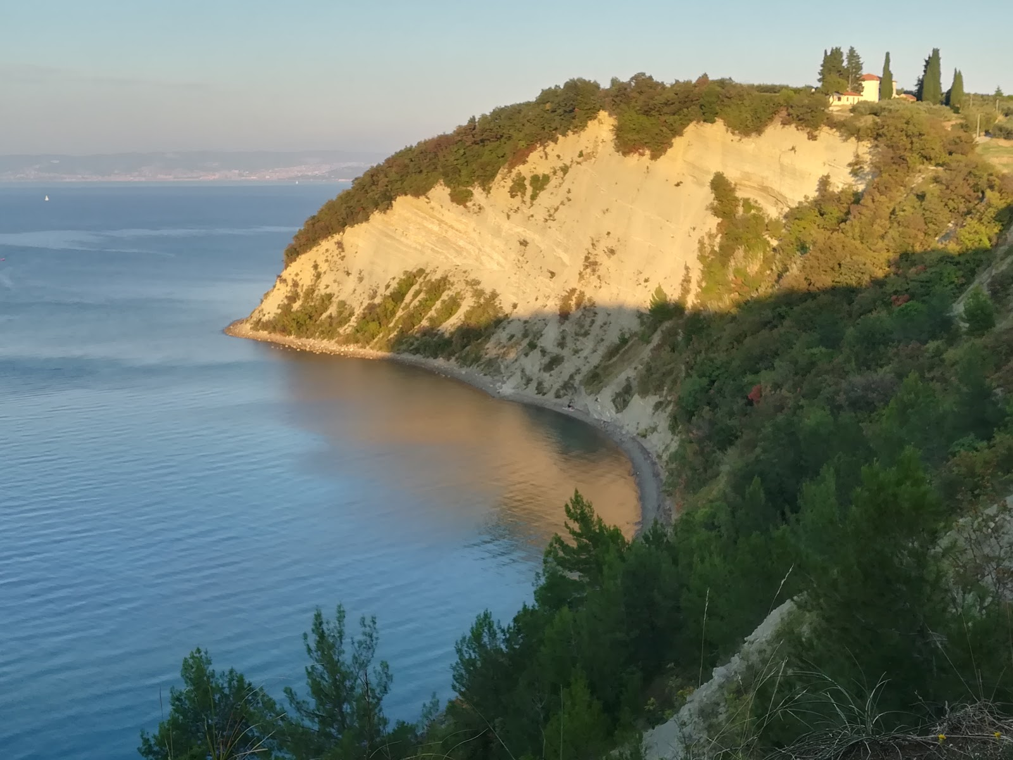
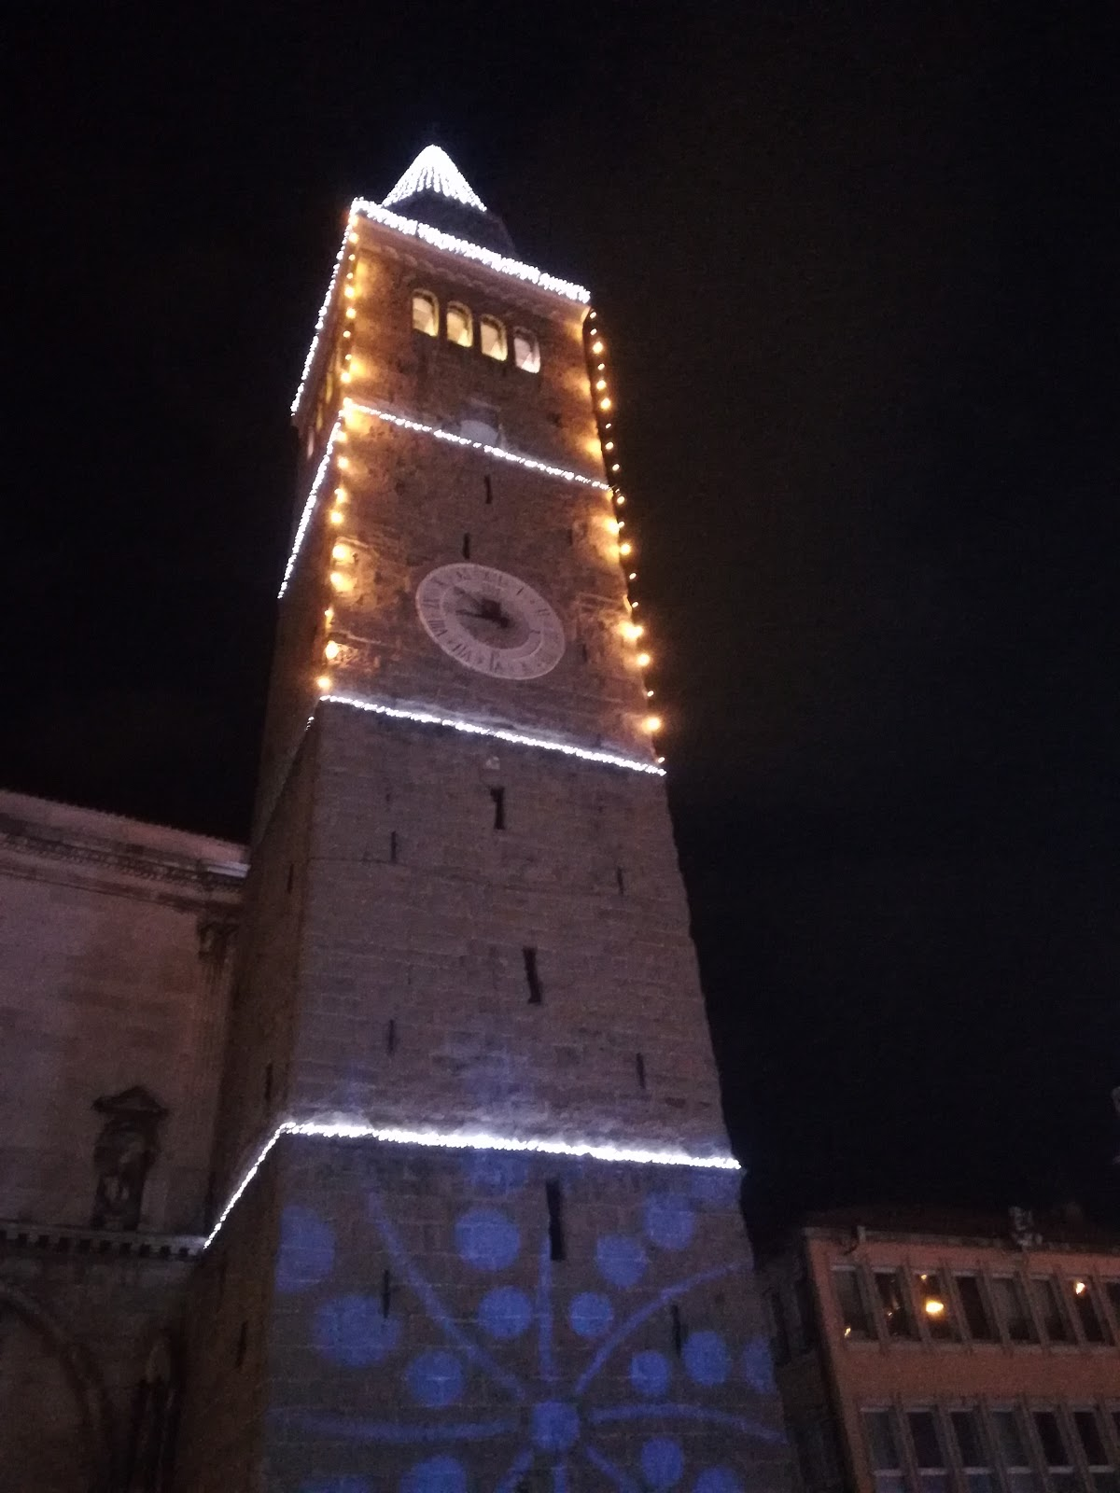
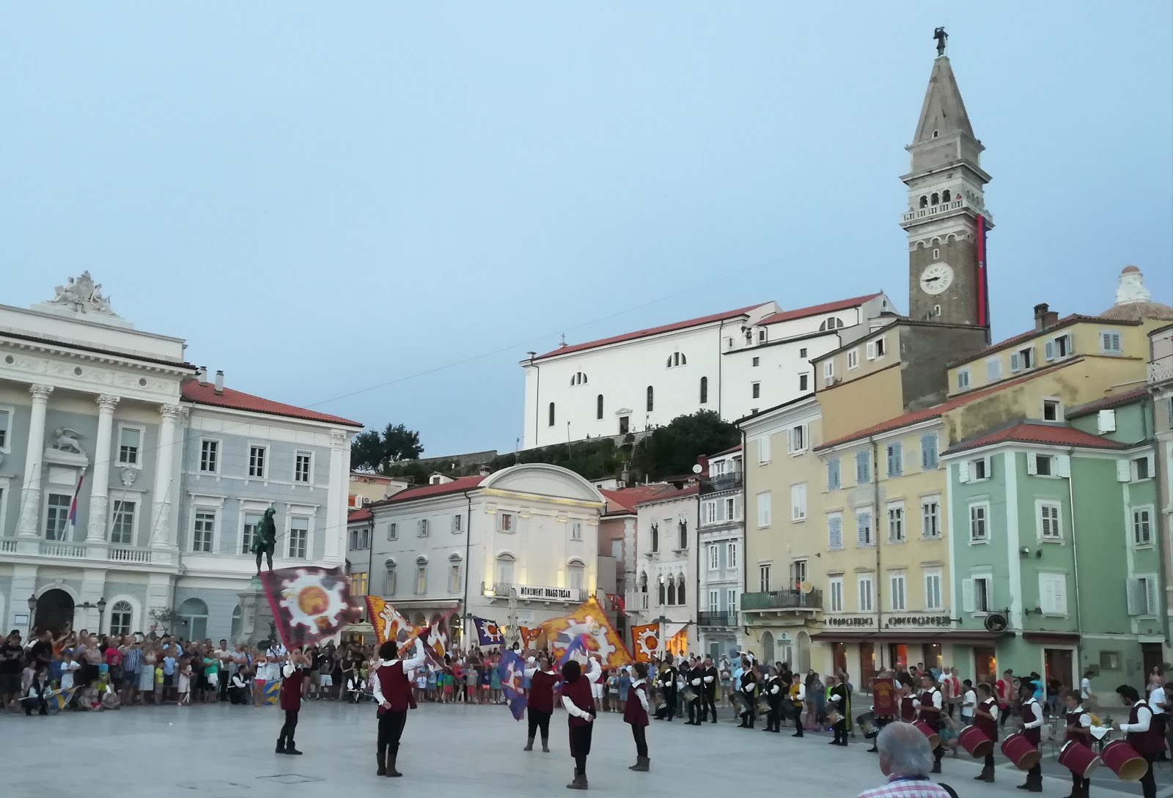
THE SLOVENIAN COAST
It is part of the peninsula, called ISTRIA.
It‘s only 46.6 km long.
The main towns are: Koper, Izola, and Piran.

Slide 5
SLOVENIA OUR COUNTRY
The United Nations proclaimed 2017 as the INTERNATIONAL YEAR OF SUSTAINABLE TOURISM.
The winner was SLOVENIA, which got most of the points in all categories, and met 96 of the hundred criteria for this prestigious award.
Watch the video:
https://www.youtube.com/watch?v=tLQRg8hDMx8
https://www.youtube.com/watch?v=jqTsrMh28E0

Slide 6
Thank you!

