Slide 1
SALT-WORK-IN PROGRESS: YOUNG CICERONES
Virtual meeting
Fauna in the saltpans in Italy

Slide 2
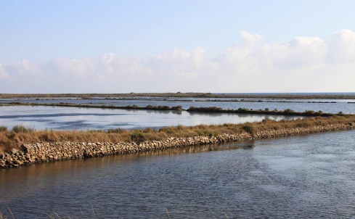
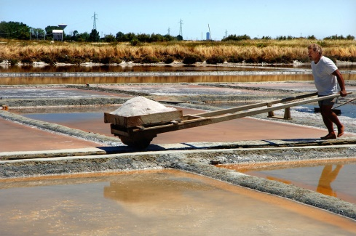
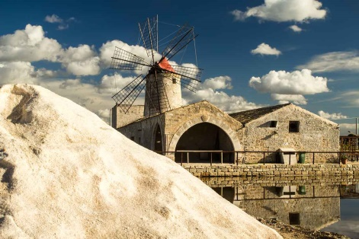
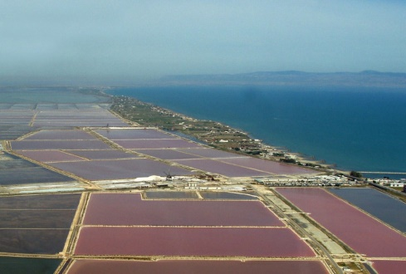
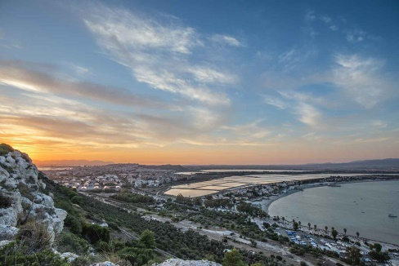
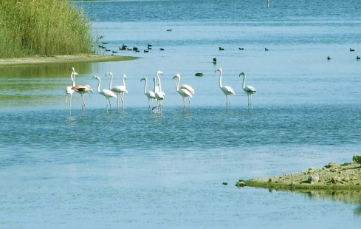
SALTPANS IN ITALY
CERVIA
TARQUINIA
TRAPANI
MARGHERITA DI SAVOIA
MOLENTARGIUS
PIROLO

Slide 3
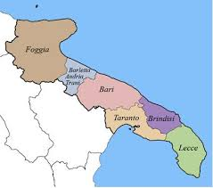
WHERE WE ARE
Margherita di Savoia

Slide 4
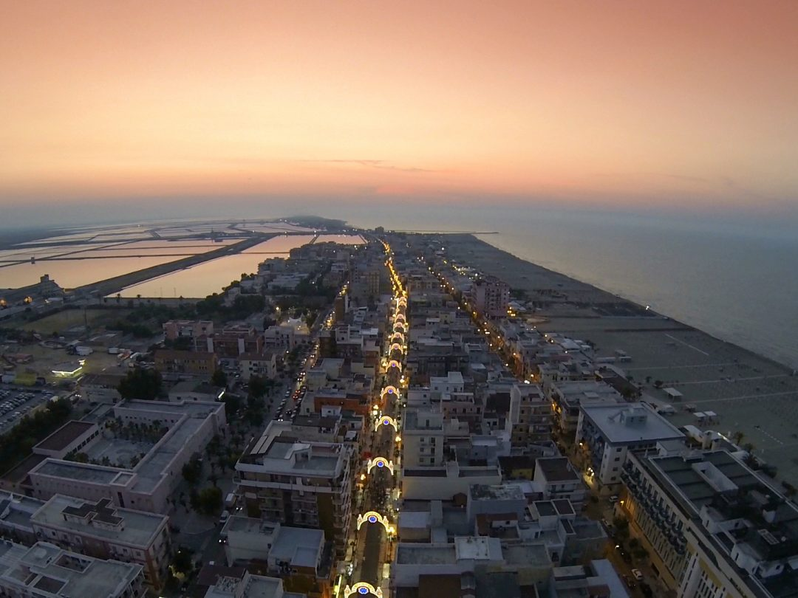
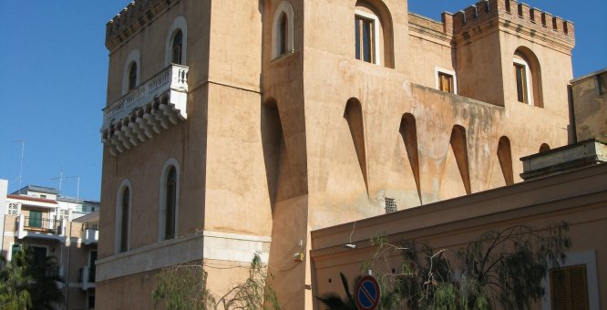
MARGHERITA DI SAVOIA
The first name of Margherita di Savoia had been Saline di Barletta (a large town near Margherita) until 1879, when its name was changed in honor of an Italian queen, Queen Margherita of Savoy, the wife of King Umberto I of Italy, and the inhabitants were called Margheritani or Salinari (that is people who work salt).

Slide 5
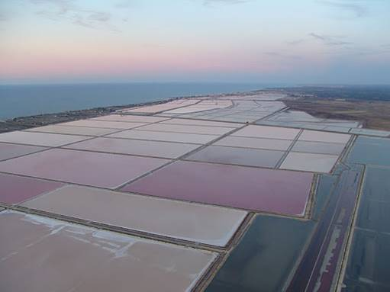
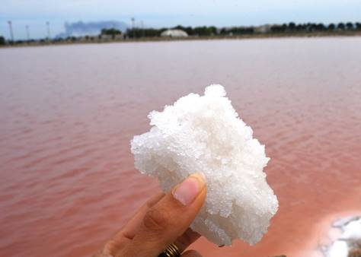
OUR SALTWORK

Slide 6
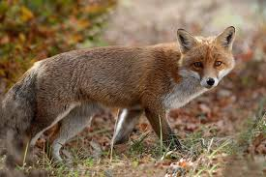
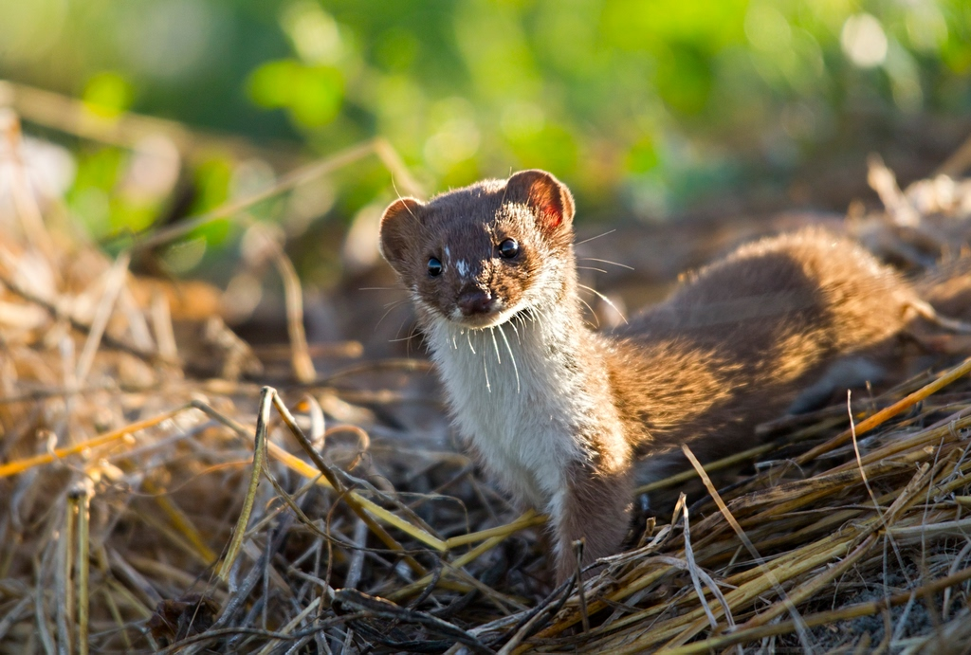
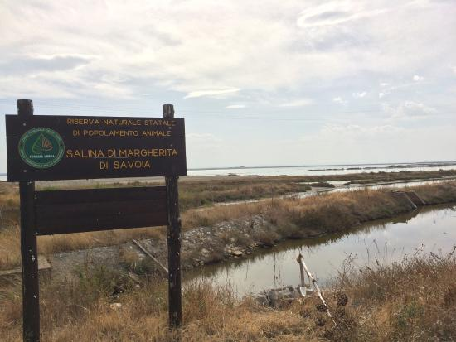
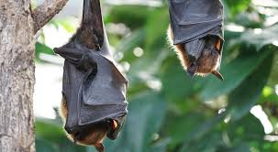
Animals in the salt pan
In the Margherita di Savoia saltpan, we can meet a lot of animals such as foxes, weasels and bats in every season of the year.

Slide 7
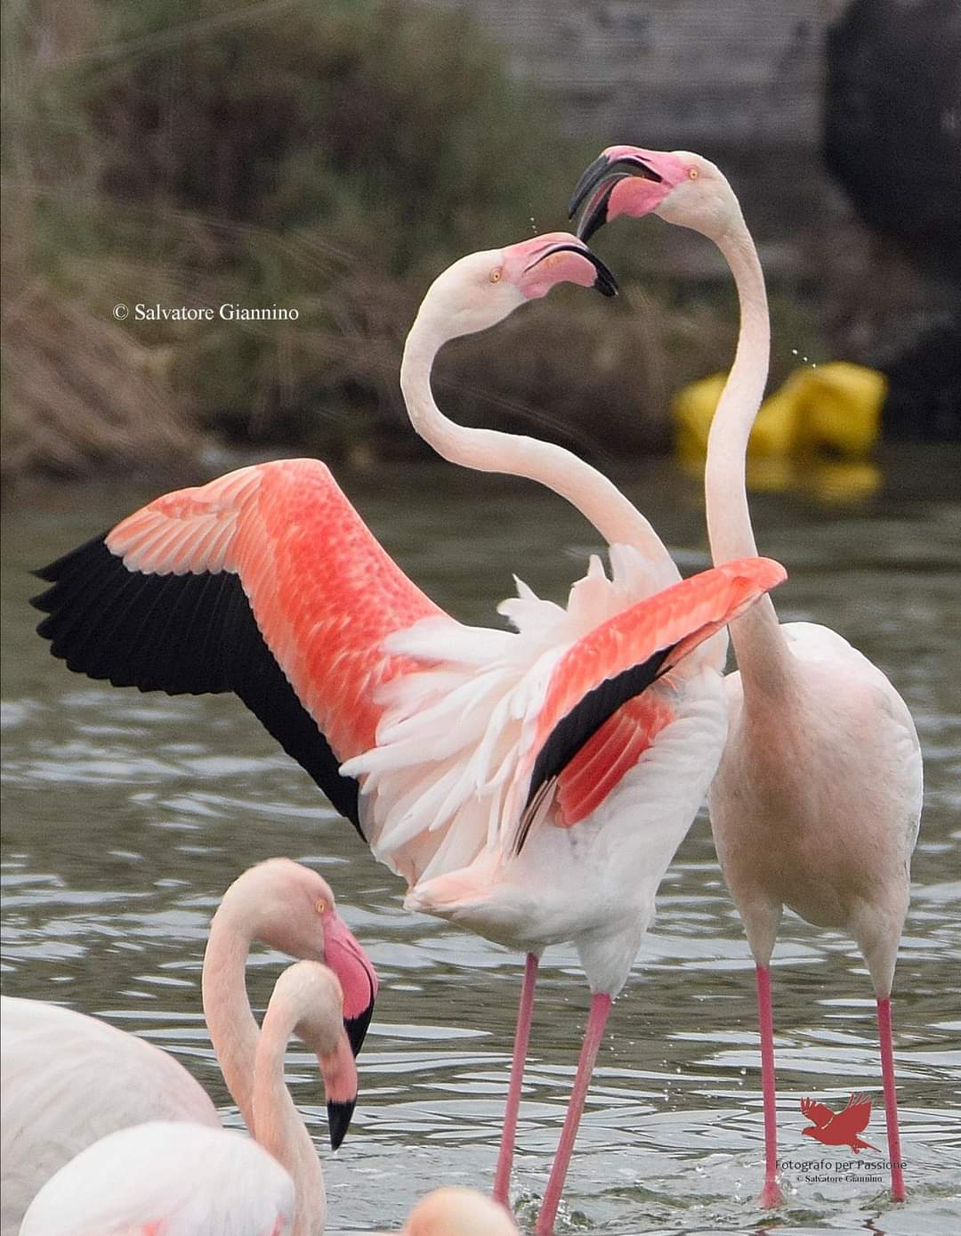
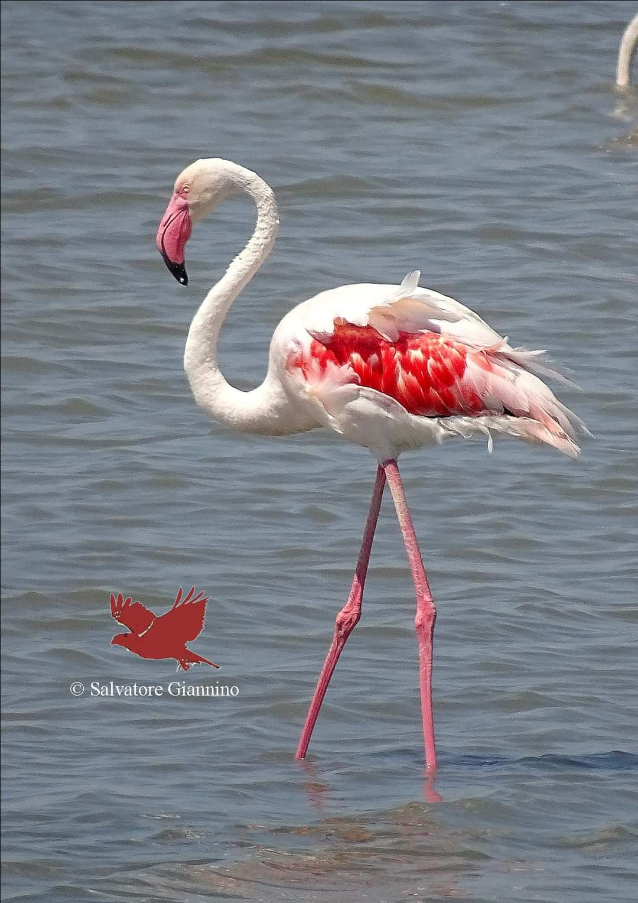

Slide 8
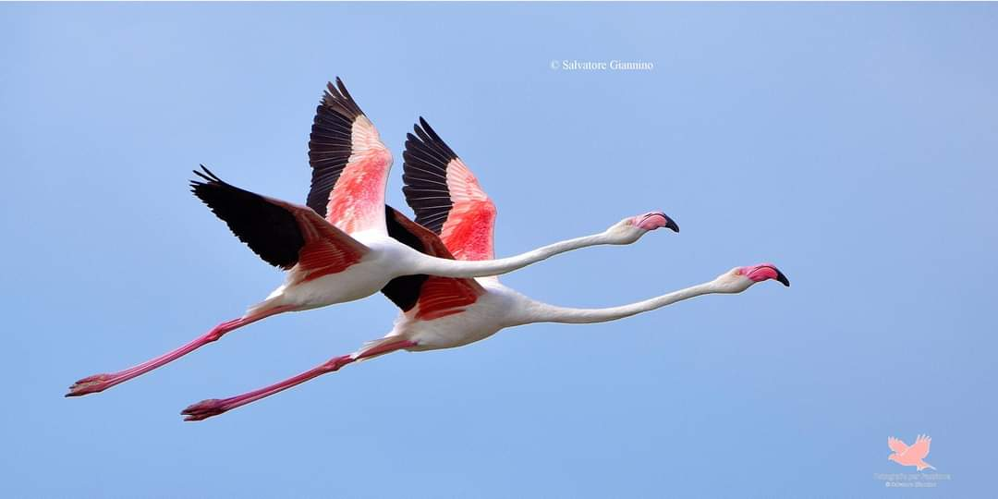

Slide 9
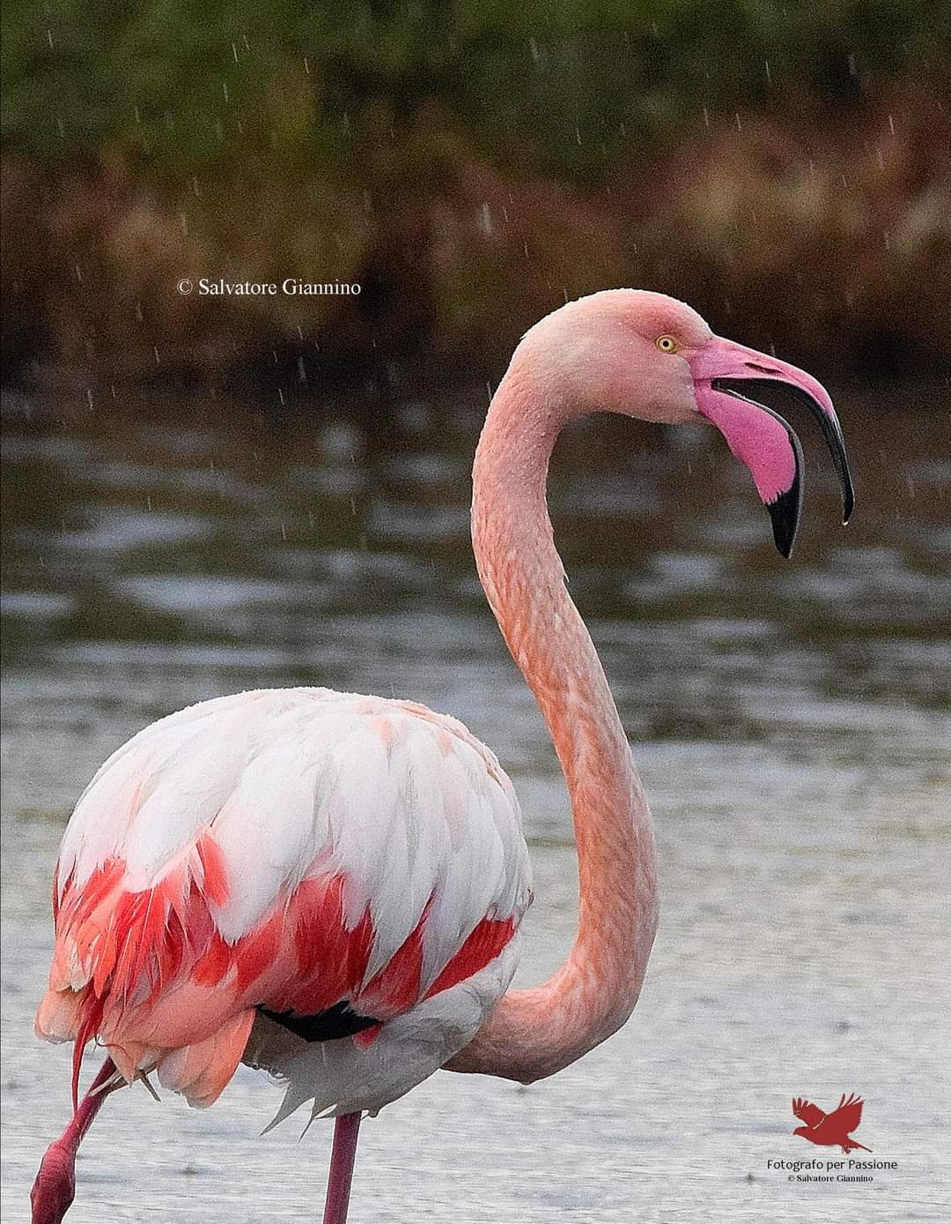
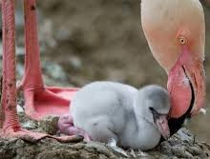
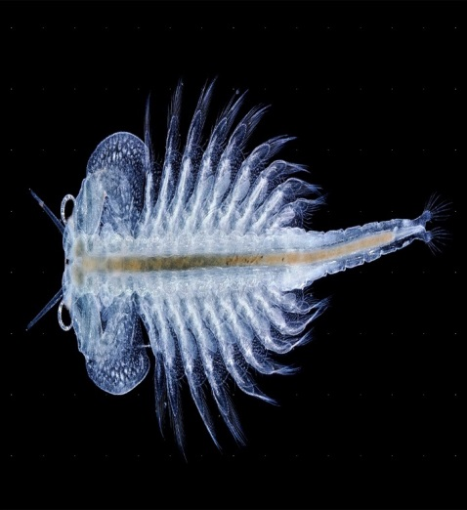
THE PINK FLAMINGO or GREATER FLAMINGO
Scientific name: phoenicopterus roseus
Height: 1.5 m
Weight: 2-4 kg
Males and females: different
Max wing span: 1.5 m
Food: small invertebrates, crustaceans and mollusks
Curiosity: at the birth flamingos are gray but feeding on the Artemia Salina their plumage becomes pink
Nest: in the water
Living/Origins: Asia and Southern Europe
Non-migratory bird and a protected species

Slide 10
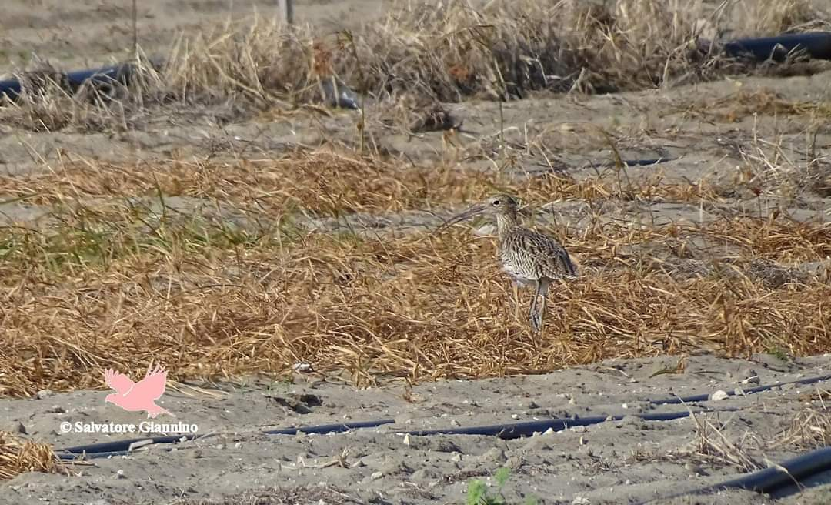
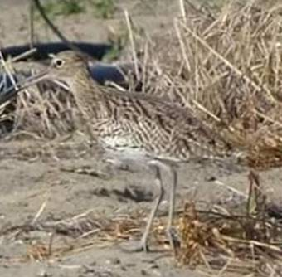

Slide 11
CURLEW
Scientific name: Numenius Arquata
Height: 50-60 cm
Weight: 500-1300 gr
Plumage: brown with light spots
Food: insects, crustaceans, berries and earthworms
Males and females: different
Nest: on the ground in a small cavity in the vegetation
Living/Origins: Asia and Northern Europe
Migratory bird and a protected species

Slide 12
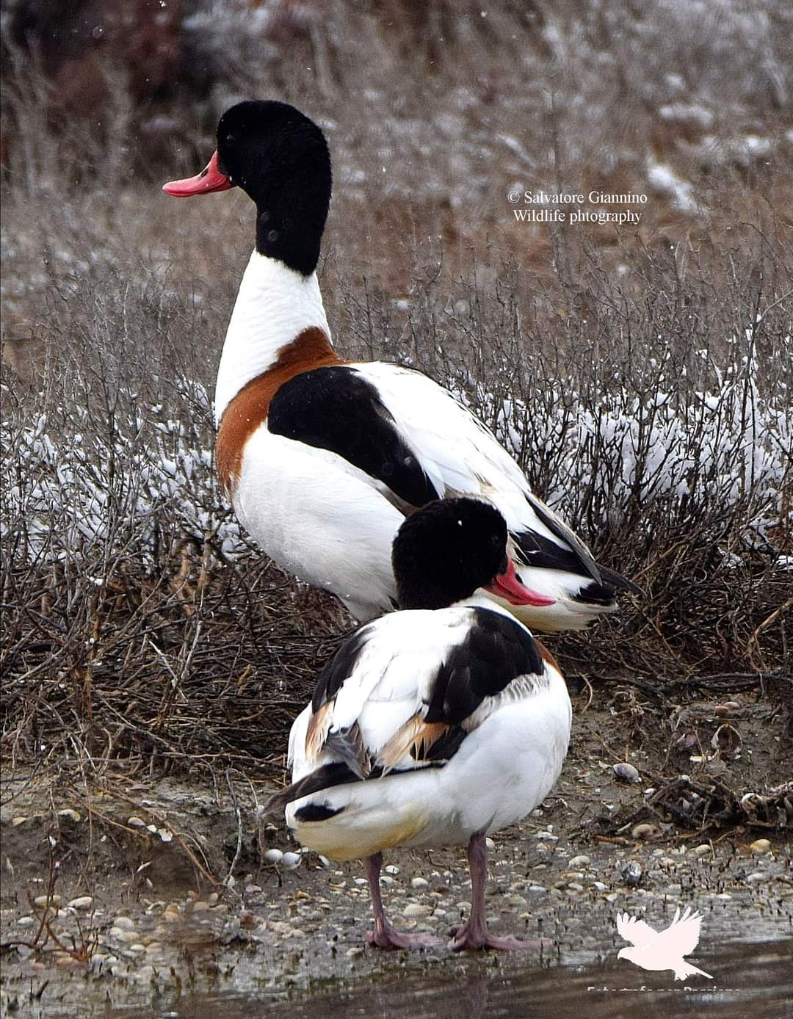
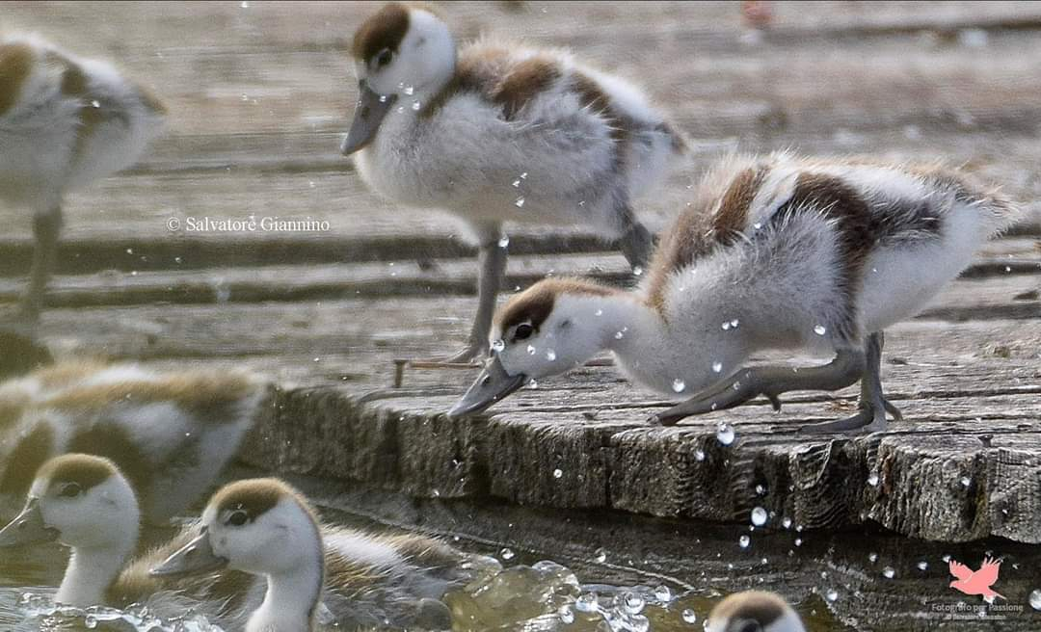

Slide 13
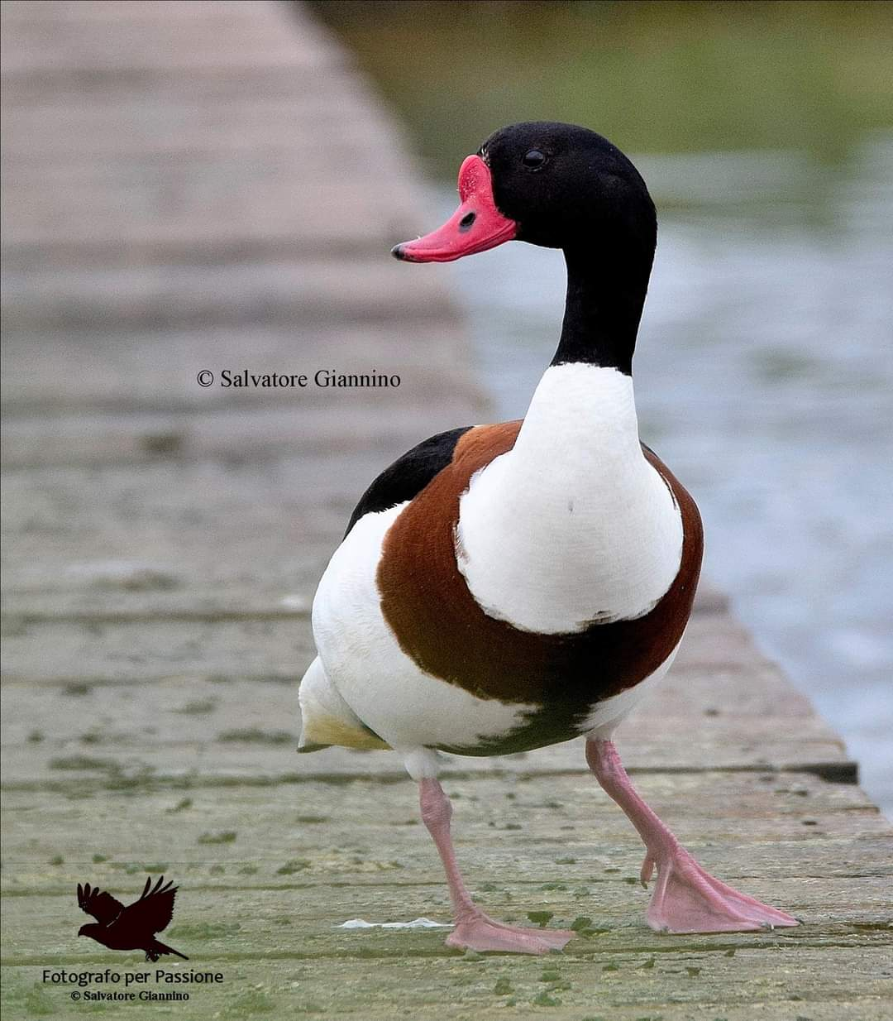
THE SHELDUCK
Scientific name: Tadorna tadorna
Height: 55/65 cm
Weight: 1.1 kg
Max wing span: 1.20 m
Males and females: different
Food: insects, mollusks, crustaceans, herbs, seeds and berries
Curiosity: the beak becomes red in spring and fades in winter
Nest: in cavities of the ground
Living/Origins: Turkey and Asia Minor (Anatolia) - North West countries
A migratory and protected species

Slide 14
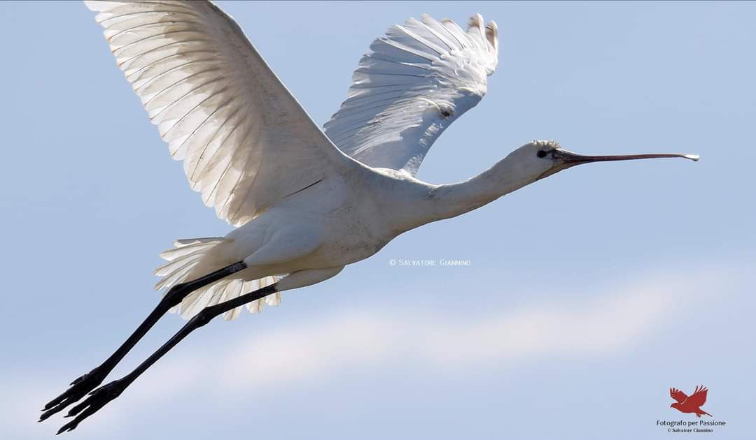

Slide 15
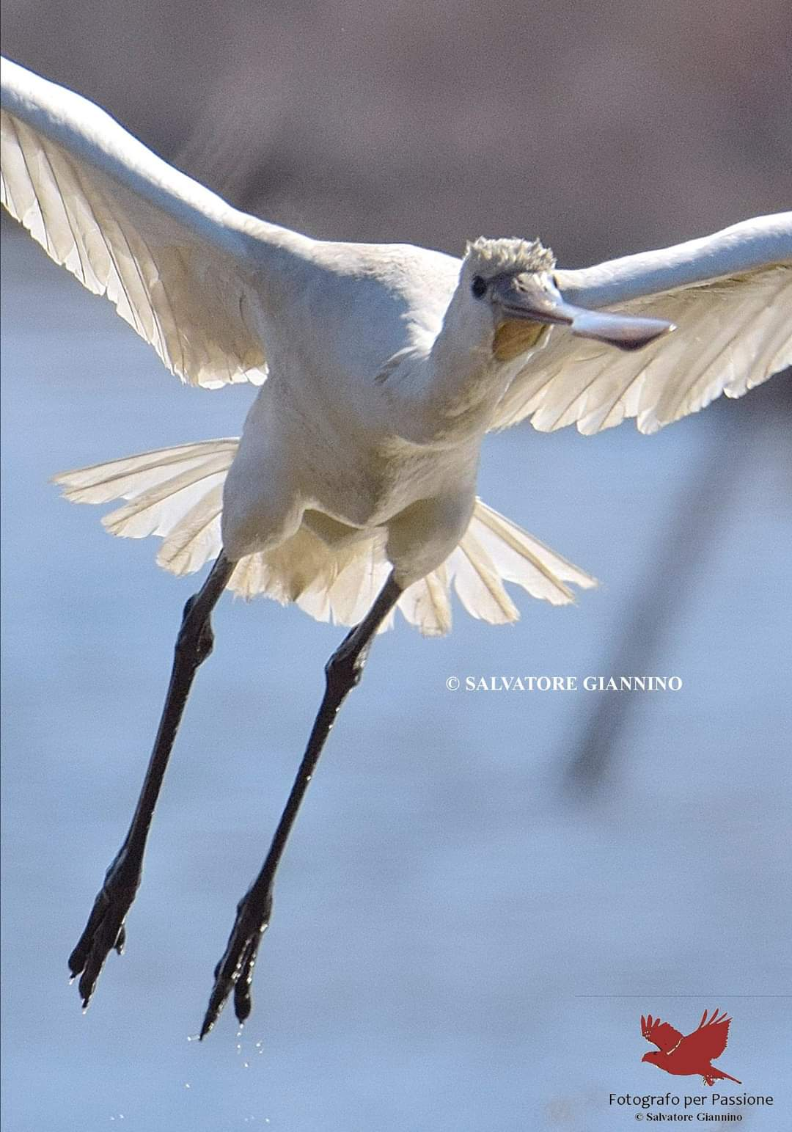
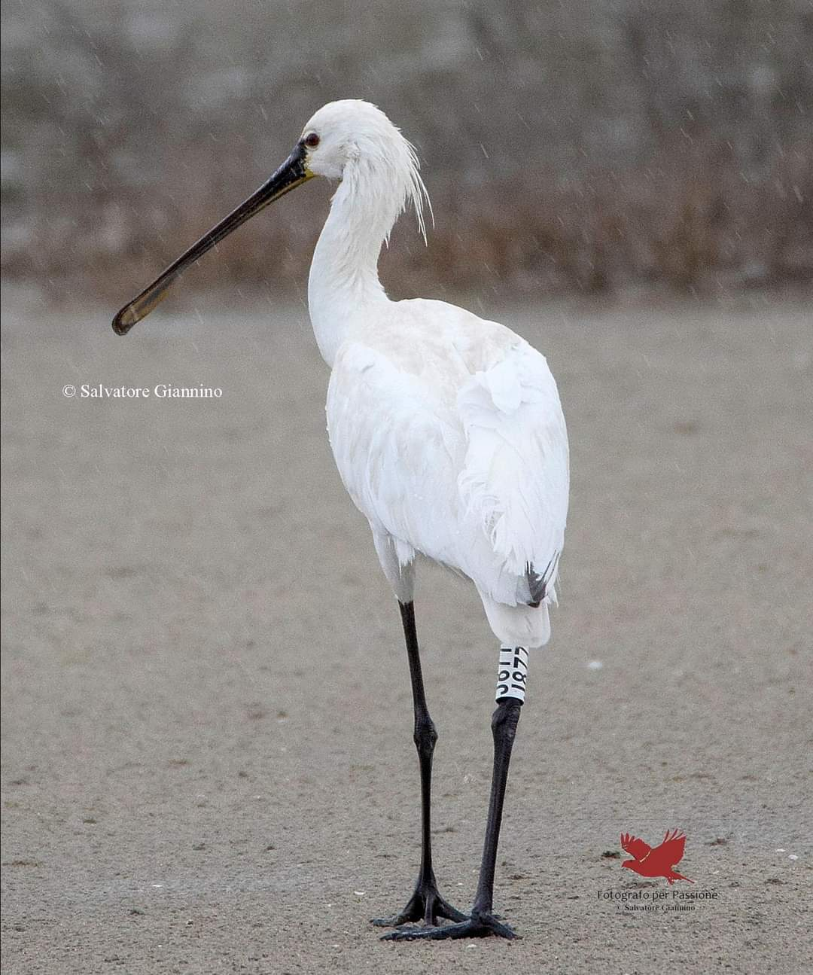

Slide 16
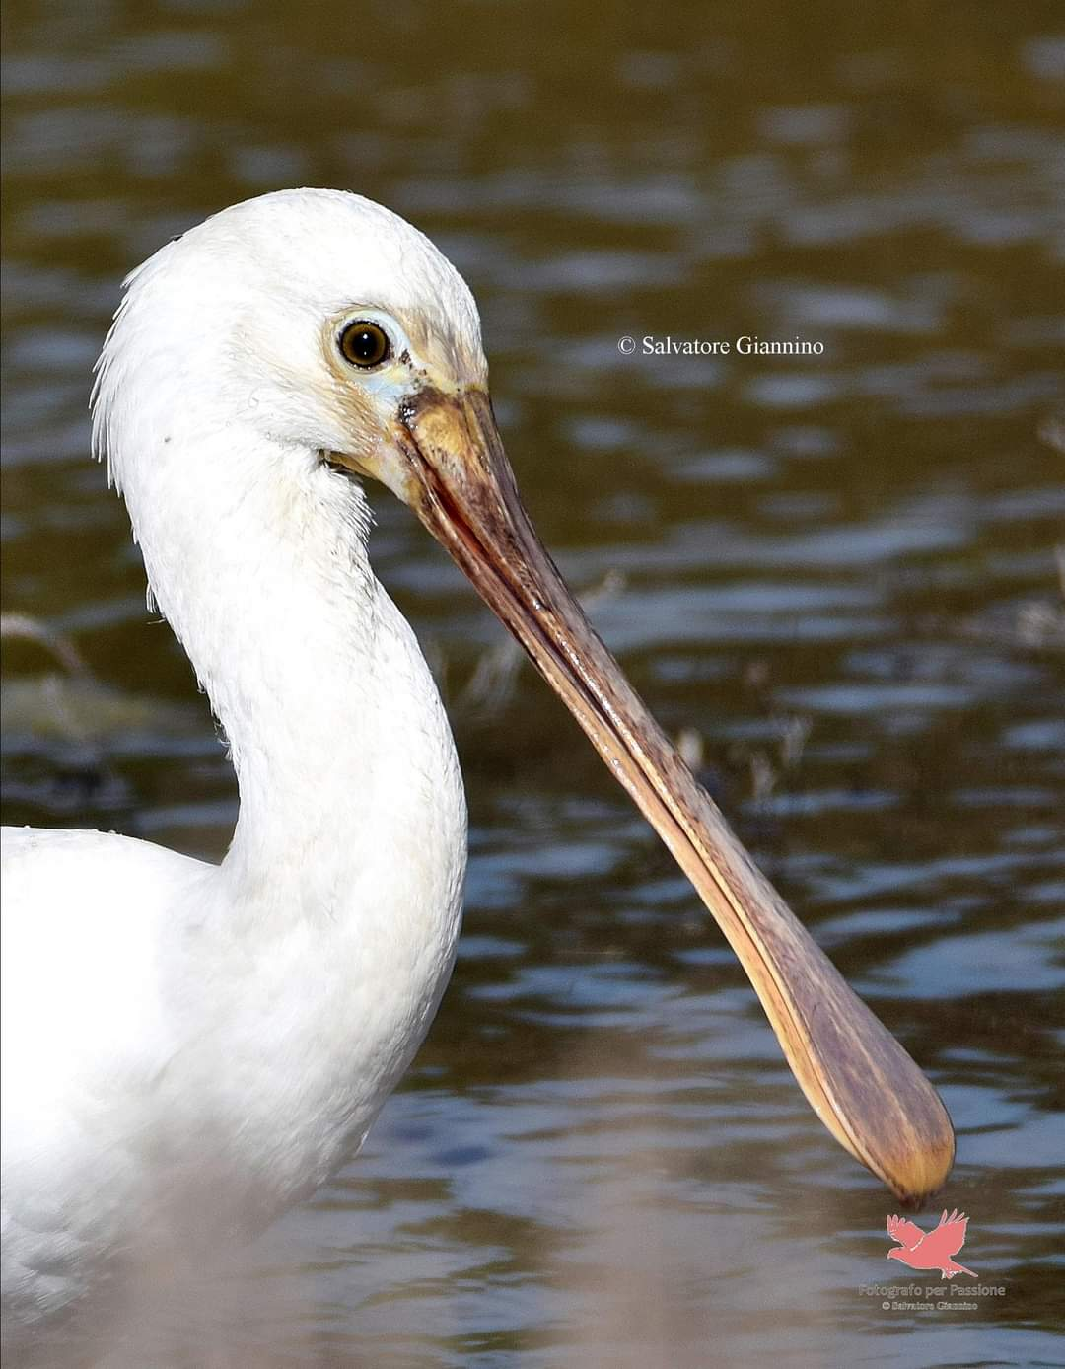
THE SPOONBILL
Scientific name: Platalea Leucorodia
Height: 85 cm
Weight: 1,9 kg
Plumage: white
Males and females: indistinguishable
Food: small invertebrates, fish and amphibians
Nest: in the thickest marshes
Living/Origins: Asia, North Africa
A migratory and protected species

Slide 17
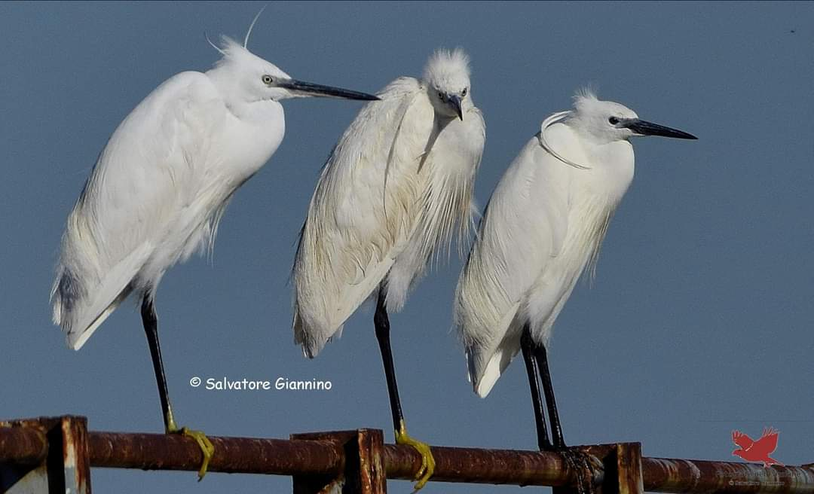

Slide 18
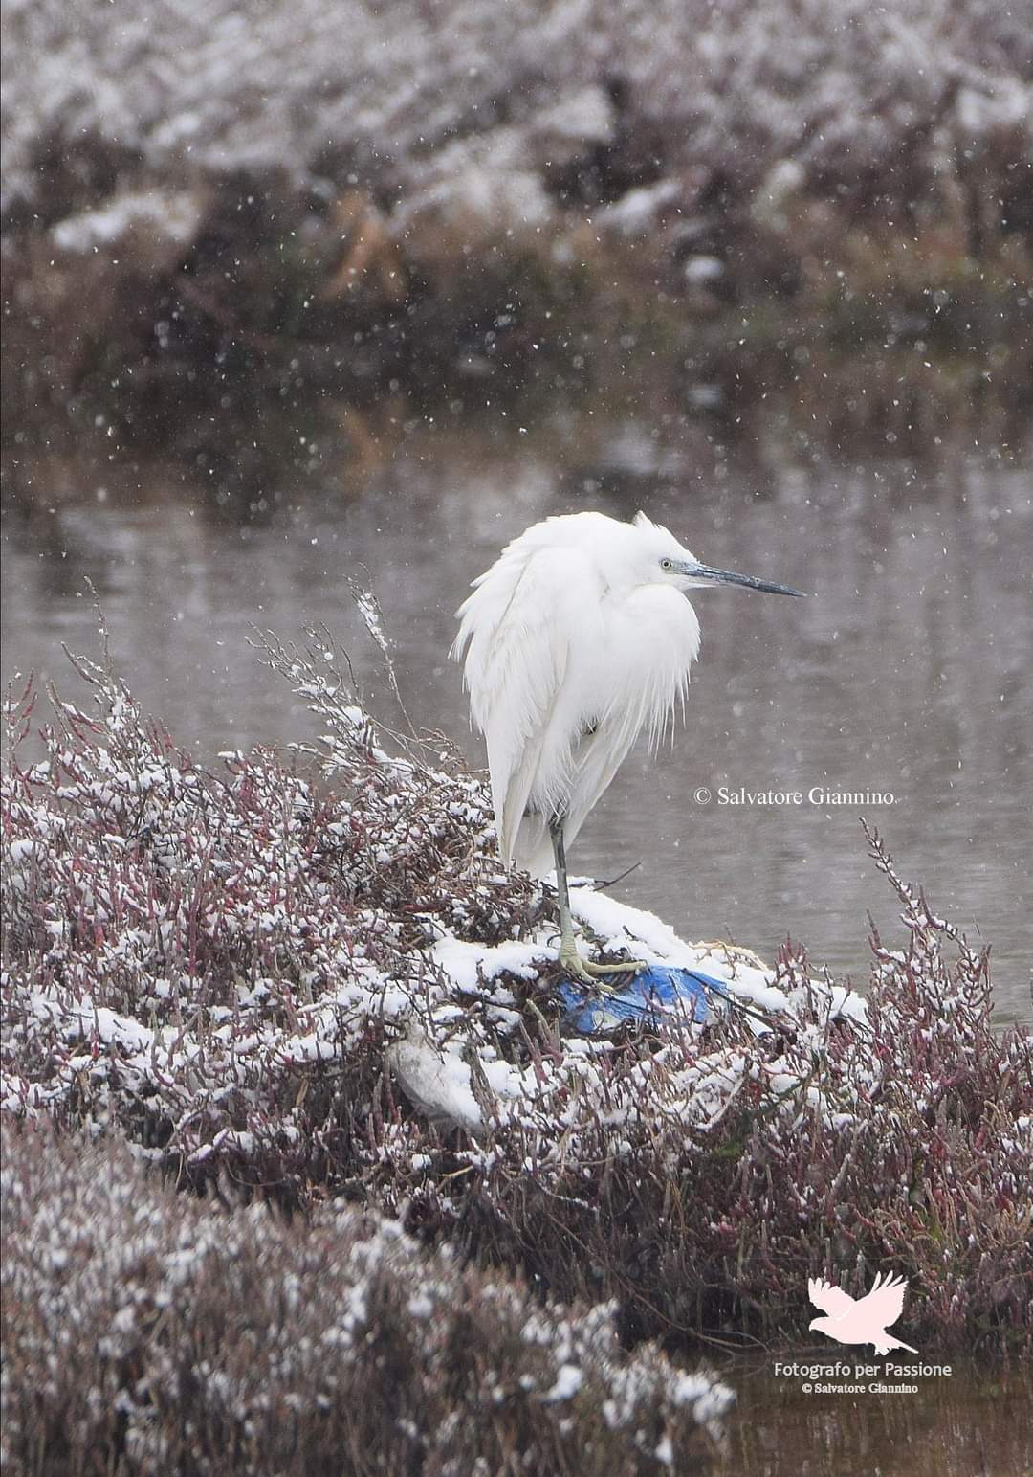
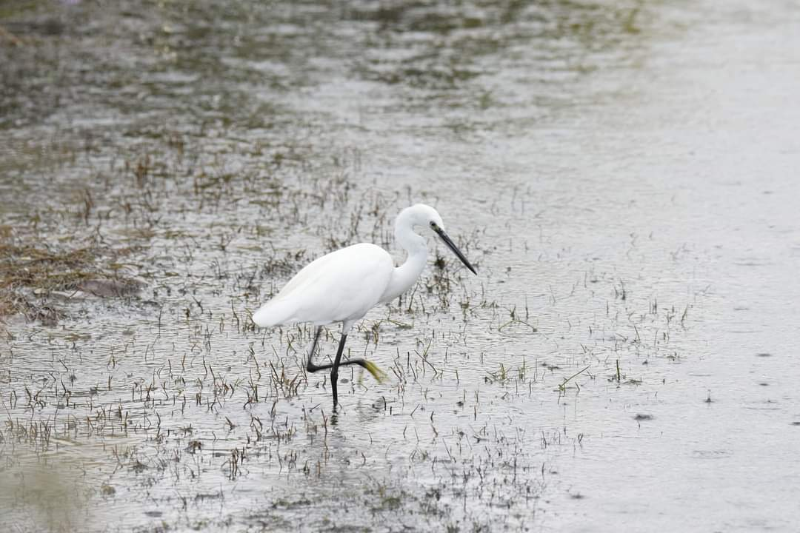

Slide 19
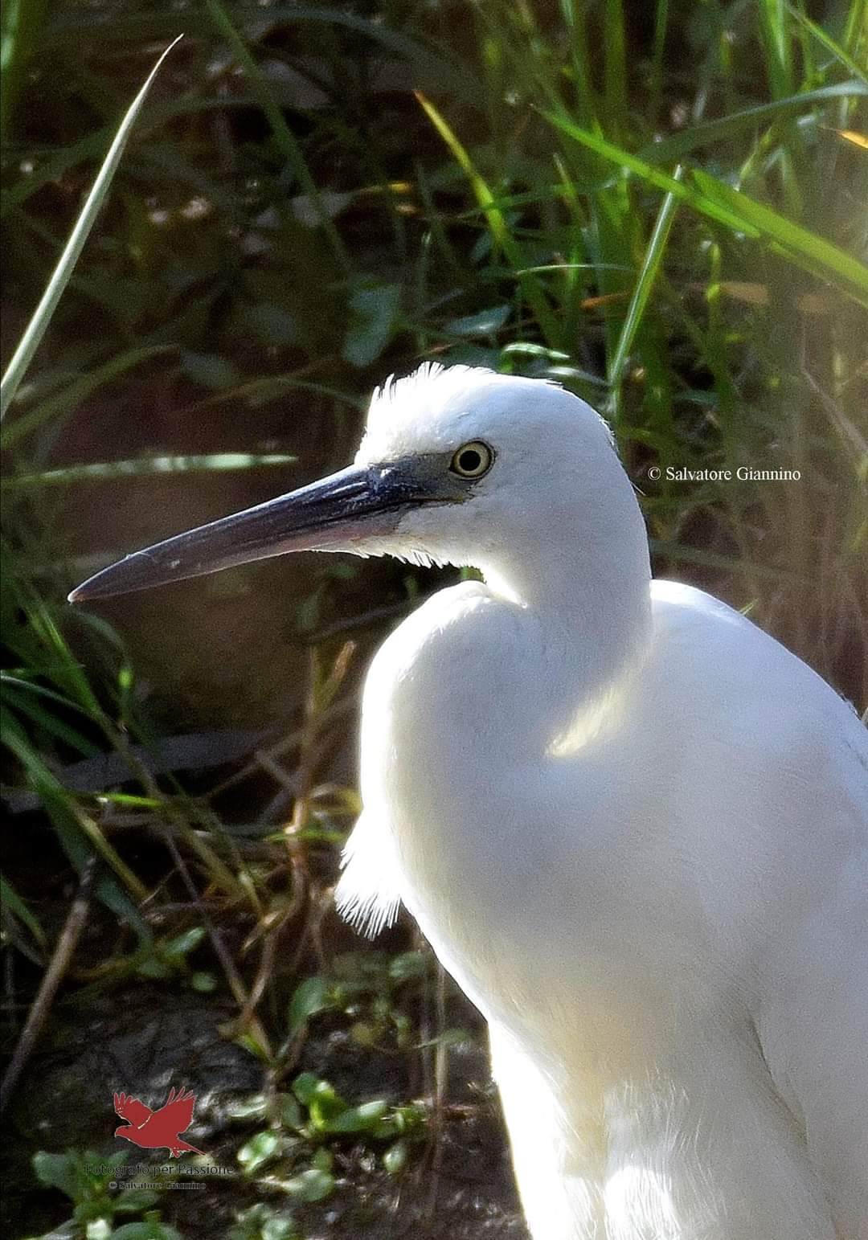
THE LITTLE EGRET
Scientifica Name: Egretta Garzetta
Height: 55-65cm
Weight: 310 gr
Plumage: white
Males and females: males haven’t two feathers
Food:mollusks,insects and crustaceans
Nest: in the woods or in especially marshy environments
Living/Origins: Asia and Africa
A migratory and proctected species

Slide 20
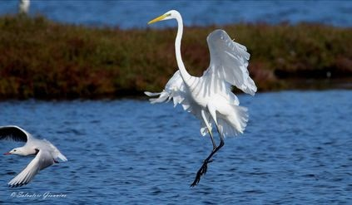
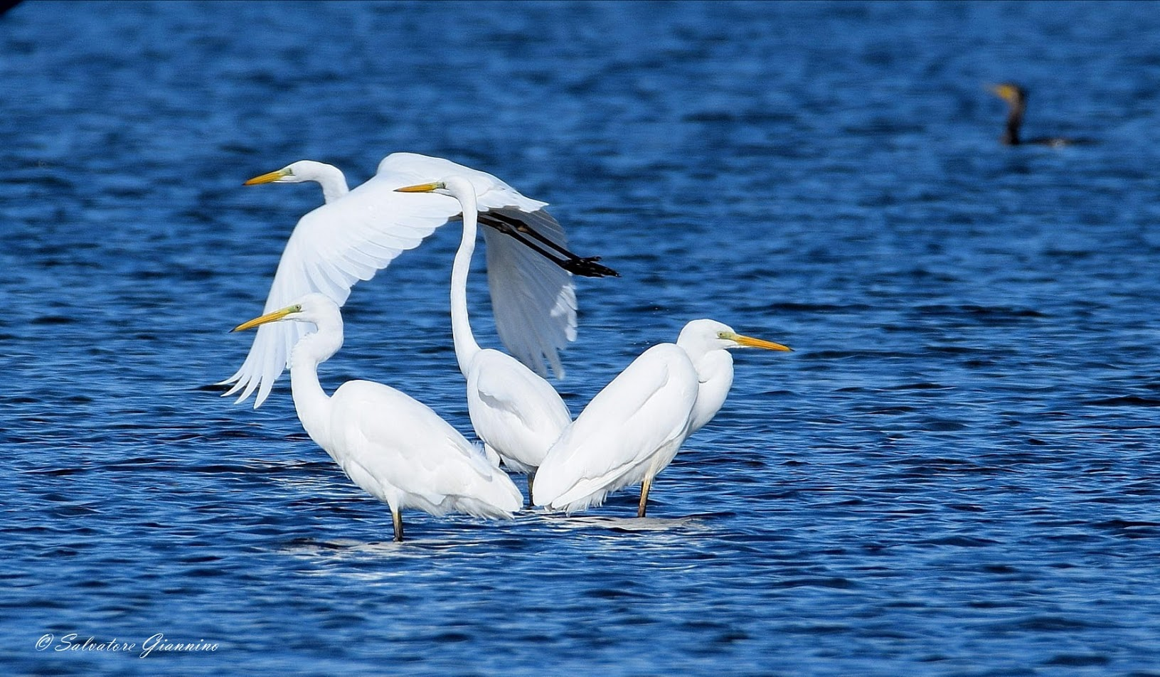

Slide 21
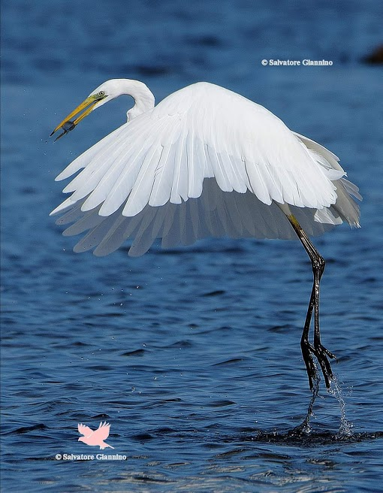
THE WHITE HERON
Scientific name: Ardea alba
Height: 85-120 cm
Weight: 1.5 kg
Plumage: white
Food: Fish, frogs and small mammals
Nest: Between the rushes
Living/Origins: North and Central America
Migratory bird and protected species

Slide 22
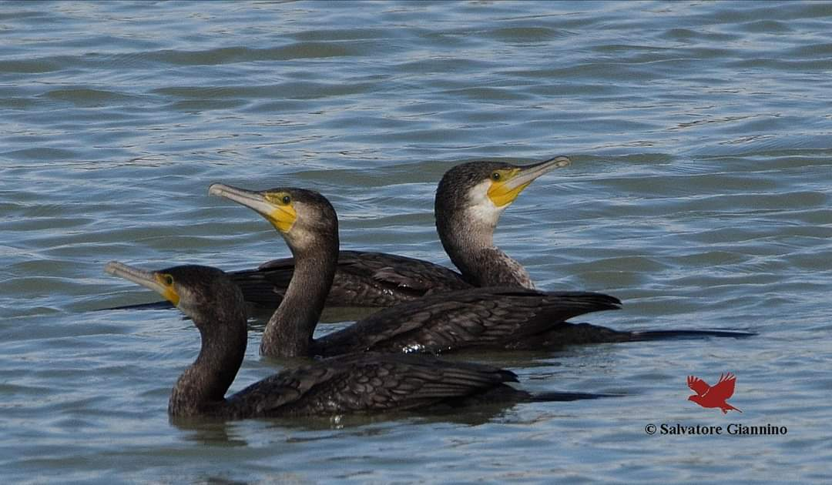

Slide 23
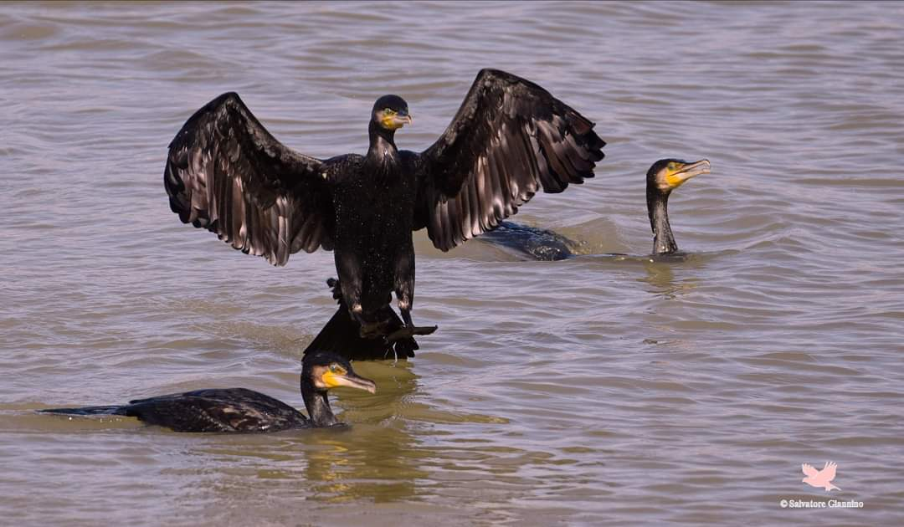

Slide 24
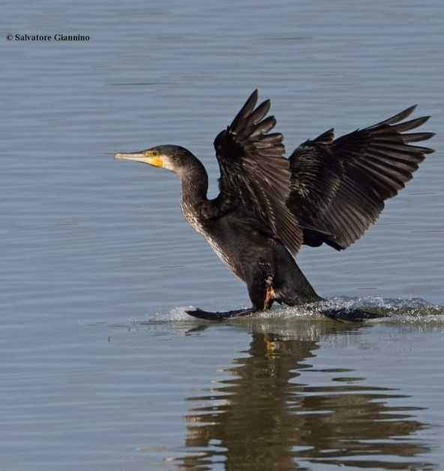
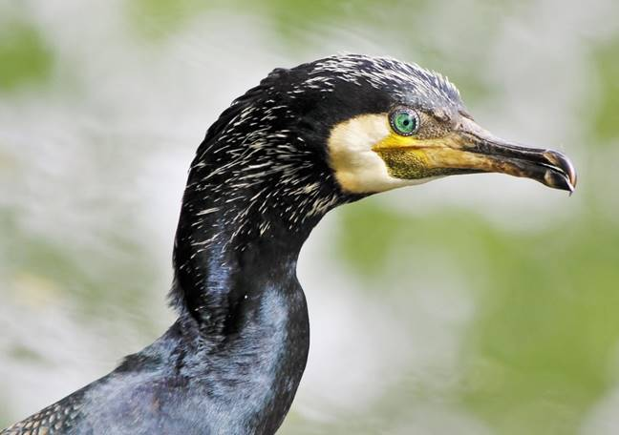
THE CORMORANT
Scientific name: phalacrocorax carbo
Height: 80-100 cm
Weight: 1.8-2.8 kg
Plumage: almost entirely black
Food: fish such as cod, eel, perch, trout
Nest: near the water
Features: due to its eye its vision is excellent both underwater and on the surface
Living/Origins: Central and Southern Europe, Oceania, Africa
Migratory and protected species

Slide 25
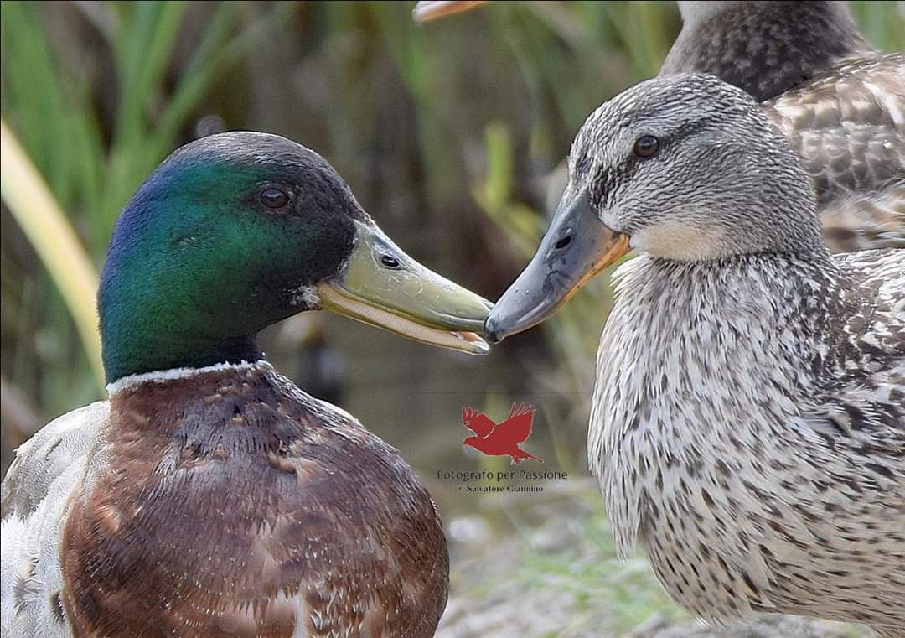

Slide 26
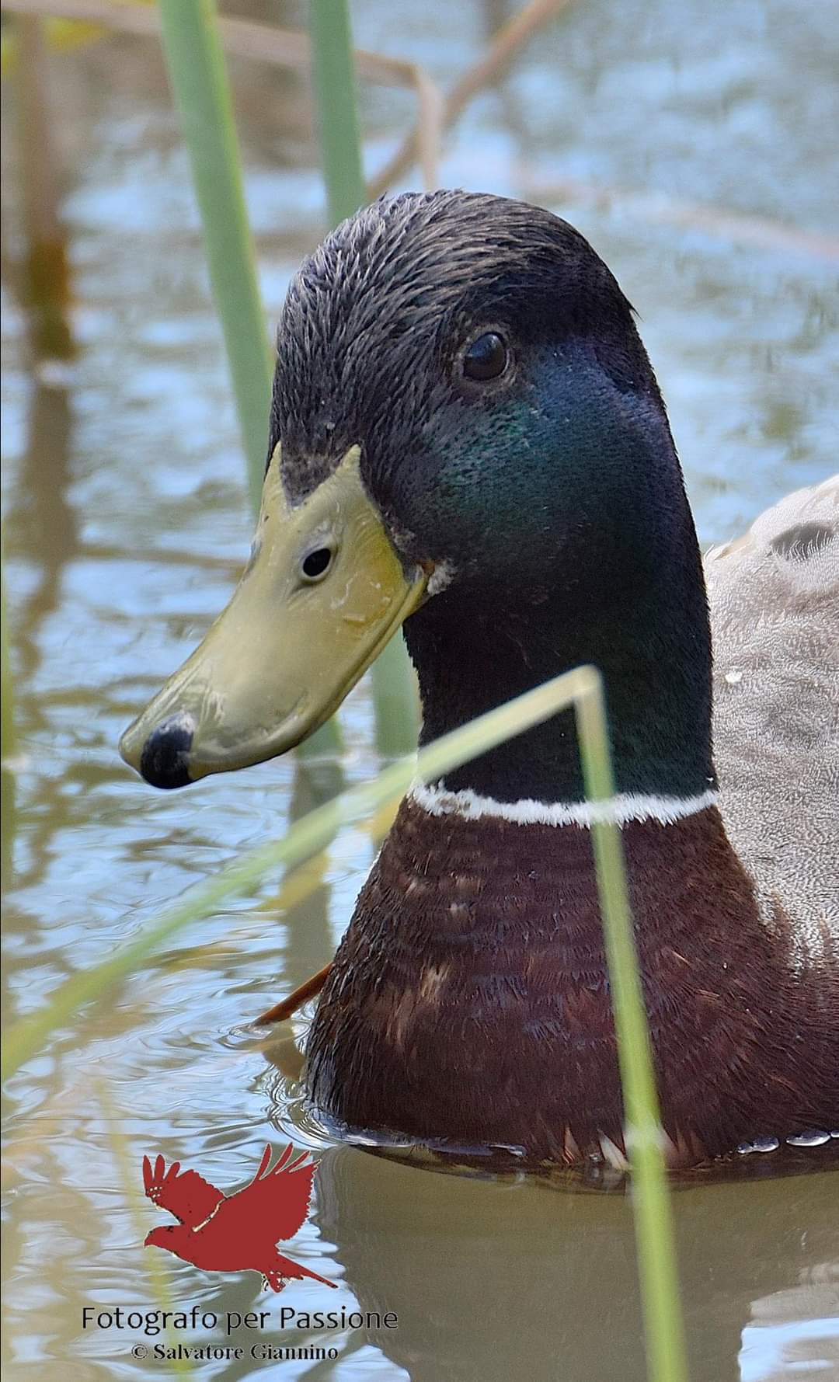
Scientific name: Anas platyrhynchos Height: 52/56 cm Weight: 700/1400 gr Max wing span: 91/98 cm Males and females: different Plumage: dark green and white for males and light brown for females Food: algae, insects, larvae, mollusks Nest: on mirrors of water Living/Origins: North America, Europe and Asia A sedentary and protected species
THE MALLARD

Slide 28
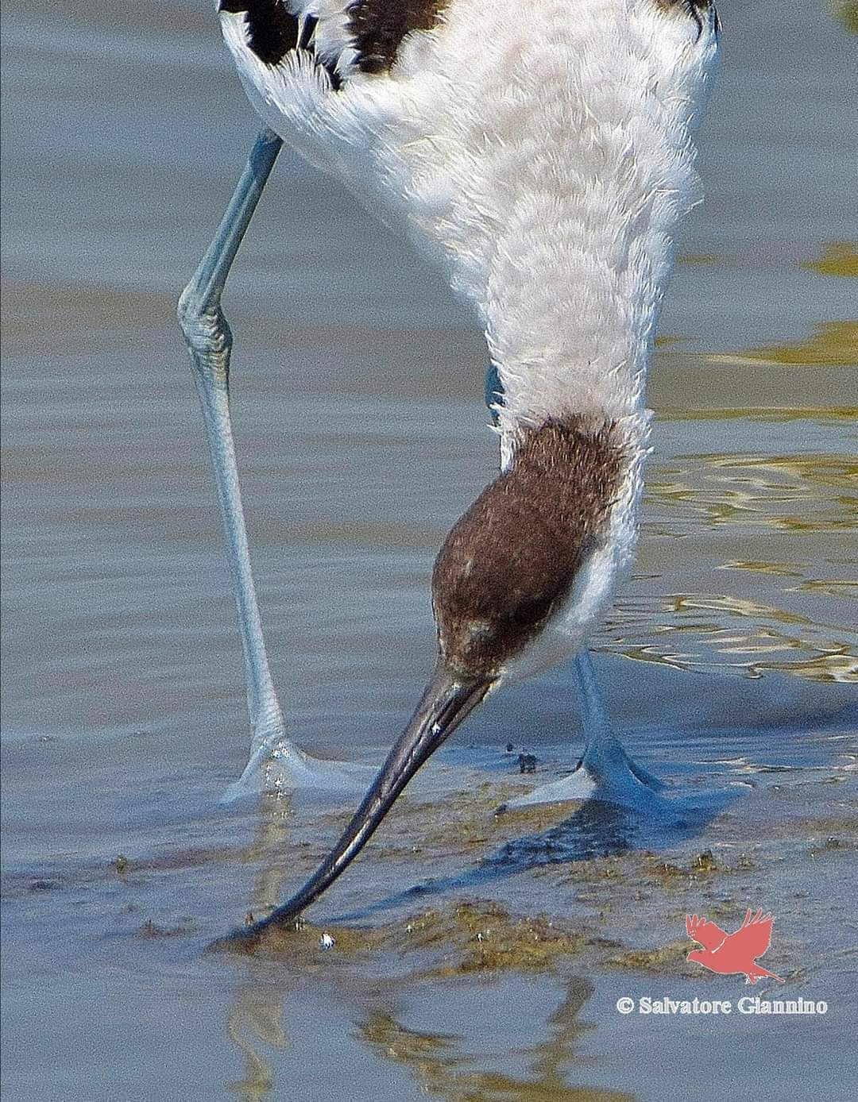
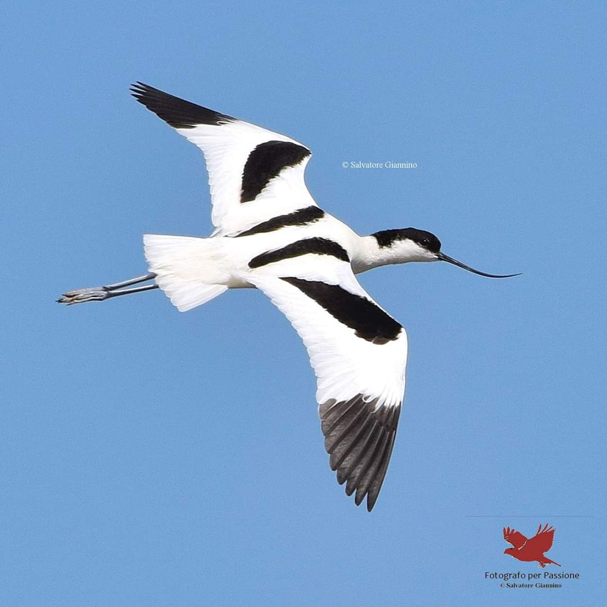

Slide 29
THE AVOCET
Scientific name: Recuvirosta
Height: about 40 cm
Weight: about 300 gr
Plumage: black and white
Max wig span: 77 cm
Males and females: indistinguishable
Food: invertebrates found in water
Nest: on the mud plains, lagoons, salt pans
Living/Origins: Eurasia and Africa
Migratory bird and a protected species

Slide 30
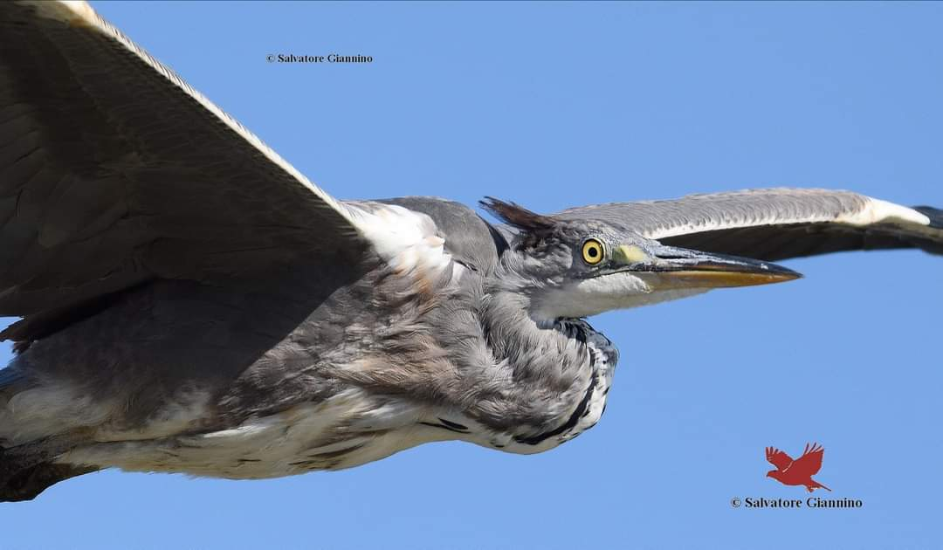

Slide 31
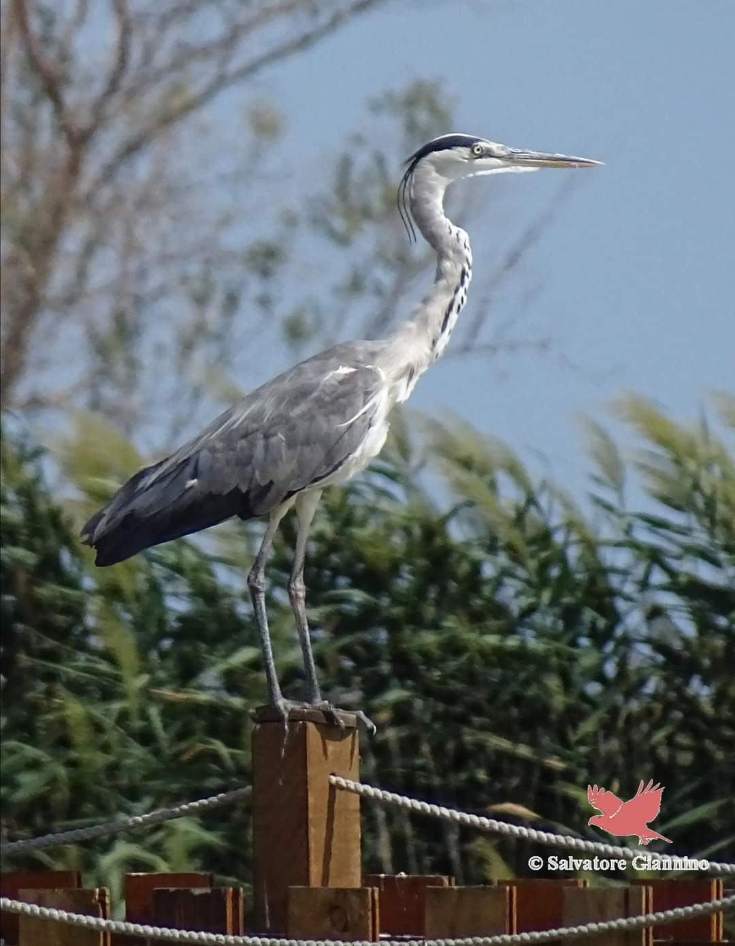
THE GRAY HERON
Scientific name: Ardea Cinerea Linnaeus
Height: 90-98 cm
Weight: 1-2 kg
Plumage: grey
Food: gish, frogs, tadpoles, water snakes, crustaceans, mollusks, aquatic insects, small mammals and small other birds
Nest: on low trees, shrubs or reeds
Living/Origins: Africa, West and East and Madagascar
Migratory bird and a protected species

Slide 33
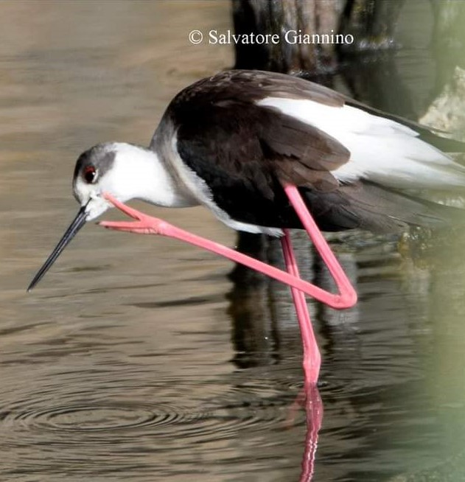
THE BLACK WINGED STILT
Scientific males: Himantopus
Height: about 33-34 cm.
Weight: about 160 gr
Plumage: black and white
Wing span: 65-83 cm
Males and females: males haven’t brown scapulars
Living/Origins: Senegal and Mali
Food: insects, mollusks and crustaceans
Migratory but someone stays in Italy even in winter
They are a protected species

Slide 34
THANKS FOR LISTENING
GIULIA
VIVIANA
AND LOOKING FORWARD TO MEETING YOU SOON
Chiara
GRAZIANA
Annalisa

Slide 35
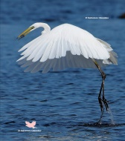
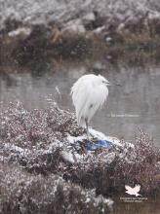
ANIMAL PUZZLES
Click to play
Click to play
Click to play
Click to play
Click to play

Slide 36
Click to play
Click to play
Click to play
Click to play

Slide 37
And now let’s play with our Kahoot Game
Kahoot game

