Slide 1
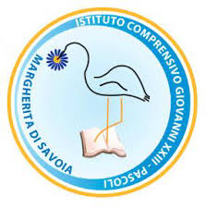
ITALIAN PRESENTATION
Erasmus + project
Salt-work in progress: piccoli ciceroni

Slide 2
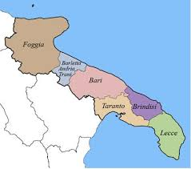
Where we are
Margherita di Savoia

Slide 3
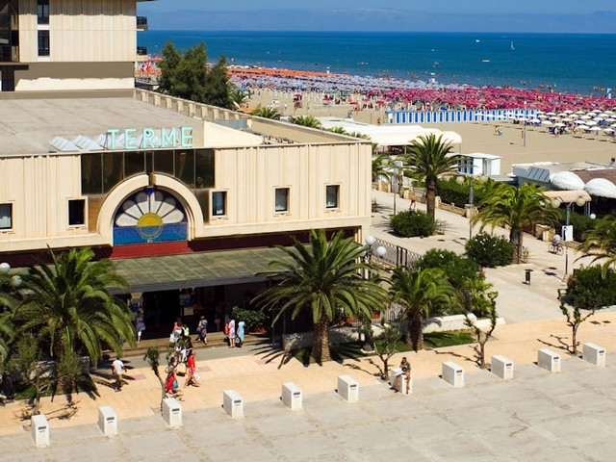
MARGHERITA DI SAVOIA
Our school is located in Margherita di Savoia in Puglia in the South of Italy, in a land with good tourist capabilities due to a large coast with iron sand, a large number of beach resorts and the largest saltworks in Europe, which are the source for tourist, fauna and thermal wealth.

Slide 4
THE TOWN
Founded in the 4th century BC as a trading center along the salt routes, its name was in Latin times Salinae Cannarum, was then changed in the Christian era to Sancta Maria de' Salinis.
The name Margherita di Savoia was given in 1879 in honour of Queen Margherita of Savoy, the Queen consort of Umberto I, King of Italy. Previously it had been known as Saline di Barletta. The town is in the Province of Barletta-Andria-Trani and around 12.000 inhabitants live there, though the population doubles in summer. Their main economic industries are: agriculture, fishing and tourism, in addition to salt production.

Slide 5
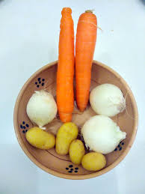
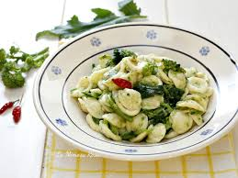
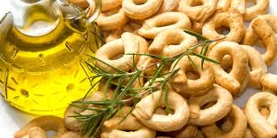
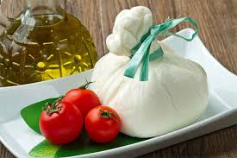
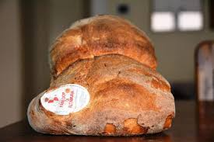
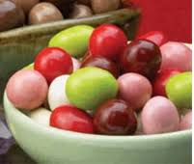
Some Typical Products

Slide 6
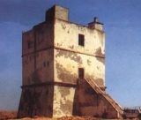
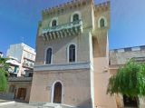
Some Points of Interest
THE TORRIONE
TORRE PIETRA
Torrione, a sighting tower built in the 16th century, later a military garrison used as a checking point, then changed in the 19th century into the telegraph office. Today it’s used as the Museum of salt.
Torre Pietra, 11 km north of the town, also a sighting and defensive tower, named after a promontory called Punta della Pietra which has by now disappeared throgh the slow erosion during the centuries.

Slide 7
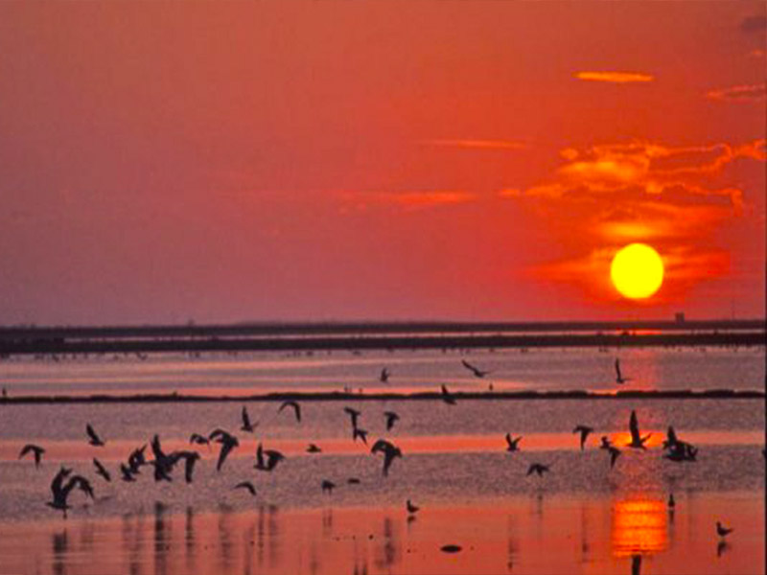
OUR SALTWORKS
Margherita Di Savoia lays claim to the biggest salt basins in Europe, second only worldwide to the ones in Bolivia. These are 45,000 hectares of fruitful wetlands that take on a beautiful pink hue as the day comes to a close. This natural oasis in the Italian landscape is not to be missed. the various stages of the slow production of salt, from evaporation through to harvesting. The basin is divided into shallow pools to aid salt production, all of varying depths, degrees of salinity and shades of colour. An impressive hydraulic system makes the salt flat functional: the water is let into the large basins and then begins its slow journey from one pool into another until it reaches the salting pools, where the mineral precipitates into the water and can be collected and stored.

Slide 8
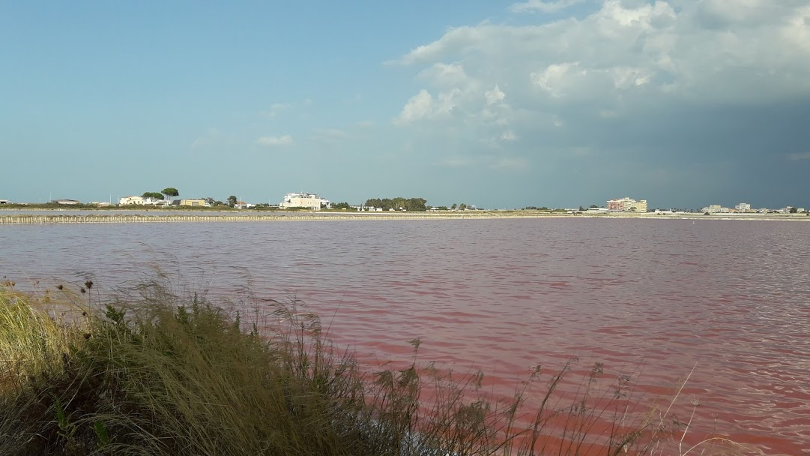
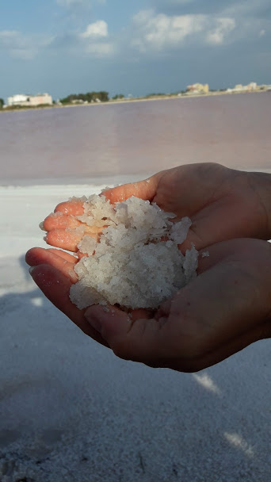
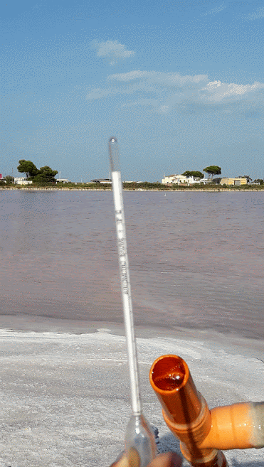
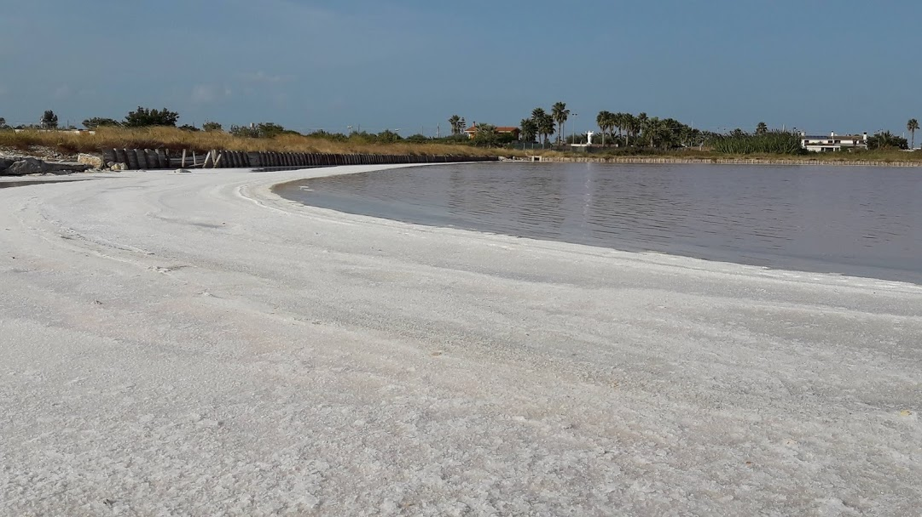
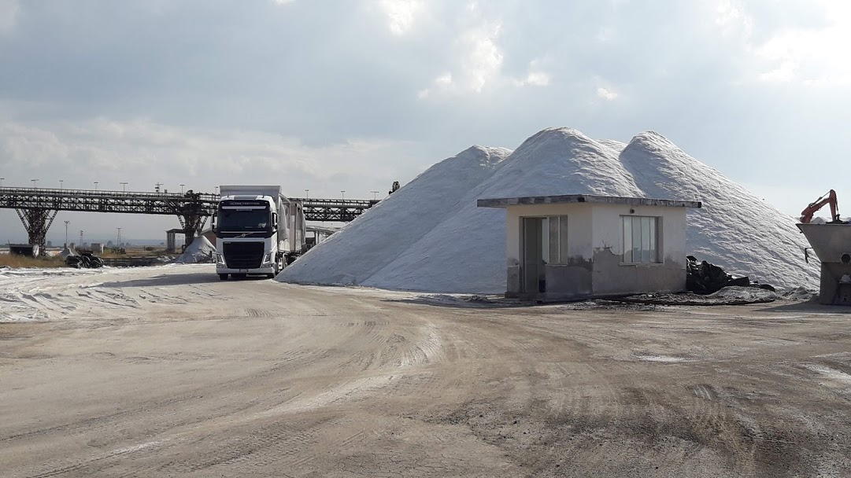
OUR SALTWORKS

Slide 9
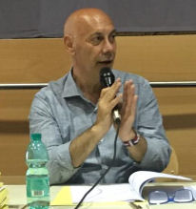
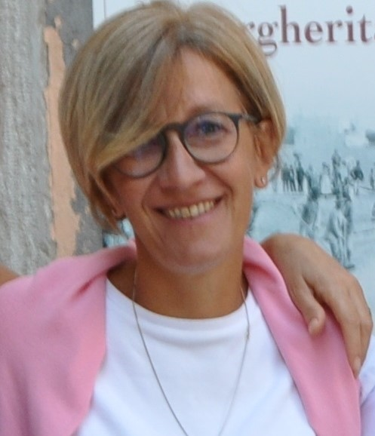
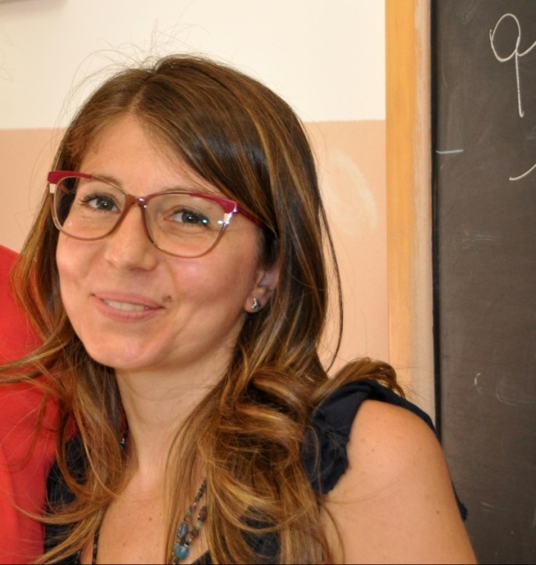
ERASMUS TEAM
Valentino Di Stolfo
The School Director
Beatrice di Venosa
English Teacher at the Lower Secondary School
Mariangela Tedesco
Teacher at the Primary School

Slide 10
Italian Compulsory Education System (credits: Eurydice – Indire)

Slide 11
In the IC you can find three school levels: kindergarten (3-5 year pupils) Primary School (6-10 year students) Lower Secondary School (11-14 year students) located in different zones of the city. People working in the school are 121 members, of which 102 are teachers; all school pupils are 962, of which 23 come from other cultures;
OUR SCHOOL

Slide 12
kindergarten

Slide 13
Primary School

Slide 14
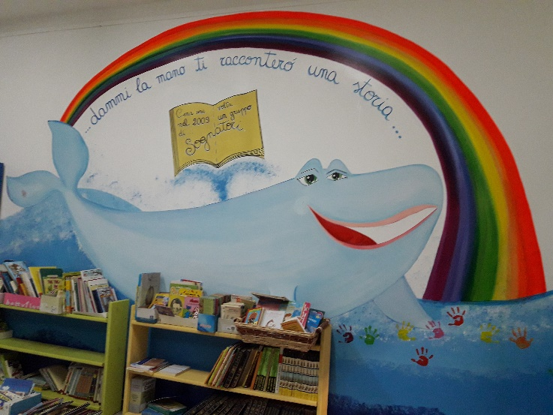
Primary School Organisation
Primary education (scuola primaria) starts at 6 years of age and lasts 5 years.
Pupils study the following school subjects:
- Italian, English, Maths, Science, Technology, History, Geography, Art, Music, Physical Education, Religion
School Time: 27 hours
from 8.15 to 13.15 (Monday - Friday)
from 13.30 to 15.15 (Thurdsay)

Slide 15
Lower Secondary School

Slide 16
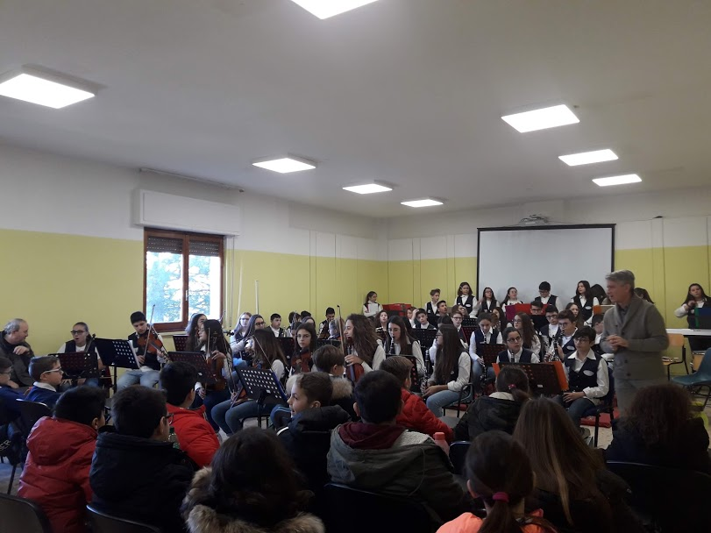
Lower Secondary School Organisation
Lower Secondary Education (scuola secondaria di I grado) starts at 11 years of age and lasts 3 years.
Students study the following school subjects:
- Italian, English, French, Maths, Science, Technology, History, Geography, Art, Music, Physical Education, Religion
Ordinary School Time: 30 hours
from 8.20 am to 1.20 pm (Monday - Saturday)
School Time for 4 Music Classes: 30 hours
from 8.20 to 13.20 (Monday - Saturday)
from 3.00 pm to 7.00 pm (Monday – Friday)

Slide 17
Thanks for your attention!
Erasmus Team
Beatrice di Venosa
Mariangela Tedesco

