Slide 1
ROLE OF WATER
IN LIVING SYSTEM
J. Andreu Enguix Torres
4º ESO C

Slide 2
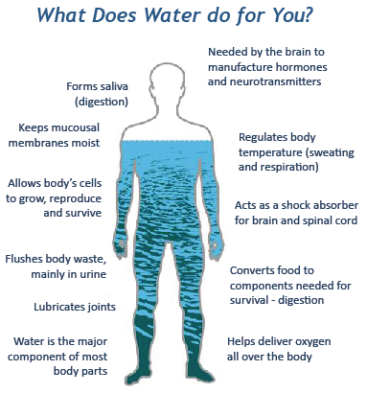
Think of what you need to survive, really just survive. Food? Water? Air? Facebook? Naturally, I'm going to concentrate on water here. Water is of major importance to all living things; in some organisms, up to 90% of their body weight comes from water. Up to 60% of the human adult body is water.
According to H.H. Mitchell, Journal of Biological Chemistry 158, the brain and heart are composed of 73% water, and the lungs are about 83% water. The skin contains 64% water, muscles and kidneys are 79%, and even the bones are watery: 31%.
Each day humans must consume a certain amount of water to survive. Of course, this varies according to age and gender, and also by where someone lives. Generally, an adult male needs about 3 liters per day while an adult female needs about 2.2 liters per day. Some of this water is gotten in food.

Slide 3
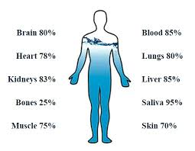
Water serves a number of essential functions to keep us all going:
A vital nutrient to the life of every cell, acts first as a building material.
It regulates our internal body temperature by sweating and respiration
The carbohydrates and proteins that our bodies use as food are metabolized and transported by water in the bloodstream;
It assists in flushing waste mainly through urination
acts as a shock absorber for brain, spinal cord, and fetus
forms saliva
lubricates joints
According to Dr. Jeffrey Utz, Neuroscience, pediatrics, Allegheny University, different people have different percentages of their bodies made up of water. Babies have the most, being born at about 78%. By one year of age, that amount drops to about 65%. In adult men, about 60% of their bodies are water. However, fat tissue does not have as much water as lean tissue. In adult women, fat makes up more of the body than men, so they have about 55% of their bodies made of water.

Slide 4
6 Reasons to drinks water on an Empty Stomach:
Help to Eliminating Toxins:Drinking 1 or 2 glasses of water before breakfast is perfect for wiping out poisons and all substances that our body does not require. Because of this, water avoids sicknesses and helps digestion system toward the start of consistently. Amid the night the body works repairing cells and cleaning itself, accordingly, drinking a glass of water on a vacant stomach is extremely advantageous in light of the fact that this will give a help to the body and will discharge all squanders, through pee.
Good for you Skin: Water is an extraordinary associate for the skin and extremely advantageous to your wellbeing; drinking some water on unfilled stomach will keep up the versatility and tonicity of the skin and anticipate untimely wrinkles.
Keep Hydrate our vital Organ: Drinking water in the morning secures and hydrates our imperative organs and makes them solid and keeps up their working.

Slide 5
Help to lose Wight: Drinking 2-3 glasses of water on unfilled stomach is perfect for weight reduction. Other than taking out toxins from the body, water blazes fat and calories, so it lessens the sentiments of overeating so as to crave abstaining from putting on weight.
Help to Prevent Constipation: Drinking water before breakfast is perfect for stimulating so as to fight and avoiding blockage the solid discharge.
Prevent Gastritis: In the event that you encounter issues, for example, gastritis, water can turn into your best associate in treating this issue. Drink no less than 3 glasses of water on unfilled stomach and this will decrease the level of sharpness in your stomach and the issues that can bring about you gastritis.

Slide 6
Water: You are presumably not new to drinking water to lose weight. In any case, you might be pondering whether it truly offers you some assistance with shedding pounds. The short answer is yes.
Drinking water offers you some assistance with losing weight, support your digestion system, wash down your collection of waste and stifle a longing. Likewise, it might sound repudiating, yet drinking water keeps your body from holding water, offering you some assistance with losing the additional water weight you might be conveying.

Slide 7
Why do plants need water, sun and oxygen?
Plants use the light energy to create glucose, a kind of sugar, to keep the plant alive, and oxygen.
Water is needed to make the chemistry behind all life possible. Plants use water to transport all those metabolic products to where they are needed and to get nutrients from the surroundings.
Plants also use water to make food for us in photosynthesis where water molecules and carbon dioxide molecules combine to form glucose and oxygen
Plants respire exactly the same way that animals do. If thy don’t have oxygen plants will suffocate and die within a few hours..

Slide 10
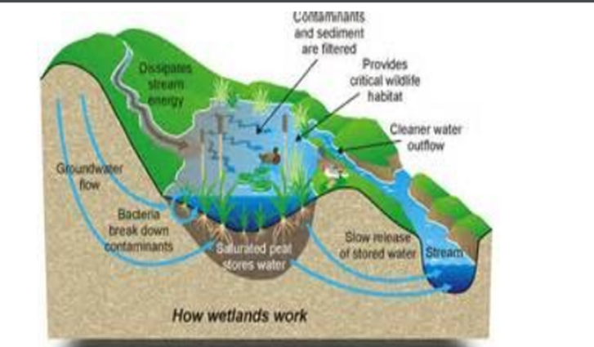
Water covers 71% of the Earth's surface.[1] It is vital for all known forms of life. On Earth, 96.5% of the planet's crust water is found in seas and oceans, 1.7% in groundwater, 1.7% in glaciers and the ice caps of Antarctica and Greenland, a small fraction in other large water bodies, and 0.001% in the air as vapor, clouds (formed of ice and liquid water suspended in air), and precipitation. Only 2.5% of this water is freshwater, and 98.8% of that water is in ice (excepting ice in clouds) and groundwater. Less than 0.3% of all freshwater is in rivers, lakes, and the atmosphere, and an even smaller amount of the Earth's freshwater (0.003%) is contained within biological bodies and manufactured products. Water on Earth moves continually through the water cycle of evaporation and transpiration (evapotranspiration), condensation, precipitation, and runoff, usually reaching the sea. Evaporation and transpiration contribute to the precipitation over land. Large amounts of water are also chemically combined or adsorbed in hydrated minerals.

Slide 11
Webgraphy
https://water.usgs.gov/edu/propertyyou.html
http://healthbringsjoy.com/category/weight-loss/
https://www.slideshare.net/Rbr1188/plants-and-water-the-evolutionary-model
http://slideplayer.com/slide/6291583/
http://slideplayer.com/slide/8518383/

