Slide 1
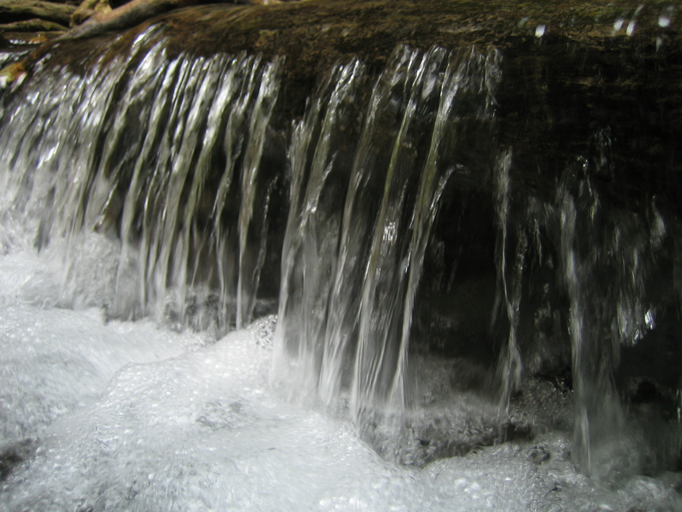
Water Properties and living systems

Slide 2
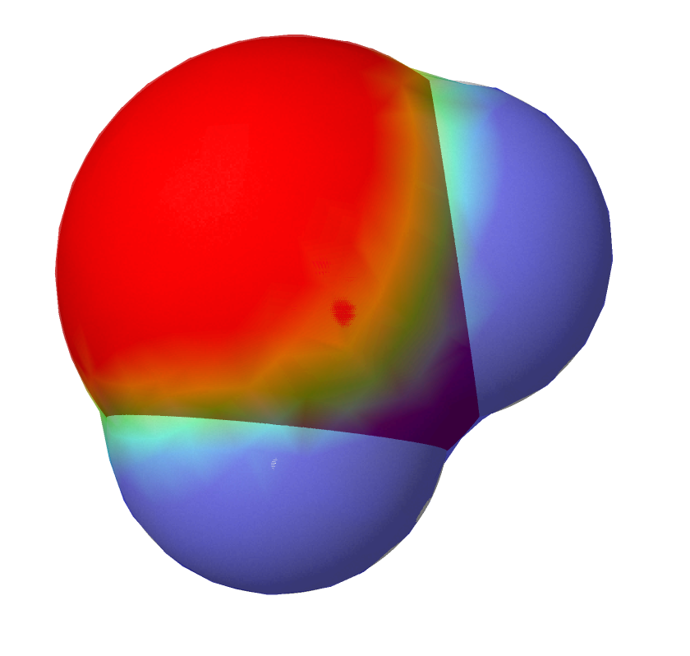
The chemical composition of water is H₂O - two hydrogen atoms and one oxygen atom.
This molecular structure gives the water molecule polarity, or a lopsided electrical charge that attracts other atoms.
The end of the molecule with the two hydrogen atoms is positively charged.
The other end, with the oxygen, is negatively charged.
Just like in a magnet, where north poles are attracted to south poles ('opposites attract'), the positive end of the water molecule will connect with the negative end of other molecules.
H
H
O

Slide 3
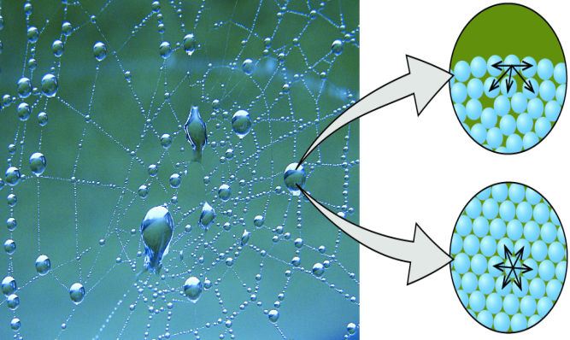
Water's Attraction to Other Polar Molecules
Cohesion, otherwise known as water's attraction to other water molecules, is one of the major properties of water. Water's polarity lends it to be attracted to other water molecules. The hydrogen bonds in water hold other water molecules together.
Due to water's cohesiveness:
Liquid water has surface tension. This allows for insects, such as Water Striders, to walk on water.
Water is a liquid at moderate temperatures, and not a gas.
http://cnx.org/resources/c76ff0948f3e68952380b2e687f5a970b4fb742b/CNX_Chem_10_02_Droplet.jpg
http://cnx.org/resources/0738f6772fde761a9a391f0f3ea7cbc7e1791703/CNX_Chem_10_02_Strider.jpg

Slide 4
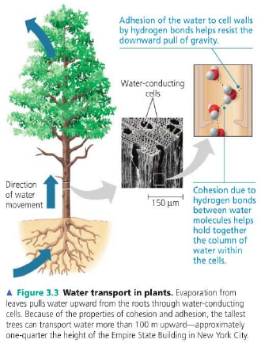
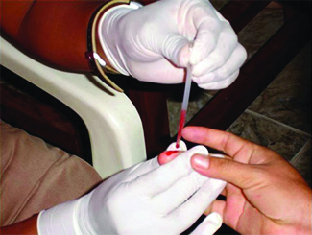
Water's Attraction to Other Polar Molecules
Adhesion. Water's attraction between molecules of a different substance is called adhesion. Water is adhesive to any molecule it can form hydrogen bonds with. Due to water's adhesiveness:
Capillary action occurs. For example, when you have a narrow tube in water, the water will rise up the tube because of water's adhesiveness to the glass "climbing" up the tube.
Blood is collected for medical analysis by capillary action, which draws blood into a small diameter glass tube.
http://biosejati.files.wordpress.com/2012/02/image49.png
http://cnx.org/resources/43a911369ae8892e6cb47328bb112776af3ac555/CNX_Chem_10_02_BloodDraw.jpg

Slide 5
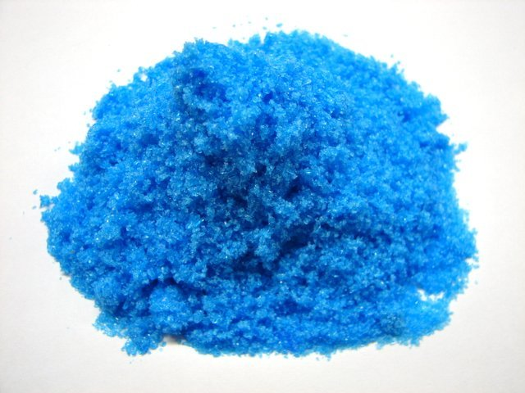
Water's polarity allows it to dissolve other polar substances very easily
When a polar substance is put in water, the positive ends of its molecules are attracted to the negative ends of the water molecules, and vice versa. The attractions cause the molecules of the new substance to be mixed uniformly with the water molecules. Water dissolves more substances than any other liquid - even the strongest acid! Because of this, it is often called the 'universal solvent
water
Solution of copper sulphate
Copper (II) sulphate salt
The dissolving power of water is very important for life on Earth.
Wherever water goes, it carries dissolved chemicals, minerals, and nutrients that are used to support living things.

Slide 6
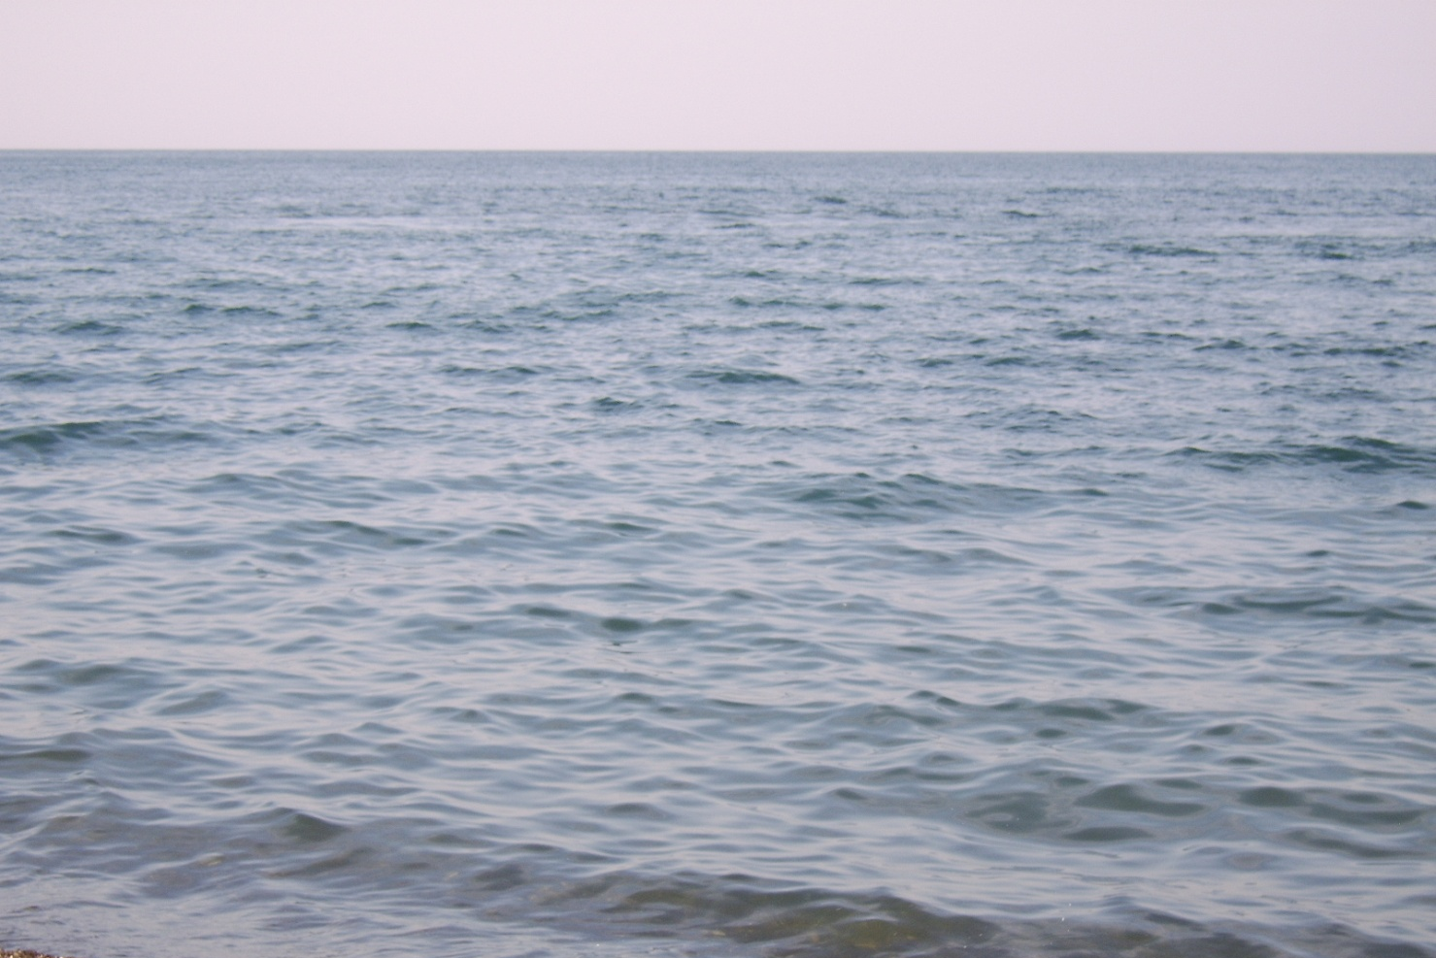
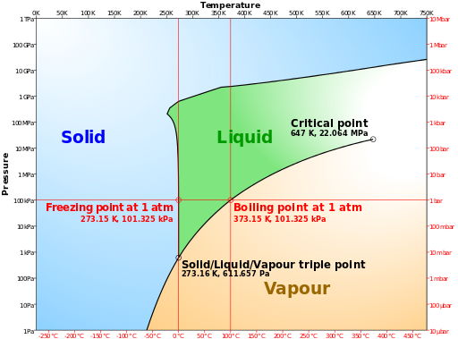
Water is the only natural substance that can exist in all three states of matter - solid, liquid, and gas - at the temperatures normally found on Earth.
The gaseous state of water is present continually in our atmosphere as water vapor.
Phase diagram of water
The liquid state is found everywhere in rivers, lakes, and oceans.
https://upload.wikimedia.org/wikipedia/commons/thumb/3/33/Phase_diagram_of_water_simplified.svg/512px-Phase_diagram_of_water_simplified.svg.png

Slide 7
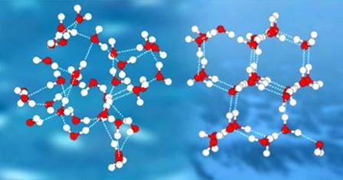
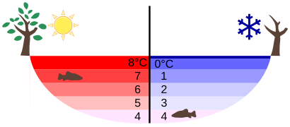
The solid state of water, ice, is unique
Most liquids contract as they are cooled, because the molecules move slower and have less energy to resist attraction to each other. When they freeze into solids they form tightly-packed crystals that are much denser than the liquid was originally. Water doesn't act this way. When it freezes, it expands: the molecules line up to form a very 'open' crystalline structure that is less dense than liquid water. This is why ice floats. And it's a good thing it does! If water acted like most other liquids, lakes and rivers would freeze solid and all life in them would die.
Temperature distribution in a lake in
summer and winter
liquid water solid water
http://soznanie.info/st_vodarod.html
https://upload.wikimedia.org/wikipedia/commons/thumb/3/32/Anomalous_expansion_of_water_Summer_Winter.svg/410px-Anomalous_expansion_of_water_Summer_Winter.svg.png

Slide 8
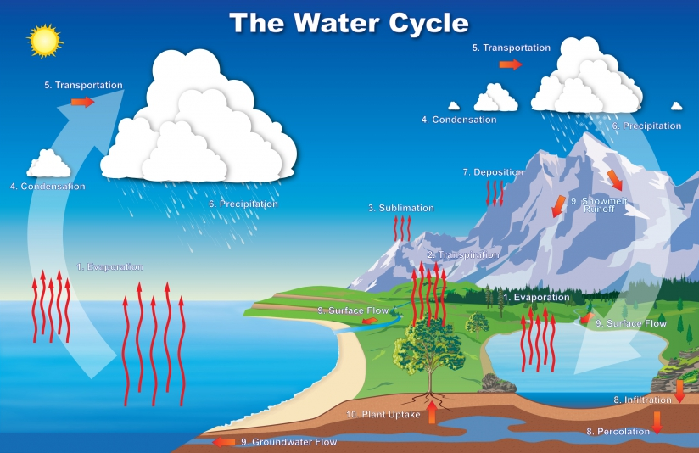
http://www.noaa.gov/sites/default/files/styles/scale_crop_1120x534/public/thumbnails/image/hydro2010_landscape.jpg?itok=OchCA2Zh

Slide 9
