Slide 1
CLICK on e-CLIL
Evaluation of C1: Short term joint staff training event – Jibou, Romania
OCTOBER 2019

Slide 2
Number of responses: 9
Liceul Tehnologic Octavian Goga Jibou, Romania – 3 teachers
Vilniaus Sausio 13-osios Progimnazija, Lithuania – 3 teachers
Agrupamento de Escolas do Barreiro, Portugal – 2 teachers
CEIP Santa María del Mar, Spain – 1 teacher

Slide 3
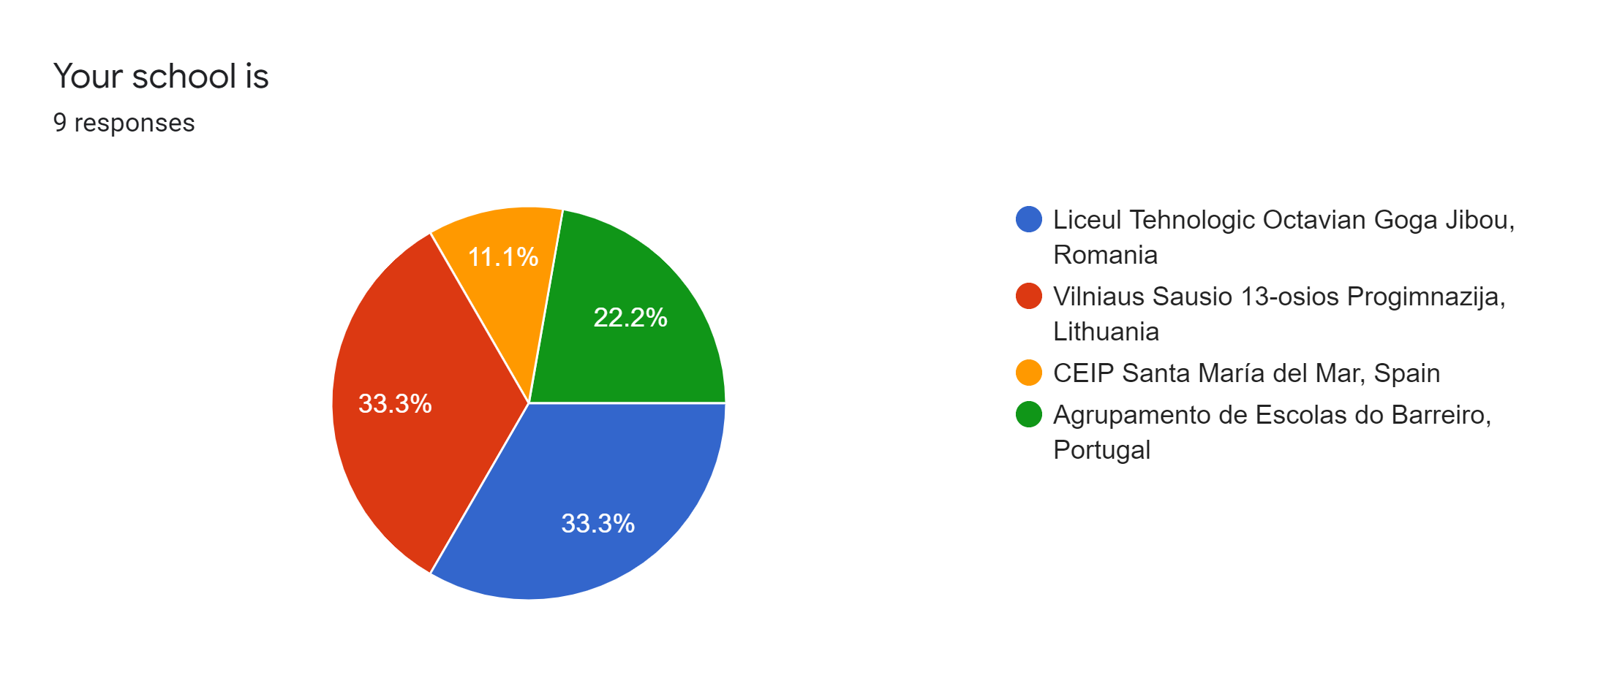

Slide 4
What subject(s) do you teach?
English – 3 teachers
Headmaster – 2 teachers
History – 1 teacher
ICT – 1 teacher
Maths - 1 teacher
P.E. – 1 teacher

Slide 5
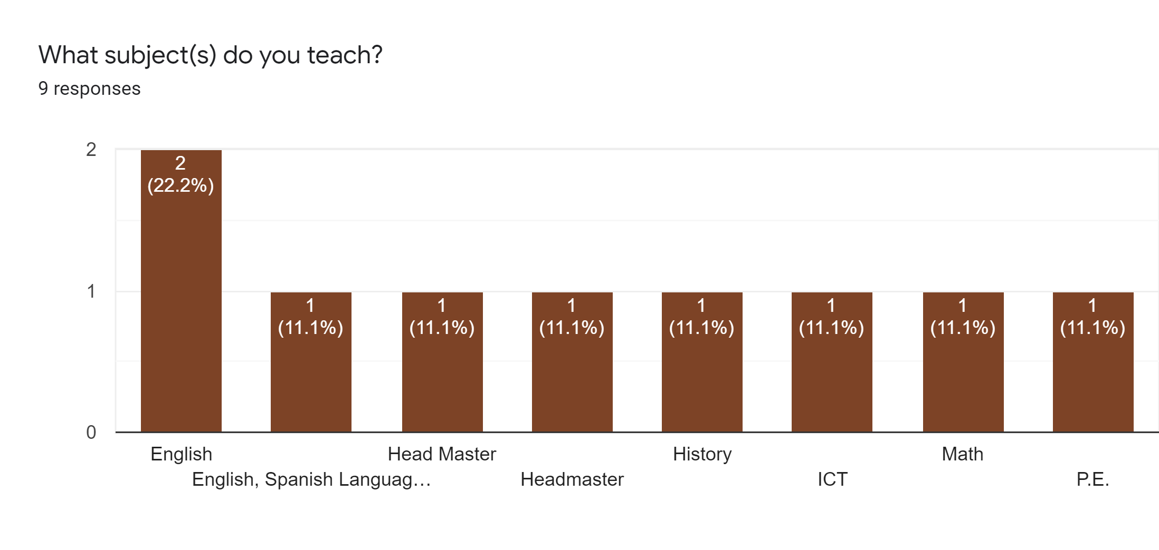

Slide 6
Sufficient information was sent before the meeting and communication was efficient
Strongly agree – 8 teachers
Agree – 1 teacher

Slide 7
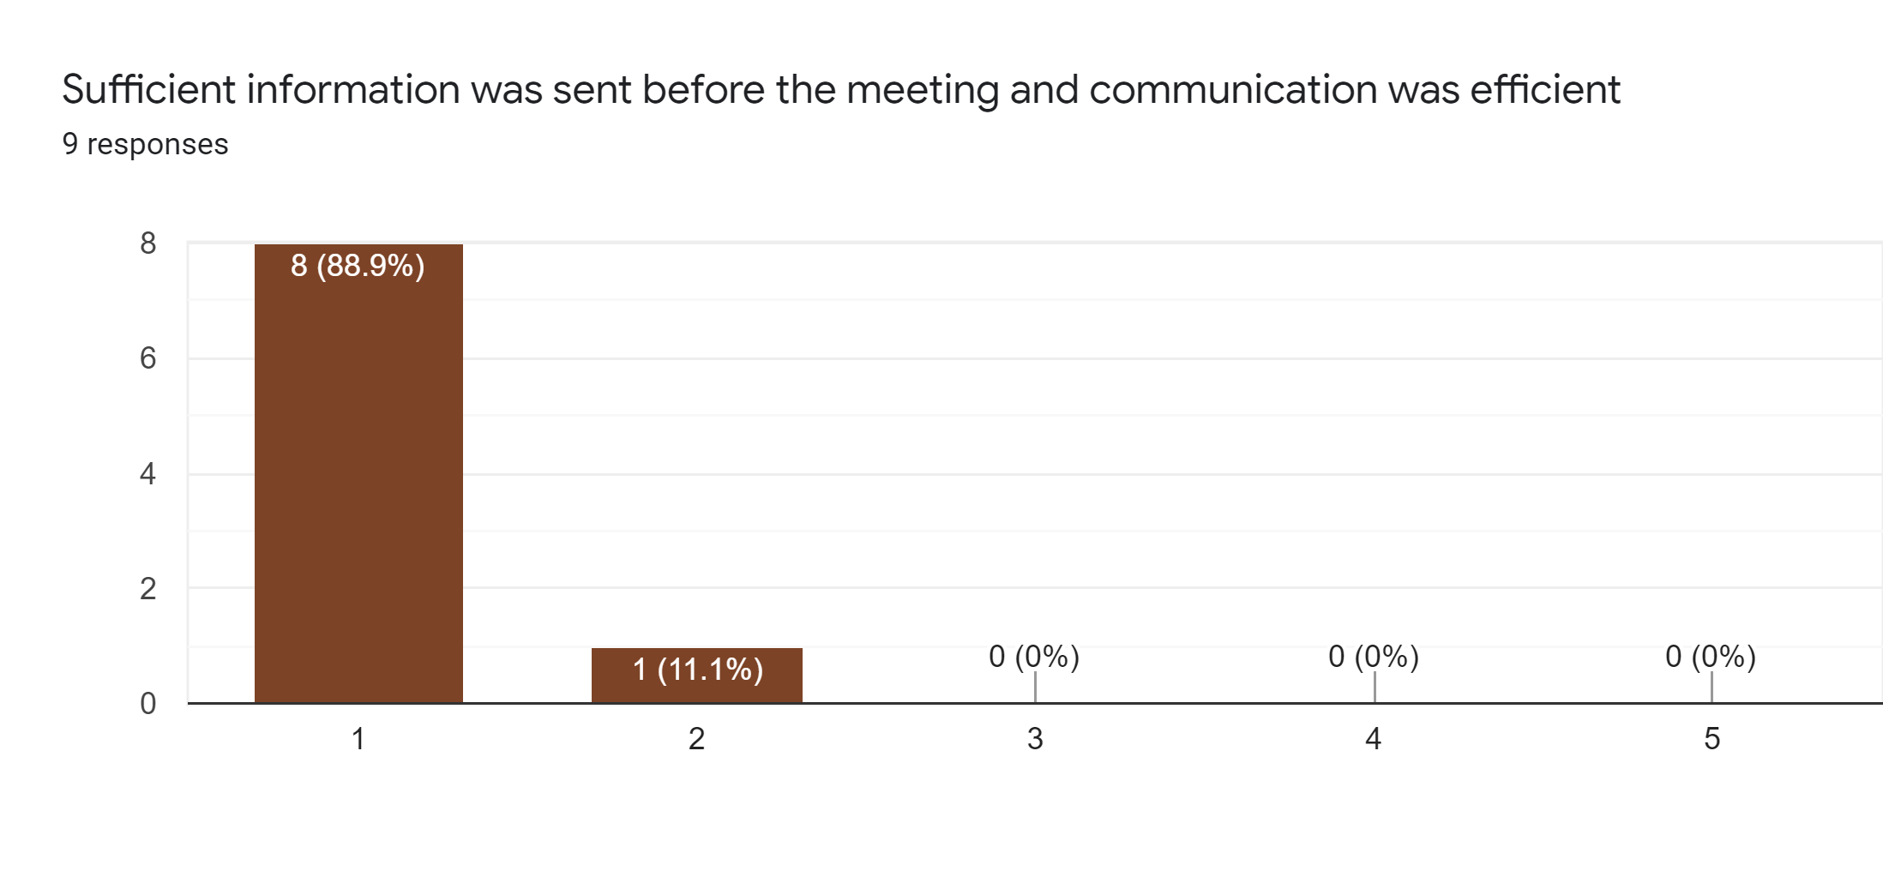

Slide 8
Partners were given time for introductions (or re-introductions) and had time to update each other on their backgrounds and what they can bring to the project
Strongly agree – 9 teachers

Slide 9
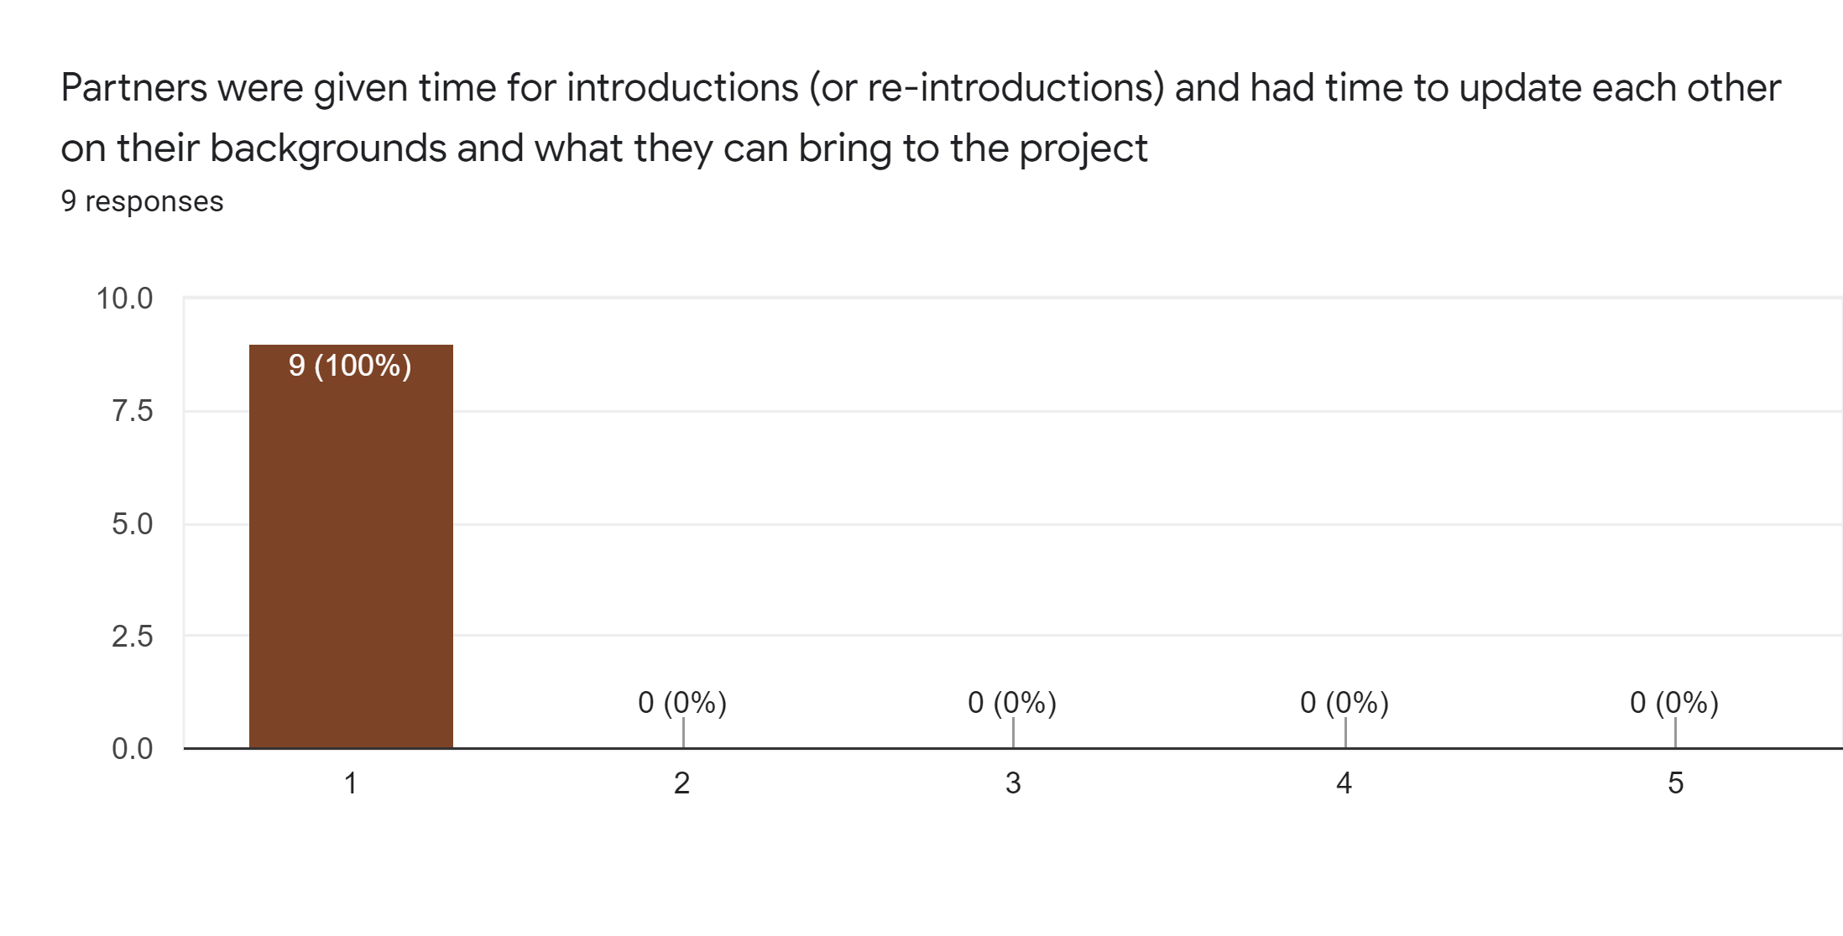

Slide 10
The agenda has been respected and any changes negotiated
Strongly agree – 9 teachers

Slide 11
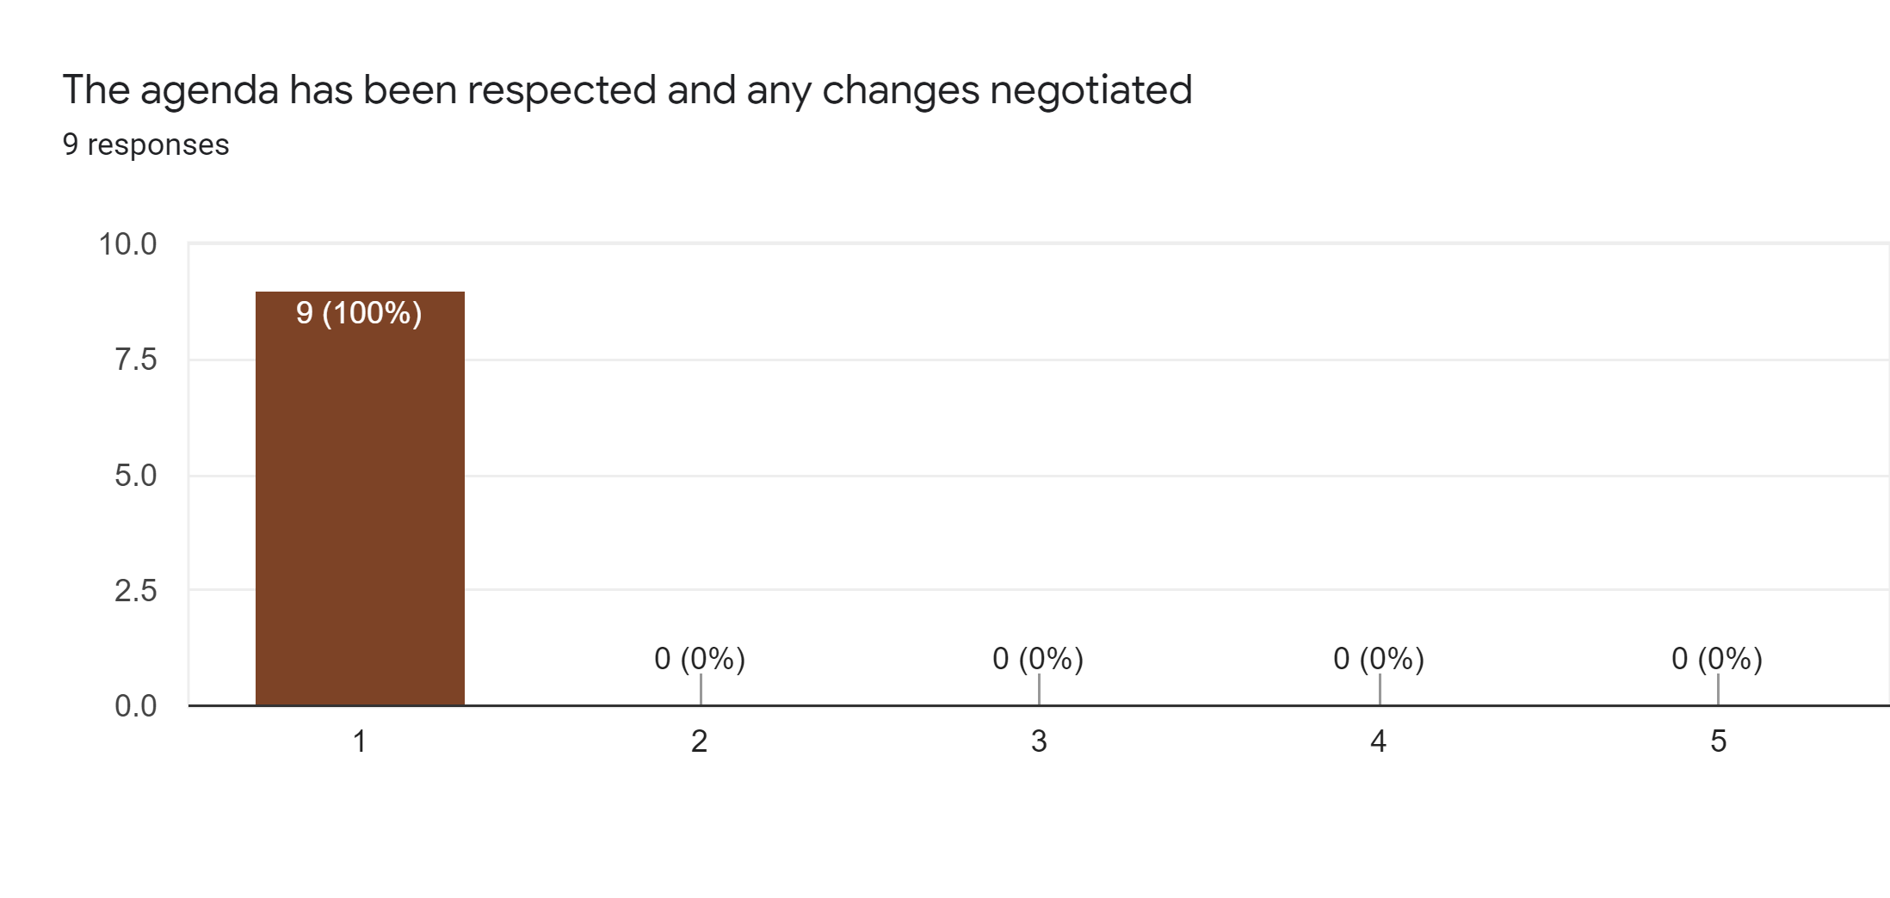

Slide 12
Partners have all contributed to the meeting
Strongly agree – 7 teachers
Agree – 2 teachers

Slide 13
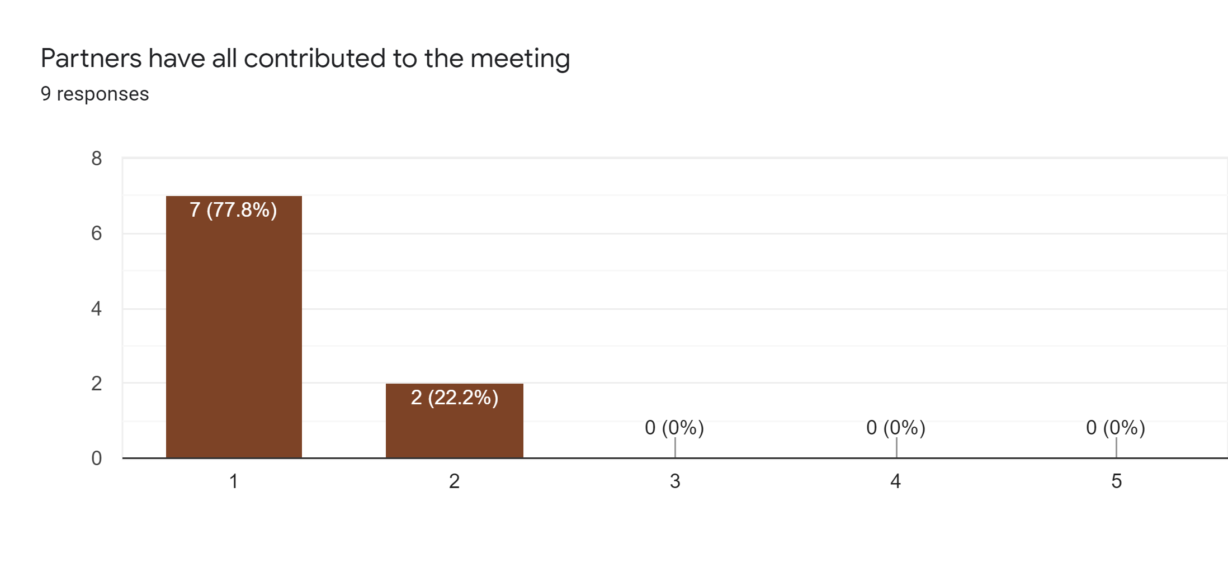

Slide 14
The goals of the meeting were met
Strongly agree – 9 teachers

Slide 15
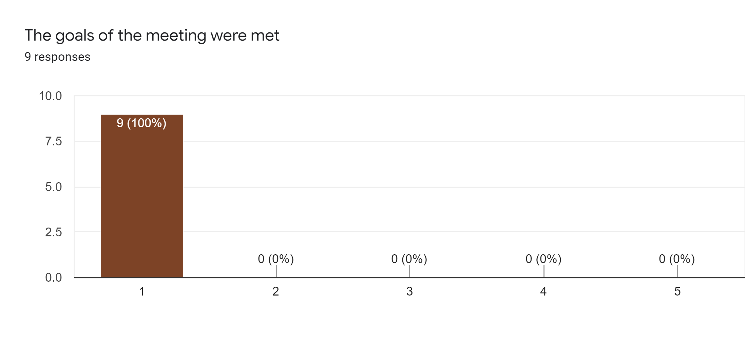

Slide 16
The working environment was adequate for the proposed tasks
Strongly agree – 9 teachers

Slide 18
The accommodation, food and social element were adequate
Strongly agree – 9 teachers

Slide 20
I know clearly what CLIL is.
Strongly agree – 9 teachers

Slide 22
I learnt useful digital and web tools to use during lessons.
Strongly agree – 9 teachers

Slide 24
I understand the lesson plan that I need to use for the future CLIL lessons in the project.
Strongly agree – 9 teachers

