Slide 1
PLANNING CLIL LESSONS
CEIP Santa María del Mar, Tenerife, Spain
Erasmus+ meeting, Jibou, Romania
21/25 October 2019

Slide 2
Clil: content and language integrated learning
This presentation is based on our 10 years of experience using CLIL as the methodology approach for teaching English in our school.
We hope that sharing our successes and errors will help you to overcome your coming questions, doubts and mistakes that certainly will occur in the process.
CHILDREN LEARN LANGUAGES WHEN THEY NEED THEM, SO IF WE STIMULATE AND SPARK THEIR CURIOSITY, THEY WILL LEARN.
ALL TEACHERS ARE TEACHERS OF LANGUAGE (Bullock report 1975)

Slide 3
HOW DOES CLIL WORK?
BASE OF CLIL: Content subjects are taught and learnt in a language (English for us) which is not the mother tongue of the learners
FLUENCY is much more important than ACCURACY.
ERRORS ARE A NATURAL PART OF LEARNING

Slide 5
Clil is based in language acquisition rather than enforced learning
This principle is of the utmost importance. It may be the key in order to integrate pupils of all levels and capabilities in the frame of this methodological approach.
Every speaker was a beginner speaker once, at least in the early childhood, and every progress received greetings instead of corrections.
This is the way. Support and encourage are the verbs.

Slide 6
ENGLISH As THE VEHICULAR LANGUAGE IN OUR TEACHING/LEARNING PROCESS
English shouldn’t be the subject matter, but the learning objective
Proficient English teachers, facilitate the introduction of CLIL approaches into the school (Language assistants)
Using the Target Language (English) among the pupils, fosters fluency and regular use of L2 within the class.
ACCURACY IS NOT THE TARGET.

Slide 7
The four cs OF CLIL CONTENT COMMUNICATION COGNITION CULTURE
These four principles are essential to the CLIL approach. They should be used as the framework for creating and delivering successful lessons.

Slide 8
content
That’s easy: It refers to the subject or theme.
When planning the content, it is essential to think of the knowledge, skills and understanding we want our students to learn, not only the knowledge they should acquire.
You must analyse the language demands and consider how to present the content in an understandable way.

Slide 9
communication
That’s not so easy.
It refers to students using the target language to communicate their thoughts, opinions, discoveries… referred to the lesson.
Both speaking and writing skills are emphasized. (Real language/Group work). Using language for learning content, it becomes meaningful.
Key then, is to present motivational contents. Usually, our starting point is just a text, a video or a research about a selected topic. From there, we build the lesson.
CLIL lessons connect language to real life, so students must develope their speaking skills as the build their vocabulary, grammar and language skills as they do in L1: naturally
Most difficult: Reduce TTT and Increase STT (youtube video “Teach as a champion” ReduceTTT & Increase STT)

Slide 10
cognition
It refers to the critical thinking skills that students use to engage with and understand course content, to solve problems and to reflect on their learning.
CREATE
SOLVE
EXPERIMENT
APPLY
INVENT
EXPLAIN
CLASSIFY
ANALYSE
EVALUATE
AND MANY OTHERS…

Slide 11
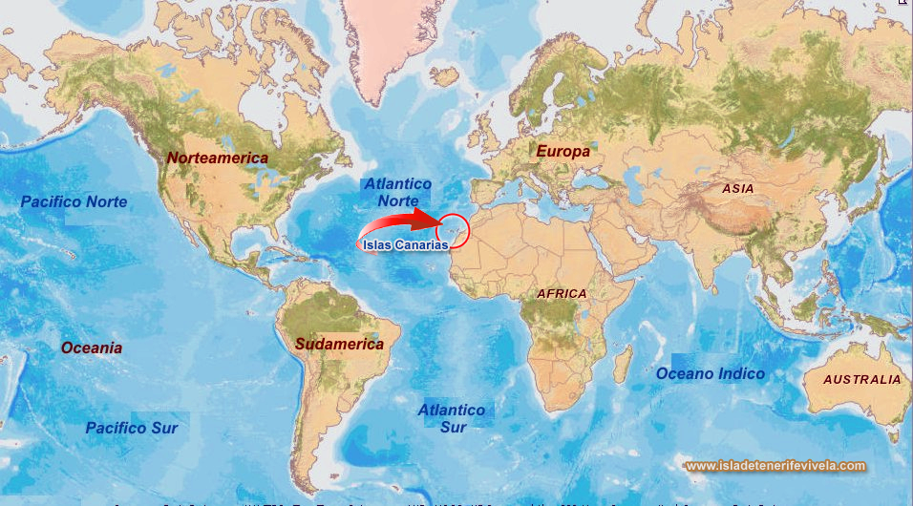
CULTURE
Also known as community and citizenship, refers to the learning community not only of a class or school but more broadly, to local ang global cultures.
Students are encouraged to understand themselves not only as citizens of the world but to understand themselves as citizens of a wider and global world, promoting international awareness and understanding.

Slide 12
The four skills in clil
LISTENING: Vital for lenguage learning. Involved in the vast majority of every input activity and the most common in our language classes; exposition to the target language is essential.
READING: When meaningful and attractive materials are used, they become the major source of input.
SPEAKING: Focused on fluency. Accuracy is seen as subordinate.
WRITING: Mainly through activities that include “recicled” grammar
Peviously shown and used; then explanation if necessary; (naturall acquisition, same as L1)

Slide 13
SCAFFOLDING PROCESS OF SUPPORTING YOUR STUDENTS DURING THEIR LEARNING PROCESS AND GRADUALLY REMOVING THAT SUPPORT AS YOUR STUDENTS BECOME MORE INDEPENDENT
Vygotsky wrote: “What the child can do in cooperation today, he can do alone tomorrow” (19349

Slide 14
Use of first language
Connect to background knowledge
Viisuals, realia, videos, graphic organizers…
SCAFFOLDING STRATEGIES
Read aloud and or groupal reading
Modeling
& gestures
Intentional small group and or partner work
Thinking based learning (TBL) organizers
Sentence structures
& Starters
I know… because….
And everything else that may work with your pupils

Slide 15
