Slide 1
TKINTER
LESSON
by GVOZA students ; )

Slide 2
TABLE OF CONTENTS
01
02
03
Drawing rectangles
Drawing line and oval
Introduction
04
05
Creating text
Function

Slide 3
01
INTRODUCTION

Slide 4
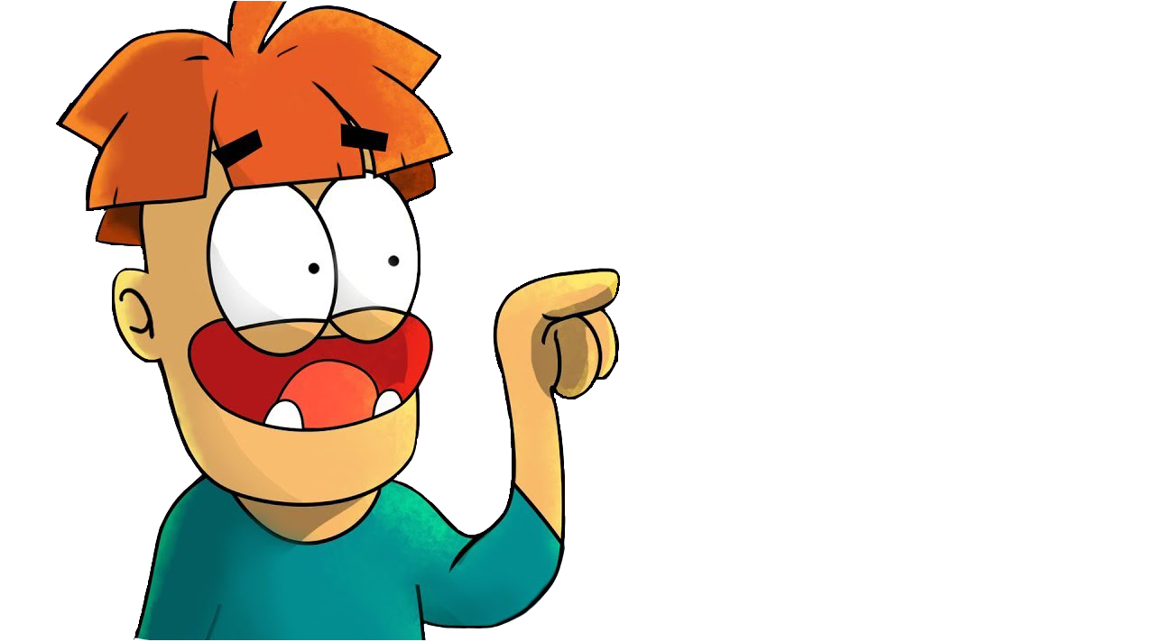
CODE
#at the beginning of every programme, the following lines are needed to be written for your code to be executed
import tkinter
canvas = tkinter.Canvas()
canvas.pack()
#canvas is a variable name, so you can choose a different one
… your code

Slide 5
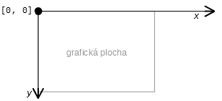
Coordinate system
in tkinter we use coordinate system to orientate on graphical area
starting point is located in the upper left corner (its coordinates are [0,0])

Slide 6
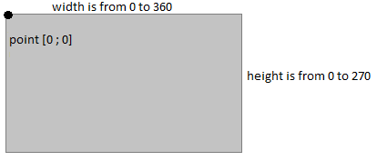
Have a look at the drawing window
Dimensions
Coordinate x in (0; 360>
Coordinate y in (0; 270>
Coordinate [0; 0] is not used because the border lines of the rectangle would not be visible
Nothing outside the drawing area is displayed, be careful during calculations

Slide 7
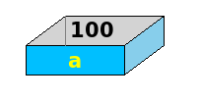
Variables
variable in a python program stores data in the computer for processing.
Variables in Python can be defined by any name or even letters like x, y, a, aa...

Slide 8
CODE
x = 30
Name = ‘Dingeľ‘
Number_of_pages = 130
#Variable can be used in a statement or expression, and its value will be substituted
print(x)
>>> 30

Slide 9
02
DRAWING RECTANGLES

Slide 10
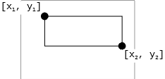
How to draw a rectangle
command for creating a rectangle is:
canvas.create_rectangle(x1, y1, x2, y2)
x1, y1 are coordinates of the left upper vertex
x2, y2 are coordinates of the right lower vertex
note: Square is just a special case of rectangle!

Slide 11
CODE
import tkinter
canvas = tkinter.Canvas()
canvas.pack()
canvas.create_rectangle(50, 70, 220, 150)
[x1 = 50,y1 = 70]
width=170
height=80
[x2 = 220,y2 = 150]

Slide 12
Task 1
Draw a square with size 50 px!

Slide 13
CODE
import tkinter
canvas = tkinter.Canvas()
canvas.pack()
x= 100
y= 70
canvas.create_rectangle(x , y , x+50, y+50)
#x,y are numbers that you choose as your left upper vertex

Slide 14
Drawing a rectangle with variables
x = 100,y = 70
you can use variables as coordinates
the easiest way is to select the upper left corner or center point of the rectangle
Exercise
draw a square with side 100
the upper-left corner is specified by x, y

Slide 15
CODE
import tkinter
canvas = tkinter.Canvas()
canvas.pack()
x = 100
y = 70
canvas.create_rectangle(x, y, x+100, y+100)

Slide 16
Drawing a rectangle with variables
draw a square with side 100
the center of the rectangle is specified by x,y
the result will be the same as in the last exercise, but the position of the square differs
[100, 70]

Slide 17
CODE
import tkinter
canvas = tkinter.Canvas()
canvas.pack()
x = 100
y = 70
canvas.create_rectangle(x-50,y-50,x+50,y+50)

Slide 18
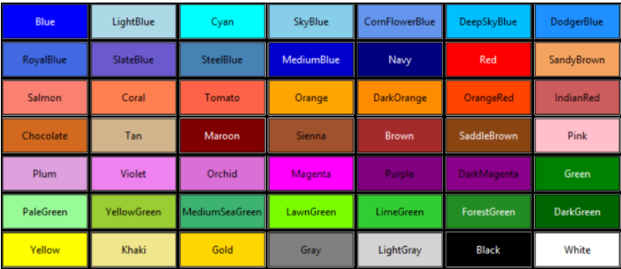
Filling rectangle with color
now when you know how to create a rectangle, we can proceed to adjusting its properties such as color
that’s easily done by adding “fill” property after coordinates
(e.g. canvas.create_rectangle(x1, y1, x2, y2, fill = “color”)
color examples:

Slide 19
CODE
import tkinter
canvas = tkinter.Canvas()
canvas.pack()
canvas.create_rectangle(30, 30, 130, 130, fill = ‘yellow’)
#you can replace ‘yellow’ with a different color, it can be green, blue, red or any color you want..

Slide 20
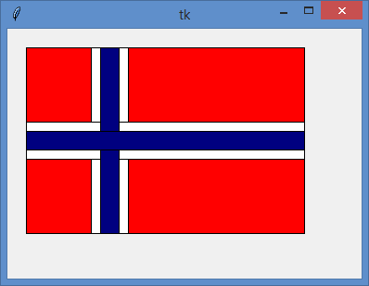
Draw the flag of Norway. Use variables x, y.
Before, you can start to train by writting commands for French flag.
Task 2

Slide 21
Code for flag
import tkinter
canvas = tkinter.Canvas()
canvas.pack()
x = 20
y = 20
canvas.create_rectangle(x, y, x + 300, y + 200, fill = 'red')
canvas.create_rectangle(x + 70, y, x + 110, y + 200, fill = 'white')
canvas.create_rectangle(x, y + 80, x + 300, y + 120, fill = 'white')
canvas.create_rectangle(x + 80, y, x + 100, y + 200, fill = 'navy')
canvas.create_rectangle(x, y + 90, x + 300, y + 110, fill = 'navy')

Slide 22
03
Drawing line and oval

Slide 23
How to draw a line
Line width = 1
Command for creating line is:
canvas.create_line (x1,y1,x2,y2)
x1, y1 are coordinates of the starting point
x2, y2 are coordinates of the final point
default width of the line is 1
You can change it by typing width = value
canvas.create_line(x1,y1,x2,y2, width = 3)
Line width = 3

Slide 24
CODE
import tkinter
canvas=tkinter.Canvas()
canvas.pack()
x = 100
y = 70
canvas.create_line(x,y,x+50,y)

Slide 25
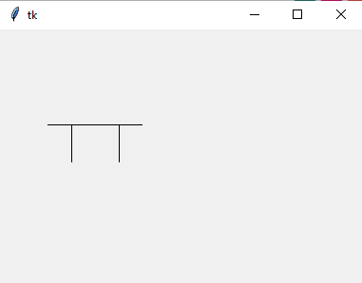
Create table using lines (something like this )
Task 3

Slide 26
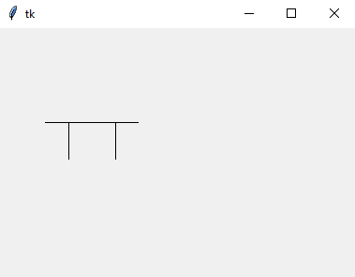
CODE
import tkinter
canvas=tkinter.Canvas()
canvas.pack()
x = 100
y = 100
canvas.create_line(x-50,y,x+50,y)
canvas.create_line(x-25,y,x-25,y+40)
canvas.create_line(x+25,y,x+25,y+40)

Slide 27
How to draw an oval
command for creating an oval is:
canvas.create_oval(x1, y1, x2, y2)
x1, y1 are coordinates of the left upper vertex of the rectangle circumscribed to circle
x2, y2 are coordinates of the right lower vertex of the circumscribed rectangle
Note: circle is just a special case of the oval!!

Slide 28
CODE
import tkinter
canvas = tkinter.Canvas()
canvas.pack()
canvas.create_oval(50, 70, 220, 150)
[x1 = 50,y1 = 70]
width=170
height=80
[x2 = 220,y2 = 150]

Slide 29
Task 4
Draw an oval 50 px high and 100 px wide!

Slide 30
CODE
import tkinter
canvas = tkinter.Canvas()
canvas.pack()
x= 50
y= 50
canvas.create_oval(x ,y , x+100, y+50)
#x,y in your solution can differ - they are numbers that you choose as your left upper vertex

Slide 31
04
CREATING TEXT

Slide 32
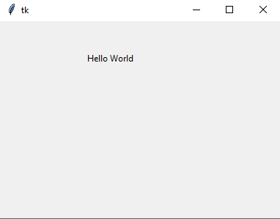
Creating text
text is created by the command:
canvas.create_text(x,y, text = “Hello World”)
in this case x, y are coordinates of the center point of the text
you can also change the font of the text, the only thing you have to do is to write font = ’ Arial n ’ where n is the size of the text

Slide 33
CODE
import tkinter
canvas = tkinter.Canvas()
canvas.pack()
canvas.create_text(150, 50, text = 'Hello World’, font=‘Arial 50’)

Slide 34
Task 5
Draw this ME logo!

Slide 35
How to make ME logo
First of all we choose x and y in the upper left corner of the square
x= n
y= m
canvas.create_rectangle(x, y, x+a, y+a, fill=”color”)
canvas.create_text(x+n,y+n,text=”left/up/down/right/M/E”,font=arial *n*)
n, m - numbers that you choose

Slide 36
CODE
import tkinter
canvas=tkinter.Canvas()
canvas.pack()
x=135
y=90
canvas.create_rectangle(x,y,x+100,y+100,fill="lightblue")
canvas.create_text(x+50,y-10,text="up",font="arial 10")
canvas.create_text(x+50,y+110,text="down",font="arial 10")
canvas.create_text(x-15,y+50,text="left",font="arial 10")
canvas.create_text(x+118,y+50,text="right",font="arial 10")
canvas.create_text(x+30,y+50,text="M",font="arial 45")
canvas.create_text(x+75,y+50,text="E",font="arial 45")
#you can replace ‘lightblue’ with a different color, it can be green, yellow, red or any color you want..

Slide 37
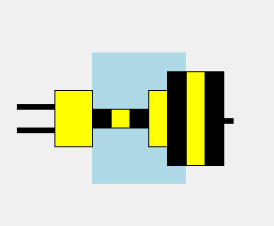
hint: code “width=0” removes the outlines
Difficult task:
Draw the picture using the center points!

Slide 38
05
Function

Slide 39
Define and call a function
word def begins the definition of your new command - function
square_example is the name of the function
the next lines form the body of the function
in order for the function to execute a group of commands, you must type in the command line:
blank brackets are important ! ! !

Slide 40
CODE
import tkinter
canvas = tkinter.Canvas()
canvas.pack()
def square_example():
x = 100
y = 50
canvas.create_rectangle(x,y,x + 50,y + 50,
fill = ('red')
square_example()

Slide 41
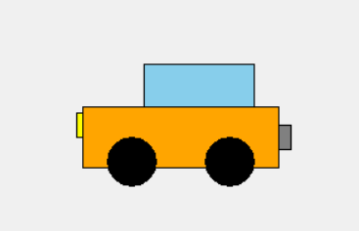
Task 6: Draw this picture using a function car_model!
hint:
Use central point coordinates: x = 200,y = 150

Slide 42
CODE
import tkinter
canvas = tkinter.Canvas()
canvas.pack()
def car_model():
x = 200
y = 150
canvas.create_rectangle(x - 80,y - 25,x + 80,y + 25, fill = 'orange')
canvas.create_oval(x - 60,y,x - 20,y + 40, fill = 'black')
canvas.create_oval(x + 20,y,x + 60,y + 40, fill = 'black')
canvas.create_rectangle(x - 30,y - 60,x + 60,y - 25, fill = 'skyblue')
canvas.create_rectangle(x- 85,y - 20,x - 80,y, fill = 'yellow')
canvas.create_rectangle(x + 80,y - 10,x + 90,y + 10, fill = 'grey')
car_model()

Slide 43
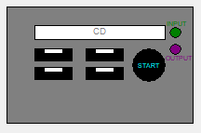
Task with multiple functions:
Write a code that draws a PC with Start button, multiple ports, PC box and CD rom (include texts like CD, INPUT, OUTPUT, START) using functions.
It should look like this

Slide 44
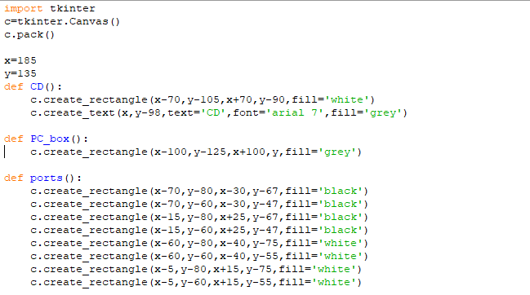
CODE
Following this code should bring you the same result (try to play with it to get familiar with the system):
Rest is on the other slide

Slide 45
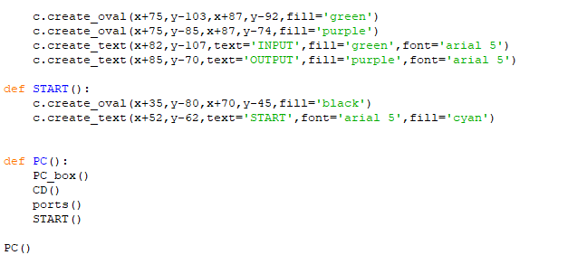
CODE

Slide 46
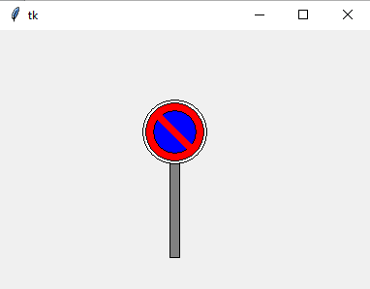
Final task: Road sign
Create this road sign, use variables x and y, which are the coordinates of the center of the pole.

Slide 47
CODE
import tkinter
canvas=tkinter.Canvas()
canvas.pack()
def road_sign():
x=180
y=185
canvas.create_rectangle(x-5,y-50,x+5,y+50,fill='grey')
canvas.create_oval(x-33,y-47,x+33,y-113,fill='white')
canvas.create_oval(x-30,y-50,x+30,y-110,fill='red')
canvas.create_oval(x-22,y-58,x+22,y-102,fill='blue')
canvas.create_line(x-20,y-100,x+20,y-60,fill='red',width=7)
road_sign()

Slide 48
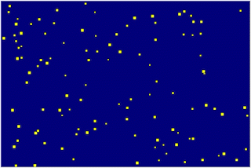
In tkinter you can do this too

Slide 49
Following this code
import random
import tkinter
canvas=tkinter.Canvas(bg='navy',width=600,height=400)
canvas.pack()
def obloha():
x=random.randint(5,595)
y=random.randint(5,395)
a=random.randint(1,4)
canvas.create_rectangle(x,y,x+3+a,y+3+a,fill='yellow')
for i in range(1000):
obloha()
canvas.after(20)
canvas.update()

Slide 50
Finally...
x=5
while True:
print(x)
#wait till end

Slide 51
...small joke for you, guys.
now your computer is burning
don't do this if you don't want your computer to burn
HAHAA PRANK

Slide 52
THANK YOU FOR YOUR ATTENTION ::)

Slide 53
Authors
2.B - Lukas Moravčík, Michal Solár, Barbora Tabačková, Jakub Škobák, Marko Vríčan, Alexandra Žideková, Barbora Pobudová, Adrián Šoška, Samuel Neslušan, Nina Nagyová,
Matej Mečár, Marek Miklo, Martin Majčin, Tereza Pekárová
2.A
Marek Kuchar, Marek Roman, Lutišanová Tatiana, Mihalčatinová Vanesa, Polkorábová Eliška, Sedliak Jozef, Sirovatka Jakub, Slivoň Stanislav, Ševčíková Bronislava, Šmárik Jozef, Tomaníková Radka, Tomaníková Tereza, Uríčová Vanesa, Vajdová Eliška, Vandžurová Stanislava
under the leading of: Jana Pekárová

