Slide 1
Christmas card by the french team! Children from Tousson

Slide 2
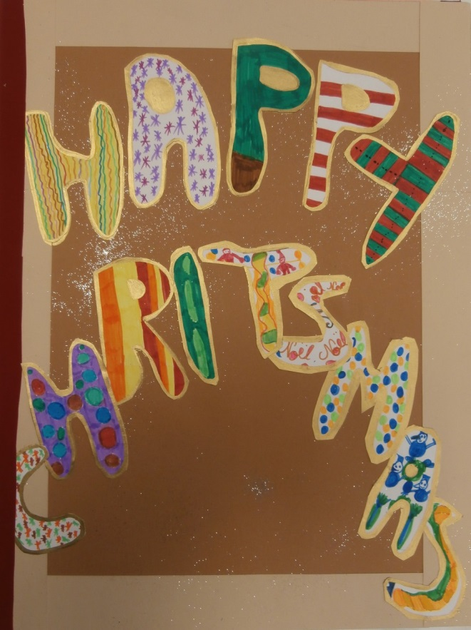

Slide 3
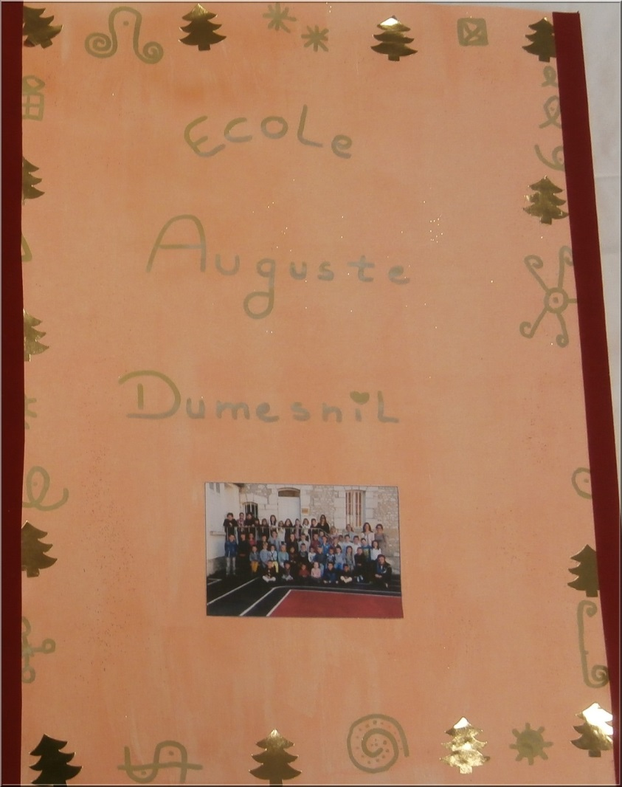

Slide 4
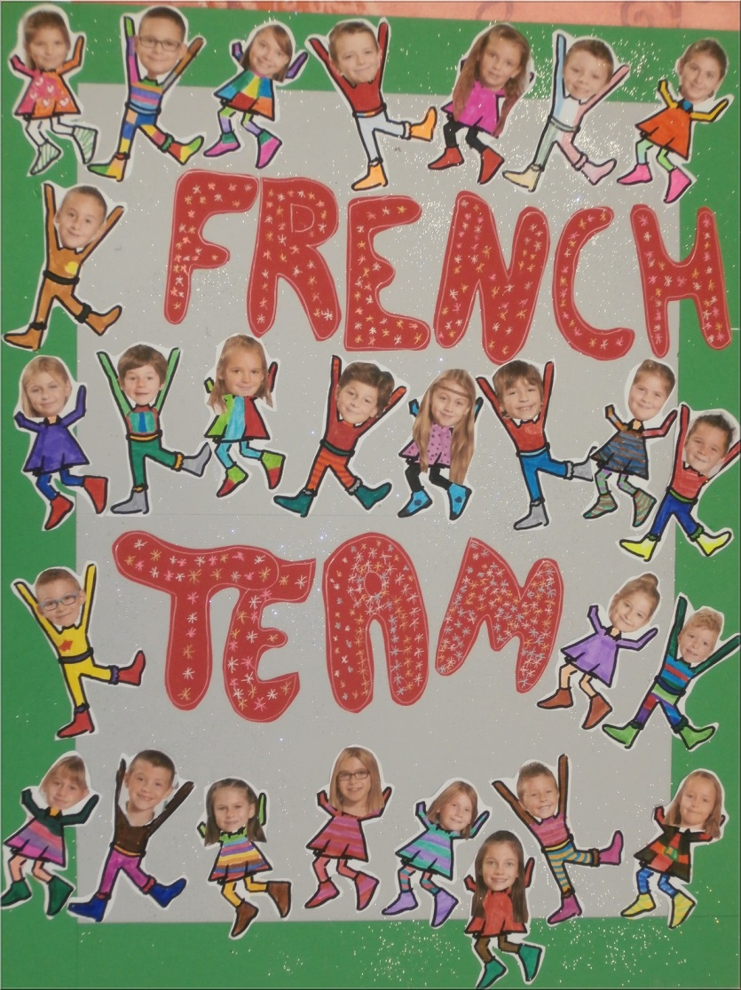

Slide 5
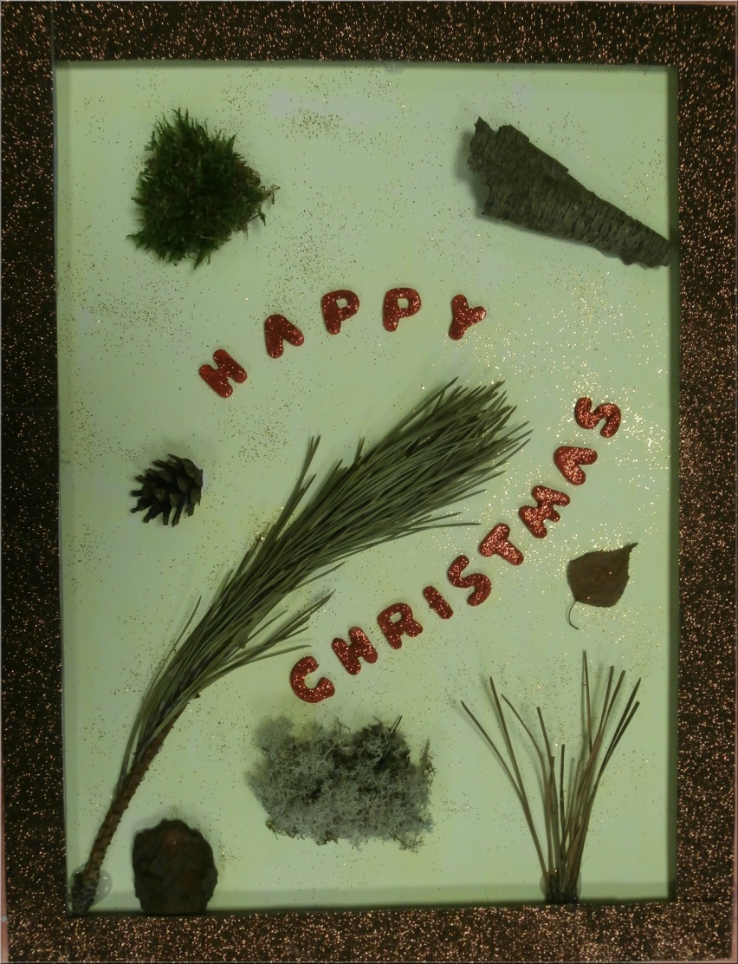

Slide 6
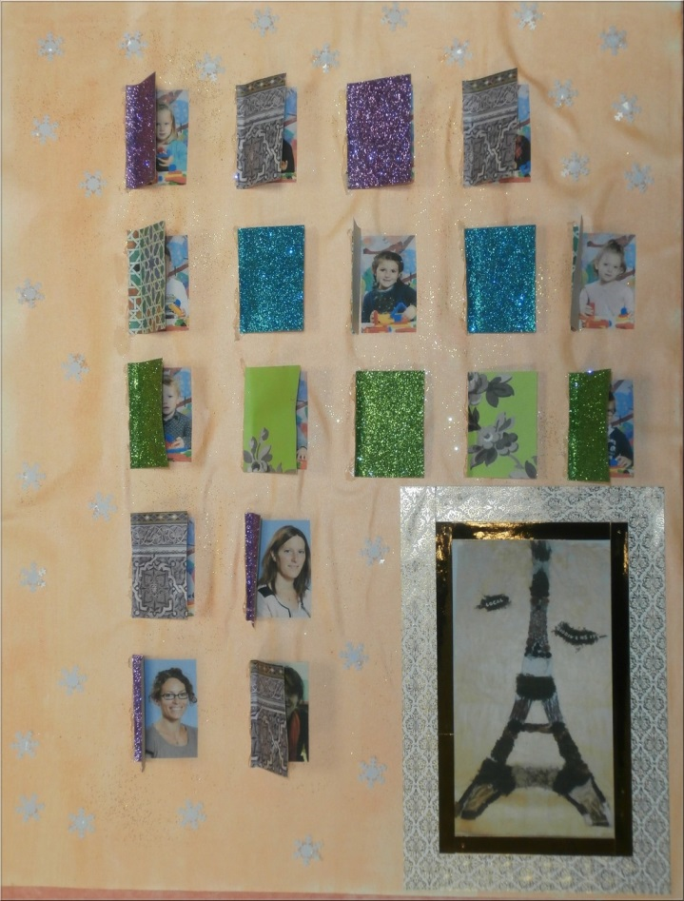

Slide 8
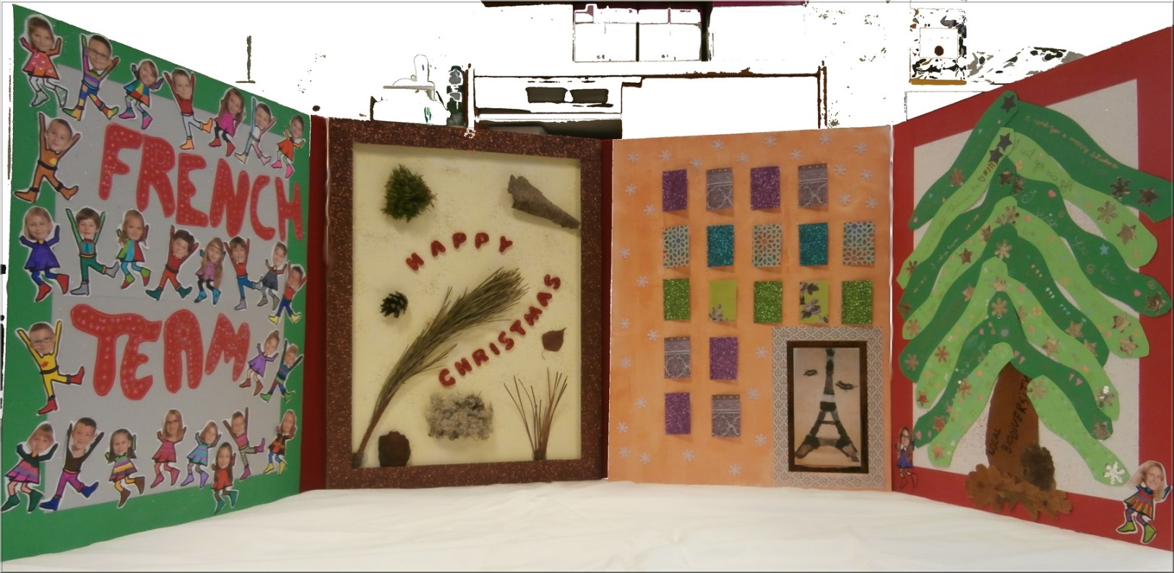
Here the whole map, unfolded. It closes with a folding system!

Slide 9
Happy
Christmas
French team!

