Slide 1
Local Biodiversity Logos
San Martín de Montalbán, Spain, October 2015

Slide 2
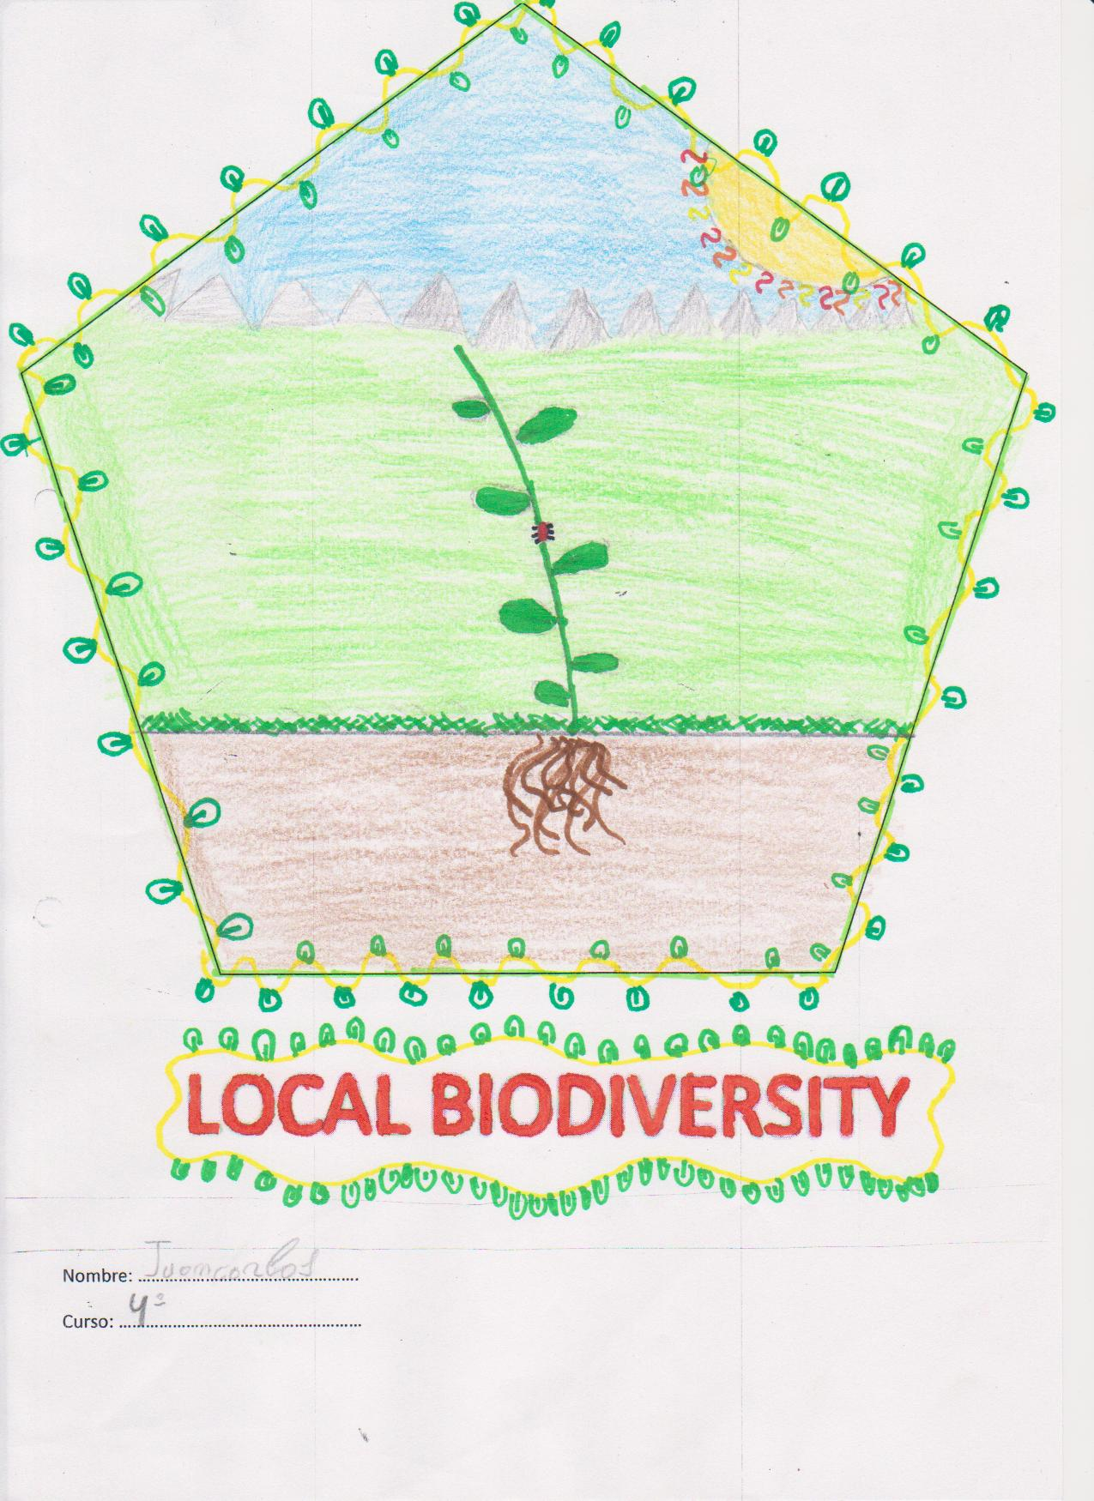
Our candidate is.....
Author: Tito

Slide 3
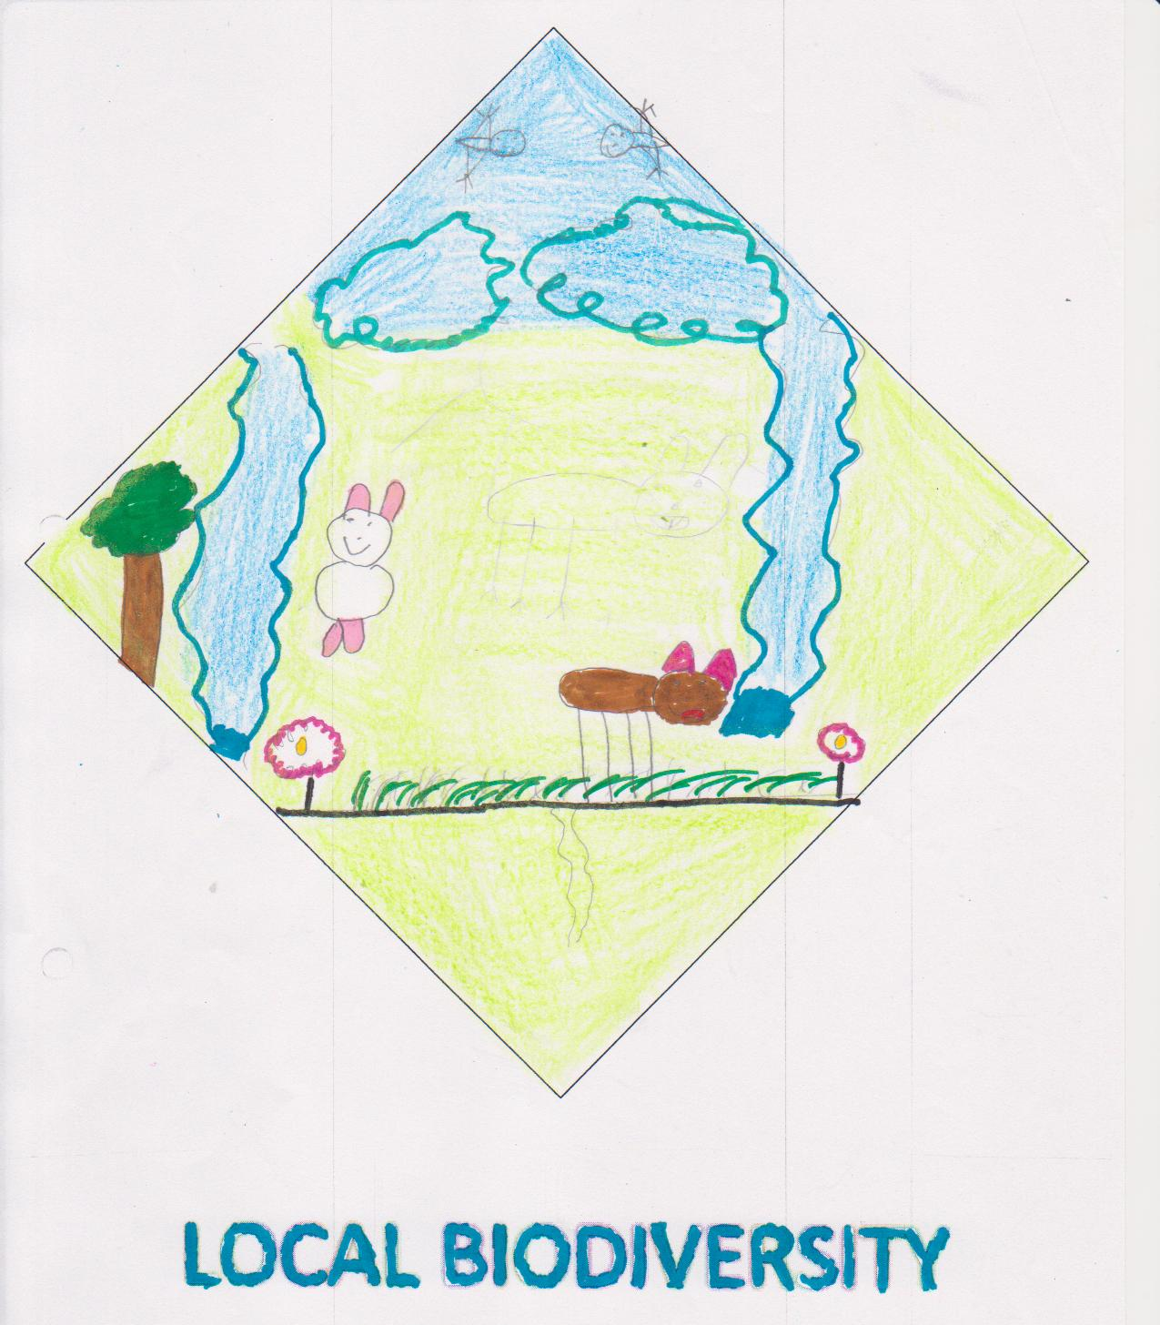
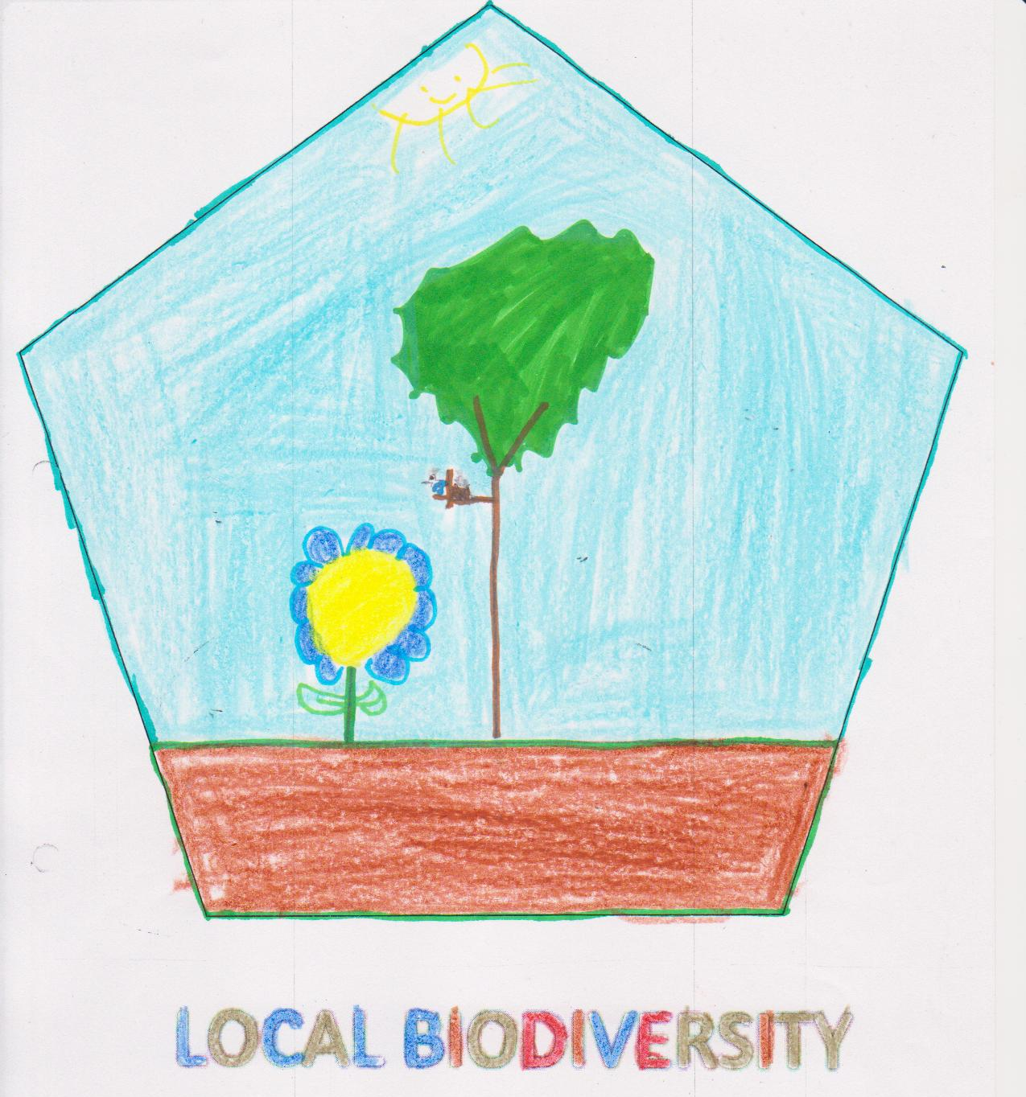
Participants:
Author: Iván
Author: Cristina

Slide 4
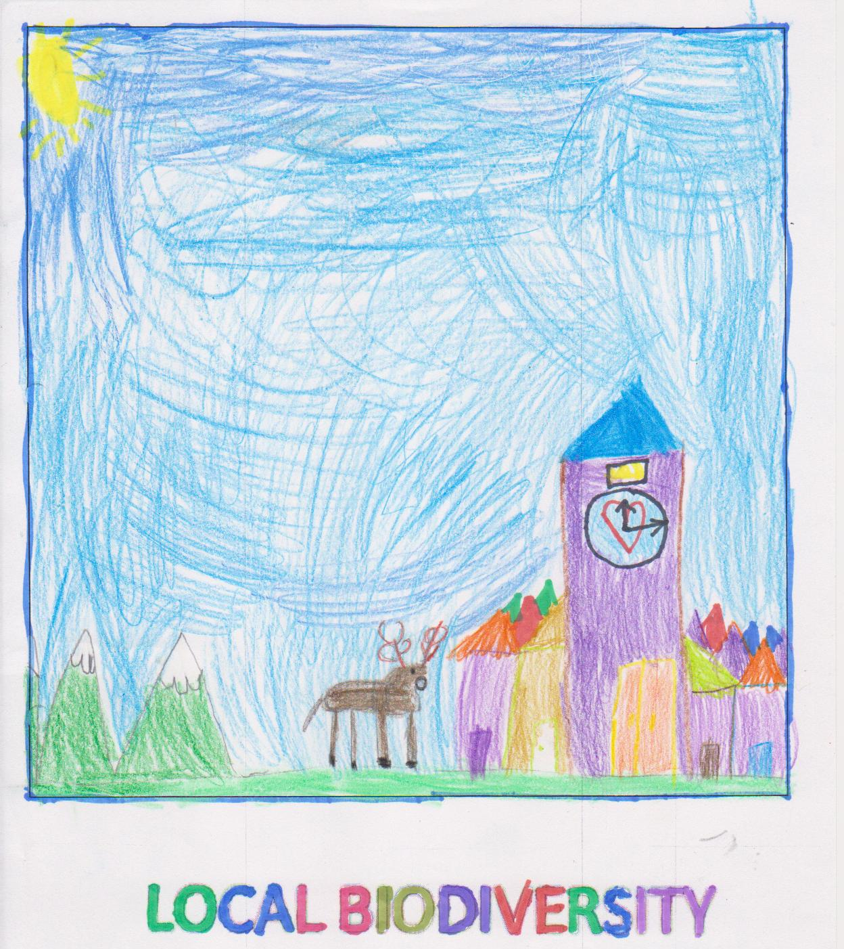
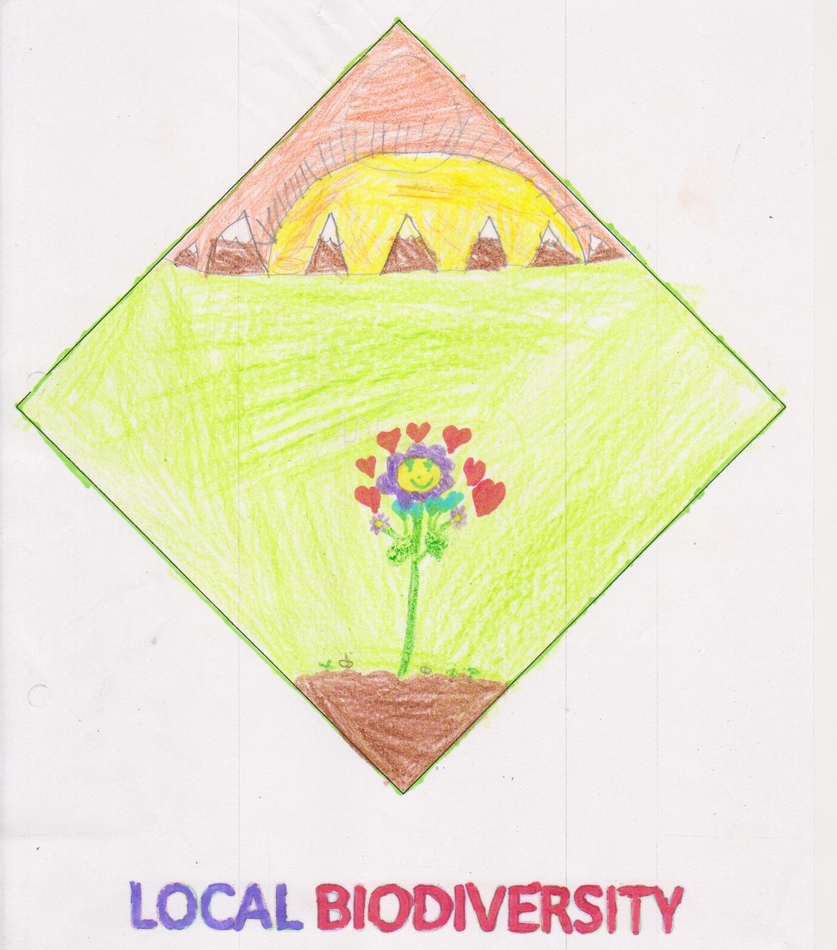
Participants:
Author: Leire
Author: Laura

Slide 5
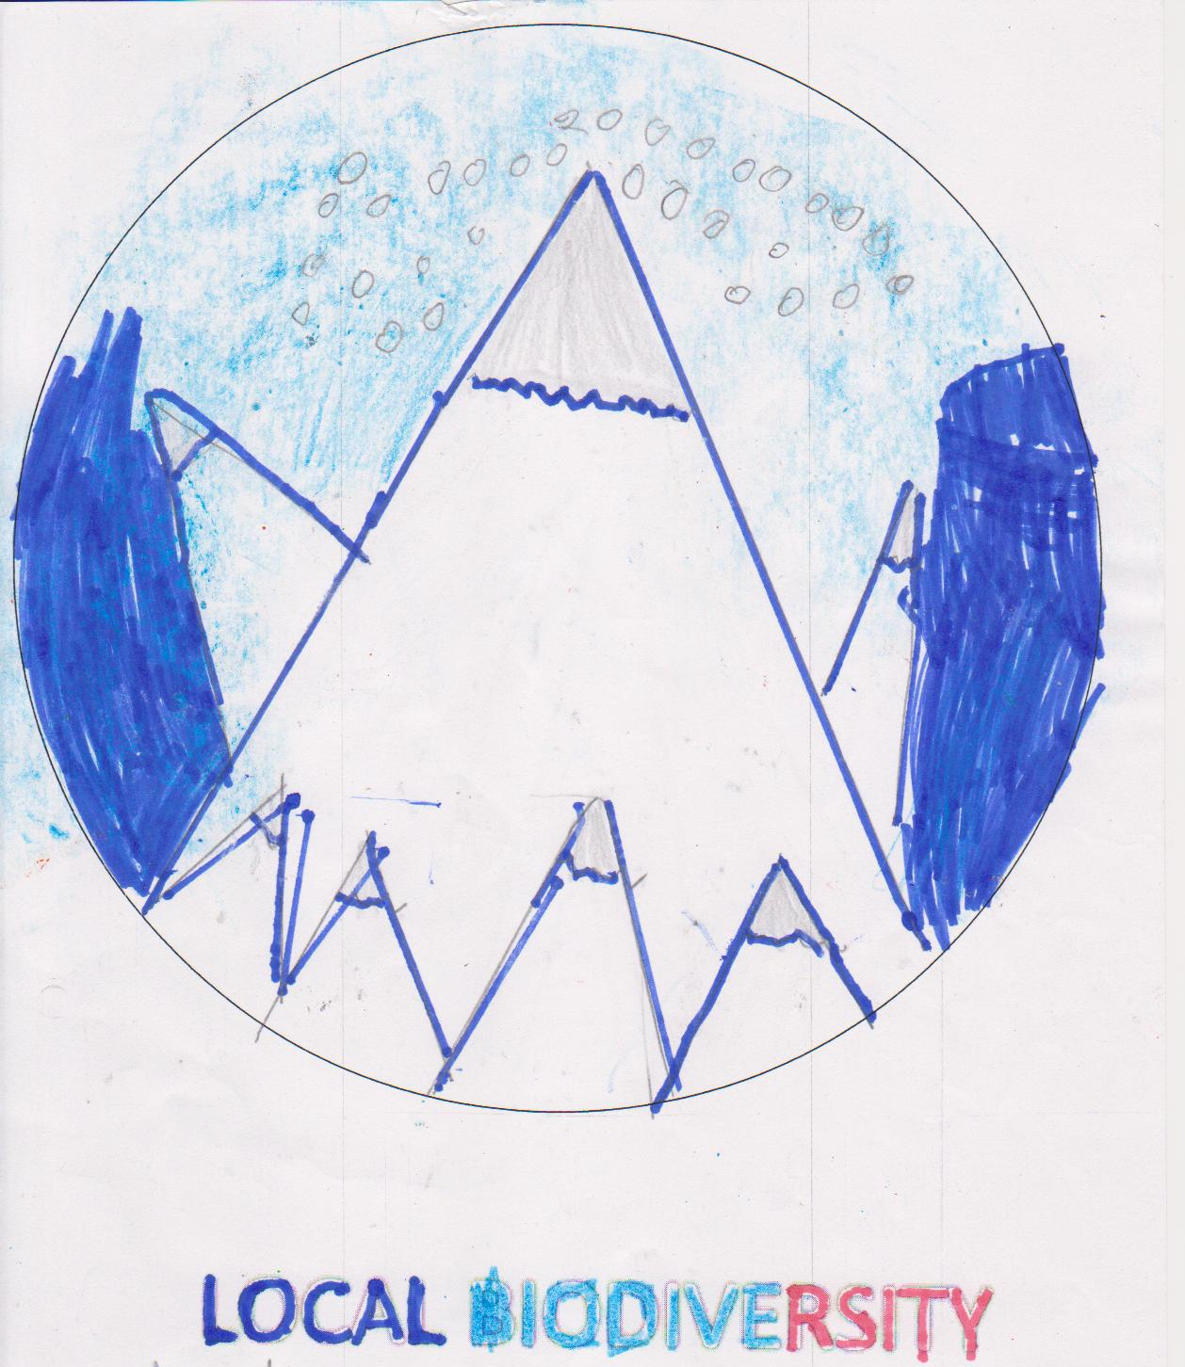
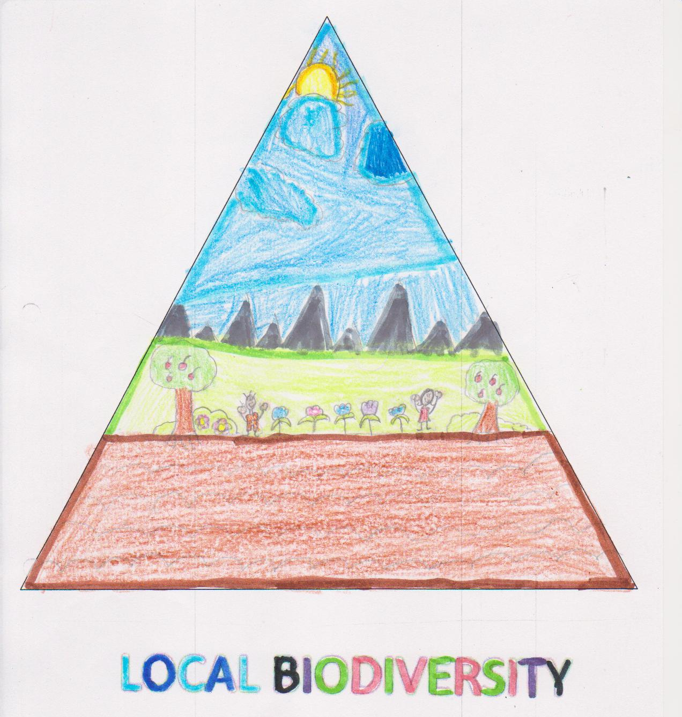
Participants:
Author: Marcos
Author: María

Slide 6
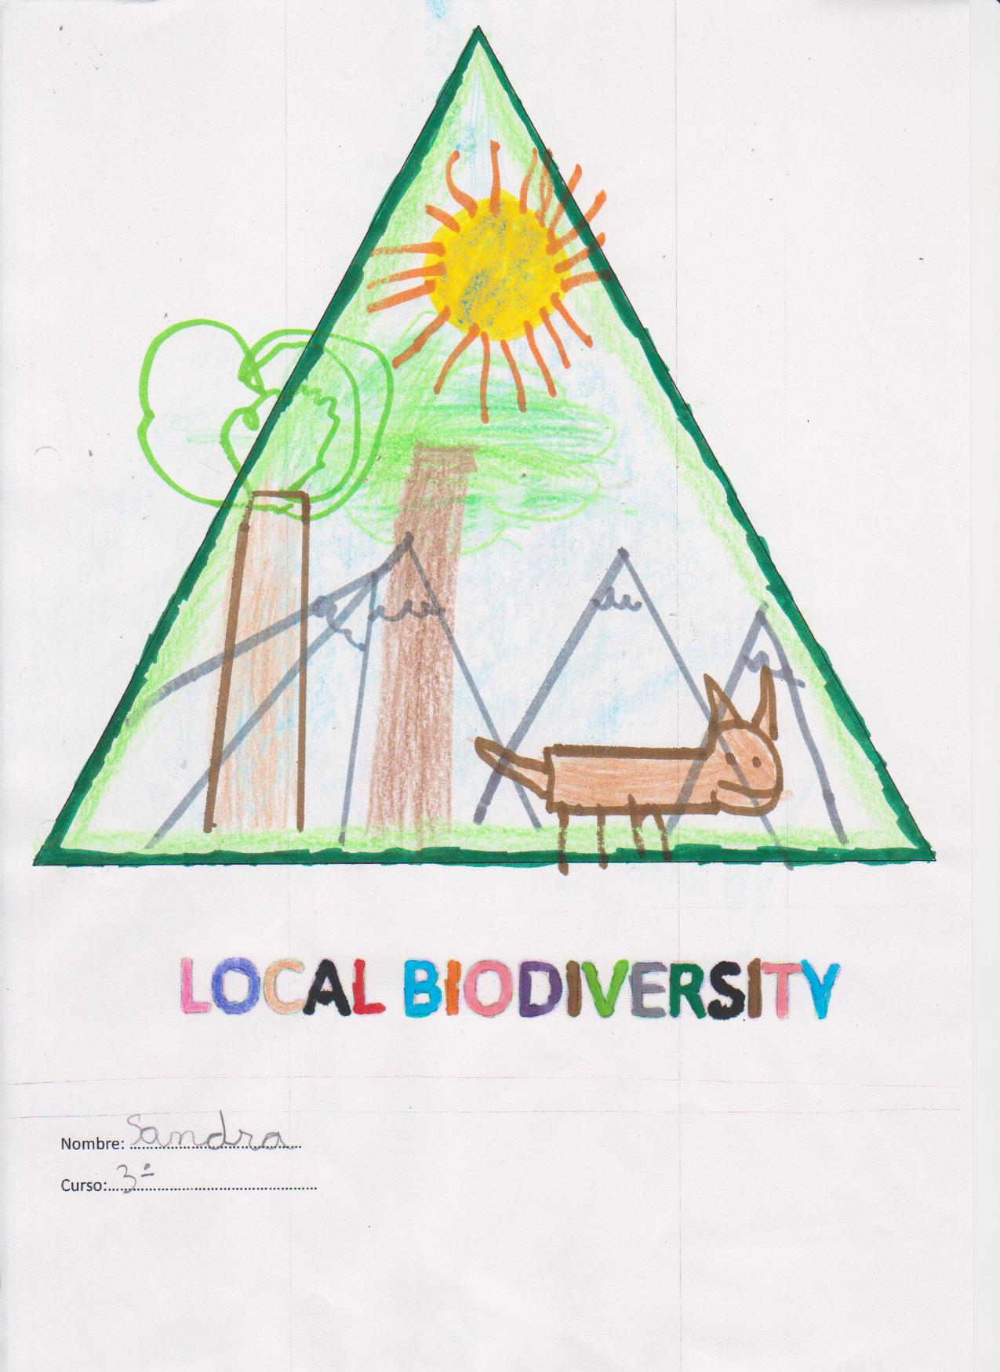
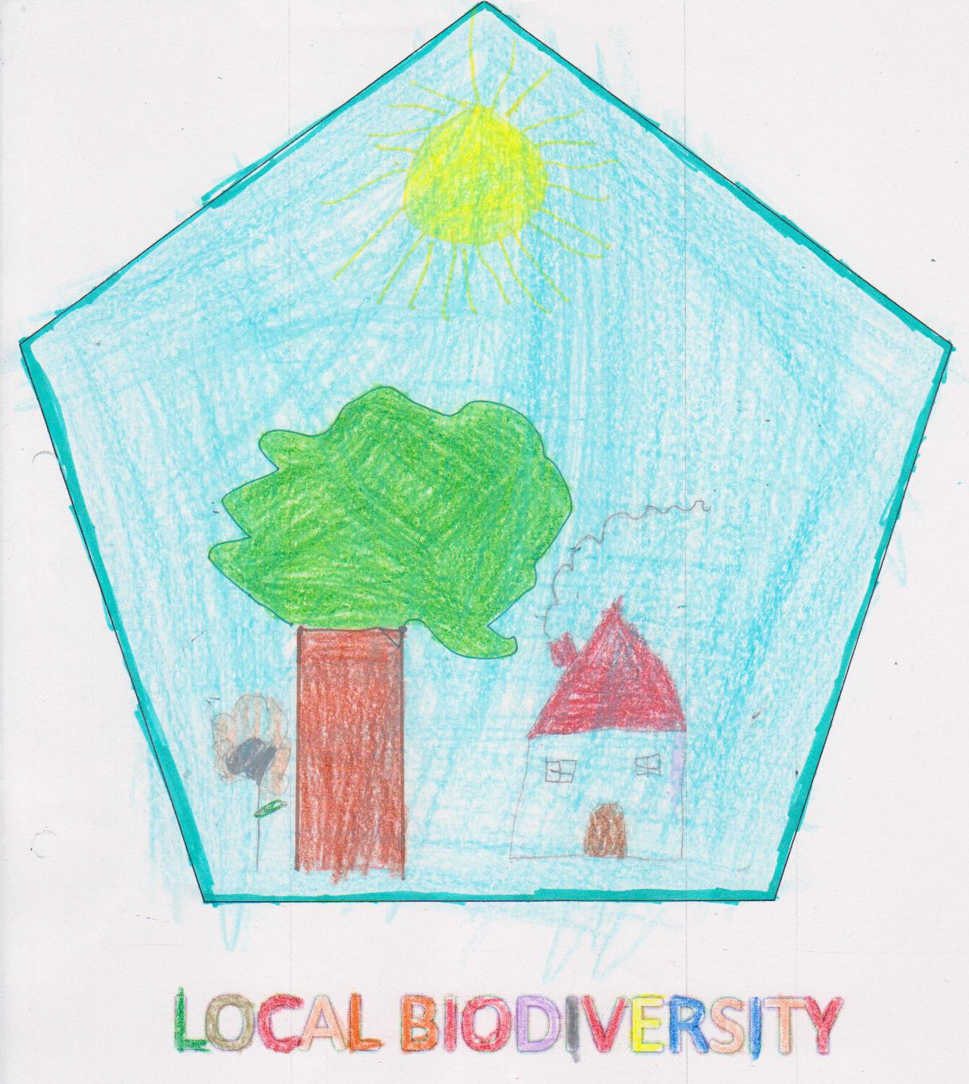
Participants:
Author: Sandra
Author: Noelia

Slide 7
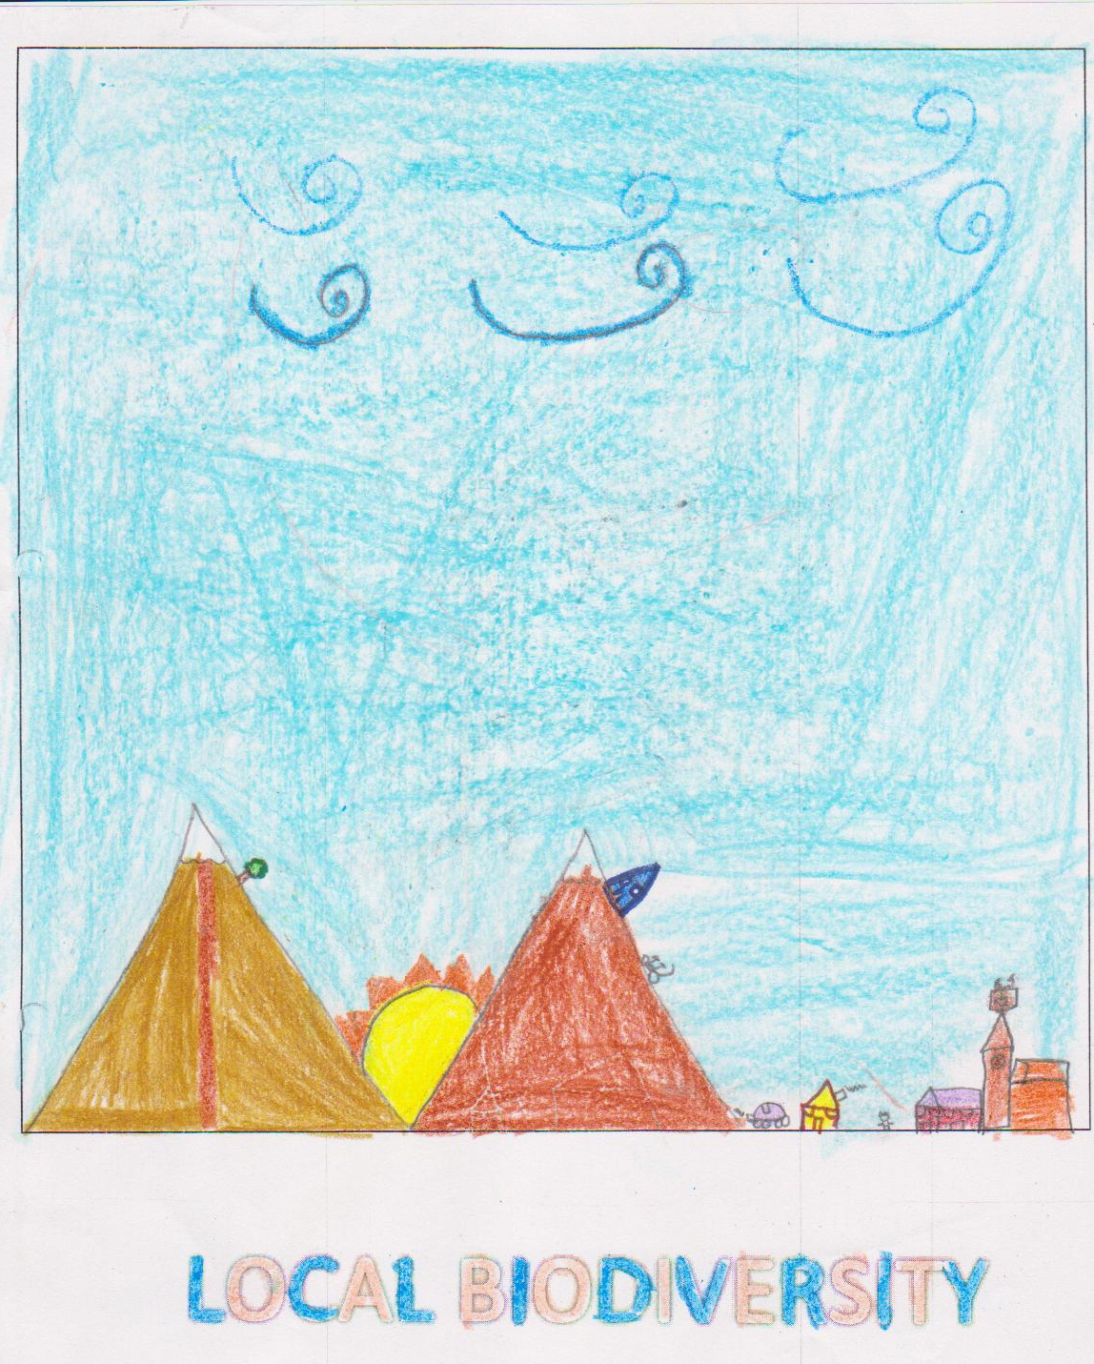
Participants:
Author: Yassin

