Slide 1
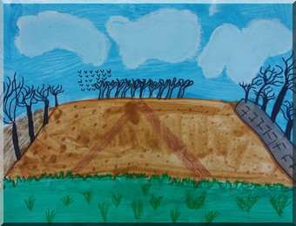
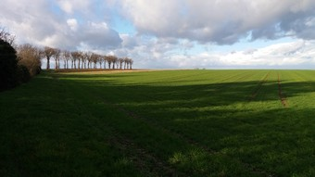
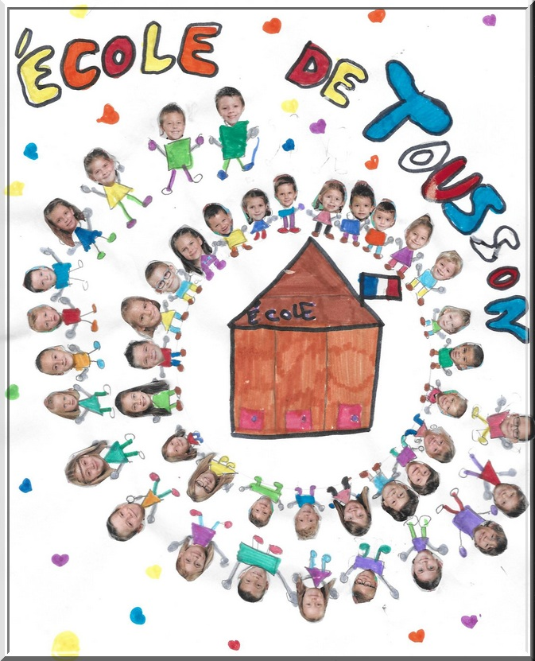
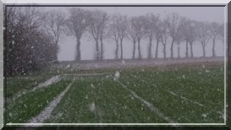
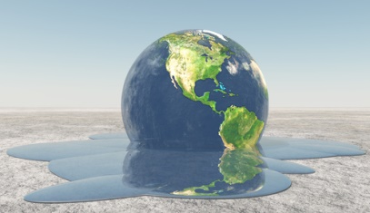
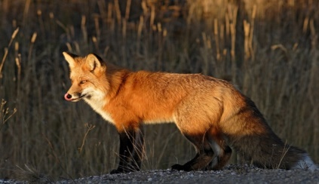
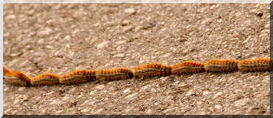
Les écoliers déchainés !
p.3 snow in Tousson
p.3 COP 21
What is it ?
p.2 invasion : hairy caterpillars
p.4-5 Animals

Slide 2
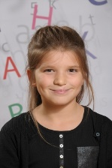
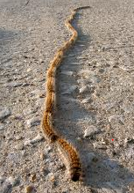
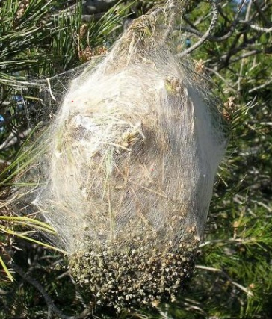
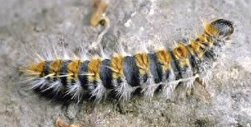
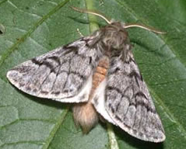
hairy caterpillars in Fontainebleau forest
HAIRY CATERPILLARS Hairy caterpillars are the larvae of night butterflies and form cocoons hanging from the trees. In a cocoon, there is 150/200 caterpillars. They are hairy .their hair is stinging. They cause allergies and kill pines. Their predators are both birds: chickadees (tit)and the cuckoo.
Alyssa
A tree full of hairy caterpillars cocoons next to our school !
We are worried! Next to our garden where we play in the spring, there is a tree full of cocoons. There about 15 meters from our school!

Slide 3
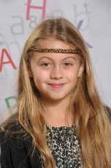
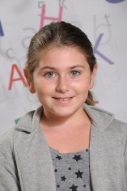
Cop 21 all concerned!
the COP21 COP21 is the conference with a representative from each country. They went to Paris (nov/dec 2015) to speak about the climate warms too much. They must take a decision as quickly or we will have less ice at the North Pole and the sea will rise !!! Unfortunately, because of the sea, the islanders will be flooded and must leave !!!
Everyone must make an effort to protect our planet!
Manon
Weather: Snow fell in Tousson
The winter in Tousson is cold
The trees have no leaves
The wind is blowing
The days are shorts
Meyline

Slide 4
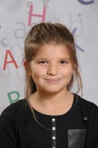
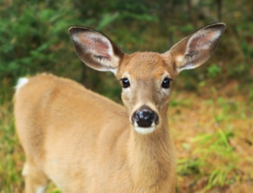
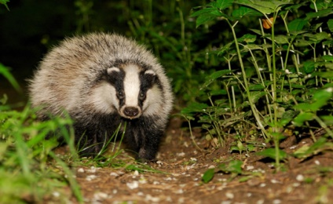
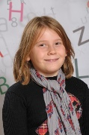
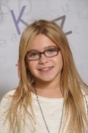
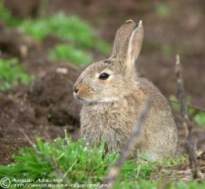
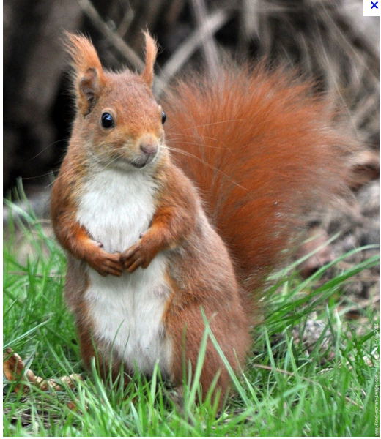
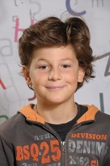
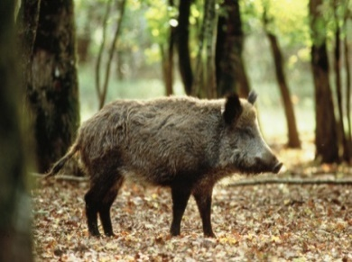
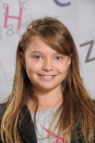
Animals in the area surrounding Tousson
the deer lives in the forest. It can be seen day and night. the doe is a female deer. On the deer’s coat, there are sometimes small Honey points.
Alyssa
badger lives in our forests. It eats vipers, Badger has black and white fur. It can be agresife,
Arwen
Rabbits eat carrots. It runs fast. the rabbit is wild. It jumps high.
Lola
Squirrels squirrel lives in the forests. He eats mostly hazelnuts
and apple bread.
The squirrel digs holes under trees to hide his food. It goes up and down the trees very easily.
Baptiste
the wild boar is an animal that lives in the woods. it feeds on roots, acorns, corn and insects. its coat can be red, black, or gray and its weigh between 80 and 100kg.
Clara

Slide 5
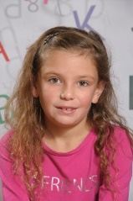
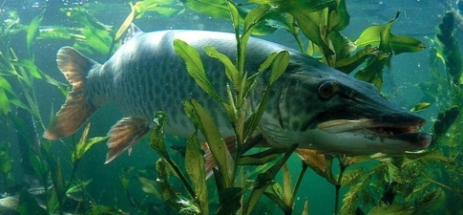
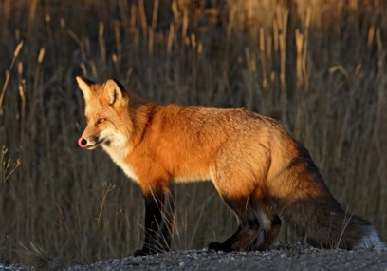
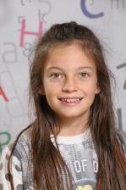
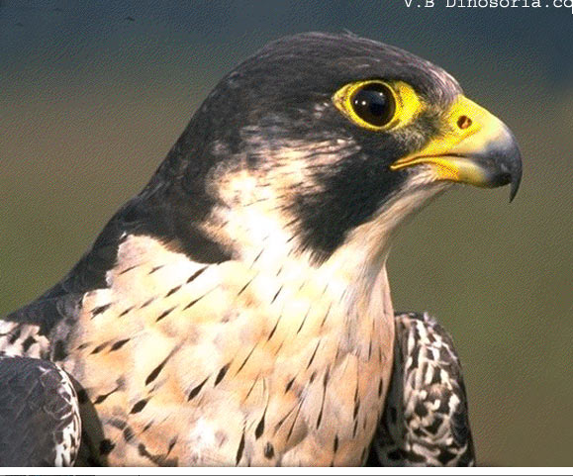
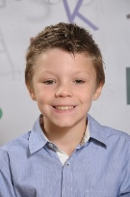
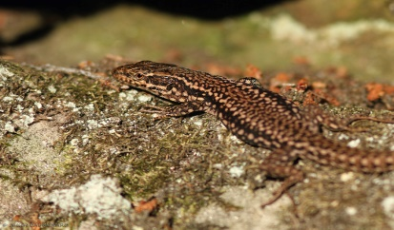
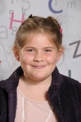
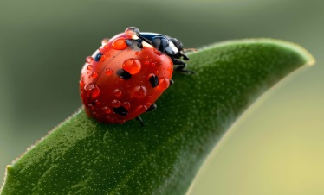
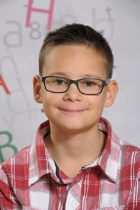
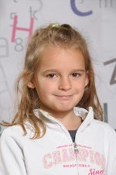
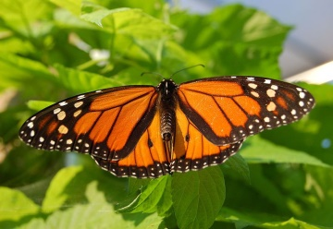
The pike fish is a very voracious fish who lives in freshwater. It has a jaw filled with teeth.
Elenna
the fox can weigh 3.6 to 6.8 kg, and can measure 90-112 cm.It shelters in abandoned dens .Its coat is reddish brown.
Emilie
The falcon is a diurnal raptor. It shows the day. It flies high and fast. It is a carnivore, it eats mice and rats.
Joshua
Lizard Small reptile with four legs and long tapering tail. It saws in nature.It is insectivorous. The little lizard can losing its tail.
Gabrielle
The ladybird is a small insect that can fly .There are several colors for ladybirds: red, black, yellow, orange .Its feeds aphids. The ladybird weighs a few grams.
Tom
Butterfly belongs to the order Lepidoptera which means "scaly wings”. The butterfly is an insect. Its larva is a caterpillar. It’s got colorful wings. It feeds on pollen.
Emma

Slide 6
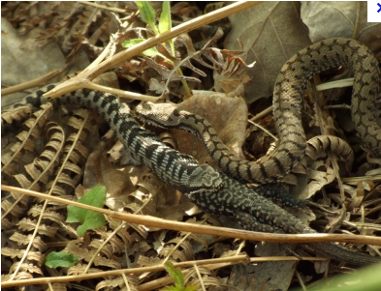
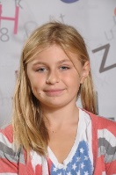
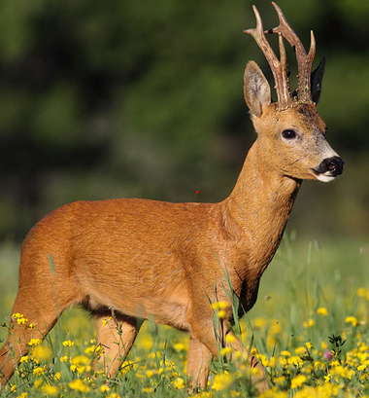
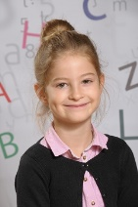
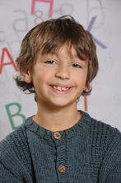
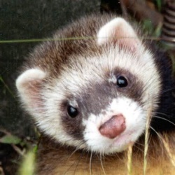
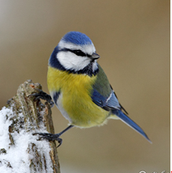
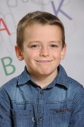
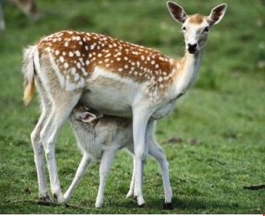
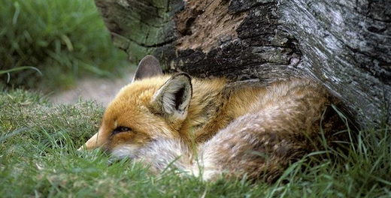
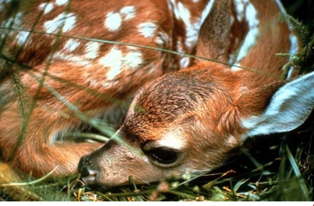
The viper’s a snake. It has a triangular head. The bite of the viper is dangerous. Snakes eat mouse. The snake is often long.
Maïlis
Deer Deer eats grass and fruit. The male deer is called single brocade. It has wood on the head, but it loses in the fall. The female has no wood. The small at birth is called fawn and a little later he called chevrillard.
Méline
Ferrets
It is carnivorous
It has a yellowish white coat.
It's a thief!
It has red eyes.
Yoann P
Tit It’s small bird with colorful plumage it can lay eggs 7-16 The female incubates for 13 to 14 days We can find it in our forest .. With the cuckoo, it’s the only predator of hairy caterpillars!
Yoann M

Slide 7
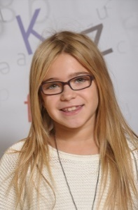
Map of our school
Lola
STREET
Entrance
playground
Nursery class
canteen
Hairy caterpillars
Elementary class
garden
FIELDS

Slide 8
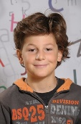
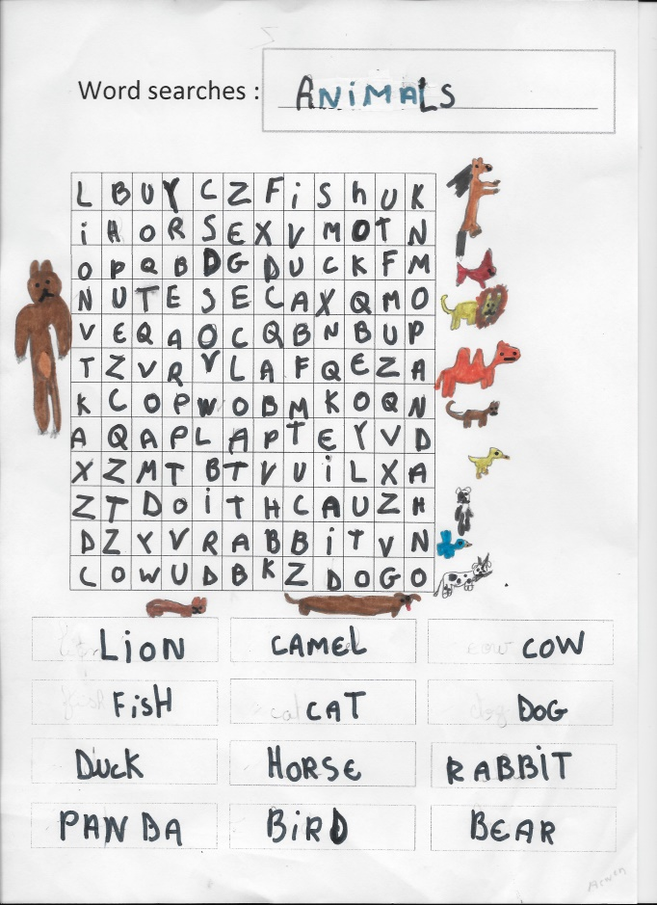
Let’s Play!! …word searches
Baptiste
Arwen
FIND THE WORD… You can find it to the newspaper!
F _ X F_ _ _ _ N C _ _ _ _ _ _ _ _ _ R T _ t
Link the word with the good picture! Good luck

Slide 9
French children are proud to present their first newspaper !
It’s name is : « les écoliers déchainés! »
That means : the rampaging schoolchildren
We learned to do research on the internet and using word processing tools such as journalists!

