Slide 1
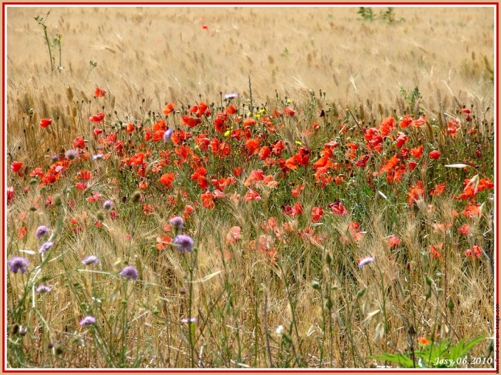
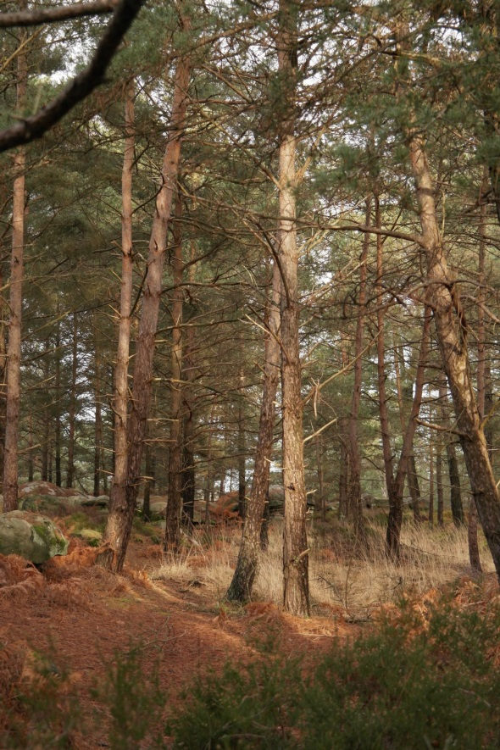
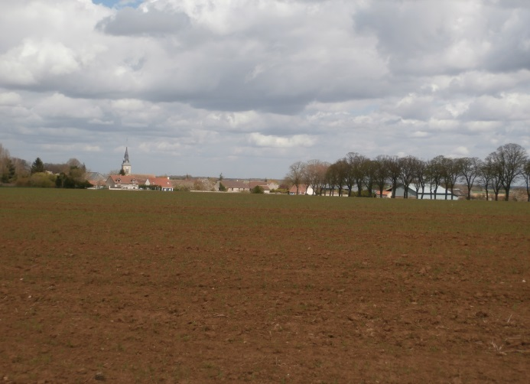
Local Biodiversity by Tousson from France
vocabulary on what can be seen in the area
1° Locate Tousson in France
3° field vocabulary
2° forest vocabulary
With children voices

Slide 2
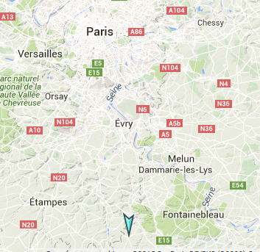
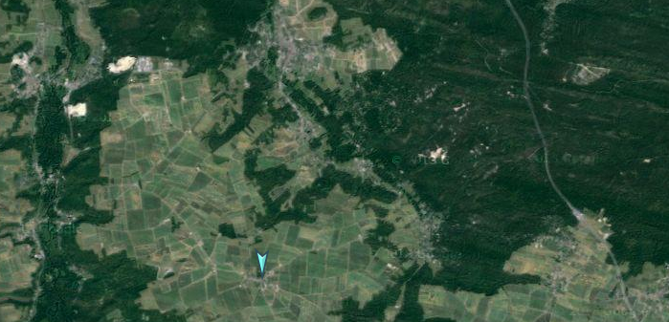
Tousson is a charming village, 70 km from Paris.
TOUSSON
In the surounding of our school, there are fields and forests.
Tousson is 8 km from the famous Fontainebleau forest.

Slide 3
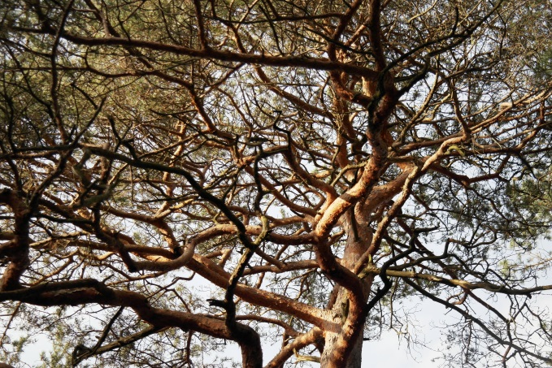
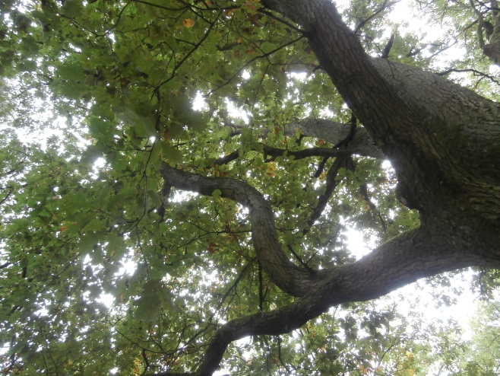
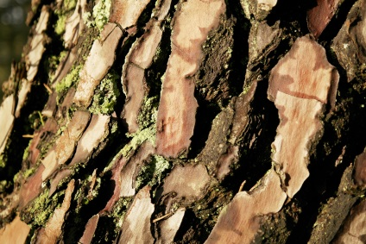
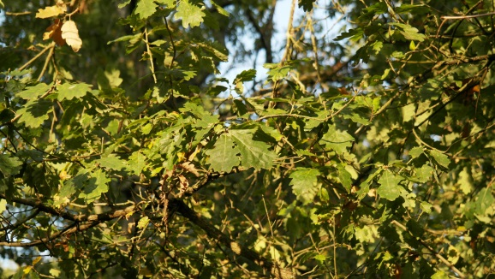
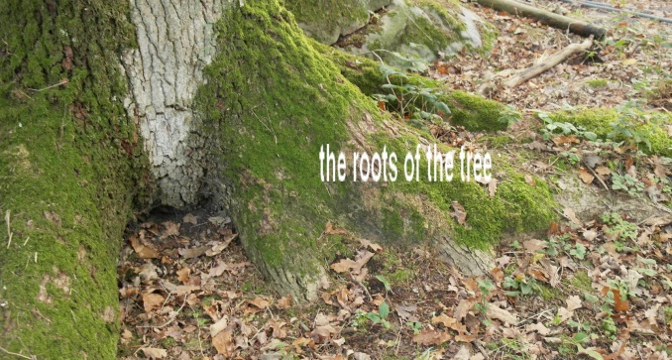
FOREST vocabulary
fields
Forest
TOUSSON
The trunk
branches of the tree
bark
leaves of the tree

Slide 4
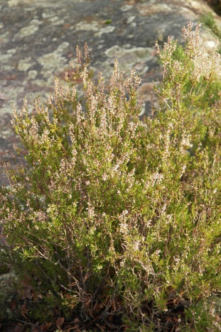
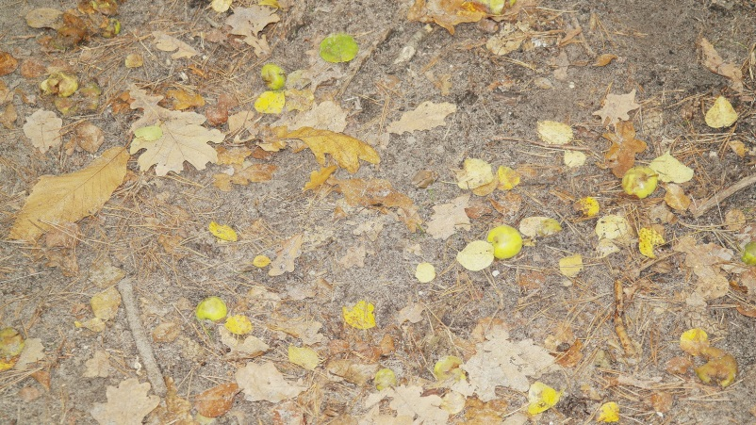
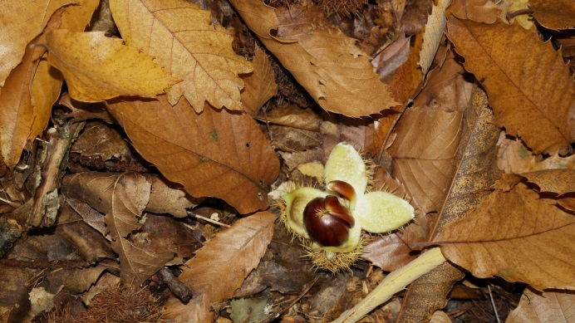
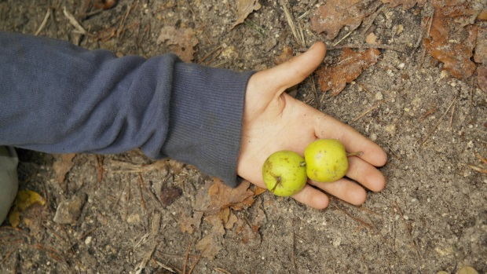
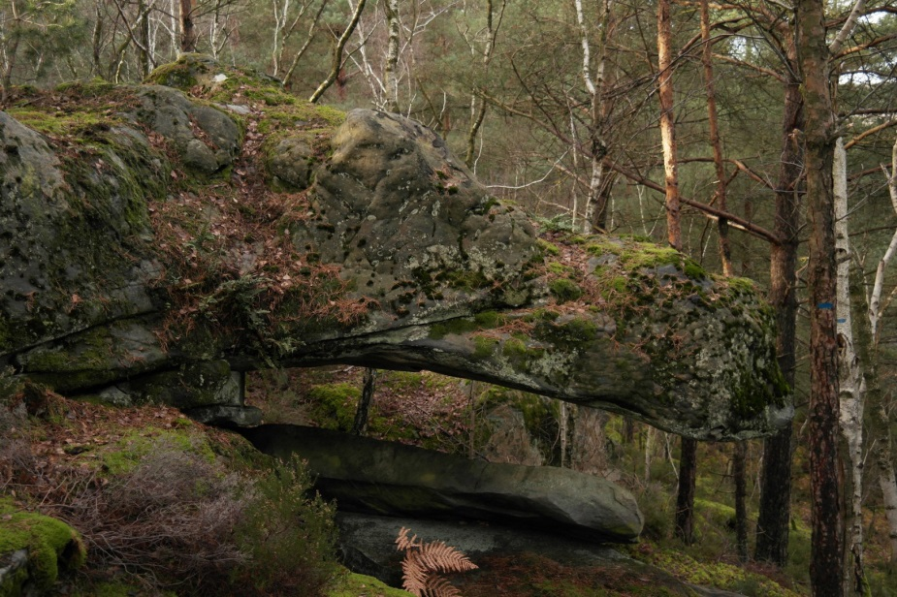
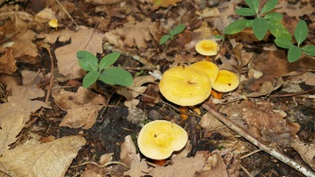
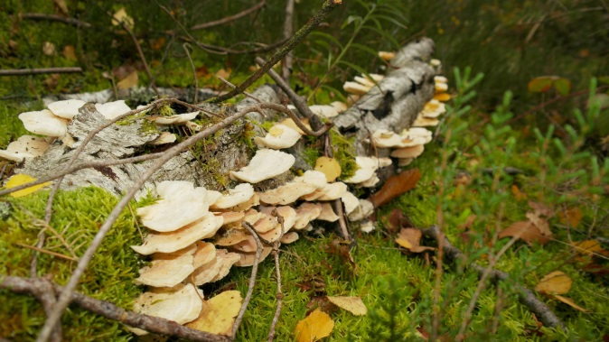
vocabulary of the forest in autumn
Wild apples!
wildflowers
chestnuts
Lots of rocks in the Fontainebleau forest look like animals: can you see a crocodile head here?
rocks
Wild mushrooms

Slide 5
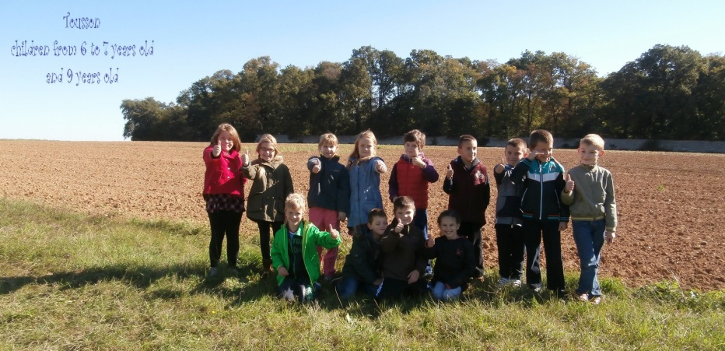
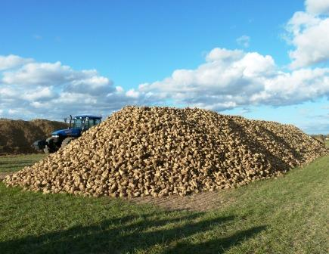
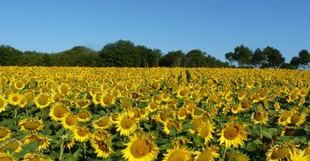
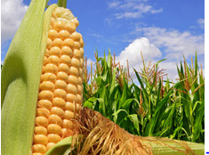
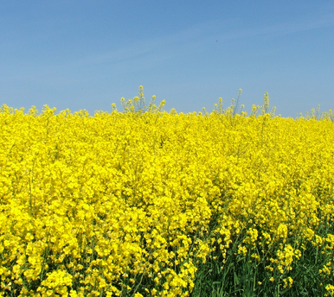
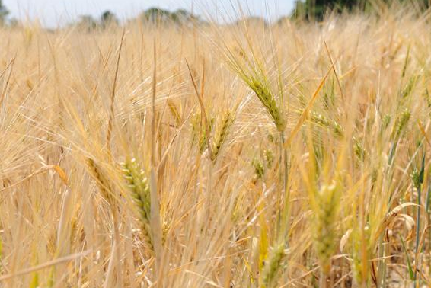
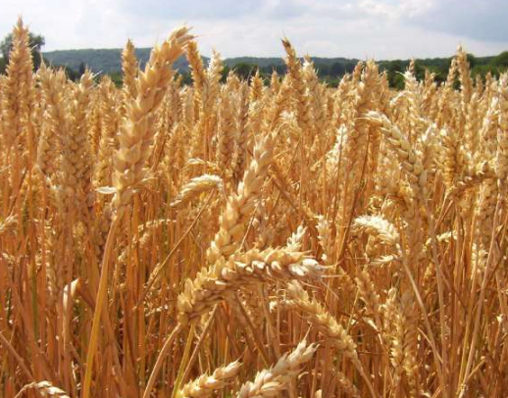
Fields vocabulary
Tousson village is part of a protected park called "gâtinais park"
In the fields around Tousson we can see growing
sunflowers
Sugar beet (and a roe deer)
Sugar beet
corn
Oilseed rape
Wheat
Barley

