Slide 1
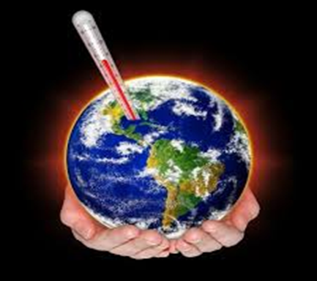
Greenhouse effect
2022
Krokialaukis

Slide 2
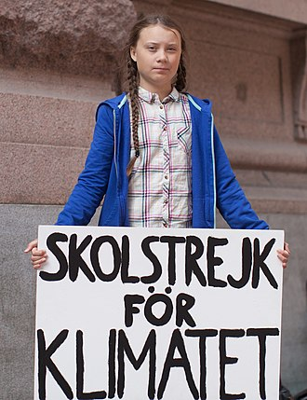
Introduction
Climate change and global warming – a very important and
debatable problem that has a wide range of opinions.
Most scientists agree, that the temperature is rising due to human work.
And only by working together can we solve this problem.
The fact that we can all contribute to solving global warming was demonstrated by Greta Thunberg. In 2018, Greta Thunberg, at the time a ninth grade student, after heatwaves and wildfires in sweden, spent three weeks in front of the swedish parliament with a poster saying „School‘s strike against climate“ (Skolstrejk för klimatet), in such way protesting against the nations inactivity in solving global warming. Greta Thunberg‘s actions were taken as example by young people in other countries. With her actions she also took the attention of various world leaders.

Slide 3
Erasmus+ project
Krokialaukis Tomas Noraus-Naruševičius
gymnasium involved into international
Erasmus + project Climate Change –
Let’s Save the Planet! Pupils and their
families will use the knowledge gained
from the project to try to change their
lifestyles by mitigating the effects of climate change.

Slide 4
Lesson objectives
Make posters using the film seen and test made:
1. Explain in your own words how the greenhouse effect occurs.
2. Name consequences of the greenhouse effect.
3. List ways you can contribute to reducing the greenhouse effect.
4. Name greenhouse effect‘s facts and causes.
5. Name the measures to cut down the greenhouse effect.
6. You will learn to communicate and collaborate.

Slide 5
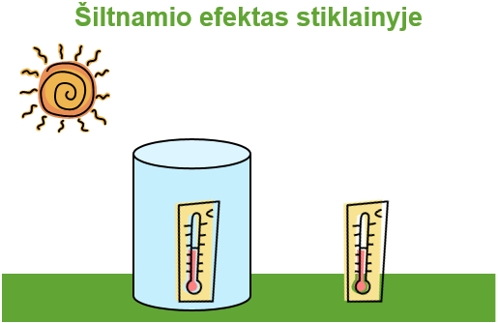
Greenhouse effect in a jar

Slide 6
https://youtu.be/-D_Np-3dVBQ

Slide 7
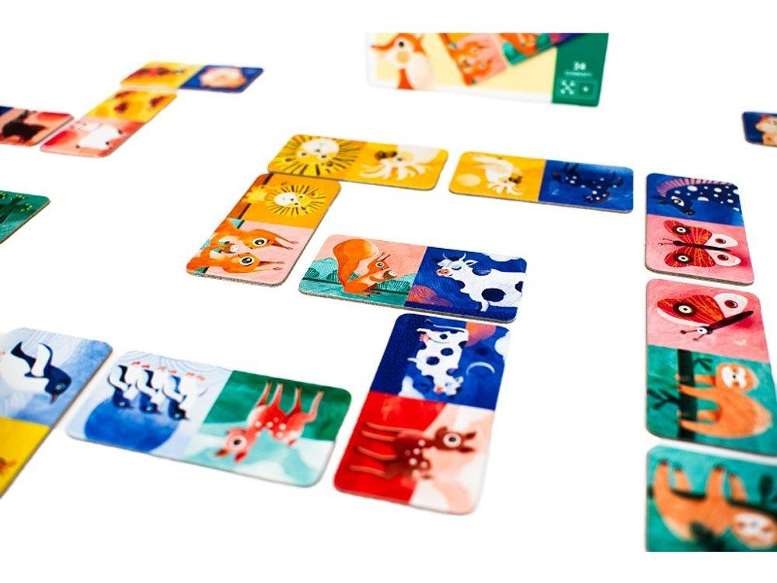
Domino game
The goal is to collect the playing cards in the correct order as quickly as possible.

Slide 8
Domino game questions and answers
1. What gases are called greenhouse gases?
Carbon dioxide, methane, water vapor
2. Why are they called greenhouse gases?
They prevent the warmed Earth from radiating all the heat back into the atmosphere
3. What do greenhouse gases do in the atmosphere ?
Prevent heat from dissipating from the Earth's surface
4. What happens to climate where heat cannot dissipate from the Earth’s surface?
The climate is warming
5. What are the consequences of global warming ?
Glaciers are melting, global ocean levels are rising, and conventional plants and animals (such as polar bears) are disappearing; droughts are intensifying, fires are on the rise and river floods are more frequent. More extreme events are also being recorded - tropical cyclones, hurricanes, torrential rains, heat waves, etc.
6. Where is the energy that people, businesses use every day from?
From organic fuels or fossil fuels

Slide 9
7. What are the types of fossil fuels?
Coal, oil, natural gas
.What gases are formed when coal burns in conjunction with oxygen?
Carbon dioxide (CO 2)?
9. How naturally (not due to human activities) is carbon dioxide formed on Earth?
Burning forests, grass, erupting volcanoes
10. Who are the main consumers of carbon dioxide and contribute to reducing the greenhouse effect?
Forests
11. What are the sources of energy without burning fuel?
Renewables
12. What renewable energy sources do you know? Wind energy, hydropower, solar energy, geothermal energy
13. How can you contribute to reducing the greenhouse effect?
Sort garbage, turn off unused electrical appliances, save paper, use reusable shopping bags, save water, plant a tree, etc.

Slide 10
Posters
1 group: poster on „ Facts and Causes of the Greenhouse Effect Greenhouse “.
2 group: poster on „ Greenhouse“.
3 group: poster on „ Consequences of the Greenhouse Effect “
4 group: poster on „ Measures to reduce global warming “.
5 group: poster on „ Ways we can contribute to reduce the greenhouse effect“.
You must create a poster in 5-8 minutes.
You will need to present the poster

Slide 11
https://youtu.be/-D_Np-3dVBQ https://youtu.be/BPJJM_hCFj0 Thank you!

