Slide 1
WELCOME TO SERBIA
presentation

Slide 2
Serbia
Serbia is a continental country located in southeastern Europe, in the central part of the Balkan Peninsula.

Slide 3
NATURAL BEAUTIES OF SERBIA
What makes Serbian landscape so diverse?
There are beautiful mountains, plains, deserts, forested landscapes with streams and calm rivers, steep canyons , caves and thermal springs that have been used for healing since the age of Romans.

Slide 4
Kopaonik Mountain
Kopaonik Mountain, also known as the Roof of Serbia, is the largest mountain range in Serbia and the best-known Serbian ski centre.
Mount Kopaonik is covered with snow from late November until May .
Kopaonik became a national park in 1981. It is especially beautiful for its landscape of forests .

Slide 5
Kopaonik Mountain

Slide 6
Kopaonik Mountain

Slide 7
Kopaonik Mountain

Slide 8
Kopaonik Mountain

Slide 9
ZLATIBOR MOUNTAIN
The most popular destination for vacationing, recreation and enjoying Serbia certainly belongs to Zlatibor.
It is one of the most famous Serbian mountain chains and tourist centers .

Slide 10
ZLATIBOR MOUNTAIN

Slide 11
ZLATIBOR MOUNTAIN

Slide 12
Tara National park
The best part about Tara National park is that it is heavily forested. It is also known as the lungs of Serbia.
With many mountains, hiking trails, rivers, lakes, waterfalls and forests – there is a lot to see in Tara National Park.

Slide 13
Tara National park

Slide 14
Tara National park

Slide 15
Tara National park

Slide 16
Tara National park

Slide 17
The Lonely House on River Drina
The Lonely House on river Drina is one of the most photographed spot in Tara National Park.
It is near Bajina Basta and is also called the Drina house.

Slide 18
The Iron Gates gorge on the Danube River
(Serbian: Ђердапска клисура) is the biggest and the longest gorge in Europe.
The gorge is actually a river valley formed of three gorges .
The National park and the gorge itself have diversified plant and animal life .

Slide 19
The Iron Gates gorge on the Danube River

Slide 20
LEPENSKI VIR

Slide 21
Taorska vrela (Taor springs)
Taorska vrela (Taor springs) are certainly the most beautiful springs in the surroundings of Valjevo.
The magic of this place lies in its mysterious location and the fact that even on a really hot day it can be quite chilly there.

Slide 22
Taorska vrela (Taor springs)

Slide 23
RIVERS
THE DANUBE
After the Volga, the Danube is the second longest and the second richest river in Europe.

Slide 24
THE SAVA RIVER
The Sava River is a long river in Southeast Europe. It flows into the Danube near Belgrade.

Slide 25
UVAC CANYON
Uvac Canyon is one of the most beautiful regions of Serbia and a protected nature reserve.
Legend says that it was covered by a large lake where a three-headed dragon lived.
It was killed by St. George ,but just before it died, the dragon damaged the forest with its tail.
While fighting the dragon, St. George struck a rock with his sword and a cold mountain water started pouring from it.

Slide 26
UVAC CANYON

Slide 27
UVAC CANYON

Slide 28
SPAS
Serbia has more than a thousand mineral water springs and over 40 spas, many of which date back to Roman times.
Here is the most popular spa in Serbia...

Slide 29
Vrnjačka Banja
Vrnjačka Banja is the best known and the most popular spa town of Serbia and at same time, a very attractive recreation center.

Slide 30
Gočko
Gočko, a sparrow with opanci (Serbian leather sandals) on his legs and šajkača (Serbian folk hat) on his head, is the symbol of Vrnjačka Banja.
The sculpture is located in the town center.

Slide 31
Devil's Town
Devil's Town, a true masterpiece of nature, is situated in Southern Serbia. This unusual "town" consists of 202 earthen figures of different shapes and sizes, from 2 to 15 m tall.

Slide 32
CITIES OF SERBIA
Belgrade
The capital and the most populous city of our country.
It is also the economic, educational and cultural center of the country.
It lies at the mouth of the Sava River into the Danube.
It is one of the oldest cities in Europe.

Slide 33
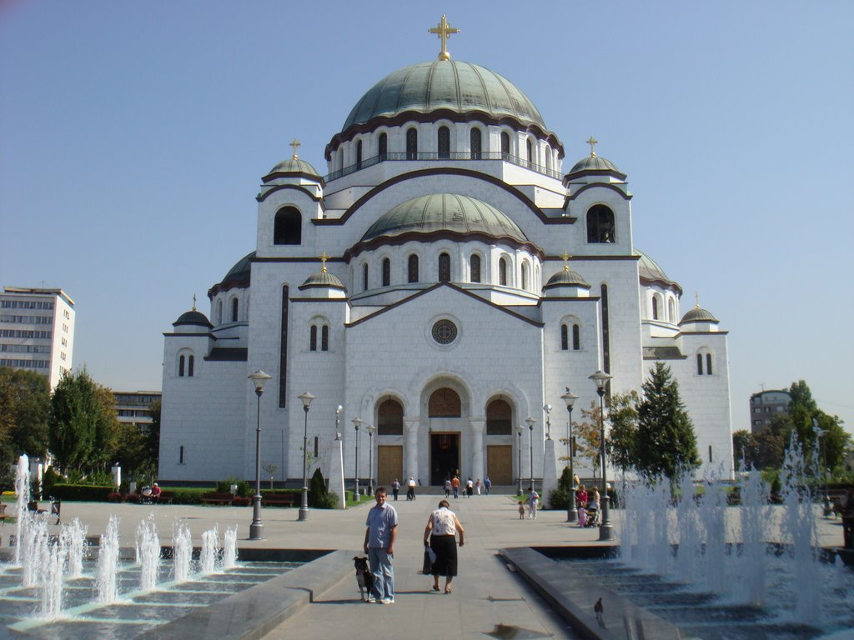
BELGRADE

Slide 34
NOVI SAD
After Belgrade the second city in Serbia by population and area.
The city lies on the banks of the Danube.

Slide 35
KRAGUJEVAC
THE HEART OF ŠUMADIJA
The name Kragujevac is derived from the name of the bird Kraguj.
The First Grammar School in Kragujevac was founded in 1833 as the first grammar school in Serbia.

Slide 36
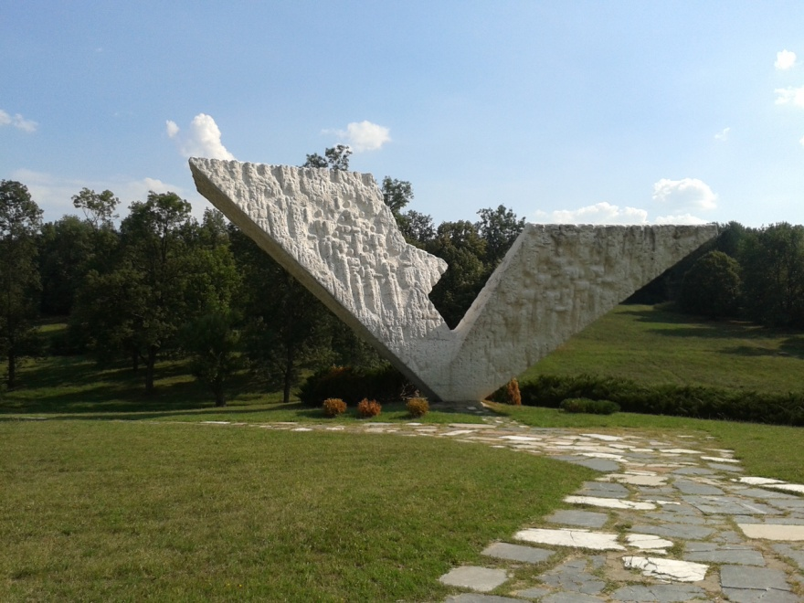
Memorial Museum '21st October'
Memorial Museum '21st October'

Slide 37
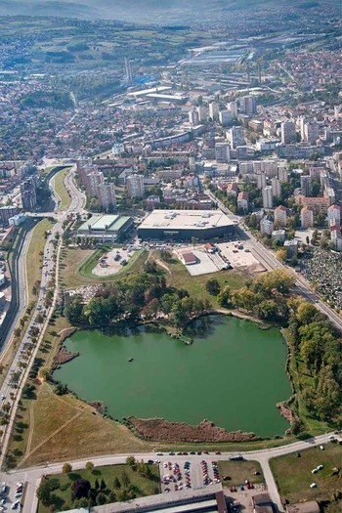
KRAGUJEVAC

Slide 38
ENJOY THE VIDEO

Slide 39
The Orthodox Monasteries and Churches in Serbia
There are many monasteries and churches that are very important part of a culture that Serbia is proud of.
However, Serbia and Serbian orthodox church can be most proud of its monasteries – from Studenica and Sopoćani near Peć; from the monasteries on Mt. Fruška Gora to Manasija, Ravanica and Žiča.

Slide 40
Студеница- Studenica
The Studenica Monastery was established in the late 12th century by Stefan Nemanja, founder of the medieval Serb state.
It is the largest and richest of Serbia's Orthodox monasteries.

Slide 41
Студеница- Studenica

Slide 42
Ђурђеви Ступови-Đurđevi Stupovi
Djurdjevi stupovi, one of the oldest Serbian monasteries, was built in the late 12th century and dedicated to St. George, and is nowadays protected by the UNESCO.

Slide 43
Ђурђеви Ступови-Đurđevi Stupovi

Slide 44
Милешева- Mileševa
White Angel is a detail of one of the most well-known frescoes in Serbian culture in the Mileševa monastery.
This fresco is considered to be one of the great achievements in European painting.

Slide 45
Милешева- Mileševa

Slide 46
Крушедол-Krušedol
The Krušedol Monastery is situated on the Fruška Gora mountain in the Syrmia region, northern Serbia, in the province of Vojvodina.
The monastery is the legacy of the last Serbian despot family of Syrmia -Branković.

Slide 47
Крушедол-Krušedol

Slide 48
Лелић-Lelić
In 1991 a museum was opened within the monastery complex Lelić, dedicated to the memory of Bishop Nikolay ,one of the greatest minds among the bishops of the Serbian Orthodox Church.
He was a great educator, Doctor of Philosophy from Oxford, author of large numbers of religious and philosophical works.

Slide 49
Лелић-Lelić

Slide 50
Ралетинац-Raletinac
The Raletinac monastery is situated near Kragujevac.
It’s dedicated to apostles St. Peter and St. Paul.
The church has a single nave with arched sealing and the narthex is more decorative.

Slide 51
Ралетинац-Raletinac

Slide 52
Храм Свети Сава на Врачару- The Church of Saint Sava
The Church of Saint Sava or "The Temple of Saint Sava", is a Serbian Orthodox church which sits on the Vračar plateau in Belgrade. The church is dedicated to Saint Sava, the founder of the Serbian Orthodox Church.It is the largest Orthodox church in Serbia and it ranks among the largest churches in the world.

Slide 53
The Church of Saint Sava

Slide 54
Високи Дечани- Visoki Dečani
Visoki Dečani is a medieval Serbian Orthodox Christian monastery located in the region Kosovo and Metohija in Serbia.
It was founded in the first half of the 14th century by Serbian king Stefan Dečanski.
The monastery is a part of the World Heritage site.

Slide 55
Високи Дечани- Visoki Dečani

Slide 56
Петрова Црква- Petrova Crkva
The Church of the Holy Apostles Peter and Paul or simply Peter's Church is , the oldest intact church in Serbia and one of the oldest ones in the region, situated on a hill of Ras, in Novi Pazar, Serbia.
The church frescoes date to the 10th, 12th and 13th centuries.

Slide 57
Петрова Црква- Petrova Crkva

Slide 58
Манасија-Manasija
Manasija is a Serbian Orthodox monastery near Despotovac, founded by Despot Stefan Lazarević between 1406 and 1418. The church is dedicated to the Holy Trinity. The monastery is surrounded by massive walls and towers. Its School of Resava was well known for its manuscripts and translations throughout the 15th and 16th centuries.

Slide 59
Манасија-Manasija

