Slide 1
Welcome to the UK
This is info about the uk

Slide 2
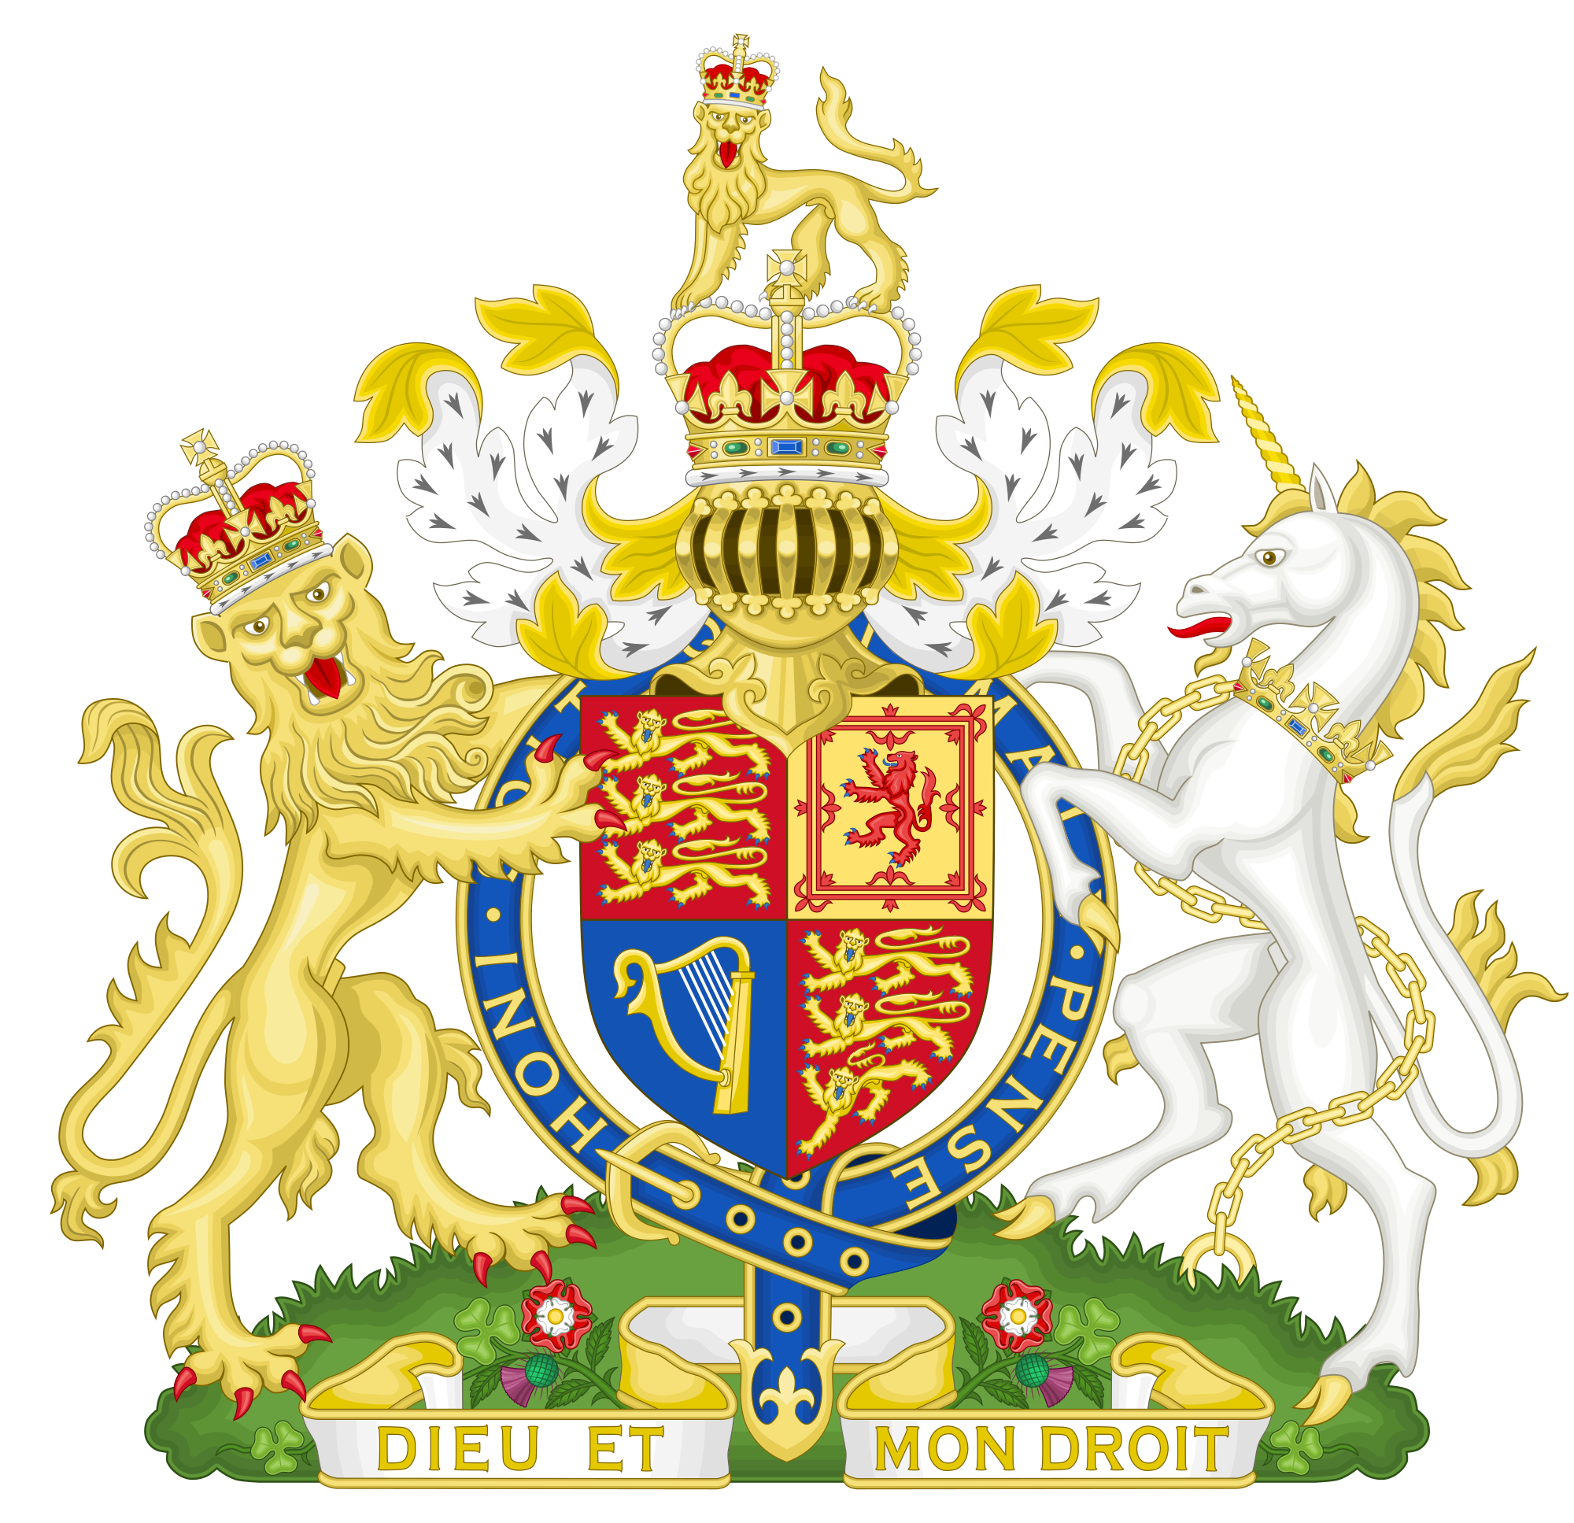
What does the uk stand for ?
UK stands for a United Kingdom. It is United because it is made up of Four smaller countries. These countries are: England, Scotland, Northern Ireland and finally Wales.

Slide 3
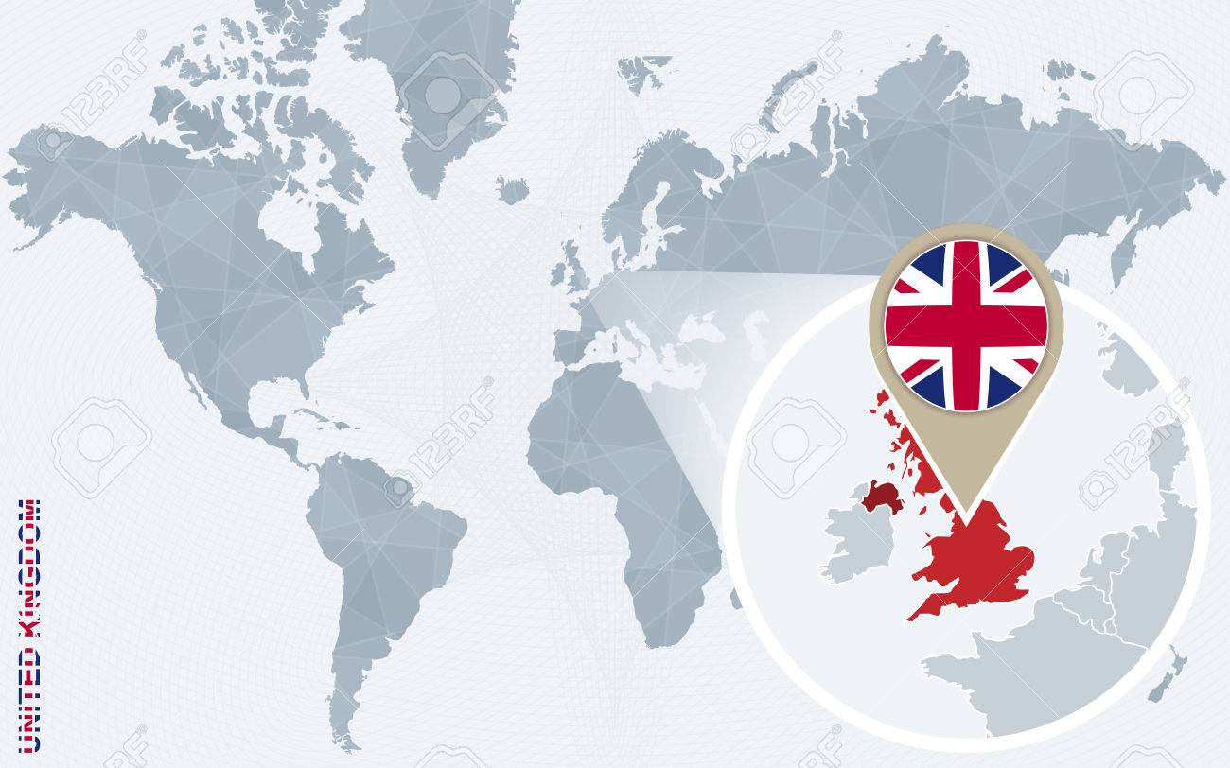
Where is the uk?
The Uk is surrounded by the North Atlantic Ocean, the North sea and the English Channel. UK, an AMAZING community, is southwest of Norway, north of France, west of Denmark, northwest of Germany, and to the west of Belgium and the Netherlands.

Slide 4
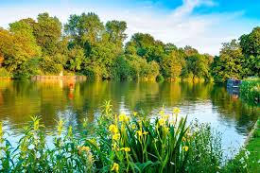
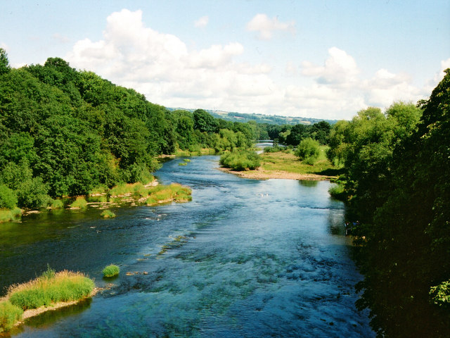
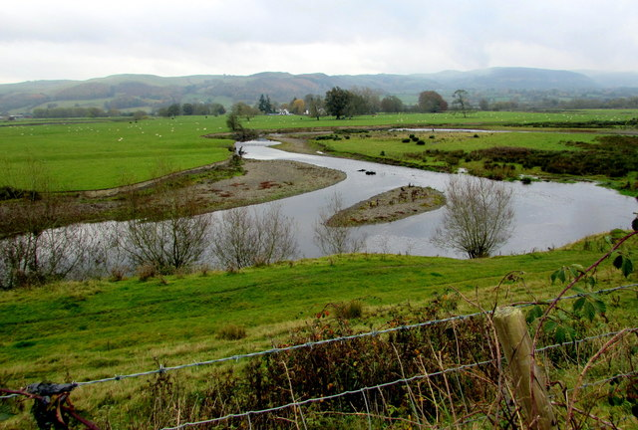
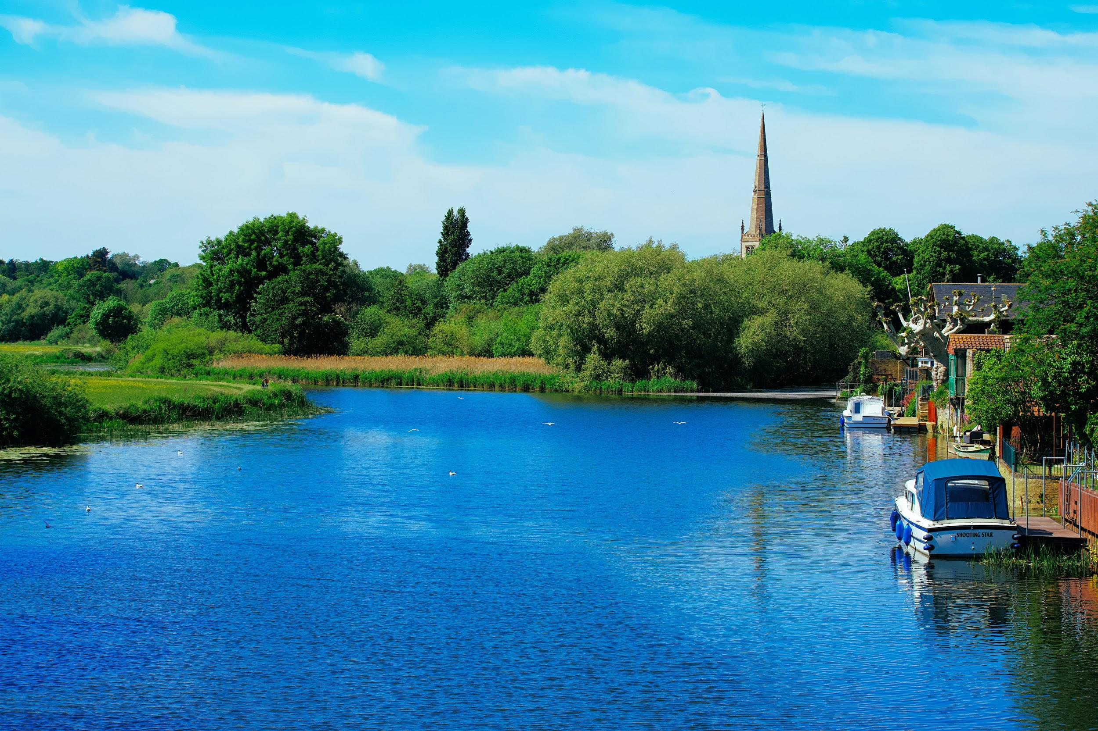
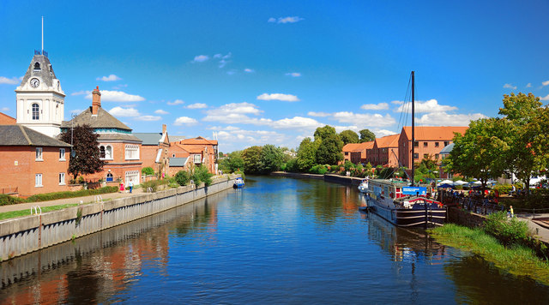
Rivers in the UK
The 5 main rivers in the UK are the River Severn, the River Thames, the River Trent, the River Great Ouse and the River Wye.
River Severn
River Wye
River Great Ouse
River Thames
Did you Know?
There are are more than 1,500 rivers in the uk.
River Trent

Slide 5
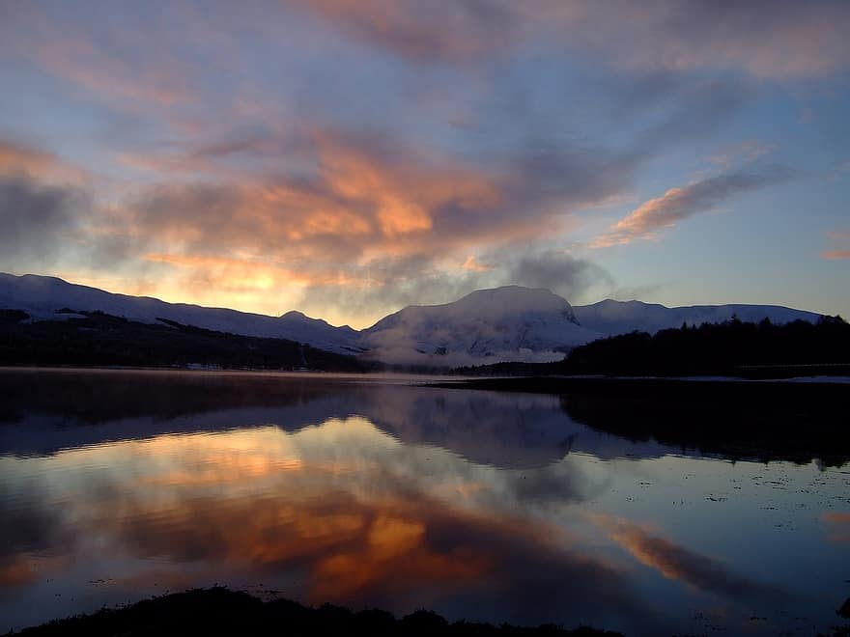
Mountains
Ben Nevis is the highest mountain in the UK at 1345m. It is in Scotland, which has the top 10 mountains in the UK.
The highest mountains in the other
Countries in the UK are:
England: Scarfell Pike (978m)
Wales: Snowdon (1085m)
Northern Ireland: Slieve Donard (850m)
This is a picture of Ben nevis mountain standing at 1,345m tall.

Slide 6
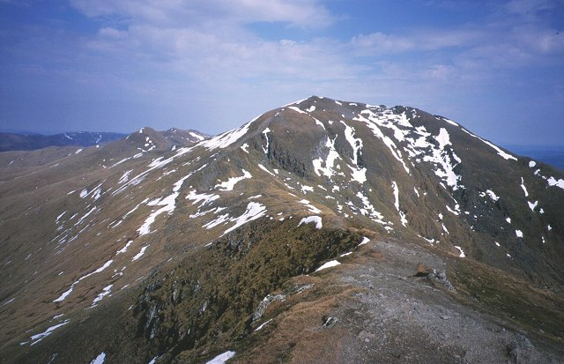
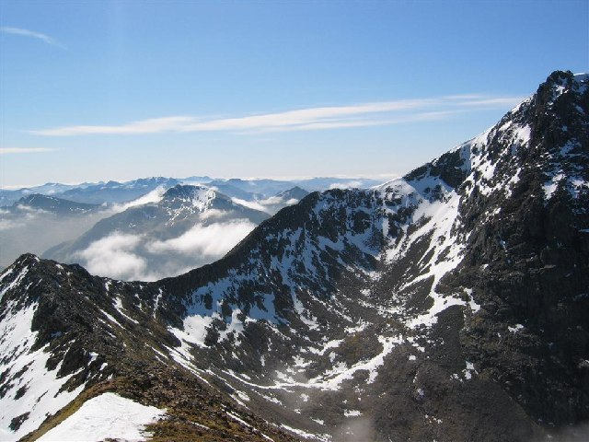
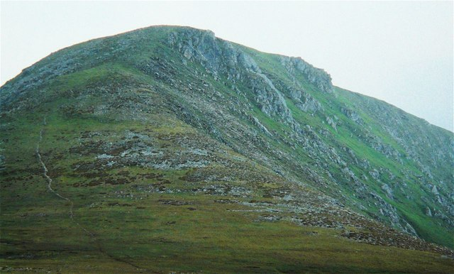
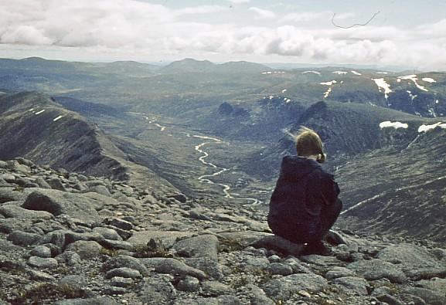
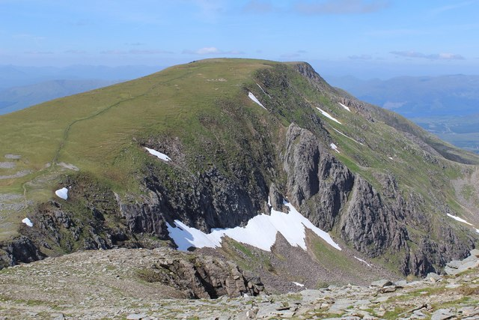
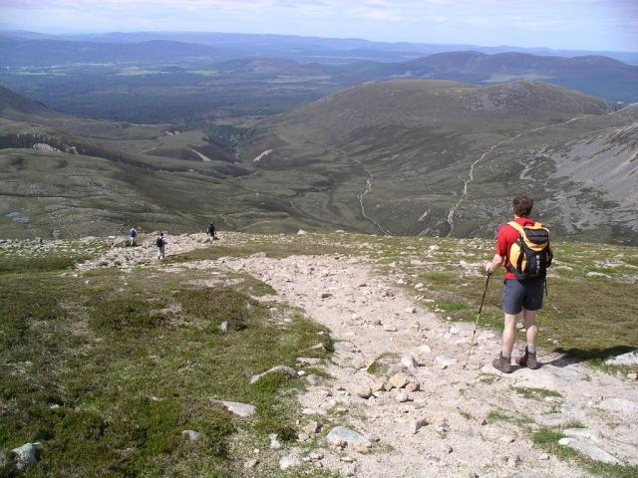
Pictures of mountains

Slide 7
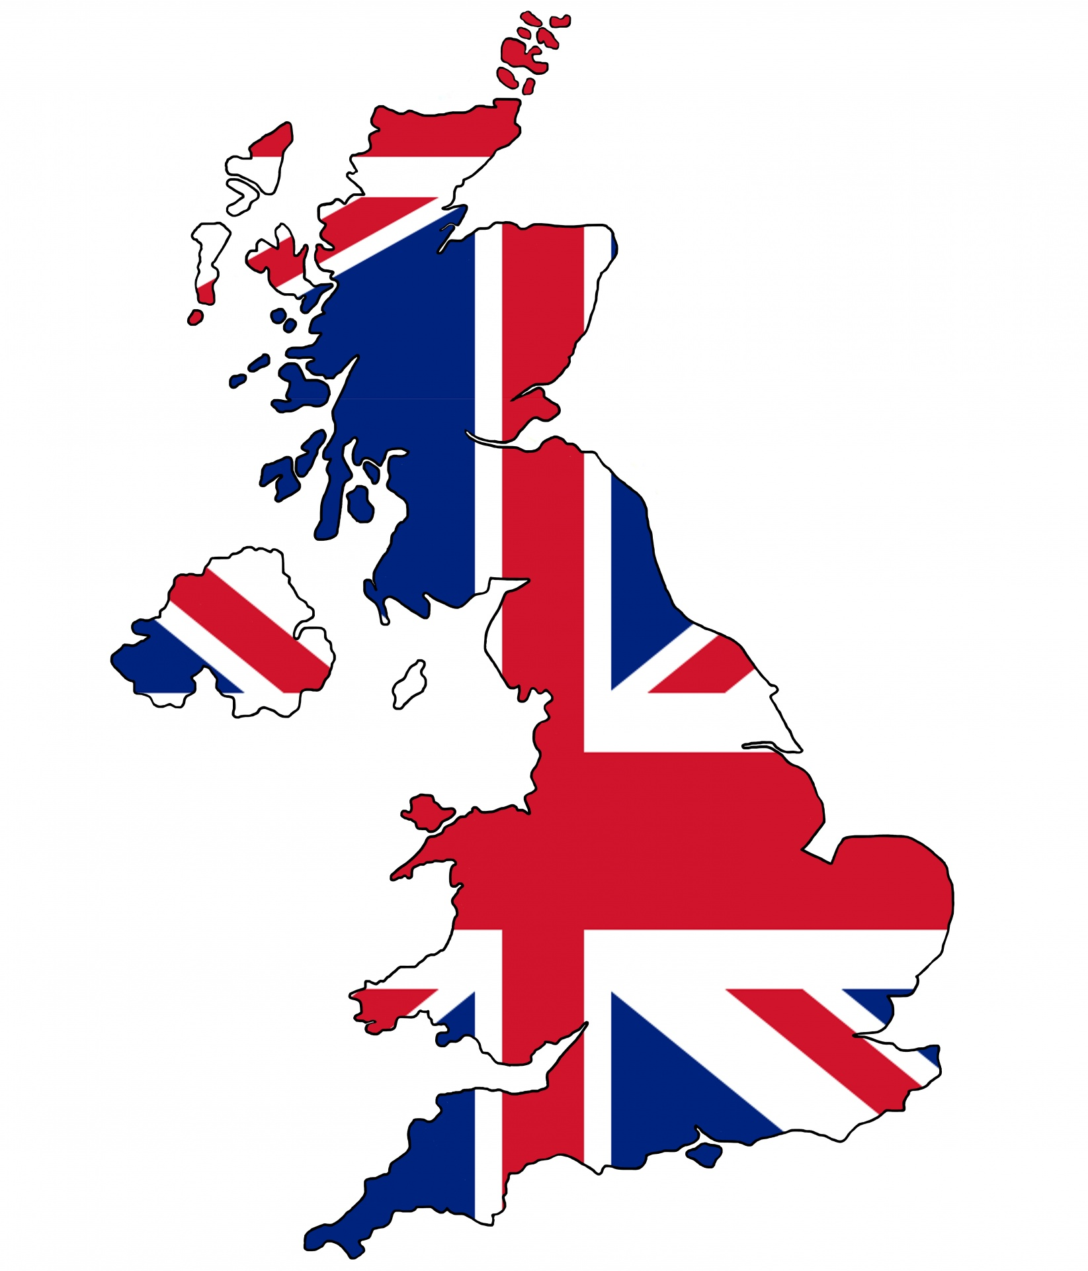
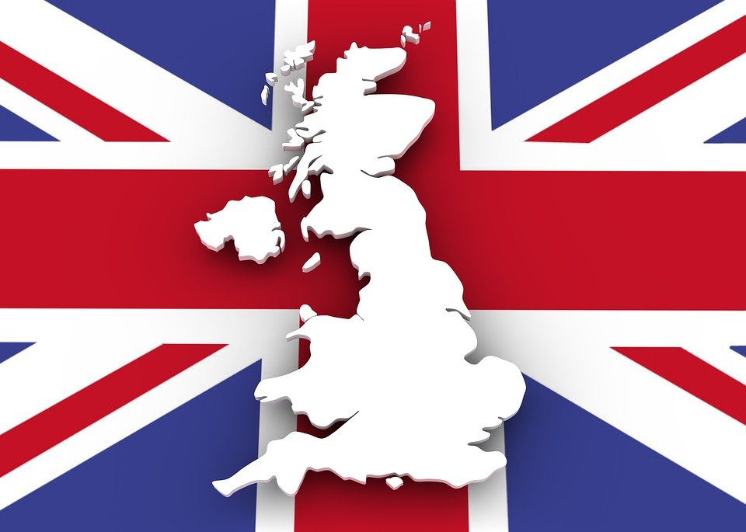
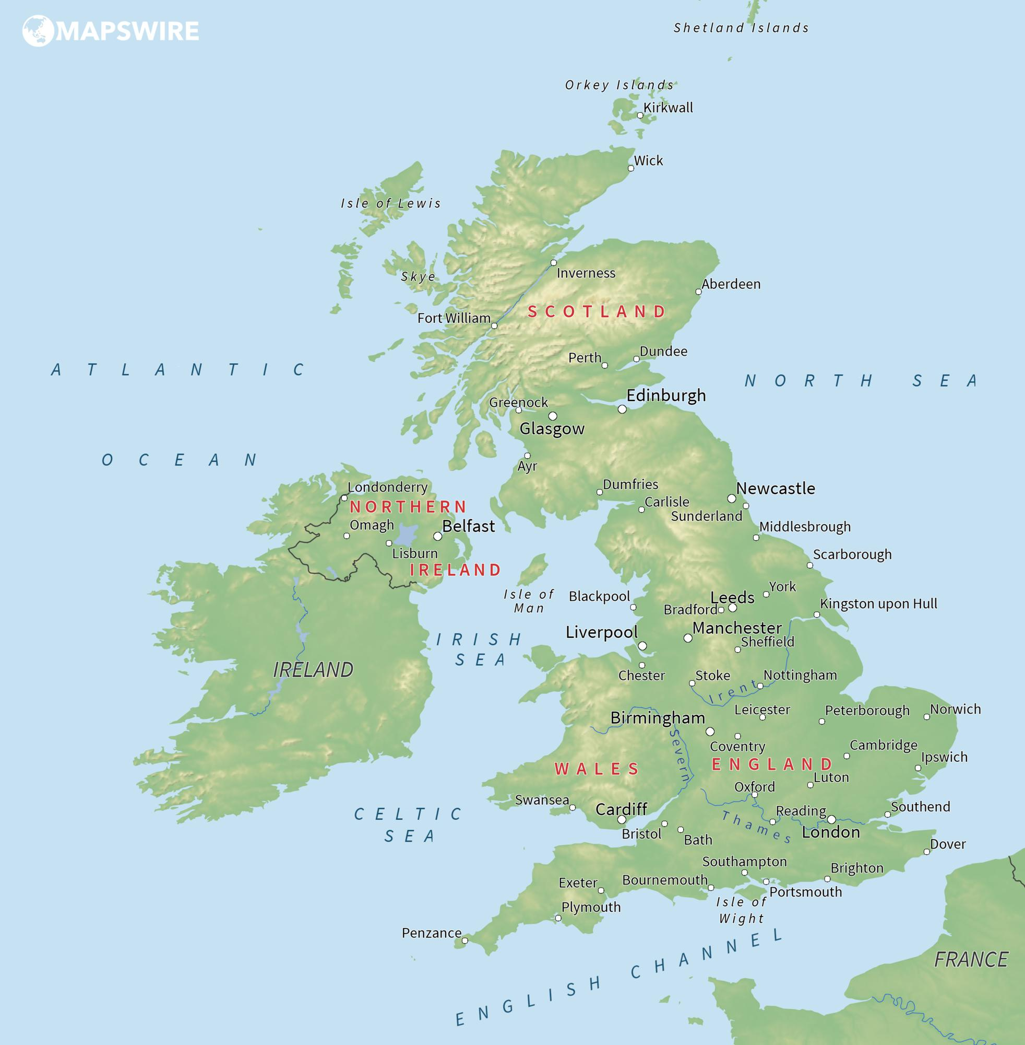
What are the countries in the UK?
There are 4 countries in the UK called: England, Wales, Scotland and Northern Ireland. England is the biggest country in the UK both in population and size. Population in the UK countries are: England 56,286,961; Northern Ireland 1,893,667; Wales 3,152,879 and Scotland 5,463,300. That means that a staggering 66,796,807 people live in the UK. WOW!

Slide 8
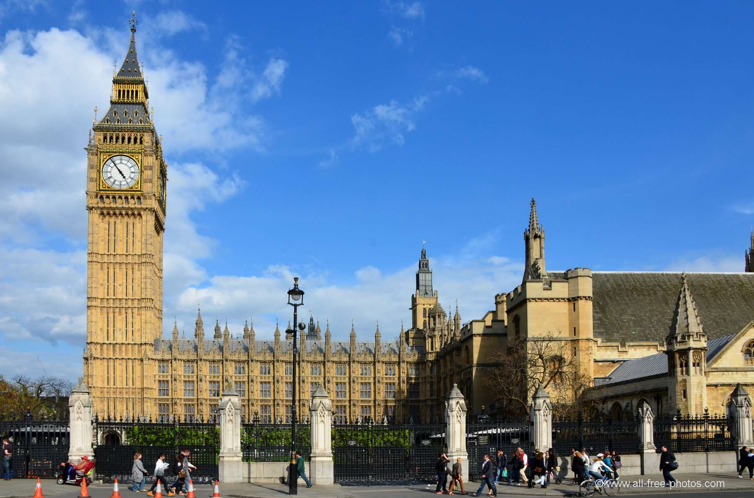
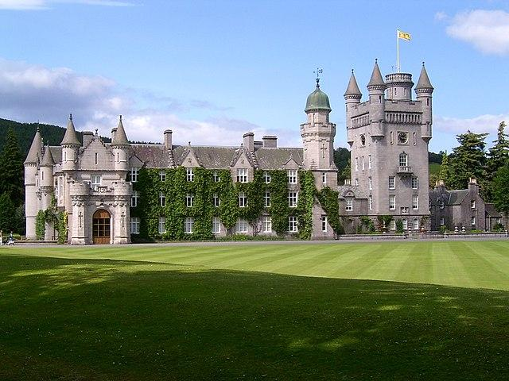
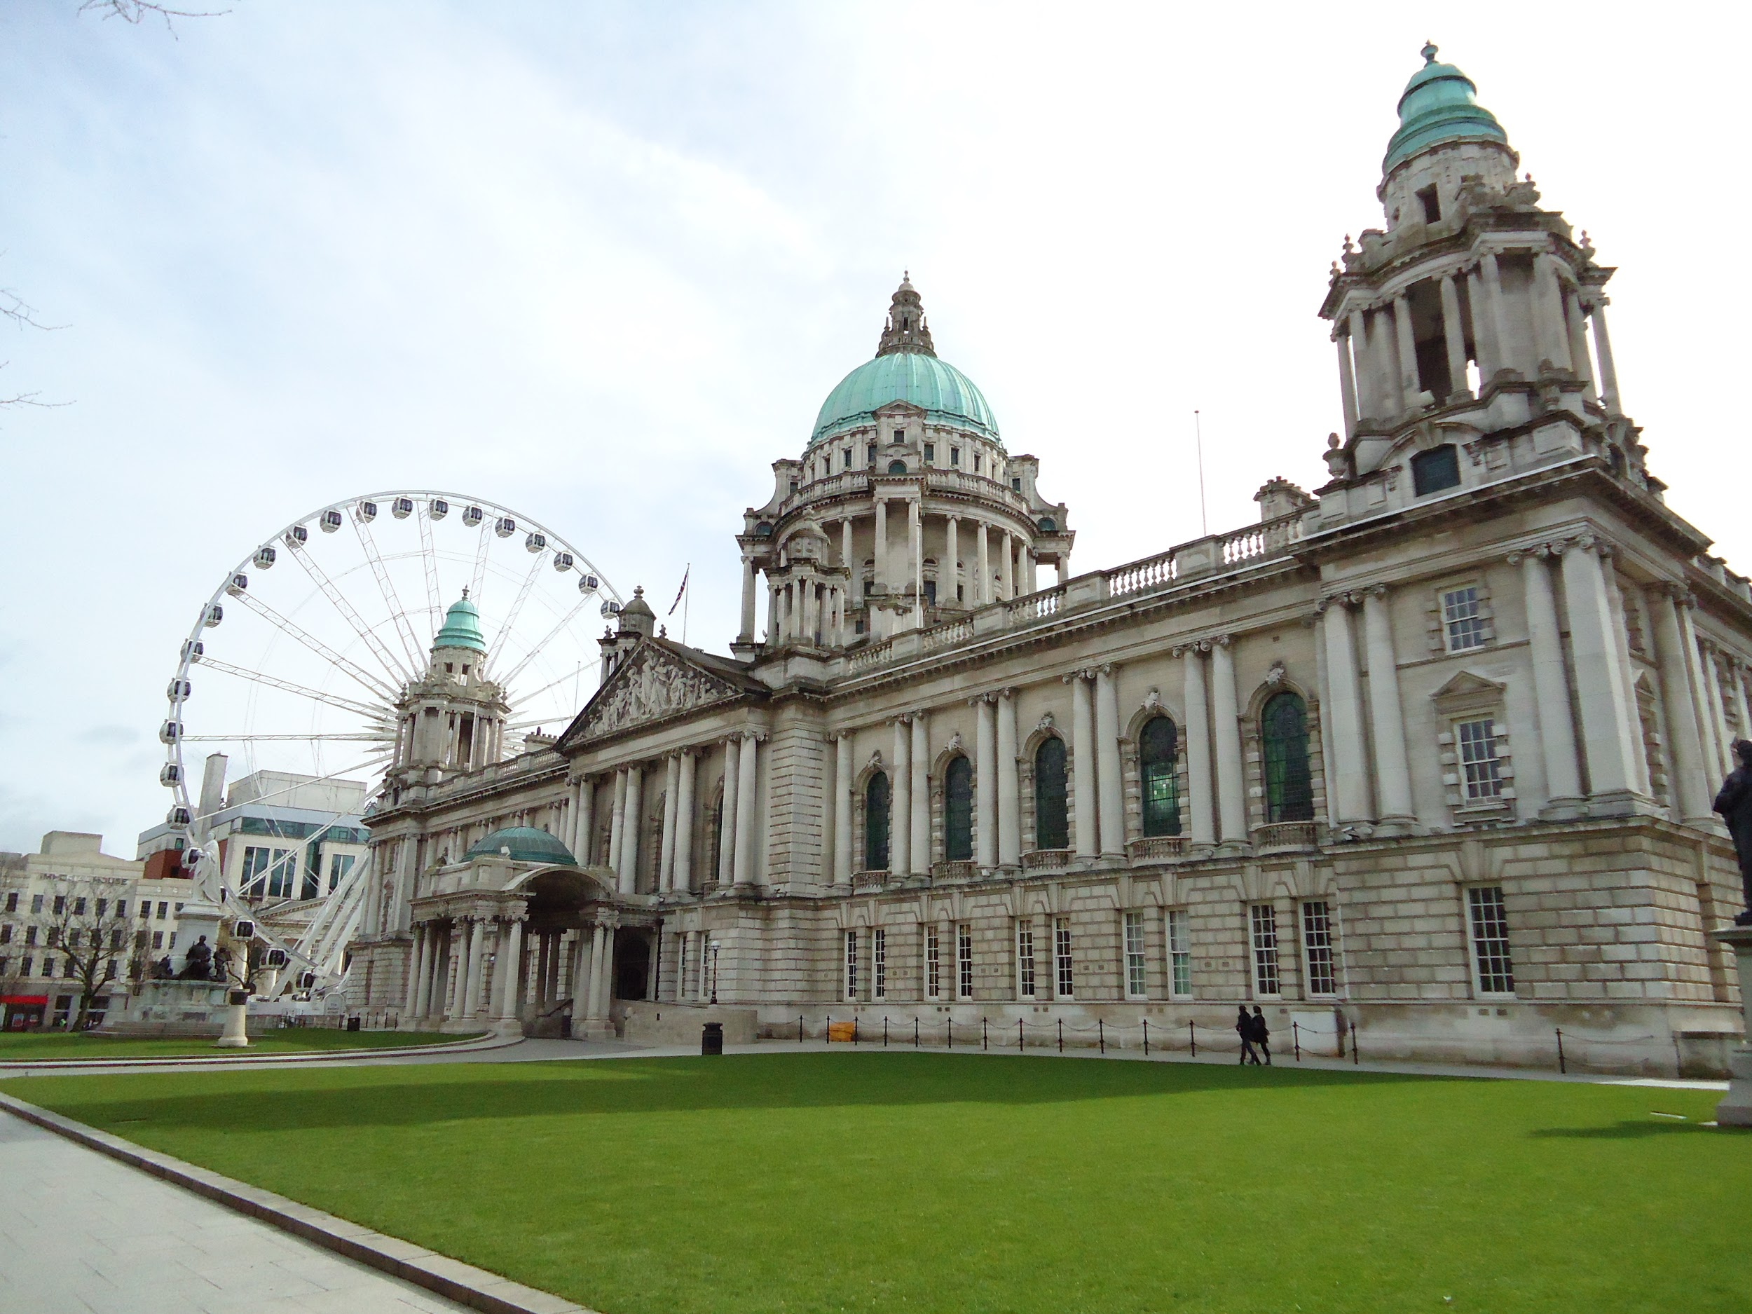
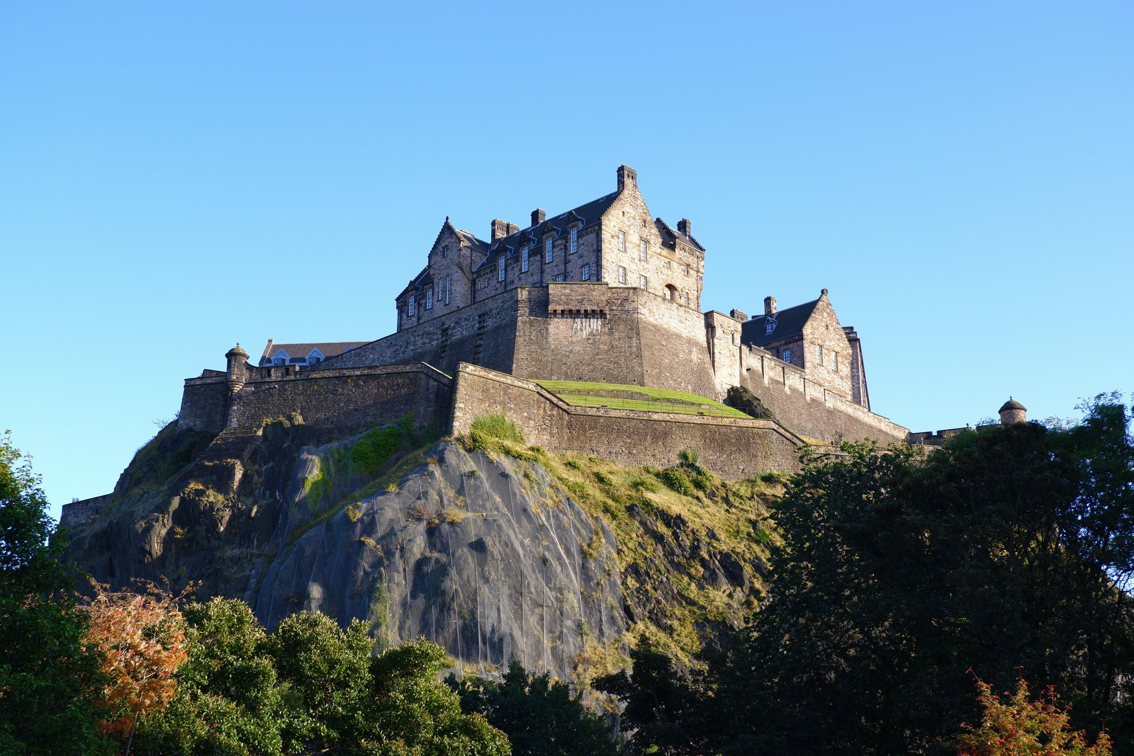
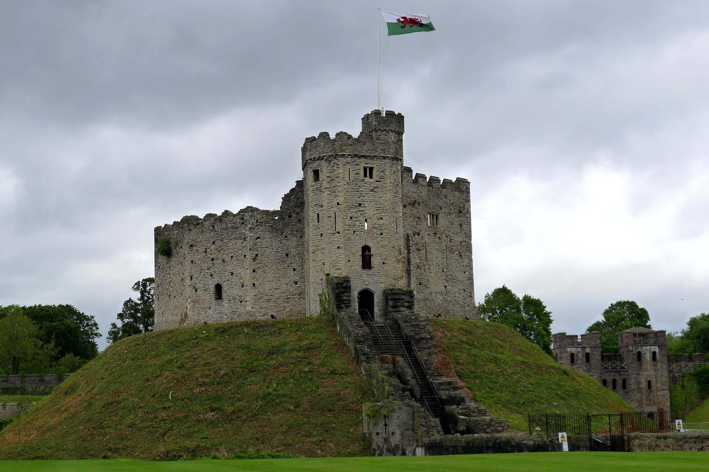
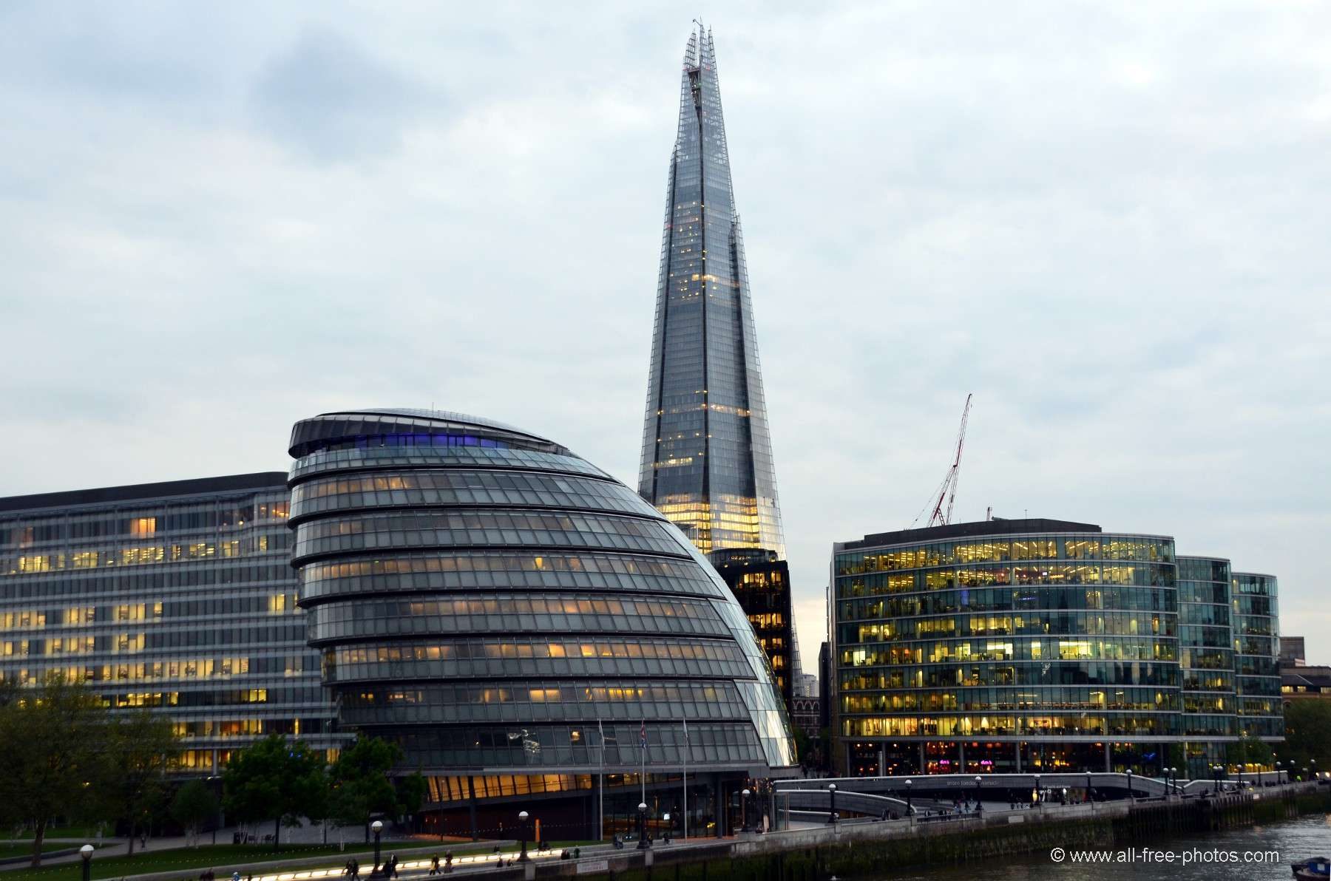
Famous Buildings
Some of the famous building in the UK are Big Ben, the Shard, Edinburgh Castle, Balmoral Castle, Belfast City Hall and Cardiff Castle.
Big Ben
Balmoral Castle
Belfast city hall
Edinburgh Castle
The Shard
Cardiff Castle

Slide 9
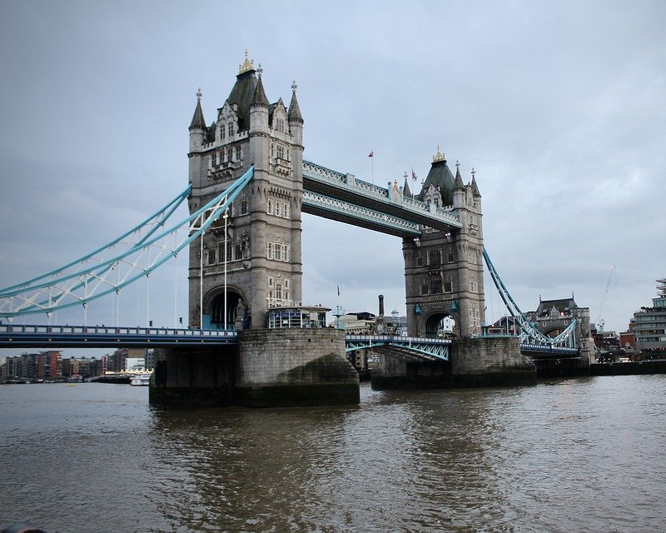
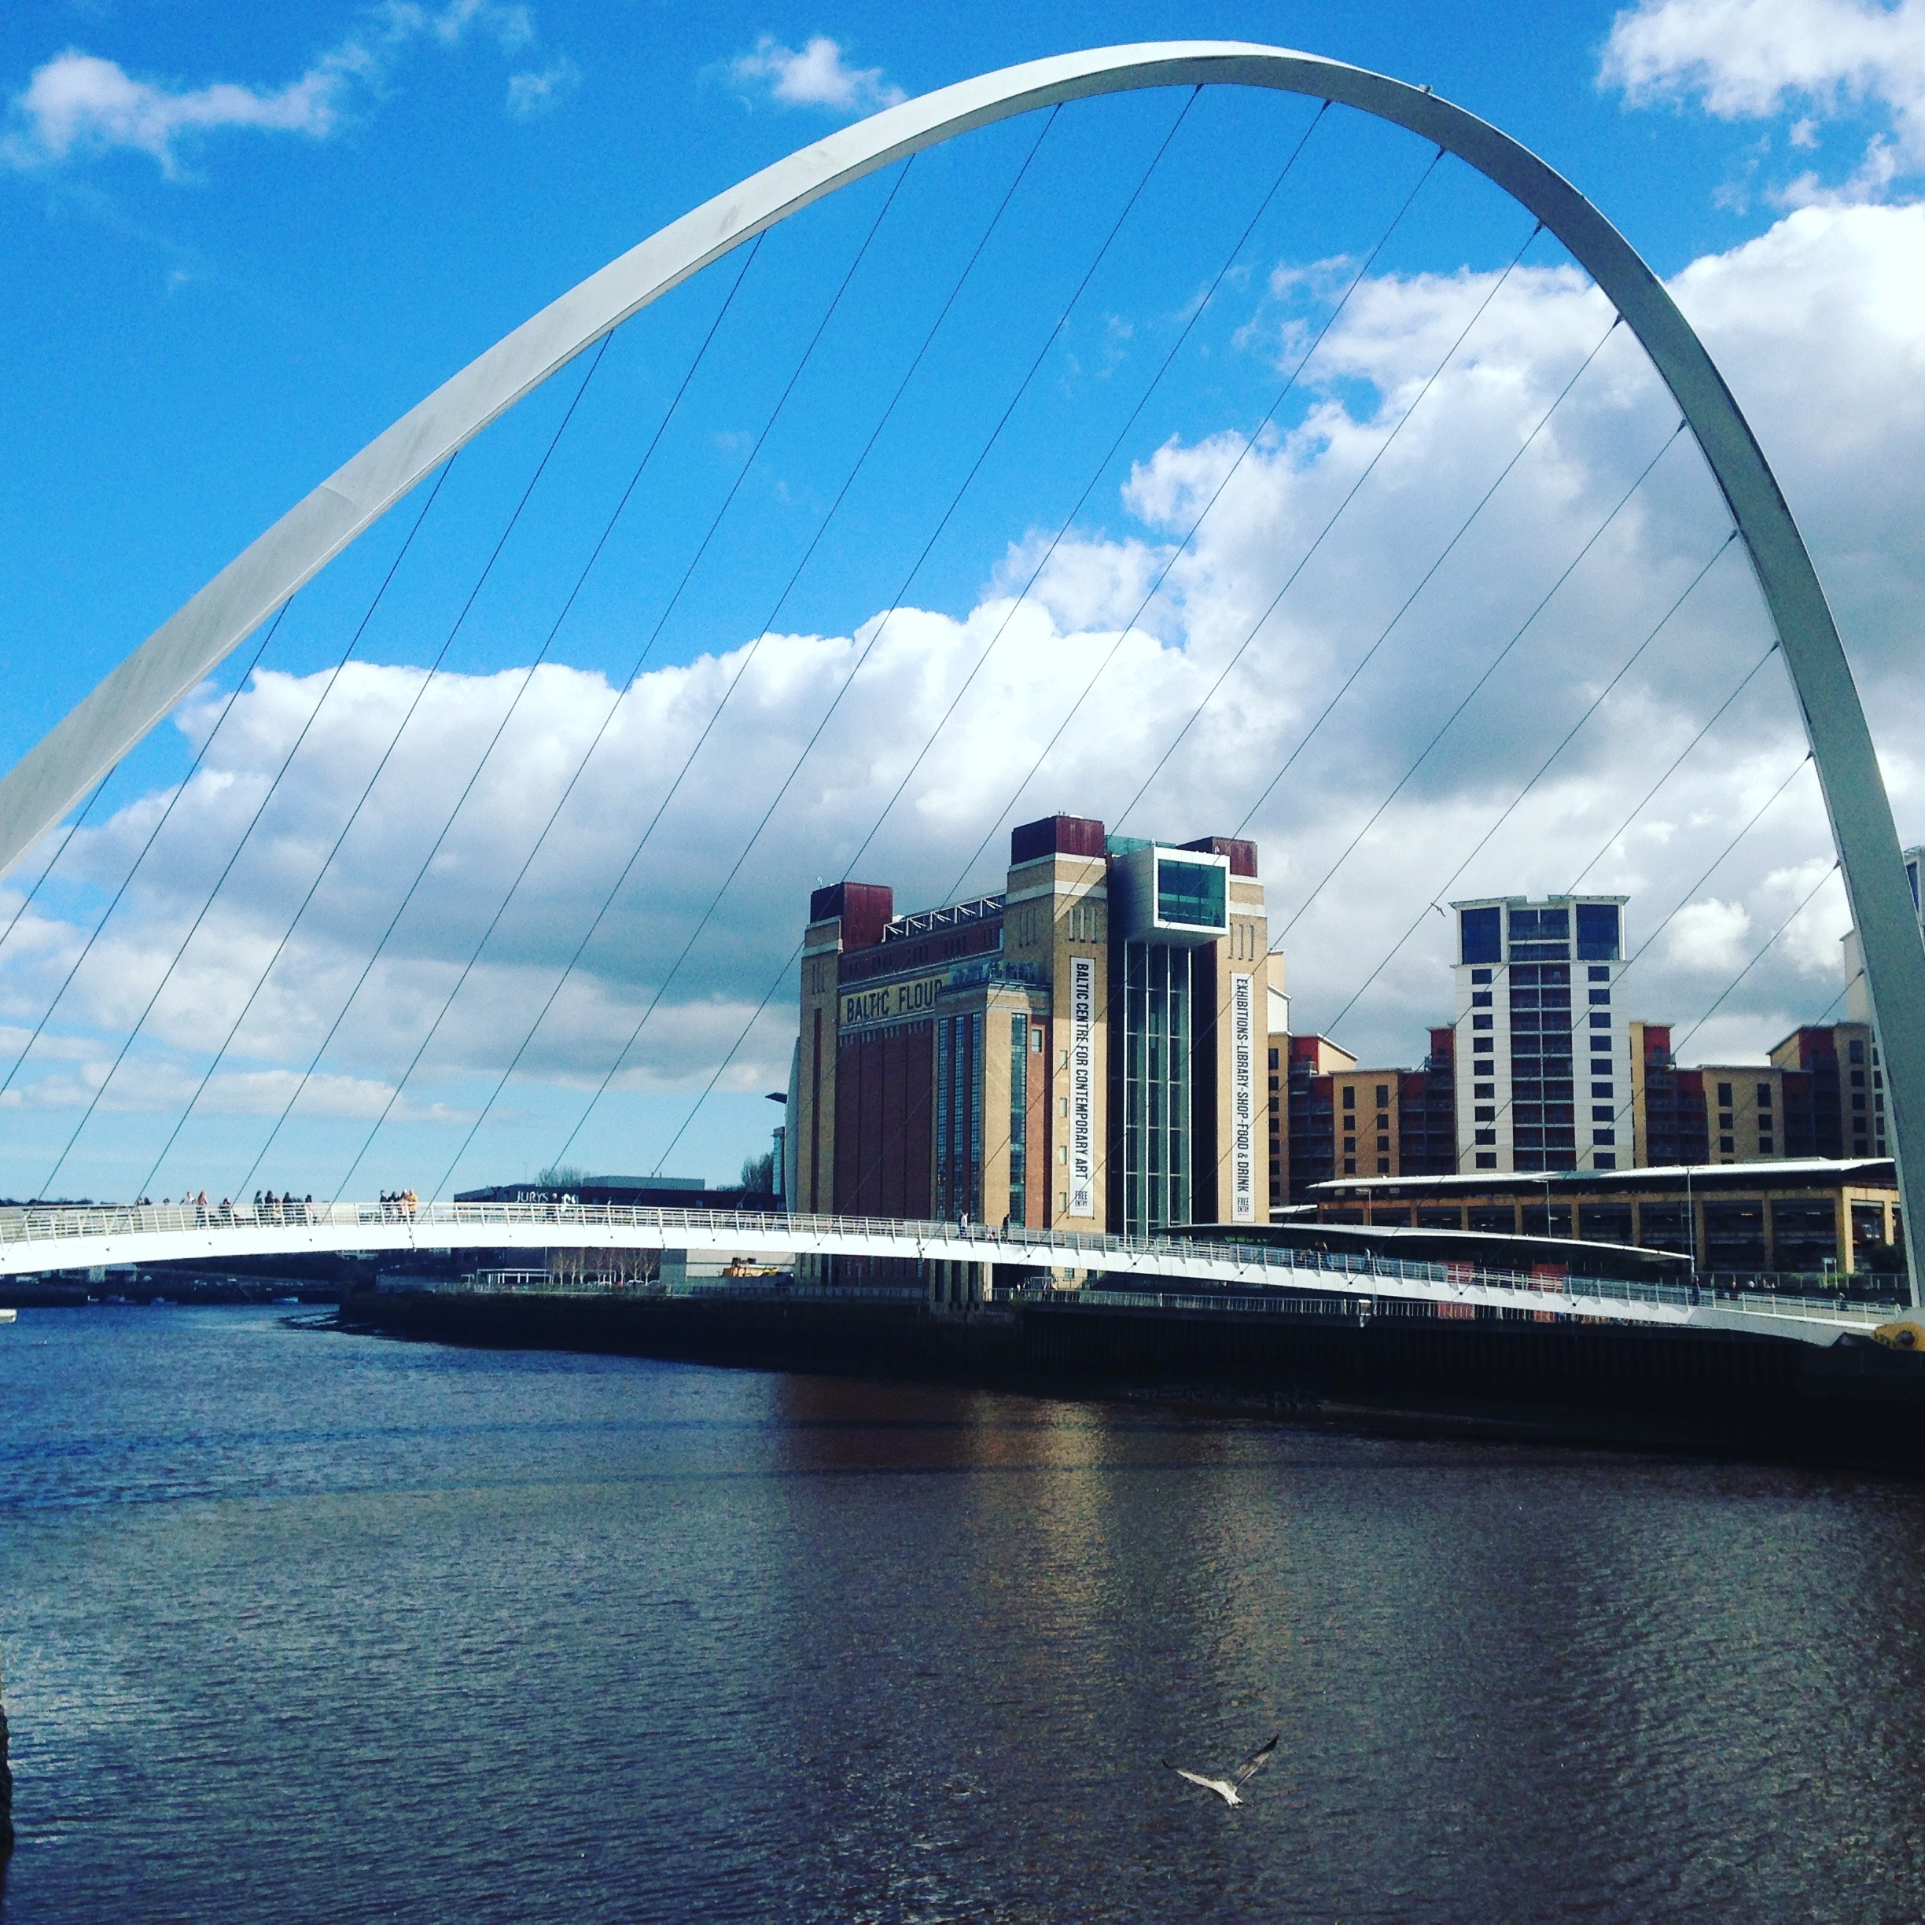
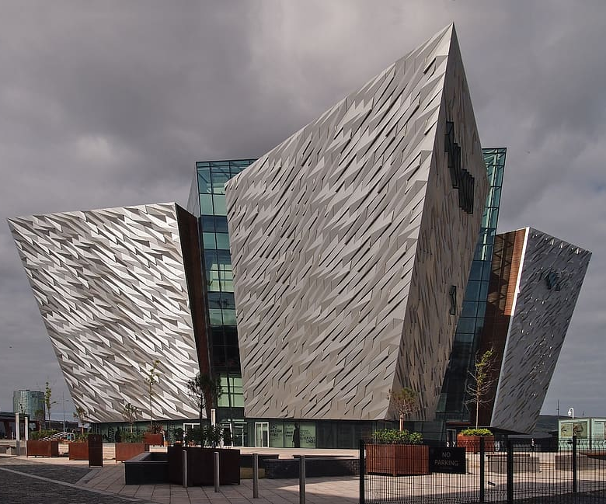
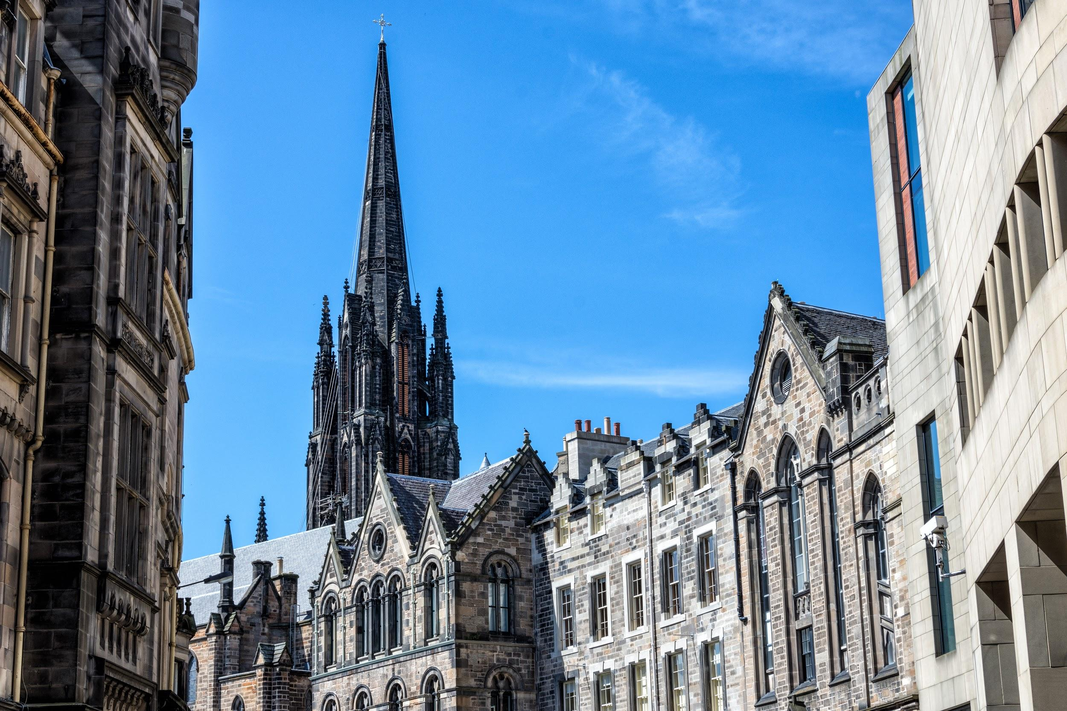
Main cities
The capital cities in the UK are:
London Cardiff Belfast Edinburgh
(England) (Wales) (Northern Ireland) (Scotland)
Some of the other cities in the UK are: Manchester, Glasgow, Birmingham, Liverpool, Leeds, Swansea, Cambridge, Redding, Bath, Dundee, Portsmouth, Westminster, Halifax, Exeter, Durham, Newport, Cork, Limerick.

Slide 10
National Parks
There are 15 national parks in the UK. The most popular one is the lake district. The newest national park is the south downs.
Lake District

Slide 11
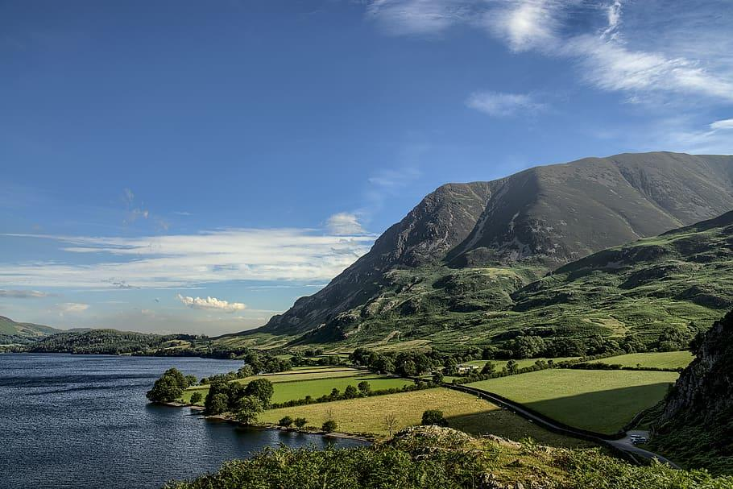
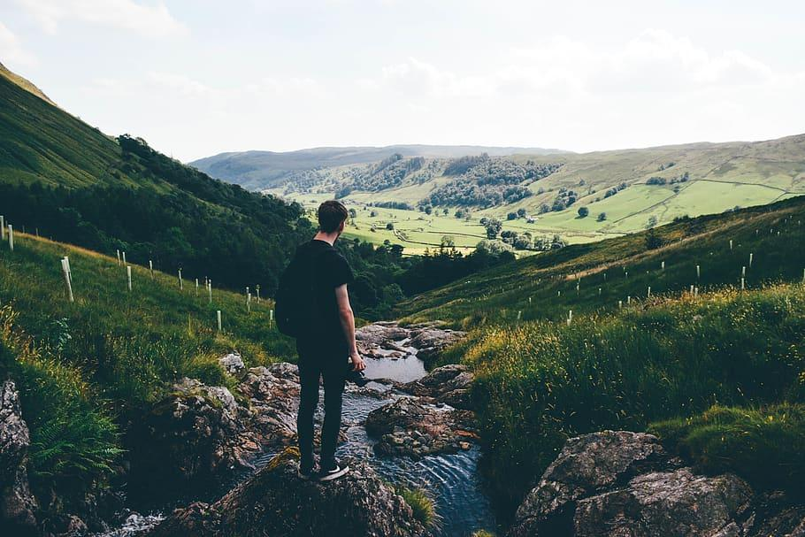
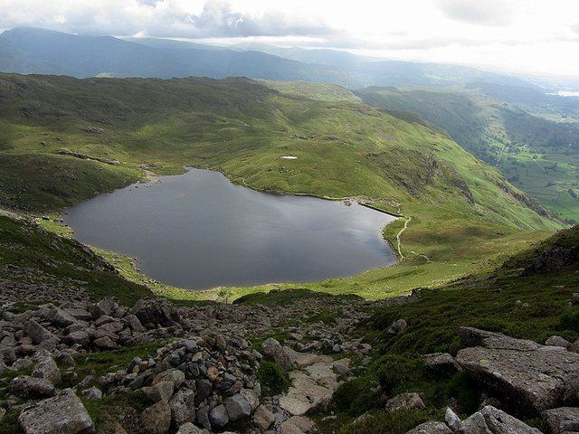
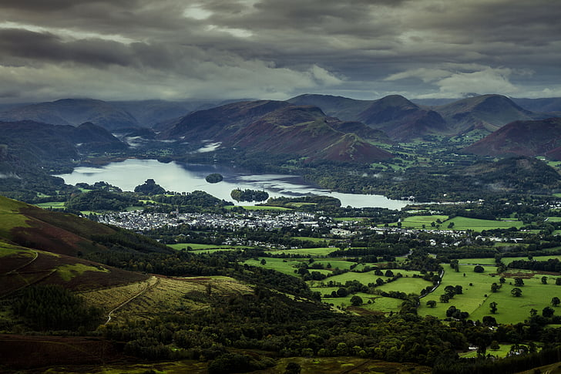
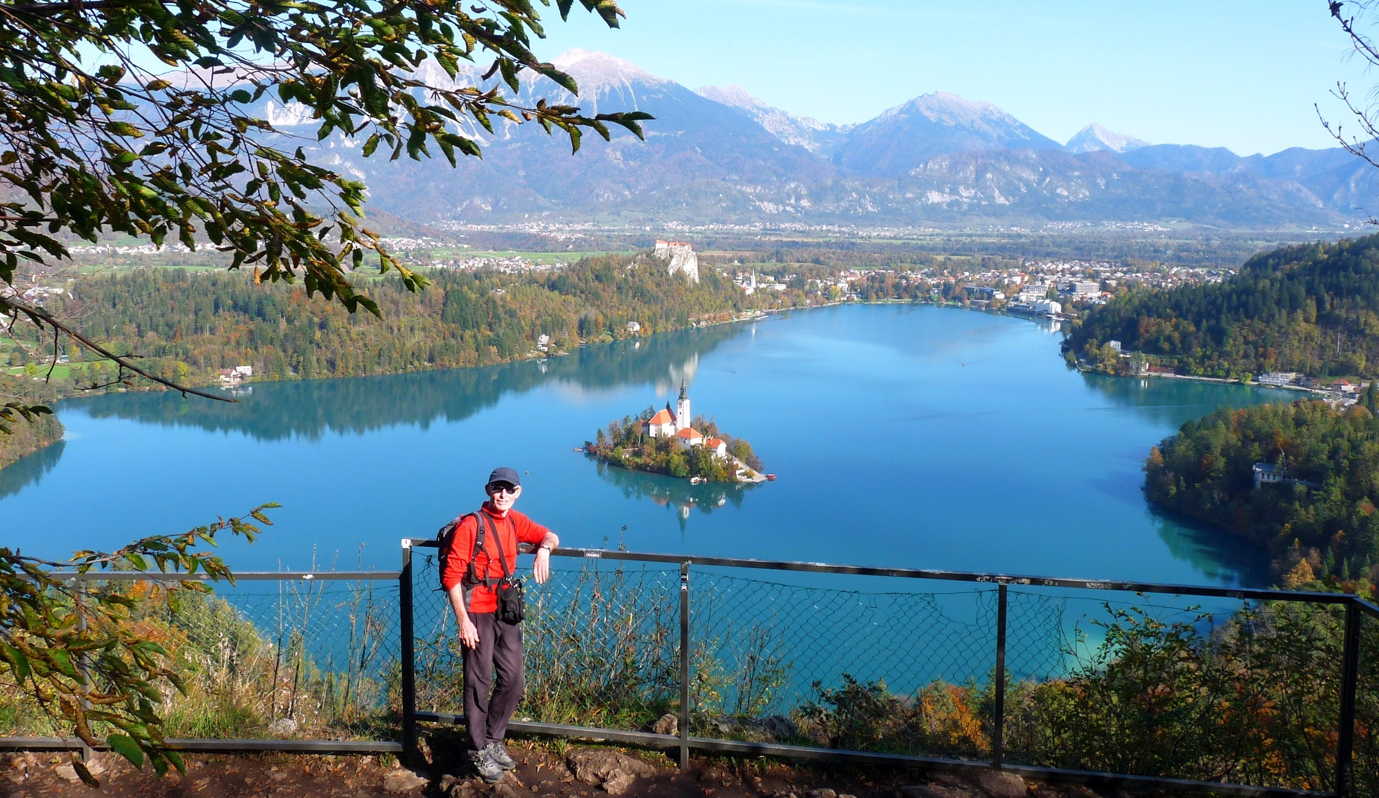
Lake District National park

Slide 12
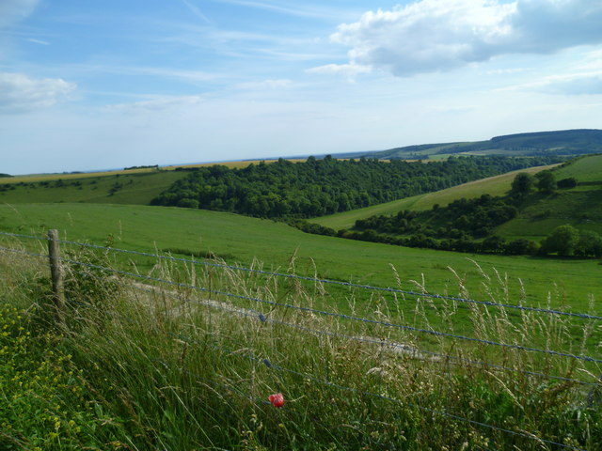
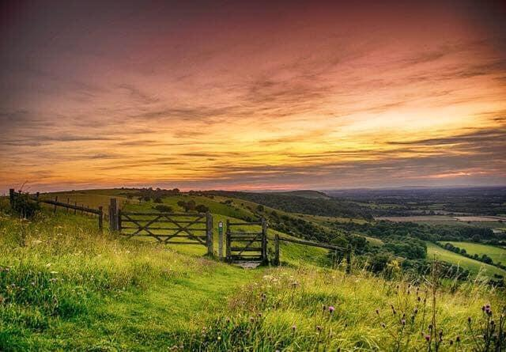
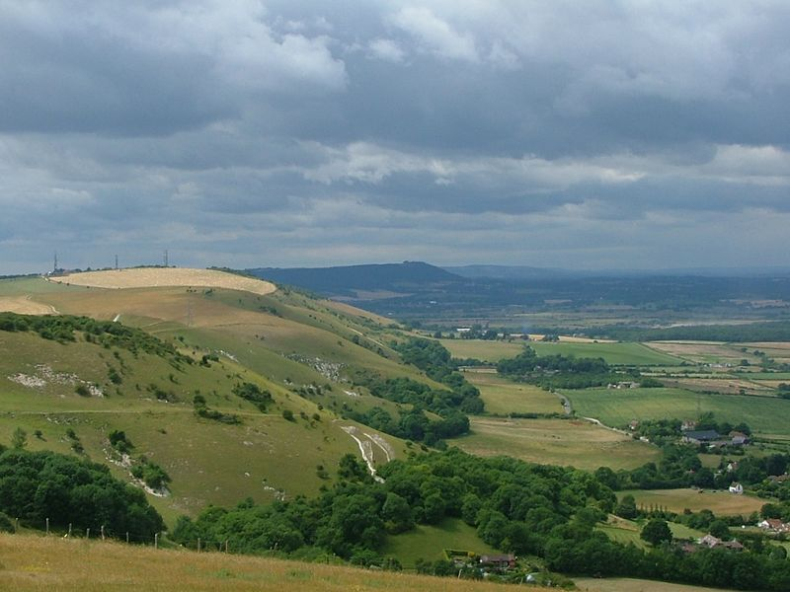
South Downs National Park

Slide 13
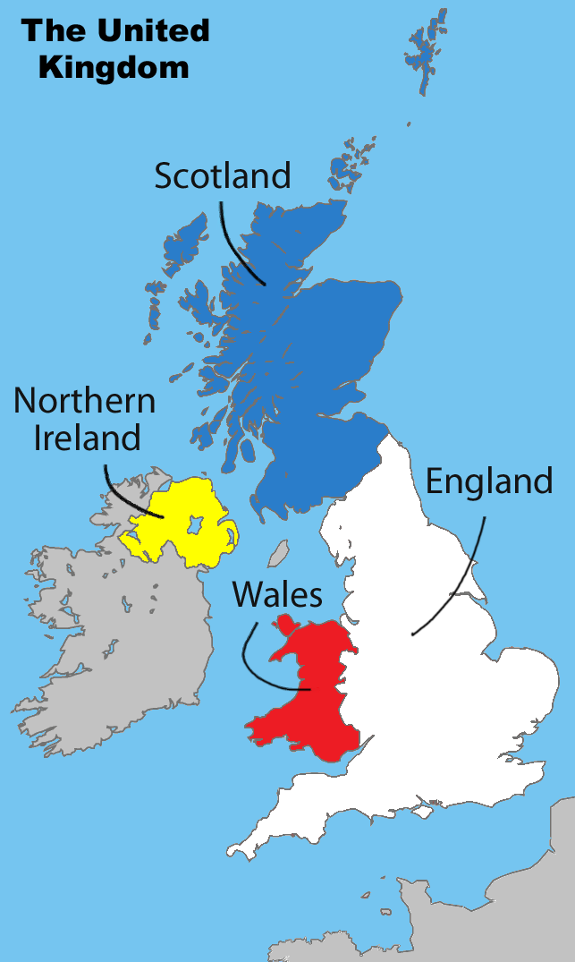
The Difference between Great Britain, Uk and England
The difference between the UK, Great Britain and England is:
England is a country
The UK contains the countries England, Scotland, Wales and Northern Ireland
Great Britain contain the countries England, Wales and Scotland.

Slide 14
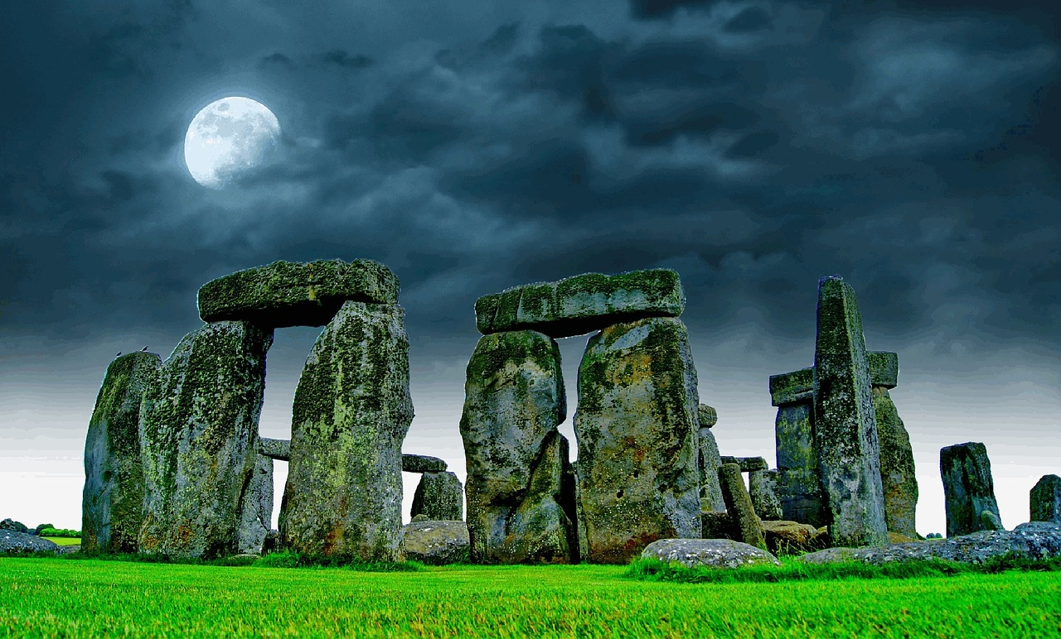
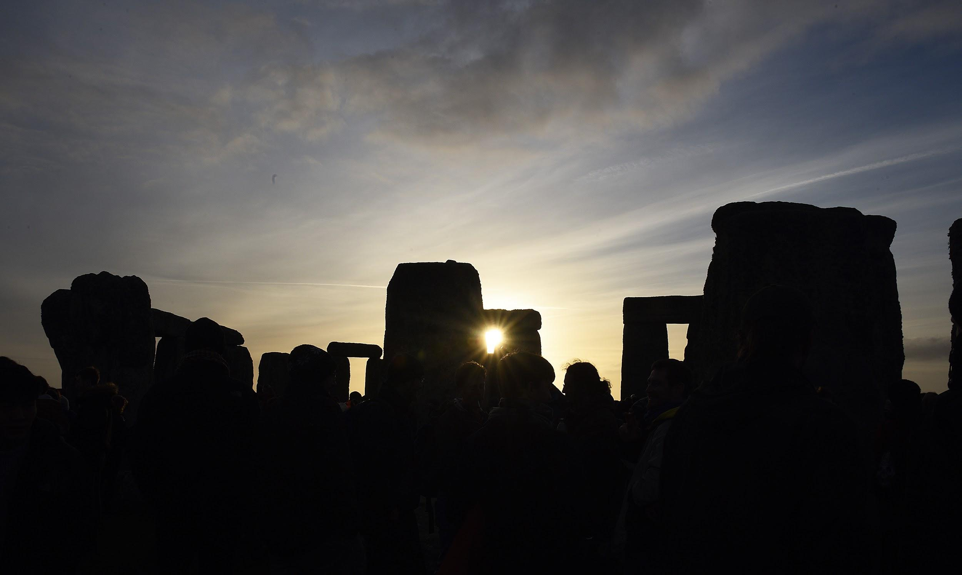
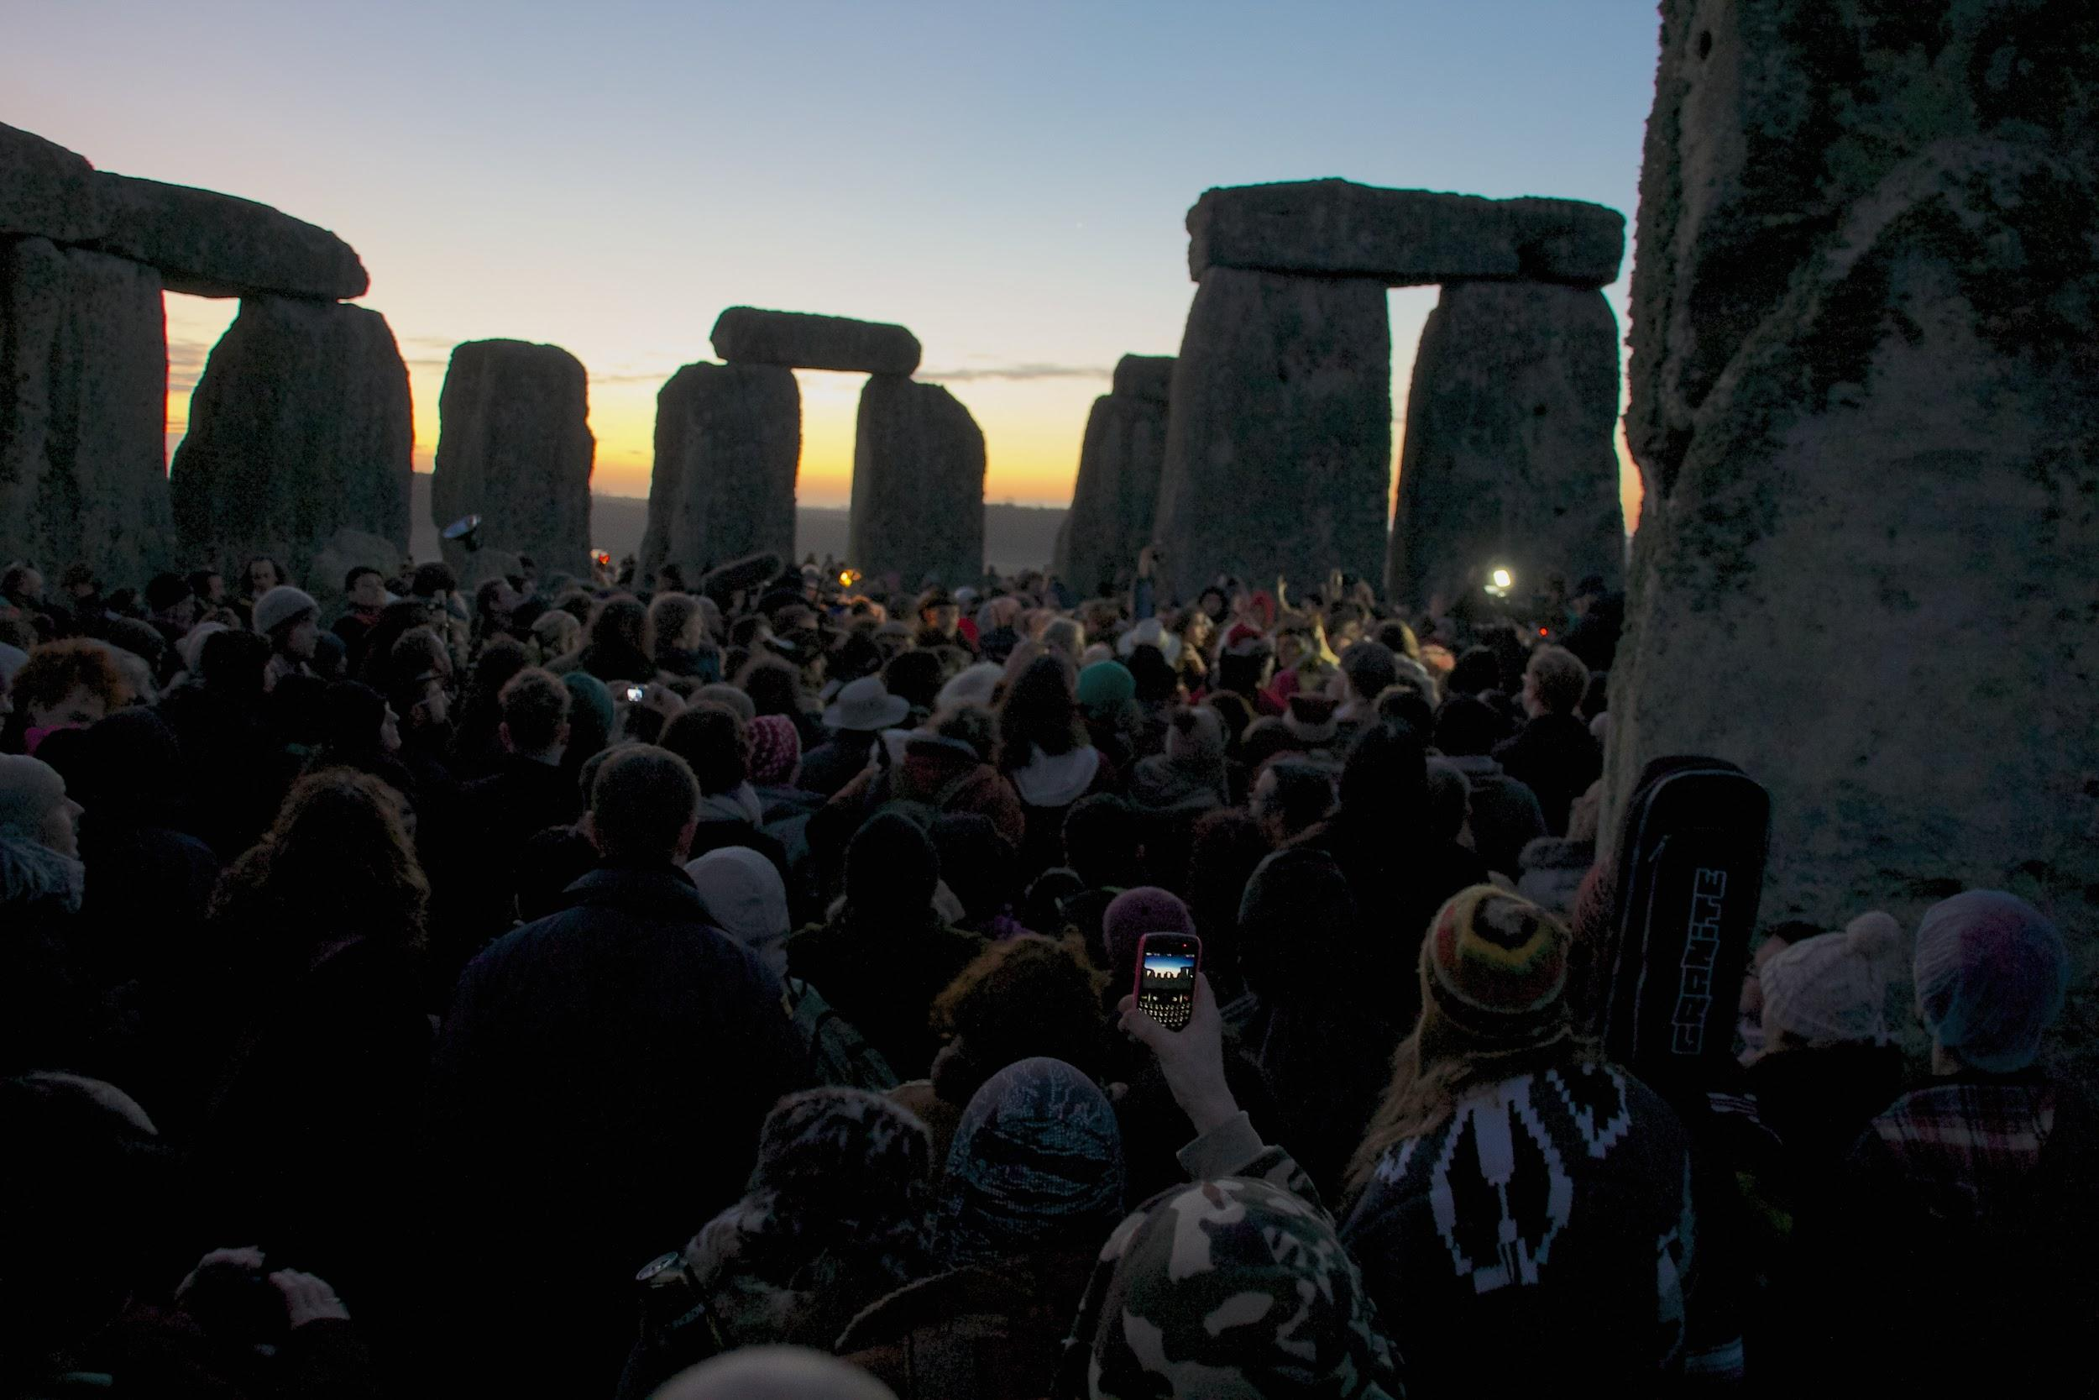
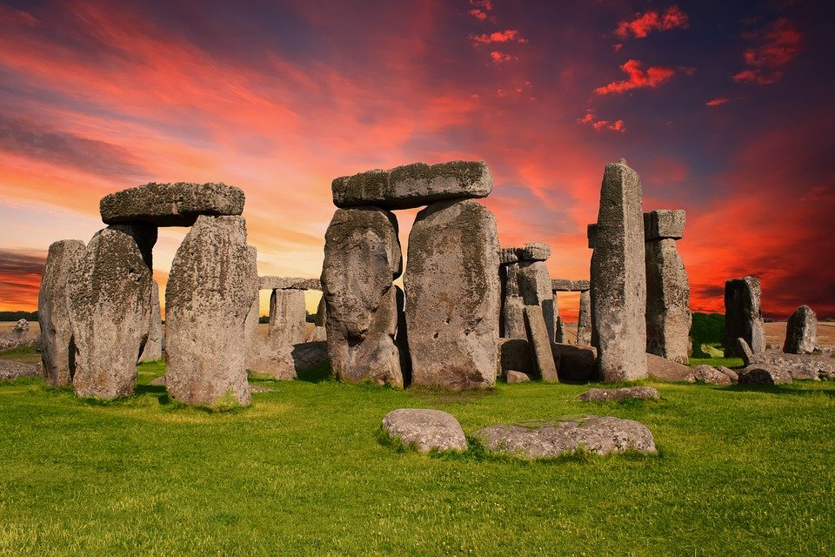
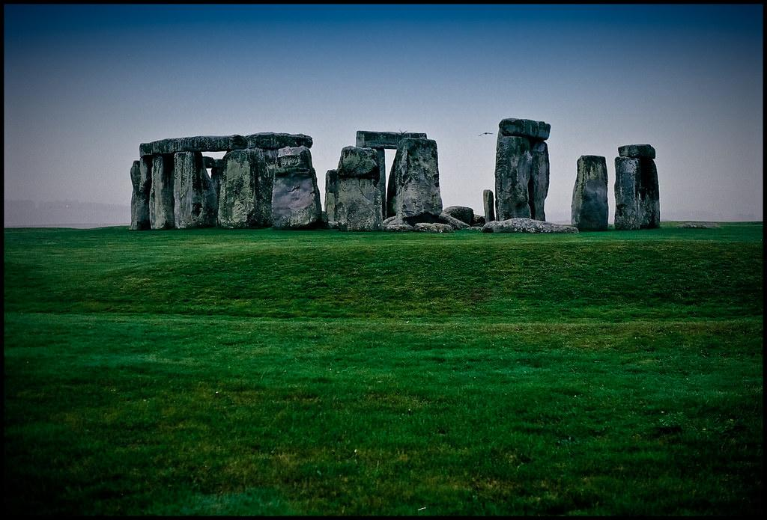
Stonehenge
Stonehenge was built by people in the stone age if you want to know more about Stonehenge click here.

