Slide 1
SERBIA

Slide 2
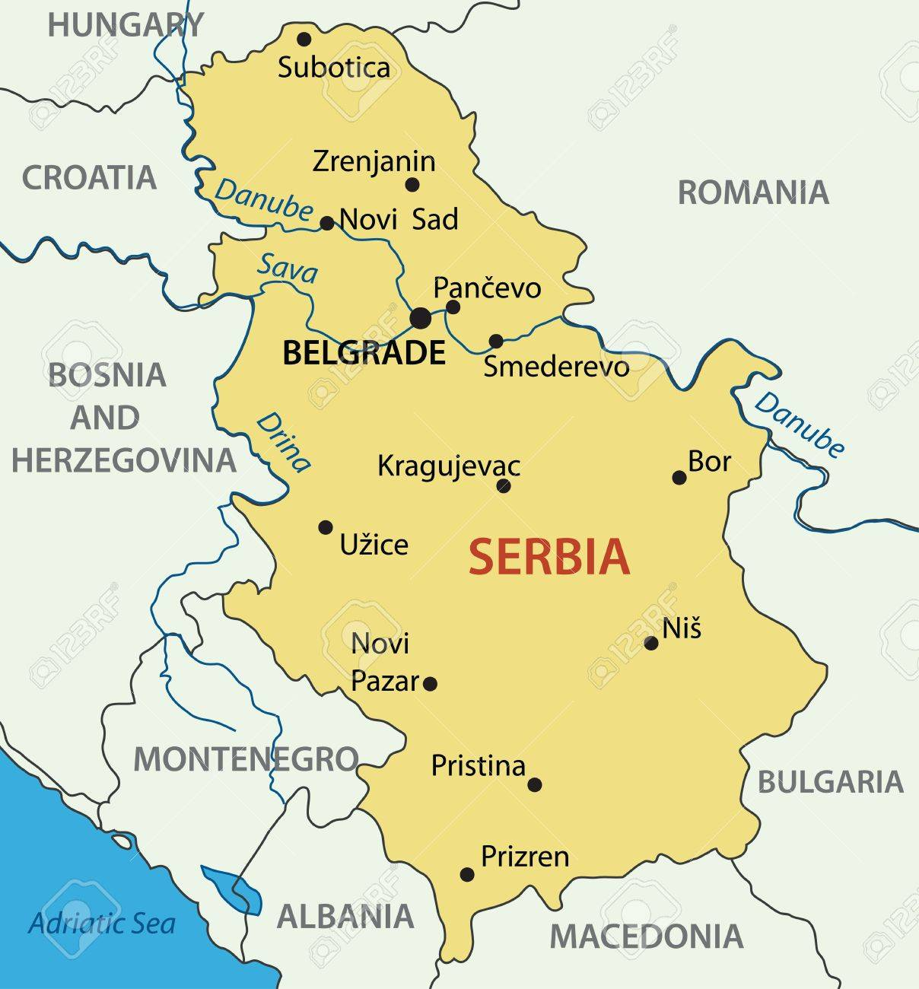
GEOGRAPHICAL POSITION
Serbia is a continental country located in southeastern Europe, in the central part of the Balkan Peninsula. Due to the part of the Pannonian Plain in the north, Serbia also belongs to the region of Central Europe, and geographically and climatically its southern part is also included in the Mediterranean countries.
2

Slide 3
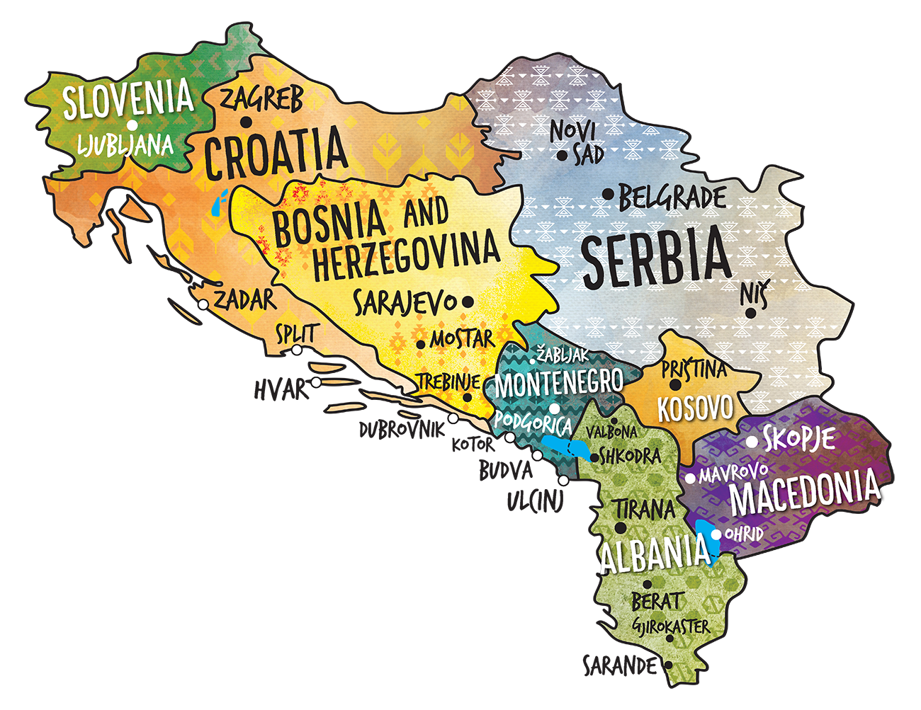
HISTORY
The Serbs, like other southern Slavic tribes, came to the Balkans in a large population movement during the 6th and 7th centuries. They still live in the area today, receiving various influences and representing the imaginary boundary between East and West while taking the best of both worlds.
3

Slide 4
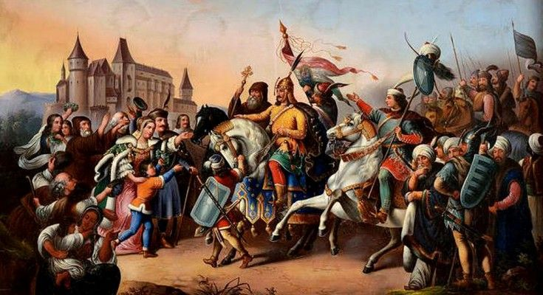
With the arrival of Nemanjic, Serbia experienced a major economic, political and military boom. At the end of the 14th century, the last ruler of the Nemanjić dynasty died. One of Serbia's regional masters, Lazar Hrebeljanovic, seized power in an attempt to unite Serb lands and strengthen in the fight against the Turks. One of the biggest battles in Serbian history ensued, the battle in Kosovo in 1389, in which Prince Lazar and much of his army died and Serbia became a Turkish vassal. Until the end of the 17th century, the entire territory of present-day Serbia was under the rule of the Ottoman Empire. The Principality of Serbia was completely liberated from the Ottoman military presence by Prince Mihailo Obrenovic, son of Prince Milos Obrenovic, in 1867. This event is remembered as getting cities. The Principality of Serbia became an internationally recognized independent state by the decisions of the Berlin Congress in 1878.

Slide 5
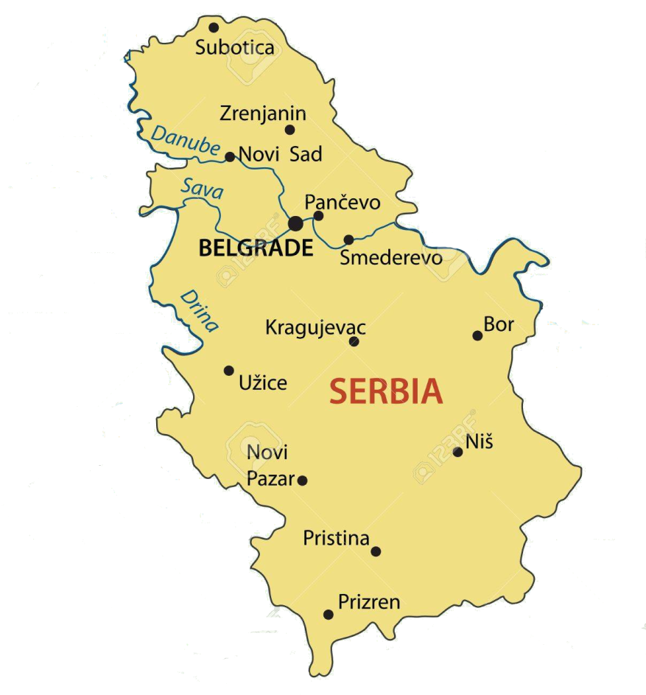
CITIES OF SERBIA
Here are 4 major cities in Serbia - Belgrade, Novi Sad, Niš and Kragujevac
Belgrade
Novi Sad
Capital and the most populous city of our country
The economic, educational and cultural center of the country
It lies at the mouth of the Sava River into the Danube
It is one of the oldest cities in Europe
The city was founded by the Celts in the 3rd century BC, before it became the Roman settlement of Singidunum.
The largest city in the Autonomous Province of Vojvodina
For a long time it was the center of Serbian culture, which is why it was often called "Serbian Athens"
After Belgrade the second city in Serbia by population and area.
The city lies on the banks of the Danube
Novi Sad has road, rail and river connections with its surroundings
5

Slide 6
BELGRADE
Population: 1.374 million
6

Slide 7
CITIES OF SERBIA
Niš
Kragujevac
The largest city in southeastern Serbia and the seat of the Nisava Administrative District
It is located on the river Nišava
It was the administrative, military and trade center of the various states and empires to which it belonged, throughout its long history
Transport infrastructure in the territory of Niš makes it a crossroads of land and air transport in the Balkans
THE HEART OF ŠUMADIJA
The name Kragujevac is derived from the name of the bird Kraguj
One of the strongest administrative, cultural, financial, industrial and political centers in Serbia
The first gymnasium in Kragujevac was founded in 1833 as the first gymnasium in the territory of the then Serbia.
7
5

Slide 8
KRAGUJEVAC
Population: 150.850
8

Slide 9
First Kragujevac Gymnasium
9

Slide 10
SPORTS
Popular sports in Serbia are:
football
basketball
water polo
volleyball
handball
tennis
23

Slide 11
FOOTBALL
Serbia's national team has twice reached the semifinals at the World Championships, twice won a silver medal at the European Championships (1960 and 1968) and won a total of five medals at the Olympics, including a gold at the 1960 Olympics in Rome.
EAGLES
24

Slide 12
BASKETBALL
The Serbian national basketball team won two gold medals at the 1998 and 2002 World Championships. In 2012, the first World Basketball Championship 3 to 3 was held, with the Serbian national team winning the gold, and the following, two years later, a silver medal.
25

Slide 13
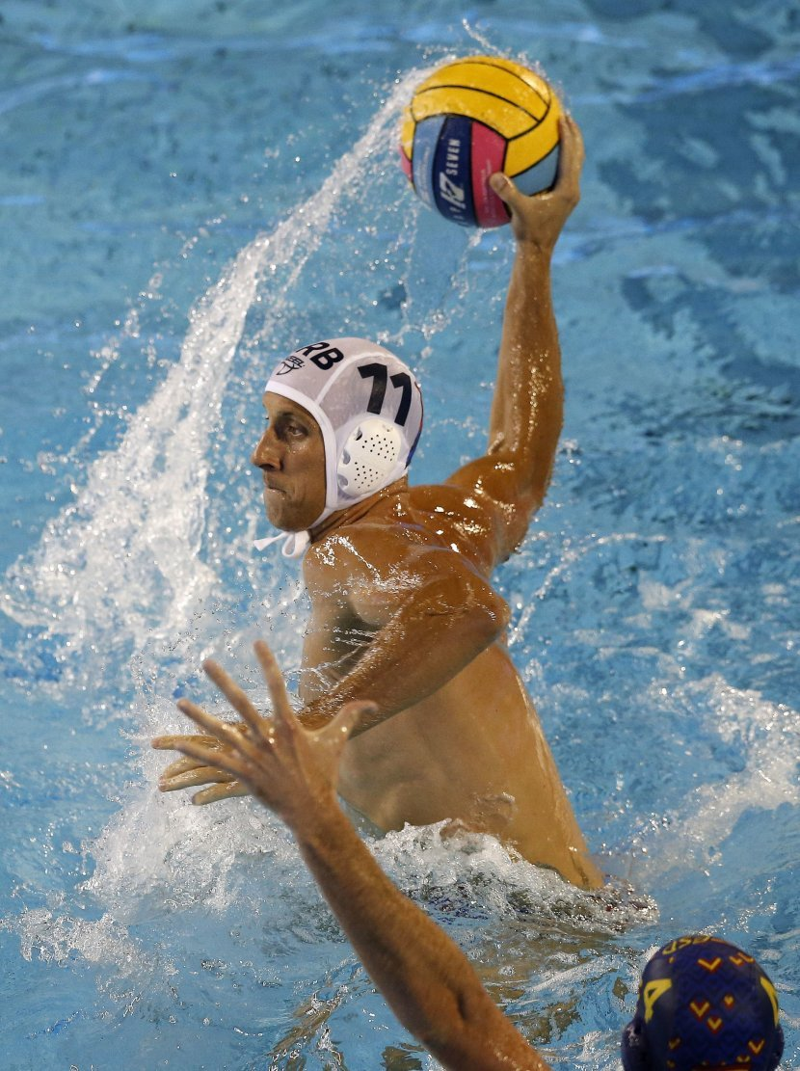
WATERPOLLO
Serbia's waterpollo team is the most successful at the World Championships and one of the most successful counting all competitions. FINA and LEN consider the Serbian national team the successor to the results and success of the national teams of the SFR Yugoslavia and Serbia-Montenegro, and Serbia with five World Cup titles is the most trophy team in this competition.

Slide 14
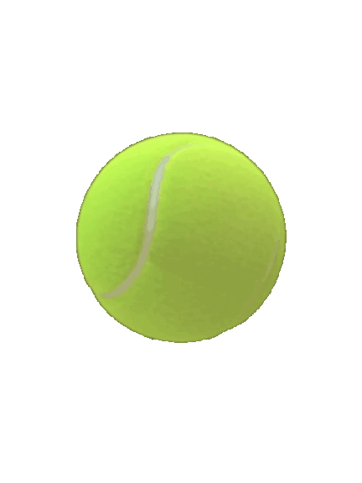
TENNIS
NOVAK ĐOKOVIĆ
Serbia's most successful tennis player is Novak Djokovic, winner of seventeen Grand Slam trophies in individual competition: eight times winner of the Australian Open, once at the French Open, five times Wimbledon winner and three times US Open, bronze medal winner at the 2008 Olympic Games in Beijing the first Serbian tennis medals in history.
27

Slide 15
TRADITIONAL FOOD
Specialties you must try in Serbia: burek, gibanica, grilled meat, roast, sarma, stew, moussaka, shaker, cracklings, kajmak, prosciutto, sour milk.
28

Slide 16
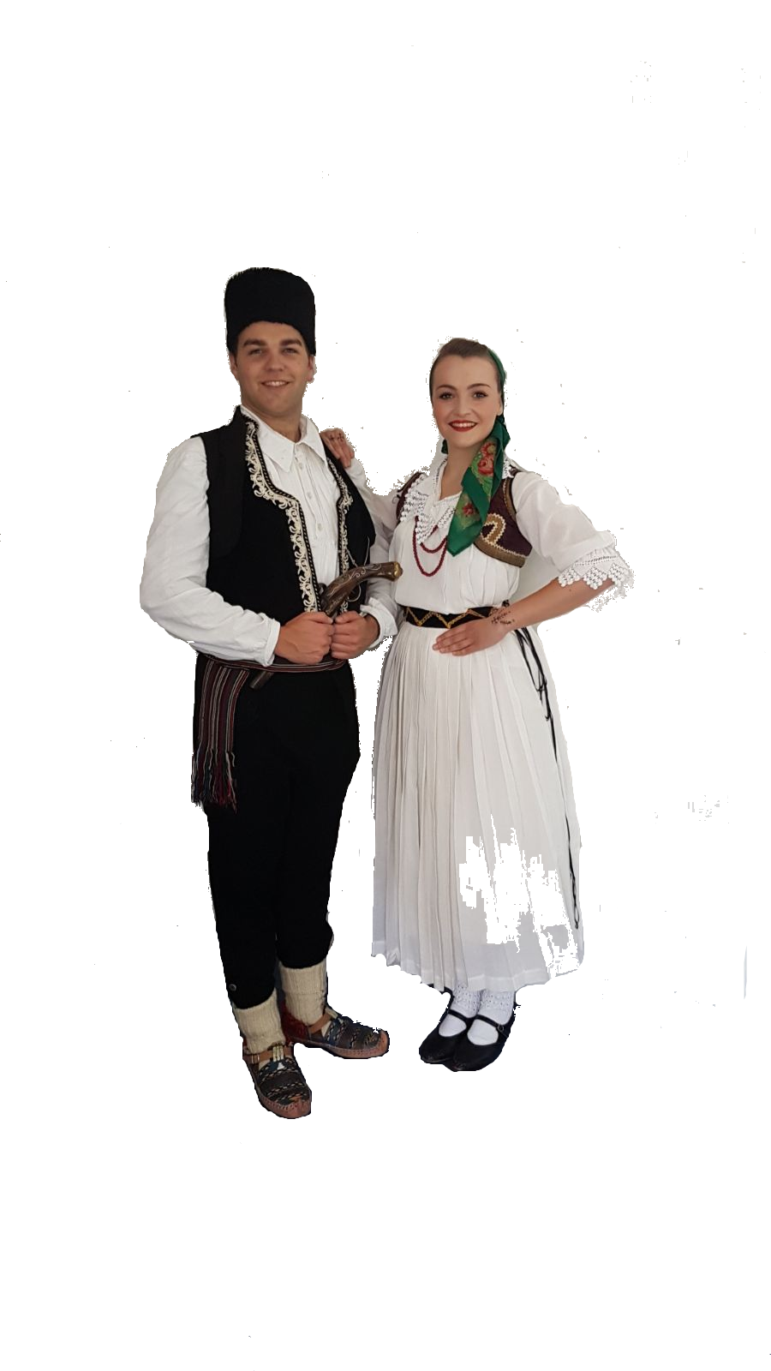
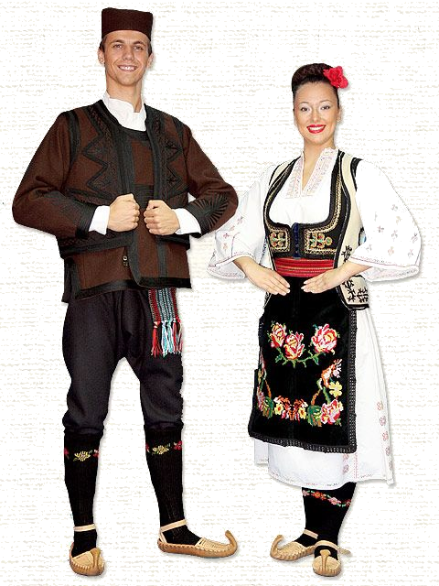
NATIONAL COSTUMES
30

Slide 17
FESTIVALS
Young people in Serbia are constantly trying to find a valve between obligations. Whether it's a vacation or a vacation, a large percentage of them decide to spend the best time.
31

Slide 18
EXIT
Located in Novi Sad, on Petrovaradin Fortress, it is one of the largest and best festivals not only in Serbia but in the whole region. It was first organized in 2000 after being launched by the student movement as a symbol of the struggle for democracy.
32

Slide 19
GUCA
The Dragacev Trumpet Council is one of the oldest and most visited manifestations of folk original music. The parliament was first held in October 1961 in Guca, a small town in western Serbia. This festival may actually best show the core and heart of Serbia itself.
33

