Slide 1
THE UNITED KINGDOM
UK

Slide 2
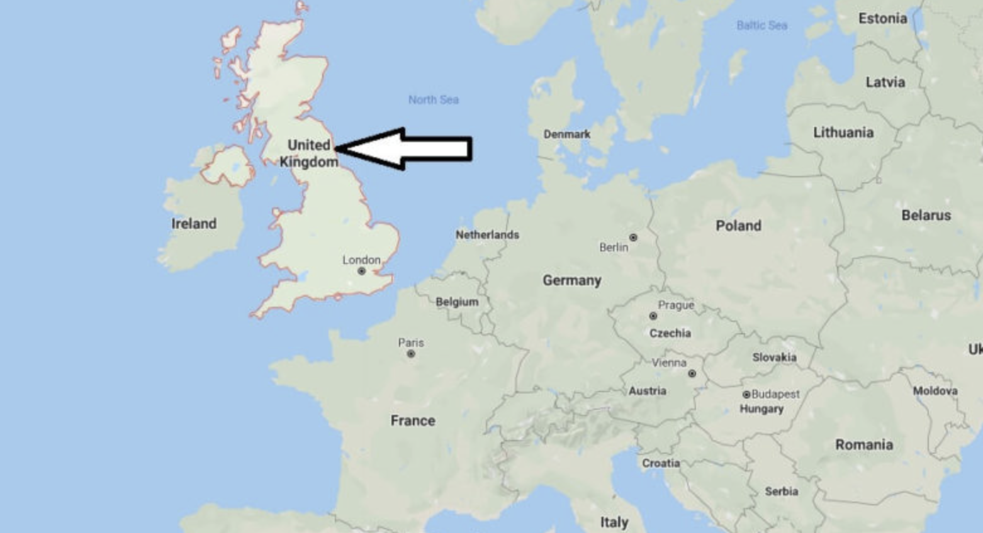
This is the UK.

Slide 3
The UK
The UK started in 1922. Wales, Scotland, Northern Ireland and England are in the UK.

Slide 4
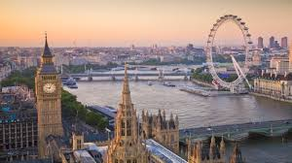
London
The capital city of England is London

Slide 5
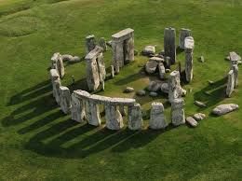
Stonehenge
This is Stonehenge. It was built in 3000 BC. Nobody knows what it is for because it was built a long time ago.

Slide 6
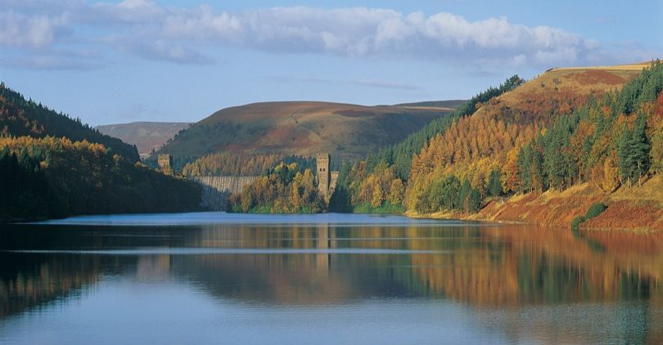
Peak District
Peak District is the oldest National Park in the UK. It is in the centre of England and it was built in 1951. You can do rock climbing, you can go in caves, you an see the amazing lakes and hills and you can see alpacas.

Slide 7
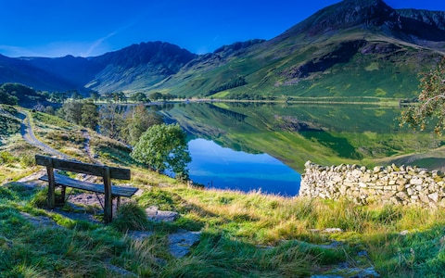
Lake District
Lake District is in North West England. It is a popular holiday place. Lake District is famous for its mountains and lakes. The Lake District National Park was made in 1951. In the national park is the deepest lakes in England and the tallest mountain in England, the Scafell Pike.

Slide 8
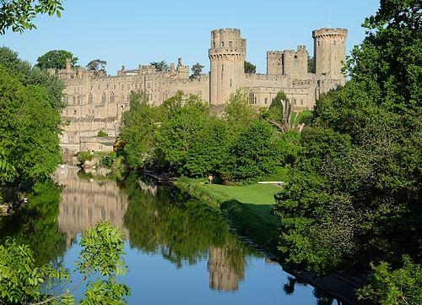
Warwick Castle
Warwick Castle is a medieval castle built in 1068 by William the Conqueror. People were not allowed to go in until 1978.

Slide 9
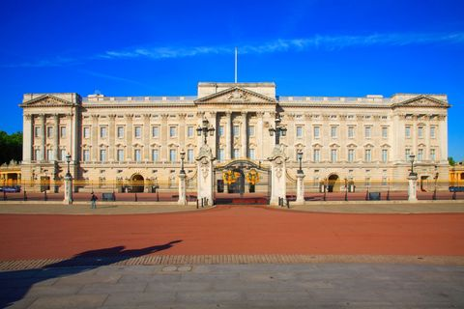
Buckingham Palace
Buckingham Palace was built in 1703. It is home to Queen Elizabeth, Prince Philip, Prince Andrew, Prince Edward, His wife and their daughter.

Slide 10
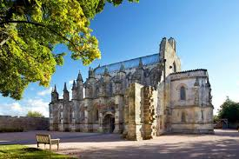
Rosslyn Chapel
Rosslyn Chapel in Scotland was built in 1446. It is a Catholic church.

Slide 11
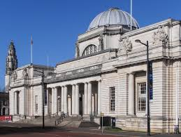
National Museum Cardiff
The National Museum Cardiff in Cardiff, Wales was built in 1907. You will see paintings, statues, insects, old weapons and much more.

