Slide 1
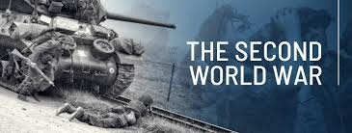
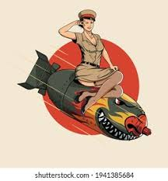
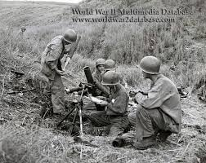
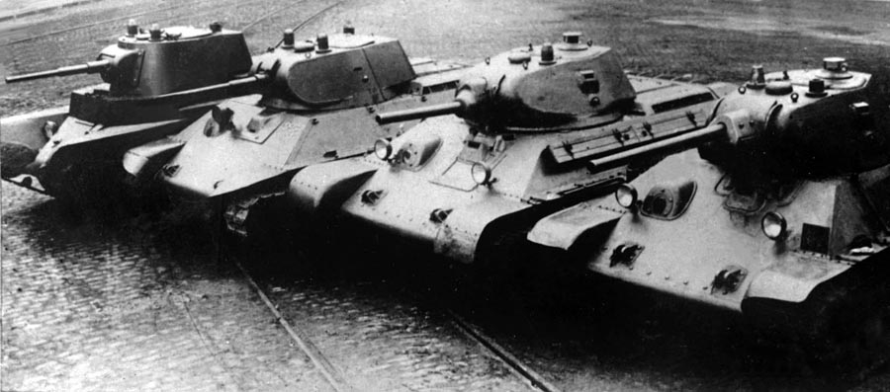

Slide 2
Content
1. Causes and Outbreak of WWII
2. Course of WWII, Major Events and Battles
3. Technological progress in armament and its impact on course of WW II

Slide 3
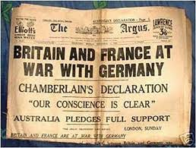
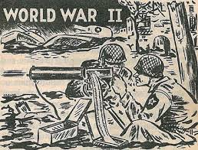
Causes of WWII
https://www.youtube.com/watch?v=AUd1HSWoMVQ&ab_channel=HistoryVids

Slide 4
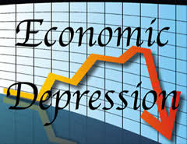
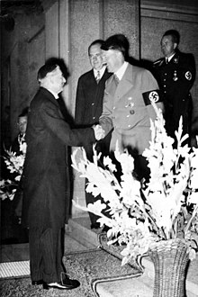
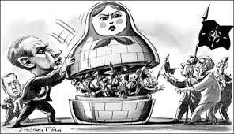
Causes of WWII
Treaty of Versailles
Economic Depression
Germany’s Militarism
Failure of Appeasement
Failure of the League of Nations
Japan’s Militarism
Notes:
Causes of World War II The death and destruction of World War I was so horrible that it was called “the war to end all wars.” Yet, the agreement to end World War I did not resolve the problems of the world and, according to some historians, lead directly to the next catastrophe: World War II. The major causes of World War II were numerous. They include the impact of the Treaty of Versailles following WWI, the worldwide economic depression, failure of appeasement, the rise of militarism in Germany and Japan, and the failure of the League of Nations.
Treaty of Versailles Following World War I, the victorious Allied Powers met to decide Germany’s future. Germany would be forced to sign the Treaty of Versailles. Failure of Appeasement Appeasement meant agreeing to the demands of another nation in order to avoid conflict. During the 1930s, politicians in Britain and France began to believe that the Treaty of Versailles was unfair to Germany and that Hitler’s actions were understandable and justifiable. This belief, adopted by Britain, was the Policy of Appeasement. An example of appeasement was the Munich Agreement of September 1938. In the Agreement, Britain and France allowed Germany to annex areas in Czechoslovakia where German-speakers lived. Germany agreed not to invade the rest of Czechoslovakia or any other country. In March 1939, Germany broke its promise and invaded the rest of Czechoslovakia. Neither Britain nor France was prepared to take military action. Then, on September 1, 1939, German troops invaded Poland. Britain and France immediately declared war on Germany. World War II had begun in Europe.
Economic Depression The whole world was hit by an economic depression in the late 1920s. In a depression, economies shrink, trade is reduced, businesses close, prices fall, banks fail, and unemployment rises. Sometimes during a depression, people look for a strong political leader to resolve their problems. In 1933, Adolf Hitler became the leader of Germany by promising to restore German wealth and power.
Germany’s Militarism Hitler immediately began secretly building up Germany’s army and weapons. Although Britain and France knew of Hitler’s actions, they thought a stronger Germany would stop the spread of Communism from Russia. In 1936 Hitler ordered German troops to enter the German-speaking areas of the Rhineland (France), Austria, and Czechoslovakia. At this point neither France nor Britain was prepared to go to war. In 1936, Hitler made alliances with Italy and Japan. The military alliance of Germany, Italy, and Japan was called the Axis Powers.
Failure of Appeasement Appeasement meant agreeing to the demands of another nation in order to avoid conflict. During the 1930s, politicians in Britain and France began to believe that the Treaty of Versailles was unfair to Germany and that Hitler’s actions were understandable and justifiable. This belief, adopted by Britain, was the Policy of Appeasement. An example of appeasement was the Munich Agreement of September 1938. In the Agreement, Britain and France allowed Germany to annex areas in Czechoslovakia where German-speakers lived. Germany agreed not to invade the rest of Czechoslovakia or any other country. In March 1939, Germany broke its promise and invaded the rest of Czechoslovakia. Neither Britain nor France was prepared to take military action. Then, on September 1, 1939, German troops invaded Poland. Britain and France immediately declared war on Germany. World War II had begun in Europe.
Failure of the League of Nations The League of Nations was an international organization set up in 1919 to keep world peace. It was intended that all countries would be members and that if there were disputes between countries, they could be settled by negotiation rather than by force. The League of Nations was a good idea, but ultimately a failure. Not all countries joined the league and the League had no army to prevent military aggression such as Italy’s invasion of Ethiopia in Africa or Japan’s invasion of Manchuria in China.
Japan’s Militarism In 1931, Japan was hit badly by the economic depression. Japanese people lost faith in the government. They turned to the army in order to find a solution to their economic problems. In order to produce more goods, Japan needed natural resources for its factories. The Japanese army invaded China, an area rich in minerals and resources. China asked for help from the League of Nations. Japan ignored the League of Nations and continued to occupy China and Korea. As Japan invaded other areas of South East Asia including Vietnam, the United States grew concerned about its territories in Asia, such as the Philippines and Guam. Japan felt that its expansion could be threatened by the United States military and attacked Pearl Harbor, Hawaii, in December 1941. World War II had begun in Asia

Slide 5
Nazi foreign Policy and the War
Hitlers main aims abroad were to reverse the Treaty of Versialles, unite all the German-speaking peoples again, and give the nation more „living space“ – Lebensraum
Hitler‘s foreign policy ( 1933 – 1939 ) helped to start another War
https://www.youtube.com/watch?v=7kbM_F51pc0
Notes:
Hitler‘s foreign policy
1933 – 1936
Left league of nations 1933
Began to built up armed forces 1933
Introduced Conscription 1935
Refused to accept Treaty of Versailles 1935
Anglo – German Naval agreement ( German‘s navy is 36% of Britain‘s and allowed submarines)
Occupation of Rhineland March 1936
Rome – Berlin Axis October 1936
1936 – 1939
Anti-comintern pact with Japan and Italy 1936
Anschluss with Austria march 1938
Occupied Sudetenland october 1938
Occupied rest of Czechoslovakia march 1939
Pact of Steel with Italy may 1939
Treaty with Russia august 1939
Invaded Poland september 1939

Slide 6
Nazi foreign Policy and the War
Arguments in favor of Hitler‘s foreign policy
Hitler was only doing what most Germans wanted
Germany had suffered the humilitation of Versailles long enough.
No other country would disarm – even though it was one of main aims of the league of Nations.
Hitler had some support in Britain, Britain agreed with Nazis aggresion
https://www.youtube.com/watch?v=AUd1HSWoMVQ

Slide 7
Nazi foreign Policy and the War
Arguments against Hitler‘s foreign policy
Taking the whole of Czechoslovakia and Poland
Hitler showed he couldn‘t be trusted
He took advantage of the weakness of League of nations
His view on other races made him a real danger

Slide 8
Outbreak of WWII
Germany attacked Poland on 1st September 1939
Poland was Defeated within One Month
Reasons:
Hitler made a pact with USSR so that Soviets wouldn‘t help Poland
Hitler didn‘t believe anyone would try to stop him.
Blitzkrieg ( Suprise and mobility )
Notes:
On September 1, 1939, German troops invaded Poland. Britain and France declared war on Germany two days later. By the end of the month, Hitler’s armies had overrun western Poland. Soviet armies occupied eastern Poland, and the two countries subsequently formally divided Poland between them. In April 1940, German forces conquered Denmark and Norway, and in May they struck at the Netherlands, Belgium, Luxembourg, and France.
French and British troops offered ineffective resistance against the lightning-like strikes, or blitzkrieg, of German tanks and airplanes. A large part of the French army surrendered, and some 300,000 British and French soldiers were trapped at Dunkirk on the coast of northern France. However, because Hitler, for a combination of political and military reasons, had halted the advance of his armored divisions, the British were able to rescue the men at Dunkirk. France, however, surrendered in June.
For Hitler the war in the west was a sideshow, a prelude to the building of an empire in eastern Europe and the Soviet Union. Hitler had hoped that Britain would stay out of the war. In his vision of the near future, he foresaw the two countries sharing the world between them–Britain would keep its overseas empire, and Germany would construct a new one to its east. When approached with the suggestion of a separate peace, British prime minister Winston Churchill rejected the offer and rallied his people to fight on. The Third Reich experienced its first military defeat in the Battle of Britain, in which the Royal Air Force, during the summer and fall of 1940, prevented the German air force from gaining the air superiority necessary for an invasion of Britain. Consequently, Hitler postponed the invasion.
Hitler concluded by June 1941 that Britain’s continuing resistance was not a serious impediment to his main geopolitical goal of creating an empire extending east from Germany deep into the Soviet Union. On June 22, 1941, negating their 1939 non-aggression pact, Germany invaded the Soviet Union. Eagerness to realize his long-held dream caused Hitler to gamble everything on a quick military campaign. He had anticipated victory within three months, but effective Soviet resistance and the early onset of winter stopped German advances. A counteroffensive, launched in early 1942, drove the Germans back from Moscow. In the summer of 1942, Hitler shifted the attack to the south of the Soviet Union and began a large offensive to secure the Caucasian oil fields. By September 1942, the Axis controlled an area extending from northern Norway to North Africa and from France to Stalingrad.

Slide 9
Outbreak of WWII
Britain and France declared war on Germany, but there was no time to help Poland
The Soviet Red Army crossed the border to occupy Eastern Poland
The next 6 months are called the Phoney War because nothing happened.
France and Britain were waiting for Hitler‘s next move.

Slide 10
Outbreak of WWII
Germany‘s 1940 Spring Offensive nearly defeated the allies.
Operation Dynamo saved the army trapped at Dunkirk
The Offensive of 1940 changed the war completely
The Phoney war suddenly became very real
Notes:
Germany‘s 1940 Spring Offensive nearly defeated the allies.
In April Germany invaded Denmark and Norway
On May 10th German forces swept through Holland, Belgium and Luxemburg towards France
This Blitzkrieg forced French and British forces to retreat until they were trapped at Dunkirk.
Operation Dynamo saved the army trapped at Dunkirk
Between May 28th and June 6th 200 000 British and 140 000 French soldiers were rescued from the beaches. A fleet of ships including civilian pleasure boats crossed the English Channel for the rescue.
But over 68 000 soldiers were killed in the retreat, and most of the army‘s equipment was abandoned on the Beach.
The Offensive of 1940 changed the war completely
France surrendered – German-controlled Europe was ready to invade Britain
Neville Chamberlain had already resigned as British Prime Minister. Failed military action in Norway meant MP‘s had decided he was too weak to lead the country
Winston Churchill became leader. He insisted Britain would „never surrender“

Slide 11
Causes and Outbreak
Short review exercise about causes and outbreak of WWII
https://quizizz.com/admin/quiz/623d8acb54c599001e8d120d/causes-and-outbreak-of-wwii?queryId=4771813305890737-1648452084222
https://learningapps.org/view24749565

Slide 12
Causes and Outbreak Review Questions
Questions for students :
1. Give four reasons for discontent in Germany after World War I. ?
2. Which party was responsible for the Munich Putsch?
Who was its leader?
3. Name the military force which was set up to support the Nazi.
4. What title did Hitler give himself on the death of Hindenburg in 1934?
5. What was the main difference between SA and SS forces?
6. What kind of organization was the GESTAPO?
7. Give reasons why did German people followed the Nazis?
8. Descirbe what happend during „The Night of Broken Glass“?
9.Name four important Nazis apart from Adolf Hitler.
10. What were Nuremberg Laws? What did they do?

Slide 13
Course of WW II
Try to put major events of WW II into chronological order.
(order it from top left to bottm right corner )
https://learningapps.org/watch?v=pu7s6141k22

Slide 14
Course of WWII
Short Video Course of WW II.
https://www.youtube.com/watch?v=AUXIuYHFgBE
Timeline of WW II.
https://cdn.knightlab.com/libs/timeline3/latest/embed/index.html?source=1dGWstm3befixJG3MGsuIuLOZbnEo0QyxM3UtUveqbr0&font=Default&lang=en&initial_zoom=2&height=650

Slide 15
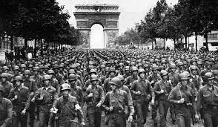
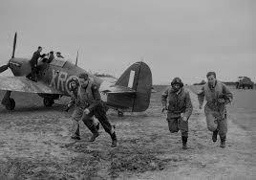
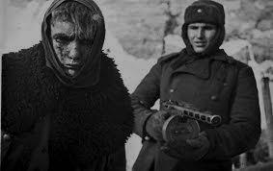
Course of WWII
France falls on June 22, 1940.
Hitler now controls much of Europe
The Battle of Britain, September 7, 1940
The Mediterranean and Eastern Front September, 1940
Invasion into USSR, morning of June 22, 1941
Notes:
France Falls Following Dunkirk, resistance in France began to crumble. By June 14, the Germans had taken Paris. Accepting the inevitable, French leaders surrendered on June 22, 1940. The Germans took control of the northern part of the country. They left the southern part to a puppet government headed by Marshal Philippe Pétain, a French hero from World War I. The headquarters of this government was in the city of Vichy. After France fell, Charles de Gaulle, a French general, set up a government-in-exile in London. He committed all his energy to reconquering France. In a radio broadcast from England, de Gaulle called on the people of France to join him in resisting the Germans.
The Battle of Britain : With the fall of France, Great Britain stood alone against the Nazis. Winston Churchill, the new British prime minister, had already declared that his nation would never give in. In a rousing speech, he proclaimed, “We shall fight on the beaches, we shall fight on the landing grounds, we shall fight in the fields and in the streets . . . we shall never surrender.” Hitler now turned his mind to an invasion of Great Britain.
In the summer of 1940, the Luftwaffe, Germany’s air force, began bombing Great Britain. At first, the Germans targeted British airfields and aircraft factories. Then, on September 7, 1940, they began focusing on the cities, especially London, to break British morale. Despite the destruction and loss of life, the British did not waver. The RAF, although badly outnumbered, began to hit back hard. Two technological devices helped turn the tide in the RAF’s favor. One was an electronic tracking system known as radar. Developed in the late 1930s, radar could tell the number, speed, and direction of incoming warplanes. The other device was a German code-making machine named Enigma.
This Battle of Britain continued until May 10, 1941. Stunned by British resistance, Hitler decided to call off his attacks. Instead, he focused on the Mediterranean and Eastern Europe.
The Mediterranean and Eastern Front: Germany’s first objective in the Mediterranean region was North Africa, mainly because of Hitler’s partner, Mussolini. Despite its alliance with Germany, Italy had remained neutral at the beginning of the war. With Hitler’s conquest of France, however, Mussolini knew he had to take action. After declaring war on France and Great Britain, Mussolini moved into France. Mussolini took his next step in North Africa in September 1940. While the Battle of Britain was raging, he ordered his army to attack British-controlled Egypt. Egypt’s Suez Canal was key to reaching the oil fields of the Middle East. Within a week, Italian troops had pushed 60 miles inside Egypt, forcing British units back. Then both sides dug in and waited.
To reinforce the Italians, Hitler sent a crack German tank force, the Afrika Korps, under the command of General Erwin Rommel. In late March 1941, Rommel’s Afrika Korps attacked. Caught by surprise, British forces retreated east to Tobruk, Libya.
Rommel’s successes in North Africa earned him the nickname “Desert Fox.”
The War in the Balkans While Rommel campaigned in North Africa, other German generals were active in the Balkans. Hitler had begun planning to attack his ally, the USSR, as early as the summer of 1940. The Balkan countries of southeastern Europe were key to Hitler’s invasion plan. Hitler wanted to build bases in southeastern Europe for the attack on the Soviet Union. He also wanted to make sure that the British did not interfere. To prepare for his invasion, Hitler moved to expand his influence in the Balkans. By early 1941, through the threat of force, he had persuaded Bulgaria, Romania, and Hungary to join the Axis powers. Yugoslavia and Greece, which had proBritish governments, resisted. In early April 1941, Hitler invaded both countries. Yugoslavia fell in 11 days. Greece surrendered in 17. In Athens, the Nazis celebrated their victory by raising swastikas on the Acropolis.
Invasion into USSR: The Soviet Union was not prepared for this attack. Although it had the largest army in the world, its troops were neither well equipped nor well trained. The invasion rolled on week after week until the Germans had pushed 500 miles inside the Soviet Union. As the Soviet troops retreated, they burned and destroyed everything in the enemy’s path.

Slide 16
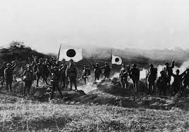
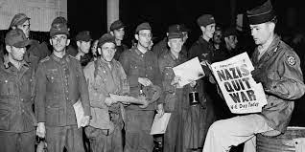
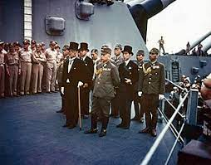
Course of WWII
Japan at war, December 7, 1941
Pacific front
The Allies Advance
Germany’s Unconditional Surrender
Japany’s Unconditional Surrender
Notes:
Japan at war: By October 1940, Americans had cracked one of the codes that the Japanese used in sending secret messages. Therefore, they were well aware of Japanese plans for Southeast Asia. If Japan conquered European colonies there, it could also threaten the American-controlled Philippine Islands and Guam. To stop the Japanese advance, the U.S. government sent aid to strengthen Chinese resistance. And when the Japanese overran French Indochina—Vietnam, Cambodia, and Laos—in July 1941, Roosevelt cut off oil shipments to Japan. Despite an oil shortage, the Japanese continued their conquests. They hoped to catch the European colonial powers and the United States by surprise. So they planned massive attacks on British and Dutch colonies in Southeast Asia and on American outposts in the Pacific—at the same time. Admiral Isoroku Yamamoto, Japan’s greatest naval strategist, also called for an attack on the U.S. fleet in Hawaii. It was, he said, “a dagger pointed at [Japan’s] throat” and must be destroyed. Day of Infamy Early in the morning of December 7, 1941, American sailors at Pearl Harbor in Hawaii awoke to the roar of explosives.
Pacific front: After a string of victories, the Japanese seemed unbeatable. Nonetheless, the Allies—mainly Americans and Australians—were anxious to strike back in the Pacific. The United States in particular wanted revenge for Pearl Harbor. In April 1942, 16 B-25 bombers under the command of Lieutenant Colonel James H. Doolittle bombed Tokyo and several other Japanese cities. The bombs did little damage. The raid, however, made an important psychological point to both Americans and Japanese: Japan was vulnerable to attack.
The Allies Advance: While the Allies were dealing with issues on the home front, they also were preparing to push toward victory in Europe. In 1943, the Allies began secretly building an invasion force in Great Britain. Their plan was to launch an attack on Germanheld France across the English Channel.
On the Eastern front Hitler attacks Stalingrad in November 1942 by Feb. 1943, the Soviets counter-attack. The combination of Russian troops and the Russian winter defeat Hitler‘s troops.
Germany‘s Unconditional Surrender: On May 7, 1945, General Eisenhower accepted the unconditional surrender of the Third Reich from the German military. President Roosevelt, however, did not live to witness the long-awaited victory. He had died suddenly on April 12, as Allied armies were advancing toward Berlin. Roosevelt’s successor, Harry Truman, received the news of the Nazi surrender. On May 9, the surrender was officially signed in Berlin. The United States and other Allied powers celebrated V-E Day—Victory in Europe Day. After nearly six years of fighting, the war in Europe had ended.
Japany‘s Unconditional Surrender: The first atomic bomb was exploded in a desert in New Mexico on July 16, 1945. President Truman then warned the Japanese. He told them that unless they surrendered, they could expect a “rain of ruin from the air.” The Japanese did not reply. So, on August 6, 1945, the United States dropped an atomic bomb on Hiroshima, a Japanese city of nearly 350,000 people. Between 70,000 and 80,000 people died in the attack. Three days later, on August 9, a second bomb was dropped on Nagasaki, a city of 270,000. More than 70,000 people were killed immediately. Radiation fallout from the two explosions killed many more. The Japanese finally surrendered to General Douglas MacArthur on September 2. The ceremony took place aboard the United States battleship Missouri in Tokyo Bay. With Japan’s surrender, the war had ended. Now, countries faced the task of rebuilding a war-torn world.

Slide 17
Major Events and Battles
1. Battle of France, May to June, 1940
2. Battle of Britain, July to October, 1940
https://www.youtube.com/watch?v=9sO5AXP2RjM
3. Battle of Pearl Harbor, December 7, 1941
https://www.youtube.com/watch?v=9_e_1fNH2aI
4. Battle of Moscow,
October 1941 to January 1942
5. Second Battle of Kharkov, May 1942
Notes:
Battle of France: The German invasion of France and the Low Countries in 1940 is known as the Battle of France or the Fall of France. In a short space of six weeks starting on May 10, 1940, the German forces defeated the Allies and conquered France, Belgium, Luxembourg, and the Netherlands. Italy also tried to invade France by entering the war on June 10, 1940. The land operations on the Western Front from the German side were all over by June 6, 1944.
The Battle of France saw two main operations on the German side. Fall Gelb (Case Yellow) saw the armored German units break through the Ardennes along the Somme Valley cutting off and surrounding the Allied units advancing to Belgium. After the Belgian and French forces were driven back to the sea, the British evacuated their own troops and several French divisions from Dunkirk in Operation Dynamo. After the British troops left, Fall Rot (Case Red) began on June 5. The remaining French divisions resisted but were soon overcome. Paris was occupied by German forces on June 14. After the battle, France was divided up and occupied by Germany, Italy, and the neutral Vichy government.
2. Battle of Britain: After the fall of France, Hitler expected the British to seek a peace settlement with Germany, but Britain continued to fight. To bring the war to a quick end Hitler planned an invasion of Britain, codenamed Operation Sealion. For the operation to be successful, the Germans had to first secure the skies over the United Kingdom which were protected by the Royal Air Force (RAF). Germany had been banned from having an air force after the First World War but the Nazi government had reestablished it and it was one of the most formidable air forces in the world. The RAF fought the Germans off with the Hawker Hurricane and the Supermarine Spitfire, two of the best fighter aircraft in the world.
Unable to gain advantage over the RAF, the Germans shifted their focus to London. This would be a critical error by the Germans, because despite the devastation it caused to the residents of London, it also gave the British defenses time to recover. On September 15, the British resisted another massive attack by the Germans who suffered many losses. Later, Hitler postponed Operation Sealion indefinitely. This victory was one of the most important for Britain and proof that air power alone could be used to win a major battle.
3. Battle of Pearl Harbor: The devastating attack on the US naval base at Pearl Harbor in Hawaii by Operation AI of the Japanese Imperial Army, was a complete surprise and took place on December 7, 1941. This attack marked a climax in the worsening relationship between Japan and the Unites States. Once the US fleet was out of their way, the road to conquering all of Southeast Asia and the Indonesian archipelago would open up for the Japanese.
On November 26, a Japanese fleet including six aircraft carriers, two battleships, three cruisers, and eleven destroyers sailed 275 miles north of Hawaii. About 360 planes were launched from this point for the final assault. Four US Navy battleships were sunk and the remaining four were damaged. Additionally three cruisers, three destroyers, an anti-aircraft training ship and one minelayer were also sunk or damaged. A total of 2,403 Americans died in the attack and 1,178 others were wounded. This surprise attack came as a shock to the American people and led to the US entering the Second World War in both Europe and the Pacific. On December 8, the United States declared war on Japan.
4. Battle of Moscow: The Battle of Moscow represents two significant periods of fighting on the Eastern Front during the Second World War from October 1941 to January 1942. By early October, after four million casualties on the Soviet side, the German army had come to within 200 miles of Moscow. This was when Operation Typhoon was launched, an offensive intended to seize the Soviet capital and put an end to the campaign. But the reality turned out to be far from what either side had expected.
The Soviets had a huge but badly organized army. The Germans, on the other hand, with their expertise and equipment could have won any war on the planet. But due to the freezing weather and inability to get supplies through to the Panzer Army, the Soviet defense was able to hold off the Germans. The poor-quality Russian roads had taken out about 40 percent of the German truck fleet and by the time the Germans were within 15 miles (24 kilometers) of Moscow, they were battered and exhausted. The Soviets defended the city by constructing three defensive belts, deploying new armies and bringing troops from the Siberian and Far Eastern Military Districts.
5. Second Battle of Kharkov: The Second Battle of Kharkov was fought from May 12 to 28, 1942. It was an Axis counter-offensive in the region around Kharkov against the Red Army on the Eastern Front. The objective of the offensive was to eliminate the Izium bridgehead over Seversky Donets or the “Barvenkovo bulge,” an area known for staging Soviet offensives. After the Battle of Moscow, which drove the German forces away from the Soviet capital, the Kharkov Offensive was a new attempt from the Soviet side to expand their strategic initiative.
On May 12, 1942, under the command of Marshal Semyon Timoshenko, the Soviet forces attacked the German 6th Army from a salient established during the winter counterattacks. This offensive further depleted the Red Army’s reserves and failed to gain a significant element of surprise. Initially there were promising signs for the Red Army but the offensives were stopped by German counterattacks. Joseph Stalin and several staff officers made critical errors in underestimating the 6th Army’s potential and overestimating their own forces. This cut off the advancing Soviet troops from the rest of the front. The battle led to almost 300,000 casualties on the Soviet side and 20,000 for the Germans and their allies.

Slide 18
Major Events and Battles
6. Battle of Midway, June 1942
7. Battle of Stalingrad,
July 1942 to February 1943
https://www.youtube.com/watch?v=gHkELWFqGKQ
8. Battle of Kursk, July to August 1943
9. Battle of Normandy, June to August 1944
10. Battle of Berlin, April to May 1945
Notes:
6. Battle of Midway: The Japanese planned to eliminate the United States’ position as a strategic power in the Pacific by launching the Battle of Midway. At the start of the battle, the Americans were outnumbered about 2 to 1. Between June 4 and 7, 1942, the Battle of Midway began with the US side commanded by Admirals Chester Nimitz, Frank Jack Fletcher, and Raymond A. Spruance and the Imperial Japanese Navy under Admirals Isoroku Yamamoto, Chuichi Nagumo, and Nobutake Kondo. Largely due to developments in codebreaking, the US was able to predict the date and location of the attack, giving them the upper hand.
The Japanese plan was also a failure due to their incorrect assumptions about the American mindset. All of the four large Japanese aircraft carriers which were a part of the force that attacked Pearl Harbor were sunk while the US only lost the carrier Yorktown and a destroyer. Six months after the attack on Pearl Harbor, the Americans had earned a decisive victory over the Japanese and gained an offensive position for the Allies. Military historian John Keegan called the Battle of Midway one of the most stunning and decisive moments in the history of naval warfare.
7. Battle of Stalingrad: Considered by many historians as the turning point of the Second World War, the Battle of Stalingrad was fought between July 1942 and February 1943. The German army suffered many losses, after which it began its full retreat and the war turned in favor of the Allies. The Russians consider this battle to be the greatest of the Second World War, and it is also known as the Great Patriotic War in Russia. The battle was devastating with nearly two million military and civilian casualties, one of the greatest losses in military history.
The German 6th Army was not required to fight the battle. Army groups A and B were already on their way to the Caucasus in southwest Russia to secure the oil fields there when Hitler ordered the attack on the city. While it was generally unwise to leave a major city unconquered during an advance, some historians believe that it was mainly Hitler’s personal hatred of the Russian leader Stalin (whose name was part of the city’s identity) which led to the attack. For simple reasons of morale, the Russian army could not afford to lose the city.
8. Battle of Kursk: The Battle of Kursk was fought during the Second World War from July to August 1943. It was a series of offensives between the German and Soviet forces on the Eastern Front near Kursk, 450 kilometers southwest of Moscow. Operation Citadel was the German codename for the offensive. It led to one of the largest ever armored clashes, the Battle of Prokhorovka, fought on July 12, 1943. The Battle of Kursk was an unsuccessful attempt by the Germans to take over the Soviet forces, and they lost a huge number of men and tanks in the process.
The Soviet line at Kursk was protruding into enemy territory and the Germans attempted to attack from different directions. The Soviet forces held off the offensive and launched counterattacks called Operation Polkovodets Rumyantsev and Operation Kutuzov which helped reclaim the cities of Orel and Kharkov. This was the first time during the war that a German strategic offensive was halted before it could break through enemy lines. The German advance was 8 to 12 kilometers in the north and 35 kilometers in the south.
9. Battle of Normandy: The Battle of Normandy was codenamed Operation Overlord. With Operation Overload, the Allies launched the largest amphibious invasion of Normandy to free German-occupied Western Europe during the Second World War. Commonly known as D-Day, the operation was launched on June 6, 1944 with the Normandy landings. About 160,000 troops crossed the English Channel on the same day and over two million Allied troops had reached France by the end of August. Special technology was developed to cope with the conditions on the Normandy beaches, including artificial ports known as “Mulberry harbors” and a series of specialized tanks called Hobart’s Funnies.
The Allies carried out a military deception plan called Operation Bodyguard in which electronic and visual misinformation tricked the Germans over the date and location of the main landings. The Allies did not attain their objectives on the first day but gained substantial momentum and captured the port of Cherbourg on June 26 and the city of Caen on July 21. Operation Dragoon was launched to invade southern France followed by the liberation of Paris on August 25. By August 30, 1944, the German forces had retreated across the Seine which marked the end of Operation Overlord.
10. Battle of Berlin: Also known as the Berlin Strategic Offensive Operation by the Soviet Union, the Battle of Berlin was the final major offensive of the Second World War in Europe. After the Vistula-Oder Offensive of January–February 1945, the Red Army halted on a line 60 kilometers east of Berlin. Operation Clausewitz was the German defense plan against the Soviet attack. After the Soviet offensive was resumed on April 16, the city was attacked from the east and south, and a third force countered the Germans in the north. A Soviet soldier described the enormous amount of equipment deployed during the attack.
The Soviet army was successful in encircling the city and on April 20, 1945, also Hitler’s birthday, the 1st Belorussian Front started shelling the city center, while the 1st Ukrainian Front advanced to the southern suburbs. Hitler and a number of his followers committed suicide before the battle was over. The city surrendered on May 2 while fighting continued to the northwest, west and southwest of the city until May 8, when the war finally ended in Europe. After this battle, the city of Berlin was divided into four as agreed by the Allies.

Slide 19
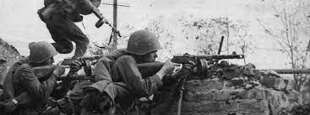
Major Events and Battles
Major events and battles short quiz
https://learningapps.org/display?v=prut9vqb322

Slide 20
Technological progress
Video: The Deadliest Weapons of The Second World War https://www.youtube.com/watch?v=FgeBoDuf5lg
Questions:
How did technology change the nature of war in the 20th century?
Compared with earlier guns, what made machine guns so effective?
How did airplanes change the way war was carried out?

Slide 21
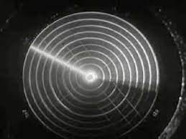
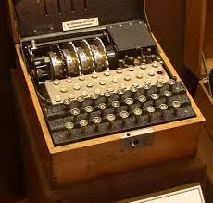
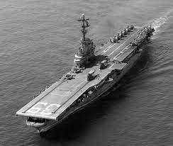
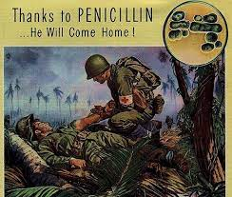
Technological progress
1. Radar
2. Codebreaking
3. Aircraft carriers
4. Submarines
5. Air Technology
6. The Arsenal
7. Medical Advancements

Slide 22
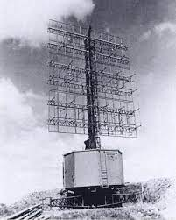
RADAR
British and Americans agreed to share military and technological research
Development in 1930s to detect distant objects, including weather fronts
Essential in the Battle of Britain, providing an early warning of german attacks
Essential in Battle of Atlantic
ASV ( Air to surface vessel Radar ) to detect submarines

Slide 23
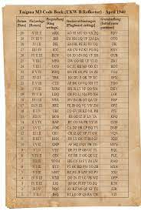
CODEBREAKING
The Germans employed an encription device known as ENIGMA ( Could not be decrypted by hand)
The British devoted resources to breaking the ENIGMA code at the Bletchley park facility
The Developement of the Bombe an electro-mechanical computer to help decrypt the code

Slide 24
AIRCRAFT CARRIERS
Aircraft carriers became the most important in WW II navies
Especially important to the Pacific theater
Pearl Harbor was a carrier attack
Battles of Coral Sea and Midway were each carrier-based battles

Slide 25
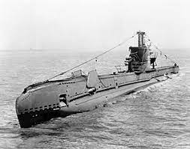
SUBMARINES
Submarine Warefare played a major role in both European and Pacific Wars
German U-Boats were a constant threat to allied shipping in the Atlantic

Slide 26
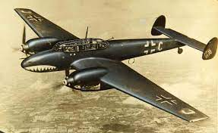
AIR TECHNOLOGY
Video: 10 Fastest World War II Aircraft
https://www.youtube.com/watch?v=aPw-G_zVneA
Jet Aircraft
Introduced at the end of the war, but they would become the foundation of Future Air Forces
Planes as transport and bombers

Slide 27
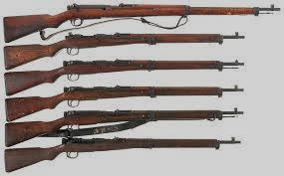
THE ARSENAL
The Us ability to manufacture the weapons of war led to it being called the „ Arsenal of Democracy“ by president Roosevelt
The manufacture of private automobiles was halted to produce tanks, planes and other equipment
Over 4600 warships were created from
1941 – 1945
Axis powers could not keep up with this pace

Slide 28
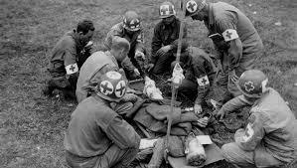
MEDICAL ADVANCEMENTS
WW 2 brought tremendous advancements in the field of medicine
Blood Plasma was used during the war for soldiers suffering from blood loss
Morphine was developed
Penicillin – the first mass-produced antibiotic was vital for battlefield
Podcast medical advancements during WW2
https://www.youtube.com/watch?v=fJL2H1saV0k

Slide 29
Technological progress - Review
https://quizizz.com/admin/quiz/5a8b64a0d7c2a300208711d4/5-46-ww2-technology-weaponry-and-communication
https://learningapps.org/watch?v=prxeprib522

