Slide 1

Memory of Europe: Historical intersections and their message for the contemporary generation
PaedDr. Eva Szanyiová

Slide 2
Second Page
Organisations:
Slovakia: Gymnazium Pavla Jozefa Safarika - Pavol Jozef Safarik Gimnazium
Greece: Geniko Lykeio Mouzakiou
Italy: I.I.S.S. CANUDO
Poland: I Liceum Ogolnoksztalcace im. St. Dubois
Total budget:
Total grant: 131.988 EUR
Our school : 37.497,00 EUR

Slide 3
Main topics
The first module will focus on Contemporary witnesses and monuments of WWII.
Within the second module” The Great Depression as one of the causes of WWII” students will learn more about the events that led to the WWII.
The activities in the third module will be carried out in “Cooperation with the regional institutions representing survivors of WWII”. Here students will co-operate with regional archives.
The fourth module will focus on a board game involving all the results from the meeting with the witnesses, and from the cooperation with the archives and regional institutions.

Slide 4

Short-term exchanges of groups of pupils
10-2020 - Slovakia: Contemporary witnesses and monuments of WWII
04-2021 - Poland: The Great Depression as one of the causes of WWII
10-2021 - Greece: Cooperation with the regional institutions representing survivors of WWII
04-2022 - Italy: Literature focusing on WWII module

Slide 5
Short-term joint staff training events
10-2020 - Slovakia: Innovative crosscurricular methodologies and lesson plans - Rise of militarism and dictators during the WWII
04-2021 - Poland: Innovative crosscurricular methodologies and lesson plans - Technological advancement caused by WWII
10-2021 - Greece: Innovative crosscurricular methodologies and lesson plans - Economic situation before and after WWII
04-2022 - Italy: Innovative crosscurricular methodologies and lesson plans - WWII literary heroes

Slide 6
Creating a School team: Students and teachers
September:
“Let us introduce ourselves” Each partner school works on the project preparation phase:
● Zoom meeting of the teachers involved is planned at the beginning to discuss the rules and to set up the instructions ● Selection of students who will participate in the project will be carried out.
● Presentation of the project and discussion of the time schedule with the involved students and the project plans will be presented at the parental meeting and at the meeting with the school staff.

Slide 7
September:
● Dividing students from each participating country to groups, these groups will be responsible for different project activities
● Appointing teachers to lead groups of students ● Implementation of the virtual space (Zoom, Messenger, Facebook, Blog, Google drive, Instagram, homepage, etc.)
● Creating a project-logo – each school will organize a project logo competition, they will choose the best
● Project management online Kick-off meeting focused on the project plans and project cycle.
● Dissemination plans will be created.
● The project coordinators in each country will work out the evaluation, impact, quality control and the risk management plans.

Slide 8
October
● Preparation phase: Class-room project work with learners: Module 1: Contemporary witnesses and monuments of WWII Students prepare a video/presentation about their school, city, country focused mostly on the history and how has their country changed in the past few years.
● Preparing a questionnaire to the student community about “What do you know about the WWII and its impact on our country
● Dissemination activities- informing the students, teachers and parents about the projectand project plans: school website, Newsletter, eTwinning, local media announcements.

Slide 9
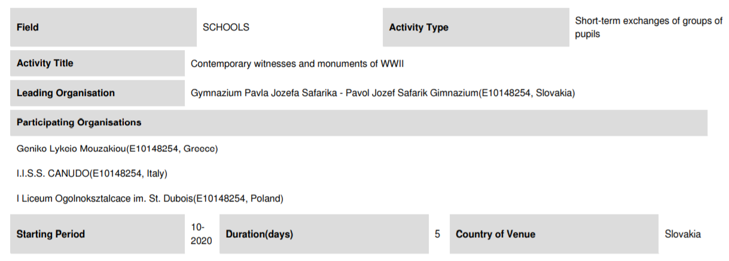
Short-term exchanges of groups of pupils

Slide 10
Description of the activity:
Contemporary witnesses and monuments of WWII - ice breaking activities to make students more comfortable about working in teams with new student (teachers of the host country)
- presentations of each school, city and country the partners are from (PowerPoint presentation or a video)
a questionnaire which will be evaluated during LTTA C1- to gather some information about students´ awareness of the causes, events during the WWII and its consequences
a project logo competition - this logo will be used throughout all the on-going project activities.

Slide 11
October
interviews of contemporary witnesses of WWII who will talk about their personal experience with the war and how it affected their lives and lives of their loved ones but also the country itself ( political, economic, social situation).
visiting of the monuments of WWII – Údolie smrti/Banská Bystrica museum of WWII
worksheets for students to complete during the visit to the museums (Slovak teachers).
creating a historical documentary movie, illustrated comic, slam poetry, songs or paintings. Each group will work on a different task and the outcomes from this meeting will be used in the final outcome and will be integrated in the curriculums of the participating schools.

Slide 12
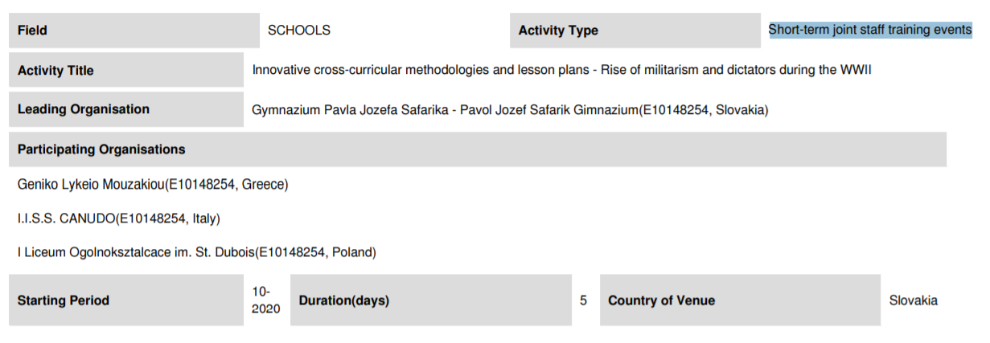
Short-term joint staff training events

Slide 13
Description of the activity:
to create a team of teacher-experts who will focus on exchange of good practices and they will work our new methodologies and lesson plans dedicated to teaching history in an innovative and interactive way.
Each school will choose a teacher of history who will cooperate during the assigned week.
The history teachers will start the chain of staff training events as the topic of the project is focused on WWII history.
As learning history for the contemporary generation is boring, this team of teachers will create new interactive and innovative methodologies and lesson plans for the students.

Slide 14
Description of the activity:
During this event the history teachers will focus on enriching the curriculum with more effective ways of teaching history and developing new content which would enhance the students´ interest and awareness.
The teachers will focus on the rise of militarism and dictators in different countries.
They will tailor interactive classes that go beyond manuals and sheets of dates and events.

Slide 15
THANK YOU FOR YOUR ATTENTION

