Slide 1
POLSKA - POLAND
PRESENTATION

Slide 2
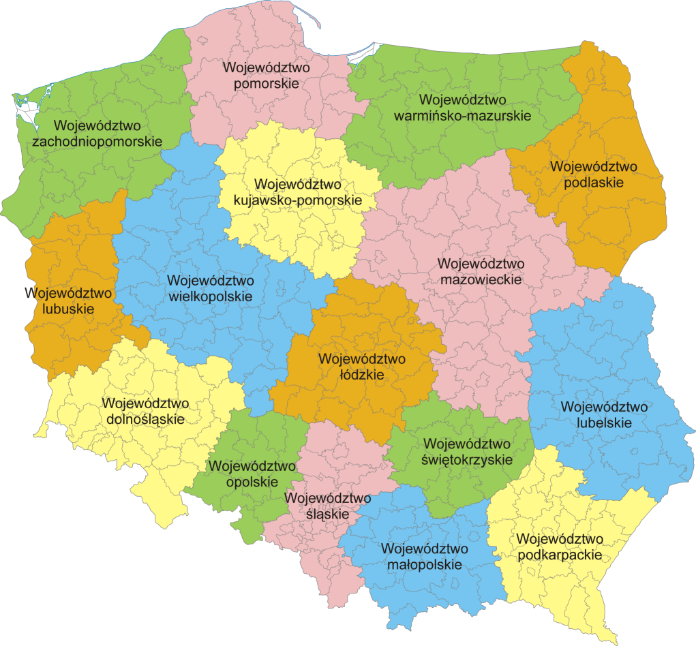
Let's start with general information about Poland.
Poland is a varied country as far as the landscape is concerned. We have beautiful mountains, sea and lakes. Each region is a very interesting place to visit and see.

Slide 3
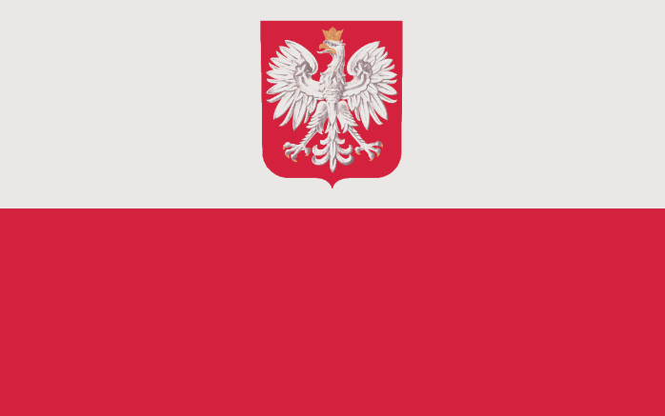
Country's full name: The Republic of Poland
National flag/Color: top - white, bottom - red
National banner: flag with national emblem -national symbol used by ships, civil air ports, diplomatic missions and consular posts

Slide 4
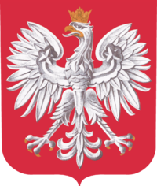
National emblem: white eagle in crown against a red background
National anthem: MAZUREK DĄBROWSKIEGO

Slide 5
A Few Facts About Poland
Poland is a member of the European Union.
The money used is 1 zloty = 100 groszy.
The population of Poland is 38,621,000.
The language spoken is Polish.
The capital of Poland is Warsaw.

