Slide 1
E-TWINNING CLUB
FATMA BAYSAL

Slide 2
THE E-TWINNERS

Slide 3
İBRAHİM KUTAY ARDA * AHMET POYRAZ CANGER
HALİL EFE ÇAĞIL * SADİ TACETTİONOĞLU
EMİR YÜCEL * SİMGE ÇEŞME
MURAT YÜCEL * SEBAHAT KÖSEOĞLU
ALP DELİCEO * SERTAÇ TACETTİNOĞLU
METİN MERT ÖZDEN * EMİRHAN DUYGULU
İNCİ ÜNSAL * AHMET EFE ELMAAĞAÇLI
ATADENİZ BEKTAŞ * DİLARA YAVUZ
SUAT KÖSEHALİLOĞLU * DOĞU YAZICIOĞLU

Slide 4
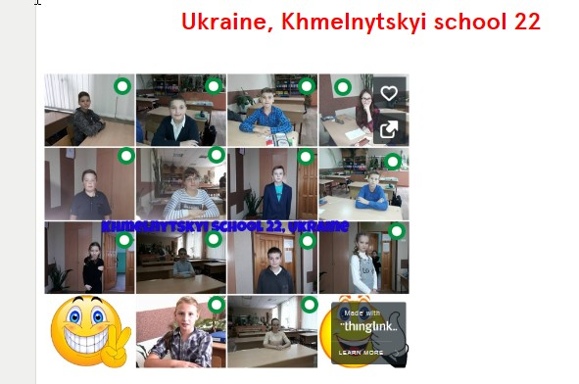
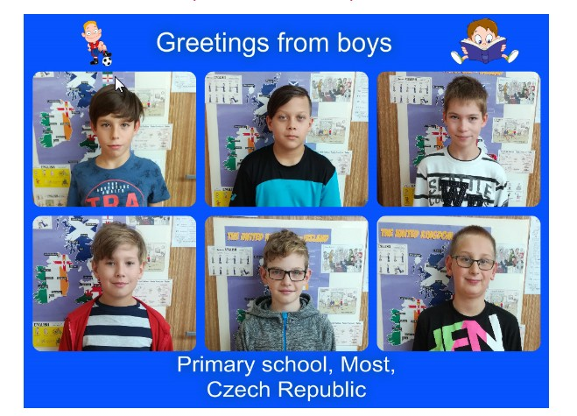

Slide 5
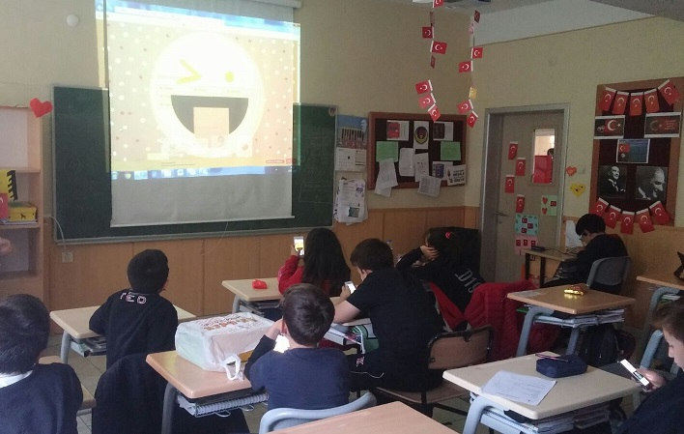

Slide 7
OUR PROJECTS 1) TONGUE TWISTERS FROM EUROPE

Slide 9
PROJECT ACTIVITIES
1.LET'S MEET!
2.THE PRESENTATION OF STUDENTS
3.LOGO COMPETITION
4.ENGLISH TONGUE TWISTERS
5.CHRISTMAS CARDS EXCHANGE
6. TONGUE TWISTERS IN OUR MOTHER LANGUAGES
7.OUR CHAIN CREATED STORY
8. CREATING AND EXCHANGING BOARD GAMES

Slide 10
CHAIN CREATED CALENDER

Slide 11
NEW YEAR CARDS

Slide 12
CHAIN CREATED STORY

Slide 16
OUR FAVOURITE TONGUE TWISTERS TONGUE TWISTERS FROM OTHER COUNTRIES
*I scream you scream we all scream for ice-cream.
*How can a clam cram in a clean cream can?
*The thirty-three thieves thought that they thrilled the throne throughout Thursday.
*I wish to wish the wish you wish to wish, but if you wish the wish the witch wishes, I won't wish the wish you wish to wish.
*One-one was a race horse Two-two was one too. One-one won one race. Two-two won one too.

Slide 17
TONGUE TWISTERS FROM OTHER COUNTRIES
1.If you're keen on stunning kites and cunning stunts, buy a cunning stunning stunt kite.
Dolyna school 6 with advanced study of subjects, Ukraine
2-Stupid superstition!
Primary school, Most, Okružní 1235
3-I can think of six thin things, but I can think of six thick things too.
4-What noise annoys an oyster? Any noise annoys an oyster. But a noisy noise annoys an oyster most
Primary School, Solec Stary 22
5-Betty bought some butter, but the butter Betty bought was bitter, so Betty bought some better butter.
Ukraine, Oleh Olzhych school 22 in Khmelnytskyi

Slide 18
Křeček křičí na křečka: "Řekni třikrát vařečka". ( CZECH REPUBLIC) Ce cebula nebimela ce bi bila bula. ( SLOVENIA) Gori na gori gori. ( SLOVENIA)

