Slide 1
TURKEY

Slide 3
Where is our country?
SWEDEN
THE UK
SPAİN
ROMANİA

Slide 4
Turkey is on the north hemisphere between Europe and Asia continents.

Slide 5
It’s like a bridge between Asia and Europe. Mediterranen sea, Aegean sea and Black sea surround our country.

Slide 6
Our neigbours are Greece, Bulgaria, Iraq, Syria, Iran, Gerorgia and Armania.

Slide 7
Turkey was founded by ATATÜRK in 1923.
Turkey is a repulic.
Our offical language is Turkish. Ankara is the capital city of Turkey. Currency of Turkey is Turkish lira.

Slide 8
There are 81 cities in Turkey.
Our school is in Dalaman,Muğla

Slide 9
Population
Our population is over 82 million Turkey has got mixed population Turkish, Kurdish, Armanian, Bosnian,
Makedonian, Arabian, Africans and others.
Last day’s 3 million Syrian’s emigrated to Turkey.

Slide 10
Religion
Churc
Camii (Mosque)
Synagogues

Slide 11
-Turkey is a laic country. Goverment and religious issues are seperated from each other.
-Everybody is free to choose his/her own religion in our country
-Most of people are muslim on the other hand Christian and Jewish people live in our country.
-There are many Mosques, Churches and Synagogues in many cities.

Slide 12
Turkish scientist Aziz Sancar, He got the Nobel Prize for mechanistic studies of DNA repair in 2015.

Slide 13
Some Famous Cities

Slide 14
Ankara is the capital city of Turkey and in the central Anatolia.

Slide 15
İstanbul is the biggest city and cultural, econimical centre of Turkey.

Slide 16
Bursa is ski centre of Turkey.

Slide 17
Antalya is a touristic destination in south of Turkey.
Every year, a lot of tourist come to Antalya for holiday.

Slide 18
İzmir has got an important seaport. The ancient city of Ephesus is located here.

Slide 19
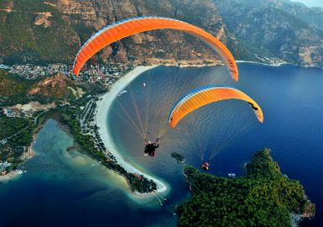
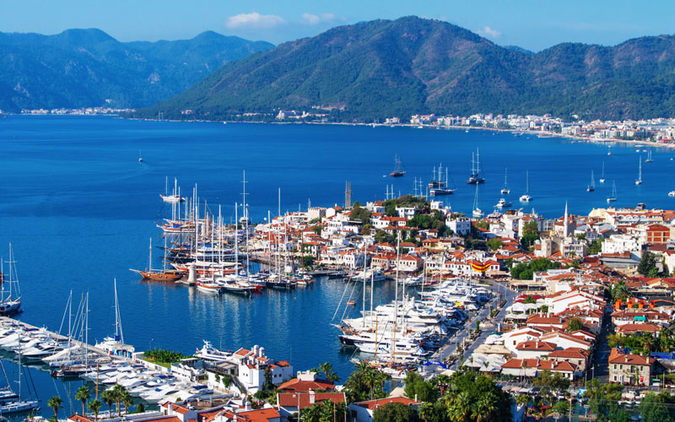
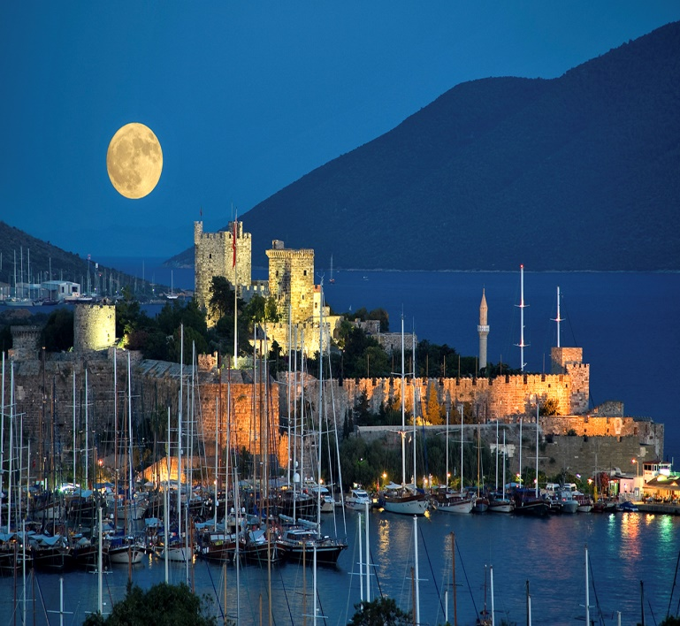
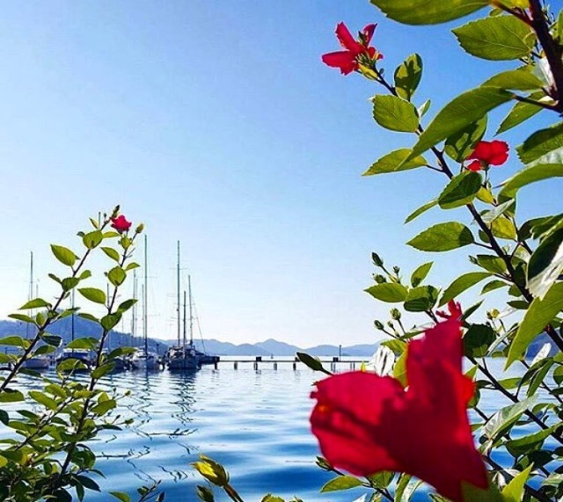
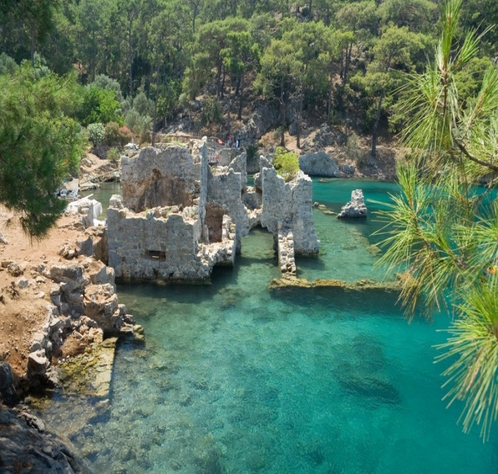
Muğla is located at the south west coast of Turkey.The city has so many touristic attractions;especially famous with natural bays and excellent seasides.

Slide 20
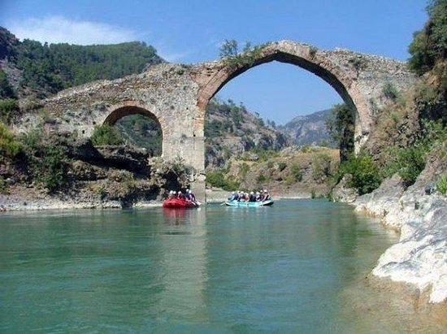
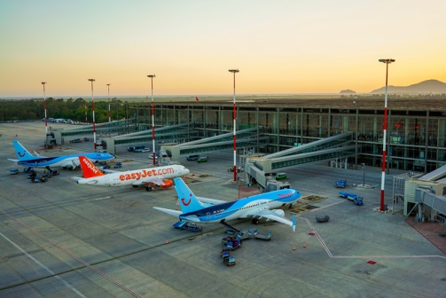
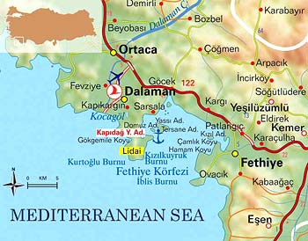
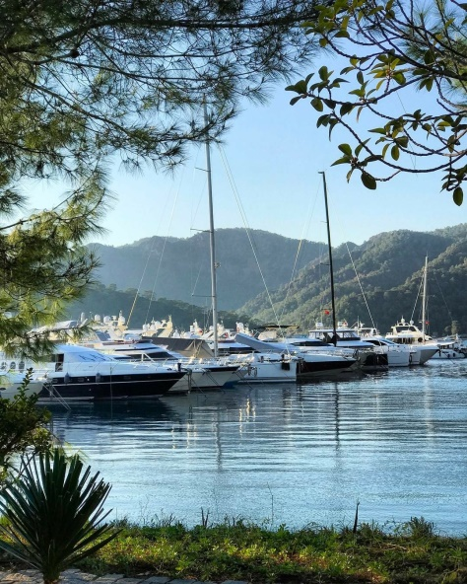
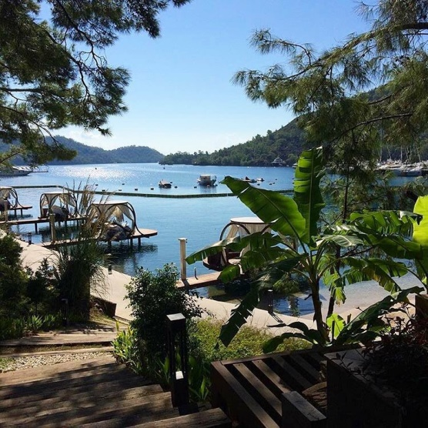
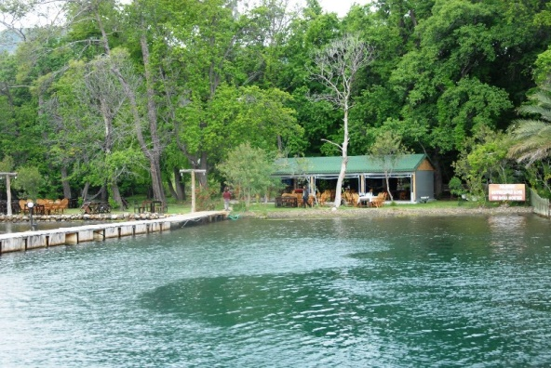
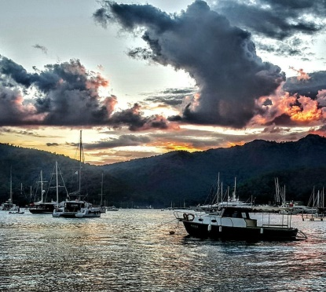
Our city is Dalaman and located at the south west coast of Turkey.

Slide 21
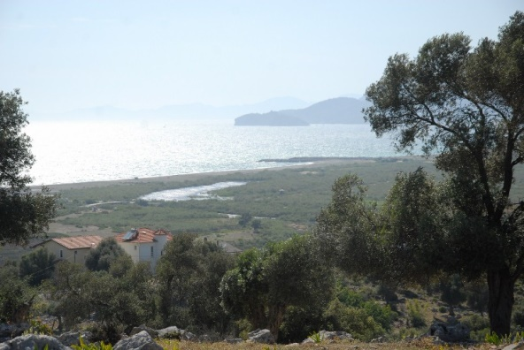
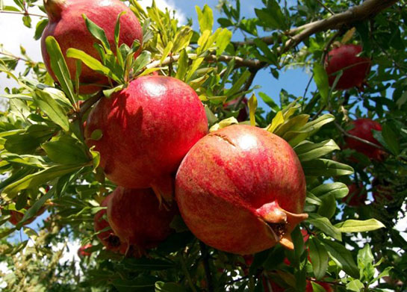
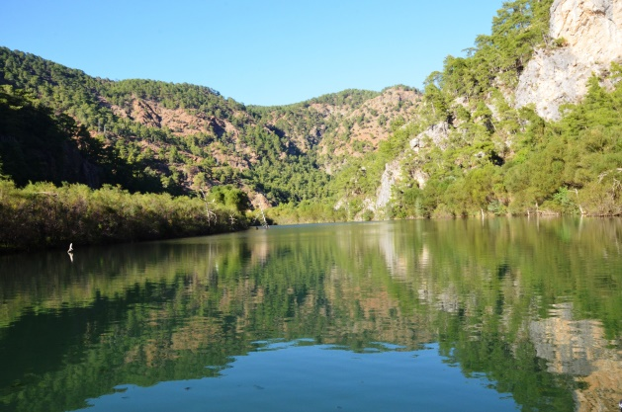
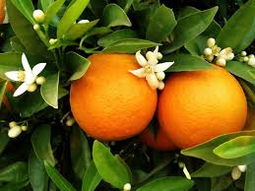
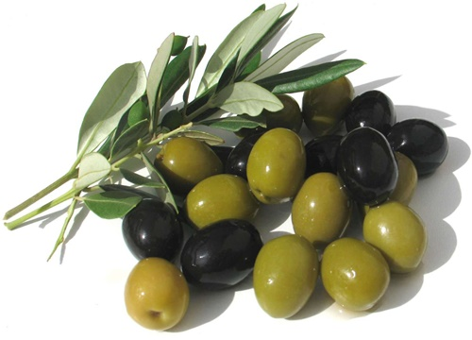
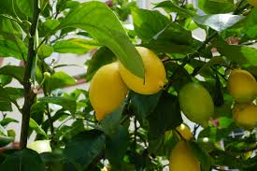
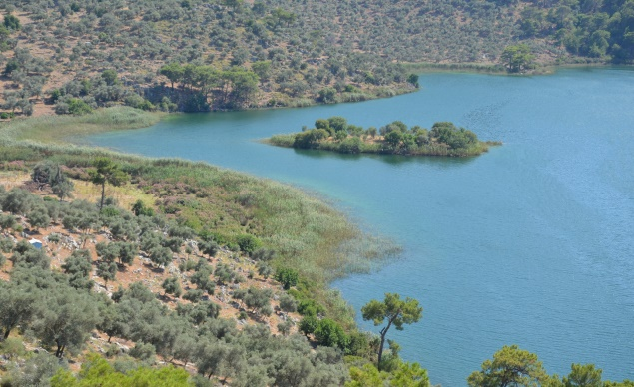
There are so many orange,lemon,olive and pomagrate gardens in our city..and natural bays…

Slide 22
Touristic and Historical Desinations
Ephesus
Sumela Monastery
Mount Nemrut

Slide 23
Istanbul has a lot of Ottoman and Byzantine Empires Monuments
Basilica Cistern
Hagia Sophia
Dolmabahçe Palace

Slide 24
Two of the seven marvels of ancient world are in Anatolia
The Mausoleum at
The Temple of ARTEMİS
HALİKARNASSOS

Slide 25
Cappadocia
-It is a historic area of central Anatolia region
-It has a lunar-like landscape (fairy chimneys)
-The caves and underground cities

Slide 26
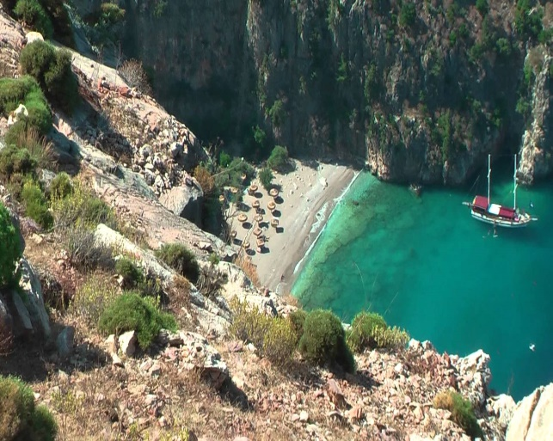
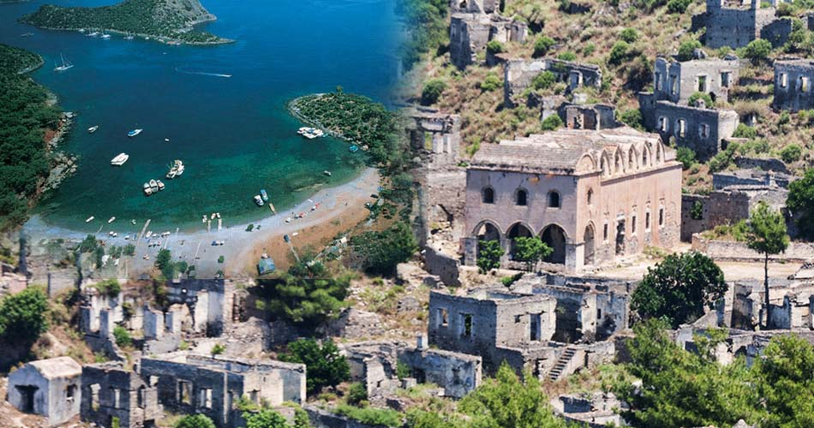
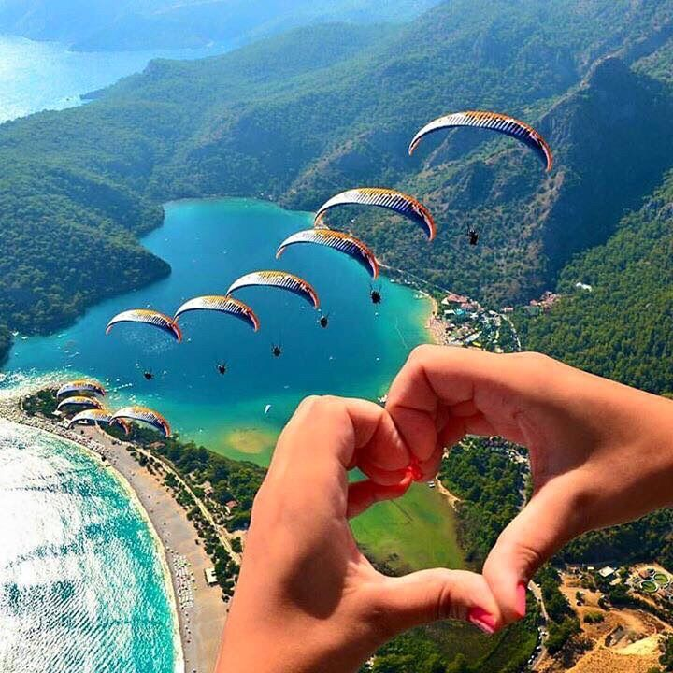
Fethiye
It is located on the southwest coast of Turkey, in Muğla.

Slide 27
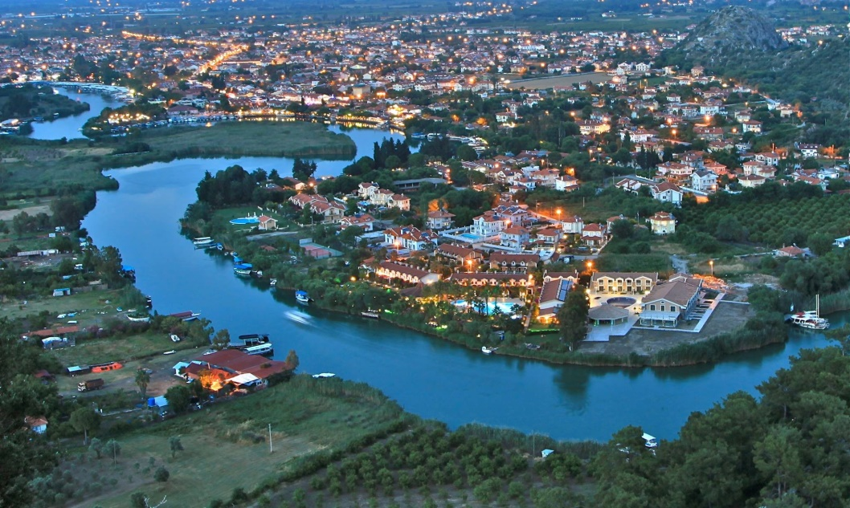
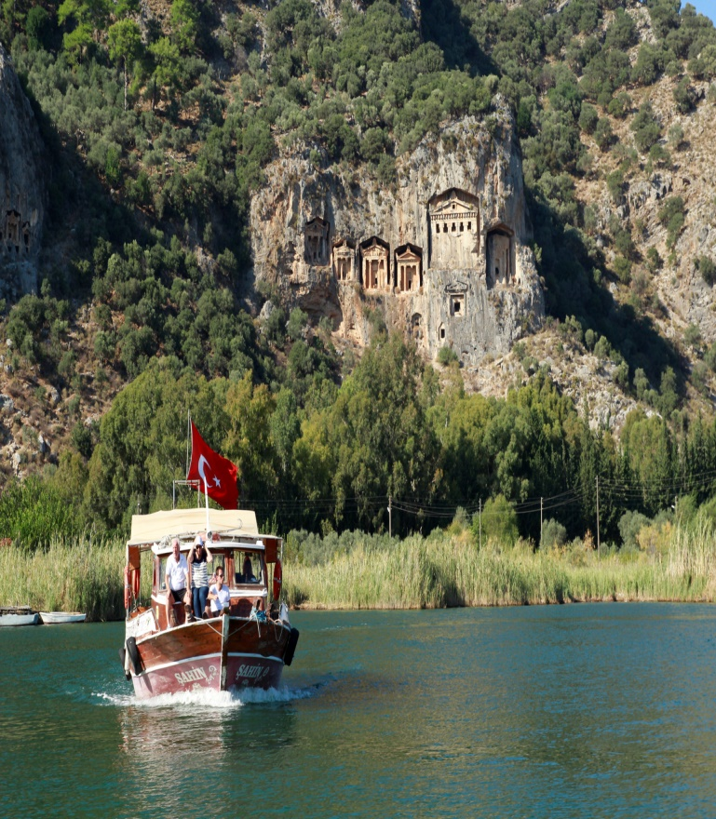
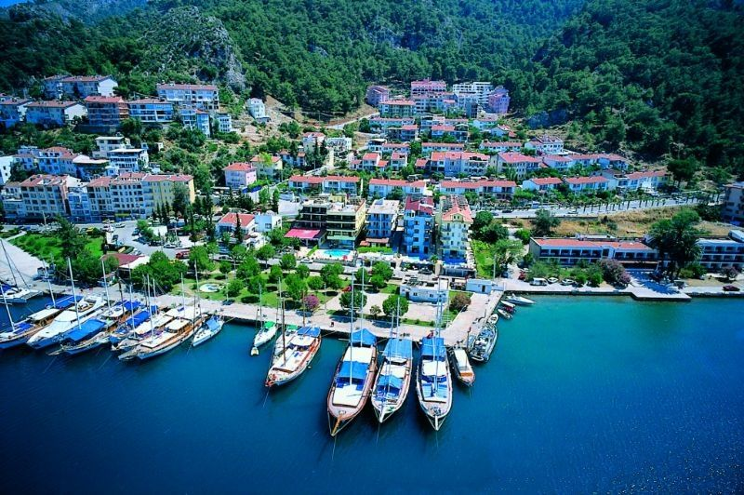
Dalyan is located at the southwest coast of Turkey,in Muğla.

Slide 28
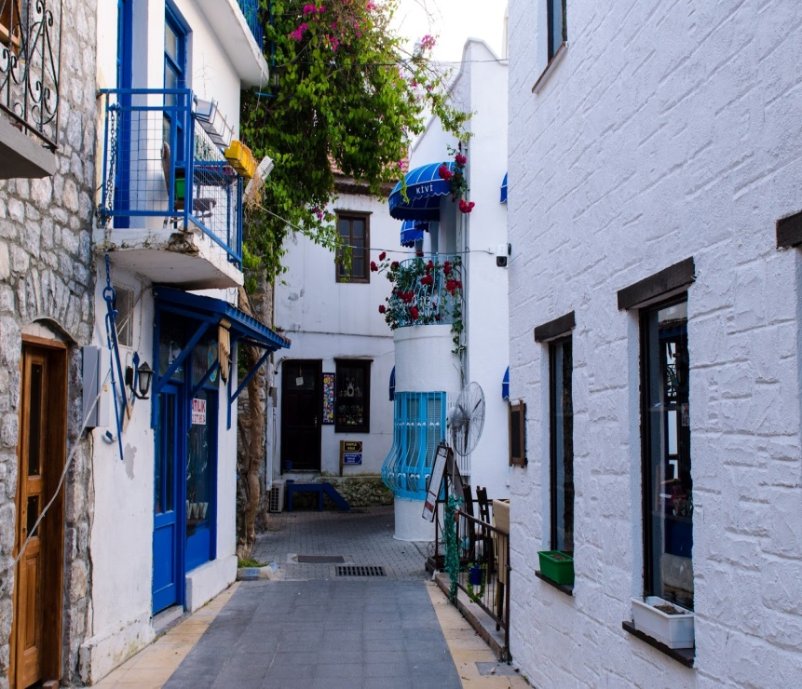
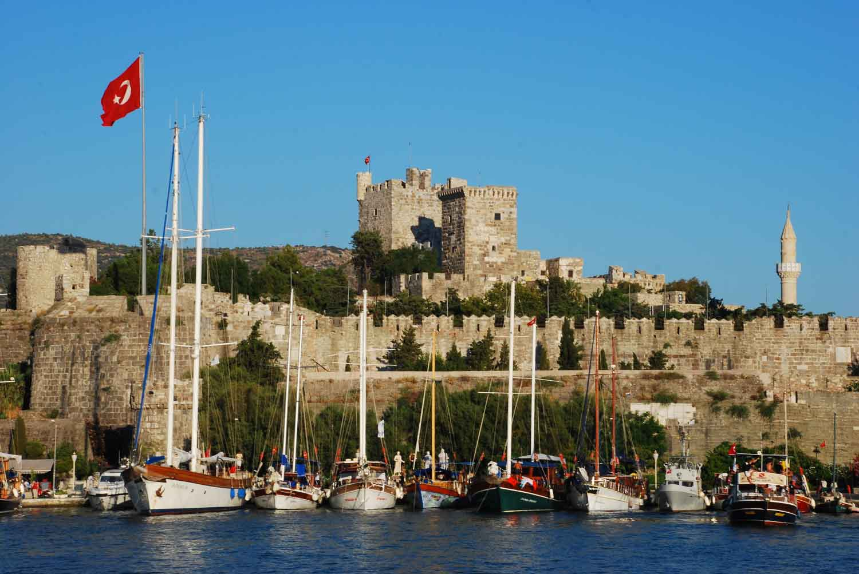
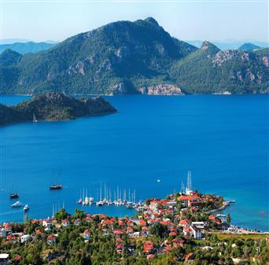
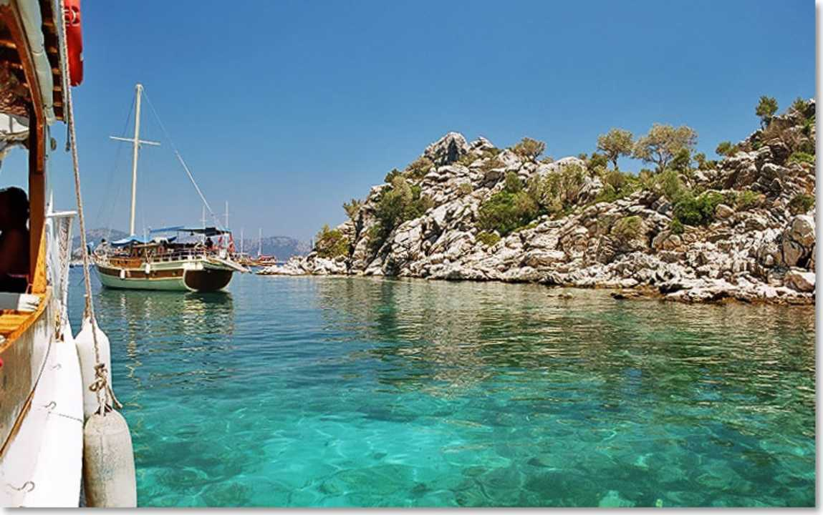
Marmaris is at the southwest coast of Turkey, in Muğla..with natural seasides and coasts.

