Slide 1
Climate
“This world must be unique.” -Aristotle (384-322 BC)
Notes:
mieke vult aan met foto en tekstmateriaal

Slide 2
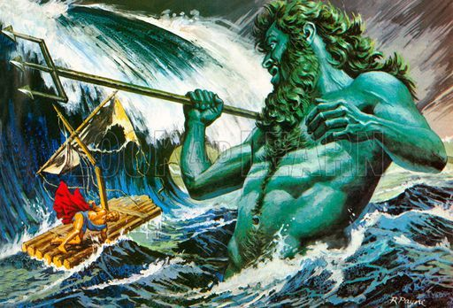
Iliad
The mood of the gods controlled the climate
Poseidon: god of the seas: decisive for return of soldiers after Trojan War e.g. Odysseus

Slide 3
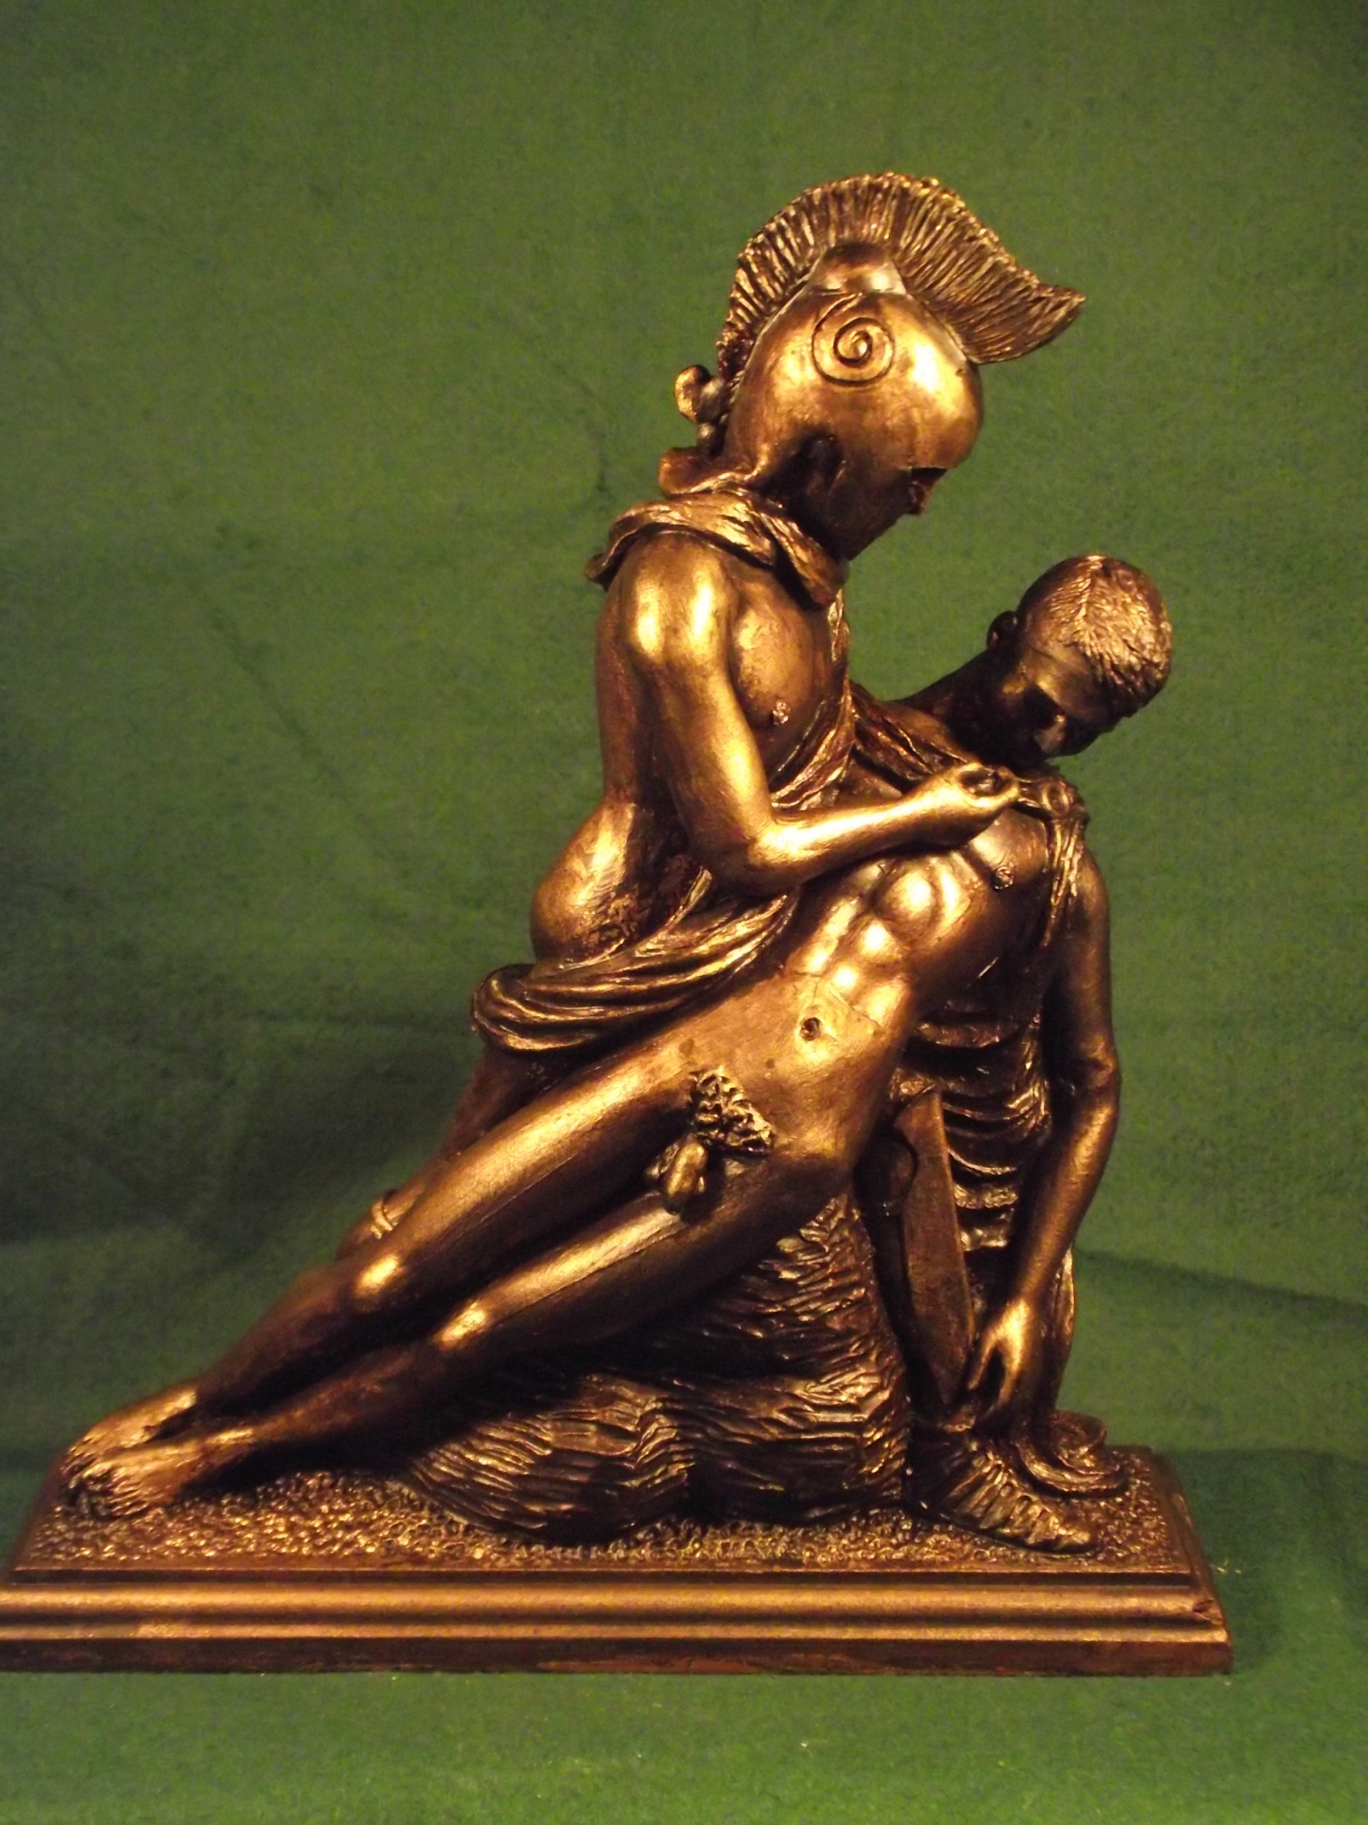
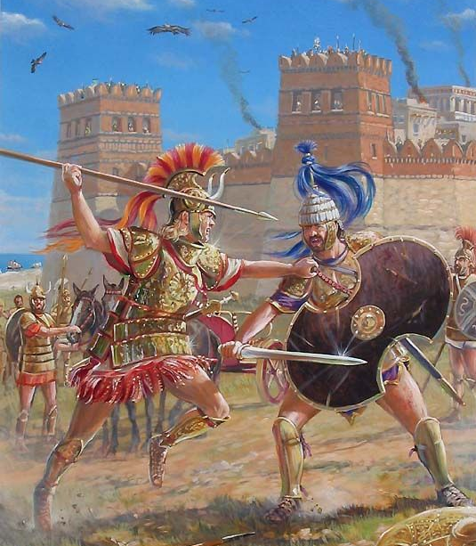
Intervention of nature in the Iliad
Achilles: very mad because best friend Patroklos was killed by Hector, his enemy
“Extreme violence starts, nothing will stop him, no mercy, no compassion, no difference, no fear, no pity
He murders, he slaughters, he kills …” -Iliad, Homer

Slide 4
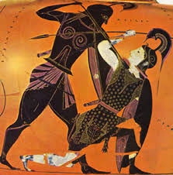
“Achilles jumped on the Trojans
with terrible screams, his heart covered
with power
First he killed Iphtion …”
This is how Xanthos’ water flew again and again towards
Achilles, although he was running so fast
Because gods are stronger than people

Slide 5
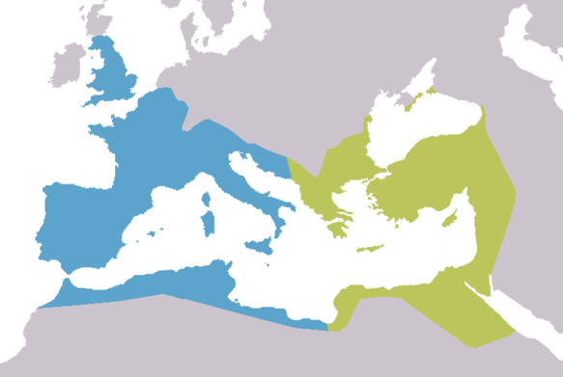
Fall of the Western Roman Empire
Kyle Harper, “The fate of Rome”
hayday Roman Empire: favorable climate conditions
fall: epidemics, disease, climate change
=> resilience of society decreased
=> West-Roman Empire has fallen apart
(blue part of the map)
Notes:
then moet verdwijnen - dia opsplitsen

Slide 6
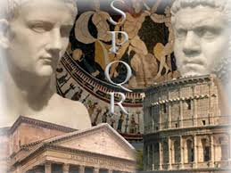
Wake-up call
Roman globalizing world began to feel revenge of nature = our world

Slide 7
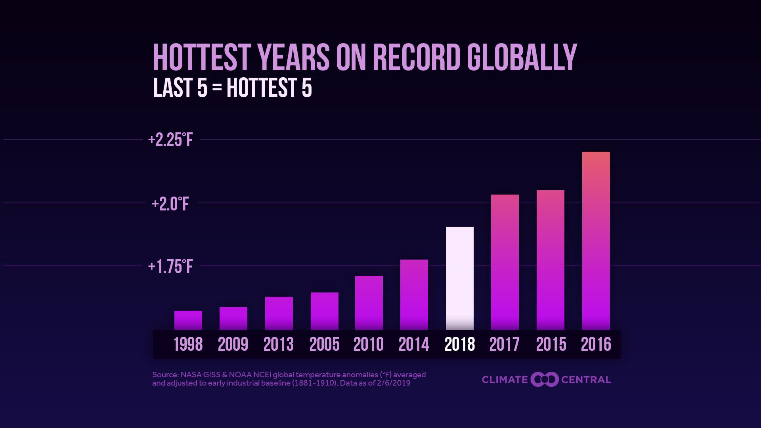
The climate issue: now
-95% sure: humans responsible
-temperature+0.85 degrees since 1880 due to human activity
-1 trillion tons of carbon dioxide = destruction of the world

Slide 8
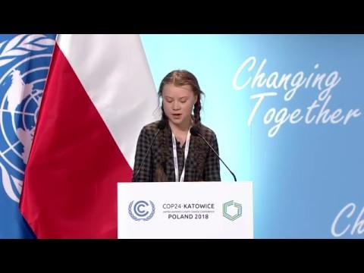
Greta Thunberg

Slide 9
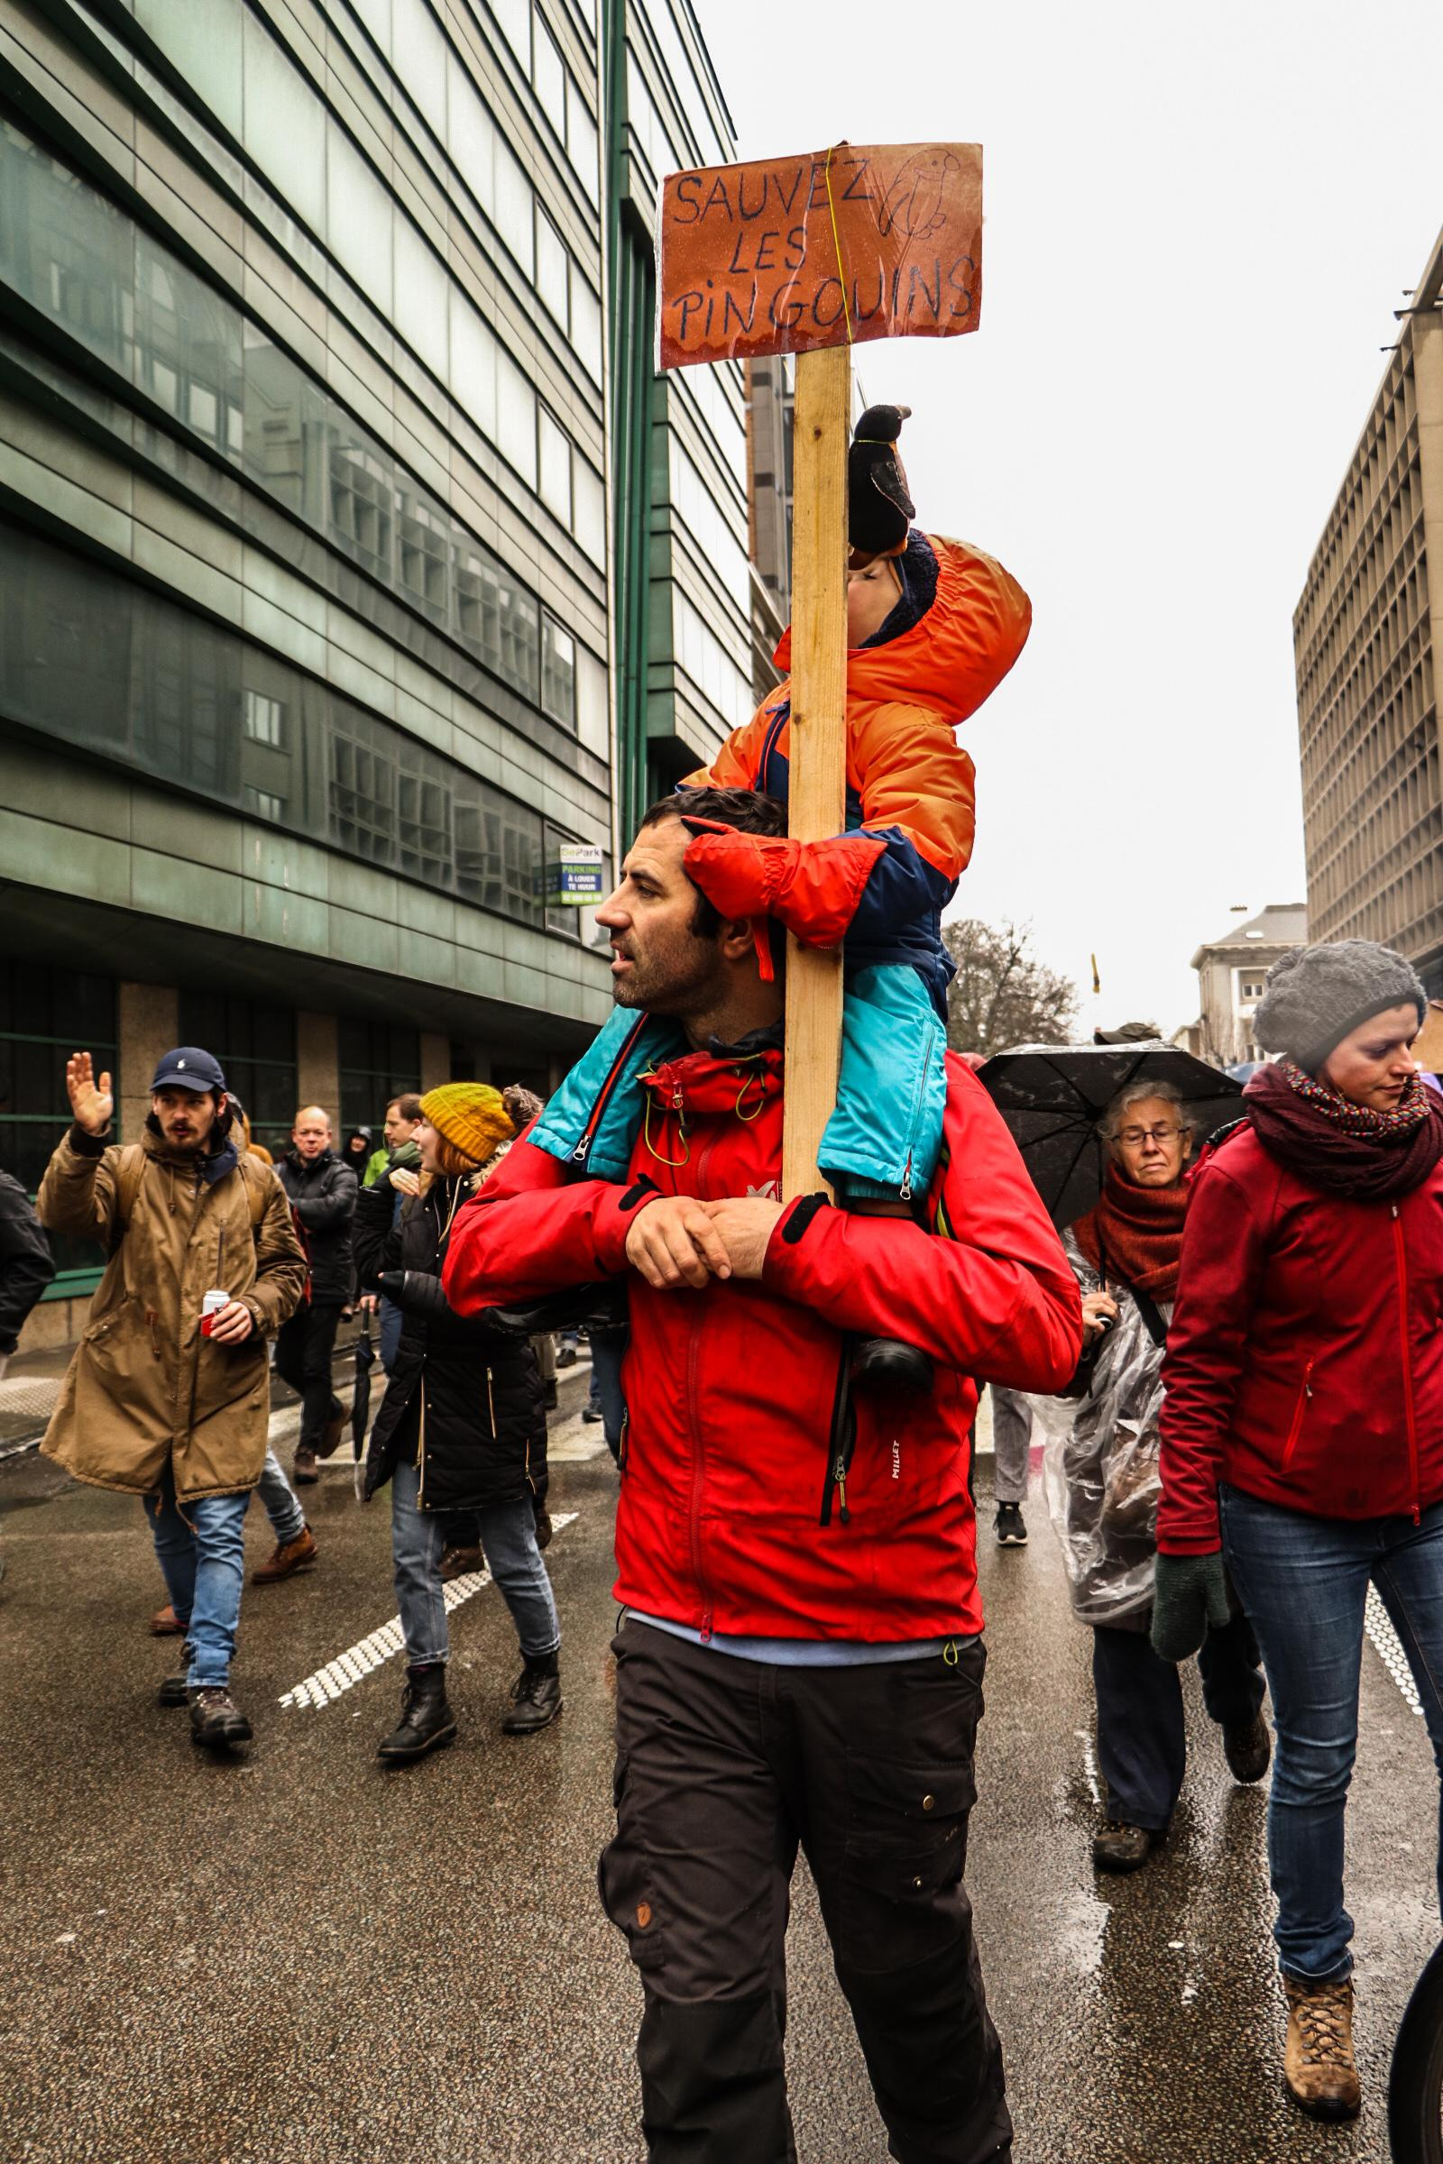
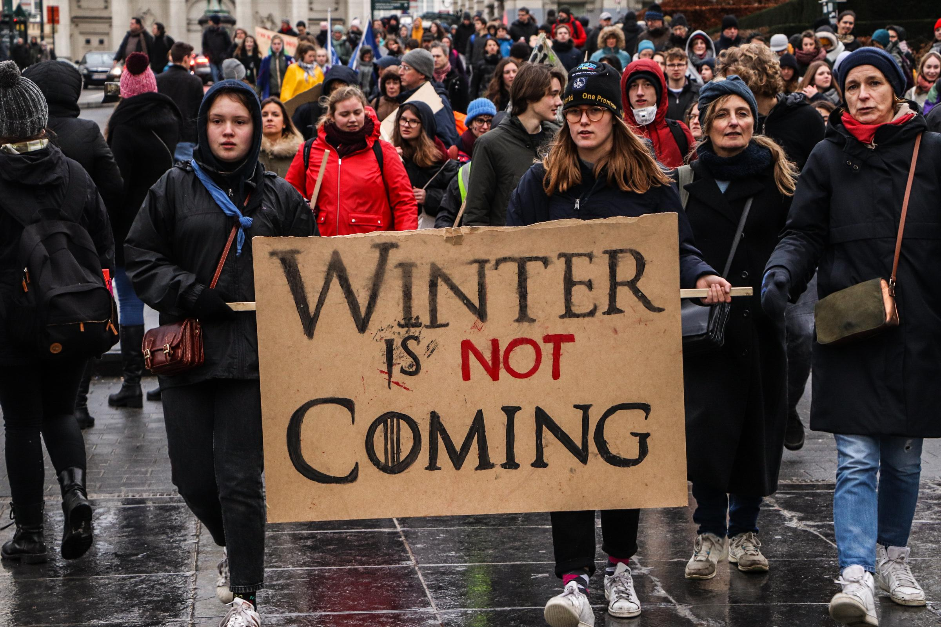
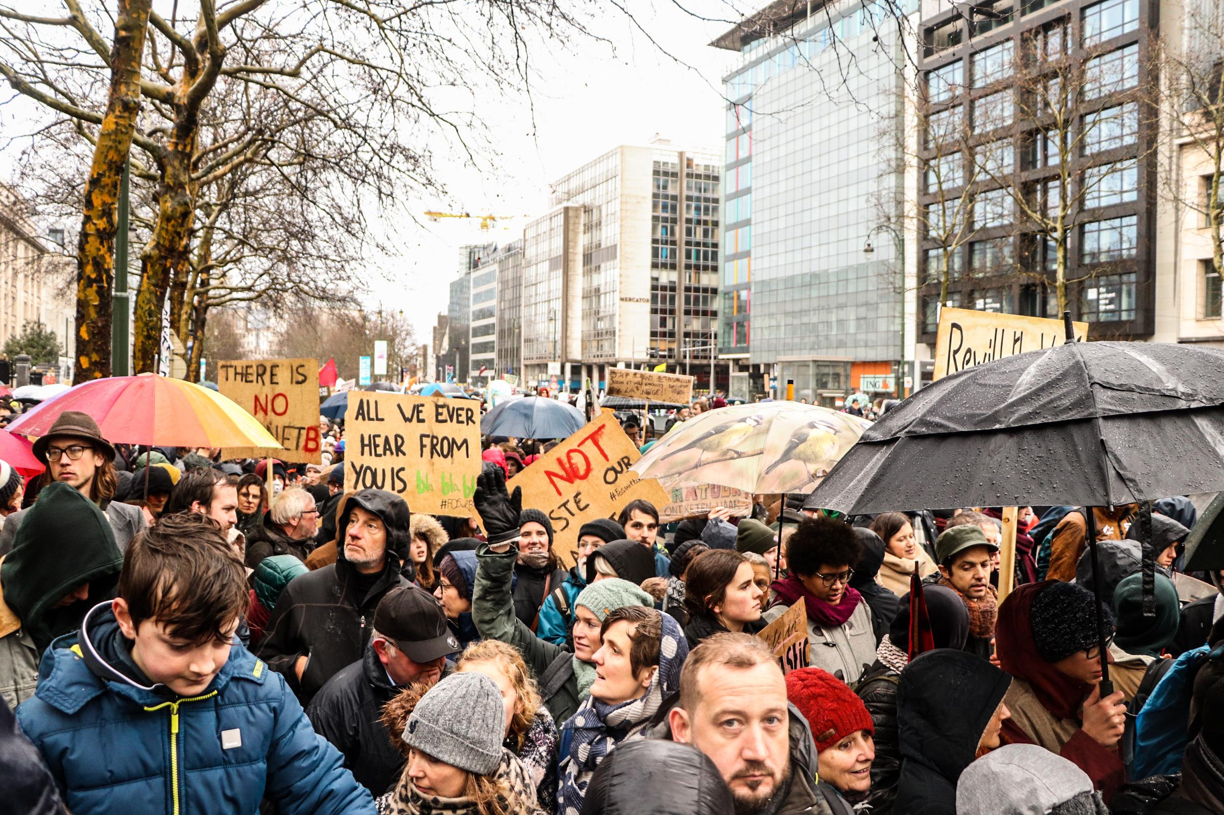

Slide 10
#MeToo
Crossing personal boundaries
Notes:
uitleg in aparte dia plaatsen

Slide 11
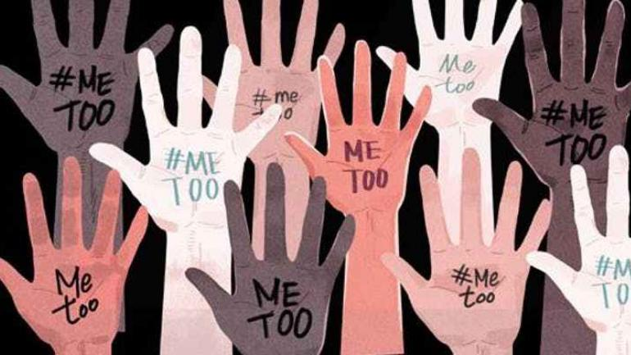
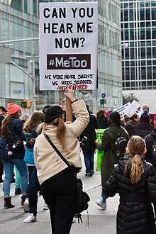
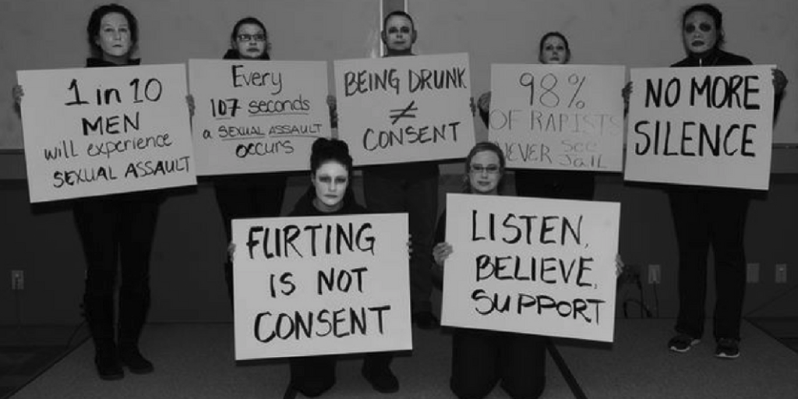
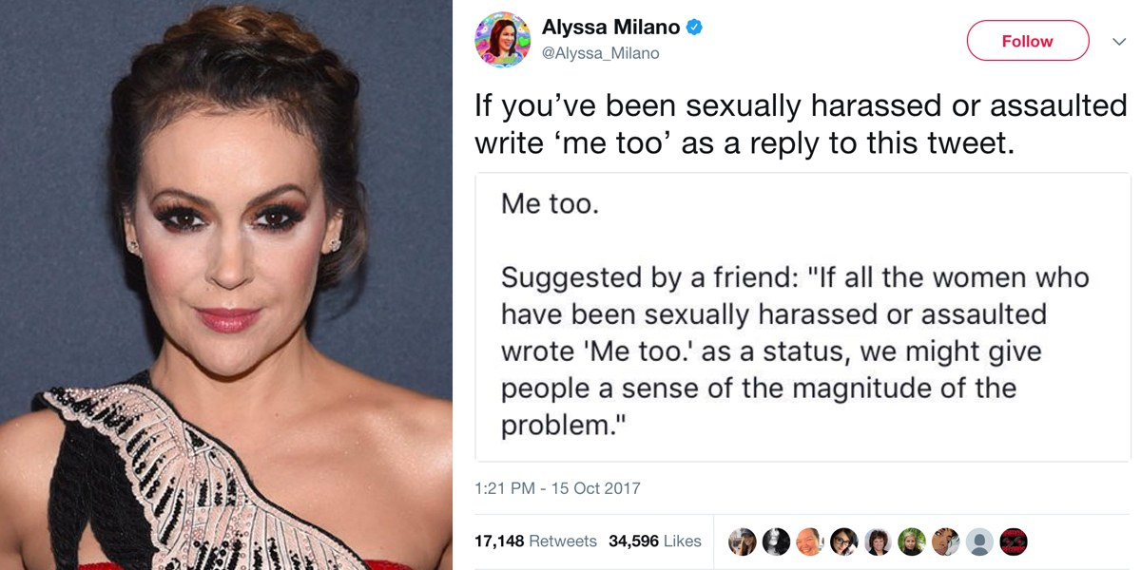

Slide 12
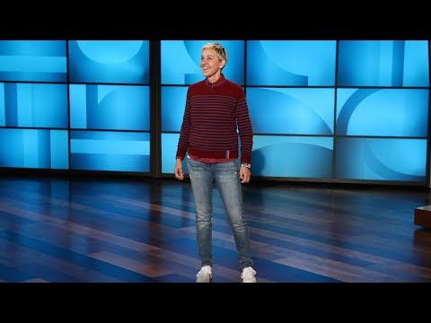
#MeToo movement = movement against sexual harassment and sexual assault
in October 2017
Harvey Weinstein
= a Hollywood producer, accused of sexual misconduct

Slide 13
Zeus: before his marriage
married to Metis
married to Thetis
Married to Mnemosyne, affaire with Leto
During his marriage with Hera:
Europa - Callisto
Io - Maia
Semele - Metis
Ganymedes (male) - Dione
Danaë
Notes:
onderscheid maken vrouwen misbruik - kindermisbruik

Slide 14
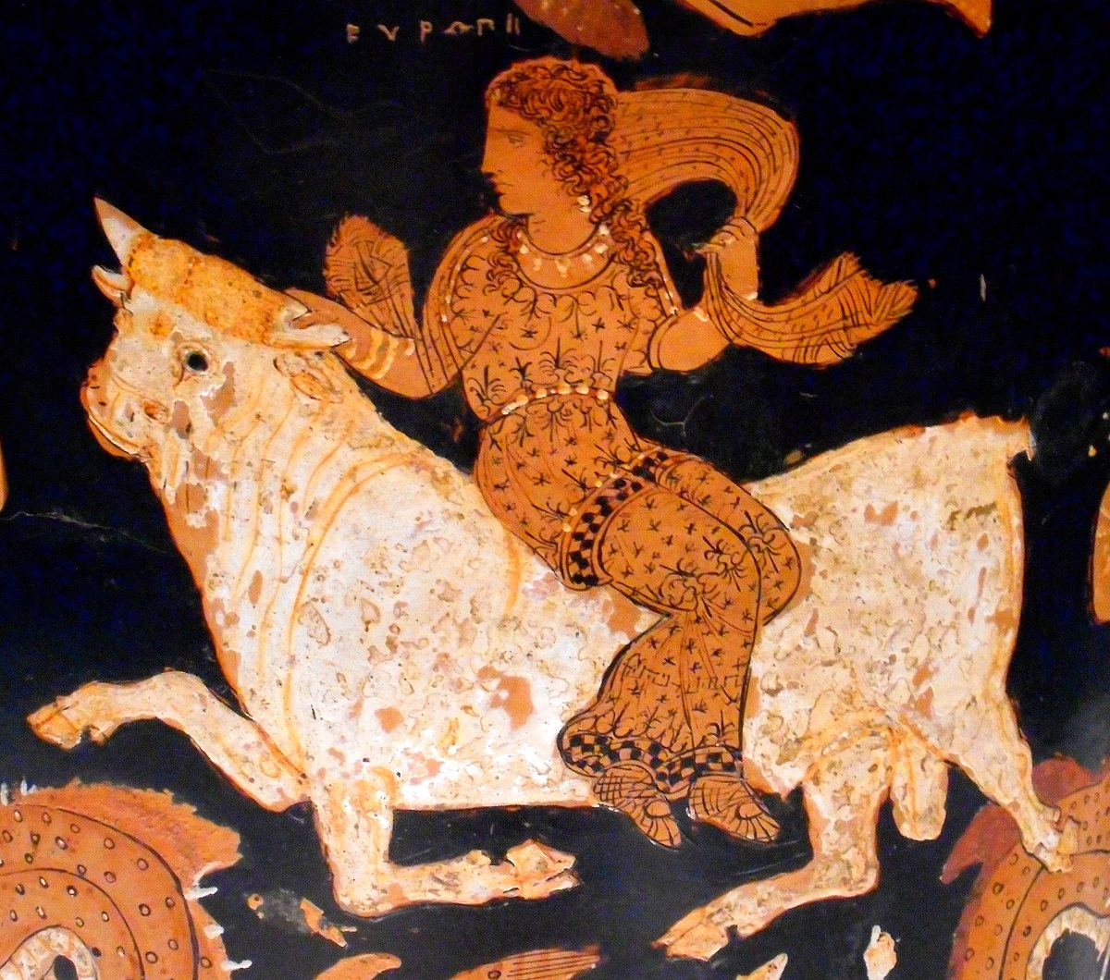
Europe
Zeus: struck by her charms
White bull
Crete
Raped her in the shadow of a tree and returned to his wife

Slide 15
Larry Nassar: child abuse
cumulative criminal acts of sex abuse, in which he was accused of molesting at least 250 girls and young women
child pornography charges
child abuse of Michael Jackson

Slide 16
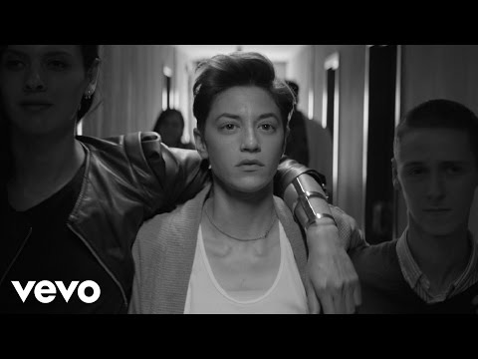
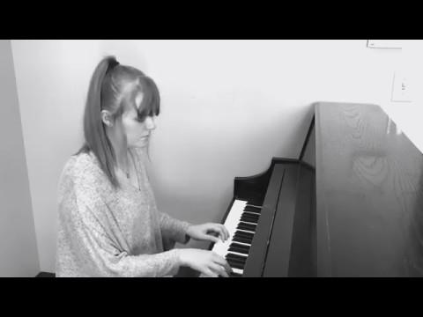
Brett Kavanaugh
Woody Allen
Ryan Adams
John Travolta
Alfred Hitchcock
Sean Penn
Dustin Hoffman
Chris Brown
Bill Cosby
R. Kelly
Patrick Kluivert
Morgan Freeman
Donald Trump
Michael Jackson
Cristiano Ronaldo
Kevin Spacey
Ben Affleck
Mariah Carey
Gerard Depardieu
David Copperfield
James Franco
Stan Lee
Sylvester Stallone
Harvey Weinstein

Slide 17
Conclusion
We can and have to stop unacceptable behavior (=hubris in Greek antiquity) sexually, in science, in medicine, during war, regarding climate and so on …
In antiquity: the gods send their punishment
In the present: laws and commissions protect us against overstepping boundaries

Slide 18
Thank you for your attention!

