Slide 1
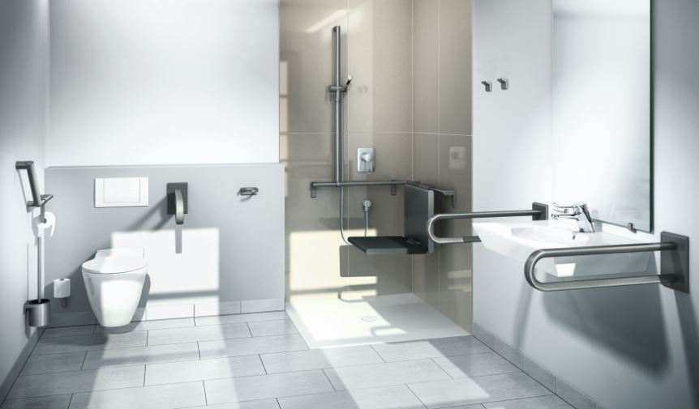
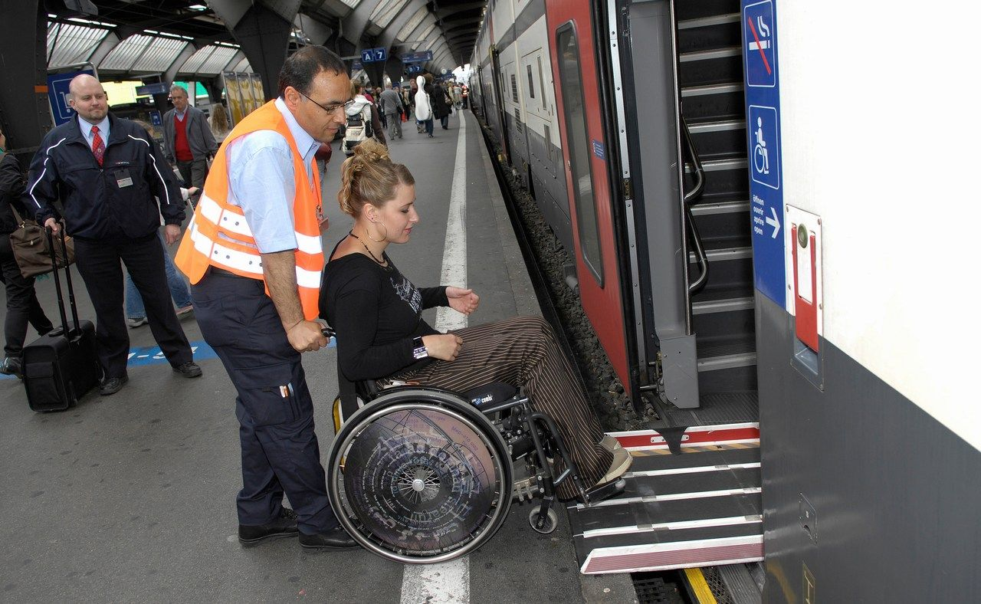
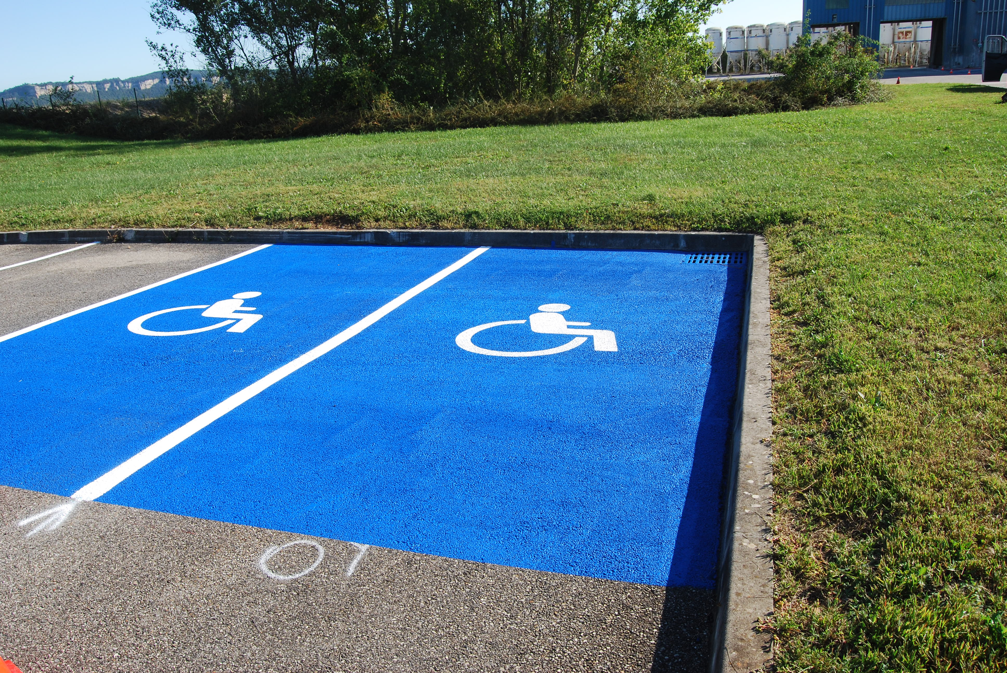
Special houses
Paralympic games
Help with public transport
Car park, reserved for disabled people

Slide 2
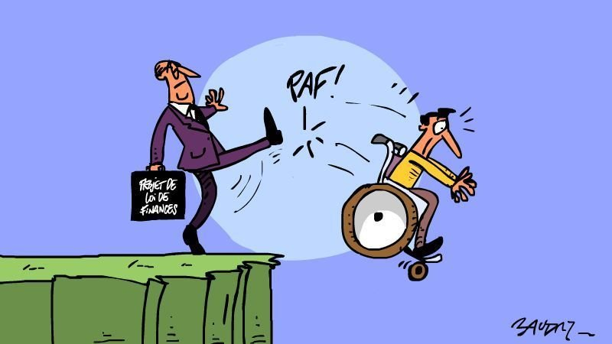
EXCLUSION

Slide 3
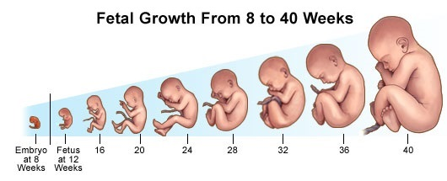
Abortion
Since roman age
kill a unborn child
When child = handicapped
Less barbaric than kill a living child?

Slide 4
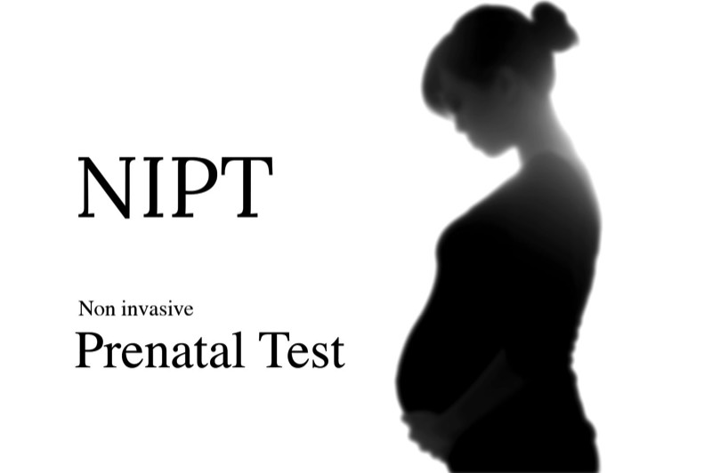
The NIP-test
Non invasive prenatal test
Pregnancy of 10 weeks
Search for 3 syndromes
Down syndrome
Edward syndrome
Pataus syndrome

Slide 5
You can anticipate on it
Move to spacious house
Close to all the facilities
Syndromes will be distinct
Number of handicaps decrease
Handicaps

Slide 6
We accept handicaps
Well paid job
Lies Lefever

