Slide 1
This is our country Sweden
We hope you will learn a lot from our presentation!

Slide 2
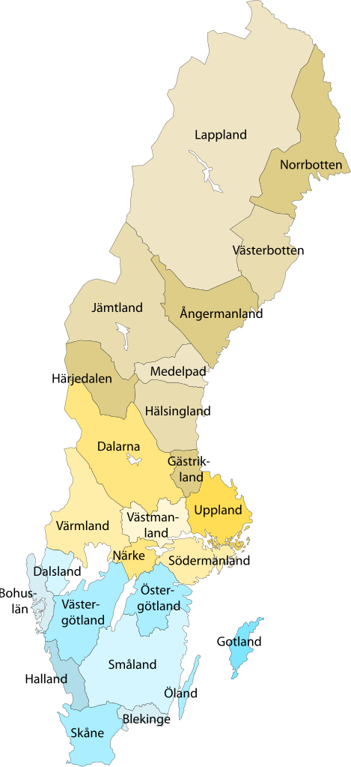
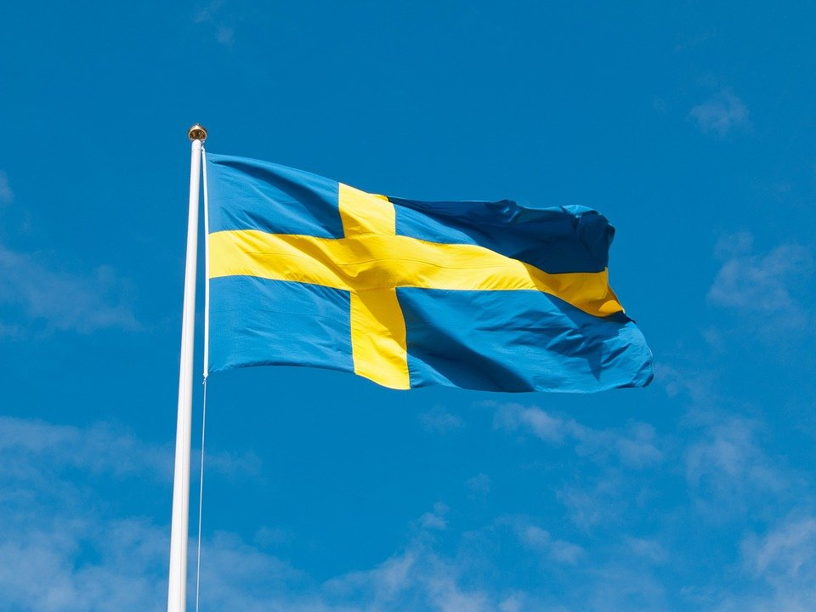
Sweden
In Sweden we have 10,5 million inhabitants.
The country is located in northern Europe.
The weather can be very different. On the summer we often
have sun on the days and it's warm but on the winter it's
much colder. We have about 2-15 degrees below minus and
we also have snow.

Slide 3
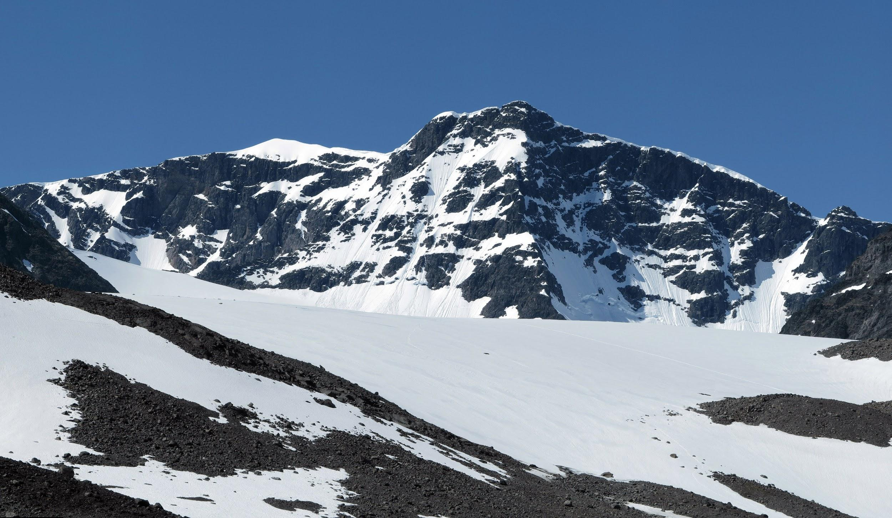
Sweden
Swedens highest mountain is called Kebnekaise
and is located in the northern Sweden in the
landscape Lappland.
Fun fact
Sweden has the worlds fastest car, the name is Koenigsegg
but the model name is Koenigsegg Jesko and that is the worlds fastest car.

Slide 4
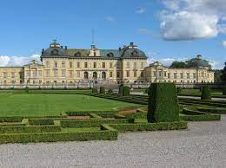
Stockholm
Stockholm is a big city which is very rich in history, culture and activities that you must not miss. Stockholm is Sweden's capital.
Carl XIV Gustav is the Swedish king, he lives in the south part of a big castle called “Drottningsholms slott” in Stockholm. He is 75 years old.
Queen Silvia grew up in Germany but
on 19th of June 1976 she became a
Swedish citizen. She is 78 years old
and a really good queen.

Slide 5
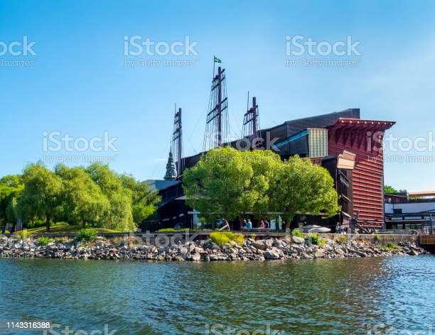
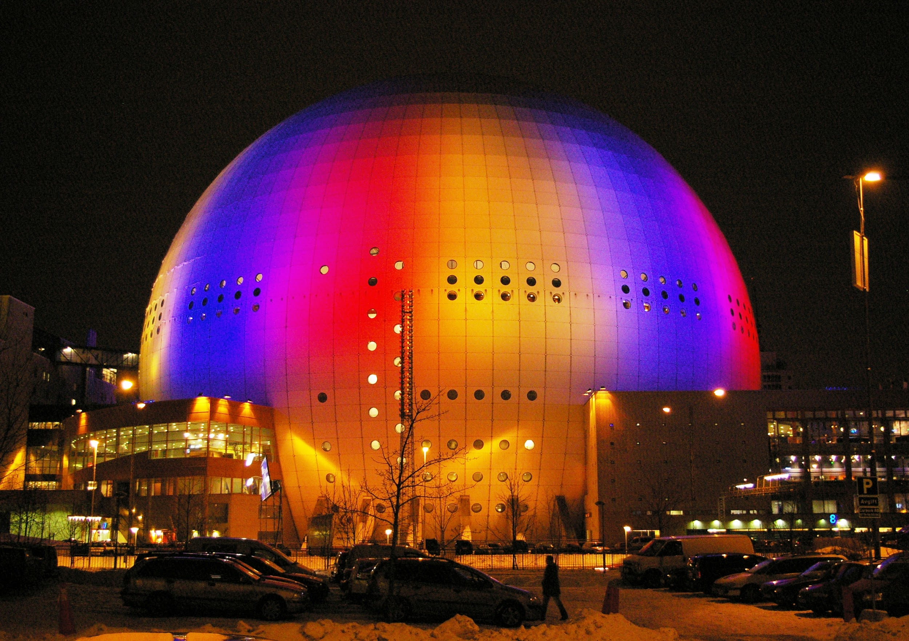
Stockholm
Fun fact
Stockholm has a really popular museum named
“Vasa museet”.
“Globen”is a famous building. It is the biggest
round building in the whole world, it`s 85 meters high.
Globen is a football arena and
it IS also called “avicii arena''.

Slide 6
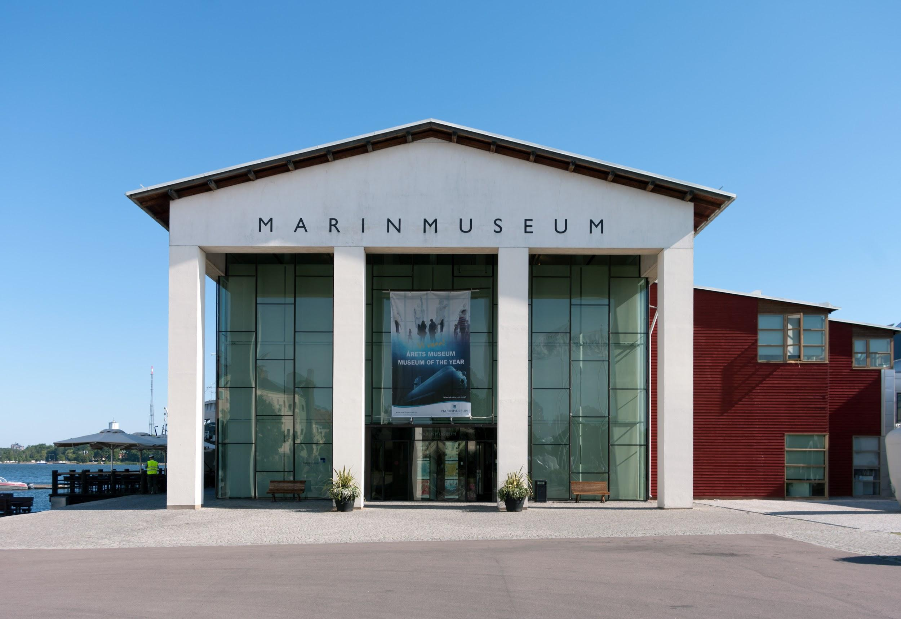
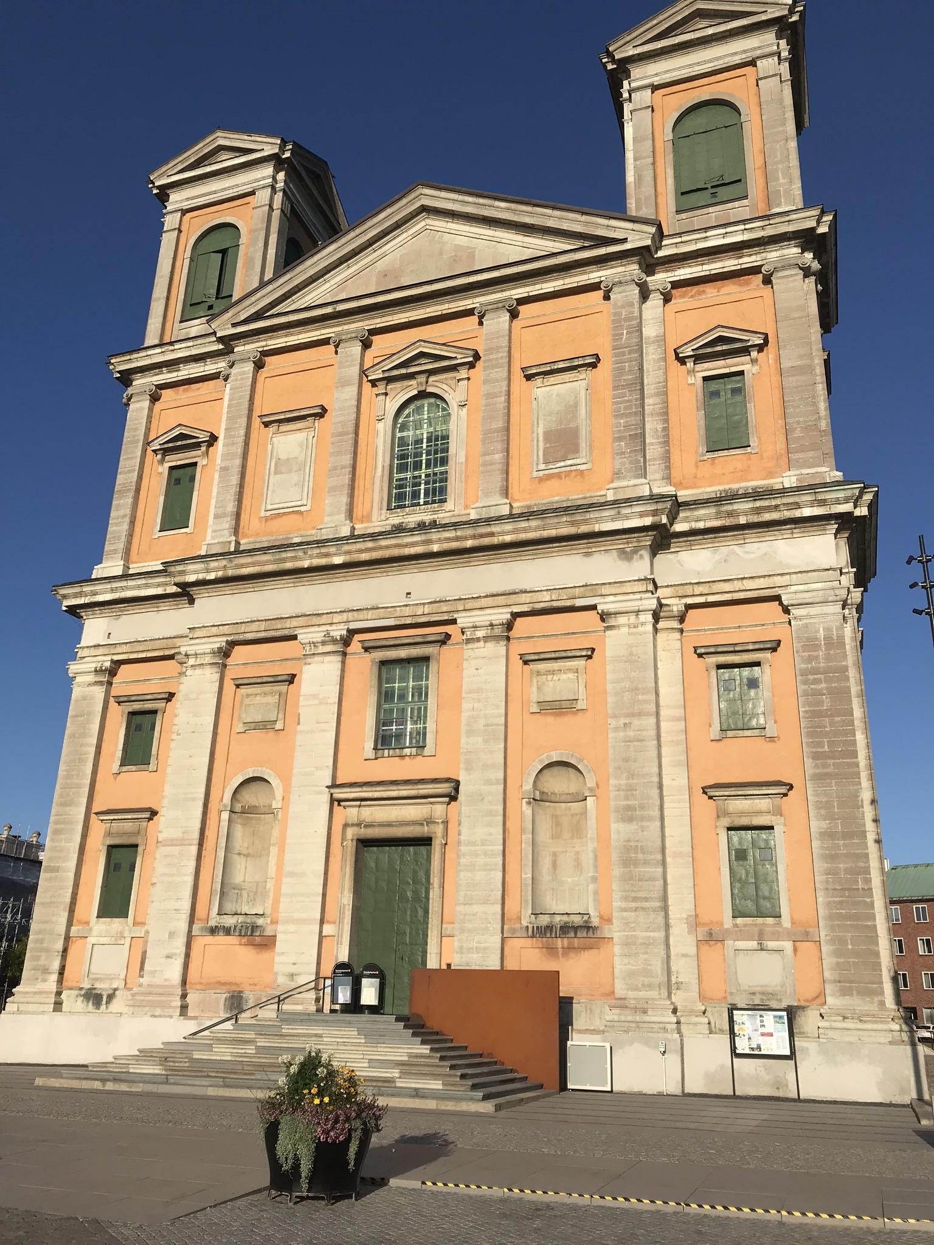
Karlskrona - our hometown
Karlskrona is located in the southern part of Sweden, in Karlskrona it lives around 66 675 people.
Important places in Karlskrona are the museum called “Marinmuseum” and the church called “Fredrikskyrkan”. At the Marinmuseum you can look at old submarines, eat food, buy things and you can do crafts.

Slide 7
Karlskrona
Fun fact
You can have fun in a park called Wämö in Karlskrona. In Wämö you can look at cute animals (farm animals).
There is also an agility park in Wämöpark, it's fun to play and train with dogs!

Slide 8
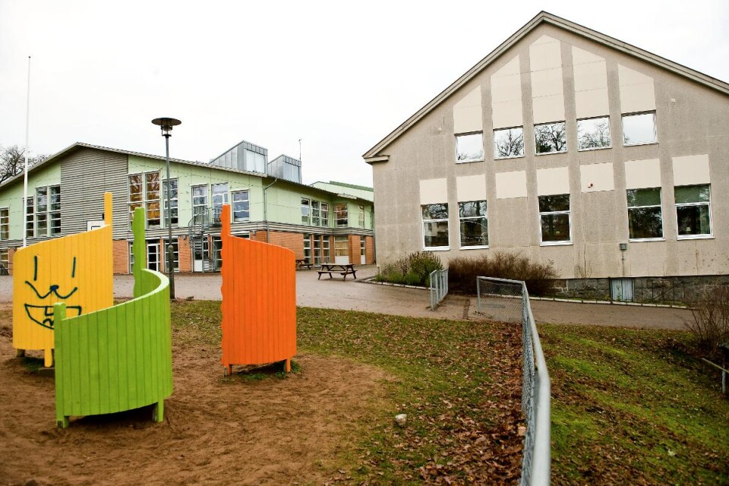
Nättrabyskolan - our school
Nättrabyskolan is a big school, it is the biggest school in the
landscape Blekinge.
It is about 900 pupils here and it works a lot of teachers and other staff in the school.
We have classes from first school year (it is 6 year old children) to 9th grade (teenagers who are 16 years old). We have A,B,C and D classes.
A bit of our school building is 120-150 years old.
We are a very creative school! The pupils in Nättrabyskolan are doing well and have good results.

Slide 9
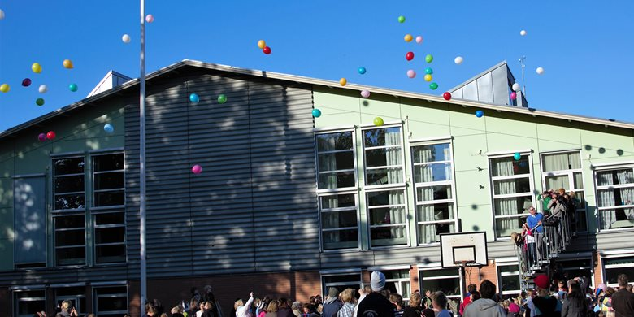
Nättrabyskolan
FUN FACT
Under one year in school we have five breaks:
-The summer break is ten weeks long.
-The sports break is one week long.
-The christmas break is three weeks long.
-The Easter holiday break is one week long.
-The reading break is one week long.
We get free school lunch every day. We need to go down to the dining room.

Slide 10
Thanks for looking at our presentation
We hope to see you in the future!
Best regards
Class 4A at Nättrabyskolan

