Slide 1
PETAR ZORANIĆ

Slide 2
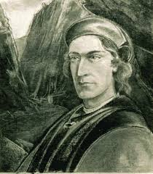
Petar Zoranić was born in 1508. He was a descendant of the old noble family Tetačić from Nin, who took refuge in Zadar at the end of the 15th century due to malaria in Nin and the Turkish danger. At that time, his mother Elizabeth was expecting a child. The earliest information about his life dates back to 1531, when he is mentioned as a paid Nin notary, lawyer and court clerk, which means that he most likely completed his studies in legal sciences; probably in Padua.
It is not known for sure exactly when he died. There are certain indications of his death, and the last information about his life is from 1543. It is assumed that he died after 1543, but certainly before 1569 when the Mountains were printed, because if he had been alive he would probably have changed his dedication from 1536 to Matija Matijević, the canon of Nin, who at the time the work was already was dead.

Slide 3
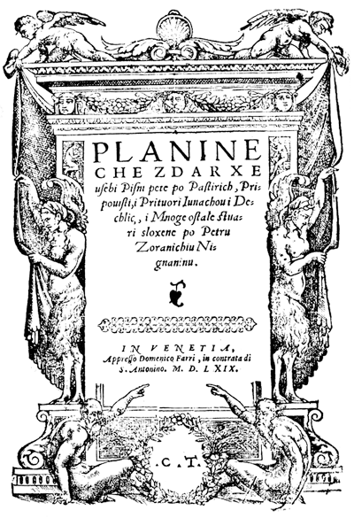
Zoranić is known as the author of the first Croatian novel Mountain from 1536. The pastoral novel (travel elements) of the Mountain was published in Venice in 1569 and it is the only preserved work of his (along with two lost ones known: "Love Hunt" and "Vilenica")
The work of an unknown author, a 16th-century pastoral eclogue purchased in London in the 1970s, is attributed to his works. His novel testifies to a thorough humanistic and theological education he probably acquired at the Dominican General University in Zadar . The novel Mountains contains love songs. According to these inserted poems, Zoranić is a contemporary Petrarchist. It is a work of patriotic character and depicts Croatia torn between two conquerors: "when on the one hand the Turks, and on the other the Venetians attack the people to destroy it, and the people do not give up".
Zoranić belonged to the circle of writers who contributed to Zadar, along with Hvar, Korčula, Split and Dubrovnik, becoming one of the main centers of Croatian Renaissance literature.

Slide 4
END

