Slide 1
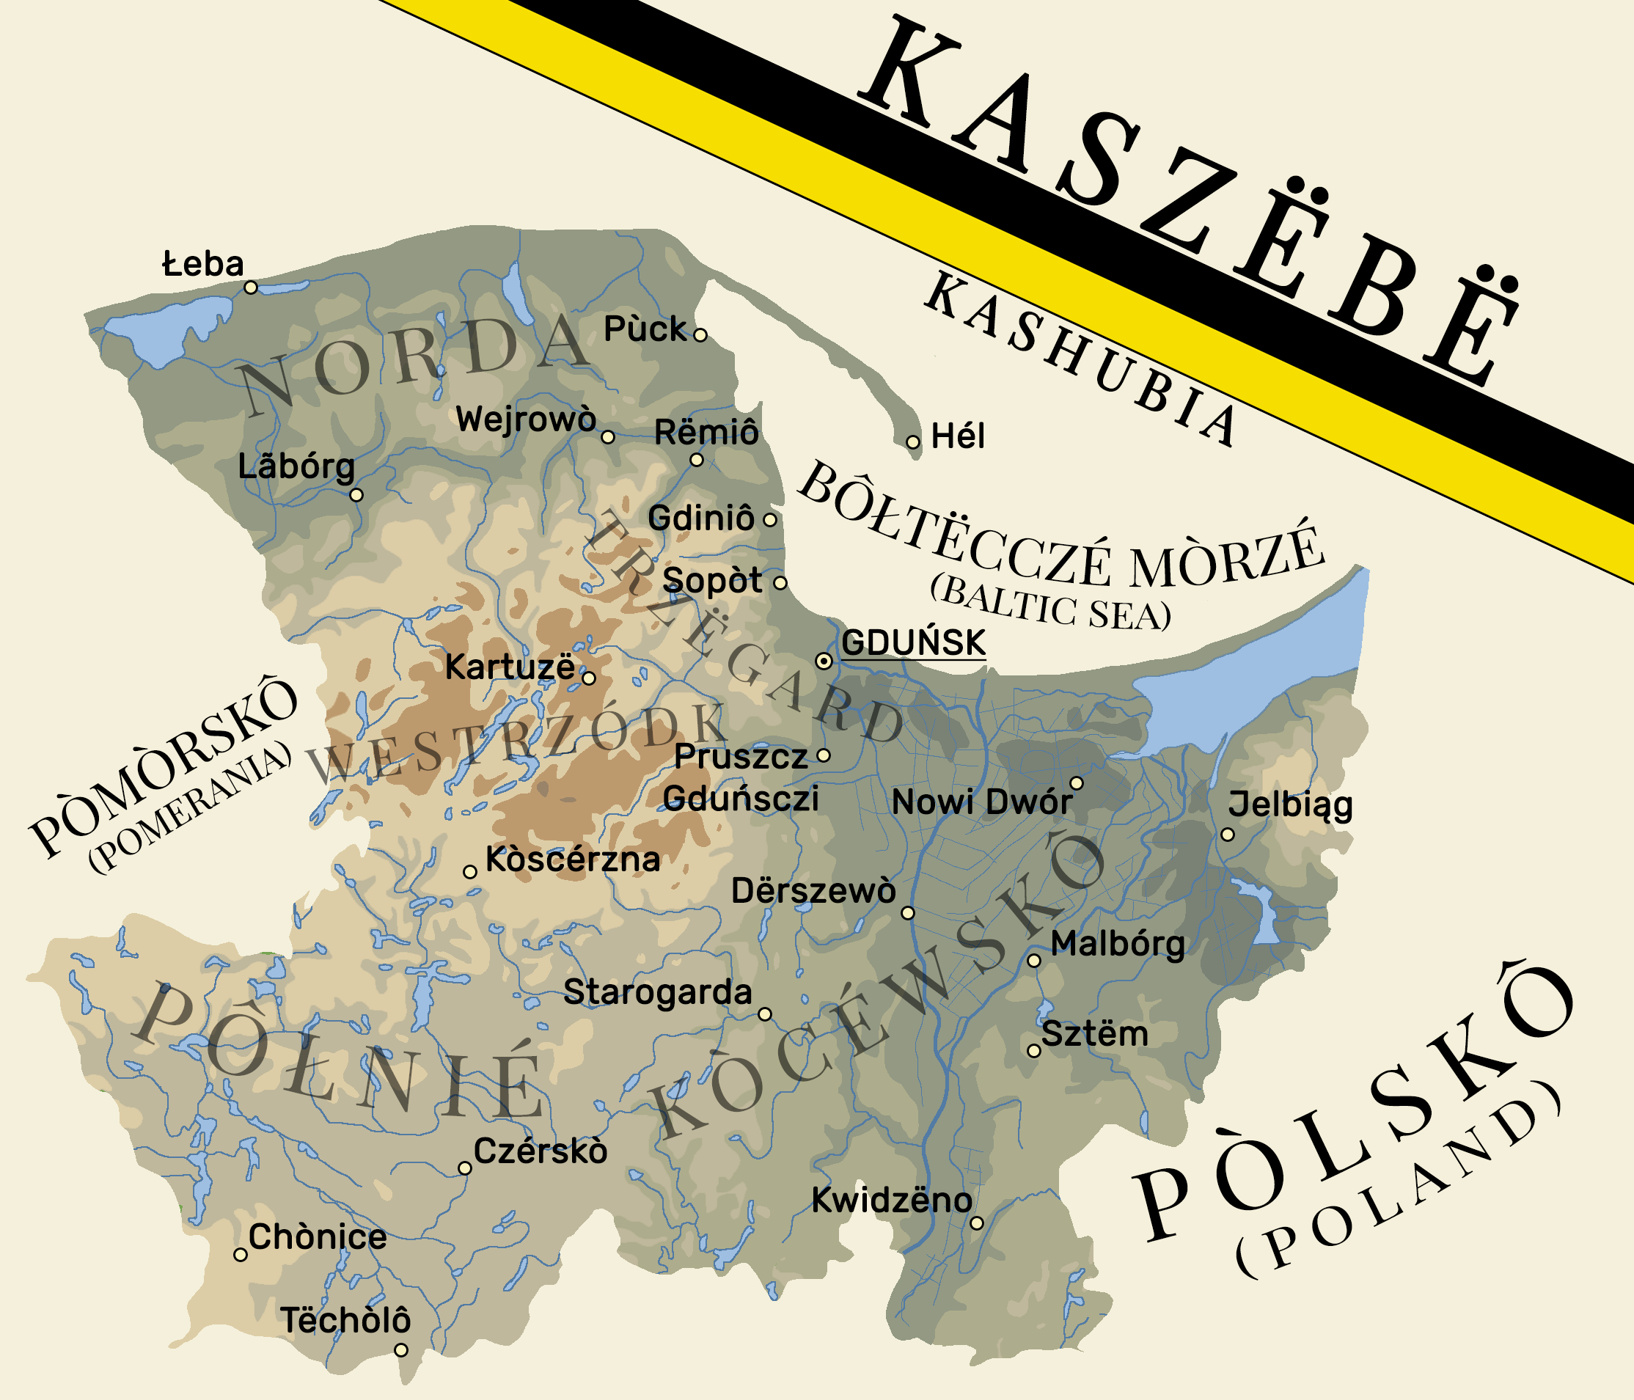
Our region
Kashubia

Slide 2
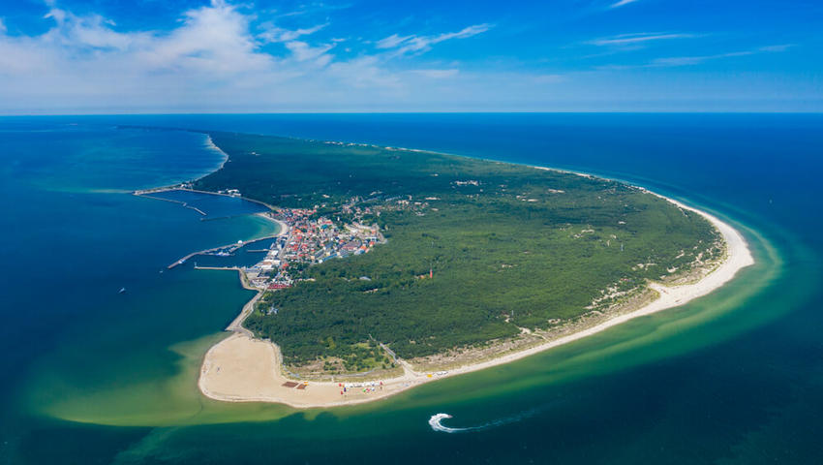
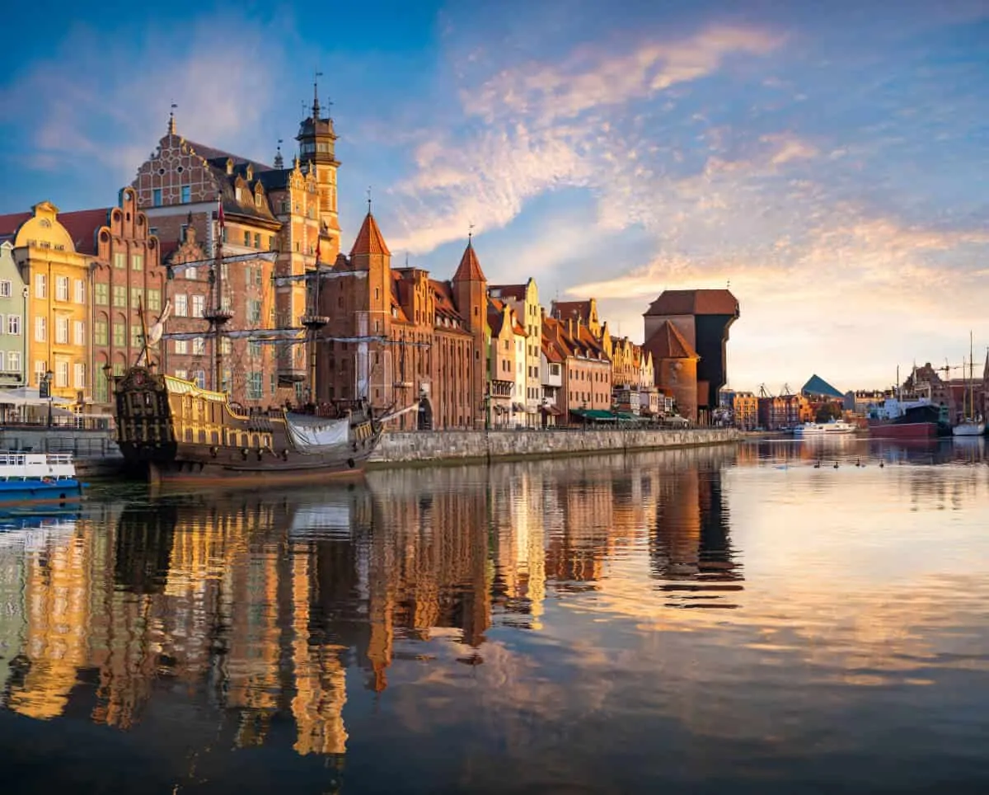
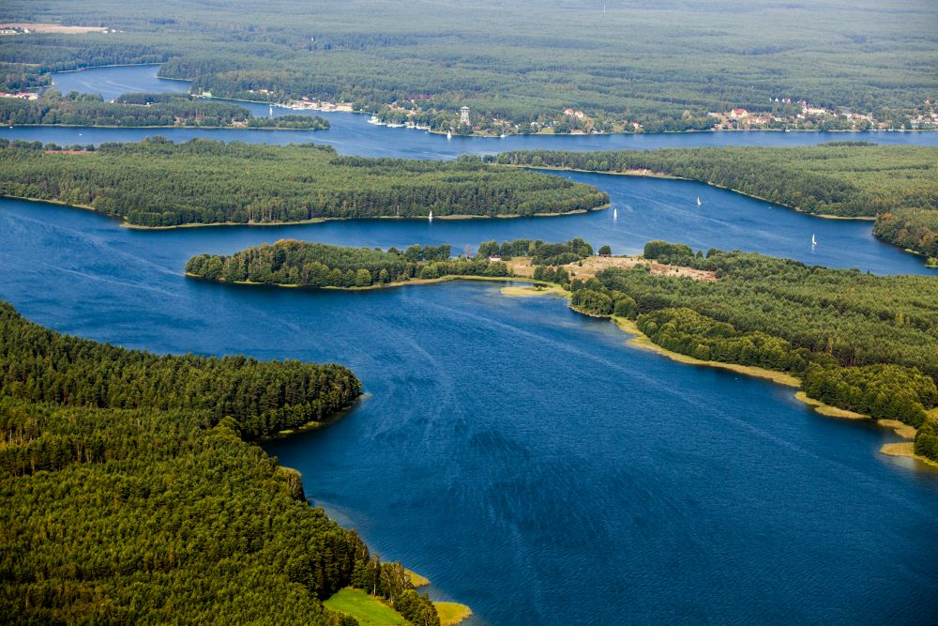
Location
Kashubia is a geographical region and a cultural land in northern Poland, it includes areas belonging to the Pomeranian Voivodeship. It borders the Baltic Sea to the north and the the capital city is Gdańsk.

Slide 3
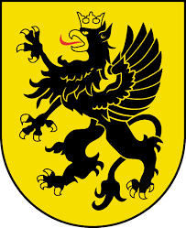
Kashubian coat of arms
Kashubian flag

Slide 4
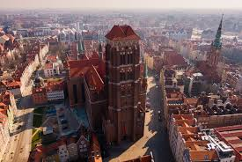
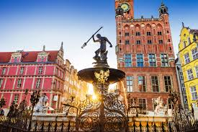
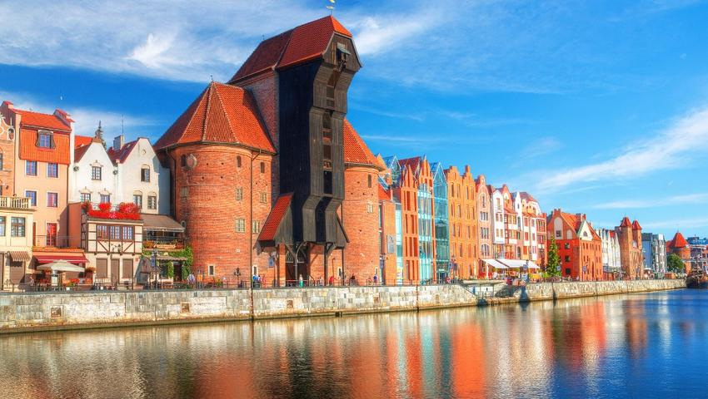
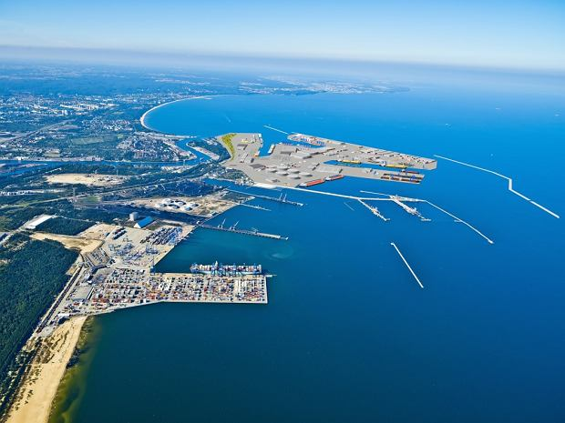
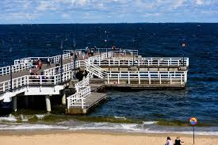
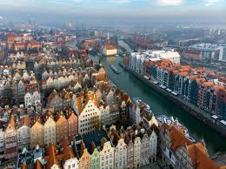
Gdańsk

Slide 5
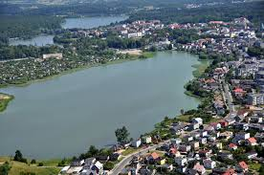
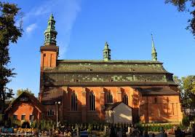
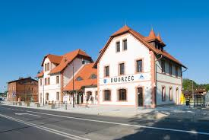
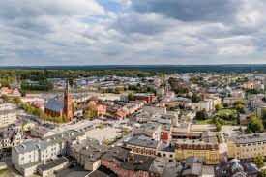
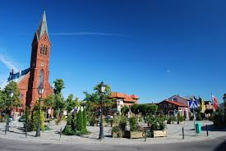
Kartuzy

Slide 6
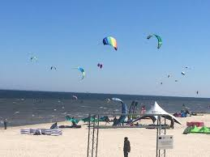
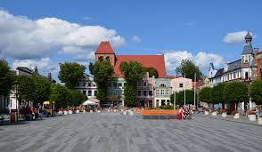
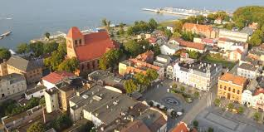
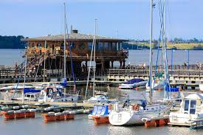
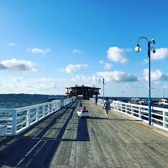
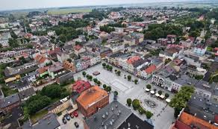
Puck

Slide 7
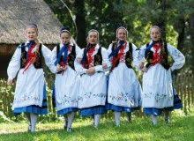
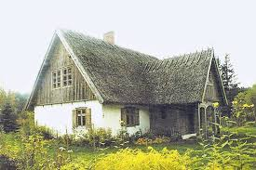
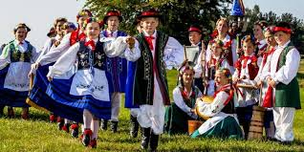
In contrast to most of the other groups who gradually merged to form one big family of Poles, the Kashubians have managed to retain some of their early ethnic identity, expressed in their distinctive culture, dress, crafts, architecture and language. Kashubian, still spoken in the home by some 50,000, mostly elderly locals, is the most distinct Polish dialect. It’s thought to derive from the old Slavic Pomeranian language.
Kashubians

Slide 8
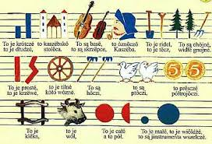
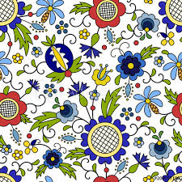
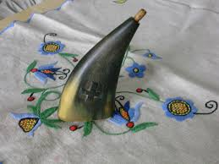
Kashubian music notes
Kashubian patterns
Kashubian snuff

Slide 9
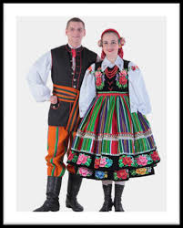
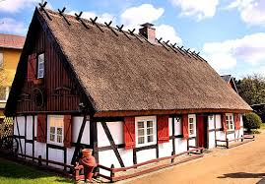
Kashubian costumes
Kashubian folk instrument
Kashubian architecture

Slide 10
The European Commission support for the production of this publication does not constitute an endorsement of the contents which reflects the views only of the authors, and the Commission cannot be held responsi­ble for any use which may be made of the information contained therein.

Slide 11
Prepared by:
Zuzanna Derc
1 LO im. Stefana Żeromskiego w Pucku
Thank you for watching!

