Slide 1
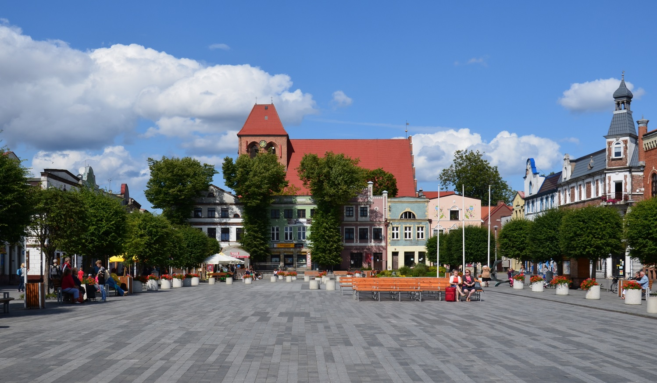
Puck

Slide 2
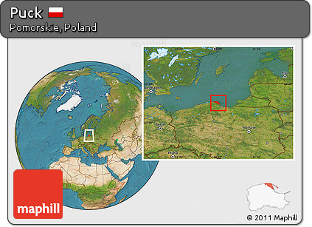
LOCATION
It is in Gdańsk Pomerania on the south coast of the Baltic Sea (Bay of Puck) and part of Kashubia with many Kashubian speakers in the town. Puck has been the capital of Puck County in the Pomeranian Voivodeship since 1999.

Slide 3
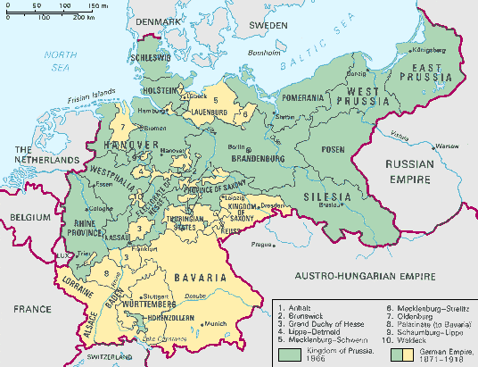
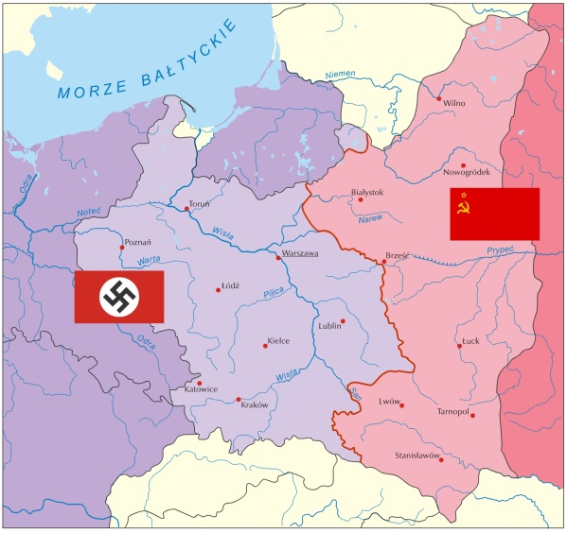
History
The origins date back to the early Middle Ages.
From 1309 in the hands of the Teutonic Order, it received city rights in 1348.
In 1466 Puck was incorporated into Royal Prussia.
The city fell into decline and in 1772 was incorporated into the state of Frederick the Great.
Poland's wedding to the sea was held here with the participation of General Haller.
Until 1926, Puck and Hel were the only Polish ports by the sea (apart from Gdańsk).
In the years 1939–1945 the city was under German occupation.
In 1956 the puck district was reactivated, which existed until 1975 and again from 1999.

Slide 4
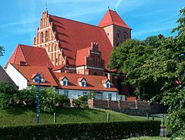
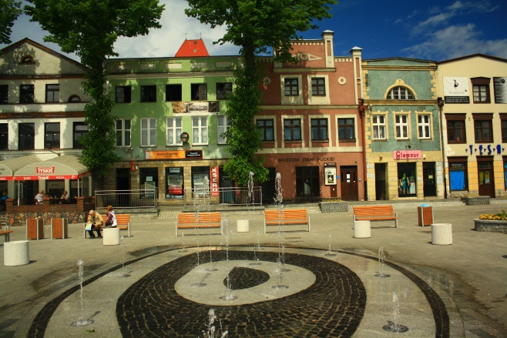
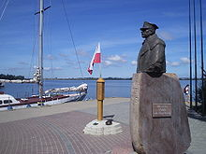
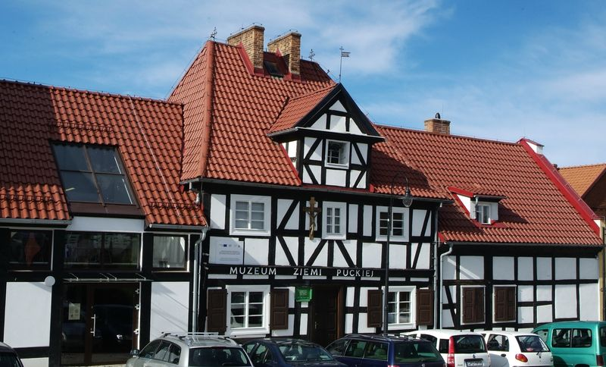
INTRESTING PLACES
In Puck, you can admire a historic church, which probably dates back to the 12th century.
Historic tenement houses from the mid-18th and 19th centuries. Baroque hospital from around 1720, which houses the Museum of the Puck Region. There are also various monuments, for example to General Józef Haller

Slide 5
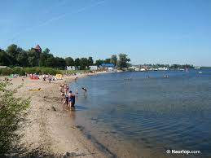
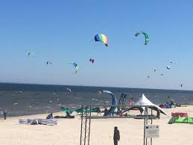
there are also beautiful beaches. Lovers of sailing, windsurfing and other water sports can admire the Bay of Puck. walking along the beach, you can often meet people who are actively spending their free time

Slide 6
“The European Commission support for the production of this publication does not constitute an endorsement of the contents which reflects the views only of the authors, and the Commission cannot be held responsi­ble for any use which may be made of the information contained therein.”

