Slide 1
A tourist guide about Poland

Slide 2
Main and the most interesting places in Poland
• Warsaw
• Cracow
• Wieliczka Salt Mine
• Tatra Mountains
• Wrocław
• Gdańsk
• Łeba
• Masuria
• Poznań

Slide 3
Warsaw - The capital city of Poland
Warsaw (Polish: Warszawa) The metropolis stands on the Vistula River in east-central Poland and its population is officially estimated at 1.8 million residents. Warsaw is mixture of architectural styles the turbulent history of the city and country.
Although today's Warsaw is very young city, it has many very interesting places. Warsaw's Old Town is 50 years old and after World War II it was proudly reconstructed to its present form. Among the most notable landmarks of the Old Town are the Royal Castle, Barbican, Market Square and St. John's Cathedral.
Warsaw is a city with the tallest four-faced clock tower in the world. Its faces are 6 m in diameter, making it the largest clock of its kindin Europe. The tower sits on the Palace of Culture and Sciencewhich was built in 1956.

Slide 4
Wilanów Palace is a royal Palace located in the Wilanów disctrict. Wilanów Palace survived Poland's partitions and both World Wars. Wilanów Palace is classical palace, another place like that is the Presidential Palace which was originally constructed in 1643 and it's the official residence of the Polish head of state and president.
There are also many places commemorating the heroic history of Warsaw. Pawiak was a German Gestapo prison, now it's a Mausoleum of Memory of Struggle and Martyrdom. Another important monument, The Ghetto Heroes Monument (Polish: pomnik Bohaterów Getta) it is located in the area which was formerly a part of the Warsaw Ghetto.

Slide 5
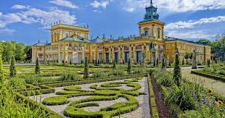
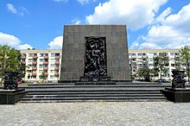
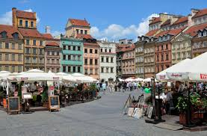
Wilanów Palace
The Ghetto Heroes Monument
Old Town Market

Slide 6
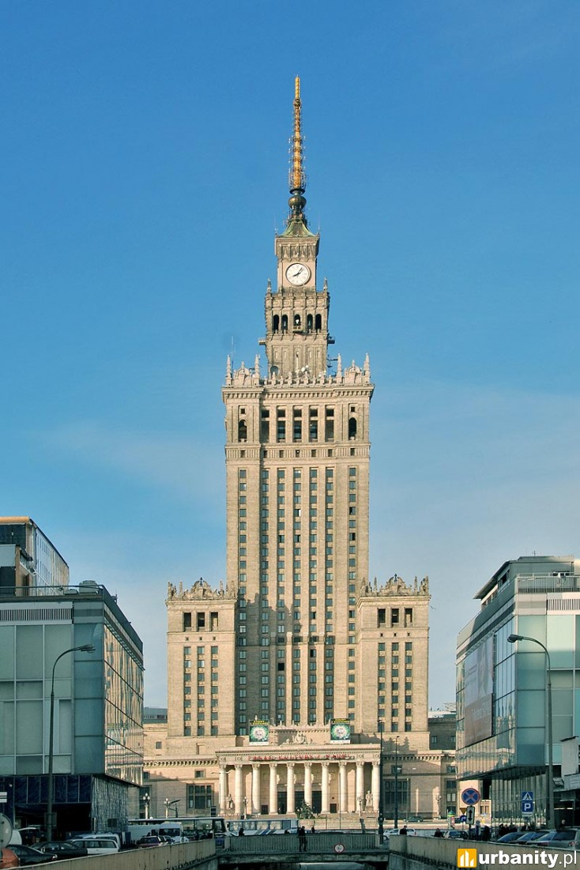
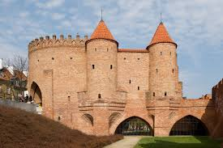
The barbican
Palace of Culture and Science

Slide 7
Cracow
Cracow or Krakow (Polish: Kraków) Is the second largest and one of the oldest cities in Poland. Cracow has traditionally been on of the leading centres of Polish academic, cultural and artistic life. Cited as one of Europe's most beautiful cities
The Wawel Royale Castle is located in central Kraków. The castle, being one of the largest in Poland, represents nearly all European architectural styles of medieval, renaissance and baroque periods. Wawel Castle is now one of the country's premier art museums.
In 1978, Karol Wojtyła, archbishop of Kraków, was elevated to the papacy as Pope John Paul II—the first non-Italian pope in 455 years. Also that year, UNESCO approved Kraków's entire Old Town and historic centre as its first World Heritage List alongside Quito.

Slide 8
Cracow is known as the city of churches. The churches of Kraków comprise over 120 places of workship of which over 65 were built in the 20th century.
Main Square of the Old Town of Cracow is located at the centre of the city, i t dates back to the 13th century, and it is the largest medieval town square in Europe. The main square is a square space surrounded by historic townhouses (kamienice) and churches. The center of the square is dominated by the Cloth Hall (Sukiennice), topped by a beautiful attic or Polish parapet decorated with carved masks. On one side of the cloth hall is the Town Hall Tower (Wieża ratuszowa), on the other the 11th century Church of St. Adalbert and 1898 Adam Mickiewicz Monument. Rising above the square are the Gothic towers of St. Mary's Basilica (Kościół Mariacki).

Slide 9
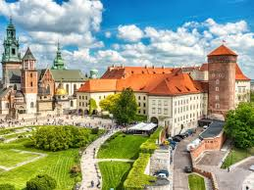
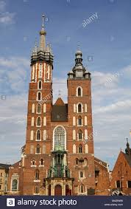
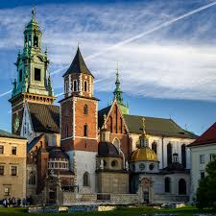
Cracow's Historic Centre
Saint Mary's Basilica
Wawel Cathedral

Slide 10
Wieliczka Salt Mine
The Wieliczka Salt Mine (Polish: Kopalnia soli Wieliczka), in the town of Wieliczka, southern Poland, lies within the Kraków metropolitan area. Opened in the 13th century, the mine produced table salt continuously until 2007, as one of the world's oldest salt mines in operation.
The Wieliczka Salt Mine is now an official Polish Historic Monument (Pomnik Historii). Its attractions include the shafts and labyrinthine passageways, displays of historic salt-mining technology, an underground lake, four chapels and numerous statues carved by miners out of the rock salt, and more recent sculptures by contemporary artists.

Slide 11
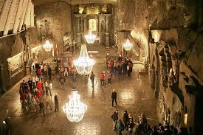
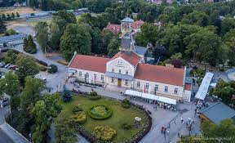
St. Kinga's Chapel, deep in the Wieliczka salt mine

Slide 12
Tatra Mountains
The Tatra Mountains, Tatras, or Tatra is a mountin range that forms a natural border between Sloviaka and Poland. They are the highest mountain range in the Carpathian Mountains. The Tatras are distinct from the Low Tatras, a separate Slovak mountain range further south.
The Tatras are protected by law by the establishment of the Tatra National Park, Slovakia and the Tatra National Park, Poland, which are jointly entered in UNESCO's World Network of Biosphere Reserves

Slide 13
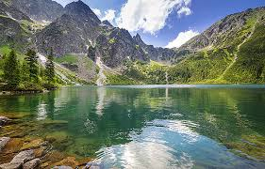
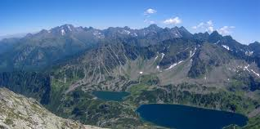
Tatra views

Slide 14
Wrocław
Wrocław is the largest city in western Poland. Wrocław is the historical capital of Silesia and Lower Silesia. Today, it is the capital of the Lower Silesian Voivodeship. The history of the city dates back over a thousand years at various times, it has been part of the Kingdom of Poland, the Kingdom of Bohemia, the Kingdom of Hungary, the Habsburg Monarchy of Austria, the Kingdom of Prussia and Germany. Wrocław became part of Poland again in 1945
The 13th century Main Market Square (Rynek) features the Old Town Hall. In the north-west corner of the Market Square is St. Elisabeth's Church (Bazylika Św. Elżbiety) with its 91.46 m tower, which has an observation deck (75 m). Salt Square (now a flower market) is located at the south-western corner of the Market Square. Close to the square, between Szewska and Łaciarska streets, is the 13th century St. Mary Magdalene Church (Kościół Św. Marii Magdaleny).

Slide 15
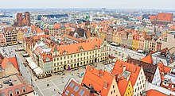
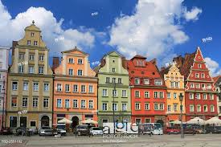
Wrocław Old Town
Salt Market Square

Slide 16
Gdańsk
Gdańsk is a city on the Baltic coast of northern Poland. With a population of 470,907, Gdańsk is the capital and largest city of the Pomeranian Voivodeship and one of the most prominent cities within the cultural and geographical region of Kashubia. It is Poland's principal seaport and the centre of the country's fourth-largest metropolitan area.
The city is situated on the southern edge of Gdańsk Bay on the Baltic Sea, in a conurbation with the city of Gdynia, the resort town of Sopot, and suburban communities; these form a metropolitan area called the Tricity (Trójmiasto). Gdańsk lies at the mouth of the Motława River, connected to the Leniwka, a branch in the delta of the nearby Vistula River, which drains 60 percent of Poland and connects Gdańsk with the Polish capital, Warsaw.

Slide 17
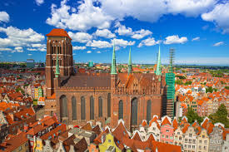
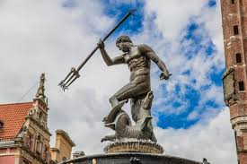
Gdańsk is home to the University of Gdańsk, Gdańsk University of Technology, the National Museum, the Gdańsk Shakespeare Theatre, the Museum of the Second World War, the Polish Baltic Philharmonic and the European Solidarity Centre. Gdańsk has also topped rankings for the quality of life, safety and living standards worldwide.
The monuments in Gdańsk

Slide 18
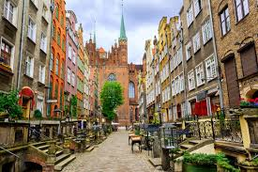
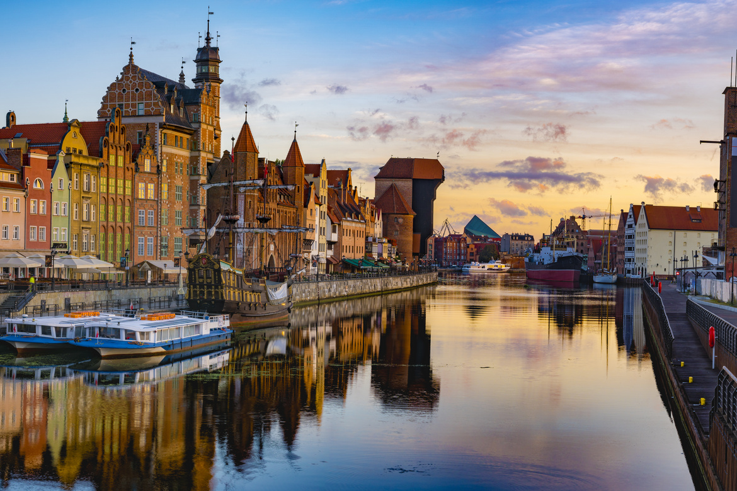
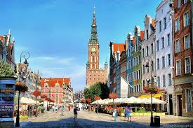
The main streets in Gdańsk

Slide 19
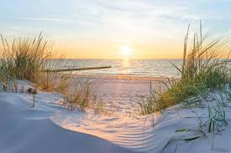
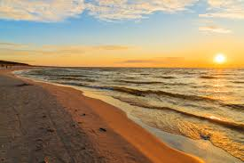
Łeba
Łeba is a town in the Pomeranian known for located there sand dunes. It lies at the edge of Słowinski National Park, of which the sand dunes are part of.
The dunes are impressive, with them over 40 metres in height. Considering that they are right beside the sea, it is a big jump up on sands. Due to the winds, the dunes can move up to 10 metres in direction over the timeframe of a year.

Slide 20
Masuria
Masuria (Polish: Mazury) is a region in northeastern Poland, famous for its 2,000 lakes. Masuria occupies much of the Masurian Lake District (Polish: Pojezierze Mazurskie).
Masuria and the Masurian Lake District are known in Polish as Kraina Tysiąca Jezior These lakes were ground out of the land by glaciers during the Pleistocene ice age around 14,000 - 15,000 years ago, when ice covered northeastern Europe.
Masuria has more lakes than in other parts of northen Poland, such as from Pomerania, this continous stretch of lakes is popular among tourist. The terrain is rather hilly, with connecting lakes, rivers and streams. Forest account for about 30% of the area.

Slide 21
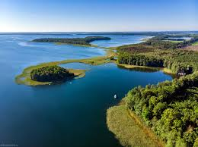
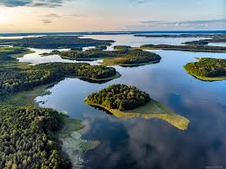
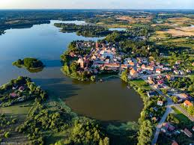
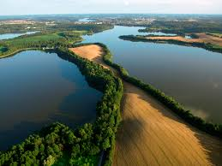
Masuria views

Slide 22
Poznań
Poznańis a city on the Warta River in west-central Poland, in the Greater Poland region. It is best known for its renaissance Old Town and Ostrów Tumski Cathedral. Today, Poznań is an important cultural and business centre and one of Poland's most populous regions with many regional customs such as Saint John's Fair (Polish: Jarmark Świętojański), traditional Saint Martin's croissants and a local dialect.
Poznań is a center of trade, sports, education, technology and tourism. It is an important academic site, with about 130,000 students and Adam Mickiewicz University, the third largest Polish university. Poznań is also the seat of the oldest Polish diocese, now being one of the most populous archdioceses in the country. The city also hosts the Poznań International Fair – the biggest industrial fair in Poland and one of the largest fairs in Europe. The city's most renowned landmarks include Poznań Town Hall, the National Museum, Grand Theatre, Fara Church, Poznań Cathedral and the Imperial Castle.

Slide 23
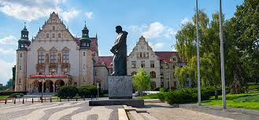
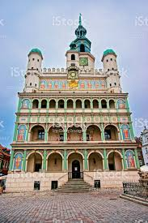
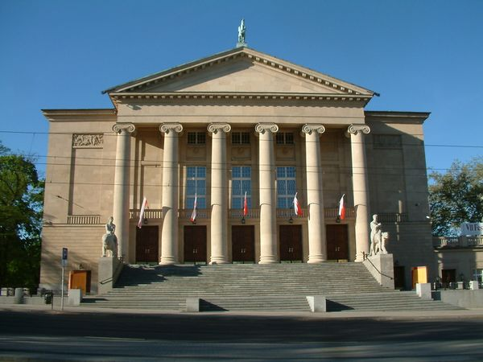
Adam Mickiewicz university
Poznań Town hall
Grand Theatre

Slide 24
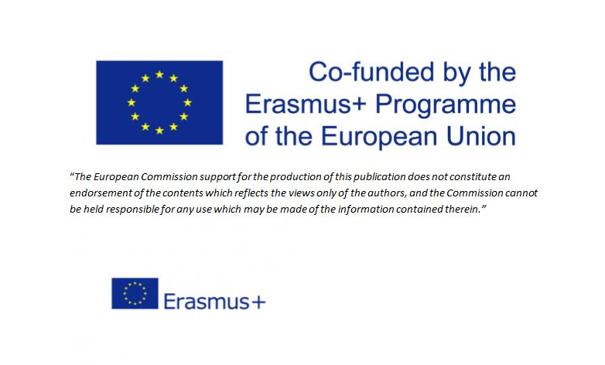
Presentation by Wiktoria Lademann

