Slide 1
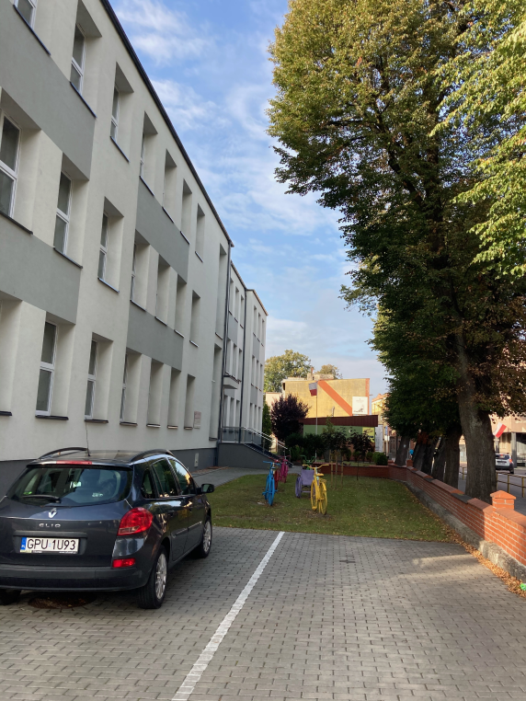
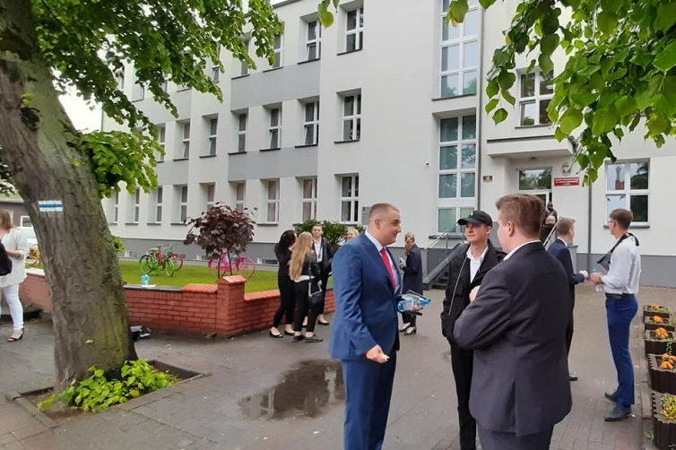
OUR SCHOOL AND ITS HISTORY

Slide 2
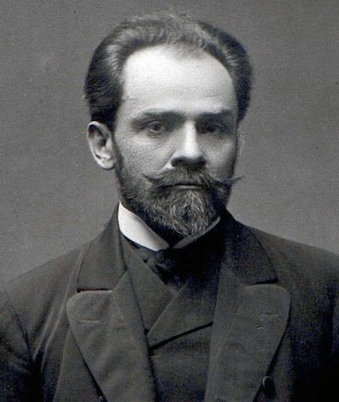
History of our school patron
First High School is 75 years old . We solemnly celebrated the anniversary this year .Our Patron is Stefan Żeromski . He was one of the greatest creators of Polish prose . His most popular works are
,,Syzyfowe prace’’, ,,Przedwiośnie’’, ,Popioły’’, ,,Dzienniki’’

Slide 3
In our sch00l we have different types of profiles. You will find something for yourself.
A1
Academic – polytechnic class
If you want to go to universities , polytechnic univesities or technical colleges , this is the course for you . Extended knowledge: maths , physics and a foreign language.
A2
Academic – medical class
If you want to study in the future in the field of medical sciences ,biology and chemistry ,this is the perfect profile for you.

Slide 4
B
Multimedia class
In this class there are classes in the broadly understood audiovisual and media culture. In this class you will extend geography, computer science and a foreign language
Nature class
If you are interested in the natural environment, biological mechanisms and living organisms, this is the profile for you.
D
Journalism – theater class
This class will prepare you for studies, for example, journalism, media studies, law, sociology, etc. In this class, subjects such as Polish, history or knowledge of society and a foreign language are extended.
C

Slide 5
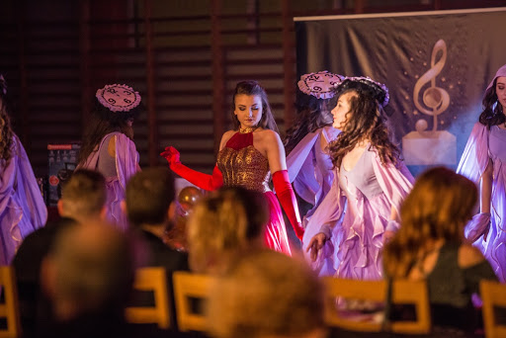
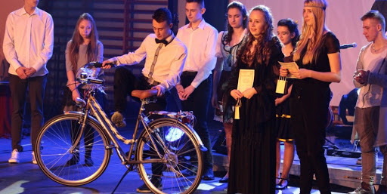
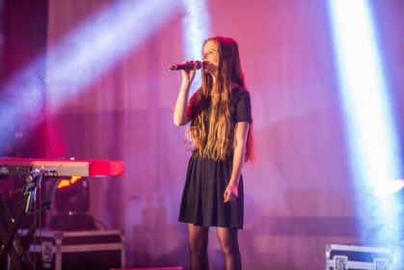
IN our school we have a lot of intersting activities , for example:
„Bursztynowe Klucze” , „Amber Keys”
it is a singing competition with students from different schools and it is great fun and a great experience for them

Slide 6
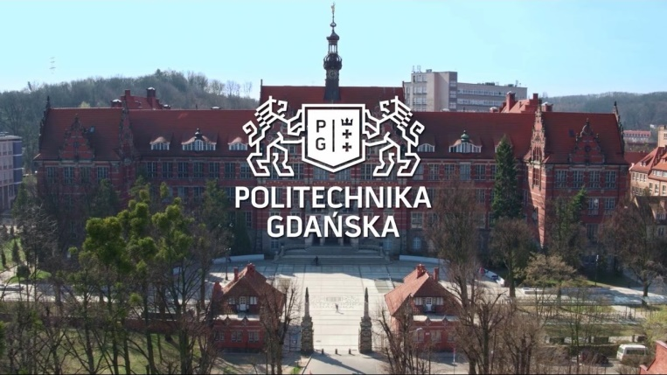
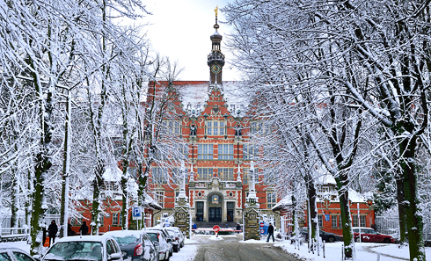
Our school is coomperating with Gdańsk Politechnics and University of Gdańsk
Main purposes of that cooperation with universities are:
wider educational offer for our students;
getting students into academic system of education;
uprising level ofa school by getting better results of education;
promotion of our High School in the area of ​​Puck;
helping a student after finishing Clever from Pomeranian 'project

Slide 7
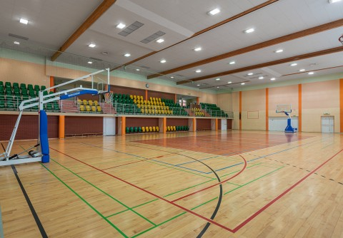
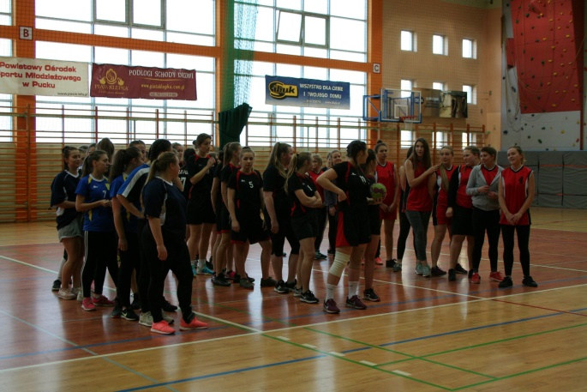
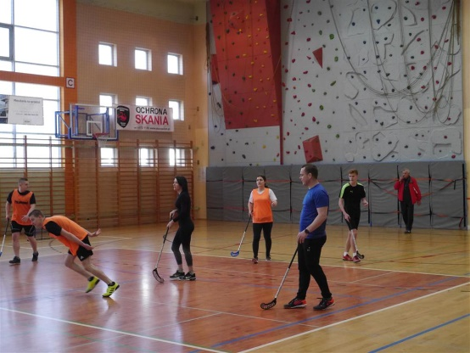
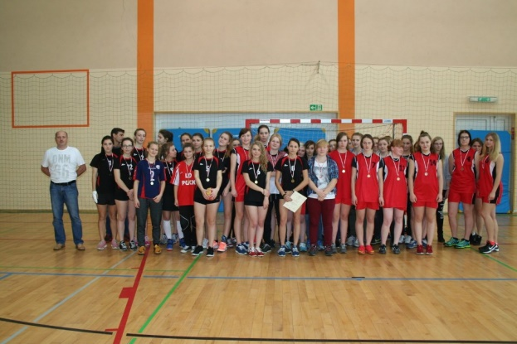
A lot of sports competitions

Slide 8
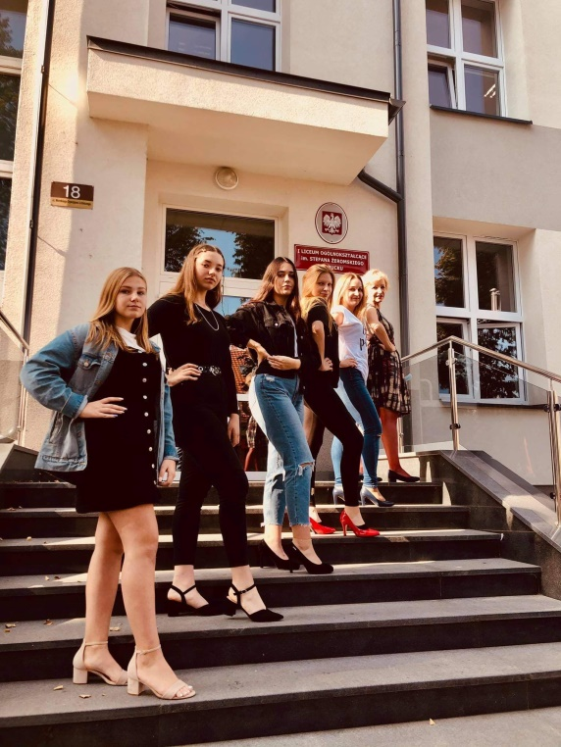
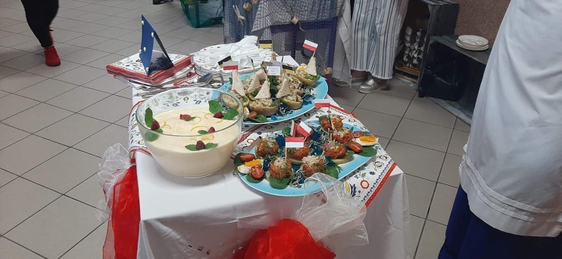
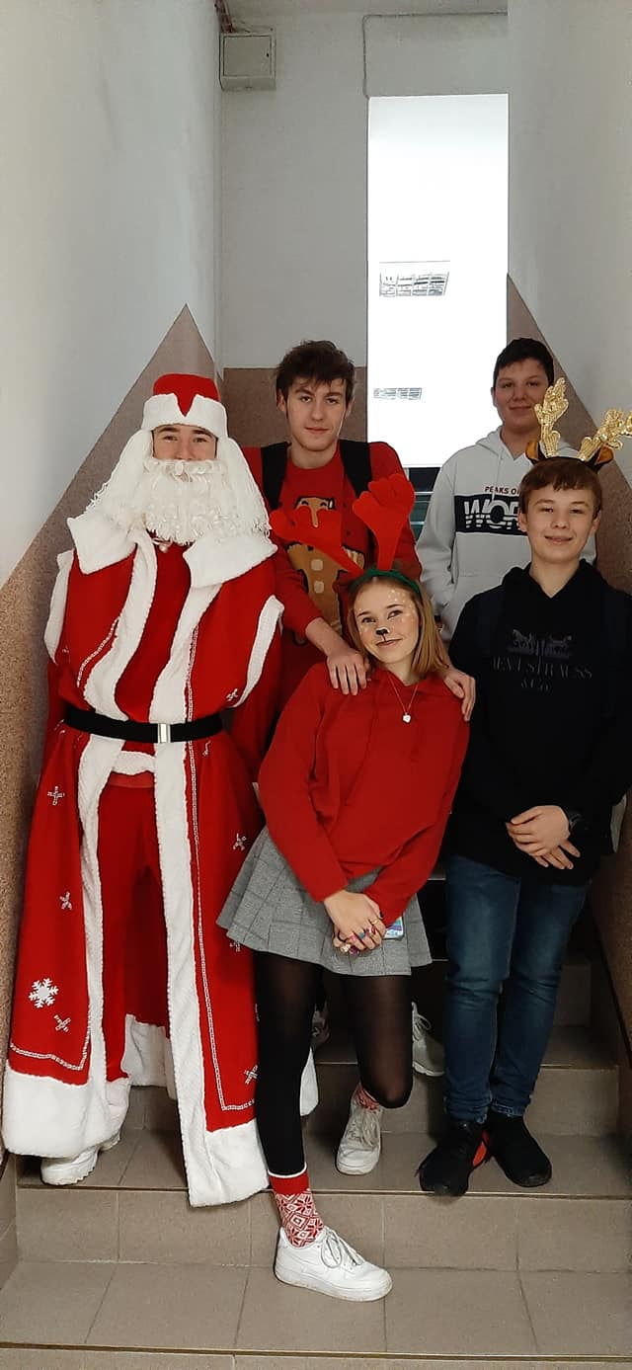
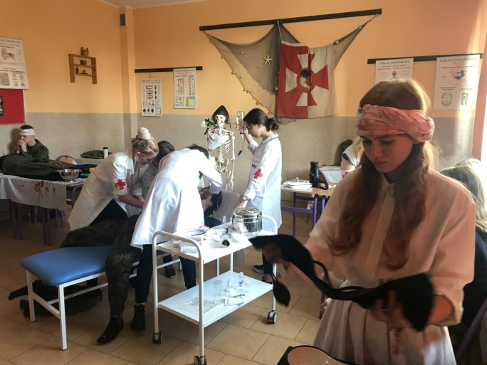
We are celebrating different topic days
Polish wedding with the sea
Pin day
Independence day
Santa Claus day

Slide 9
We also take part in projects and exchanges with different countries. This allows us to learn about new cultures, meet people and make friends and practise our English. My school finished three projects and now we are taking part in fourth.

Slide 10
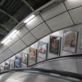
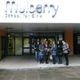
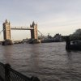
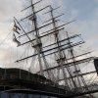
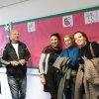
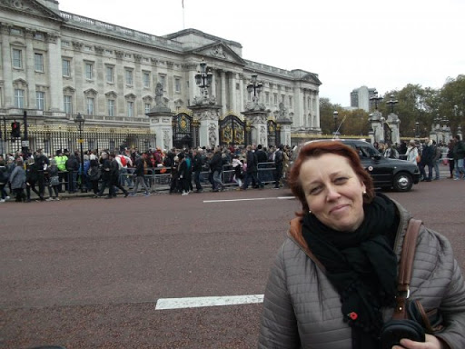
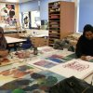
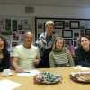
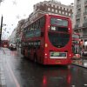
Comenius 2011-2013

Slide 11
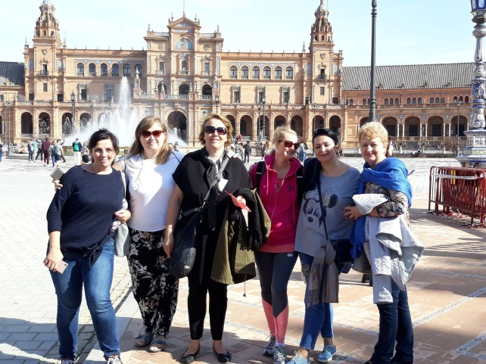
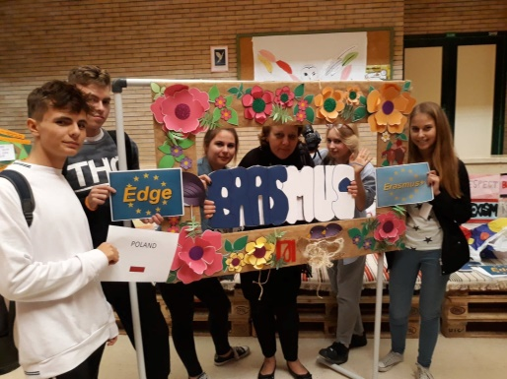
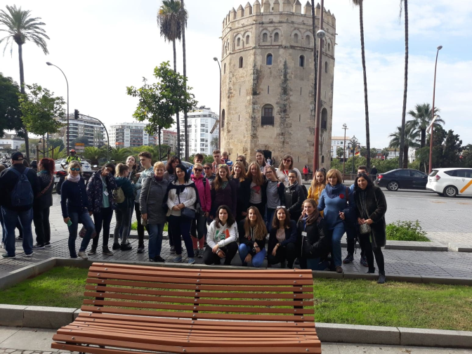
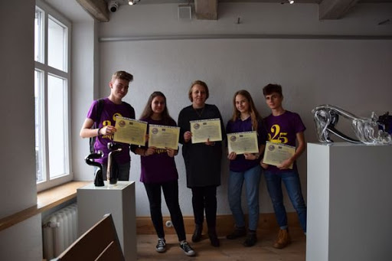
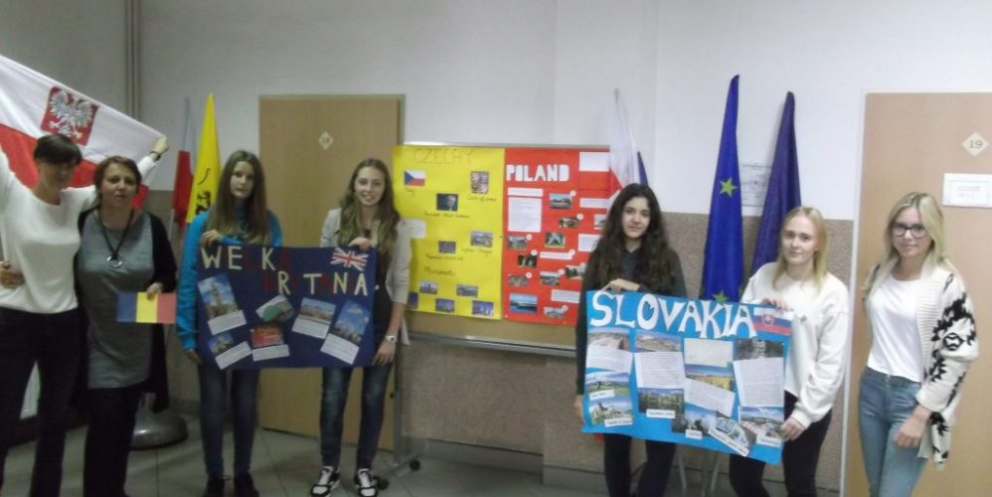
Erasmus + 2018-2021 EDGE

Slide 12
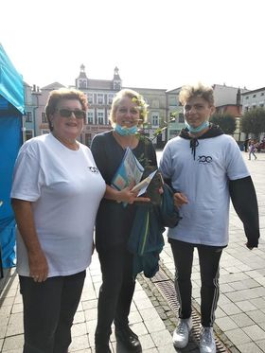
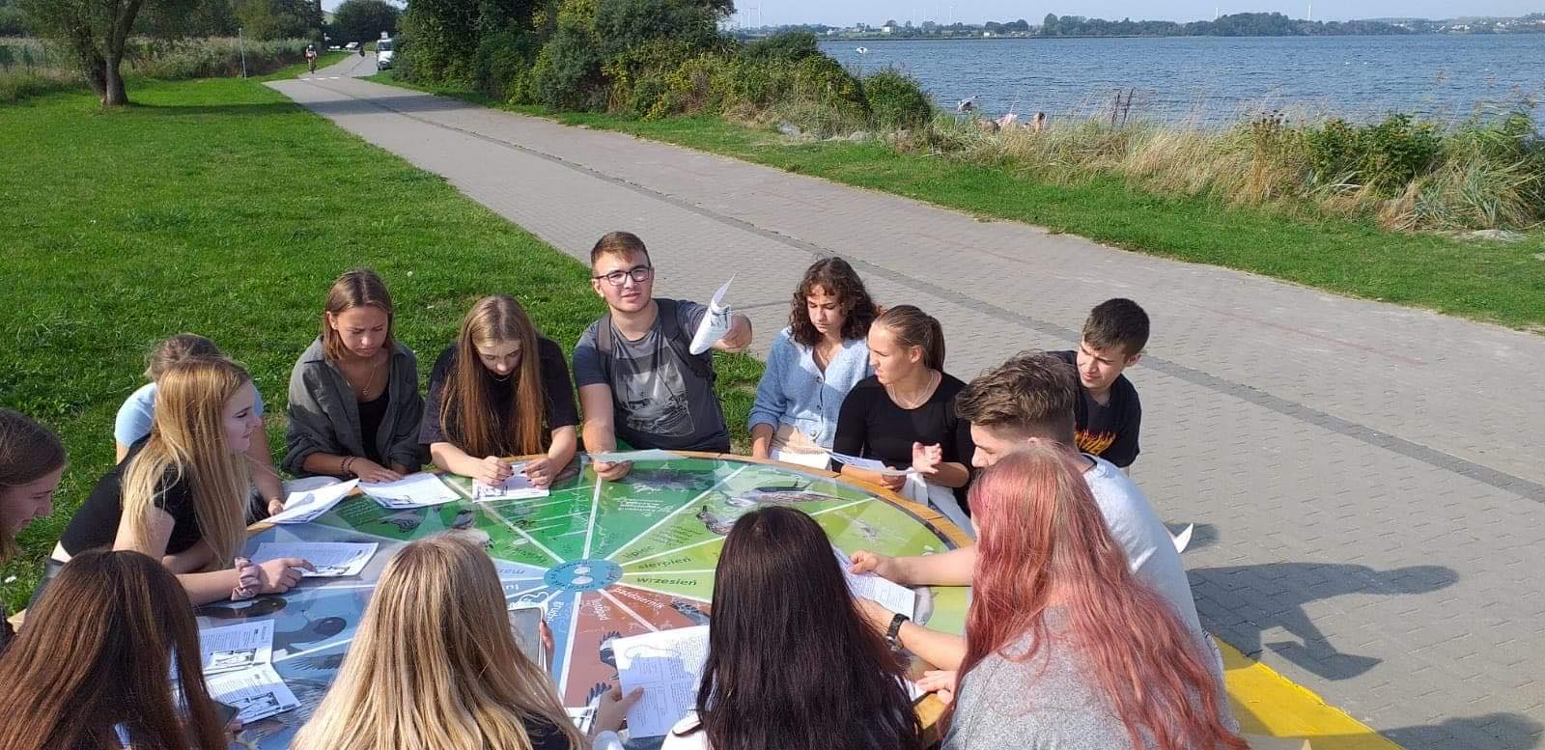
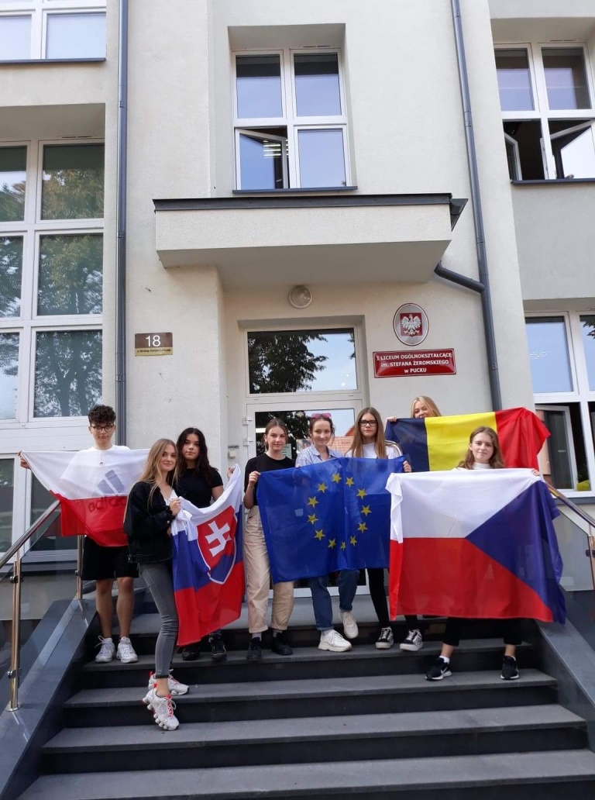
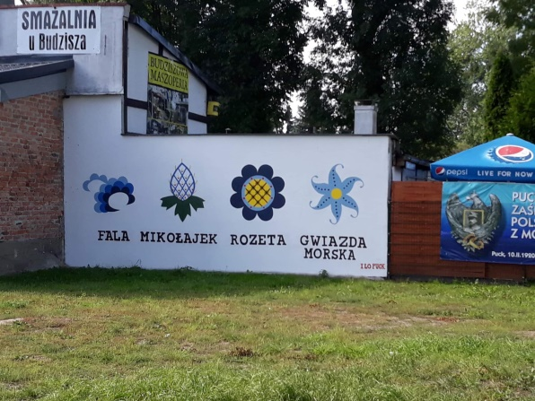
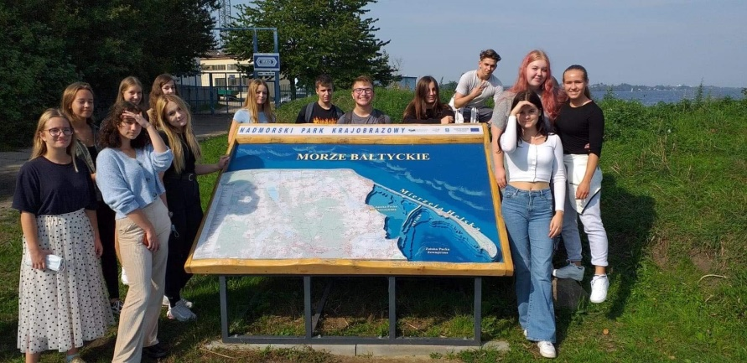
Erasmus + 2020-2022 WAVES

Slide 13
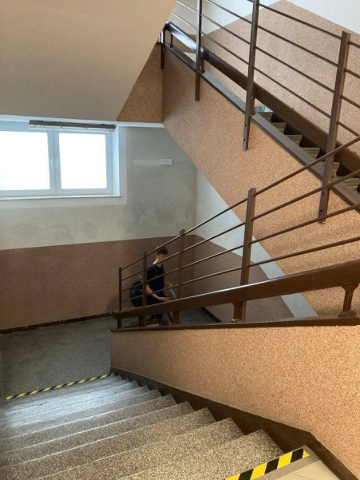
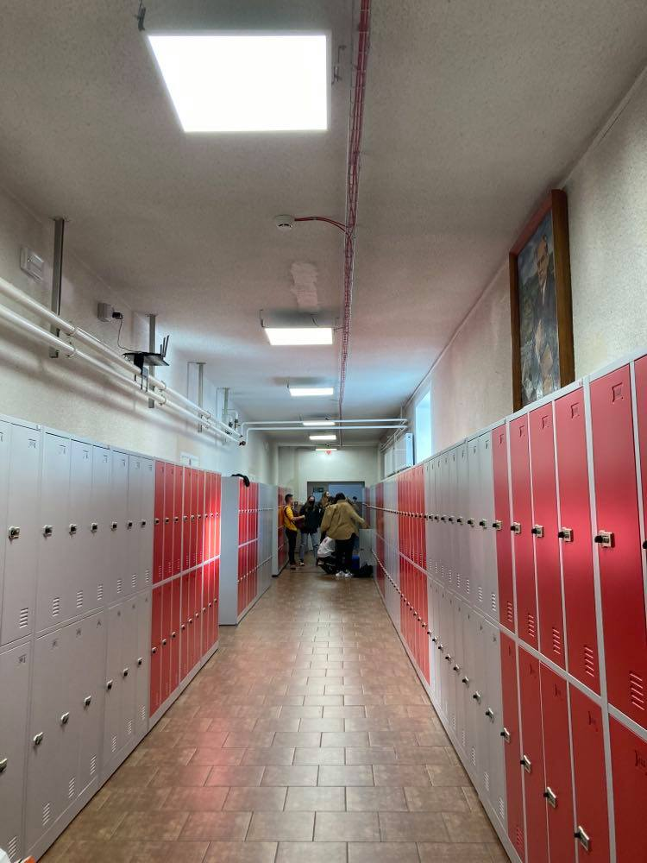
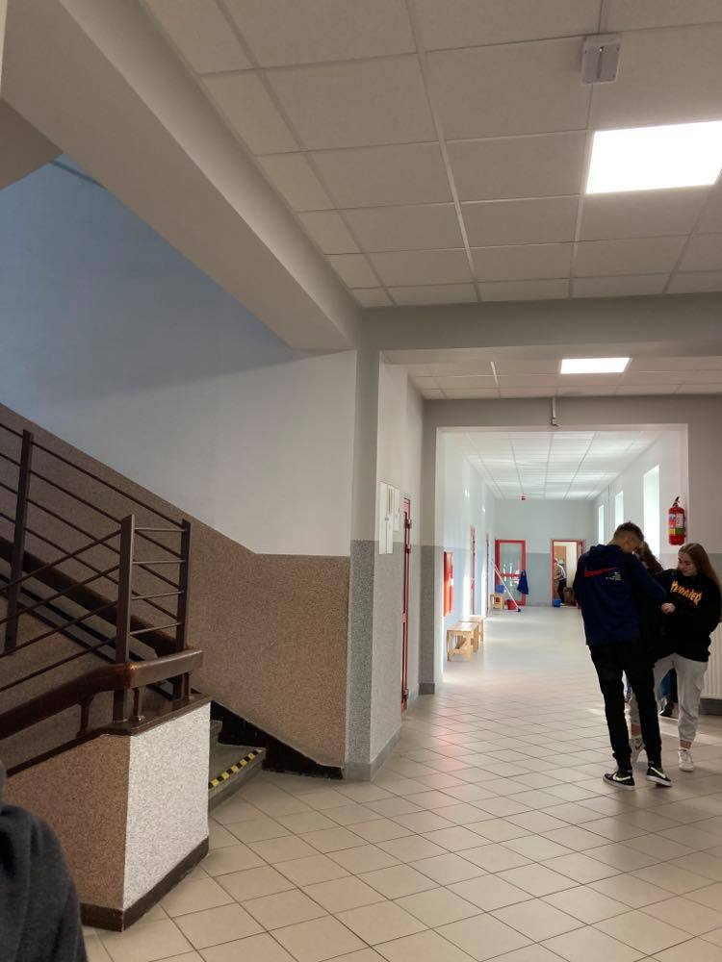
A few photos of our school

Slide 14
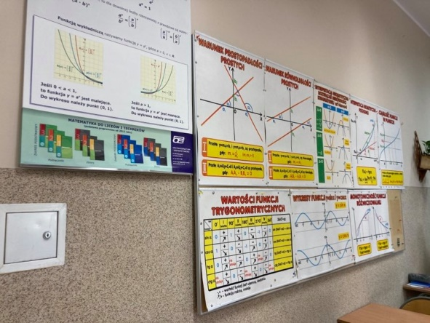
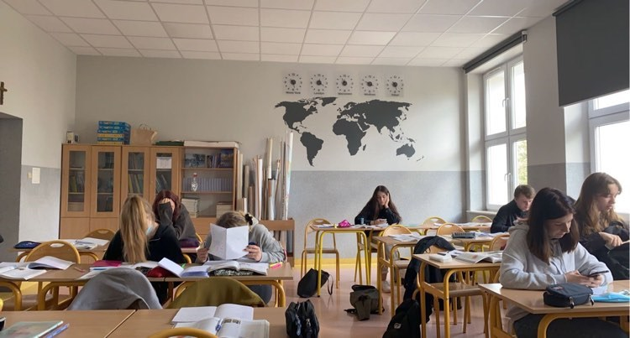
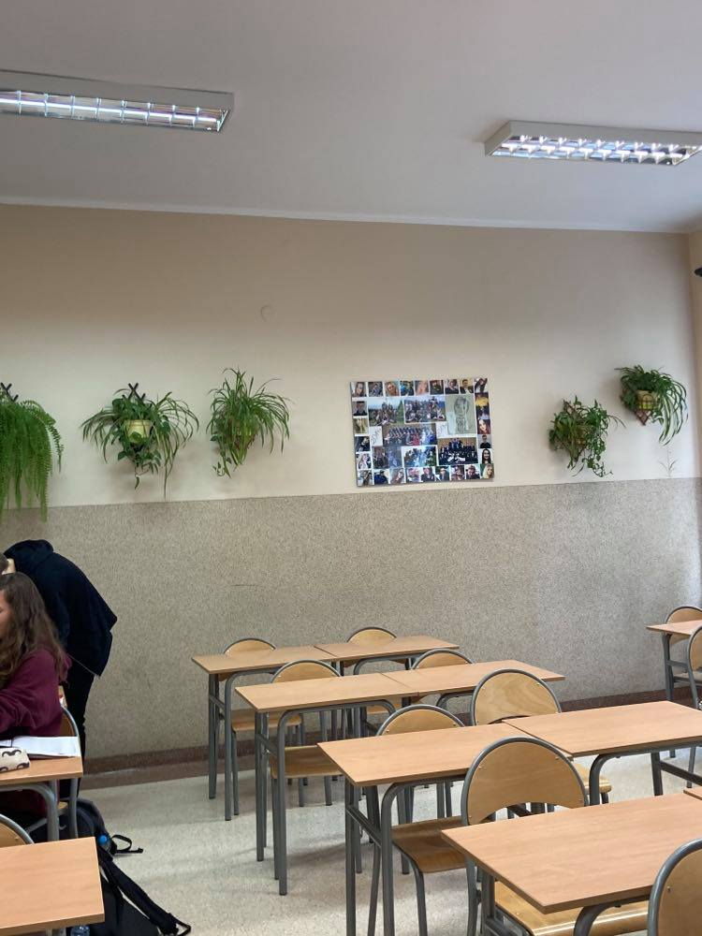
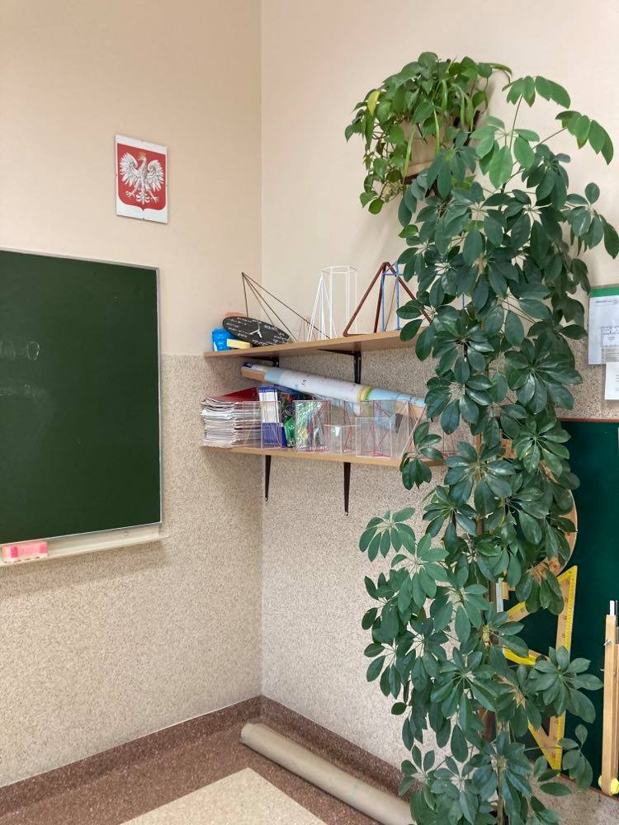
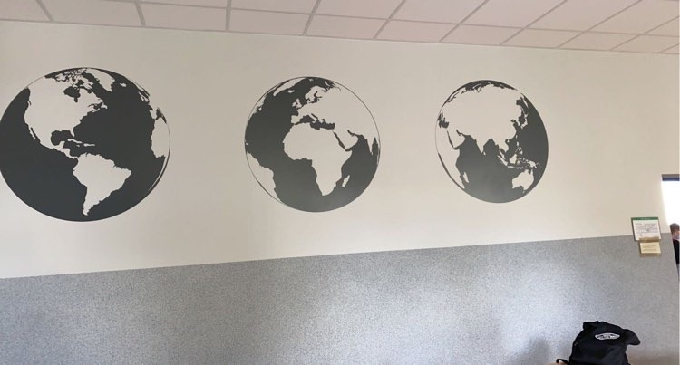
Geography class
Math class

Slide 15
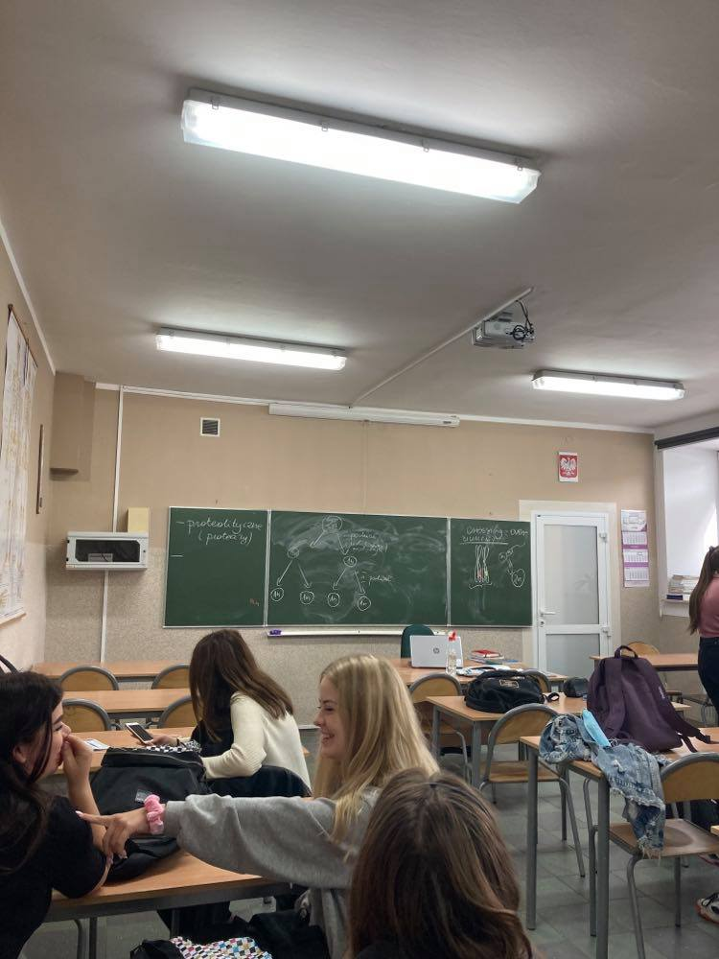
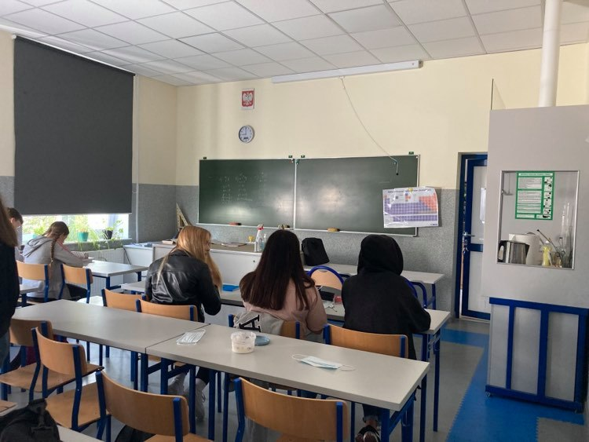
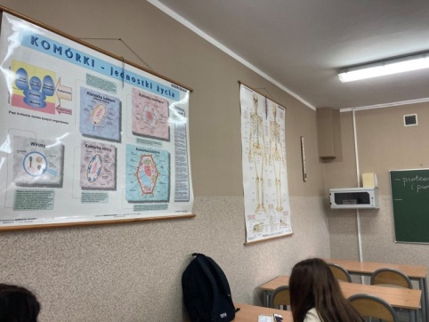
Chemistry class
Biology class

Slide 16
Co- funded by the erasmus + programme of the european union
"The European Commission support forthe production of this publication does not constitutean endorsement of the contents which reflects the views only of the authors, and the Commission cannot be held responsible for any use which may be made of the information contained therein."
Made by Margot Głowienka and Joanna Pałucka

